Slide 1
EE 303 Energy Systems and Power Electronics
Energy Overview
ECpE Department
GRA: Prashant Tiwari
Advisor: Dr. Zhaoyu Wang
1113 Coover Hall, Ames, IA
wzy@iastate.edu

Slide 2
Energy Related Statistics
ECpE Department

Slide 3
ECpE Department

Slide 4
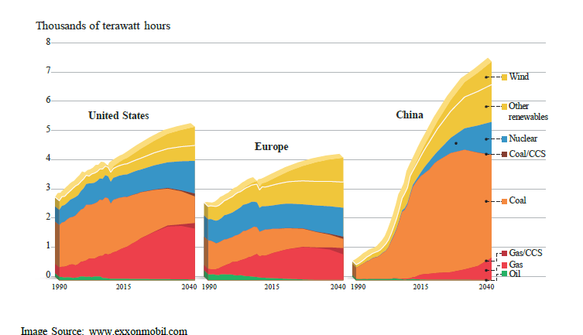
Electricity Generation by Fuel – 1990-2040
ECpE Department

Slide 5
Electricity Demand by Fuel and By Sector – 2000-2040
ECpE Department

Slide 6
Electricity Use by Region
ECpE Department

Slide 7
CO2 Emission Plateau
ECpE Department

Slide 8
Earth Average Temperature Increase – 2011-2099
ECpE Department

Slide 9
Renewable Energies – Wind and Solar
ECpE Department

Slide 10
Renewable Energies – Wind and Solar
ECpE Department

Slide 11
Renewable Energies – Wind and Solar
ECpE Department

Slide 12
Solar Energy Grid Integration
ECpE Department

Slide 13
Solar Energy Grid Integration
ECpE Department

Slide 14
Solar Energy Grid Integration
ECpE Department

Slide 15
Solar Energy Grid Integration
ECpE Department

Slide 16
Solar Energy Grid Integration
ECpE Department

Slide 17
Solar Energy Grid Integration
ECpE Department

Slide 18
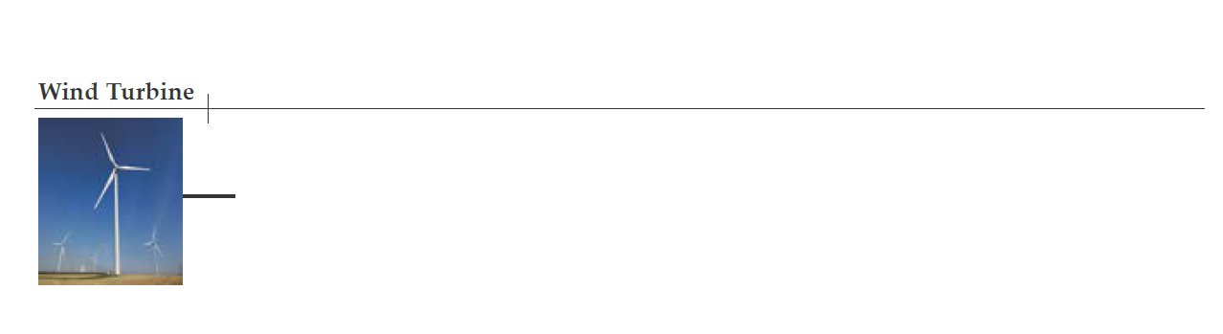
Wind Energy Grid Integration
ECpE Department

Slide 19
Wind Energy Grid Integration
ECpE Department

Slide 20
Wind Energy Grid Integration
ECpE Department

Slide 21
Wind Energy Grid Integration
ECpE Department

Slide 22
Wind Energy Grid Integration
ECpE Department

Slide 23
Wind Energy Grid Integration
ECpE Department

Slide 24
Wind Energy Grid Integration
ECpE Department

Slide 25
What is a Microgrid?
ECpE Department

Slide 26
What is a Microgrid?
ECpE Department

Slide 27
What is a Microgrid?
ECpE Department

Slide 28
What is a Microgrid?
ECpE Department

Slide 29
What is a Microgrid?
ECpE Department

Slide 30
Energy Quiz
Here is a quick quiz on several energy-related issues:
http://corporate.exxonmobil.com/en/company/multimedia/energy-lives-here/quiz
ECpE Department

Slide 31
Main components of Power system
ECpE Department

Slide 32
Categorization of transmission lines
ECpE Department

Slide 33
Power plants: Nuclear, Hydro and Thermal
ECpE Department

Slide 34
Main components of Power System
ECpE Department

Slide 35
Insulators
ECpE Department

Slide 36
Distribution line tower
ECpE Department

Slide 37
Bundled Conductor
ECpE Department

Slide 38
Bundled Conductor with four sub-conductors
ECpE Department

Slide 39
Power System Basics
Notation: Power
Power: Instantaneous consumption of energy
Power Units
Watts = voltage x current for dc (W)
kW – 1 x 103 Watt
MW – 1 x 106 Watt
GW – 1 x 109 Watt
Installed U.S. generation capacity is about 1,100 GW (about 3.5 kW per person)
ECpE Department

Slide 40
Notation - Energy
Energy: Integration of power over time; energy is what people really want from a power system
Energy Units
Joule = 1 Watt-second (J)
kWh = kilowatt hour (3.6 x 106 J)
1 Watt-hour = 3.4121 BTU
U.S. annual electric energy consumption is about 4,000 billion kWh (about 13,000 kWh per person, which means on average we each use 1.5 kW of power continuously)
ECpE Department

Slide 41
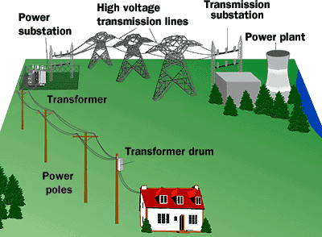
Electric Power System
Usually Divided into:
Generation: Source of power, ideally with a specified voltage and frequency.
Transmission: Transmits power; ideally as a perfect conductor.
Loads: Consumes power; ideally with a constant resistive value.
ECpE Department

Slide 42
Electric Power System
Complications:
No ideal voltage sources exist,
Loads are seldom constant,
Transmission system has resistance, inductance, capacitance and flow limitations,
Simple system has no redundancy so power system will not work if any component fails.
ECpE Department

Slide 43
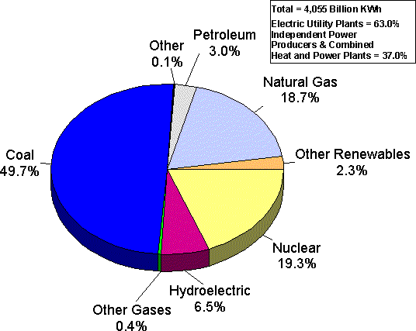
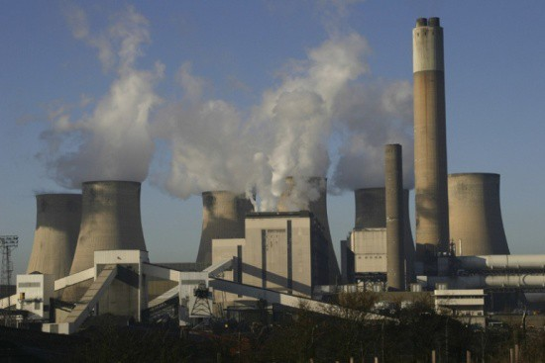
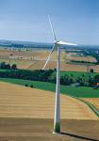
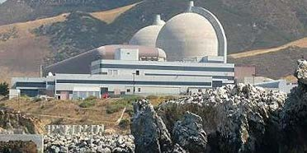
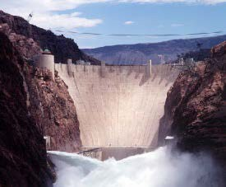
US Electric Power Generation
ECpE Department

Slide 44
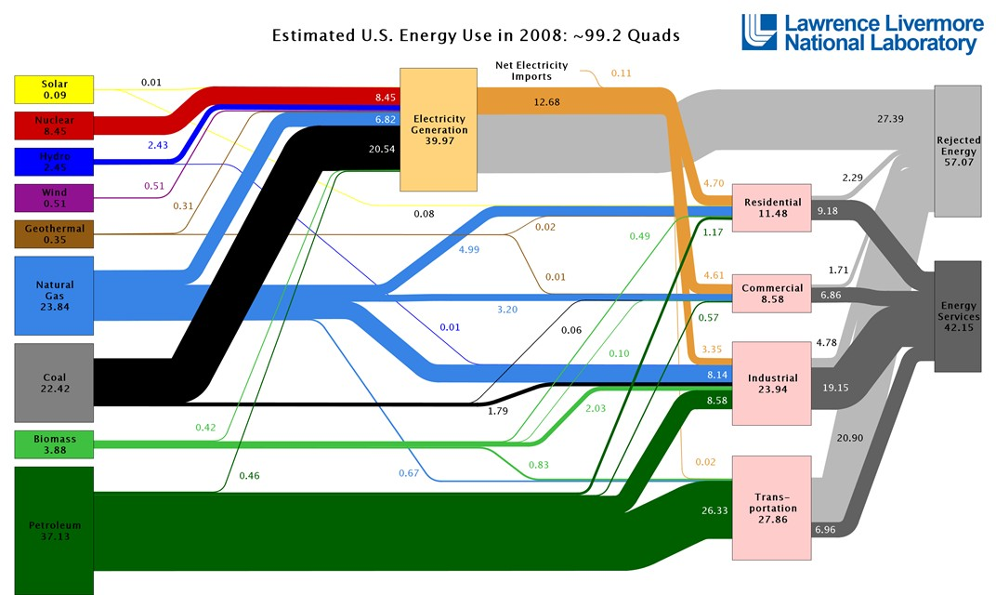
Energy Flow
1 QUAD = 1015 BTU
ECpE Department

Slide 45
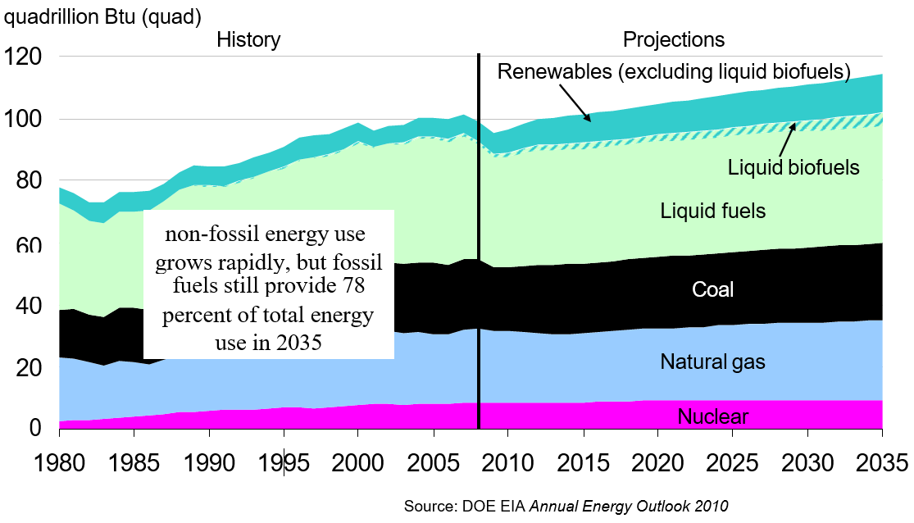
Electric Power Generation
ECpE Department

Slide 46
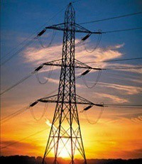
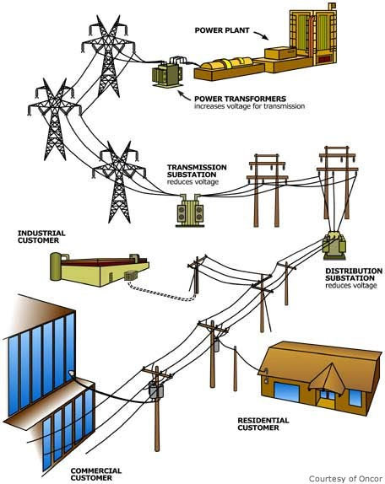
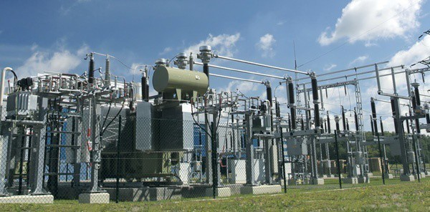
Electric Power Transmission
ECpE Department

Slide 47
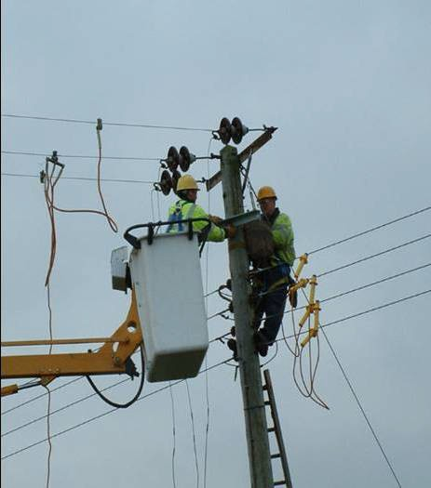
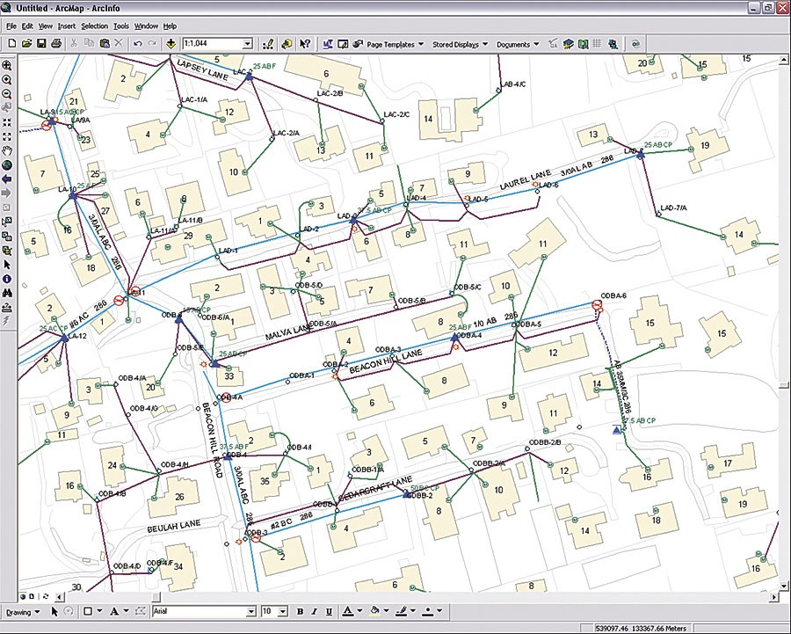
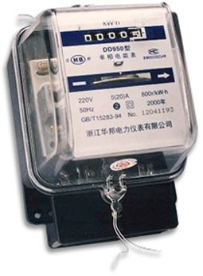
Electric Power Distribution
ECpE Department

Slide 48
Goals of Power System Operation
Supply load (users) with electricity at:
    Specified voltage (120 ac volts common for residential),
    Specified frequency,
    With minimum cost (usually).
ECpE Department

Slide 49
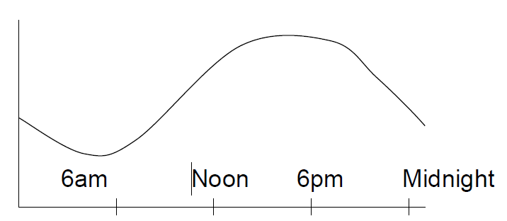
Major Impediments
Load is constantly changing.
Power system is subject to disturbances, such as lightning strikes.
Engineering tradeoffs between reliability and cost.
ECpE Department

Slide 50
Brief History of Electric Power
Early 1880’s –Edison introduced Pearl Street dc system in Manhattan supplying 59 customers
1884 –Sprague produces practical dc motor
1885 –Invention of transformer
Mid 1880’s –Westinghouse/Tesla introduce rival ac system
Late 1880’s –Tesla invents ac induction motor
1893 –First 3 phase transmission line operating at 2.3 kV
1896 –ac lines deliver electricity from hydro generation at Niagara Falls to Buffalo, 20 miles away
Early 1900’s –Private utilities supply all customers in area (city); recognized as a natural monopoly; states step in to begin regulation.
ECpE Department

Slide 51
Contd…
By 1920’s –Large interstate holding companies control most electricity systems.
1935 –Congress passes Public Utility Holding Company Act (PUHCA) to establish national regulation, breaking up large interstate utilities
1935/6 –Rural Electrification Act brought electricity to rural areas
1930’s –Electric utilities established as vertical monopolies
ECpE Department

Slide 52
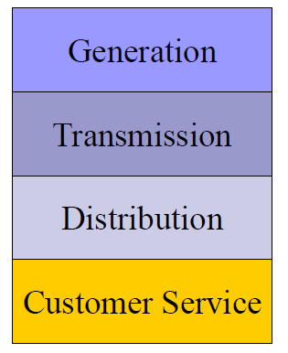
1930’s: Vertical Monopolies
Within a particular geographic market, the electric utility had an exclusive franchise.
In return for this exclusive franchise, the utility had the obligation to serve all existing and future customers at rates determined jointly by utility and regulators.
It was a “cost plus” business.
ECpE Department

Slide 53
Contd, 1930’s: Vertical Monopolies…
Within its service territory each utility is the only game in town.
Neighboring utilities functioned more as colleagues than competitors.
Utilities gradually interconnected their systems so by 1970 transmission lines crisscrossed North America, with voltages up to 765 kV.
Economies of scale keep resulting in decreasing rates, so everyone was happy.
ECpE Department

Slide 54
Contd, History – 1970’s…
1970’s brought inflation, increased fossil-fuel prices, calls for conservation and growing environmental concerns.
Increasing rates replaced decreasing ones.
As a result, U.S. Congress passed Public Utilities Regulator Policies Act (PURPA) in 1978, which mandated utilities must purchase power from independent generators located in their service territory.
PURPA introduced some competition.
ECpE Department

Slide 55
Contd, History – 1990’s…
Major opening of industry to competition occurred as a result of Federal Power Act of 1992
This act mandated that utilities provide “nondiscriminatory” access to the high voltage transmission
Goal was to set up true competition in generation markets
Result over the last few years has been dramatic restructuring of electric utility industry
ECpE Department

Slide 56
Utility Restructuring
Driven by significant regional variations in electric rates.
Goal of competition is to reduce rates through the introduction of competition.
Eventual goal is to allow consumers to choose their electricity supplier.
ECpE Department

Slide 57
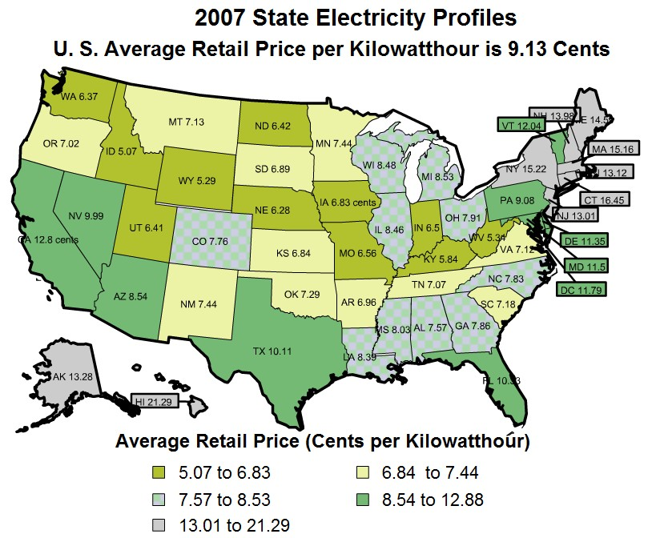
State Variation in Electric Rates
ECpE Department

Slide 58
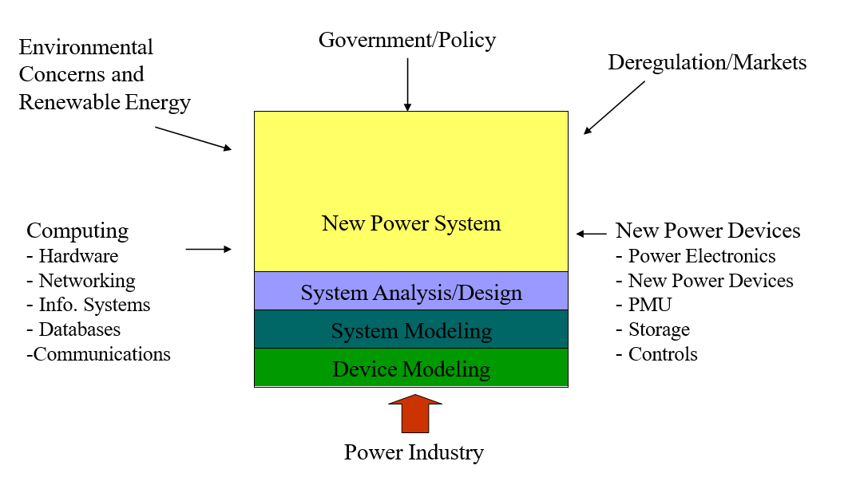
Industry Forces Today
ECpE Department

Slide 59
Thank You!
ECpE Department

