Slide 1
EE 303 Energy Systems and Power Electronics Introduction to Power Basics
ECpE Department
GRA: Prashant Tiwari
Advisor: Dr. Zhaoyu Wang
1113 Coover Hall, Ames, IA
wzy@iastate.edu

Slide 2
Phasor
Complex Number: $Z=a+jb$
Exponential Form: $Z=\left|Z\right| . e^{jθ};$
where, $\left|Z\right|= \sqrt{a^{2}+b^{2}}$,
$θ=\arctan{\frac{b}{a}}$,
$e^{jθ}=\cos{θ}+\sin{θ}$
Polar Form: $Z=\left|Z\right|∡θ$
Rectangular Form: $Z=\left|Z\right|\cos{θ}+j\left|Z\right|\sin{θ}$
Conjugation: $Z^{∗}=a−jb$

Slide 3
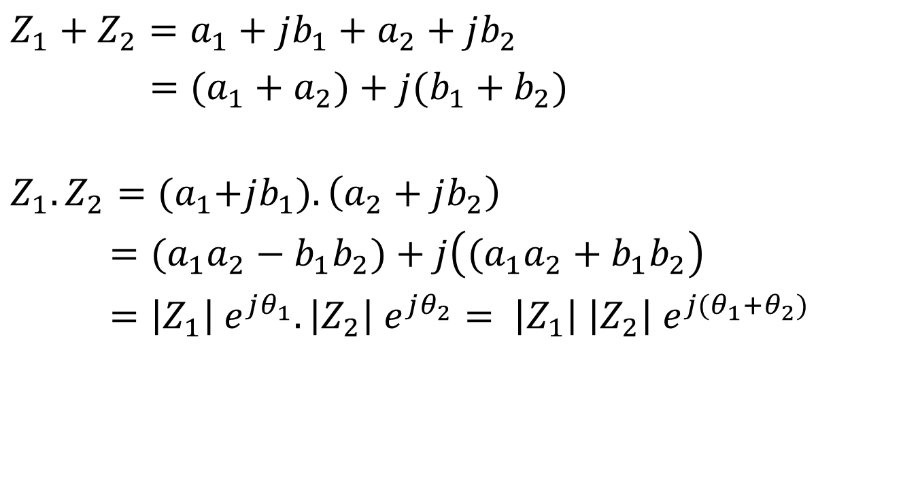
Mathematical Operations
$$Z_{1}+Z_{2}=a_{1}+jb_{1}+a_{2}+jb_{2}$$
$=(a_{1}+a_{2})+j{(b_{1}+b}_{2})$
$$Z_{1}.Z_{2}={(a}_{1}+jb_{1}).\left(a_{2}+jb_{2}\right)$$
$={(a}_{1}a_{2}−{b_{1}b}_{2})+j\left({(a}_{1}a_{2}+{b_{1}b}_{2}\right)$
$=\left|Z_{1}\right| e^{jθ_{1}}.\left|Z_{2}\right| e^{jθ_{2}}= \left|Z_{1}\right| \left|Z_{2}\right| e^{j{(θ_{1}+θ}_{2})}$

Slide 4
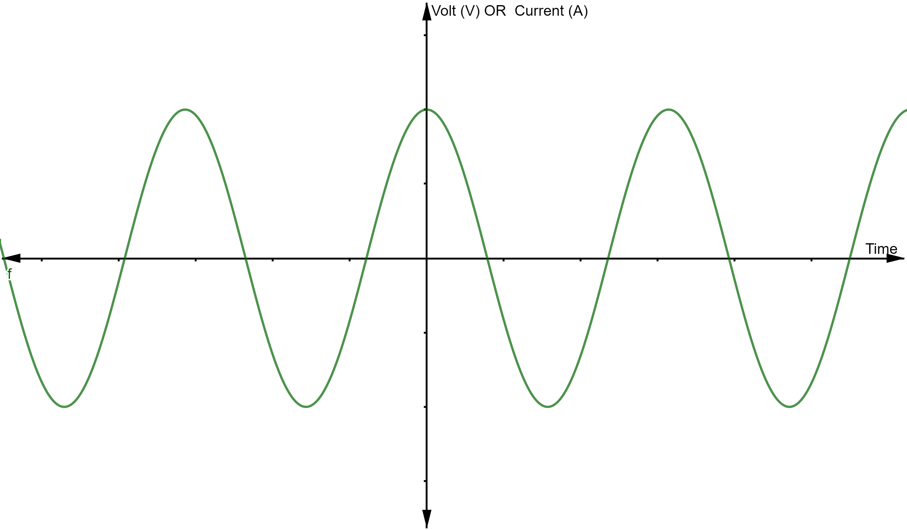
Time Domain
$$V\left(t\right)=V_{max}\cos{(ωt+θ_{V})}$$
I$\left(t\right)=I_{max}\cos{(ωt+θ_{I})}$ ; where,
$ω=2πf;f is 60Hz$

Slide 5
Time Domain VS Phasor Domain
Objective: Phasor Domain Analysis for simplifying calculations
Assumption:
Constant frequency system
Sine Wave
ECpE Department

Slide 6
Time Domain Representation
We discussed in Lecture 1, the Time domain representation of voltage and current are,
$$V\left(t\right)=V_{max}\cos{(ωt+θ_{V})}$$
I$\left(t\right)=I_{max}\cos{(ωt+θ_{I})}$
Root Mean Square (RMS) of a sine signal is,
$\left|V\right|= \sqrt{\frac{1}{T}\int_{0}^{T}{V^{2}\left(t\right)dt}}= \frac{V_{max}}{\sqrt{2}}; where T=\frac{1}{f}$
ECpE Department

Slide 7
Contd…
$V\left(t\right)=\sqrt{2} \left|V\right|\cos{(wt+θ_{V})}$
I$\left(t\right)=\sqrt{2} \left|I\right|\cos{(wt+θ_{I})}$
$V\left(t\right)=\sqrt{2} \left|V\right| Re [e^{j(ωt+θ_{V})}]$
I$\left(t\right)=\sqrt{2} \left|V\right| Re [e^{j(ωt+θ_{I})}]$
Note: [For conversion of equation (i) to (ii)]
As, $e^{jθ}=\cos{θ}+j\sin{θ}$
$∴ e^{j(ωt+θ_{V})}=\cos{(ωt+θ_{V})}+j\sin{(ωt+θ_{V})}$
…………………………… (i)
………………..……….. (ii)
Real Part
Imaginary Part
ECpE Department

Slide 8
Phasor Domain Representation
Voltage and Current can be represented in phasor domain as,
$V=\left|V\right|e^{jθ_{V}}=\left|V\right|∠θ_{V}=\left|V\right|\cos{θ_{V}}+j\left|V\right|sin{θ_{V}}$
I $=\left|I\right|e^{jθ_{I}} =\left|I\right|∠θ_{I} =\left|I\right|\cos{θ_{I}}+j\left|V\right|sin{θ_{I}}$
Exponential
Polar
Rectangular

Slide 9
Representation of Electrical Components
Component | Time Domain | Phasor Domain
Resistor | $$V\left(t\right)=R. i(t)$$ | $$V=R. I$$
Inductor | $$V\left(t\right)=L. \frac{d i(t)}{dt}$$ | $$V=jωL. I$$
Capacitor | $$V\left(t\right)=\frac{1}{C}\int_{0}^{t}{i\left(t\right)dt}+V(0)$$ | $$V=\frac{1}{jωC}. I$$
ECpE Department

Slide 10
Impedance
‘Z’ denotes the impedance.
Mathematically,
$Z=R+jX$, where R = resistance and
X = reactance
$=R+j\left(X_{L}−X_{C}\right)$
$=R+j\left(ωL−\frac{1}{ωC}\right)$
Note:
Here, $X_{L}=ωL$ and is called ‘Inductive Impedance’
and,$X_{C}=\frac{1}{ωC}$ and is called ‘Capacitive Impedance’
ECpE Department

Slide 11
Contd..
Expression of $Z$ in polar form.
As, $Z=R+jX$
In Polar Form, $Z=\left|Z\right| ∠ϕ$ ; where, $\left|Z\right|= \sqrt{R^{2}+X^{2}}$
and $ϕ$ $=$ $arctan(\frac{X}{R})$
The reciprocal of Impedance is termed as admittance.
i.e. $Y=\frac{1}{Z}$
ECpE Department

Slide 12
Example 1: Find i(t)
The voltage source in the figure shown is defined as $V\left(t\right)$where,
$$V\left(t\right)=\sqrt{2} 100 \cos{(ωt+30)}$$
Find i$\left(t\right).$
ECpE Department

Slide 13
Solution
Given,
R = 4Ω,
X = $ωL$ = $2ΠfL$ = 3
$$∴Z=4+j3$$
$\left|Z\right|= \sqrt{4^{2}+3^{2}}=5$ and
$ϕ$ $=$ $arctan\left(\frac{3}{4}\right)=\text{36.9}\text{o}$
Now, I = $\frac{V}{Z}=\frac{100∠30}{5∠36.9}=20∠−6.9\text{o}$ A
$$∴i\left(t\right)=20\sqrt{2}\cos\left(ωt−6.9\right)$$
$$V\left(t\right)=\sqrt{2} 100 \cos{(ωt+30)}$$
ECpE Department

Slide 14
Complex Power
P$ower\left(t\right)=V\left(t\right).I\left(t\right)$
where, $V\left(t\right)=V_{max}\cos{(ωt+θ_{V})}$
I$\left(t\right)=I_{max}\cos{(ωt+θ_{I})}$
$$∵\cos{α}\cos{β}=\frac{1}{2}[\cos\left(α−β\right)+\cos\left(α+β\right)]$$
p$ower\left(t\right)=\frac{1}{2} V_{max} I_{max}[\cos\left(θ_{V}−θ_{I}\right)+\cos\left(2ωt+θ_{V}+θ_{I}\right)]$
$$power\left(t\right)=\frac{1}{2} V_{max} I_{max}[\cos\left(θ_{V}−θ_{I}\right)+\cos\left(2(ωt+θ_{V})−(θ_{V}−θ_{I})\right)]$$
$$power\left(t\right)=\frac{1}{2} V_{max} I_{max}\cos\left(θ_{V}−θ_{I}\right)\{1+\cos{[2\left(ωt+θ_{V}\right)}]\}$$
$$∵\cos{(α−β)}=\cos{α}cosβ+\sin{α}\sin{β}$$
+ $\frac{1}{2} V_{max} I_{max}\sin\left(θ_{V}−θ_{I}\right)\sin{[2\left(ωt+θ_{V}\right)}]\}$
ECpE Department

Slide 15
Contd…
Average Power =$\frac{1}{2}\int_{0}^{T}{power(t)}dt$
$=\frac{1}{2}V_{max}I_{max}\cos{(θ_{V}−θ_{I})}$
$=\left|V\right|\left|I\right|\cos{(θ_{V}−θ_{I})}$
Power factor (pf) = cos $ϕ$ [pf lies between 0 and 1]
Average power is also referred as active power.
Power factor Angle $(ϕ)$
ECpE Department

Slide 16
Contd…
Note:
If current leads voltage, $θ_{V}−θ_{I}$ < 0
then pf is leading.
If current lags voltage, $θ_{V}−θ_{I}$ > 0
then pf is lagging.
ECpE Department

Slide 17
Contd…
Active Power (P)$=\left|V\right|\left|I\right|\cos{(θ_{V}−θ_{I})}$ (Watts)
Reactive Power (Q) )$=\left|V\right|\left|I\right|\sin{(θ_{V}−θ_{I})}$ (VAr)
Complex Power, S = P+jQ (Unit of S is usually VA, kVA)
S = $\left|V\right|\left|I\right|[\cos\left(θ_{V}−θ_{I}\right)+j\sin{(θ_{V}−θ_{I})}$]
= $V.I^{∗}$
= $\left|V\right|∠θ_{V}.$ $\left|I\right|∠{−θ}_{I}$
= $\left|V\right|\left|I\right|∠{(θ}_{V}−θ_{I})$
ECpE Department

Slide 18
Contd…
Magnitude of Apparent Power:
$$\left|S\right|=\left|V\right|.\left|I\right|=\sqrt{P^{2}+Q^{2}}$$
The real power, reactive power and apparent power can be represented as shown in the figure. The figure is called power triangle.
From Power Triangle, we can get,
$$P=S.\cos{ϕ}$$
$$Q=S.\sin{ϕ}=±S\sqrt{1−{pf}^{2}}$$
ECpE Department

Slide 19
Example 2:
A load draws 100kW with leading pf of 0.85. What is $ϕ$, Q and S?
Solution:
ECpE Department

Slide 20
Contd…
Q. A load draws 100kW with leading pf of 0.85. What is $ϕ$, Q and S?
Solution:
$Φ=−cos \left(0.85\right)=−31.8^{0}$
Apparent Power (S) $= \frac{P}{\cos{Φ}}=117.6 Kva$
Reactive Power (Q) = $S.\sin{Φ}=−62kVAr$
Complex Power (S) = $P+jQ=100−j62$
ECpE Department

Slide 21
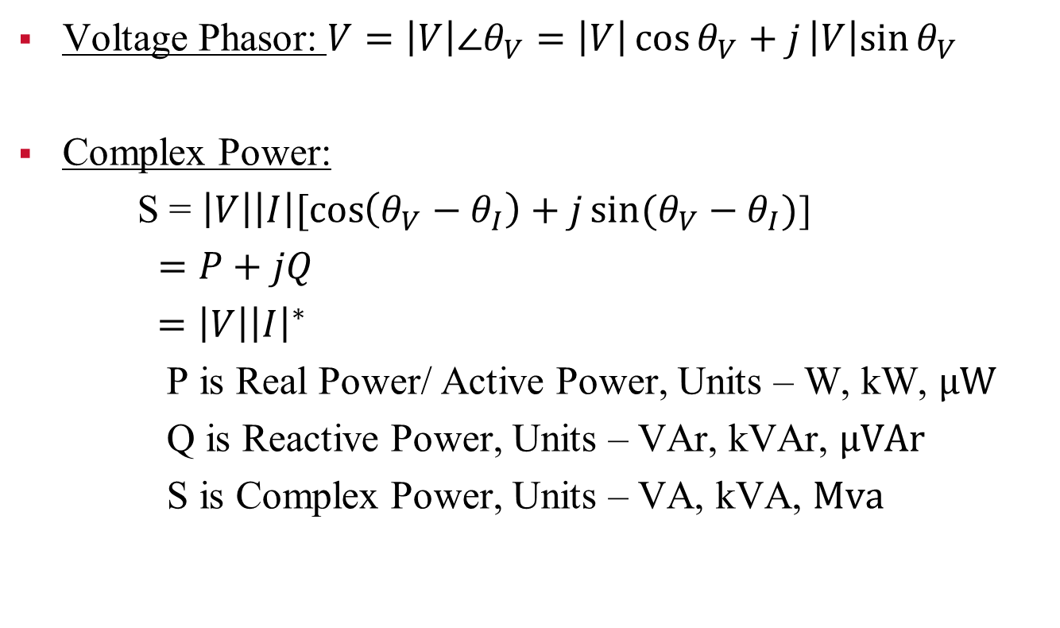
Review
Voltage Phasor: $V=\left|V\right|∠θ_{V}=\left|V\right|\cos{θ_{V}}+j\left|V\right|sin{θ_{V}}$
Complex Power:
S = $\left|V\right|\left|I\right|[\cos\left(θ_{V}−θ_{I}\right)+j\sin{(θ_{V}−θ_{I})}$]
$=P+jQ$
$=\left|V\right|{\left|I\right|}^{∗}$
P is Real Power/ Active Power, Units – W, kW, μW
Q is Reactive Power, Units – VAr, kVAr, μVAr
S is Complex Power, Units – VA, kVA, Μva
ECpE Department

Slide 22
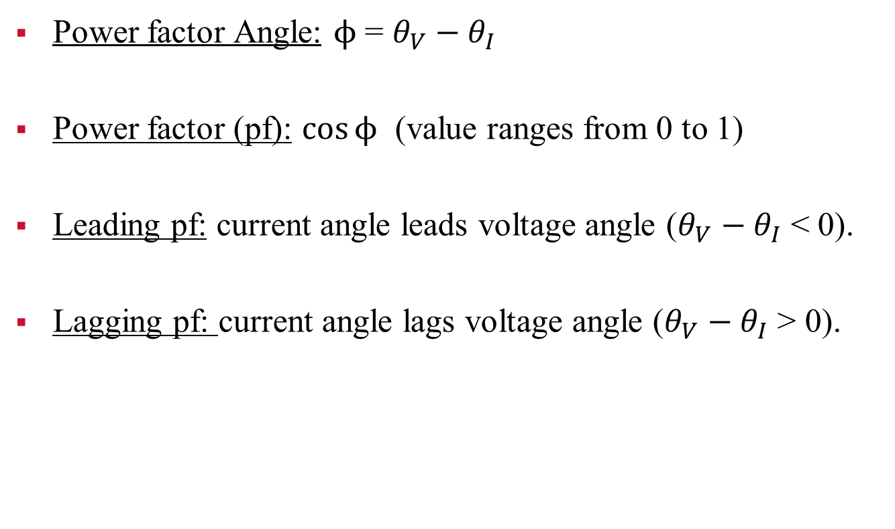
Contd…
Power factor Angle: $ϕ$ = $θ_{V}−θ_{I}$
Power factor (pf): $\cos{ϕ}$ (value ranges from 0 to 1)
Leading pf: current angle leads voltage angle ($θ_{V}−θ_{I}$ < 0).
Lagging pf: current angle lags voltage angle ($θ_{V}−θ_{I}$ > 0).
ECpE Department

Slide 23
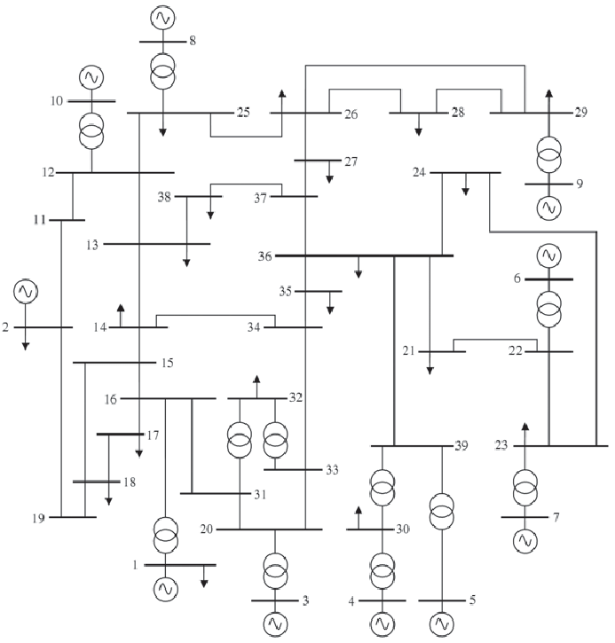
39 – Bus Test System
Bus
Transformer
Load
(P+jQ)
Line
(Z=R+jX)
ECpE Department

Slide 24
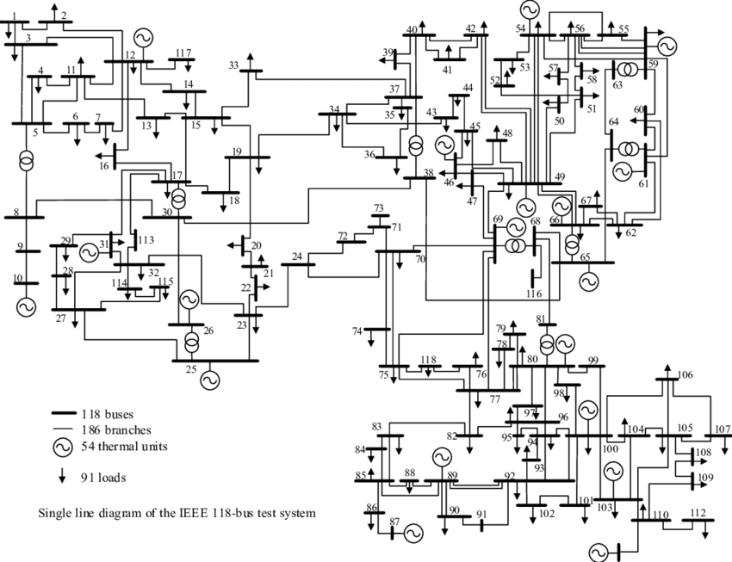
118 – Bus Test System
ECpE Department

Slide 25
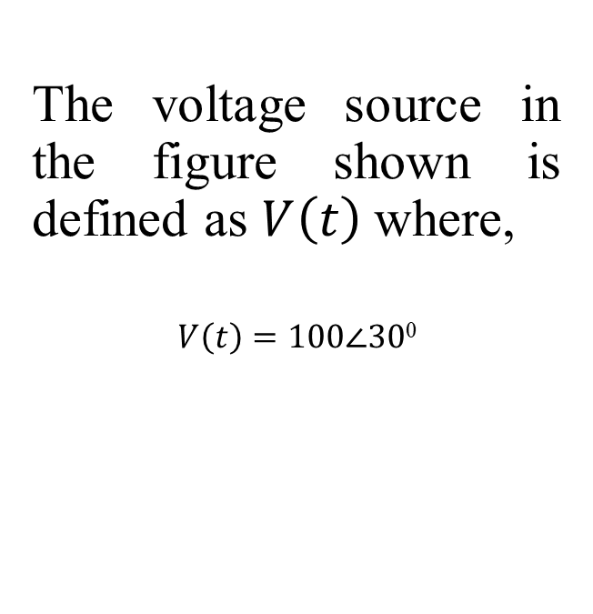
Example 1:
The voltage source in the figure shown is defined as $V\left(t\right)$where,
$$V\left(t\right)=100∠30\text{0}$$
ECpE Department

Slide 26
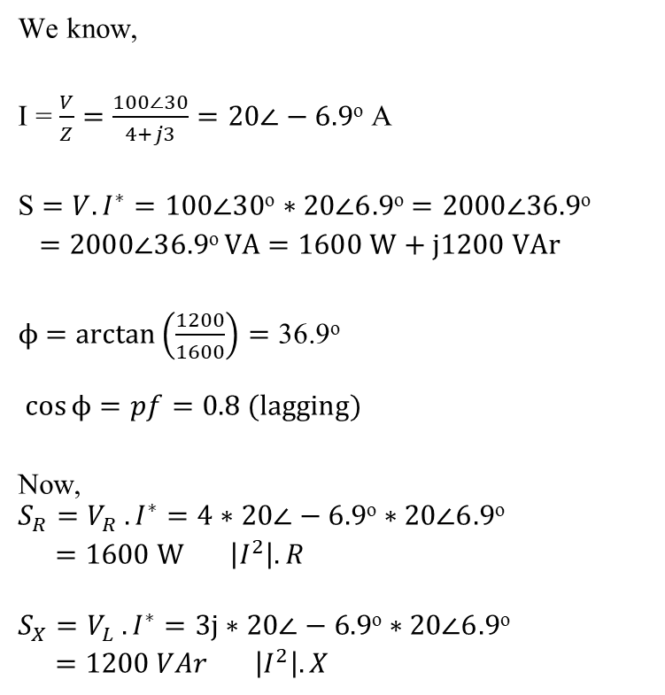
Solution
We know,
I = $\frac{V}{Z}=\frac{100∠30}{4+j3}=20∠−6.9\text{o}$ A
S $=V.I^{∗}=100∠30\text{o}∗20∠6.9\text{o}$ $=2000∠36.9\text{o}$
$=2000∠36.9\text{o} \text{VA}$ $=1600 \text{W}\text{ + }\text{j}\text{1200 }\text{VAr}$
$ϕ$ $=$ $arctan\left(\frac{1200}{1600}\right)=\text{36.9}\text{o}$
$\cos{ϕ}=pf=0.8 (lagging)$
Now,
$$S_{R}=V_{R} .I^{∗}=4∗20∠−6.9\text{o}∗20∠6.9\text{o}$$
$=\text{1600 }\text{W} \left|I^{2}\right|. R$
$$S_{X}=V_{L} .I^{∗}=3j∗20∠−6.9\text{o}∗20∠6.9\text{o}$$
$=\text{1200 }VAr \left|I^{2}\right|. X$
ECpE Department

Slide 27
Contd…
Notes:
Inductors only consume reactive power.
$Q_{inductor}={\left|I_{inductor}\right|}^{2}. X_{L}$
where, $X_{L}=jωL$
Capacitors only generate reactive power.
$Q_{capacitor}={\left|I_{capacitor}\right|}^{2}. X_{C}$
where, $X_{C}=\frac{1}{jωC}=−\frac{j}{ωc}$
ECpE Department

Slide 28
Example 2:
Assume a load 100 kVA with pf=0.8 lagging, where as correct pf is 0.95 lagging. Find the value of reactive power that must be injected to maintain the correct pf.
ECpE Department

Slide 29
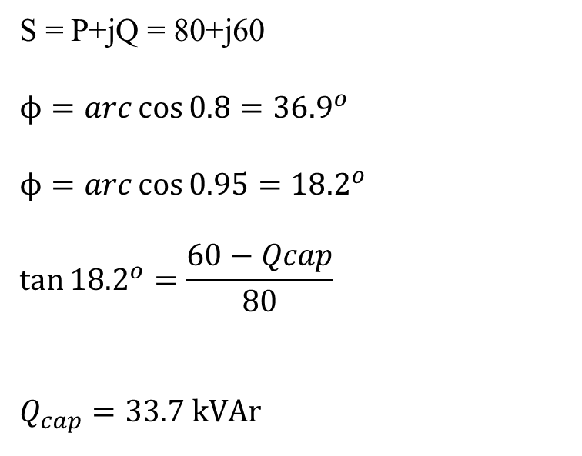
Example 2:
Assume a load 100 kVA with pf=0.8 lagging, where as correct pf is 0.95 lagging. Find the value of reactive power that must be injected to maintain the correct pf.
S = P+jQ = 80+j60
$$ϕ=arc\cos{0.8}={36.9}^{o}$$
$$ϕ=arc\cos{0.95}={18.2}^{o}$$
$$\tan{{18.2}^{o}}=\frac{60−Qcap}{80}$$
$$Q_{cap}=33.7 kVAr$$
ECpE Department

Slide 30
Thank You!

