Slide 1
EE 303 Energy Systems and Power Electronics Three Phase Systems
ECpE Department
GRA: Prashant Tiwari
Advisor: Dr. Zhaoyu Wang
1113 Coover Hall, Ames, IA
wzy@iastate.edu

Slide 2
Three Phase Systems
High-power equipment such as generators, transformers, and transmission lines are built as three phase equipment. However, at the distribution level, depending on the voltage/power rating, a mixture of single phase and three-phase systems is used.
The three-phase system has many advantages over the single-phase system.
Three-phase systems produce a rotating magnetic field inside the alternating current (ac) motors and, therefore, cause the motors to rotate without the need for extra controls.
Three-phase generators produce more power than single-phase generators of equivalent volume.
Three-phase transmission lines transmit three times the power of single-phase lines.
Three-phase systems are more reliable; when one phase is lost, the other two phases can still deliver some power to the loads
ECpE Department

Slide 3
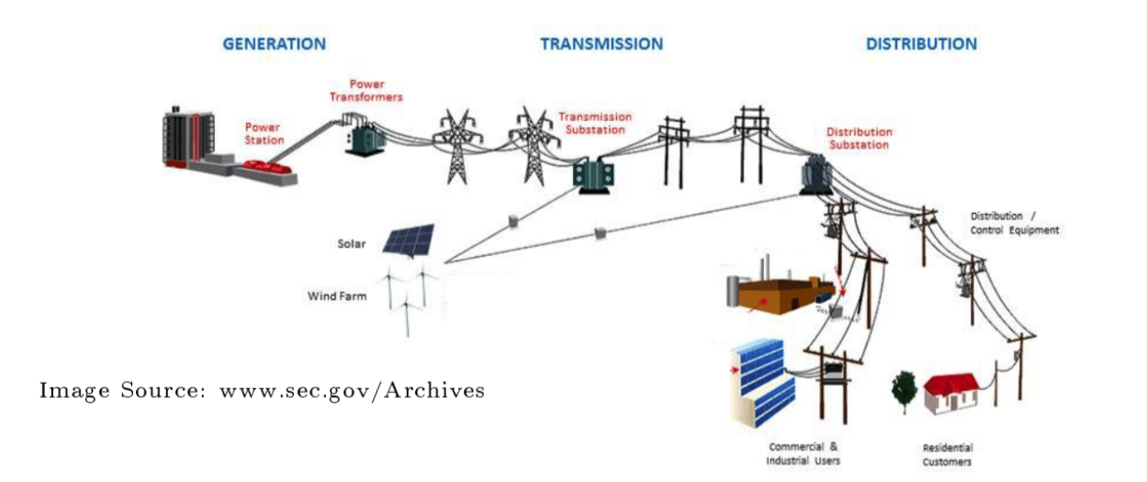
ECpE Department

Slide 4
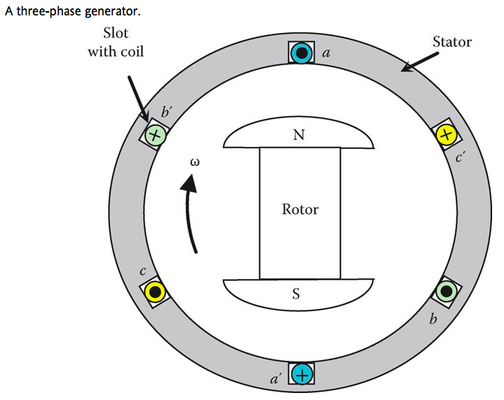
Generation of Three-Phase Voltages
According to Faraday’s law, when a conductor cuts magnetic field lines, a voltage is induced across the conductor. The synchronous generator uses this phenomenon to produce a three-phase voltage.
The generator consists of an outer frame called stator and a rotating magnet called rotor.
At the inner perimeter of the stator, coils are placed inside slots. Each of the two slots separated by 180° houses a single coil (a–a′, b–b′, or c–c′). The coil is built by placing a wire inside a slot in one direction (e.g., a), and winding it back inside the opposite slot (a′).
ECpE Department

Slide 5
Generation of Three-Phase Voltages
When the magnet is spinning clockwise inside the machine by an external prime mover, the magnetic field then cuts all coils and, therefore, induces a voltage across each of them.
If each coil is connected to a load impedance, a current would flow into the load, and the generator produces electric energy that is consumed by the load.
The dot inside the coil indicates a current direction toward the reader, and the cross indicates a current in the opposite direction.
The voltage across any of the three coils can be expressed by Faraday's law
$$e=nBlω$$
Where,
$e$ is the voltage induced across the coil $n$ is the number of turns in the coil $B$ is the flux density of the magnetic field $I$ is the length of the slot $ω$ is the angular speed
ECpE Department

Slide 6
Generation of Three-Phase Voltages
The voltage induced on a conductor is proportional to the perpendicular component of the magnetic field with respect to the conductor.
At the rotor position in Figure, coil a–a′ has the maximum perpendicular field and, hence, it has the maximum induced voltage. Coil b–b′ will have its maximum voltage when the rotor moves clockwise by 120°, and coil c–c′ will have its maximum voltage when the rotor is at 240° position.
If the rotation is continuous, the voltage across each coil is sinusoidal, all coils have the same magnitude of the maximum voltage, and the induced voltages are shifted by 120°.
ECpE Department

Slide 7
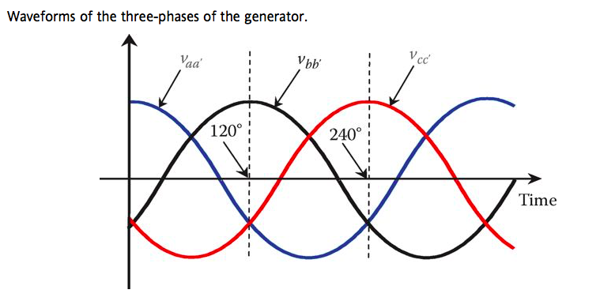
Generation of Three-Phase Voltages: Mathematical Expression
$v_{aa^{′}}$ as reference,
$$\begin{matrix} & {\overset{‾}{V}}_{aa^{′}}=\frac{V_{max}}{\sqrt{2}}∠0^{∘}=V∠0^{∘} \\ & {\overset{‾}{V}}_{bb^{′}}=\frac{V_{max}}{\sqrt{2}}∠−{120}^{∘}=V∠−{120}^{∘} \\ & {\overset{‾}{V}}_{cc^{′}}=\frac{V_{max}}{\sqrt{2}}∠{120}^{∘}=V∠{120}^{∘}\end{matrix}$$
$$\begin{matrix} & v_{aa^{′}}=V_{max}cos⁡(ωt) \\ & v_{bb^{′}}=V_{max}cos⁡\left(ωt−{120}^{∘}\right) \\ & v_{cc^{′}}=V_{max}cos⁡\left(ωt−{240}^{∘}\right)=V_{max}cos⁡\left(ωt+{120}^{∘}\right)\end{matrix}$$
Where, $\overset{‾}{V}$ is the phasor voltage in complex number form $V$ is the magnitude of the rms voltage
ECpE Department

Slide 8
Connection of Three-Phase Circuits
The three-phase generator has three independent coils and each coil represents a phase.
Since each coil has two terminals, the generator has six terminals.
To transmit the generated power from the power plant to the load centers, six wires seem to be needed.
Since the transmission lines are often very long (hundreds of miles), the cost of the six wires is very high.
To reduce the cost of the transmission system, the three coils are connected in a wye or delta configuration.. The end of all the coils are bonded to a single point known as neutral. The other ends are connected to the three-wire (three-phase) system.
In the delta configuration, the end of each coil is connected to the entrance of the adjacent coil. The entrance of each coil is then connected to one of the phases of the transmission line. In each of these configurations, only three wires are needed to transmit the power. These three wires are considered to be one circuit.
ECpE Department

Slide 9
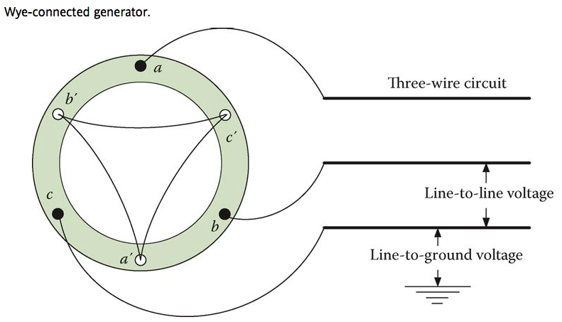
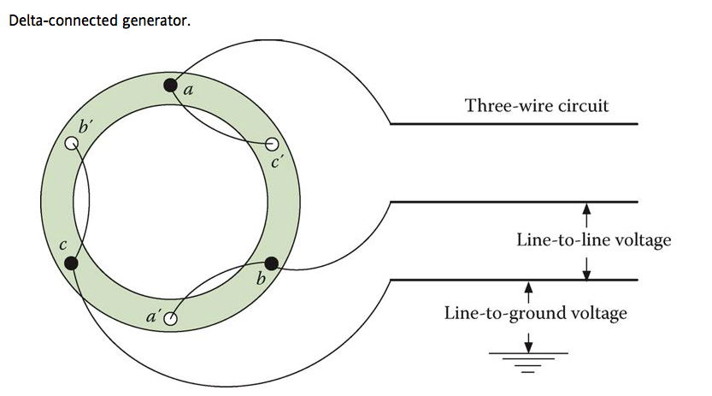
ECpE Department

Slide 10
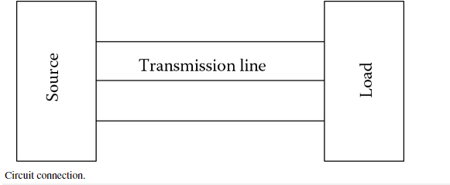
Connection of Three-Phase Circuits
The generator is connected to the load via the three-wire transmission circuit.
This simple power circuit is divided into three distinct parts: source, load, and three-wire circuit. The three-wire circuit is called three-phase transmission line.
The currents in the transmission line conductors are called line currents. The voltages of the transmission line are classified by two variables: (1) line-to-neutral (line-to-ground) voltage and (2) line-to-line voltage
The line-to-ground voltage is also called phase voltage or phase-to-ground voltage. The phase voltage is the voltage between any line and the ground (or neutral).
The voltage between any two lines is the line-to-line voltage.
ECpE Department

Slide 11
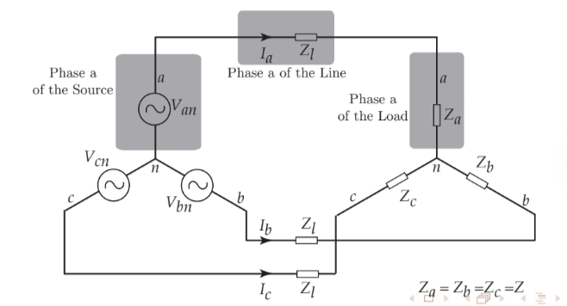
Main Components
A balanced 3-phase system has:
Three sinusoidal voltage sources with equal magnitude, but with an angle shift of ${120}^{∘}$.
equal loads on each phase.
equal impedance on the lines connecting the sources to the loads
ECpE Department

Slide 12
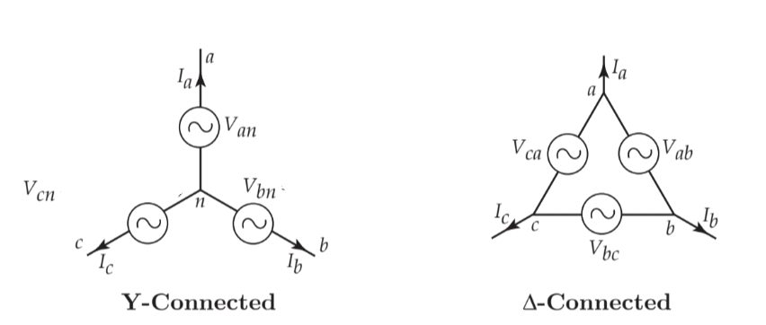
3-Phase Voltage Source
We have two type of 3-Phase voltage source:
Y- Connected
𝚫- Connected
ECpE Department

Slide 13
Y- Connected Voltage Source
$$V_{an}=V∠α$$
$$V_{bm}=V∠α−{120}^{∘}$$
$$V_{cn}=V∠α−{240}^{∘}$$
Positive Sequence Voltage Source
Note:
$$V=\frac{V_{max}}{\sqrt{2} }$$
$v_{an}=V_{max}cos⁡(ωt+α)$
$v_{bn}=V_{max}cos⁡(ωt+α−{120}^{o})$
$v_{cn}=V_{max}cos⁡(ωt+α−{240}^{o})$
ECpE Department

Slide 14
Pictures of Generators and Transformers
ECpE Department

Slide 15
ECpE Department

Slide 16
ECpE Department

Slide 17
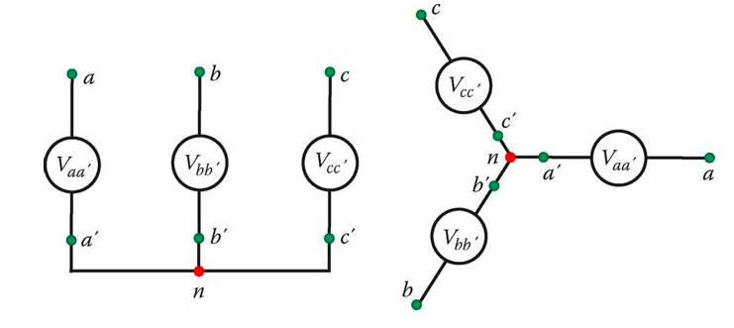
ECpE Department

Slide 18
ECpE Department

Slide 19
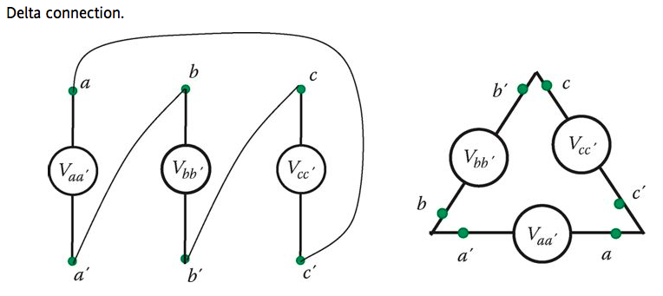
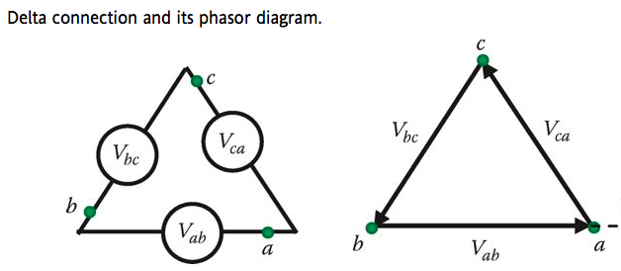
ECpE Department

Slide 20
ECpE Department

Slide 21
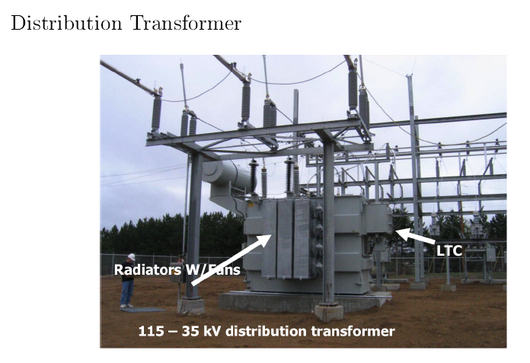
ECpE Department

Slide 22
ECpE Department

Slide 23
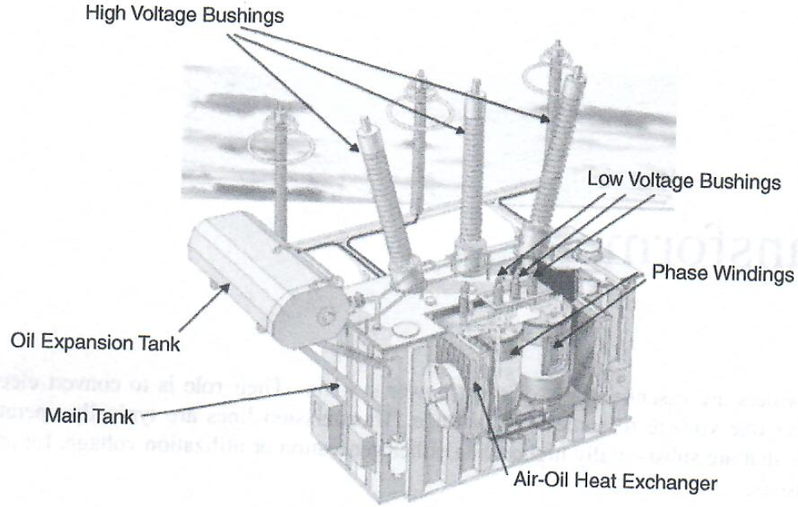
ECpE Department

Slide 24
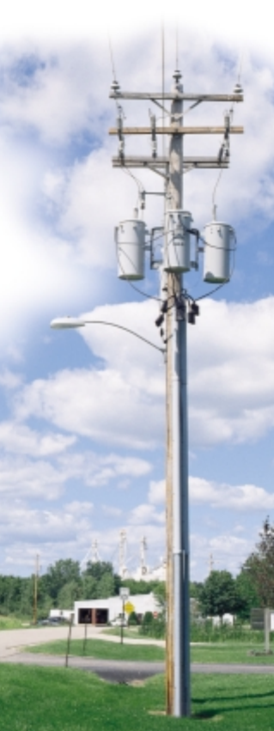
ECpE Department

Slide 25
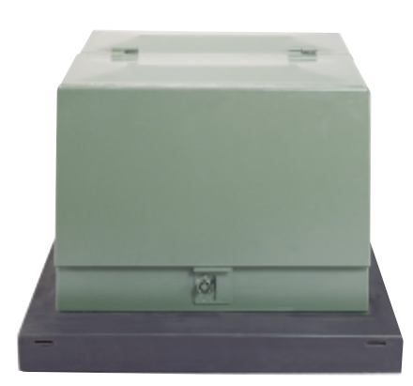
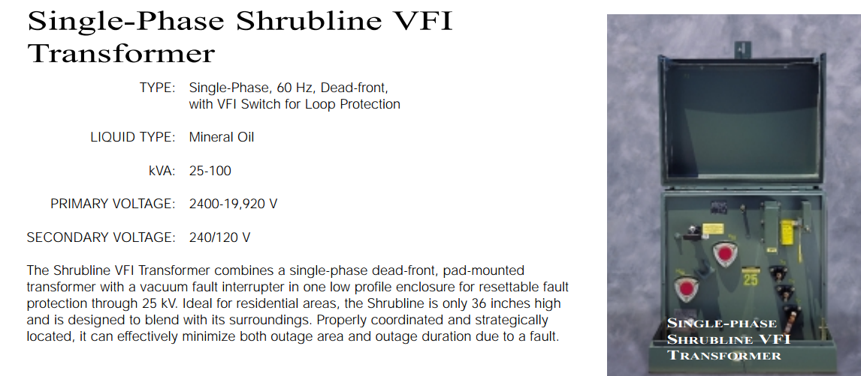
ECpE Department

Slide 26
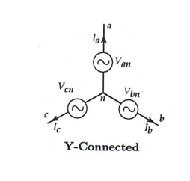
3-Phase Voltage Source – (Y-Connection)
Y-Connected 3-Phase Voltage Source
$$\begin{matrix} & V_{an}=V∠α \\ & V_{bn}=V∠(α−{120}^{∘}) \\ & V_{cn}=V∠(α−{240}^{∘})\end{matrix}$$
In every balanced three-phase system, the sum of abc variables is ALWAYS zero:
$$V_{an}+V_{bn}+V_{cn}=0$$
ECpE Department

Slide 27
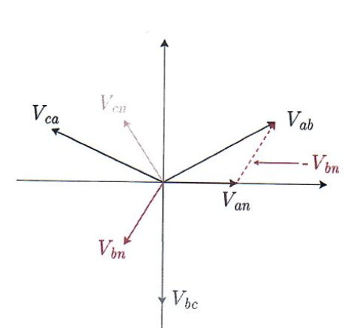
Contd…
Y-Connected 3-Phase Voltage Source
$$\begin{matrix} & V_{an}=V∠α \\ & V_{bn}=V∠α−{120}^{∘} \\ & V_{cn}=V∠α−{240}^{∘}\end{matrix}$$
Therefore,
$V_{ab}=V_{an}−V_{bn}=V\left(1∠α−1∠(α−{120}^{∘})\right)$
$=\sqrt{3}V∠α+{30}^{∘}$
$$V_{bc}=V_{bn}−V_{cn}=\sqrt{3}V∠α−{90}^{∘}$$
$$V_{ca}=V_{cn}−V_{an}=\sqrt{3}V∠α−{210}^{∘}$$
ECpE Department

Slide 28
Contd…
Y-Connected 3-Phase Voltage Source
$$\begin{matrix} & V_{an}=V∠α \\ & V_{bn}=V∠α−{120}^{∘} \\ & V_{cn}=V∠α−{240}^{∘}\end{matrix}$$
Or,
$$V_{ab}=V_{an}−V_{bn}=\sqrt{3}V_{an} ∠{30}^{∘}$$
$$V_{bc}=V_{bn}−V_{cn}=\sqrt{3}V_{bn} ∠{30}^{∘}$$
$$V_{ca}=V_{cn}−V_{an}=\sqrt{3}V_{cn} ∠{30}^{∘}$$
Line to Line voltages are also balanced.
ECpE Department

Slide 29
Contd…
So, in a Y-connected source
$V_{line}=\sqrt{3}V_{phase} ∠{30}^{∘}$
$I_{line}=I_{phase}$
$S_{3−∅}=3V_{phase} I^{∗}$
ECpE Department

Slide 30
Summary of 3-Phase, Y-Connection
Time Domain Representation
$$V_{an}\left(t\right)=\sqrt{2}V\cos{(wt+α)}$$
$${120}^{o}$$
$${120}^{o}$$
$${120}^{o}$$
$$V_{cn}\left(t\right)=\sqrt{2}V\cos{(wt+α−{240}^{o})}$$
$$V_{bn}\left(t\right)$$
$$=\sqrt{2}V\cos{(wt+α−{120}^{o})}$$
ECpE Department

Slide 31
Contd…
Phasor Domain Representation
a
L-N
$$\begin{matrix} & V_{an}=V∠α \\ & V_{bn}=V∠(α−{120}^{∘}) \\ & V_{cn}=V∠(α−{240}^{∘})\end{matrix}$$
Line to Neutral (L-N) Voltage, also called Phase Voltage
n
c
b
Relationship between Line to Line (L-L) and L-N voltage
$$\begin{matrix}V_{ab}=V_{an}−V_{b_{n}} & =V∠α−V∠(α−{120}^{∘}) \\ & =\sqrt{3}V∠(α+{30}^{∘})\end{matrix}$$
$$\begin{matrix}V_{bc}=V_{bn}−V_{c_{n}}=\sqrt{3}V_{bn}∠{30}^{∘};where V_{bn}=V∠(α+{120}^{∘}) & \\ & \end{matrix}$$
$$\begin{matrix}V_{ca}=V_{cn}−V_{an}=\sqrt{3}V_{cn}∠{30}^{∘};where V_{cn}=V∠(α−{240}^{∘}) & \\ & \end{matrix}$$
ECpE Department

Slide 32
Contd…
Conclusion: In Y- connection
$V_{line}=\sqrt{3}V_{phase} .e^{j{30}^{o}}$
$$V_{ab}$$
$$V_{an}$$
$$V_{bc}$$
$$V_{bn}$$
$$V_{ca}$$
$$V_{cn}$$
$I_{line}=I_{phase}$
$S_{3−∅}=3V_{phase} I_{phase}^{∗}$
ECpE Department

Slide 33
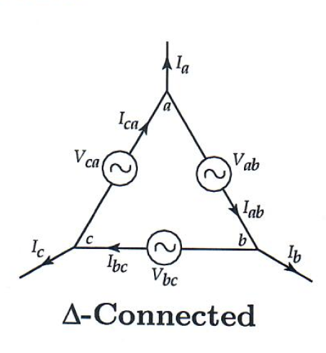
3-Phase Voltage Source – (𝚫-Connection)
(𝚫-Connection) 3-Phase Voltage Source
For the 𝚫 connection ,
Phase voltages equal Line voltages.
ECpE Department

Slide 34
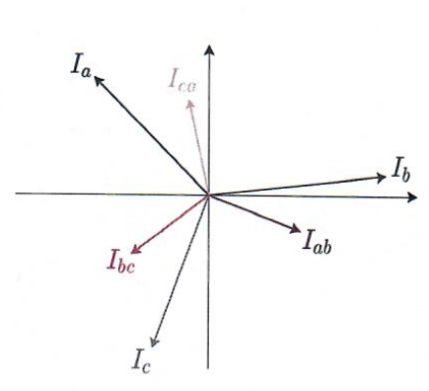
Contd…
(𝚫-Connection) 3-Phase Voltage Source
For the 𝚫 connection , phase voltages equal line voltages.
Moreover,
$$I_{a}=I_{ca}−I_{ab}=\sqrt{3}I_{ca}∠{30}^{∘}$$
$$I_{b}=I_{ab}−I_{bc}=\sqrt{3}I_{ab}∠{30}^{∘}$$
$$I_{c}=I_{bc}−I_{ca}=\sqrt{3}I_{bc}∠{30}^{∘}$$
Line Currents are also balanced.
ECpE Department

Slide 35
Contd…
So, in a 𝚫-Connection source:
$$\begin{matrix}\begin{aligned}V_{\text{line} }=V_{\text{phase} } \\ \end{aligned} \\ \\ \begin{aligned} I_{\text{line} }=\sqrt{3}I_{\text{phase} }∠{30}^{∘} \\ \\ \end{aligned} \\ S_{3φ}=3V_{\text{phase} }I_{\text{phase} }^{∗}\end{matrix}$$
ECpE Department

Slide 36
Summary of 3-Phase, 𝚫 -Connection Source
$$\begin{aligned}V_{\text{line} }=V_{\text{phase} } \\ \end{aligned}$$
Measurement from outside, the voltages are; $V_{ab}$/ $V_{bc}$/ $V_{ca}$
(Note: Line voltage=Phase Voltage in Delta Connection)
Measurement from outside, the currents are; $I_{a}$/ $I_{b}$/ $I_{c}$
$I_{a}=I_{ca}−I_{ab}=\sqrt{3}$ $I_{ca}$ $e^{j{30}^{o}}$
$I_{b}=I_{ab}−I_{bc}=\sqrt{3}$ $I_{ab}$ $e^{j{30}^{o}}$
$I_{c}=I_{bc}−I_{ca}=\sqrt{3}$ $I_{bc}$ $e^{j{30}^{o}}$
ECpE Department

Slide 37
Contd…
Conclusion: In 𝚫 - connection
$$I_{a}$$
$V_{line}=V_{phase}$
Source
(Phase Voltage and Phase Current)
Load
L-L
$$I_{b}$$
$I_{line}=\sqrt{3}I_{phase} e^{j{30}^{o}}$
$$I_{c}$$
$S_{3−∅}=3V_{phase} I_{phase}^{∗}$
Measurement from Outside
ECpE Department

Slide 38
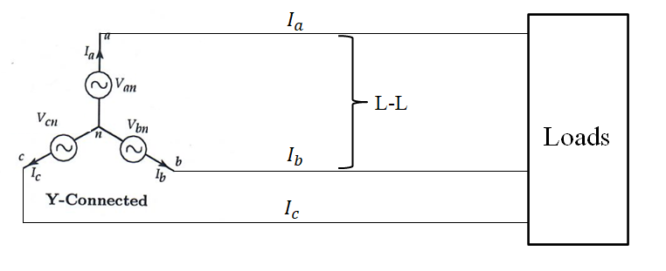
3-Phase Voltage Source: (Y-Connected Source)
$V_{line}=V_{phase}$
$I_{line}=\sqrt{3}I_{phase} e^{j{30}^{o}}$
$S_{3−∅}=3V_{phase} I_{phase}^{∗}=V_{\text{an} }.I_{\text{a} }^{∗}+V_{\text{bn}} .I_{\text{b} }^{∗}+V_{\text{c}n} .I_{\text{c} }^{∗}$
ECpE Department

Slide 39
3-Phase Voltage Source: (𝚫 -Connected Source)
$$I_{a}$$
Loads
L-L
$$I_{b}$$
$$I_{c}$$
$V_{line}=V_{phase}$
$I_{line}=\sqrt{3}I_{phase} e^{j{30}^{o}}$
$S_{3−∅}=3V_{phase} I_{phase}^{∗}$
ECpE Department

Slide 40
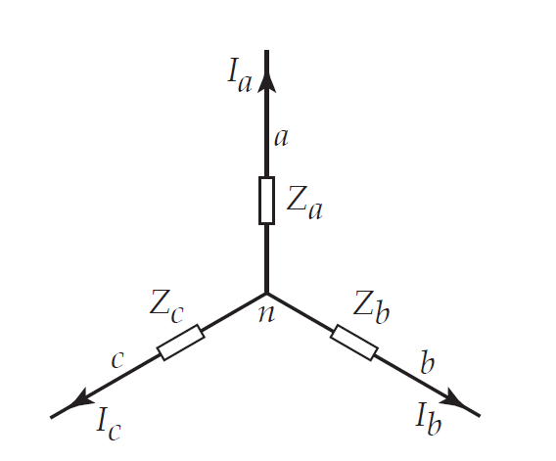
3-Phase Load: (Y-Connected Load)
Source
Phase & Line Currents are the same.
$$\begin{matrix} & V_{ab}=V_{an}−V_{bn}=\sqrt{3}V_{an}⋅e^{j{30}^{∘}} \\ & V_{bc}=V_{bn}−V_{cn}=\sqrt{3}V_{bn}⋅e^{j{30}^{∘}} \\ & V_{ca}=V_{cn}−V_{an}=\sqrt{3}V_{cn}⋅e^{j{30}^{∘}}\end{matrix}$$
ECpE Department

Slide 41
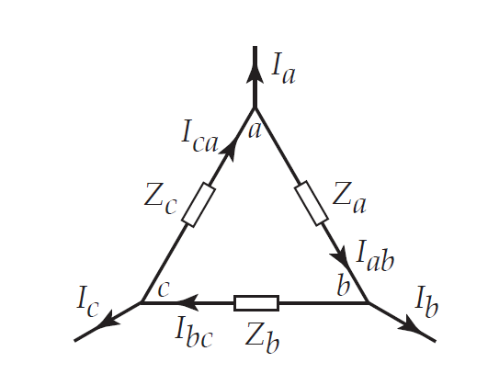
3-Phase Load: (𝚫 -Connected Load)
Loads
Phase & Line Voltages are the same.
$$I_{a}=I_{ca}−I_{ab}=\sqrt{3} I_{ca} e^{j{30}^{o}}$$
$$I_{b}=I_{ab}−I_{bc}=\sqrt{3} I_{ab} e^{j{30}^{o}}$$
$$I_{c}=I_{bc}−I_{ca}=\sqrt{3} I_{bc} e^{j{30}^{o}}$$
ECpE Department

Slide 42
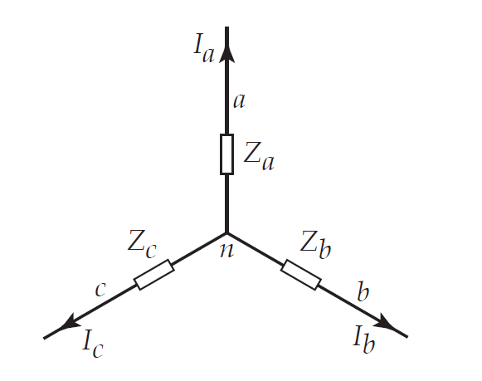
3-Phase Load: Summary
Y -Connected Load
𝚫 -Connected Load
Phase & Line Currents are the same.
$$\begin{matrix} & V_{ab}=V_{an}−V_{bn}=\sqrt{3}V_{an}⋅1∠{30}^{∘} \\ & V_{bc}=V_{bn}−V_{cn}=\sqrt{3}V_{bn}⋅1∠{30}^{∘} \\ & V_{ca}=V_{cn}−V_{an}=\sqrt{3}V_{cn}⋅1∠{30}^{∘}\end{matrix}$$
Phase & Line Voltages are the same.
$$I_{a}=I_{ca}−I_{ab}=\sqrt{3} I_{ca} 1∠{30}^{∘}$$
$$I_{b}=I_{ab}−I_{bc}=\sqrt{3} I_{ab} 1∠{30}^{∘}$$
$$I_{c}=I_{bc}−I_{ca}=\sqrt{3} I_{bc} 1∠{30}^{∘}$$
ECpE Department

Slide 43
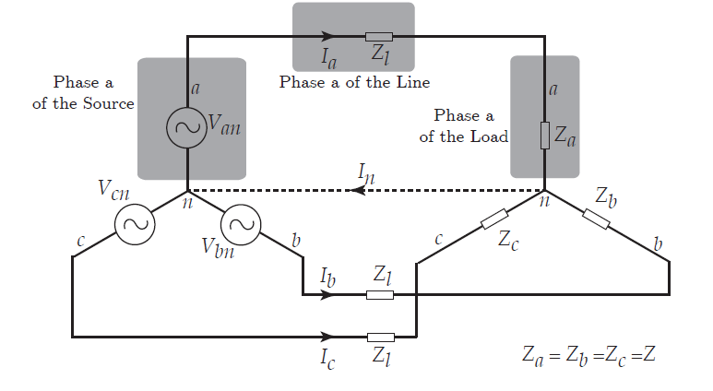
Neutral Point
$$I_{n}=I_{a}+I_{b}+I_{c}$$
ECpE Department

Slide 44
Contd…
$$I_{n}=I_{a}+I_{b}+I_{c}$$
$$I_{n}=\frac{V_{an}}{Z_{l}+Z_{a}}+\frac{V_{b_{n}}}{Z_{l}+Z_{b}}+\frac{V_{cn}}{Z_{l}+Z_{c}}=\frac{1}{Z_{l}+Z_{a}}\left(V_{an}+V_{bn}+V_{cn}\right)$$
ECpE Department

Slide 45
Contd…
$$I_{n}=I_{a}+I_{b}+I_{c}$$
$$I_{n}=\frac{V_{an}}{Z_{l}+Z_{a}}+\frac{V_{b_{n}}}{Z_{l}+Z_{b}}+\frac{V_{cn}}{Z_{l}+Z_{c}}=\frac{1}{Z_{l}+Z_{a}}\left(V_{an}+V_{bn}+V_{cn}\right)$$
$$I_{n}=\frac{1}{Z_{l}+Z_{a}}\left(0\right)=0$$
ECpE Department

Slide 46
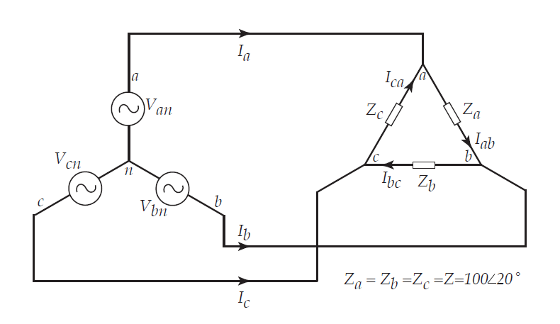
Example
Q. Assume a $Δ$-connected load is supplied from a 3-phase $13.8kV$ (L-L) source with $Z=100∠{20}^{∘}Ω$. Find $I_{a},I_{b}$, and $I_{c}$. Moreover, determine the load apparent power of the source.
$$Ω$$
ECpE Department

Slide 47
Contd…
Q. Assume a $Δ$-connected load is supplied from a 3-phase $13.8kV$ (L-L) source with $Z=100∠{20}^{∘}Ω$. Find $I_{a},I_{b}$, and $I_{c}$. Moreover, determine the load apparent power of the source.
Solution,
$$V_{ab}=13.8∠0^{∘}kV$$
$$V_{bc}=13.8∠−{120}^{∘}kV$$
$$V_{ca}=13.8∠−{240}^{∘}kV$$
ECpE Department

Slide 48
Contd…
Q. Assume a $Δ$-connected load is supplied from a 3-phase $13.8kV$ (L-L) source with $Z=100∠{20}^{∘}Ω$. Find $I_{a},I_{b}$, and $I_{c}$. Moreover, determine the load apparent power of the source.
Solution,
$$V_{ab}=13.8∠0^{∘}kV$$
$$V_{bc}=13.8∠−{120}^{∘}kV$$
$$V_{ca}=13.8∠−{240}^{∘}kV$$
$$I_{ab}=\frac{13.8k∠0^{∘}}{100∠{20}^{∘}}=138∠−{20}^{∘} A$$
$$I_{bc}=\frac{13.8k∠−{120}^{∘}}{100∠{20}^{∘}}=138∠−{140}^{∘} A$$
$$I_{ca}=\frac{13.8k∠−{240}^{∘}}{100∠{20}^{∘}}=138∠−{260}^{∘}A$$
ECpE Department

Slide 49
Contd…
Q. Assume a $Δ$-connected load is supplied from a 3-phase $13.8kV$ (L-L) source with $Z=100∠{20}^{∘}Ω$. Find $I_{a},I_{b}$, and $I_{c}$. Moreover, determine the load apparent power of the source.
$$V_{ab}=13.8∠0^{∘}kV$$
$$V_{bc}=13.8∠−{120}^{∘}kV$$
$$V_{ca}=13.8∠−{240}^{∘}kV$$
$$I_{ab}=\frac{13.8k∠0^{∘}}{100∠{20}^{∘}}=138∠−{20}^{∘} A$$
$$I_{bc}=\frac{13.8k∠−{120}^{∘}}{100∠{20}^{∘}}=138∠−{140}^{∘} A$$
$$I_{ca}=\frac{13.8k∠−{240}^{∘}}{100∠{20}^{∘}}=138∠−{260}^{∘}A$$
$$I_{a}=I_{ab}−I_{ca}=138∠−{20}^{∘}−138∠−{260}^{∘}$$
$$I_{a}=239∠−{50}^{∘}A$$
$$I_{b}=239∠−{170}^{∘}A$$
$$I_{c}=239∠−{290}^{∘}A$$
ECpE Department

Slide 50
Contd…
Q. Assume a $Δ$-connected load is supplied from a 3-phase $13.8kV$ (L-L) source with $Z=100∠{20}^{∘}Ω$. Find $I_{a},I_{b}$, and $I_{c}$. Moreover, determine the load apparent power of the source.
$$V_{ab}=13.8∠0^{∘}kV$$
$$V_{bc}=13.8∠−{120}^{∘}kV$$
$$V_{ca}=13.8∠−{240}^{∘}kV$$
$$I_{ab}=\frac{13.8k∠0^{∘}}{100∠{20}^{∘}}=138∠−{20}^{∘} A$$
$$I_{bc}=\frac{13.8k∠−{120}^{∘}}{100∠{20}^{∘}}=138∠−{140}^{∘} A$$
$$I_{ca}=\frac{13.8k∠−{240}^{∘}}{100∠{20}^{∘}}=138∠−{260}^{∘}A$$
$$I_{a}=I_{ab}−I_{ca}=138∠−{20}^{∘}−138∠−{260}^{∘}$$
$$I_{a}=239∠−{50}^{∘}A$$
$$I_{b}=239∠−{170}^{∘}A$$
$$I_{c}=239∠−{290}^{∘}A$$
$$S=3×V_{ab}I_{ab}^{∗}=3×13.8∠0^{∘}kV×138∠{20}^{∘}=5.7∠{20}^{∘}MVA=5.37+j1.95MVA$$
ECpE Department

Slide 51
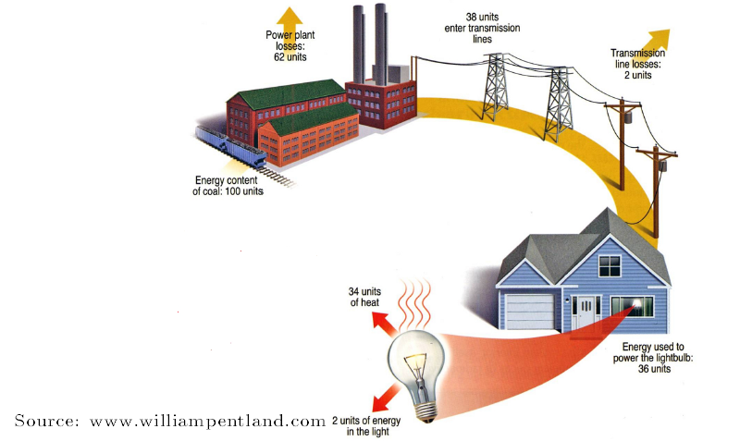
Fun Fact
Imagine you have a power plant that generates electricity from coal and transmits the generated electrical energy to your home via transmission lines.
If you use this energy to power a conventional lightbulb, how much do you think is the overall efficiency of the system (coal to light)?
ECpE Department

Slide 52
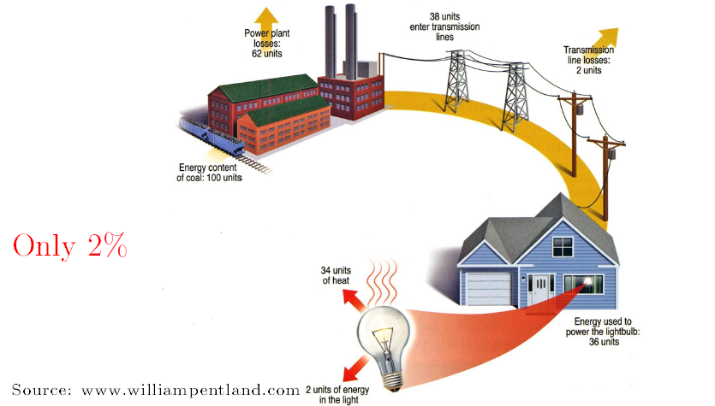
Contd…
ECpE Department

Slide 53
𝚫- Y Transformation
To simplify analysis of balanced 3 Phase systems:
𝚫-connected sources can be replaced by an equivalent Y-connected sources with $V_{\text{phase} ,Y}=\frac{V_{\text{line}\text{,}Δ}}{\sqrt{3}∠{30}^{∘}}$
𝚫-connected loads can be replaced by an equivalent Y-connected loads with $Z_{Y}=\frac{Z_{Δ}}{3}$.
ECpE Department

Slide 54
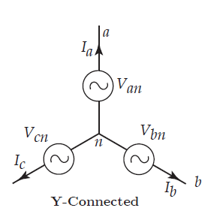
𝚫- Y Transformation - Source
We would like to have:
$$\left.\begin{matrix}V_{ab,Δ}=V_{ab,Y} \\ V_{bc,Δ}=V_{bc,Y} \\ V_{ca,Δ}=V_{ca,Y}\end{matrix}\right.$$
$$\begin{matrix}V_{ab, Y}=V_{an,Y}−V_{bn,Y}=\sqrt{3}V_{an,Y}⋅e^{j{30}^{∘}} \\ V_{ab,Δ}=\sqrt{3}V_{an,Y}⋅e^{j{30}^{∘}} \\ V_{an,Y}=\frac{V_{ab,Δ}}{\sqrt{3}⋅e^{j{30}^{∘}}}\end{matrix}$$
ECpE Department

Slide 55
Three Phase Transformers Combinations
Three phase transformers are of 𝚫 - 𝚫, Y - Y, 𝚫 - Y, and Y - 𝚫 combinations.
𝚫 - 𝚫
Common in Transmission Systems
Reliability
3rd harmonics propagation
Cannot be grounded
Cannot supply very unbalanced system
cannot handle a large amount of single-phase load.
Y - Y
Can be grounded on each side.
No phase shift
No 3rd harmonics propagation.
𝚫 - Y
Most commonly used connection scheme (Step-down transformer between Transmission and Distribution.
Presence of Neutral/ Can be grounded.
3rd harmonics propagation.
Reliable
Phase shift
ECpE Department

Slide 56
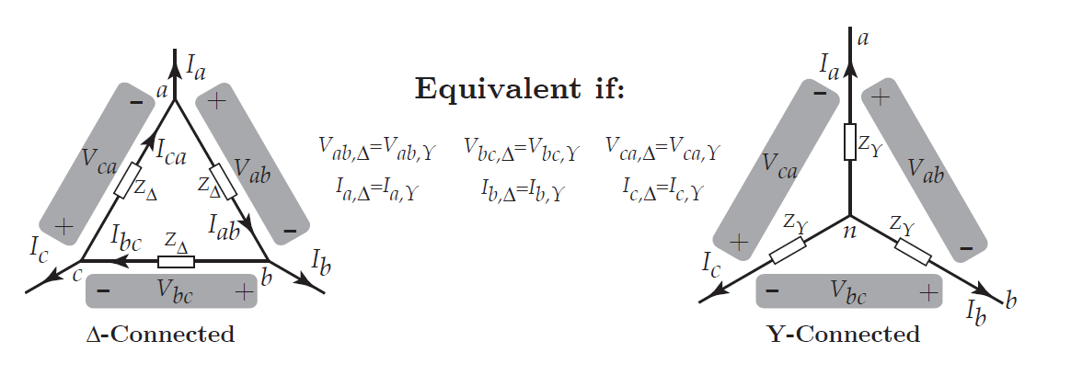
𝚫- Y Transformation - Loads
ECpE Department

Slide 57
Contd…
$Δ$- connected loads can be replaced by Y-connected loads with $Z_{Y}=\frac{Z_{Δ}}{3}$.
From $Δ$-side: we have,
$$I_{a}=I_{ca}−I_{ab}=\frac{V_{ca}}{z_{Δ}}−\frac{V_{ab}}{z_{Δ}}=\frac{V_{ca}−V_{ab}}{z_{Δ}}$$
From $Y$-side: we have,
$$V_{ab}=V_{an}−V_{bn}=I_{b}⋅z_{Y}−I_{a}⋅z_{Y}.$$
$$V_{ca}=V_{cn}−V_{an}=I_{a}⋅z_{Y}−I_{c}⋅z_{Y}$$
$$V_{ca}−V_{ab}=Z_{Y}\left(2I_{a}−I_{b}−I_{c}\right)$$
$$I_{a}+I_{b}+I_{c}=0⇒I_{a}=−I_{b}−I_{c}⋅\frac{Z_{0}}{3}$$
$$z_{Y}=\frac{z_{Δ}}{3}$$
$$V_{ca}−V_{ab}=z_{Y}⋅3I_{a}$$
ECpE Department

Slide 58
Contd…
$Δ$- connected loads can be replaced by Y-connected loads with $Z_{Y}=\frac{Z_{Δ}}{3}$.
From $Δ$-side: we have,
$$I_{a}=I_{ca}−I_{ab}=\frac{V_{ca}}{z_{Δ}}−\frac{V_{ab}}{z_{Δ}}=\frac{V_{ca}−V_{ab}}{z_{Δ}}$$
From $Y$-side: we have,
$$V_{ab}=V_{an}−V_{bn}=I_{b}⋅z_{Y}−I_{a}⋅z_{Y}.$$
$$V_{ca}=V_{cn}−V_{an}=I_{a}⋅z_{Y}−I_{c}⋅z_{Y}$$
$$V_{ca}−V_{ab}=Z_{Y}\left(2I_{a}−I_{b}−I_{c}\right)$$
$$I_{a}+I_{b}+I_{c}=0⇒I_{a}=−I_{b}−I_{c}⋅\frac{Z_{0}}{3}$$
$$z_{Y}=\frac{z_{Δ}}{3}$$
$$V_{ca}−V_{ab}=z_{Y}⋅3I_{a}$$
ECpE Department

Slide 59
Per Phase Analysis
Per phase analysis allows analysis of balanced 3-phase systems with the same effort as for a single-phase system. Per phase analysis is applicable to balanced 3-phase systems with all loads and sources $Y$-connected and no mutual inductance between phases.
In such systems:
All neutrals are at the same potential.
All phases are COMPLETELY decoupled.
All system values are the same sequence as sources. The sequence order we have been using (phase b lags phase a and phase $c$ lags phase $b$ ) is known as positive sequence.
Convert all $Δ$ load/sources to equivalent Y’s.
Keep in mind that all naturals are at the same potential.
ECpE Department

Slide 60
Contd…
Solve phase "a" independent of the other phases.
Total system power is then $S=3V_{a}I_{a}^{∗}$.
If desired, phase "b" and "c" values can be determined by inspection (i.e., $±{120}^{∘}$ degree phase shifts).
If necessary, go back to original circuit to determine line-line values or internal $Δ$ values.
ECpE Department

Slide 61
Per Phase Analysis Example
Assume a 3phase, Y-connected generator with $V_{an}=1∠0^{∘}$ volts supplies a $Δ$-connected load with $Z_{Δ}=−j$ through a transmission line with impedance of $0.1j$ per phase. The load is also connected to a $Δ$ connected generator with $V_{ajbj}=1∠0^{∘}$ through a second transmission line which also has an impedance of $j0.1$ per phase.
Find:
The load voltage $V_{a^{′}b^{′}}$
The total power supplied by each generator, $S_{Y}$ and $S_{Δ}$.
ECpE Department

Slide 62
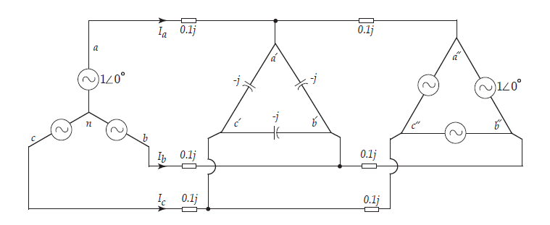
Contd…
Find:
The load voltage $V_{a^{′}b^{′}}$
The total power supplied by each generator, $S_{Y}$ and $S_{Δ}$.
ECpE Department

Slide 63
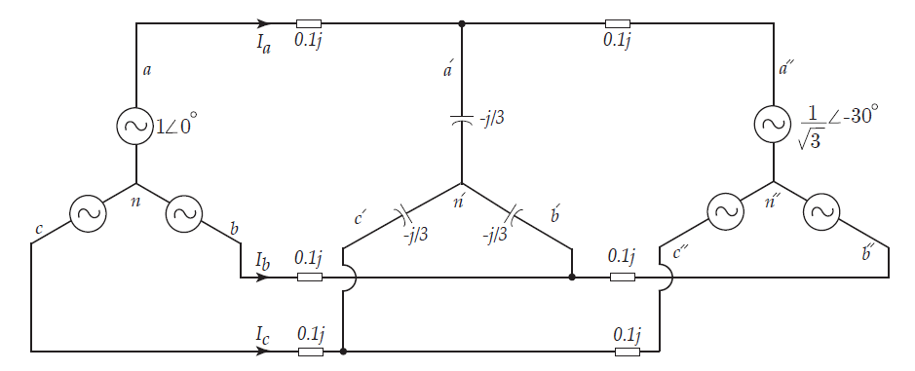
Contd…
First, convert the $Δ$ load and sources to their equivalent $Y$ load and sources.
ECpE Department

Slide 64
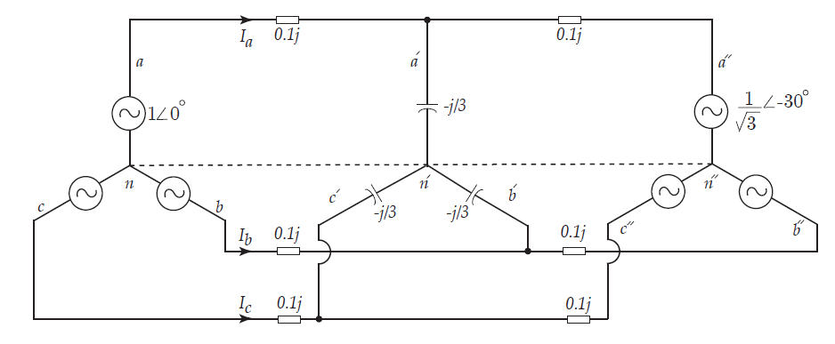
Contd…
Since all neutral points are at the same potential, we may assume a line between them to better illustrate phase a.
ECpE Department

Slide 65
Contd…
We draw phase a and solve the circuit by writing KCL at a’:
$$\left(V_{a^{′}n^{′}}−1∠0\right)(−10j)+V_{a^{′}n^{′}}(3j)+\left(V_{a^{′}n^{′}}−\frac{1}{\sqrt{3}}∠−{30}^{∘}\right)(−10j)=0$$
ECpE Department

Slide 66
Contd…
We draw phase a and solve the circuit by writing KCL at a’:
$$\left(V_{a^{′}n^{′}}−1∠0\right)(−10j)+V_{a^{′}n^{′}}(3j)+\left(V_{a^{′}n^{′}}−\frac{1}{\sqrt{3}}∠−{30}^{∘}\right)(−10j)=0$$
Therefore,
$$\left(10j+\frac{10}{\sqrt{3}}∠{60}^{∘}\right)=V_{a^{′}n^{′}}(10j−3j+10j)→V_{a^{′}n^{′}}=0.9∠−{10.9}^{∘}V$$
ECpE Department

Slide 67
Contd…
Therefore,
$V_{a^{′}n^{′}}=0.9∠−{10.9}^{∘}$ Volts
$V_{b^{′}n^{′}}=0.9∠−{130.9}^{∘}$ Volts
$V_{c^{′}n^{′}}=0.9∠−{250.9}^{∘}$ Volts
ECpE Department

Slide 68
Contd…
Therefore,
$V_{a^{′}n^{′}}=0.9∠−{10.9}^{∘}$ Volts
$V_{b^{′}n^{′}}=0.9∠−{130.9}^{∘}$ Volts
$V_{c^{′}n^{′}}=0.9∠−{250.9}^{∘}$ Volts
And,
$V_{a^{′}b^{′}}=V_{a^{′}n^{′}}−V_{b^{′}n^{′}}=1.56∠{19.1}^{∘}$ volts
ECpE Department

Slide 69
Contd…
Therefore,
$V_{a^{′}n^{′}}=0.9∠−{10.9}^{∘}$ Volts
$V_{b^{′}n^{′}}=0.9∠−{130.9}^{∘}$ Volts
$V_{c^{′}n^{′}}=0.9∠−{250.9}^{∘}$ Volts
And,
$V_{a^{′}b^{′}}=V_{a^{′}n^{′}}−V_{b^{′}n^{′}}=1.56∠{19.1}^{∘}$ volts
Thus,
$$S_{Y,Gen}=3V_{an}I_{a}^{∗}=3V_{an}{\left(\frac{V_{an}−V_{a^{′}n^{′}}}{j0.1}\right)}^{∗}=5.1+j3.5VA$$
$$S_{Δ,Gen}=3V_{a^{′′}n^{′′}}I_{a^{′′}}^{∗}=3V_{a^{′′}n^{′′}}{\left(\frac{V_{a^{′′}n^{′′}}−V_{a^{′}n^{′}}}{j0.1}\right)}^{∗}=−5.1−j4.7VA$$
ECpE Department

Slide 70
Contd…
Thus,
$$S_{Y,Gen}=3V_{an}I_{a}^{∗}=3V_{an}{\left(\frac{V_{an}−V_{a^{′}n^{′}}}{j0.1}\right)}^{∗}=5.1+j3.5VA$$
$$S_{Δ,Gen}=3V_{a^{′′}n^{′′}}I_{a^{′′}}^{∗}=3V_{a^{′′}n^{′′}}{\left(\frac{V_{a^{′′}n^{′′}}−V_{a^{′}n^{′}}}{j0.1}\right)}^{∗}=−5.1−j4.7VA$$
Note that we calculate the complex power in the transformed circuit. Since $Δ$ source and its transformed Y source are equivalent, their complex power is the same.
ECpE Department

Slide 71
Per Phase Analysis Example 2
Assume a 3-phase, $Δ$-connected generator with $V_{ab}=2∠0^{∘}$ volts supplies a $Δ$-connected load with $Z_{Δ}=−3jΩ$ through a transmission line with impedance of $0.1jΩ$ per phase. The load is also connected to another Y-connected load with impedance of $Z_{\text{load} }$ through a second transmission line which has an impedance of $0.2j Ω$ per phase.
Calculate the complex power of the second load for two scenarios:
i) $Z_{\text{load} }=1jΩ$ and
ii) $Z_{\text{load} }=1+1jΩ$
ECpE Department

Slide 72
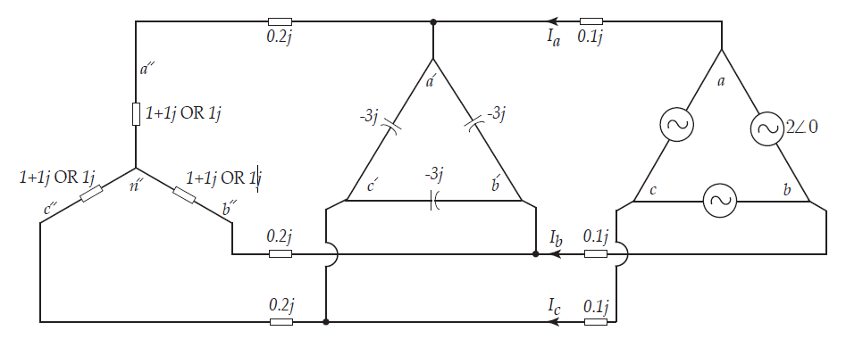
Per Phase Analysis Example 2
Calculate the complex power of the second load for two scenarios:
i) $Z_{\text{load} }=1jΩ$ and
ii) $Z_{\text{load} }=1+1jΩ$
ECpE Department

Slide 73
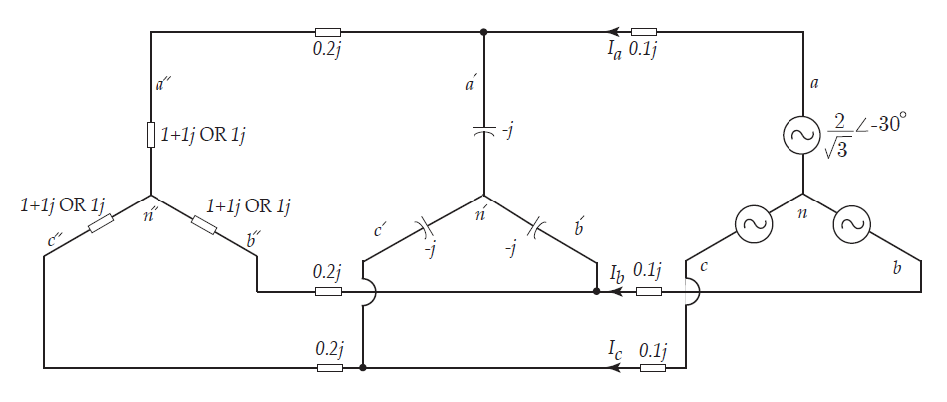
Per Phase Analysis Example 2
First, convert the $Δ$ load and sources to their equivalent $Y$ load and sources.
ECpE Department

Slide 74
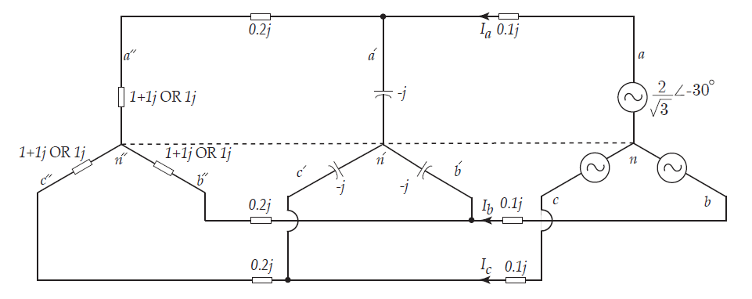
Per Phase Analysis Example 2
Since all neutral points are at the same potential, we may assume a line between them to better illustrate phase a.
ECpE Department

Slide 75
Per Phase Analysis Example 2
We draw phase a and solve the circuit by writing KCL at a':
$$\frac{V_{a^{′}n^{′}}}{0.2j+1+1j}+\frac{V_{a^{′}n^{′}}}{−j}+\frac{V_{a^{′}n^{′}}−\frac{2}{\sqrt{3}}∠−{30}^{∘}}{0.1j}=0$$
ECpE Department

Slide 76
Per Phase Analysis Example 2
We draw phase a and solve the circuit by writing KCL at a':
$$\frac{V_{a^{′}n^{′}}}{0.2j+1+1j}+\frac{V_{a^{′}n^{′}}}{−j}+\frac{V_{a^{′}n^{′}}−\frac{2}{\sqrt{3}}∠−{30}^{∘}}{0.1j}=0$$
Therefore,
$$\frac{−20}{\sqrt{3}}∠{60}^{∘}=V_{a^{′}n^{′}}\left(\frac{1}{1+1.2j}+j−10j\right)→V_{a^{′}n^{′}}=1.21∠−{32.47}^{∘}V$$
ECpE Department

Slide 77
Per Phase Analysis Example 2
Therefore,
$$I_{\text{load} 1,a}=\frac{V_{a^{′}n^{′}}}{1+1j+0.2j}=0.78∠−{82.66}^{∘}amps$$
ECpE Department

Slide 78
Per Phase Analysis Example 2
Therefore,
$$I_{\text{load} 1,a}=\frac{V_{a^{′}n^{′}}}{1+1j+0.2j}=0.78∠−{82.66}^{∘}amps$$
Thus,
$V_{a^{′′}n^{′′}}=I_{\text{load}\text{1,}\text{a} }(1+1j)=1.1∠−{37.68}^{∘}$ volts
And,
$$S_{\text{load} 1}=3V_{a^{′′}n^{′′}}I_{\text{load}\text{1,}\text{a} }^{∗}=1.81+j1.81VA$$
ECpE Department

Slide 79
Per Phase Analysis Example 2
For the other load, we write the same KCL at a':
$$\frac{V_{a^{′}n^{′}}}{0.2j+1j}+\frac{V_{a^{′}n^{′}}}{−j}+\frac{V_{a^{′}n^{′}}−\frac{2}{\sqrt{3}}∠−{30}^{∘}}{0.1j}=0$$
Therefore,
$$\frac{−20}{\sqrt{3}}∠{60}^{∘}=V_{a^{′}n^{′}}\left(\frac{1}{1.2j}+j−10j\right)→V_{a^{′}n^{′}}=1.17∠−{30}^{∘} \text{volts}$$
ECpE Department

Slide 80
Per Phase Analysis Example 2
Therefore,
$$I_{\text{load} 2,a}=\frac{V_{a^{′}n^{′}}}{1j+0.2j}=0.98∠−{120}^{∘}amps$$
ECpE Department

Slide 81
Per Phase Analysis Example 2
Therefore,
$$I_{\text{load} 2,a}=\frac{V_{a^{′}n^{′}}}{1j+0.2j}=0.98∠−{120}^{∘}amps$$
Thus,
$V_{a^{′′}n^{′′}}=I_{\text{load} 2,a}(1j)=0.98∠−{30}^{∘}$ volts and,
$$S_{\text{load} 2}=3V_{a^{′′}n^{′′}}I_{\text{load} 2,a}^{∗}=0+j2.87VA$$
ECpE Department

Slide 82
Key Messages
Three-phase systems are usually used at high power/voltage levels.
Three-phase systems are more economical for transferring energy as they need less amount of wire to transmit the same amount of energy compared to single or two-phase systems.
To analyze complicated three-phase BALANCED systems, $Δ−Y$ transformation is the key element.
In three-phase BALANCED systems, when all $Δ$ loads and sources are transformed to $Y$ connections, neutral points are at the same potential.
ECpE Department

Slide 83
Power in $1−∅$ Circuits
The instantaneous power delivered to a load is,
$$\begin{matrix} & p\left(t\right)=v\left(t\right)i\left(t\right) \\ & =\sqrt{2} Vsin⁡ωt\sqrt{2}Isin⁡(ωt−φ) \\ & =VIcos⁡φ−VIcos⁡(2ωt−φ)\end{matrix}$$
This power clearly has an average value, $P=VIcos⁡φ$ (W). This is referred to as the "real power." The second, double frequency, term has no time averaged value, and therefore does no work.
$cos⁡φ$ is the "power factor"
"Reactive Power," $Q=VIsin⁡φ$ (VAR)
$Q>0⇒φ>0⇒R−L$ load. $Q<0⇒φ<0⇒R−C$ load.
Complex Power, $S=P+jQ={VI}^{∗} \left( ^{∗}\right.$ is complex conjugate $)$
ECpE Department

Slide 84
Power in $3−∅$ Circuits
The instantaneous power is:
$$p(t)=p_{a}(t)+p_{b}(t)+p_{c}(t)$$
$$p_{a}(t)=\sqrt{2}V_{an}cos⁡(ωt)\sqrt{2}I_{a}cos⁡(ωt−φ)$$
$$p_{b}(t)=\sqrt{2}V_{an}cos⁡(ωt−2π/3)\sqrt{2}I_{a}cos⁡(ωt−2π/3−φ)$$
$$p_{c}(t)=\sqrt{2}V_{an}cos⁡(ωt+2π/3)\sqrt{2}I_{a}cos⁡(ωt+2π/3−φ)$$
$$\begin{matrix} & p(t) =2V_{an}I_{a}[cos⁡(ωt)\sqrt{2}cos⁡(ωt−φ)+cos⁡(ωt−2π/3)cos⁡(ωt−2π/3−φ)+cos⁡(ωt+2π/3)c \\ & =V_{an}I_{a}[cos⁡(2ωt−φ)cos⁡(φ)+cos⁡(2ωt−4π/3−φ)cos⁡(φ)+cos⁡(2ωt+4π/3−φ)cos⁡(φ)] \\ & \begin{aligned} =3V_{an}I_{a}cos⁡(φ) \\ =P\end{aligned}\end{matrix}$$
3x power with one more wire compared to single phase
ECpE Department

Slide 85
Thank You!
ECpE Department

