Slide 1
EE 303 Energy Systems and Power Electronics Per Unit Analysis
ECpE Department
GRA: Prashant Tiwari
Advisor: Dr. Zhaoyu Wang
1113 Coover Hall, Ames, IA
wzy@iastate.edu

Slide 2
Per Unit Analysis
Motivation:
It would be difficult to continuously refer impedance to the different sides of transformer.
Mathematically,
$$\text{Quantity} \text{in} \text{Per} \text{Unit}=\frac{ \text{Actual} \text{Quantity} }{ \text{Base} \text{value} \text{of} \text{the} \text{Quantity} }$$
ECpE Department

Slide 3
Normalization of all variables
S, V, Z & I (Note: Ohms law still holds)
Pick $S_{B} \& V_{B}$, and calculate $I_{B} \& Z_{B}$
$S_{B}=V_{B}⋅I_{B}^{∗}$
$I_{B}={\left(\frac{S_{B}}{V_{B}}\right)}^{∗}=\frac{S_{B}}{V_{B}}$
(Note: Base values are real numbers)
$Z_{B}=\frac{{\left(V_{B}\right)}^{2}}{S_{B}}$
$S_{B}$ is for the entire system.
$V_{B}$ is for each different voltage level.
Base voltages are related by transformer turns ratio
ECpE Department

Slide 4
Contd…
For a single-phase system:
Step 1: Pick a single-phase base power for the entire system $S_{B}$.
Step 2: Pick a base voltage for each different voltage level, $V_{B}$
Base voltages are related by turns ratios.
voltages are line-to-neutral.
Step 3: Calculate base impedance, $Z_{B}=\frac{{\left(V_{B}\right)}^{2}}{SB}$.
Step 4: Calculate base current, $I_{B}=\frac{V_{B}}{S_{B}}$
ECpE Department

Slide 5
Contd…
Step 5. Convert actual values to per unit (p.u.)
Notes:
Base values are real numbers. Per unit conversion only affects magnitude, not angle.
Per unit quantities no longer have units.
ECpE Department

Slide 6
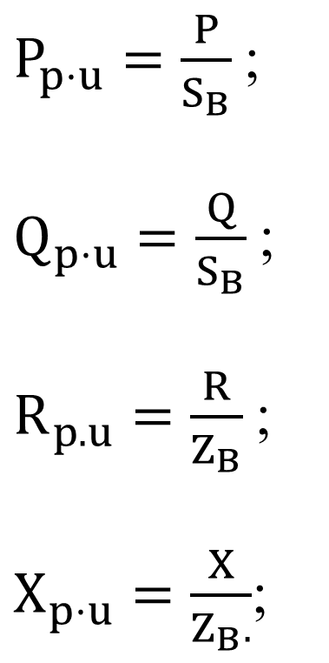

Contd…
$V_{p⋅u}=\frac{V}{V_{B}}$;
$S_{p⋅u}=\frac{S}{S_{B}}$ ;
$I_{p⋅u}=\frac{I}{I_{B}}$;
$Z_{p⋅u}=\frac{Z}{Z_{B⋅}}$;
$P_{p⋅u}=\frac{P}{S_{B}}$;
$Q_{p⋅u}=\frac{Q}{S_{B}}$;
$R_{p.u}=\frac{R}{Z_{B}}$;
$X_{p⋅u}=\frac{X}{Z_{B}.}$;
ECpE Department

Slide 7
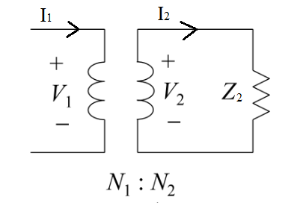
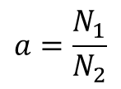
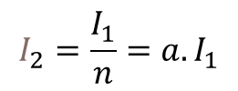
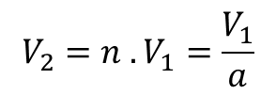
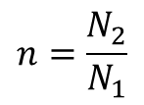
Per Unit Values of Primary and Secondary Side of a Transformer are EQUAL
$$a=\frac{N_{1}}{N_{2}}$$
$$V_{2}=n . V_{1}=\frac{V_{1}}{a}$$
$$n=\frac{N_{2}}{N_{1}}$$
$$I_{2}=\frac{I_{1}}{n}=a. I_{1}$$
Transformation Ratio
Real Values
Choose Base Values:
$S_{B}$
$V_{1B}$ & $V_{2B}=\frac{V_{1B}}{a}=n.V_{1B}$
ECpE Department

Slide 8
Per Unit Values of Primary and Secondary Side of a Transformer are EQUAL
Choose Base Values:
$S_{B}$
$V_{1B}$ & $V_{2B}=\frac{V_{1B}}{a}=n.V_{1B}$
$$V_{2,pu}=\frac{V_{2}}{V_{2B}}=\frac{n⋅V_{1}}{n⋅V_{1B}}=\frac{V_{1}}{V_{1B}}=V_{1,pu}$$
$$I_{2},pu=\frac{I_{2}}{I_{2B}}=\frac{I_{2}}{\frac{S_{B}}{V_{2B}}}=\frac{V_{2B}⋅I_{2}}{S_{B}}=\frac{n⋅V_{1B}⋅I_{2}}{S_{B}}=\frac{n⋅V_{1B}⋅a⋅I_{1}}{S_{B}}=\frac{V_{1B}⋅I_{1}}{S_{B}.}=\frac{I_{1}}{\frac{S_{B}}{V_{1B}}}=\frac{I_{1}}{I_{1B}}=I_{1,PU}.$$
ECpE Department

Slide 9
Per Unit Values of Primary and Secondary Side of a Transformer are EQUAL
Choose Base Values:
$S_{B}$
$V_{1B}$ & $V_{2B}=\frac{V_{1B}}{a}=n.V_{1B}$
$$Z_{2B}=\frac{V_{2B}^{2}}{S_{B}}=\frac{n^{2}⋅V_{1B}^{2}}{S_{B}}=n^{2}⋅Z_{1B}$$
$$Z_{2; p.u}=\frac{Z_{2}}{Z_{2B}}=\frac{n^{2}⋅z_{e}}{n^{2}⋅z_{1B}}=\frac{z_{e}}{z_{1B}}=z_{e; p.u}.$$
ECpE Department

Slide 10
Example 1
Q. Solve for the current, load voltage & load power in the following circuit using P.U. analysis with an $S_{B}=100MVA$ and base voltage of $V_{B1}=8kV, V_{B2}=80kV, and V_{B3}=16kV$.
System Representation
Actual Values
ECpE Department

Slide 11
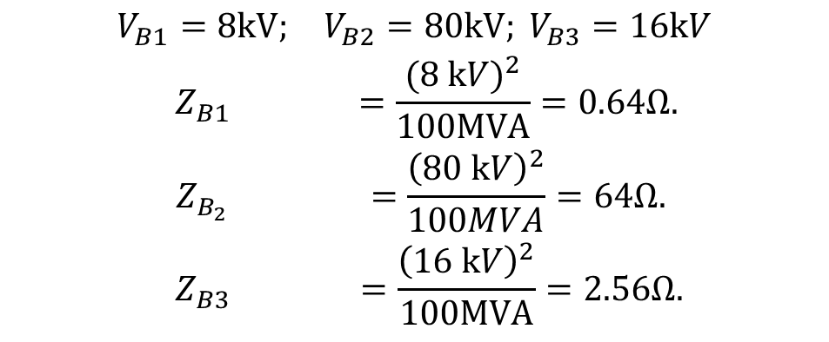
Example 1: Solution
$$\begin{matrix}V_{B1}=8kV; & V_{B2}=80kV; V_{B3}=16kV \\ Z_{B1} & =\frac{(8{ kV)}^{2}}{100MVA}=0.64Ω. \\ Z_{B_{2}} & =\frac{{\left(80 kV\right)}^{2}}{100MVA}=64Ω. \\ Z_{B3} & =\frac{{\left(16 kV\right)}^{2}}{100MVA}=2.56Ω.\end{matrix}$$
Therefore, we can convert the actual values diagram in p.u. diagram.
ECpE Department

Slide 12
Contd…
$I=\frac{1∠0^{∘}}{3.91+j2.327.}=0.22∠−{30.8}^{∘}p.u$.
$$V_{L}=1∠0^{∘}−0.22∠(−{30.8}^{∘})×j2.327=0.859∠−{30.8}^{∘} p.u.$$
$$S_{L}=V_{L}⋅I_{L}^{∗}=0.189 p.u.$$
$$S_{G}=V_{G}⋅I_{G}^{∗}=1∠0^{∘}∗0.22 ∠{30.8}^{∘}=0.22∠{30.8}^{∘} \text{p}\text{.}\text{u}$$
ECpE Department

Slide 13
Contd…
$$\text{Convert} \text{back} \text{to} \text{actual} \text{values}\text{.}$$
$$V_{L}^{actual}=0.859∠\left(−{30.8}^{∘}\right)×16kV=13.7∠\left(−{30.8}^{∘} \right) kV$$
$$S_{L}^{\text{actual} }=0.189∠0^{∘}×100MVA=18.9∠0^{∘}MVA$$
$$S_{G}^{\text{actual} }=0.22 ∠{30.8}^{∘}×100MVA=22∠{30.8}^{∘}MVA$$
$$I_{2B}=\frac{100MVA}{80kV}=1250 A$$
$$I_{2}^{\text{act}\text{ual} }=0.22∠−{30.8}^{∘}×1250 A=275∠−{30.8}^{∘}A$$
ECpE Department

Slide 14
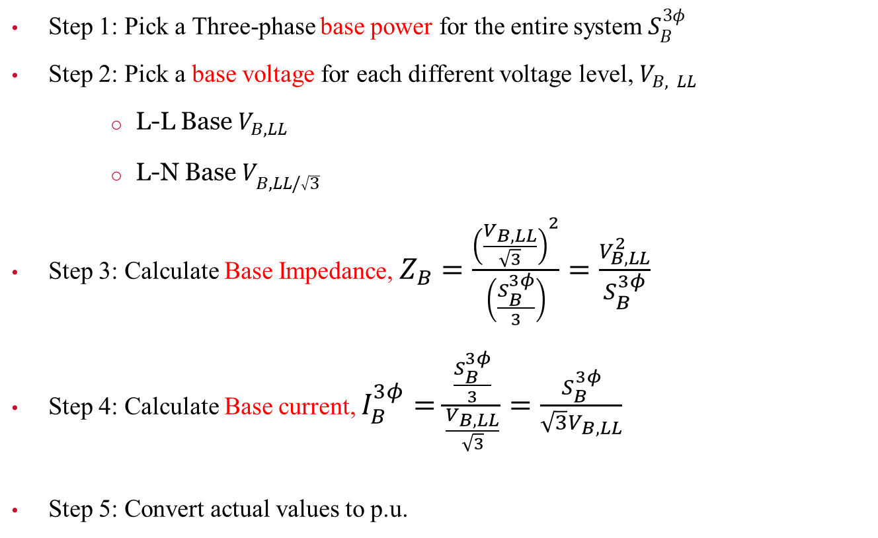
Three- Phase Per Unit Analysis
Step 1: Pick a Three-phase base power for the entire system $S_{B}^{3φ}$
Step 2: Pick a base voltage for each different voltage level, $V_{B, LL}$
L-L Base $V_{B,LL}$
L-N Base $V_{B,LL/\sqrt{3}}$
Step 3: Calculate Base Impedance, $Z_{B}=\frac{{\left(\frac{V_{B,LL}}{\sqrt{3}}\right)}^{2}}{\left(\frac{S_{B}^{3φ}}{3}\right)}=\frac{V_{B,LL}^{2}}{S_{B}^{3φ}}$
Step 4: Calculate Base current, $I_{B}^{3φ}=\frac{\frac{S_{B}^{3φ}}{3}}{\frac{V_{B,LL}}{\sqrt{3}}}=\frac{S_{B}^{3φ}}{\sqrt{3}V_{B,LL}}$
Step 5: Convert actual values to p.u.
ECpE Department

Slide 15

Example 2:
Solve for the current, load voltage and load power in the previous circuit, assuming a 3ϕ base power of 300 MVA, and line to line base voltages of 13.8 kV, 138 kV and 27.6 kV (square root of 3 larger than the 1ϕ example voltages). Also assume the generator is Y-connected so its line-to-line voltage is 13.8 kV.
$V_{B1}=13.8kV,V_{B2}=138kV and V_{B3}=27.6 kV$
ECpE Department

Slide 16
Example 2: Solution
Convert to per unit as before. Note the system is exactly the same as example 1!
$I=\frac{1.0∠0^{∘}}{3.91+j2.327}=0.22∠−{30.8}^{∘} \text{p}\text{.}\text{u}\text{. (}\text{not} \text{amps}\text{)}$
$V_{L}=1.0∠0^{∘}−0.22∠−{30.8}^{∘}×2.327∠{90}^{∘}=0.859∠−{30.8}^{∘} \text{p}\text{.}\text{u}\text{.}$
$S_{L}=V_{L}I_{L}^{∗}=\frac{{\left|V_{L}\right|}^{2}}{Z}=0.189 \text{p}\text{.}\text{u}\text{.}$
ECpE Department

Slide 17
Contd…
$S_{G}=1.0∠0^{∘}×0.22∠{30.8}^{∘}=0.22∠{30.8}^{∘} \text{p}\text{.}\text{u}\text{.}$
Again, analysis is exactly the same
$$\text{Difference} \text{appear} \text{when} \text{we} \text{convert} \text{back} \text{to} \text{actual} \text{values}$$
$$V_{L}^{actual}=0.859∠\left(−{30.8}^{∘}\right)×27.6kV=23.8∠\left(−{30.8}^{∘} \right) kV$$
$$S_{L}^{\text{actual} }=0.189∠0^{∘}×300MVA=0.567∠0^{∘}MVA$$
$$S_{G}^{\text{actual} }=0.22 ∠{30.8}^{∘}×300MVA=0.66∠{30.8}^{∘}MVA$$
$$I_{B}^{\text{Middle} }=\frac{300MVA}{\sqrt{3} ∗138kV}=1250 A (\text{same} \text{currents}\text{)}$$
$$I_{Middle}^{\text{act}\text{ual} }=0.22∠−{30.8}^{∘}×1250 A=275∠−{30.8}^{∘}A$$
ECpE Department

Slide 18
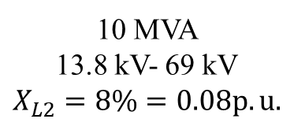
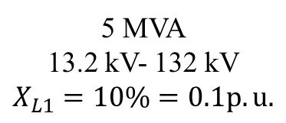
Example 3
$$△−Y$$
$$Y−△$$
$$Z_{line}=10+j100Ω$$
$$Z_{laod}=300Ω$$
13.2 kV
5 MVA
13.2 kV- 132 kV
$X_{L1}=10\%=0.1p.u.$
10 MVA
13.8 kV- 69 kV
$X_{L2}=8\%=0.08p.u.$
$$Q. Find the equivalent p.u values of each component.$$
ECpE Department

Slide 19
Example 3: Solution
$$△−Y$$
$$Y−△$$
$$Z_{line}=10+j100Ω$$
$$Z_{laod}=300Ω$$
13.2 kV
5 MVA
13.2 kV- 132 kV
$X_{L1}=10\%=0.1p.u.$
10 MVA
13.8 kV- 69 kV
$X_{L2}=8\%=0.08p.u.$
$$S_{B}^{3φ}=10 MVA$$
$$V_{3B}^{L−L}=69 kV$$
$$V_{2B}^{L−L}=138 kV$$
$$V_{1B}^{L−L}=138 kV×\frac{13.2kV}{132kV}=13.8kV$$
ECpE Department

Slide 20
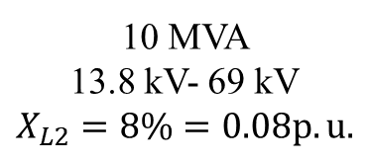

Example 3: Solution
$$△−Y$$
$$Y−△$$
$$Z_{line}=10+j100Ω$$
$$Z_{laod}=300Ω$$
13.2 kV
10 MVA
13.8 kV- 69 kV
$X_{L2}=8\%=0.08p.u.$
5 MVA
13.2 kV- 132 kV
$X_{L1}=10\%=0.1p.u.$
$$S_{B}^{3φ}=10 MVA$$
$$V_{3B}^{L−L}=69 kV$$
$$V_{2B}^{L−L}=138 kV$$
$$V_{1B}^{L−L}=13.8kV$$
$$Z_{3B}=\frac{{\left(V_{3B}^{L−L}\right)}^{2}}{S_{B}^{3φ}}=\frac{{69}^{2}}{10}=476Ω$$
$$Z_{2B}=\frac{{\left(V_{2B}^{L−L}\right)}^{2}}{S_{B}^{3φ}}=\frac{{138}^{2}}{10}=1904Ω$$
$$Z_{1B}=\frac{{\left(V_{1B}^{L−L}\right)}^{2}}{S_{B}^{3φ}}=\frac{{13.8}^{2}}{10}=19.04Ω$$
ECpE Department

Slide 21
Example 3: Solution
$$△−Y$$
$$Y−△$$
$$Z_{line}=10+j100Ω$$
$$Z_{laod}=300Ω$$
13.2 kV
10 MVA
13.8 kV- 69 kV
$X_{L2}=8\%=0.08p.u.$
5 MVA
13.2 kV- 132 kV
$X_{L1}=10\%=0.1p.u.$
$$S_{B}^{3φ}=10 MVA$$
$$V_{3B}^{L−L}=69 kV$$
$$V_{2B}^{L−L}=138 kV$$
$$V_{1B}^{L−L}=13.8kV$$
$$Z_{3B}=\frac{{\left(V_{3B}^{L−L}\right)}^{2}}{S_{B}^{3φ}}=\frac{{69}^{2}}{10}=476Ω$$
$$Z_{2B}=\frac{{\left(V_{2B}^{L−L}\right)}^{2}}{S_{B}^{3φ}}=\frac{{138}^{2}}{10}=1904Ω$$
$$Z_{1B}=\frac{{\left(V_{1B}^{L−L}\right)}^{2}}{S_{B}^{3φ}}=\frac{{13.8}^{2}}{10}=19.04Ω$$
ECpE Department

Slide 22
Example 3: Solution
$$△−Y$$
$$Y−△$$
$$Z_{line}=10+j100Ω$$
$$Z_{laod}=300Ω$$
13.2 kV
10 MVA
13.8 kV- 69 kV
$X_{L2}=8\%=0.08p.u.$
5 MVA
13.2 kV- 132 kV
$X_{L1}=10\%=0.1p.u.$
$$Z_{\text{load} }=\frac{350Ω}{476Ω}=0.63 p.u.$$
$$Z_{\text{line} }=\frac{10+j100Ω}{1904Ω}=0.005+j0.05 p.u.$$
$$E_{s}=\frac{13.2kV}{13.8 kV}=0.96 p.u.$$
ECpE Department

Slide 23
Example 3: Solution
$$△−Y$$
$$Y−△$$
$$Z_{line}=10+j100Ω$$
$$Z_{laod}=300Ω$$
13.2 kV
10 MVA
13.8 kV- 69 kV
$X_{L2}=8\%=0.08p.u.$
5 MVA
13.2 kV- 132 kV
$X_{L1}=10\%=0.1p.u.$
$$X_{L2}=\frac{0.08×\frac{{\left(V_{3B}^{L−L}\right)}^{2}}{S_{B}^{3φ}}}{Z_{3B}}=\frac{0.08×\frac{{\left(V_{3B}^{L−L}\right)}^{2}}{S_{B}^{3φ}}}{\frac{{\left(V_{3B}^{L−L}\right)}^{2}}{S_{B}^{3φ}}}=0.08$$
$$X_{L1}=\frac{0.1×\frac{{\left(13.2kV\right)}^{2}}{5 MVA}}{Z_{1B}}=\frac{0.1×\frac{{\left(13.2\right)}^{2}}{5}}{\frac{{\left(13.8\right)}^{2}}{10}}=0.183 p.u$$
ECpE Department

Slide 24
Example 3: Solution
$$△−Y$$
$$Y−△$$
$$Z_{line}=10+j100Ω$$
$$Z_{laod}=300Ω$$
13.2 kV
10 MVA
13.8 kV- 69 kV
$X_{L2}=8\%=0.08p.u.$
5 MVA
13.2 kV- 132 kV
$X_{L1}=10\%=0.1p.u.$
$$X_{L1}=\frac{0.1×\frac{{\left(13.2kV\right)}^{2}}{5 MVA}}{Z_{1B}}=\frac{0.1×\frac{{\left(13.2\right)}^{2}}{5}}{\frac{{\left(13.8\right)}^{2}}{10}}=0.183 p.u$$
Alternatively, we can find $X_{L1}$ as,
$$X_{L1}=\frac{0.1×\frac{{\left(132kV\right)}^{2}}{5 MVA}}{Z_{2B}}=\frac{0.1×\frac{{\left(132 kV\right)}^{2}}{5 MVA}}{\frac{{\left(138\right)}^{2}}{10}}=0.183 p.u$$
ECpE Department

Slide 25
Thank You!
ECpE Department

