Slide 1
EE 303 Energy Systems and Power Electronics Power Flow
ECpE Department
GRA: Prashant Tiwari
Advisor: Dr. Zhaoyu Wang
1113 Coover Hall, Ames, IA
wzy@iastate.edu

Slide 2
Power Flow Analysis
The power flow problem is a very well-known problem in the field of power systems engineering, where voltage magnitudes and angles for one set of buses are desired, given that voltage magnitudes and power levels for another set of buses are known.
A power flow solution procedure is a numerical method that is employed to solve the power flow problem.
The power flow solution contains the voltages and angles at all buses, and from this information, we may compute the real and reactive generation and load levels at all buses and the real and reactive flows across all circuits.
The above terminology is often used with the word “load” substituted for “power,” i.e., load flow problem, load flow solution procedure, load flow program, and load flow solution.
ECpE Department

Slide 3
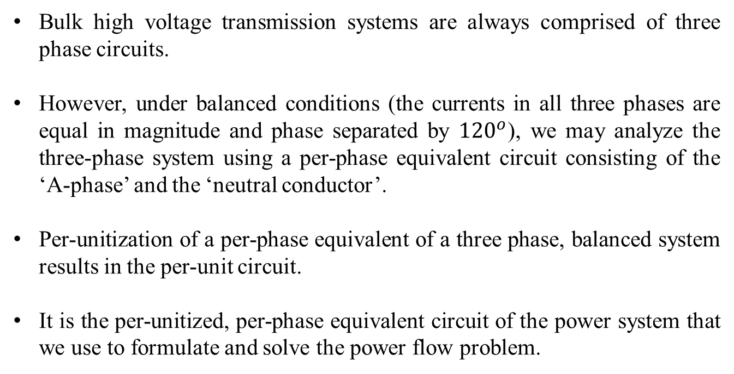
Terminologies
Bulk high voltage transmission systems are always comprised of three phase circuits.
However, under balanced conditions (the currents in all three phases are equal in magnitude and phase separated by ${120}^{o}$), we may analyze the three-phase system using a per-phase equivalent circuit consisting of the ‘A-phase’ and the ‘neutral conductor’.
Per-unitization of a per-phase equivalent of a three phase, balanced system results in the per-unit circuit.
It is the per-unitized, per-phase equivalent circuit of the power system that we use to formulate and solve the power flow problem.
ECpE Department

Slide 4
Terminologies
Bulk high voltage transmission systems are always comprised of three phase circuits.
However, under balanced conditions (the currents in all three phases are equal in magnitude and phase separated by ${120}^{o}$), we may analyze the three-phase system using a per-phase equivalent circuit consisting of the ‘A-phase’ and the ‘neutral conductor’.
Per-unitization of a per-phase equivalent of a three phase, balanced system results in the per-unit circuit.
It is the per-unitized, per-phase equivalent circuit of the power system that we use to formulate and solve the power flow problem.
It is convenient to represent power system networks using the so-called one-line diagram (per-phase equivalent), but without the neutral conductor.
ECpE Department

Slide 5
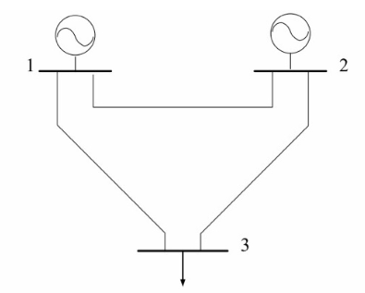
Terminologies
The figure represents the one-line diagram of 3- Bus System.
Minimum set to define a network is voltages.
Given a set of power injections & voltages, for all buses find voltage angle and magnitudes.
ECpE Department

Slide 6
Terminologies
For each bus i, there are four possible variables ${ P}_{i} , Q_{i} , \left|V_{i}\right| , θ_{i}$
Based on what is known/unknown, we can classify buses into three categories.
PV Bus – Generator Bus
PQ Bus – Load Bus
Slack (Swing) Bus – Reference Bus
Slack / Swing Bus is a mathematical artifact. Note: Slack bus is also a Generator Bus.
An injection is the power, either real or reactive, that is being injected into or withdrawn from a bus by an element.
We define a positive injection as one where power is flowing from the element into the bus (i.e., into the network); a negative injection is then when power is flowing from the bus (i.e., from the network) into the element.
ECpE Department

Slide 7
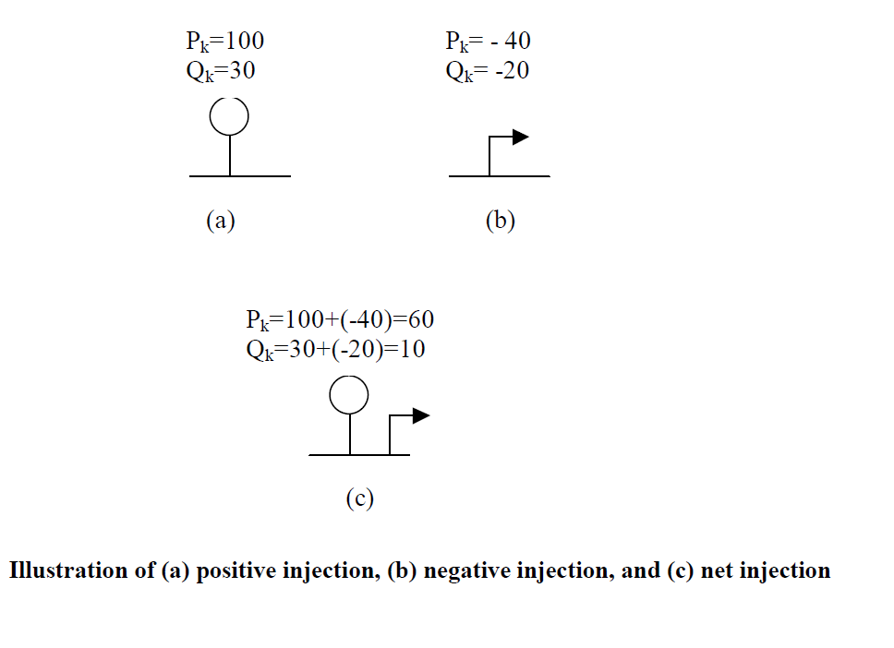
Terminologies
We define a positive injection as one where power is flowing from the element into the bus (i.e., into the network); a negative injection is then when power is flowing from the bus (i.e., from the network) into the element.
ECpE Department

Slide 8
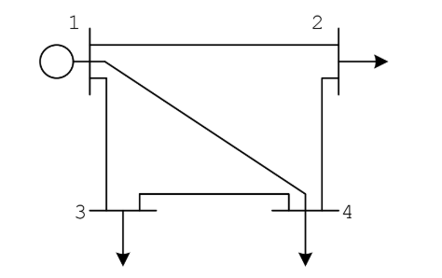
Terminologies
 | Known Value | Unknown Value
PQ (Load Bus) | $$P , Q$$ | $\left|V\right|, θ$
PV (Gen Bus) | $$P, \left|V\right|$$ | $Q$, $θ$
Slack (Swing Bus) | $\left|V\right|$, $θ$ | $P$, $Q$
Note:
N: number of buses in a network
$N_{G}:$ number of Generator Buses
Swing Bus: 1
PV Bus: $N_{G} −1$
PQ Bus: N- $N_{G}$
ECpE Department

Slide 9
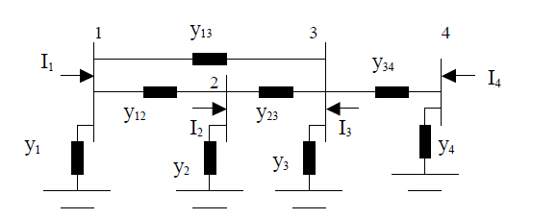
Network Matrix – Admittance Matrix
$$Z=r+jX;$$
Where, $y=\frac{1}{z};is called admittance.$
$$y=g+jb;′g′ is called conductance and ′b′ is called susceptance.$$
$$I=Y.V; where I is ′net current injection′.$$
ECpE Department

Slide 10
Contd…
Using KCL in above figure, we get,
$$I_{1}=\left(V_{1}−V_{2}\right)y_{12}+\left(V_{1}−V_{3}\right)y_{13}+V_{1}y_{1}$$
$$I_{1}=\left(V_{1}−V_{2}\right)y_{12}+\left(V_{1}−V_{3}\right)y_{13}+\left(V_{1}−V_{4}\right)y_{14}+V_{1}y_{1}$$
$Here, {(y}_{14}=0$)
In general form, we can write,
$$I_{1}=v_{1}\left(y_{1}+y_{12}+y_{13}+y_{14}\right)+v_{2}\left(−y_{12}\right)+v_{3}\left(−y_{13}\right)+v_{4}\left(−y_{14}\right)$$
ECpE Department

Slide 11
Contd…
Similarly, we can develop the current injections at buses 2,3, and 4 as:
$$I_{2}=V_{1}\left(−y_{21}\right)+V_{2}\left(y_{2}+y_{21}+y_{23}+y_{24}\right)+V_{3}\left(−y_{23}\right)+v_{4}\left(−y_{24}\right)$$
$I_{3}=v_{1}\left(−y_{31}\right)+v_{2}\left(−y_{32}\right)+v_{3}\left(y_{3}+y_{31}+y_{32}+y_{34}\right)$ $+v_{4}\left(−y_{34}\right)$
$$I_{4}=v_{1}\left(−y_{41}\right)+v_{2}\left(−y_{42}\right)+v_{3}\left(−y_{43}\right)+v_{4}\left(y_{4}+y_{41}+y_{42}+y_{43}\right)$$
ECpE Department

Slide 12
Contd…
In matrix form, the equations of $I_{1}$, $I_{2}$, $I_{3}$ and $I_{4}$ can be written as,
$$\left[\begin{matrix}I_{1} \\ I_{2} \\ I_{3} \\ I_{4}\end{matrix}\right]=\left[\begin{matrix}y_{1}+y_{12}+y_{13}+y_{14} & −y_{12} & −y_{13} & −y_{14} \\ −y_{21} & y_{2}+y_{21}+y_{23}+y_{24} & −y_{23} & −y_{24} \\ −y_{31} & −y_{32} & y_{3}+y_{31}+y_{32}+y_{34} & −y_{34} \\ −y_{41} & −y_{42} & −y_{43} & y_{4}+y_{41}+y_{42}+y_{43}\end{matrix}\right]\left[\begin{matrix}v_{1} \\ v_{2} \\ v_{3} \\ y_{4}\end{matrix}\right]$$
$(∵I=Y⋅V$)
$Y=\left[\begin{matrix}Y_{11} & Y_{12} & Y_{13} & Y_{14} \\ Y_{21} & Y_{22} & Y_{23} & Y_{24} \\ Y_{31} & Y_{32} & Y_{33} & Y_{34} \\ Y_{41} & Y_{42} & Y_{43} & Y_{44}\end{matrix}\right]$ , is an admittance matrix.
Note: $y_{ki}=y_{ik}$
ECpE Department

Slide 13
Contd…
Observations:
The Y matrix is symmetric, i.e., $Y_{ij}=Y_{ji}$
The off-diagonal elements are the negative of the admittance connecting bus $i \&$ bus $j$, i.e. $y_{ij}=−y_{ji}$
The diagonal elements are the sum of the admittances connecting to bus $i$ plus the self-admittance of bus $i$.
ECpE Department

Slide 14
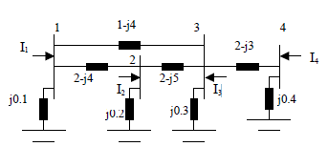
Example: Find Admittance Matrix.
The admittance matrix is:
$$j0.1+1−j4+2−j4$$
$$Y=\left[\begin{matrix}Y_{11} & Y_{12} & Y_{13} & Y_{14} \\ Y_{21} & Y_{22} & Y_{23} & Y_{24} \\ Y_{31} & Y_{32} & Y_{33} & Y_{34} \\ Y_{41} & Y_{42} & Y_{43} & Y_{44}\end{matrix}\right]=\left[\begin{matrix}3−j7.9 & −2+j4 & −1+j4 & 0 \\ −2+j4 & 4−j8.8 & −2+j5 & 0 \\ −1+j4 & −2+j5 & 5−j11.7 & −2+j3 \\ 0 & 0 & −2+j3 & 2−j2.6\end{matrix}\right]$$
ECpE Department

Slide 15
Power Flow Equations
bus$i$
$$I_{Gi}$$
$$I_{Di}$$
Using KCL, the net injection at bus $i$ is,
$$I_{i}=I_{Gi}−I_{Di}=\sum_{k=1}^{n}{Y_{ik.}V_{k}}$$
ECpE Department

Slide 16
Power Flow Equations
$$I_{i}=\sum_{k=1}^{n}{ } Y_{ik}⋅V_{k}$$
$$I_{1}^{∗}={\left(\sum_{k=1}^{n}{ } Y_{ik}⋅V_{k}\right)}^{∗}$$
$$V_{i}I_{i}^{∗}=V_{i}{\left(\sum_{k=1}^{n}{ } Y_{ik}V_{k}\right)}^{∗}$$
$$S_{i}=V_{i}\sum_{k=1}^{n}{ } Y_{ik}^{∗}V_{k}^{∗}$$
Net Power Injection
ECpE Department

Slide 17
Power Flow Equations
$$S_{i}=P_{i}+jQ_{i}$$
Notes:
$V_{i}=\left|V_{i}\right|e^{jθ_{i}}=\left|V_{i}\right|$∠ $θ_{i}$
$θ_{ik}=θ_{i}−θ_{k}$
$Y_{ik}=G_{ik}+jB_{ik}$
$e^{jθ}=cos⁡θ+jsin⁡θ$
$$=V_{i}\sum_{k=1}^{n}{ } Y_{ik}^{∗}V_{k}^{∗}$$
$$=\sum_{k=1}^{n}{ } \left|V_{i}\right|\left|V_{k}\right|e^{jθ_{ik}} \left(Gik−jB_{ik}\right)$$
$$Y_{ik}^{∗}$$
$$\left.V_{i}⋅V_{k}^{∗}=\left|V_{i}\right|e^{jθ_{i}} . \left|V_{k}\right|e^{−jθ_{k}}=\left|V_{i}\right| \left|V_{k}\right|\right.e^{jθ_{ik}}$$
$$S_{i}=\sum_{k=1}^{n}{ } \left|V_{i}\right|\left|V_{k}\right|\left(cos{θ_{ik}}+jsin{θ_{ik}}\right)\left(G_{ik}−jB_{ik}\right)$$
ECpE Department

Slide 18
Power Flow Equations
$$S_{i}=P_{i}+jQ_{i}$$
$$S_{i}=\sum_{k=1}^{n}{ } \left|V_{i}\right|\left|V_{k}\right|\left(cos{θ_{ik}}+jsin{θ_{ik}}\right)\left(G_{ik}−jB_{ik}\right)$$
bus$i$
$$P_{i}=\sum_{k=1}^{n}{ } \left|V_{i}\right|\left|V_{k}\right|\left(G_{ik}cos{θ_{ik}}+B_{ik}sin{θ_{ik}}\right)=P_{G_{i}}−P_{D_{i}}$$
$$S_{Gi}$$
$$S_{Di}$$
$$Q_{i}=\sum_{k=1}^{n}{ } \left|V_{i}\right|\left|V_{k}\right|\left(G_{ik}sin{θ_{ik}}−B_{ik}cos{θ_{ik}}\right)=Q_{G_{i}}−Q_{Di}$$
Here, $P_{i}$ and $Q_{i}$ are net power injections at bus $i$. These equations are known as power flow equations
ECpE Department

Slide 19
Power Flow Equations
How to solve the Power Flow Equations??
ECpE Department

Slide 20
Power Flow Equations
How to solve the Power Flow Equations??
The Power Flow equations are solved by using iterative methods. The most commonly used iterative methods are:
Gauss Seidel Method
Newton-Raphson Method
ECpE Department

Slide 21
Power Flow Equations
$$S_{i}=P_{i}+jQ_{i}=V_{i}\sum_{k=1}^{n}{ } Y_{ik}^{∗} V_{k}^{∗}$$
$$P_{i}=\sum_{k=1}^{n}{ } \left|V_{i}\right|\left|V_{k}\right|\left(G_{ik}cos{θ_{ik}}+B_{ik}sin{θ_{ik}}\right)=P_{G_{i}}−P_{D_{i}}$$
bus$i$
$$S_{Gi}$$
$$Q_{i}=\sum_{k=1}^{n}{ } \left|V_{i}\right|\left|V_{k}\right|\left(G_{ik}sin{θ_{ik}}−B_{ik}cos{θ_{ik}}\right)=Q_{G_{i}}−Q_{D_{i}}$$
$$S_{Di}$$
Here, $P_{i}$ and $Q_{i}$ are net power injections at bus $i$.
& $θ_{ik}=θ_{i}−θ_{k}$
$Y_{ik}=G_{ik}+jB_{ik}$
ECpE Department

Slide 22
Gauss Iteration
In Gauss method, we need to rewrite our equation as: $x=h(x)$.
To iterate, we first make an initial guess of $x,x^{(0)}$ and solve.
$x^{(v+1)}=h\left(x^{\left(v\right)}\right);$ until we find a fixed point. $|Δx^{(v)}|<ε$.
where, $Δx^{(v)}=x^{\left(v+1\right)}−x^{(v)}$
ECpE Department

Slide 23
Example
Solve $x−\sqrt{x}−1=0$. Use Gauss method.
Solution:
Rearranging the equation,
$$X^{(v+1)}=1+\sqrt{X^{\left(v)\right.}}$$
Initial Guess: $X^{(0)}=1$
$$\left.\begin{matrix} & \\ & \\ v & X^{\left(v\right)} \\ 0 & 1 \\ 1 & 1+\sqrt{1}=2 \\ 2 & 1+\sqrt{2}=2.41421 \\ 3 & 2.55538 \\ 4 & 2.59805 \\ 5 & 2.61185 \\ 6 & 2.61612 \\ 7 & 2.61744 \\ 8 & 2.61785 \\ 9 & 2.61798\end{matrix}\right. \left|X^{v+1}−X^{v}\right|<ε$$
ECpE Department

Slide 24
Power Flow : Gauss Iteration Method
$$S_{i}=V_{i}\sum_{k=1}^{n}{ } Y_{ik}^{∗} V_{k}^{∗}$$
$$S_{i}^{∗}=V_{i}^{∗}\sum_{k=1}^{n}{ } Y_{ik}{ V}_{k}$$
$$\frac{S_{i}^{∗}}{V_{i}^{∗}}=\sum_{k=1}^{n}{ } Y_{ik} V_{k}$$
$$Y_{ii}V_{i}=\frac{S_{i}^{∗}}{V_{i}^{∗}} −\sum_{k=1,k≠i}^{n}{ } Y_{ik} V_{k}$$
$$V_{i}=\frac{1}{Y_{ii}}\left(\frac{S_{i}^{∗}}{V_{i}^{∗}}−\sum_{k=1,k≠i}^{n}{ } Y_{ik}V_{k}\right)$$
ECpE Department

Slide 25
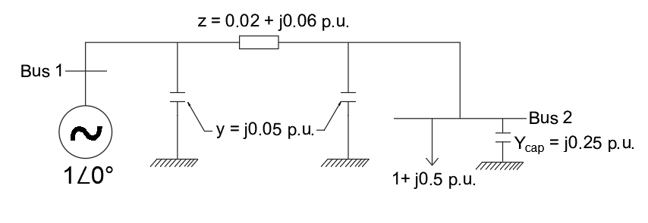
Example
Solution:
Bus 1 is a swing bus
$$Y=\frac{1}{Z}=\frac{1}{0.02+j0.06}=5−j15$$
$$Y_{\text{Bus} }=\left[\begin{matrix}5−j14.95 & −5+j15 \\ −5+j15 & 5−j14.70\end{matrix}\right]$$
$$V_{2}=\frac{1}{Y_{22}}\left(\frac{S_{2}^{∗}}{V_{2}^{∗}}−\sum_{k=1,k≠i}^{n}{ } Y_{ik}V_{k}\right)$$
ECpE Department

Slide 26
Contd…
$$V_{2}=\frac{1}{Y_{22}}\left(\frac{S_{2}^{∗}}{V_{2}^{∗}}−\sum_{k=1,k≠i}^{n}{ } Y_{ik}V_{k}\right)$$
$$Y_{21} V_{1}$$
$$V_{2}=\frac{1}{Y_{22}}\left(\frac{S_{2}^{∗}}{V_{2}^{∗}}−Y_{21}V_{1}\right)$$
We have, $Y_{22}=5−j14.70; V_{1}=1∠0^{∘}; S_{2}=−1−j0.5 p.u.$
$$V_{2}=\frac{1}{5−j14.70}\left(\frac{−1+j0.5}{V_{2}^{∗}}−\left(−5+j5\right)\left(1∠0^{∘}\right)\right)$$
ECpE Department

Slide 27
Contd…
$$V_{2}=\frac{1}{5−j14.70}\left(\frac{−1+j0.5}{V_{2}^{∗}}−\left(−5+j5\right)\left(1∠0^{∘}\right)\right)$$
$$V_{2}^{(0)}=1∠0^{∘} \text{(}\text{flatstart}\text{)}$$
$$\begin{matrix}θ & V_{2}^{\left(v\right)} \\ 0 & 1+j0. \\ 1 & 0.9671+j0.0568 \\ 2 & 0.9624−j0.0553 \\ 3 & 0.9622−j0.0556 \\ 4 & 0.9622−j0.0556.\end{matrix}$$
$$∴v_{2}=0.9622−j0.05=0.9638∠−{3.3}^{∘}$$
ECpE Department

Slide 28
Contd…
$$∴v_{2}=0.9622−j0.05=0.9638∠−{3.3}^{∘}$$
Now,
$$S_{i}^{∗}=V_{i}^{∗}\sum_{k=1}^{n}{ } Y_{ik} V_{k}$$
$$S_{1}^{∗}=V_{1}^{∗}(Y_{11}V_{1}+Y_{12}V_{2})$$
$$S_{1}^{∗}=1∠ 0[\left(5−j14.95\right)+\left(−5+j15\right)∗\left(0.9638∠−{3.3}^{∘}\right)]$$
$${∴S}_{1}=1.023+j0.239 p.u.$$
ECpE Department

Slide 29
Gauss Method with Multiple Bus
$$\begin{matrix}V_{i}^{\left(v+1\right)} & \begin{aligned} =\frac{1}{Y_{ii}}\left(\frac{S_{i}^{∗}}{V_{i}^{\left(θ\right)∗}}−\sum_{k=1,k≠i}^{n}{ } Y_{ik}V_{k}^{\left(θ\right)}\right) \\ \\ \end{aligned} \\ V_{i}\left(v+1\right) & =h_{i}\left(V_{1}^{\left(θ\right)},V_{2}^{\left(θ\right)},…,V_{n}^{\left(v\right)}\right)\end{matrix}$$
Considering, $V_{1}$slack/swing Bus.
$$V_{2}^{\left(v+1\right)}=h_{2}\left(V_{1},V_{2}^{\left(v\right)},V_{3}^{\left(v\right)},…V_{n}^{\left(v\right)}\right)$$
$$V_{3}^{\left(v+1\right)}=h_{3}\left(V_{1},V_{2}^{\left(v\right)},V_{3}^{\left(v\right)},…,V_{n}^{\left(v\right)}\right)$$
Note, these are Gauss Iterations
$$⋮$$
$$⋮$$
$${V_{n}^{(v+1)}=h}_{n}\left(V_{1},V_{2}^{\left(v\right)},V_{3}^{\left(v\right)},…V_{n}^{\left(v\right)}\right)$$
ECpE Department

Slide 30
Contd…
But after we’ve determined $V_{i}^{\left(v+1\right)},$ we have a better estimate of its voltage, so it makes sense to use this new value. This approach is known as the Gauss-Seidel iteration.
Gauss - Seidel Iteration: Immediately use the new voltage estimates
$$V_{3}^{\left(v+1\right)}=h_{3}\left(V_{1}, V_{2}^{(v+1)},V_{3}^{(v)},…V_{n}^{(v)}\right)$$
$$⋮$$
$$⋮$$
$$V_{n}^{\left(v+1\right)}=h_{n}\left(V_{1},V_{2}^{\left(v+1\right)},V_{3}^{\left(v+1\right)},…V_{n}^{\left(v\right)}\right)$$
ECpE Department

Slide 31
Advantages/ Disadvantages of Gauss Method
Advantages
Each iteration is relatively fast
Computational burden is relatively low
easy to program.
Disadvantages
Has the tendency to miss solutions, especially for large systems
Need to compute using complex numbers.
ECpE Department

Slide 32
Newton – Raphson Method
General form: Find an " $\overset{ˆ}{x}$ " such that
$$f(\overset{ˆ}{x})=0$$
For each guess of $\overset{ˆ}{x},x^{(v)}$, define,
$$\text{Δ}x^{(v)}=\overset{ˆ}{x}−x^{(v)}$$
Represent $f(\overset{ˆ}{x})$ by a Taylor series.
$$f\left(\overset{ˆ}{x}\right)=f\left(x^{\left(v\right)}\right)+\frac{df\left(x^{\left(v\right)}\right)}{dx}Δx^{\left(v\right)}+\frac{1}{2}\frac{d^{2}f\left(x^{\left(v\right)}\right)}{dx^{2}}(Δx^{\left(v\right)})^{2}+\text{higher} \text{order} \text{terms}$$
Linearization:
$f\left(\overset{ˆ}{x}\right)=0≈f\left(x^{\left(v\right)}\right)+\frac{df\left(x^{\left(v\right)}\right)}{dx}Δx^{\left(v\right)}$
$Δx^{(v)}=−{\left[\frac{df\left(x^{(v)}\right)}{dx}\right]}^{−1}f\left(x^{(v)}\right)$
$x^{(v+1)}=x^{(v)}+Δx^{(v)}$
ECpE Department

Slide 33
Example
Use $N−R$ to solve $f(x)=x^{2}−2=0$.
Solution,
$$Δx^{\left(v\right)}=−{\left[\frac{df\left(x^{\left(ν\right)}\right)}{dx}\right]}^{−1}f\left(x^{\left(v\right)}\right)$$
$$Δx^{\left(v\right)}=−{\left[2x^{\left(v\right)}\right]}^{−1}\left({x^{\left(v\right)}}^{2}−2\right)$$
$$Δx^{\left(v\right)}=−\left[\frac{1}{2x^{\left(v\right)}}\right]\left({x^{\left(v\right)}}^{2}−2\right)$$
$$x^{\left(v+1\right)}=x^{\left(v\right)}+Δx^{\left(v\right)}$$
$$x^{\left(v+1\right)}=x^{\left(v\right)}−\left[\frac{1}{2x^{\left(v\right)}}\right]\left({\left(x^{\left(v\right)}\right)}^{2}−2\right)$$
ECpE Department

Slide 34
Contd…
Use $N−R$ to solve $f(x)=x^{2}−2=0$.
Initial guess: $x^{(0)}=1$
Therefore,
$$\begin{matrix}\begin{aligned}v \\ 0\end{aligned} & \begin{aligned}x^{(v)} \\ 1\end{aligned} \\ 1 & 1.5 \\ 2 & 1.41667 \\ 3 & 1.41422\end{matrix}$$
ECpE Department

Slide 35
Multi – Variable N-R method
$$x=\left[\begin{matrix}x_{1} \\ x_{2} \\ ⋮ \\ x_{n}\end{matrix}\right] f\left(x\right)=\left[\begin{matrix}f_{1}\left(x\right) \\ f_{2}\left(x\right) \\ ⋮ \\ f_{n}\left(x\right)\end{matrix}\right]$$
Define the solution $\overset{ˆ}{x}, f(\overset{ˆ}{x})=0$.
Define $Δx=\overset{ˆ}{x}−x$
Expand $f_{i}(x)$ using Taylor series
$f_{1}\left(\overset{ˆ}{x}\right)=f_{1}\left(x\right)+\frac{∂f_{1}\left(x\right)}{∂x_{1}}Δx_{1}+\frac{∂f_{1}\left(x\right)}{∂x_{2}}Δx_{2}+⋯$ $+\frac{∂f_{1}(x)}{∂x_{n}}Δx_{n}+\text{higher} \text{order} \text{terms}$
.
.
.
$$f_{n}\left(\overset{ˆ}{x}\right)=f_{n}\left(x\right)+\frac{∂f_{n}\left(x\right)}{∂x_{1}}Δx_{1}+\frac{∂f_{n}\left(x\right)}{∂x_{2}}Δx_{2}+⋯+\frac{∂f_{n}\left(x\right)}{∂x_{n}}Δx_{n}+\text{higher} \text{order} \text{terms}$$
ECpE Department

Slide 36
Contd…
In Matrix Form:
$$f\left(\overset{ˆ}{x}\right)=\left[\begin{matrix}f_{1}\left(x\right) \\ f_{2}\left(x\right) \\ ⋮ \\ f_{n}\left(x\right)\end{matrix}\right]+\left[\begin{matrix}\frac{∂f_{1}\left(x\right)}{∂x_{1}} & \frac{∂f_{1}\left(x\right)}{∂x_{2}} & ⋯ & \frac{∂f_{1}\left(x\right)}{∂x_{n}} \\ \frac{∂f_{2}\left(x\right)}{∂x_{1}} & \frac{∂f_{2}\left(x\right)}{∂x_{2}} & ⋯ & \frac{∂f_{2}\left(x\right)}{∂x_{n}} \\ . & . & . & . \\ . & . & . & . \\ . & . & . & . \\ \frac{∂f_{n}\left(x\right)}{∂x_{1}} & \frac{∂f_{n}\left(x\right)}{∂x_{2}} & ⋯ & \frac{∂f_{n}\left(x\right)}{∂x_{n}}\end{matrix}\right]\left[\begin{matrix}Δx_{1} \\ Δx_{2} \\ ⋮ \\ Δx_{n}\end{matrix}\right]$$
n x n matrix of partial derivatives Also called as Jacobian Matrix (J(x))
ECpE Department

Slide 37
Contd…
$$\left[\begin{matrix}f_{1}\left(x\right) \\ f_{2}\left(x\right) \\ ⋮ \\ f_{n}\left(x\right)\end{matrix}\right]+J\left(x\right)\left[\begin{matrix}Δx_{1} \\ Δx_{2} \\ ⋮ \\ Δx_{n}\end{matrix}\right]=0$$
So,
$\left[\begin{matrix}Δx_{1} \\ Δx_{2} \\ ⋮ \\ Δx_{n}\end{matrix}\right]=−[J(x)]^{−1}$ $\left[\begin{matrix}f_{1}(x) \\ f_{2}(x) \\ ⋮ \\ f_{n}(x)\end{matrix}\right]$
ECpE Department

Slide 38
Example:
Solve for $x=\left[\begin{matrix}x_{1} \\ x_{2}\end{matrix}\right]$ such that $f(x)=0,$
where
$$f_{1}\left(x\right)=2x_{1}^{2}+x_{2}^{2}−8=0$$
$$f_{2}\left(x\right)=x_{1}^{2}−x_{2}^{2}+x_{1}x_{2}−4=0$$
Solution,
$$J\left(x\right)=\left[\begin{matrix}\frac{∂f_{1}\left(x\right)}{∂x_{1}} & \frac{∂f_{1}\left(x\right)}{∂x_{2}} \\ \frac{∂f_{2}\left(x\right)}{∂x_{1}} & \frac{∂f_{2}\left(x\right)}{∂x_{2}}\end{matrix}\right]$$
$$J\left(x\right)=\left[\begin{matrix}4x_{1} & 2x_{2} \\ 2x_{1}+x_{2} & x_{1}−2x_{2}\end{matrix}\right]$$
ECpE Department

Slide 39
Contd…
$$\left[\begin{matrix}Δx_{1} \\ Δx_{2}\end{matrix}\right]=−{\left[\begin{matrix}4x_{1} & 2x_{2} \\ 2x_{1}+x_{2} & x_{1}−2x_{2}\end{matrix}\right]}^{−1}\left[\begin{matrix}f_{1}\left(x_{1})\right. \\ f_{2}\left(x_{2}\right)\end{matrix}\right]$$
Now, Initial Guess, $x^{(0)}=\left[\begin{matrix}1 \\ 1\end{matrix}\right]$
$$x^{\left(1\right)}=x^{\left(0\right)}+\left[Δx^{\left(1\right)}\right]$$
$$x^{\left(1\right)}=\left[\begin{matrix}1 \\ 1\end{matrix}\right]−{\left[\begin{matrix}4 & 2 \\ 3 & −1\end{matrix}\right]}^{−1}\left[\begin{matrix}−5 \\ −3\end{matrix}\right]=\left[\begin{matrix}2.1 \\ 1.3\end{matrix}\right]$$
$x^{\left(2\right)}=\left[\begin{matrix}2.1 \\ 1.3\end{matrix}\right]−{\left[\begin{matrix}8.4 & 2.6 \\ 5.5 & −0.5\end{matrix}\right]}^{−1}\left[\begin{matrix}2.51 \\ 1.45\end{matrix}\right]$ $=\left[\begin{matrix}1.8284 \\ 1.2122\end{matrix}\right]$
$$\left[\begin{matrix}f_{1}\left(x^{\left(2\right)}\right) \\ f_{2}\left(x^{\left(2\right)}\right)\end{matrix}\right]=\left[\begin{matrix}0.1556 \\ 0.0900\end{matrix}\right]$$
ECpE Department

Slide 40
Load Flow Analysis: N-R Method
$$x=\left[\begin{matrix}θ_{2} \\ ⋮ \\ θ_{n} \\ ∣v_{2}∣ \\ \begin{aligned}⋮ \\ \left|v_{n}\right|\end{aligned} \\ \end{matrix}\right] \begin{matrix} & \text{A}\text{ssume} \text{bus} 1 \text{is} \text{the} \text{slack} \text{bus}\text{.} \\ & \\ & \left|v_{1}\right|∠θ_{1}=1∠0^{∘}\end{matrix}$$
$$f\left(x\right)=\left[\begin{aligned}P_{2}−P_{G2}+P_{D2} \\ . \\ . \\ . \\ P_{n}−P_{Gn}+P_{Dn} \\ Q_{2}−Q_{G2}+Q_{D2} \\ . \\ . \\ . \\ Q_{n}−Q_{Gn}+Q_{Dn}\end{aligned}\right]$$
$$\sum_{k=1}^{n}{\left|V_{i}\right|\left|V_{k}\right|\left(G_{ik}\cos\left(θ_{i}−θ_{k}\right)+B_{ik}\sin\left(θ_{i}−θ_{k}\right)\right)}$$
$$\sum_{k=1}^{n}{\left|V_{i}\right|\left|V_{k}\right|\left(G_{ik}\sin\left(θ_{i}−θ_{k}\right)−B_{ik}\cos\left(θ_{i}−θ_{k}\right)\right)}$$
ECpE Department

Slide 41
Contd…
Set $v=0$; make initial guess of $x$ (flat start: ${1∠0}^{∘}$ ).
$$\text{w}\text{hile} \left\|f\right.(x^{(v)}\left.)\right\|>ε \text{d}\text{o}$$
$$x(v+1)=x^{(v)}−J{\left(x^{(v)}\right)}^{−1}+f\left(x^{(v)}\right)$$
$v=v+$1
End while
Note:
Jacobian elements are calculated by differentiating each function $f_{i}(x)$ with respect to each variable.
For example: if $f_{i}(x)$ is the bus $′i′$ real power equation,
$$\begin{matrix}f_{i}(x)= & \sum_{k=1}^{n}{ } \left|V_{i}\right|\left|V_{k}\right|\left(G_{ik}cos⁡θ_{ik}+B_{ik}sin⁡θ_{ik}\right) \\ & \end{matrix}−P_{Gi}+P_{Di}$$
ECpE Department

Slide 42
Contd…
$\frac{∂f_{i}\left(x\right)}{∂θ_{i}} ??$ , when $i=k$
$$f_{i}\left(x\right)=\left|v_{i}\right|\left|v_{i}\right|\left(G_{ii}cos{0}+B_{ii}sin{0}\right)−P_{Gi}+P_{Di}$$
$$={\left|v_{i}\right|}^{2}G_{ii}−P_{Gi}+P_{Di}$$
$$\frac{∂f_{i}\left(x\right)}{∂θ_{i}}=0$$
$\frac{∂f_{i}\left(x\right)}{∂θ_{i}} ??$ When $i≠k$.
$$f_{i}\left(x\right)=\sum_{k=1, k≠i}^{n}{\left|V_{i}\right|\left|V_{k}\right|\left(G_{ik}\cos\left(θ_{i}−θ_{k}\right)+B_{ik}\sin\left(θ_{i}−θ_{k}\right)\right)−P_{Gi}+P_{Di}}$$
$$\frac{∂f_{i}\left(x\right)}{∂θ_{i}}=\left|V_{i}\right|\left|V_{k}\right|\left(−G_{ik}sin{θ_{ik}}+B_{ik}cos{θ_{ik}}\right)$$
ECpE Department

Slide 43
Contd…
When $j≠i$
$$\frac{∂f_{i}\left(x\right)}{∂θ_{j}}=\left|V_{i}\right|\left|V_{j}\right|\left(−G_{ij}sin{θ_{ij}}+B_{ij}cos{θ_{ij}}\right)$$
ECpE Department

Slide 44
Thank You!
ECpE Department

