Slide 1
EE 303 Energy Systems and Power Electronics Power Electronics
ECpE Department
GRA: Prashant Tiwari
Advisor: Dr. Zhaoyu Wang
1113 Coover Hall, Ames, IA
wzy@iastate.edu

Slide 2
DC – DC Converters
Buck Converter (Step – Down Converter)
Boost Converter (Step – Up Converter)
Buck – Boost Converter (Step Up/Down Converter)
ECpE Department

Slide 3
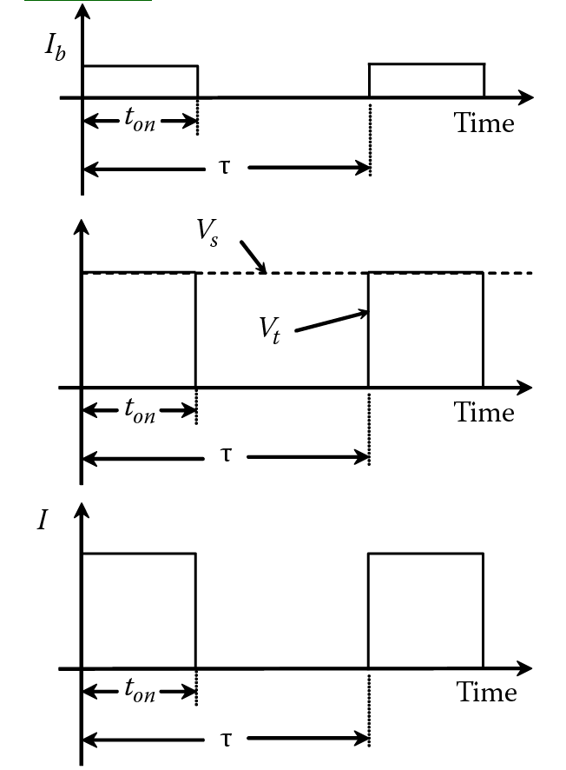
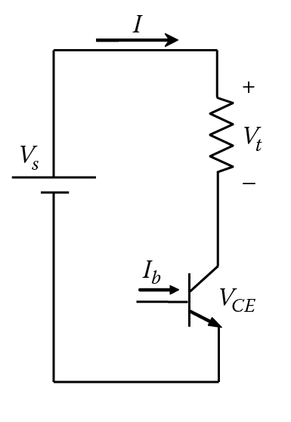
Buck Converter – Step Down Converter
ECpE Department

Slide 4
Contd…
$$V_{ave}=\frac{1}{τ} {∫_{0}^{t}V}_{s}dt$$
$=\frac{t_{on}}{τ}⋅V_{s}$
$$k=\frac{t_{on}}{τ} \text{= }\text{duty} \text{ratio}$$
$$V_{ave} =k⋅V_{s}$$
ECpE Department

Slide 5
Example
The switching frequency of a chopper is 10 KHz, and the source voltage is 40 V. For an average load voltage of 20 V and a load resistance of 10 Ω, compute the following:
Duty ratio
Average current of the load
rms voltage across the load
Load power
ECpE Department

Slide 6
Example
Solution
The duty ratio is
$$K=\frac{V_{\text{ave} }}{V_{s}}=\frac{20}{40}=0.5$$
Before we compute the on-time, we need to compute the period:
$$\begin{matrix}τ & =\frac{1}{f}=\frac{1}{10}=0.1 ms \\ t_{\text{on} } & =Kτ=0.5×0.1=0.05 ms\end{matrix}$$
The average load current is
$$I_{\text{ave} }=\frac{V_{\text{ave} }}{R}=\frac{20}{10}=2 A$$
The rms voltage of the load can be computed using the standard formula for the rms quantity
$$V=\sqrt{\frac{1}{τ}\int_{0}^{t_{on}}{ } V_{s}^{2}dt}=\sqrt{\frac{V_{s}^{2}}{τ}t_{on}}=V_{s}\sqrt{\frac{t_{on}}{τ}}=28.28 V$$
$P=\frac{V^{2}}{R}=\frac{{28.28}^{2}}{10}=80 W$
ECpE Department

Slide 7
DC – DC Converters
Buck Converter (Step – Down Converter)
Boost Converter (Step – Up Converter)
Buck – Boost Converter (Step Up/Down Converter)
ECpE Department

Slide 8
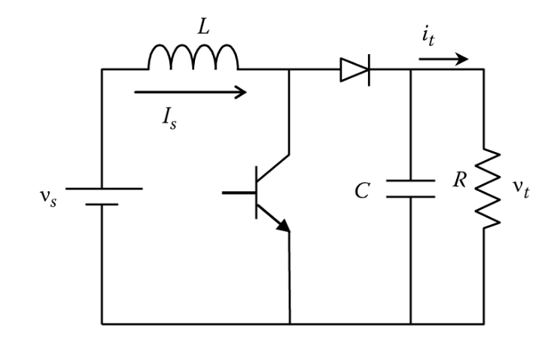
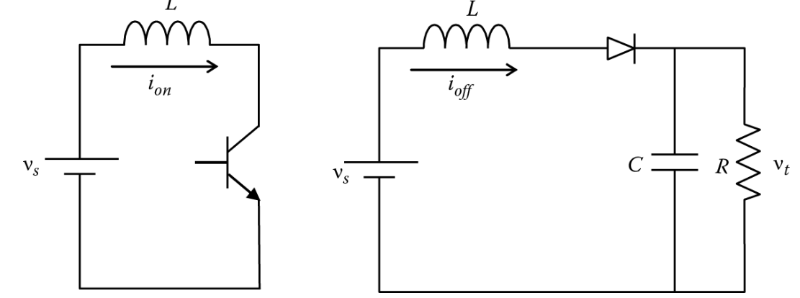
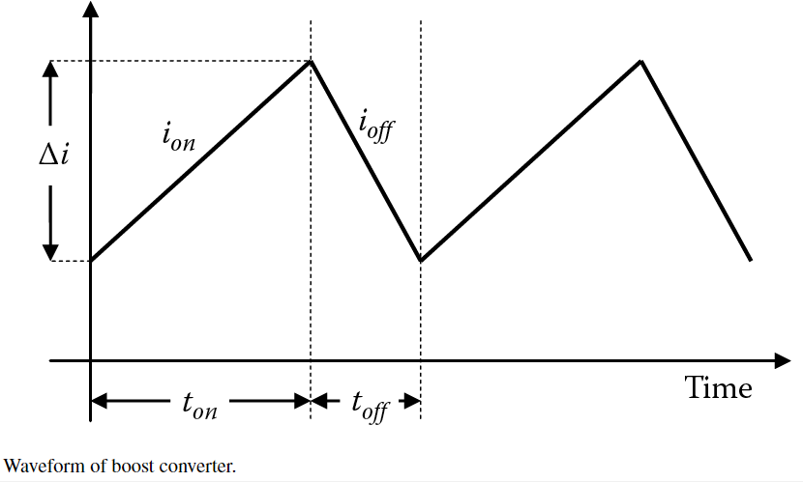
Boost Converter
Filter reduces the voltage ripple
ECpE Department

Slide 9
Contd…
When transistor is closed. ($t_{on}, i_{on}$), charge inductor
$$V_{L}=L\frac{di_{on}}{dt}=L\frac{Δi_{on}}{t_{on}}$$
where $Δi_{\text{on} }$ is the change in the current during the period $t_{on}$. Since the voltage across the inductor is equal to the source voltage when the transistor is closed.
$$V_{s}=L\frac{Δi_{on}}{t_{on}}$$
When transistor is open. ($t_{off}, i_{off}$), dicharge inductor
$V_{t}=V_{s}+V_{L}=V_{s}+L\frac{di_{off}}{dt}$= $V_{s}+L\frac{Δi_{off}}{t_{off}}$
ECpE Department

Slide 10
Contd…
$V_{t}=V_{s}+V_{L}=V_{s}+L\frac{di_{off}}{dt}$= $V_{s}+L\frac{Δi_{off}}{t_{off}}$
$$V_{t}=V_{s}+V_{s}\frac{t_{on}}{Δi_{on}} . \frac{Δi_{off}}{t_{off}}$$
$$Δi_{on}=Δi_{off}$$
$V_{t}=V_{s}+V_{s}\frac{t_{on}}{t_{off}}=V_{s}(1+\frac{t_{on}}{t_{off}}$)
ECpE Department

Slide 11
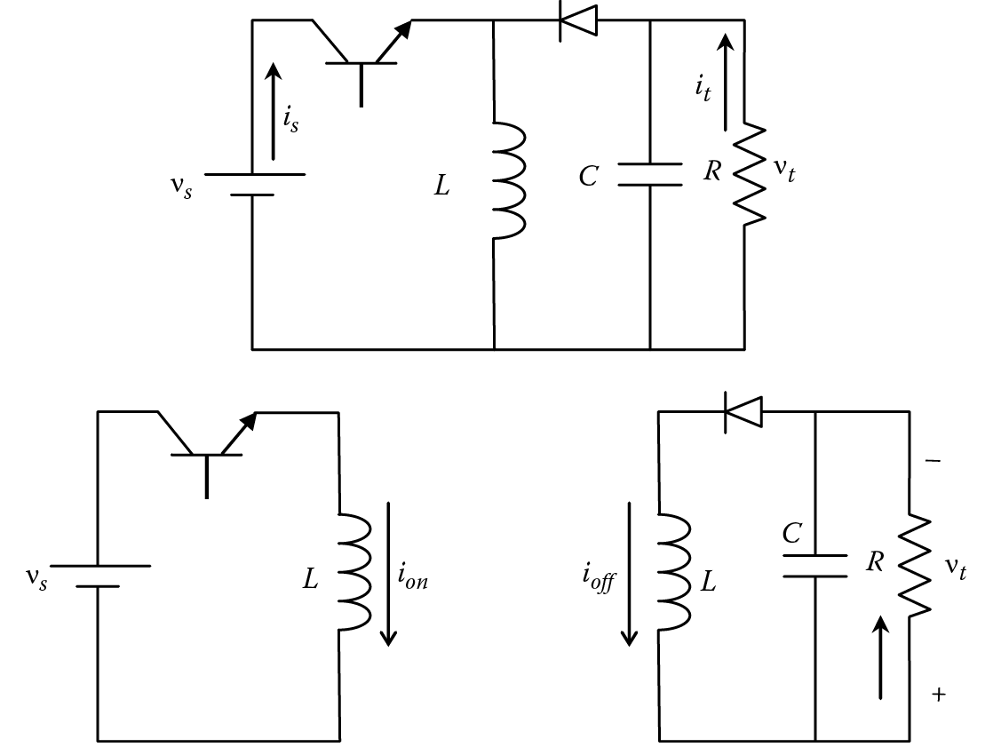
Buck – Boost Converter
ECpE Department

Slide 12
Contd…
When transistor is closed. ($t_{on}, i_{on}$)
$$V_{L}=L\frac{di_{on}}{dt}=L\frac{Δi_{on}}{t_{on}}$$
$$V_{s}=V_{L}=L\frac{Δi_{on}}{t_{on}}$$
When transistor is open. ($t_{off}, i_{off}$)
$$V_{L}=\frac{Δi_{off}}{t_{off}}$$
$$V_{t}=V_{L}=L\frac{Δi_{off}}{t_{off}}$$
$$V_{t}=V_{s}\frac{t_{on}}{Δi_{on}} . \frac{Δi_{off}}{t_{off}}$$
$$V_{t}=V_{s}\frac{t_{on}}{t_{off}}$$
$$(Δi_{on}=Δi_{off})$$
ECpE Department

Slide 13
Example
A buck–boost converter with an input voltage of 20 V is used to regulate the voltage across a 10 Ω load. The switching frequency of the transistor is 5 kHz. Compute the following:
- On-time of the transistor to maintain the output voltage at 10 V
ECpE Department

Slide 14
Example
A buck–boost converter with an input voltage of 20 V is used to regulate the voltage across a 10 Ω load. The switching frequency of the transistor is 5 kHz. Compute the following:
- On-time of the transistor to maintain the output voltage at 10 V
Solution,
The period can be computed from the switching frequency $f$
$τ=\frac{1}{f}=\frac{1}{5}=0.2 ms$
$V_{t}=V_{s}\frac{t_{on}}{Δi_{on}}$
$\frac{t_{on}}{t_{off}}=\frac{V_{t}}{V_{s}}=\frac{10}{20}=0.5$
$t_{off}+t_{on}=τ$
$t_{on}= 0.0667 ms$
ECpE Department

Slide 15
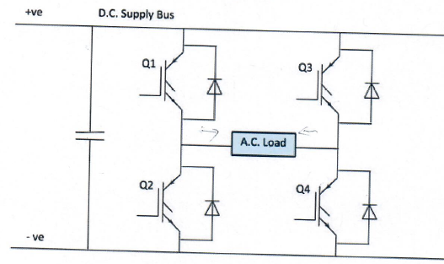
DC-AC Inverter (H- Bridge Circuit)
Most of the inverter consists of simple H-Bridge arrangement. The circuit is an implementation of a single-phase $H$-Bridge circuit using Insulated Gate Bipolar Transistors (IGBT).
The IGBT act as a switch in the above circuit.
When a signal is applied to the gate, they turn on and when the signal is removed, they turn off. By closing Q1 and Q4, a positive DC supply is applied to the load.
The Q3, and $Q3$ will result in a negative $DC$ supply across the load.
Then the control circuits are used to generate the necessary gate signals to produce the required PWM waveform.
It is necessary to avoid short circuits. This happens by closing both Q1 and $Q2$ at the same time. To avoid this, it is necessary to turn off one set of IGBT before turning on the next.
The Diodes provide a necessary path for inductive current in order to limit potential voltage build-up during the transition period. The capacitor provides smoothing to even out any variation in the DC supply.
ECpE Department

Slide 16
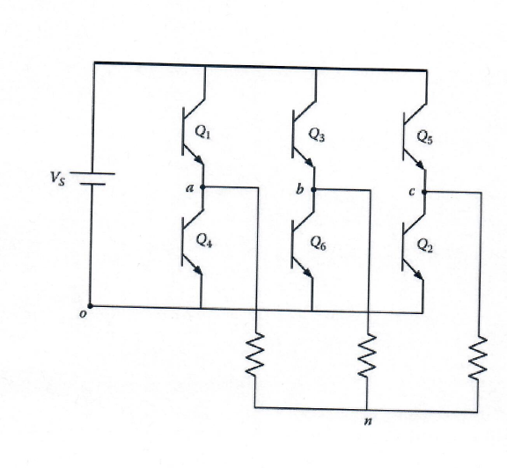
Contd…
ECpE Department

Slide 17
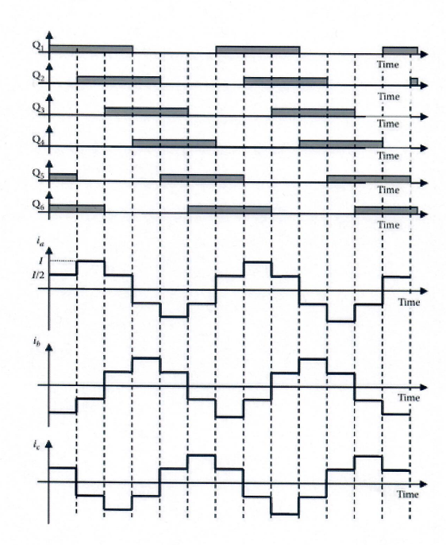
Contd…
ECpE Department

Slide 18
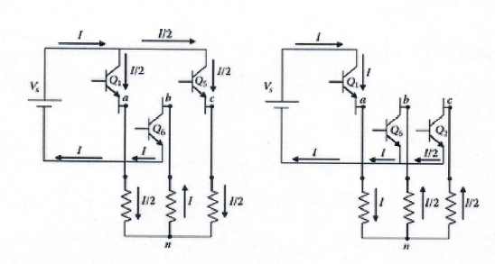
Contd…
ECpE Department

Slide 19
Thank You!
ECpE Department

