Slide 1
EE 303 – Electric Machines
Dr. Zhaoyu Wang (wzy@iastate.edu)
Dr. Salish Maharjan (salish@iastate.edu)
Department of Electrical and Computer Engineering
Iowa State University

Slide 2
Three Phase Induction Motor
Dr. Zhaoyu Wang (wzy@iastate.edu)
Dr. Salish Maharjan (salish@iastate.edu)
Department of Electrical and Computer Engineering
Iowa State University

Slide 3
Contents
Three phase induction motor types
Construction and principle of operation
Rotating magnetic field
Equivalent circuit of three phase induction motor
Torque speed characteristics
ECpE Department

Slide 4
Three phase induction motor
Invented by Nikola Tesla in 1888
Induction motor is the commonly used machine for converting electrical to mechanical energy.
Widely used in industry (e.g., water pumps, chillers, blowers, etc.) and home appliances (e.g., HVAC, Refrigerator, etc.)
Available size vary from half a kilowatt to thousands of kilowatts.
Advantages:
Rugged construction
Reliable operation
Simple mechanism for torque and speed control
ECpE Department

Slide 5
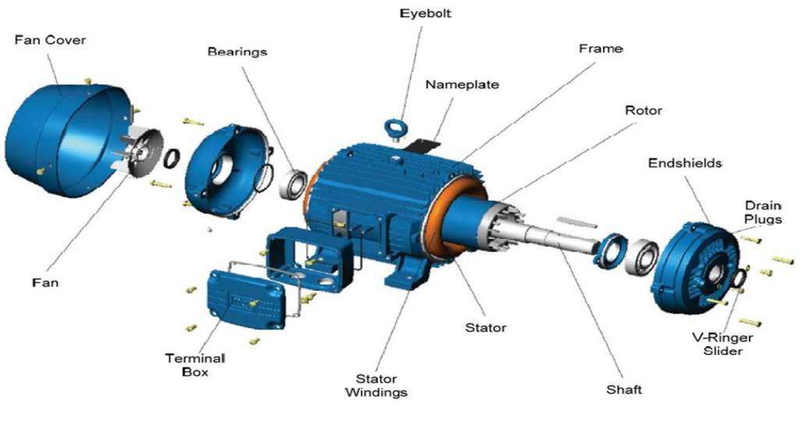
Types and construction
Squirrel cage induction motor
Slip ring induction motor
Main difference is the rotor construction
ECpE Department

Slide 6
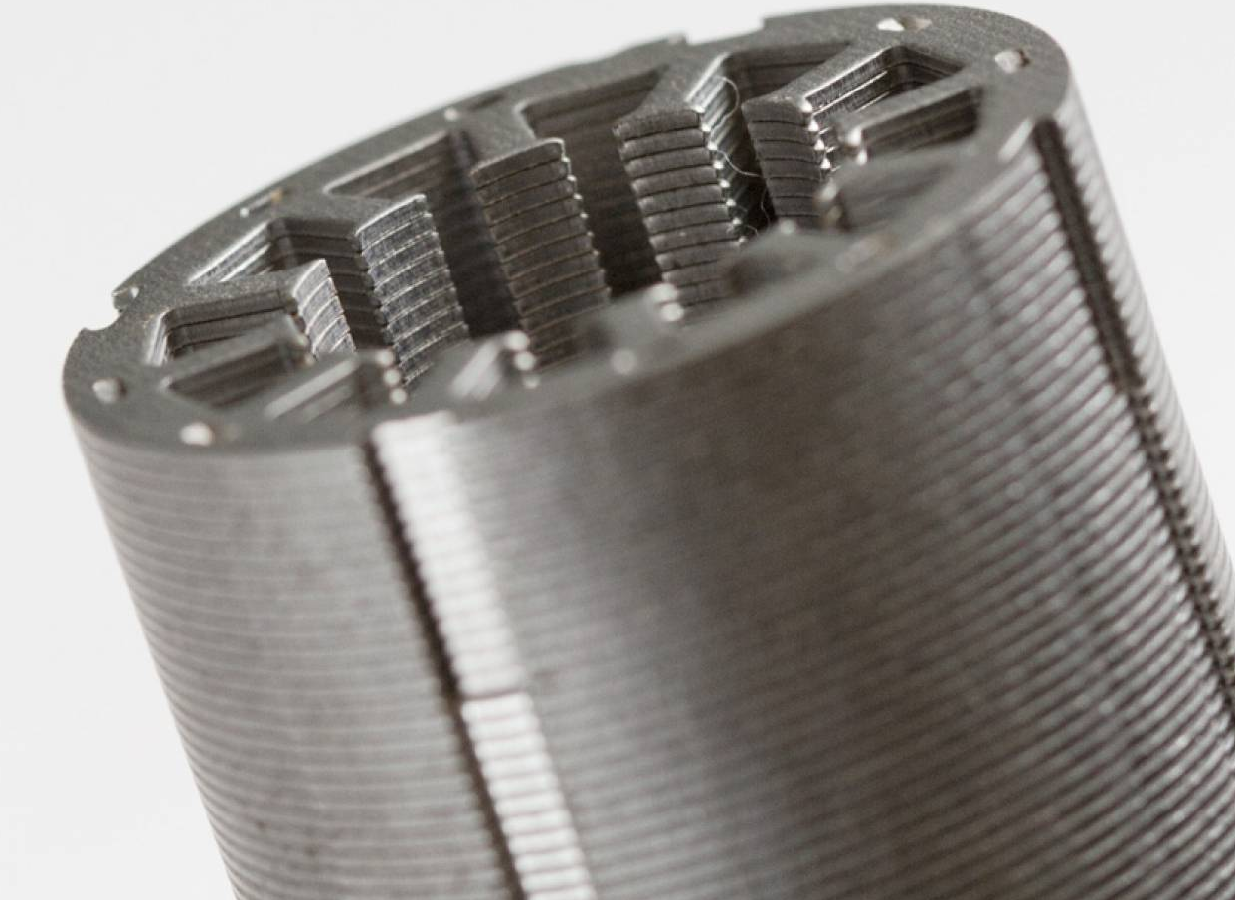
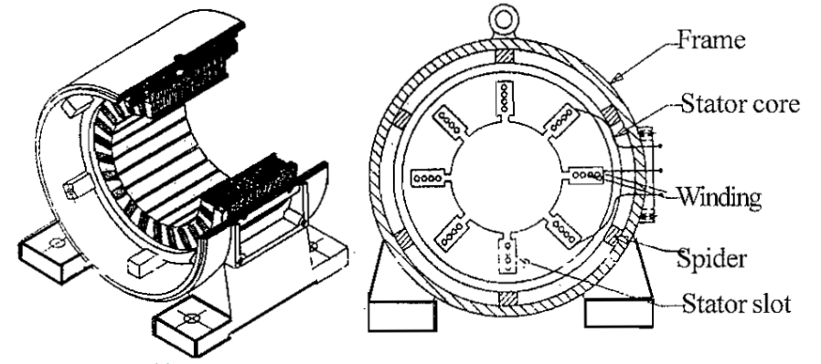
Squirrel cage induction motor
Stator
Constructed with laminated steel core
Holds the stator windings
Laminated steel core
ECpE Department

Slide 7
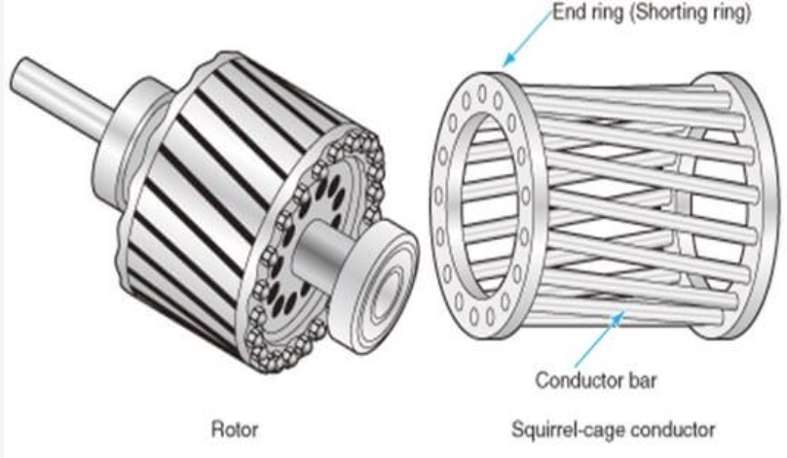
Squirrel cage induction motor
Rotor
Constructed with laminated steel core
Contains no windings but conductor bars that are short circuited by an end ring.
ECpE Department

Slide 8
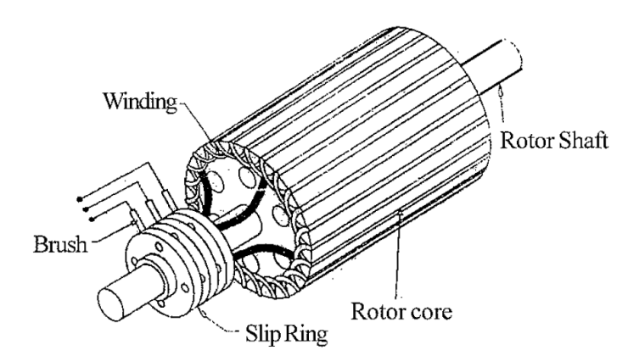
Slip ring induction motor
Stator: Same as squirrel cage induction motor
Rotor
Constructed with laminated steel core
Holds the rotor windings.
The terminals of rotor windings are connected to slip rings.
The terminals of slip rings are brough out through stationary carbon brushes.
ECpE Department

Slide 9
Comparison of Squirrel cage and slip ring motor
 | Features | Squirrel cage motor | Slip ring motor
1 | Rotor construction | Metallic bar are used in rotor No slip ring and brush rather the terminals of metallic bars are shorted by end rings. | Rotor windings are made of copper Slip ring and brush mechanism outlets the rotor windings’ terminals.
2 | Starting torque | Low | High
3 | Starting Current | High | Low
4 | Speed variation | Not easy, but could be varied by changing supply frequency | Easy to vary speed Speed can be changed by changing rotor resistance or supply frequency
5 | Maintenance | Almost ZERO maintenance | Requires frequent maintenance
ECpE Department

Slide 10
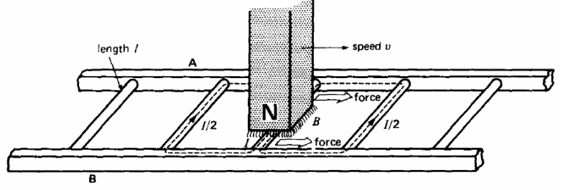
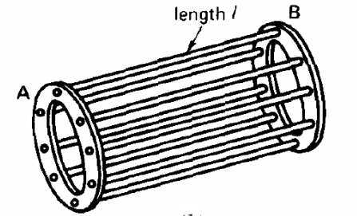
Principle of Operation
Sequence of events
A voltage E = Blv is induced in each conductor while it is being cut by the flux (Faraday law).
The induced voltage immediately produces a current I, which flows down the conductor
Because the current carrying conductor lies in the magnetic field of the permanent magnet, it experiences a mechanical force (Lorentz force)
The force always acts in a direction to drag the conductor along with the magnetic field.
Thought Experiment
ECpE Department

Slide 11
Principle of Operation
Sequence of events
If the conducting ladder is free to move, it will accelerate toward the right.
As it picks up speed, the conductors will be cut less rapidly by the moving magnet, with the result that the induced voltage E and the current I will diminish
Consequently, the force acting on the conductors wilt also decreases.
If the ladder were to move at the same speed as the magnetic field, the induced voltage E, the current I, and the force dragging the ladder along would all become zero.
Thought Experiment
ECpE Department

Slide 12
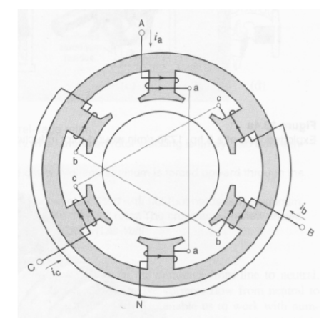
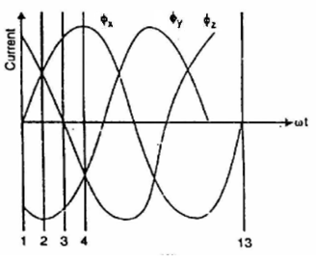
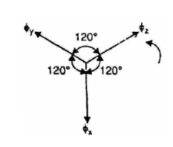
Rotating Magnetic Field
The three-phase winding produces magnetic flux along their axes.
$$φ_{x}=φ_{m}sin{ω}t$$
$$φ_{y}=φ_{m}sin\left(ωt−{120}^{∘}\right)$$
$$φ_{z}=φ_{m}sin\left(ωt−{240}^{∘}\right)$$
The resultant flux is given by vector sum of $φ_{x}$, $φ_{y}$, and $φ_{z}$.
Stator windings
ECpE Department

Slide 13
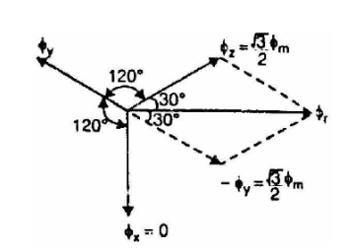
Rotating Magnetic Field
At instant $1,ωt=0^{∘},$ the three fluxes are given by;
$$\begin{matrix} & \begin{aligned}φ_{x}=0 \\ φ_{y}=φ_{m}sin⁡\left(−{120}^{∘}\right)=−\frac{\sqrt{3}}{2}φ_{m};\end{aligned} \\ & φ_{z}=φ_{m}sin⁡\left(−{240}^{∘}\right)=\frac{\sqrt{3}}{2}φ_{m}\end{matrix}$$
Resultant flux, $φ_{r}=2×\frac{\sqrt{3}}{2}φ_{m}\cos{\frac{{60}^{∘}}{2}}$
$$=2×\frac{\sqrt{3}}{2}φ_{m}×\frac{\sqrt{3}}{2}=1.5φ_{m}$$
ECpE Department

Slide 14
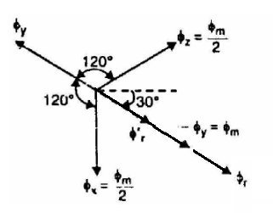
Rotating Magnetic Field
At instant $2,ωt={30}^{∘},$ the three fluxes are given by;
$$\begin{matrix} & φ_{x}=φ_{m}sin{{60}^{∘}}=\frac{\sqrt{3}}{2}φ_{m}; \\ & φ_{y}=φ_{m}sin\left(−{60}^{∘}\right)=−\frac{\sqrt{3}}{2}φ_{m}; \\ & φ_{z}=φ_{m}sin\left(−{180}^{∘}\right)=0\end{matrix}$$
resultant flux
$$φ_{r}=2×\frac{\sqrt{3}}{2}φ_{m}cos⁡\frac{{60}^{∘}}{2}=1.5φ_{m}$$
ECpE Department

Slide 15
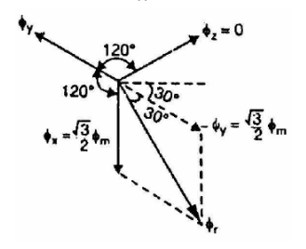
Rotating Magnetic Field
At instant $3,ωt={60}^{∘}$, the three fluxes are given by;
$$\begin{matrix} & φ_{x}=φ_{m}sin{60}^{∘}=\frac{\sqrt{3}}{2}φ_{m}; \\ & φ_{y}=φ_{m}sin\left(−{60}^{∘}\right)=−\frac{\sqrt{3}}{2}φ_{m}; \\ & φ_{z}=φ_{m}sin\left(−{180}^{∘}\right)=0\end{matrix}$$
Phasor sum of $φ_{x}$ and $φ_{z},φ_{r}^{′}=2×\frac{φ_{m}}{2}cos⁡\frac{{120}^{∘}}{2}=\frac{φ_{m}}{2}$
Phasor sum of $φ_{r}^{′}$ and $−φ_{y},$ gives the resultant flux
$$φ_{r}=\frac{φ_{m}}{2}+φ_{m}=1.5φ_{m}$$
ECpE Department

Slide 16
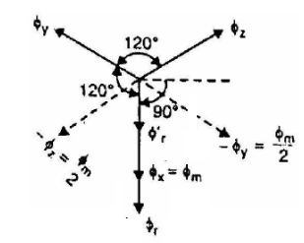
Rotating Magnetic Field
At instant $4,ωt={90}^{∘}$, the three fluxes are given by;
$$\begin{matrix} & φ_{x}=φ_{m}sin{{90}^{∘}}=φ_{m} \\ & φ_{y}=φ_{m}sin\left(−{30}^{∘}\right)=−\frac{φ_{m}}{2} \\ & φ_{z}=φ_{m}sin\left(−{150}^{∘}\right)=−\frac{φ_{m}}{2}\end{matrix}$$
Phasor sum of $−φ_{z}$ and $−φ_{y},φ_{r}^{′}=2×\frac{φ_{m}}{2}cos⁡\frac{{120}^{∘}}{2}=\frac{φ_{m}}{2}$
Phasor sum of $φ_{r}^{′}$ and $φ_{x},φ_{r}=\frac{φ_{m}}{2}+φ_{m}=1.5φ_{m}$
resultant flux
$$φ_{r}=\frac{φ_{m}}{2}+φ_{m}=1.5φ_{m}$$
ECpE Department

Slide 17
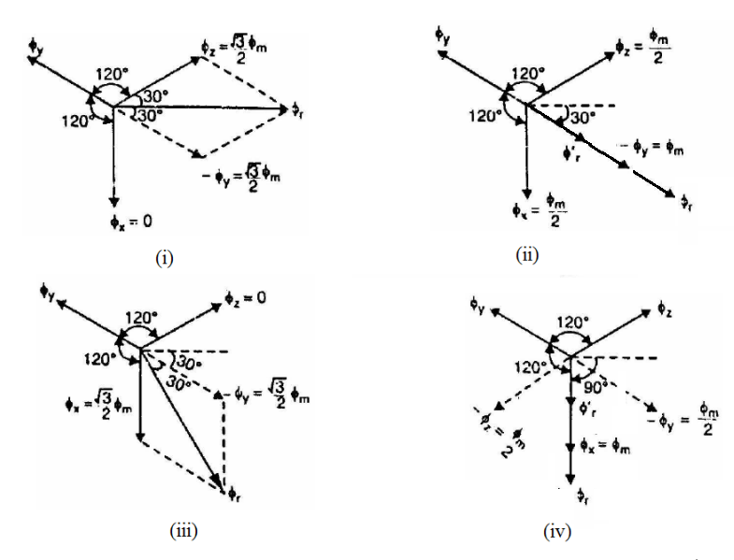
Resulting magnetic field
The 3-phase supply in the stator winding produces a rotating field of constant value (= 1.5 $φ_{m}$, where $φ_{m}$ is the maximum flux due to any phase).
The field is rotating in clockwise direction.
ECpE Department

Slide 18
Speed of rotating magnetic field
The speed at which the rotating magnetic field revolves is called the synchronous speed (Ns), which is given by
$$N_{s}=\frac{120f}{P}$$
Note $P$ refers to number of poles and f refers to frequency
ECpE Department

Slide 19
Slip
In practice, the rotor can never reach the speed of stator flux
If the relative speed between the stator field and rotor conductors is 0, then the rotor current are not induced and, hence, no torque to drive the rotor
The difference between the synchronous speed Ns of the rotating stator field and the actual rotor speed N is called slip and is given by
$$s=\frac{N_{s}−N}{N_{s}}$$
The slip is typically less than 15% in induction motors.
The induced rotor current frequency is $sf$, where $f$ is frequency of stator current.
ECpE Department

Slide 20
Equivalent circuit of Three phase induction motor
An induction motor may be considered a transformer with a rotating secondary (short-circuited).
The stator winding corresponds to a transformer primary and the rotor winding as secondary.
$$I_{2}^{′}=\frac{{sE}_{2}}{\sqrt{R_{2}^{2}+{\left(sX_{2}\right)}^{2}}}$$
ECpE Department

Slide 21
Equivalent circuit of Three phase induction motor
Alternatively, $I_{2}^{′}$ can be written as:
$$I_{2}^{′}=\frac{E_{2}}{\sqrt{{\left({R_{2}}/s\right)}^{2}+{\left(X_{2}\right)}^{2}}}$$
Hence the equivalent circuit can be written as:
ECpE Department

Slide 22
Equivalent circuit of Three phase induction motor
K is the transformation ratio at standstill position of the rotor
ECpE Department

Slide 23
Torque equation
$$I_{2}^{′}=\frac{sE_{2}}{\sqrt{R_{2}^{2}+{\left(sX_{2}\right)}^{2}}}=\frac{{sKE}_{1}}{\sqrt{R_{2}^{2}+{\left(sX_{2}\right)}^{2}}}$$
Rotor Power$=3×\frac{s^{2}E_{1}^{2}R_{2}}{R_{2}^{2}+{\left(sX_{2}\right)}^{2}}×(\frac{1}{s}−1)=\frac{3s{ E}_{1}^{2}R_{2}(1−s)}{R_{2}^{2}+{\left(sX_{2}\right)}^{2}}$
Rotor Power = T ω = 2πTN
T = $\frac{Rotor Power}{\text{2}\text{π}\text{N}}=$ $\frac{3s{ E}_{1}^{2}R_{2}}{{(R}_{2}^{2}+{\left(sX_{2}\right)}^{2}){2πN}_{s}}=\frac{3}{{2πN}_{s}}×\frac{s{ E}_{1}^{2}R_{2}}{{(R}_{2}^{2}+{\left(sX_{2}\right)}^{2})}$
ECpE Department

Slide 24
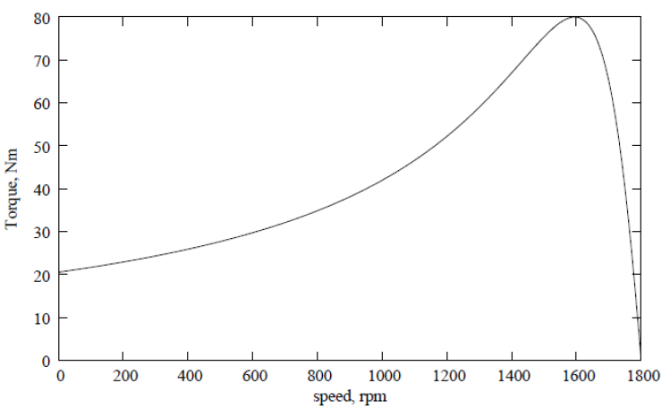
Torque speed characteristics
ECpE Department

Slide 25
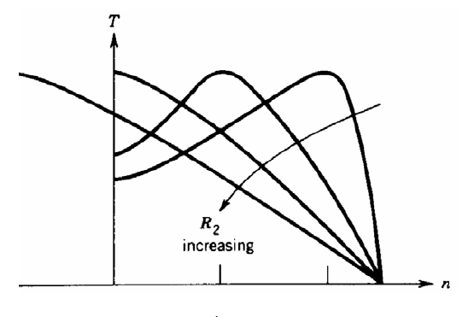
Torque speed characteristics on varying R₂
ECpE Department

Slide 26
Q&A
THANKS
ECpE Department

Slide 27
Synchronous Generator
Dr. Zhaoyu Wang (wzy@iastate.edu)
Dr. Salish Maharjan (salish@iastate.edu)
Department of Electrical and Computer Engineering
Iowa State University

Slide 28
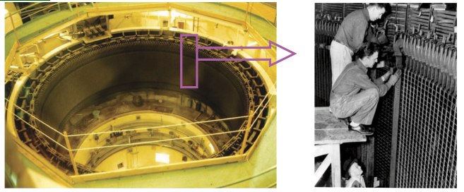
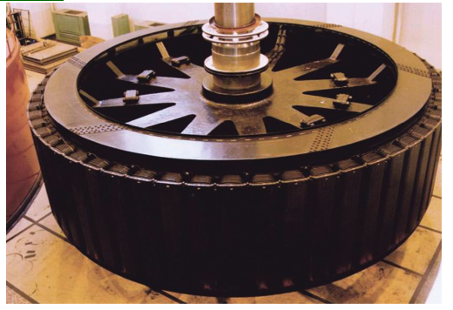
Synchronous Generator
Synchronous generators convert the mechanical power of the turbine into electrical power
The source mechanical power could be a diesel engine, steam turbine, hydro turbines, etc.
Widely used in large scale power production in the range of several Mega Watts to Giga Watts.
Stator and Rotor of Synchronous generator of Grand Coulee hydroelectric power plant on the Columbia River in Washington State.
ECpE Department

Slide 29
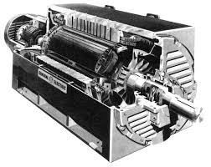
Basic Topology
Stator: support the placement of three phase winding as in Induction motor.
Stator winding are also referred to as armature winding.
Rotor
Stator
Rotor: Unlike induction generator, the magnetic field is generated either by a permanent magnet or by applying dc current to rotor windings.
Rotor winding are referred to as field windings.
ECpE Department

Slide 30
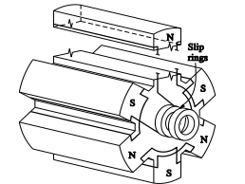
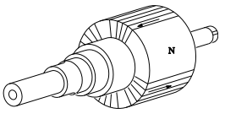
Types
Salient-pole rotor
Has protruding poles
Air gap between stator and rotor is not uniform
Designed for low-speed generator, e.g., Hydro
Cylindrical rotor
Uniform airgap
Designed for high-speed generator, e.g., steam generators
ECpE Department

Slide 31
Exciter system
DC generator-based excitation system
Brushless excitation system/AC generator-based excitation system
Exciter
Rotor
Stator
ECpE Department

Slide 32
DC generator-based excitation system
Supply DC power to field winding from a special DC generator mounted directly on the shaft of the synchronous generator.
DC generators have carbon brush, which require higher maintenance.
ECpE Department

Slide 33
AC generator-based excitation system
Commonly referred as brushless excitation system
A small AC generator whose field circuits are mounted on the stator and armature circuits are mounted on the rotor shaft.
AC exciter output is rectified to DC by a 3-phase rectifier (mounted on the shaft) and fed into the main DC field circuit.
It is possible to adjust the field current on the main machine by controlling the small DC field current of the exciter generator (located on the stator).
ECpE Department

Slide 34
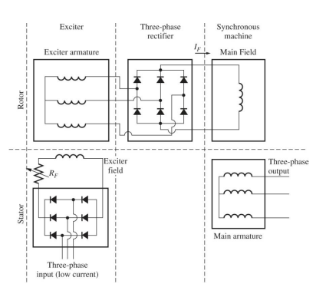
AC generator-based excitation system
ECpE Department

Slide 35
Rotation speed of synchronous generator
$$f_{e}=\frac{N_{m}P}{120}$$
Where,
$f_{e}=$ electrical frequency, in $Hz$ $N_{m}=$ mechanical speed of magnetic field, in rpm = rotor speed, in rpm $P=$ number of poles
For two pole generator to produce AC power at 60 Hz, it should be rotated at 3600 rpm
ECpE Department

Slide 36
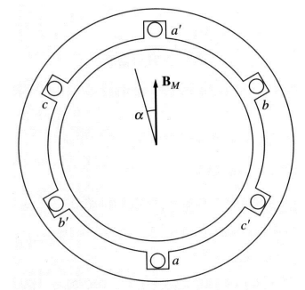
Generation Voltage
A uniform rotating magnetic flux ($φ_{r}$) produced by rotating rotor at $ω_{m}$ angular speed is $φ_{r}=φsinω_{m}t$
If $N_{c}$ is the number of coil in each stator windings, the emf induced in each phase would be
$$\begin{matrix} & e_{aa^{′}}\left(t\right)=N_{C}φω_{m}cos{ω_{m}}t \\ & e_{bb^{′}}\left(t\right)=N_{C}φω_{m}cos\left(ω_{m}t−{120}^{∘}\right) \\ & e_{cc^{′}}\left(t\right)=N_{C}φω_{m}cos\left(ω_{m}t−{240}^{∘}\right)\end{matrix}$$
Peak voltage:
$$E_{max}=N_{C}φω_{m}$$
$$E_{max}=2πN_{C}φf_{e}$$
RMS voltage:
$$E_{A}=\frac{2π}{\sqrt{2}}N_{C}φf=\sqrt{2}πN_{C}φf_{e}$$
ECpE Department

Slide 37
Q&A
THANKS
ECpE Department

