Slide 1
EE 303 Energy Systems and Power Electronics Photovoltaic Energy
ECpE Department
GRA: Prashant Tiwari
Advisor: Dr. Zhaoyu Wang
1113 Coover Hall, Ames, IA
wzy@iastate.edu

Slide 2
Benefits of PV
The advantages of PV are manifold:
unlimited resource of solar energy,
available in all parts of the world,
modular, it varies from milliwatt in consumers products up to gigawatt in future power stations,
during operation, it produces electricity with no air emissions and no waste production,
virtually no maintenance,
silent during operation,
proven technical lifetime of $30+$ years.
ECpE Department

Slide 3
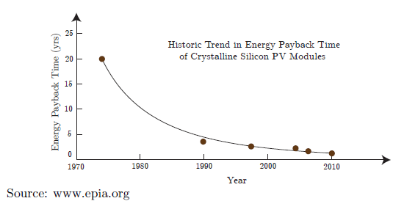
PV Energy Payback Time
The energy payback time (EPBT) of PV systems is an important criterion in understanding their sustainability. The EPBT is the amount of time a PV system has to operate in order to compensate for the energy required to fabricate the system itself.
3
ECpE Department
ECpE Department

Slide 4
Contd…
The EPBT of PV systems will continue to decrease in the future due to:
reduction in material usage (e.g. thinner silicon wafers, thin-film modules),
higher system efficiencies for converting solar energy into electricity,
improved manufacturing processes,
recycling of materials and PV systems.
4
ECpE Department
ECpE Department

Slide 5
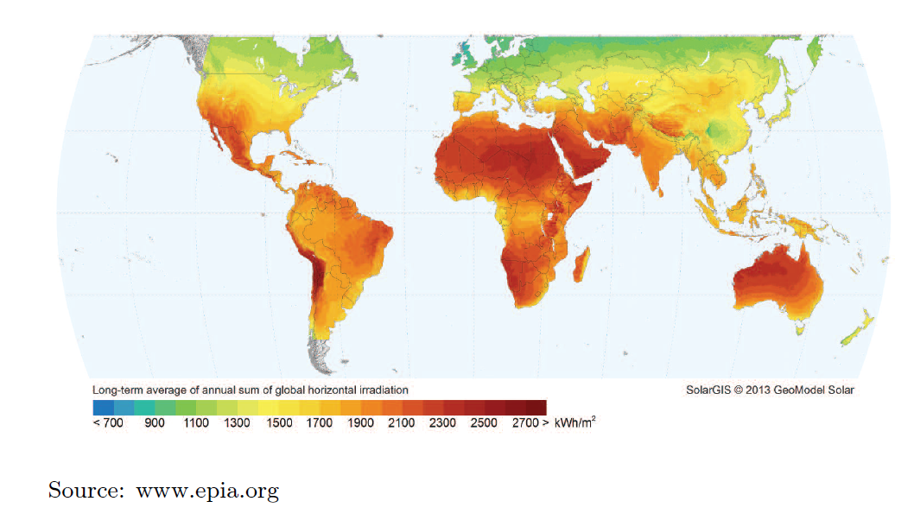
Yearly Solar Irradiation in the World
ECpE Department

Slide 6
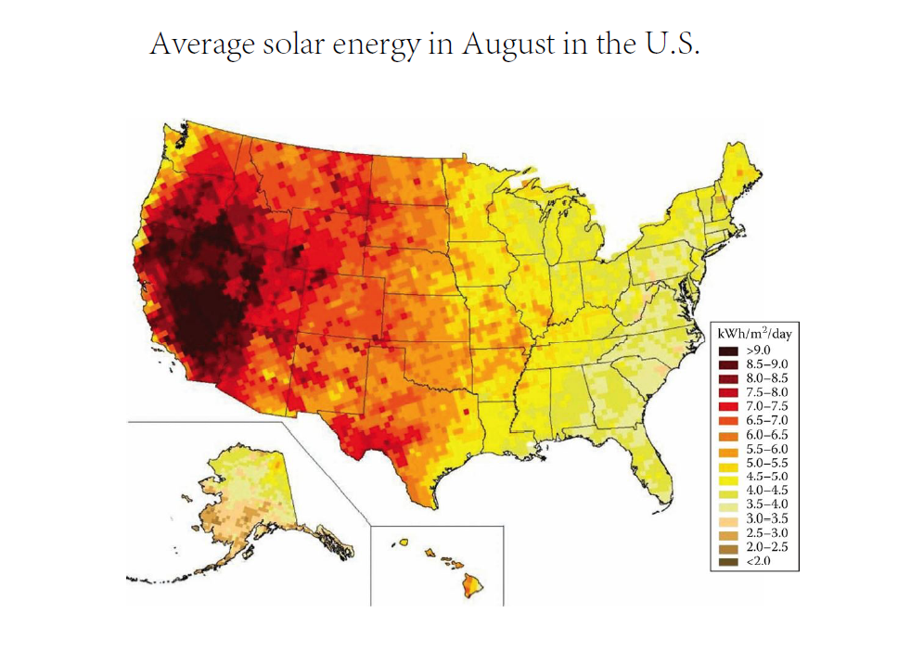
ECpE Department

Slide 7
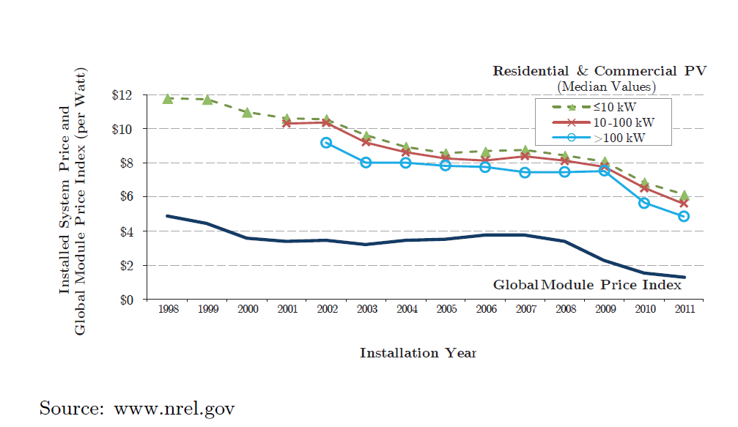
PV Price
ECpE Department

Slide 8
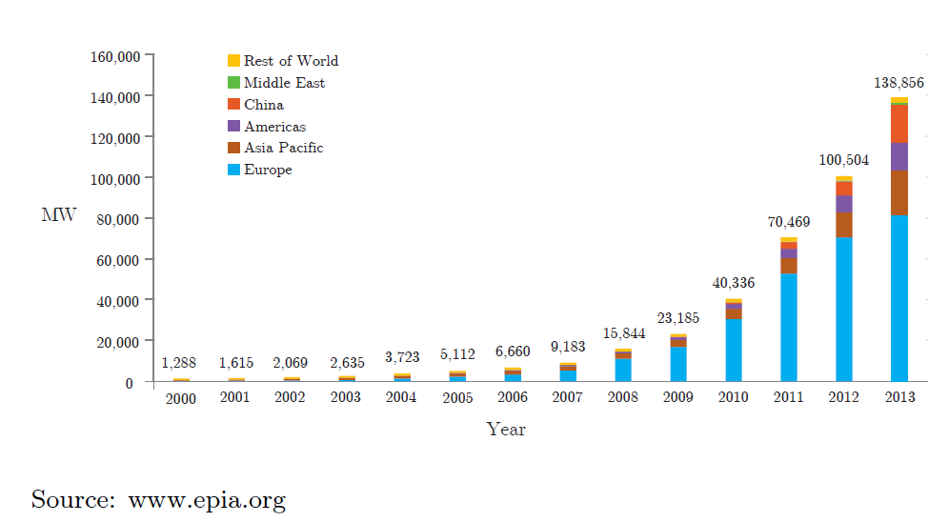
Cumulative Global PV Installation
ECpE Department

Slide 9
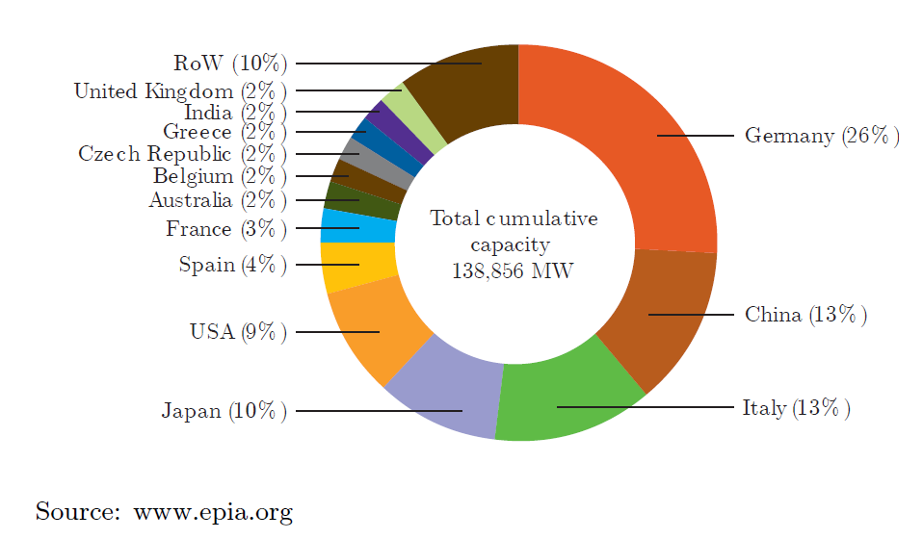
Cumulative Installed PV by Country
ECpE Department

Slide 10
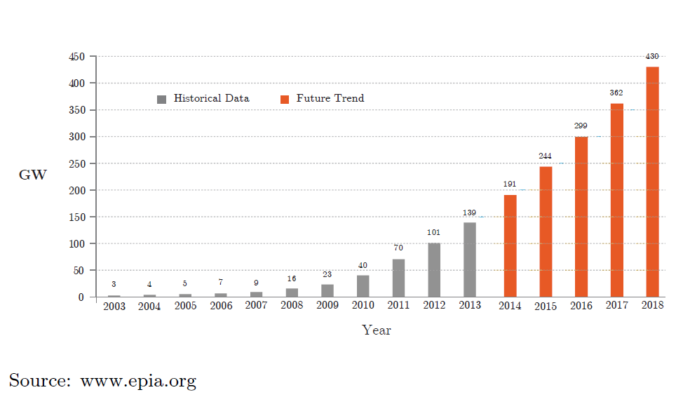
Cumulative Global PV Installation Future Trend
ECpE Department

Slide 11
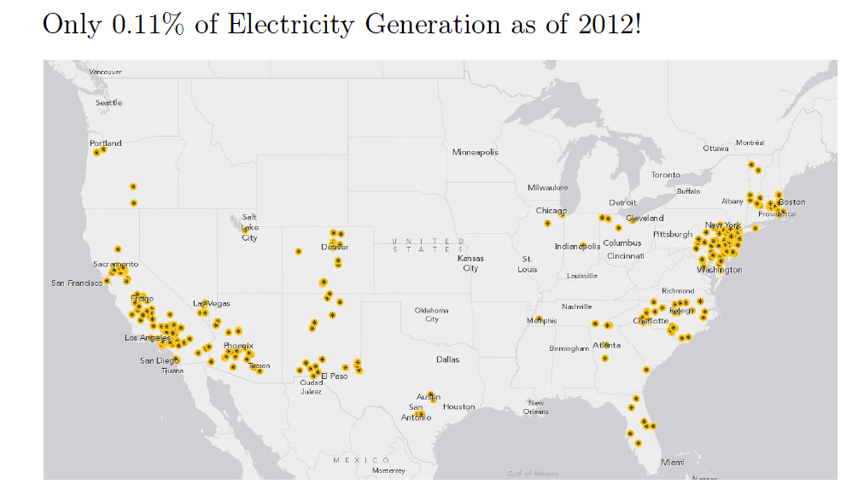
PV Installation in the USA
ECpE Department

Slide 12
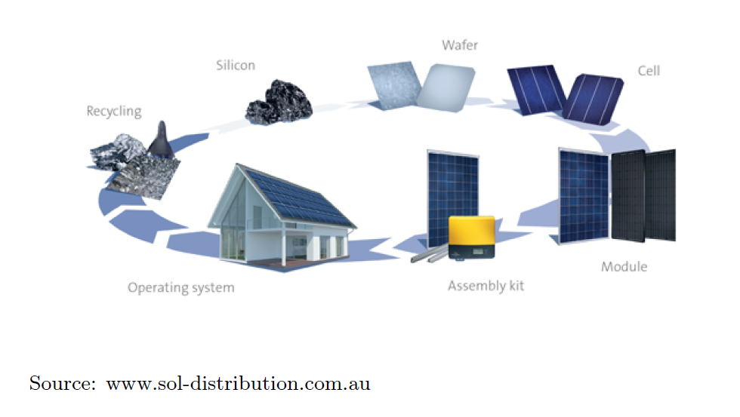
Solar Energy Chain
ECpE Department

Slide 13
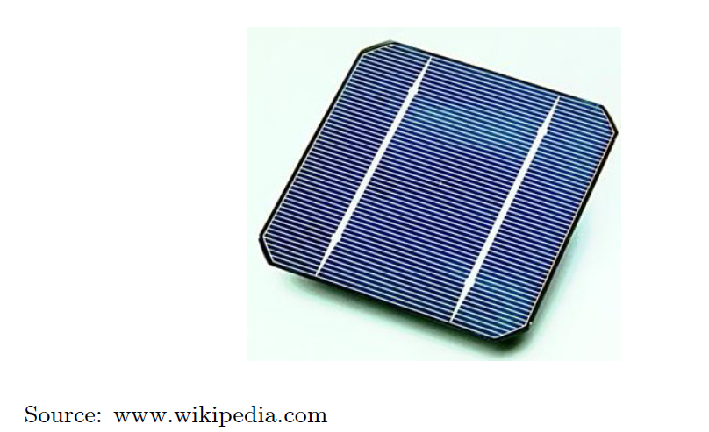
Solar Cell
A solar cell is an electrical device that converts the light energy directly into electricity by the photovoltaic effect. A solar cell is the building block of a solar panel.
ECpE Department

Slide 14
Solar Cell Equivalent Circuit
Characterizing solar cells in terms of equivalent circuits made up of discrete idealized components helps to predict their performance.
A simple equivalent circuit model for a photovoltaic cell consists of a real diode in parallel with an ideal current source as shown below. The ideal current source delivers current in proportion to the solar flux to which it is exposed.
ECpE Department

Slide 15
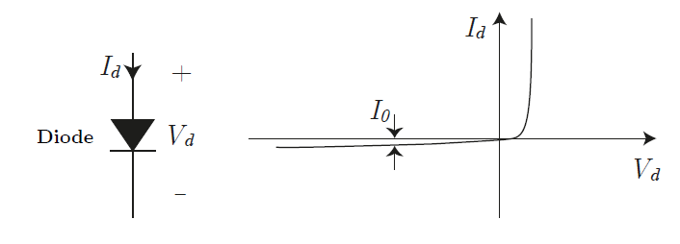
Real Diode
$V_{d}$ is the voltage across the diode, and $I_{d}$ is the diode current. The diode current is expressed by:
$$I_{d}=I_{0}\left(e^{\frac{qV_{d}}{kT}}−1\right)$$
in which $I_{0}$ is the reverse saturation current, $q$ is the electron charge $\left(1.602×{10}^{−19}\right)C, k=$ Boltzmann's constant $\left(1.381×{10}^{−23} J/K\right)$, and $T$ is the diode junction temperature (K). At $T={25}^{∘}C$ :
$$I_{d}=I_{0}\left(e^{38.9V_{d}}−1\right)$$
ECpE Department

Slide 16
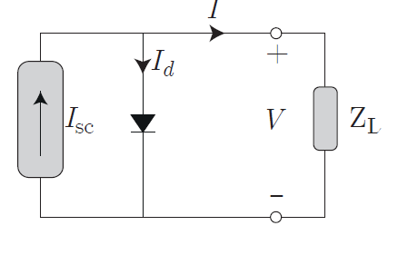
Solar Cell IV Relationship
$$I=I_{sc}−I_{d}=I_{sc}−I_{0} \left(e^{\frac{qV}{kT}}−1\right)$$
At $T={25}^{∘}C$ $$I=I_{sc}−I_{0}\left(e^{38.9V}−1\right)$$
ECpE Department

Slide 17
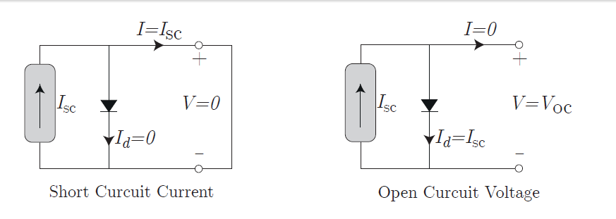
Two Particular Condition
When the PV cell is shorted, no current flows in the diode since $V_{d}=0$, so all of the current from the ideal source flows through the shorted terminals. Thus, the magnitude of the ideal current source itself must be equal to $I_{sc}$.
When the PV is open circuit, the diode current is the same as the current of the current source, and thus,
$$I_{sc}=I_{0}\left(e^{\frac{qV_{oc}}{kT}}−1\right)→V_{oc}=\frac{kT}{q}ln⁡\left(\frac{I_{sc}}{I_{0}}+1\right)\overset{At T={25}^{∘}C}{⟶}V_{oc}=0.0257ln⁡\left(\frac{I_{sc}}{I_{0}}+1\right)$$
ECpE Department

Slide 18
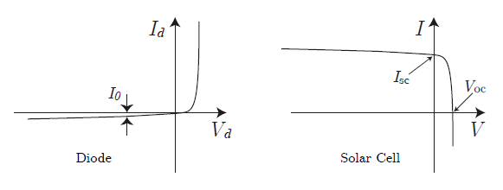
Solar Cell I-V Characteristics
$$I=I_{sc}−I_{d}=I_{sc}−I_{0}\left(e^{\frac{qV}{kT}}−1\right)$$
Note that the second term in the cell current is just the diode equation with a negative sign. That means the $I−V$ curve of a solar cell is just $I_{sc}$ added to the diode curve turned upside down as shown below.
ECpE Department

Slide 19
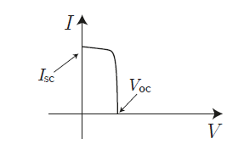
Solar Cell I-V Characteristics
$$I=I_{sc}−I_{d}=I_{sc}−I_{0}\left(e^{\frac{qV}{kT}}−1\right).$$
Note that the second term in the cell current is just the diode equation with a negative sign. That means the $I−V$ curve of a solar cell is just $I_{sc}$ added to the diode curve turned upside down as shown bellow.
For a solar cell, $V>0$ and $I>0$.
$I_{sc}$ is directly proportional to solar insolation. Thus, IV curve for varying sunlight can be achieved using the same relationship.
ECpE Department

Slide 20
Standard Testing Condition (STC)
Since PV I-V curves shift all around as the amount of insolation changes and as the temperature of the cells varies, standard test conditions (STC) have been established to enable fair comparisons of one module to another.
Those test conditions include a solar irradiance of 1 kW/m2 (1 sun). Moreover, the standard cell (not ambient) temperature for testing purposes is 25C. Manufacturers always provide performance data under these operating conditions.
The key parameter for a module is its STC rated power (maximum deliverable power), and also the current and voltage at which this maximum power is delivered.
IV characteristics that we will see in this course are usually under STC unless otherwise noted.
ECpE Department

Slide 21
IV Curves Example
Q. Consider a $150{ cm}^{2}$ photovoltaic cell with reverse saturation current $I_{0}={10}^{−12} A/{cm}^{2}$. In full sun, it produces a short-circuit current of 40 $mA/{cm}^{2}$ at ${25}^{∘}C$. What would be the short-circuit current and open-circuit voltage in full sun and again for $50\%$ sun. Plot the resulting I-V curves.
Ans: The reverse saturation current $I_{0}={10}^{−12} A/{cm}^{2}×150{ cm}^{2}=1.5×{10}^{−10}$ A. At full sun short-circuit current, $I_{sc}$, is $0.040 A/{cm}^{2}×150{ cm}^{2}=6.0 A$. Thus, the open-circuit voltage for a single cell is:
$$V_{oc,full}=0.0257ln⁡\left(\frac{I_{sc}}{I_{0}}+1\right)=0.0257ln⁡\left(\frac{6.0}{1.5×{10}^{−10}}+1\right)=0.627 V\text{.}$$
Since short-circuit current is proportional to solar intensity, at half sun $I_{sc}=3 A$ and the open-circuit voltage is
$$V_{oc, \text{half} }=0.0257ln⁡\left(\frac{I_{sc}}{I_{0}}+1\right)=0.0257ln⁡\left(\frac{3.0}{1.5×{10}^{−10}}+1\right)=0.610 V$$
ECpE Department

Slide 22
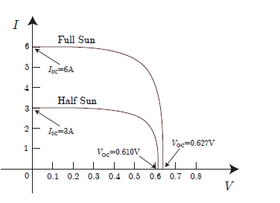
Contd…
ECpE Department

Slide 23
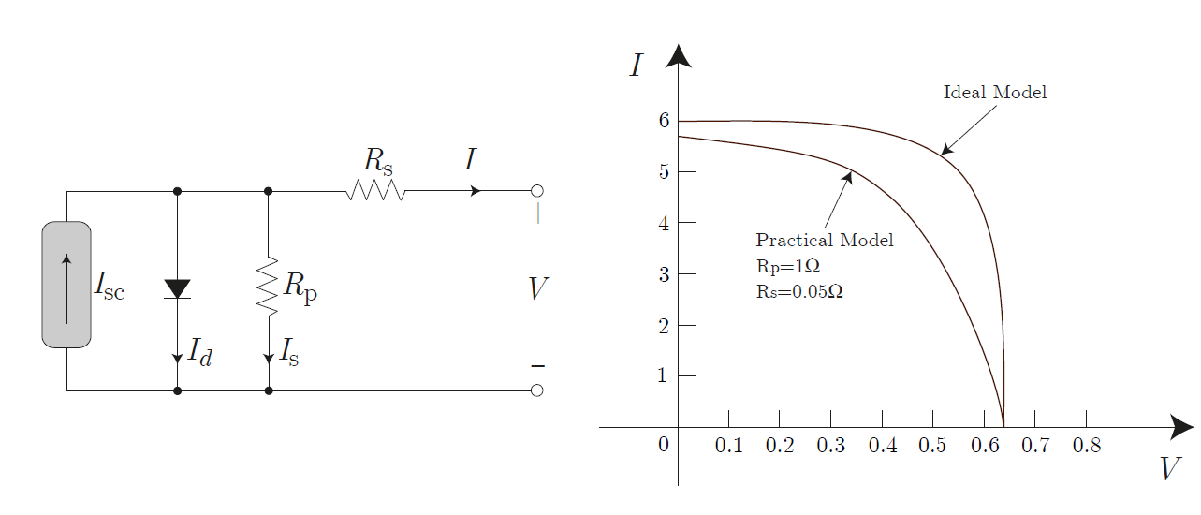
A more Accurate Model
In order to model losses of a solar cell, as well as resistive elements of the cell, we may add a series and a parallel resistor to the ideal model of the cell.
ECpE Department

Slide 24
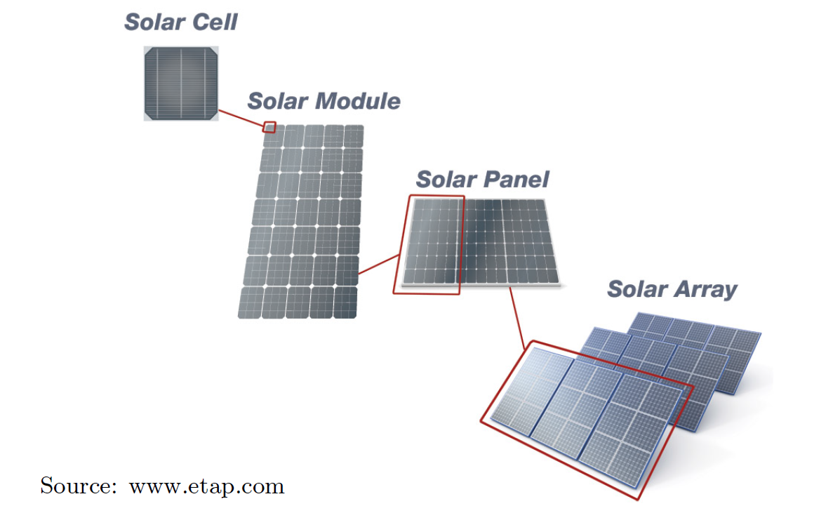
From Cell to Module to Array
A solar cell can produce voltages up to about 0.6 V. Except for very rare applications, a single solar cell is not sufficient to produce the required voltage level.
Therefore, to achieve higher voltage levels, a number of cells are wired in series and are encased in tough, weather-resistant packages. Such packages are called PV modules.
Since in a module, solar cells are wired in series, the current capability of a PV module is similar to that of a solar cell. Thus, to increase the output current of a module, we may use several modules in parallel. Note that modules may be also connected in parallel to further increase the voltage level.
ECpE Department

Slide 25
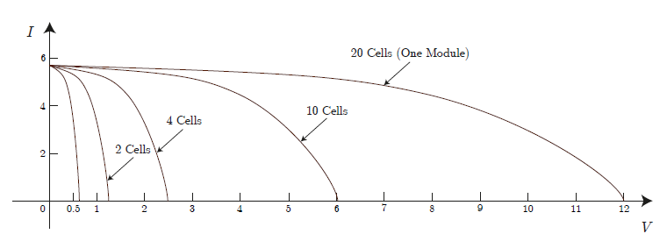
IV Characteristics of Solar Modules
Connecting several cells in series in a module results in higher voltage level at the terminals of the module, while the current capability of the module will be the same as a single cell.
ECpE Department

Slide 26
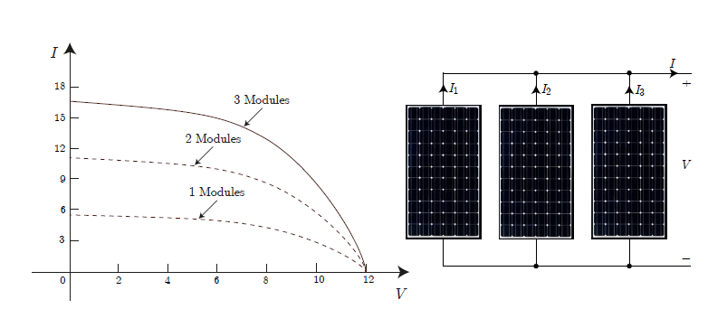
Contd…
Connecting several modules in parallel creates a panel (array) and results in higher current levels, while the voltage capability of the panel will be the same as a single module.
ECpE Department

Slide 27
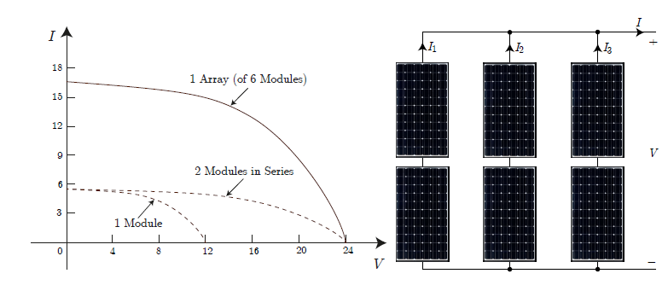
Contd…
To further increase the voltage and current levels, we may connect more modules in series and in parallel and form solar arrays.
ECpE Department

Slide 28
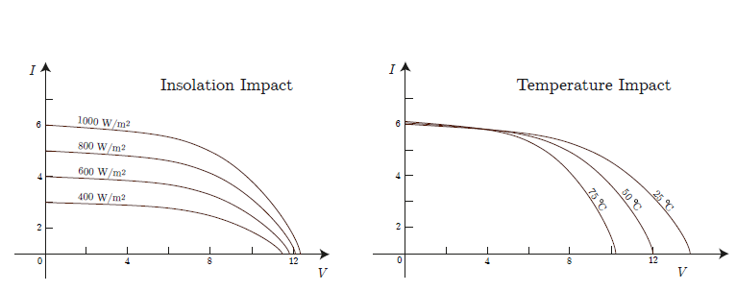
Impact of Temperature and Insolation on IV Curve
Below is the impact of insolation and temperature on the IV curve of a module consisting of 20 cells.
ECpE Department

Slide 29
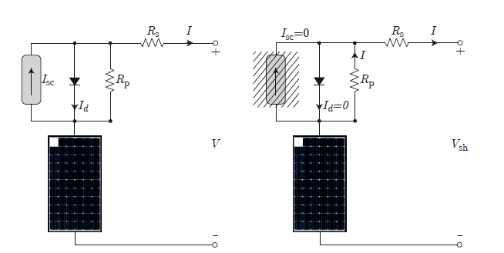
Impact of Shading
If one cell in a module is shaded, its current source $I_{sc}$ is reduced to zero. The voltage drop across $R_{p}$ as current flows through it causes the diode to be reverse biased, so the diode current is also (essentially) zero. That means the entire current flowing through the module must travel through both $R_{p}$ and $R_{S}$ in the shaded cell on its way to the load. This causes a significant voltage drop.
ECpE Department

Slide 30
Impact of Shading
$$V_{sh}=V_{n−1}−I\left(R_{p}+R_{s}\right)=V\left(\frac{n−1}{n}\right)−I\left(R_{p}+R_{s}\right)$$
The drop in the module output voltage due to shading is then
$$ΔV=V−V_{sh}⊨V\left(1−\frac{n−1}{n }\right)+I\left(R_{p}+R_{s}\right)=\frac{V}{n}+I\left(R_{p}+R_{s}\right)$$
ECpE Department

Slide 31
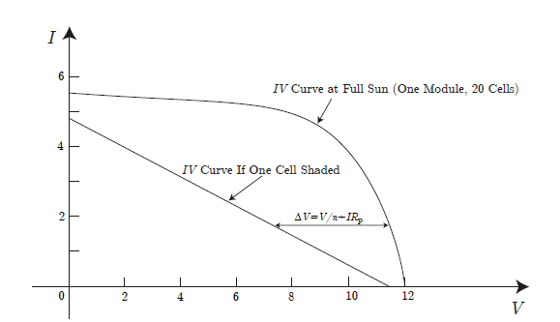
Impact of Shading on IV Curve
Since $R_{s}$ is negligible compared to $R_{p}$, the voltage drop may be approximated by
$ΔV=\frac{V}{n}+I\left(R_{p}\right)$
Then, the IV curve of a module with one shaded cell is as below.
ECpE Department

Slide 32
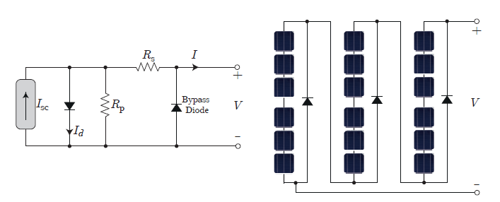
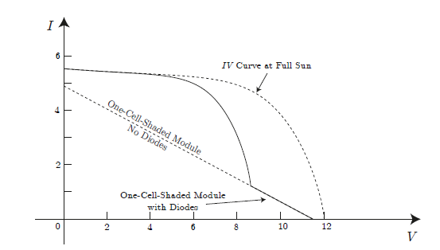
Shade Mitigation
In order to mitigate the effect of shading, bypass diodes are normally utilized in parallel with each cell. Therefore, in case one cell is shaded, it will be bypassed.
However, in practice, just one bypass diode is used for a number of cells. For example, one bypass diode is put in parallel with one third of the cells, and thus, only three bypass diodes are used per module.
ECpE Department

Slide 33
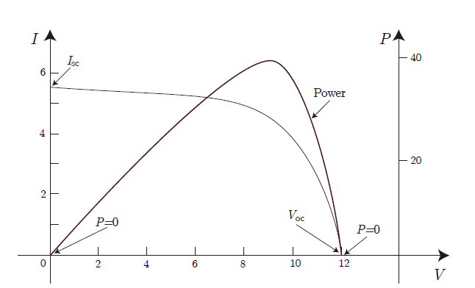
Shade Module Power
In a solar module (or array), power is the product of I and V.
ECpE Department

Slide 34
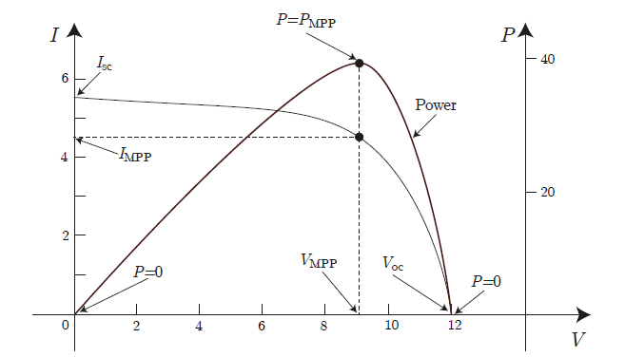
Shade Module Power
At one single point, the power delivered by the module is maximum.
ECpE Department

Slide 35
Maximum Power Point Tracker (MPPT)
We learned that due to the complex relationship between solar irradiation, temperature, and other conditions, solar cells have a non-linear output I-V curve, and for each curve there is an MPP.
Maximum Power Point Trackers (MPPTs) are control strategies along with required power electronics systems responsible for extracting the maximum power from the cell at any given environmental conditions. The MPPT system samples the output of the cells and apply the proper voltage to the cells to obtain maximum power for any given environmental conditions.
PV systems are either connected to the grid or are standalone. Standalone PV systems are particularly interesting in remote areas where no electricity network exists. In a grid-connected PV system, the MPPT extracts the maximum power and feeds it to the grid. In a standalone system, the MPPT extracts the maximum power and feeds loads connected to the standalone system, and with the surplus energy, charges a pack of batteries.
ECpE Department

Slide 36
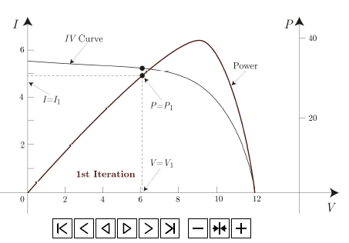
Perturb and Observe MPPT
The most common MPPT is a "Perturb and Observe" method. In this method, the MPPT changes the module voltage by a small amount and measures the output power; if the power increases, further change in that direction is imposed until the output power no longer increases. Although this method is simple and common, the drawback is that it can result in oscillations of the output power.
ECpE Department

Slide 37
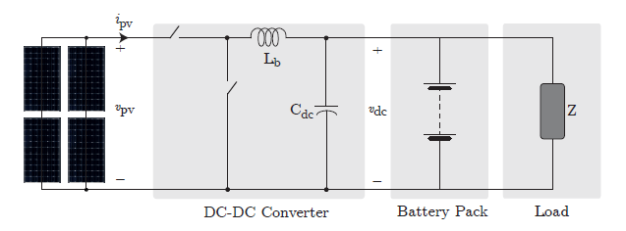
Standalone PV MPPT
In a standalone PV system, usually a battery pack is connected to the system, which stores the generated energy of the PV system. Moreover, a combination of several loads is fed by the PV system. When the required energy of the loads is less than the generation, the battery pack is charged. Otherwise, the stored energy in the battery pack is used to feed the loads along with the generated energy. In either case, the load (battery) voltage is dictated by the battery pack. The MPPT then dictates the voltage of the solar array assuming the battery voltage is fixed (in a Buck converter: $v_{pv}=\frac{v_{dc}}{D}$ ).
ECpE Department

Slide 38
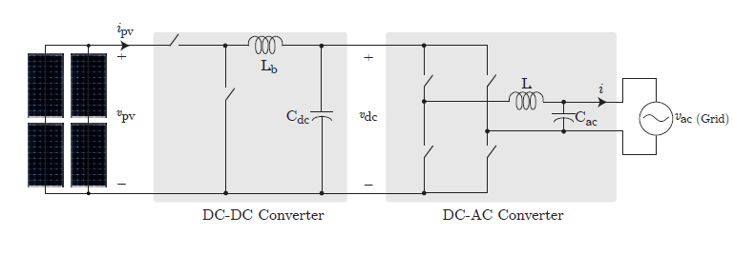
Grid – Tied PV MPPT
In a grid-connected PV system, no battery pack is essential (although it could be used). Usually, a DC-AC converter is connected to the grid and regulates the intermediate DC voltage $\left(v_{dc}\right)$ between two stages of the system. Therefore, the DC-DC stage regulates the voltage of the PV array, $v_{pv}$ similar to the standalone system.
(in a Buck converter: $v_{pv}=\frac{v_{dc}}{D}$ ).
ECpE Department

Slide 39
Drawbacks of PV
Although solar energy is very promising, PV technology is not free from drawbacks. The following list identifies the main issues associated with PV systems:
Although the power generated by the PV system is pollution free, toxic chemicals are used to manufacture solar cells including arsenic and silicon compounds. Arsenic is generally an odorless and flavorless semi metallic chemical that is highly toxic and can kill humans quickly if inhaled in large amounts. Long-term exposure to small amounts of arsenic through the skin or by inhalation can lead to slow death and a variety of illnesses. Silicon, by itself, is not toxic. However, when additives are added to make the $p−n$ junction, the compound can be extremely toxic. Since water is used in the manufacturing process, the runoff could cause the arsenic and silicon compounds to reach local streams. Furthermore, should a PV array catch fire, these chemicals can be released into the environment.
Solar power density can be intermittent due to weather conditions (e.g., cloud cover). It is also limited exclusively to use in daytime.
For high-power PV systems, the arrays spread over a large area. This makes the system difficult to accommodate in or near cities.
PV systems are considered by some to be visually intrusive (e.g., rooftop arrays are clearly visible to neighbors).
ECpE Department

Slide 40
Contd…
The reflections from large PV fields can alter the local weather.
The efficiency of the solar panel is still low, making the system more expensive and large in size.
Solar systems require continuous cleaning of their surfaces. Dust, shadows from falling leaves, and bird droppings can substantially reduce the efficiency of the system.
ECpE Department

Slide 41
Key Messages
PV systems are getting more and more attractive as their price and energy payback time is decreasing.
A solar cell is the building block of PV systems.
To better study solar cells, an equivalent circuit is essential, which is consisted of a current source (whose magnitude depends on insolation, temperature, etc.), a diode, and two resistors.
Since a single solar cell may not provide sufficient voltage/power levels, a combination of solar cells are wired in series and form a PV module. Several modules may also form a solar array.
Shading can significantly reduce the output power of a solar module. To mitigate the effect of shading, bypass diodes are utilized.
To extract maximum power of a solar module, maximum power point trackers are used by using power electronics converters.
PV systems may be used as standalone or grid-connected systems.
ECpE Department

Slide 42
Thank You!
ECpE Department

