Slide 1
OpenDSS - Introduction
ECpE Department
Dr. Zhaoyu Wang 1113 Coover Hall, Ames, IA wzy@iastate.edu

Slide 2
Contents
General introduction of OpenDSS
Installation & User interface
Workflow
Overall concept
Overall structure of solving power flow
ECpE Department

Slide 3
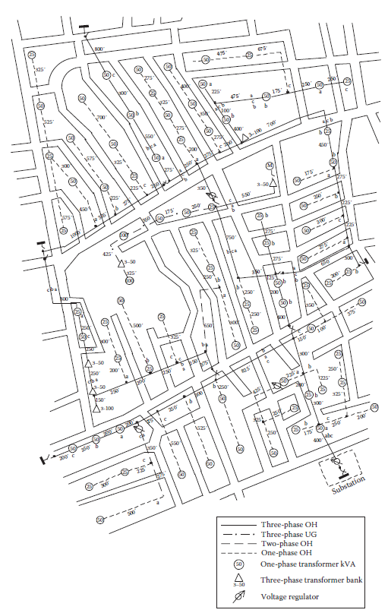
Introduction
What is OpenDSS?
The Open Distribution System Simulator (OpenDSS, or simply, DSS) is a comprehensive electrical system simulation tool for electric utility distribution systems.
Open → Open Source
DSS → Distribution System Simulator
The Development of OpenDSS began in April 1997. Roger Dugan is the principal author of the software.
In 2004, the DSS had been acquired by EPRI Solutions.
In 2008, EPRI released the software under an open-source license to cooperate with other grid modernization efforts.
ECpE Department

Slide 4


Objectives
Develop an object‐oriented circuit description language that minimize the conversion effort (files in different format).
Build a user-friendly simulation software.
Build a tool that can model several substations and the distribution circuits between them simultaneously.
Capture both the time‐ and location-dependent value of DG.
Simulate some untypical situations.
Build a tool that could seamlessly incorporate harmonics analysis into the powerflow analysis without requiring the user to laboriously enter nonlinear device models.
…
ECpE Department

Slide 5
Features
The OpenDSS supports nearly all rms steady‐state (i.e., frequency domain) analyses commonly performed for utility distribution systems planning and analysis.
In addition, it supports many new types of analyses that are designed to meet future needs (e.g. DGs), many of which are being dictated by the deregulation of utilities worldwide and the advent of the “smart grid”.
Other features: support energy efficiency analysis of power delivery, smart grid applications, and harmonics analysis.
The DSS is designed to be indefinitely expandable so that it can be easily modified to meet future needs.
ECpE Department

Slide 6
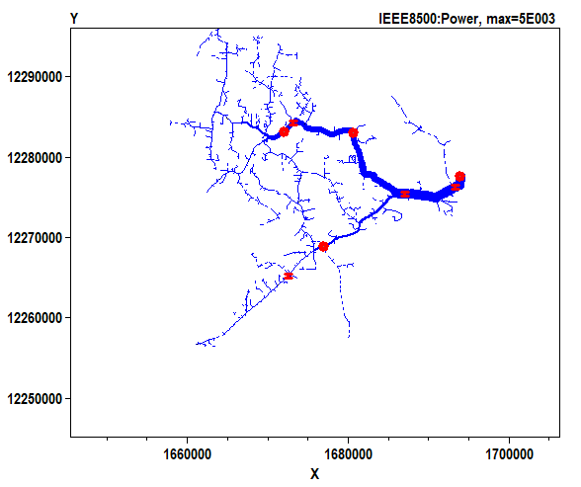
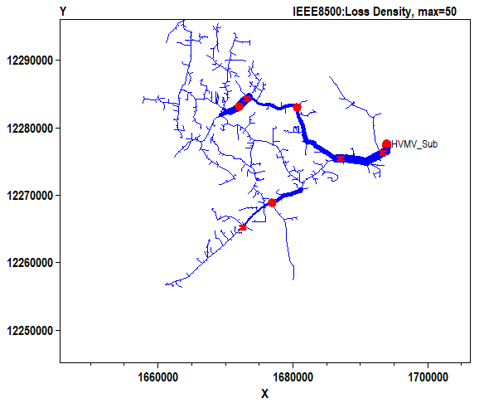
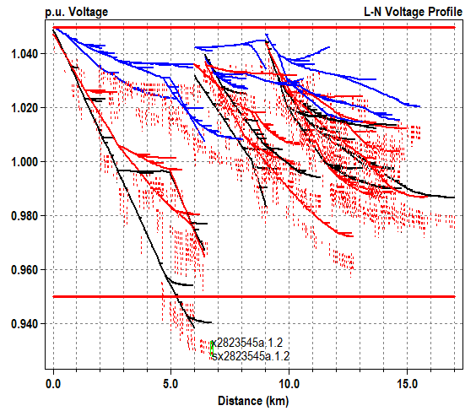
Introduction
What can OpenDSS do?
Power flow analysis
When a power flow is completed, the losses, nodal voltages, currents and power flows are available for the total system, each component, and certain defined areas.
OpenDSS can handle both radial distribution (MV) circuits and network (meshed) systems.
It can also be used to solve small‐ to medium‐sized networks with a transmission‐style power flow.
The power flow executes in numerous solution modes including the standard single Snapshot mode, and Daily mode, etc.
Black -- phase 1
Blue -- phase 3
Red -- phase 2
Solid – Primary
Dotted – Secondary
ECpE Department

Slide 7
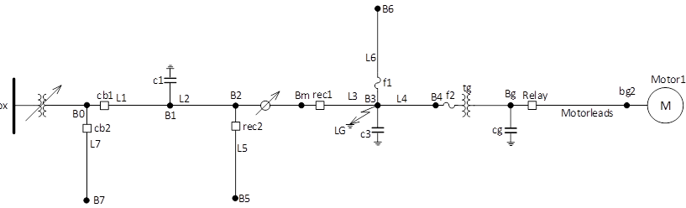
Introduction
What can OpenDSS do?
Fault study
Fault study can give us the short-circuit currents and voltages, which can further be used for selecting circuit breakers, setting relays or reclosers, and analyzing the stability of system operation.
OpenDSS can perform fault study for all buses, reporting currents and voltages on all phases for all types of faults, including 3‐phase faults, SLG faults on each phase, LL and L‐L‐G faults.
A line-to-ground short-circuit fault
ECpE Department

Slide 8
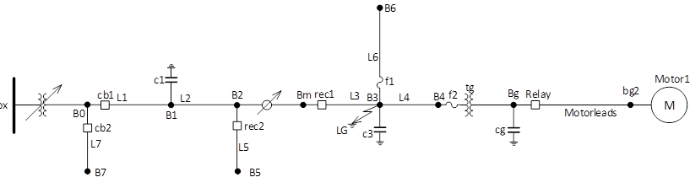
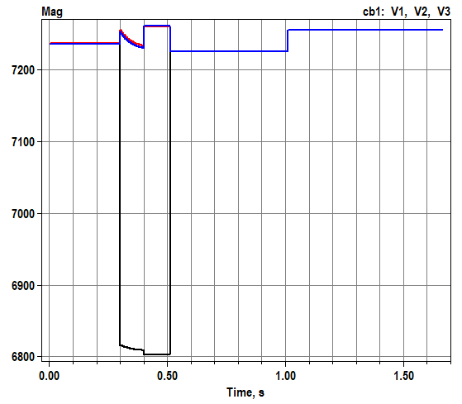
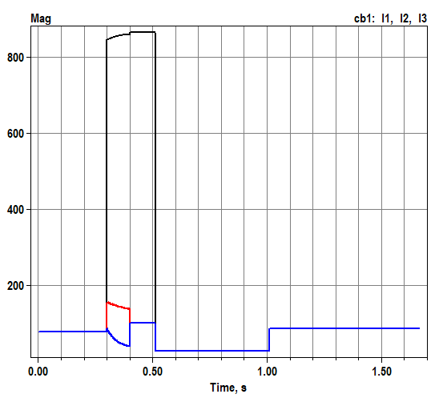
Introduction
What can OpenDSS do?
Fault study
A line-to-ground short-circuit fault
Black -- phase 1
Red -- phase 2
Blue -- phase 3
ECpE Department

Slide 9
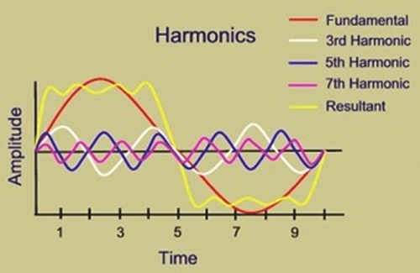
Introduction
What can OpenDSS do?
Harmonic flow analysis
It can give us power flow results corresponding to each frequency. The user defines various harmonic spectra to represent harmonic sources of interest. The spectra are connected to Load, Generator, voltage source, current source objects and a few other power conversion elements as desired.
https://www.electricalindia.in/harmonics-in-power-system/
https://electronics.stackexchange.com/questions/264234/why-are-there-no-even-harmonics-in-ac-machines
ECpE Department

Slide 10
Introduction
What can OpenDSS do?
Dynamics
The OpenDSS can perform basic electromechanical transients, or dynamics, simulations. The capability of OpenDSS has been expanding steadily due to needs in inverter modeling and other applications where machine dynamics are important.
The built‐in Generator model has a simple single‐mass model that is adequate for many DG studies for common distribution system fault conditions. In addition, users may implement more sophisticated models by writing a DLL for the Generator model or by controlling the Generator model from an external program containing a more detailed governor and/or exciter model.
ECpE Department

Slide 11
Introduction
What can OpenDSS do?
Dynamics
The OpenDSS can perform basic electromechanical transient, or dynamic simulations.
Black -- phase 1
Red -- phase 2
Blue -- phase 3
ECpE Department

Slide 12
Introduction
What can OpenDSS do?
Load parametric variation
The capabilities for doing parametric evaluation are provided for a variety of variables. Certain variables will be allowed to vary according to a function (e.g., load growth) or vary randomly for Monte Carlo and statistical studies.
ECpE Department

Slide 13
Introduction
What can OpenDSS do?
Geomagnetically induced current (GIC) analysis
OpenDSS is capable of performing geomagnetically induced current (GIC) analysis of power systems. Currently, the analysis capability is limited to three‐phase systems, and cannot be integrated into other types of simulations, e.g. load flow. The GIC analysis takes advantage of the N‐phase modeling capability of OpenDSS to perform the analysis on a three‐phase basis as opposed to a single‐phase basis.
ECpE Department
Notes:
GIC are quasi‐dc; thus, GIC simulations involve performing a low frequency (typically 0.1 Hz) analysis of the resulting dc network. The driving force behind the flow of GIC in the network is the induced voltage in the transmission lines. The induced voltage is generated by the coupling of the transmission lines with the induced geoelectric field at the surface of the earth.

Slide 14
Specific Applications
Distribution Planning and Analysis
General Multi‐phase AC Circuit Analysis
Analysis of Distributed Generation Interconnections
Annual Load and Generation Simulations
Risk‐based Distribution Planning Studies
Probabilistic Planning Studies
Solar PV System Simulation
Wind Plant Simulations
Nuclear Plant Station Auxiliary Transformer Modeling
Distribution Automation Control Assessment
Protection System Simulation
Storage Modeling
Distribution Feeder Simulation with AMI Data
Distribution State Estimation
Ground Voltage Rise on Transmission Systems
Geomagnetically‐Induced Currents (GIC)
EV Impacts Simulations
Co‐simulation of Power and Communications Networks
Analysis of Unusual Transformer Configurations
Harmonic and Interharmonic Distortion Analysis
Neutral‐to‐earth Voltage Simulations
Development of IEEE Test feeder cases
Phase Shifter Simulation
Arc Furnace Simulation
Impulse Loads (car crushers, etc.)
And more ….
ECpE Department

Slide 15
Resources
OpenDSS Download: https://sourceforge.net/projects/electricdss/
Forum/Discussion: https://sourceforge.net/p/electricdss/discussion/
Documents/Files:
https://sourceforge.net/projects/electricdss/files/
ECpE Department

Slide 16
Contents
General introduction of OpenDSS
Installation & User interface
Workflow
Overall concept
Overall structure of solving power flow
ECpE Department

Slide 17

Download
Click https://sourceforge.net/projects/electricdss/
Click “Download” button, the software will be downloaded automatically.
ECpE Department

Slide 18
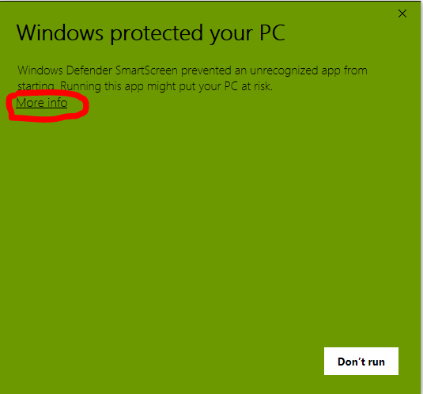
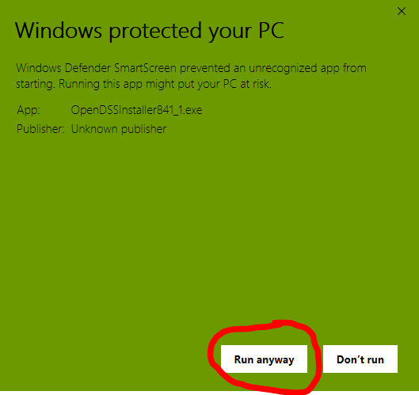
Installation
Open the downloaded OpenDSSInstaller.
(If your PC displays the reminder as below, click “more info”, then click “Run anyway”.)
ECpE Department

Slide 19
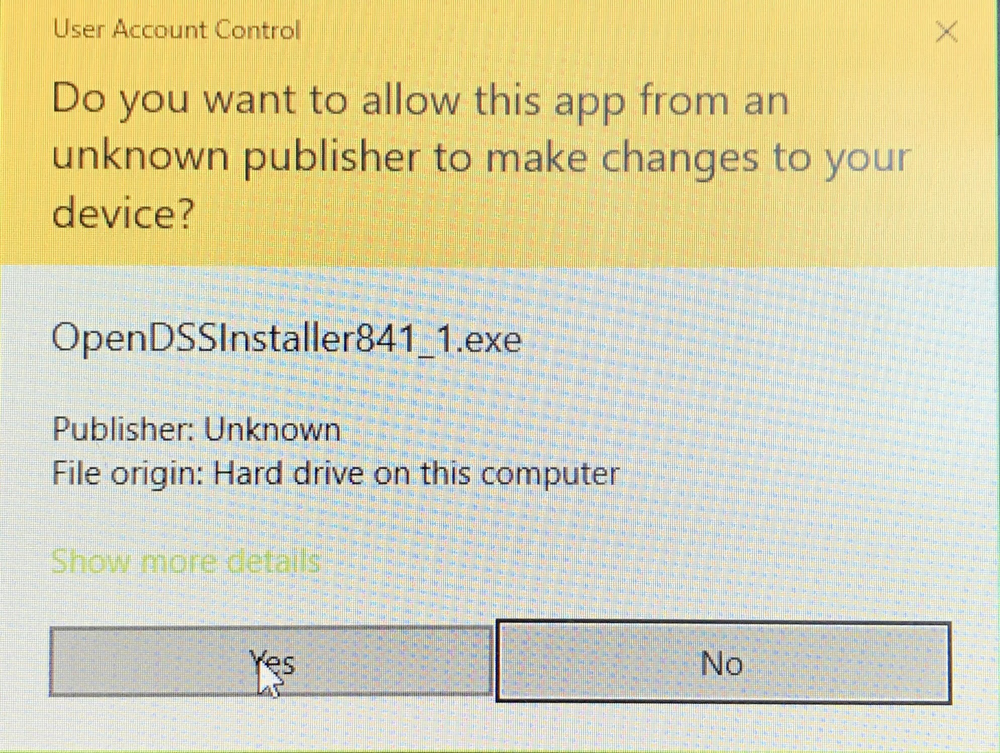
Installation
Click “Yes” in the popup dialog box.
ECpE Department

Slide 20
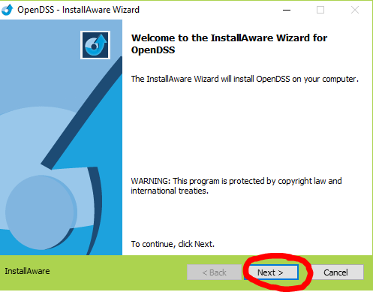
Installation
Click “Next” button.
ECpE Department

Slide 21
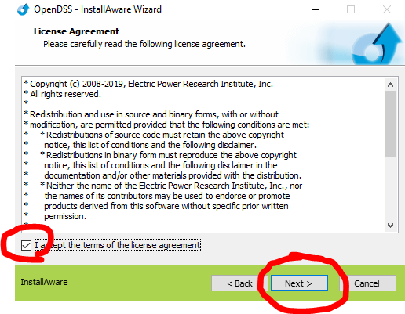
Installation
Select “I accept the terms of the license agreement” and click “Next”.
ECpE Department

Slide 22
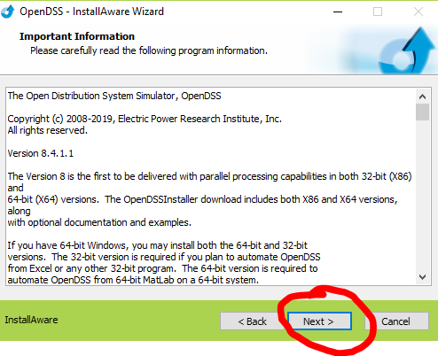
Installation
Click “Next”.
ECpE Department

Slide 23
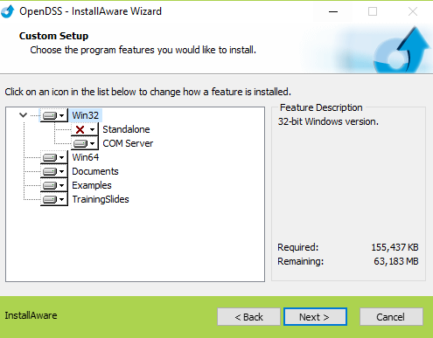
Installation
Then, a dialog box like the picture on the left will appear. Click the red cross and select “Will be installed on local hard drive”.
ECpE Department

Slide 24
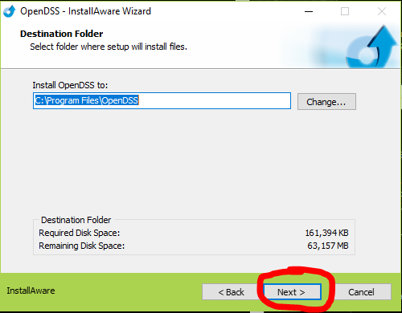
Installation
Choose the directory where you want to install and click “Next”.
ECpE Department

Slide 25
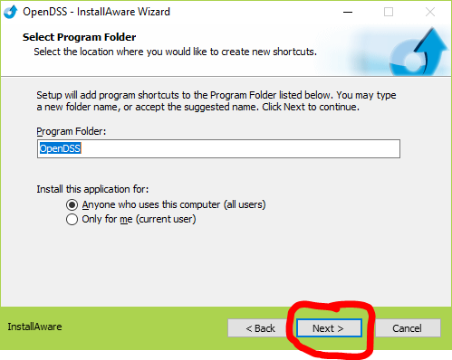
Installation
Click “Next”.
ECpE Department

Slide 26
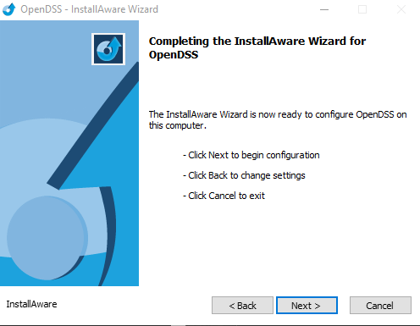
Installation
Click “Next”.
ECpE Department

Slide 27
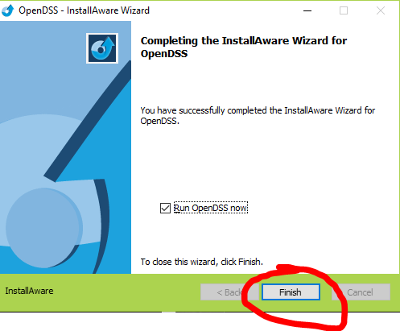
Installation
Click “Finish” and check if the software has been successfully installed.
ECpE Department

Slide 28
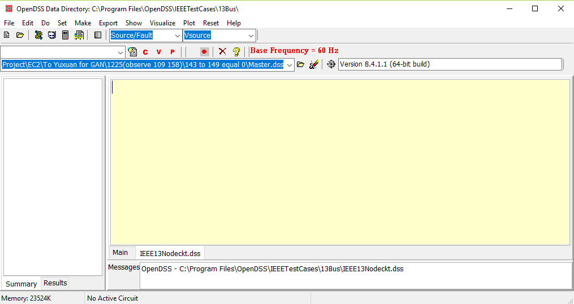
Installation
If successful, an interface like below will appear.
ECpE Department

Slide 29
User Interface
When opening OpenDSS, the user is greeted with the following window:
ECpE Department

Slide 30
User Interface
[1] Menu Structure: which drives most of the workflow in OpenDSS.
ECpE Department

Slide 31
User Interface
[1] Menu Structure:
-- Do: the “Selected Line(s)” is commonly used, it is like “Run” .
ECpE Department

Slide 32
User Interface
[1] Menu Structure:
-- “Set”: It allows us to set any solution parameter that can be set via the options scripting command.
ECpE Department

Slide 33
User Interface
[1] Menu Structure:
-- “Export”: It allows us to save various reports to csv files
ECpE Department

Slide 34
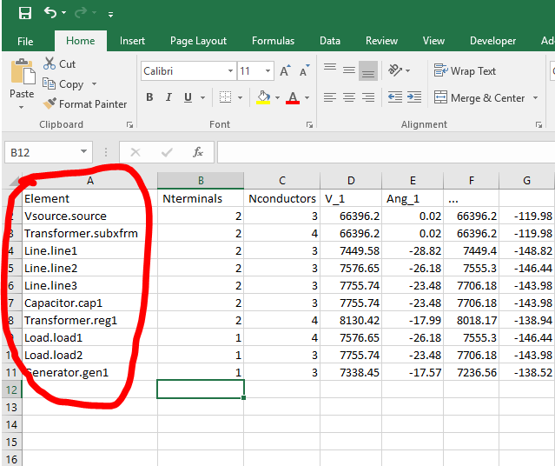
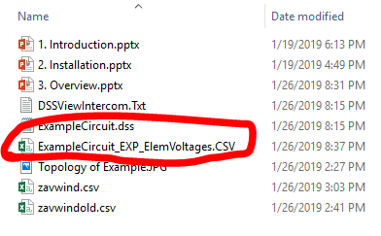
User Interface
[1] Menu Structure:
-- “Export”: e.g., Export → Voltage → Element
ECpE Department

Slide 35
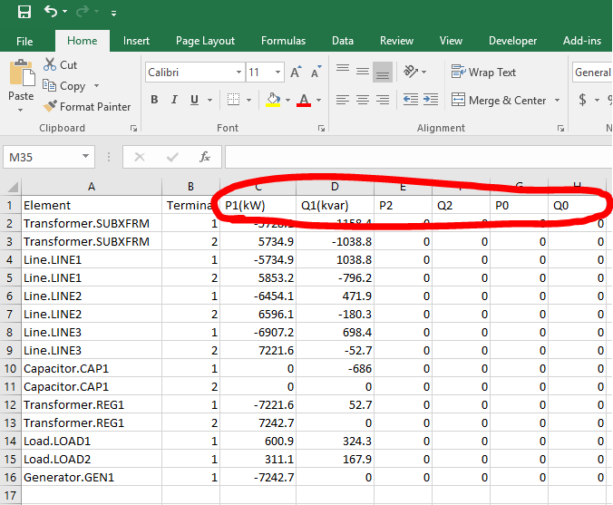
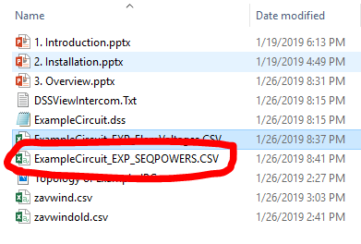
User Interface
[1] Menu Structure:
-- “Export”: e.g., Export → Powers → Sequence
ECpE Department

Slide 36
User Interface
[1] Menu Structure:
-- “Show”: It contains much of the same information as the reports as the Export menu, but displays them directly in the GUI.
ECpE Department

Slide 37
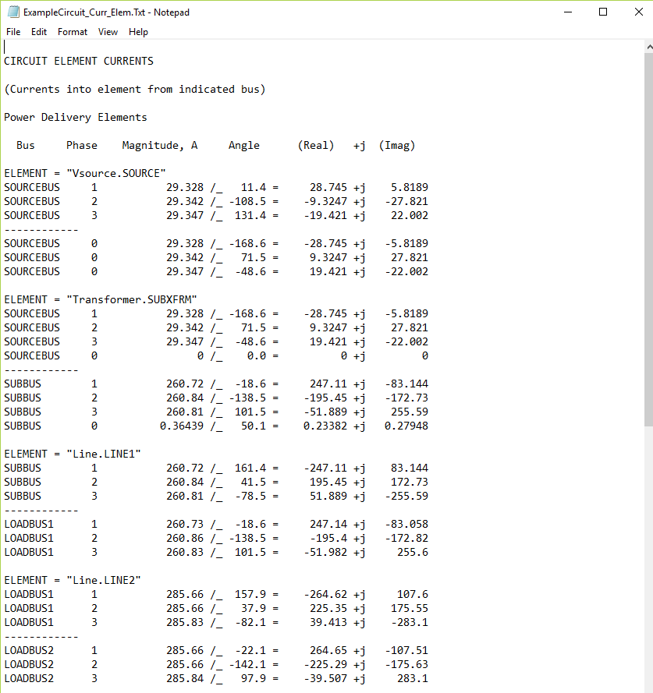
User Interface
[1] Menu Structure:
-- “Show”: e.g., Currents → Currents Elm
ECpE Department

Slide 38
User Interface
[1] Menu Structure:
-- “Visualize”: It provides a graphical output of the device
selected via the element selector.
ECpE Department

Slide 39
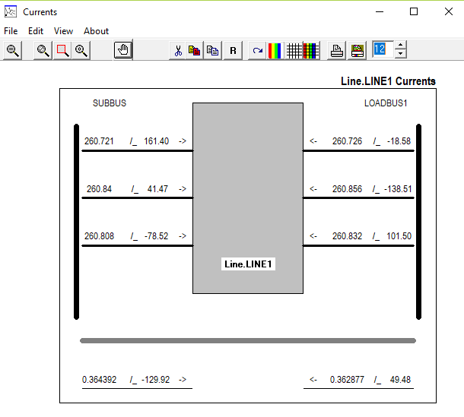

User Interface
[1] Menu Structure:
-- “Visualize”: e.g., Visualize → Currents[Element].
Note: Specific element should be firstly selected, as follows:
ECpE Department

Slide 40
User Interface
[1] Menu Structure:
-- “Plot”: It provides graphical output relevant to the whole system.
ECpE Department

Slide 41
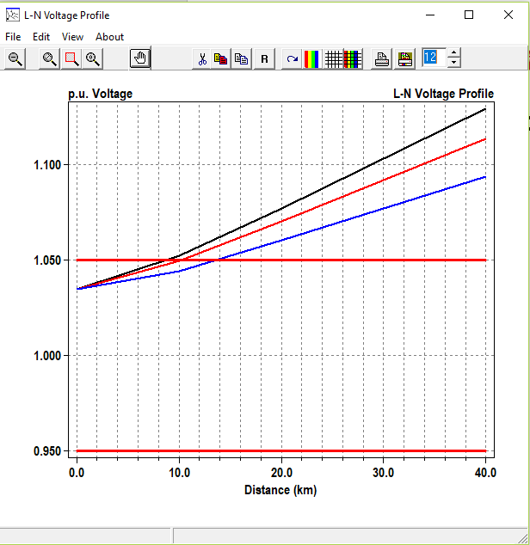
User Interface
[1] Menu Structure:
-- “Plot”: e.g., Plot → Profile.
Note, Energymeter need to be defined in the script:
e.g., New Energymeter.em1 line.line1
ECpE Department

Slide 42
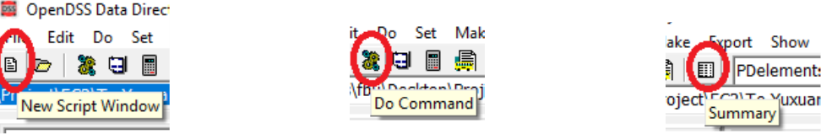
User Interface
[2] Toolbar: provides direct access to many commonly used OpenDSS commands such as “Solve,” “Summary,” and “Do Command.”
ECpE Department

Slide 43
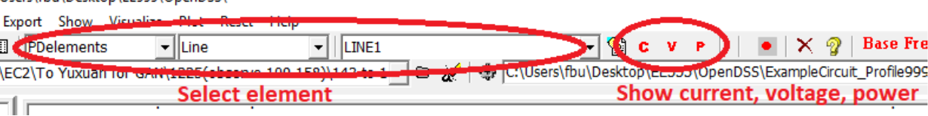
User Interface
[3] Element tools: allows the user to select what circuit element (by type) to edit or display visualizations for.
ECpE Department

Slide 44
User Interface
[4] Script tools: which allows one to select which of the current opened scripts to run.
ECpE Department

Slide 45
User Interface
[5] Results bar: which provides a condensed version of the Results window which can be accessed through Show → Result Form.
ECpE Department

Slide 46
User Interface
[6] Script Windows: to directly edit various *.dss files.
ECpE Department

Slide 47
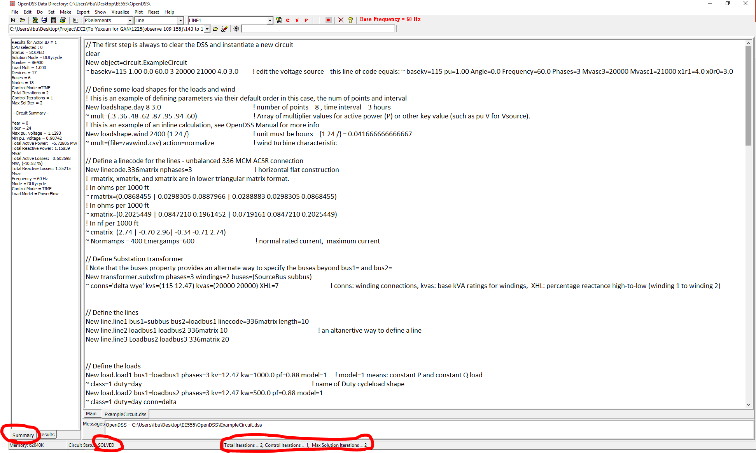
User Interface
[6] Script Windows: to directly edit various *.dss files.
ECpE Department

Slide 48
User Interface
[7] Main Script Window: Main Script Window is a sort of “notepad” or “interactive window” for OpenDSS. The user can type small commands and run them via the “Do Command” feature (Ctrl‐D).
ECpE Department

Slide 49
User Interface
[8] Help button: brings up the OpenDSS Command and Element Properties Reference which gives a tree‐view guide to the various script commands in OpenDSS.
ECpE Department

Slide 50
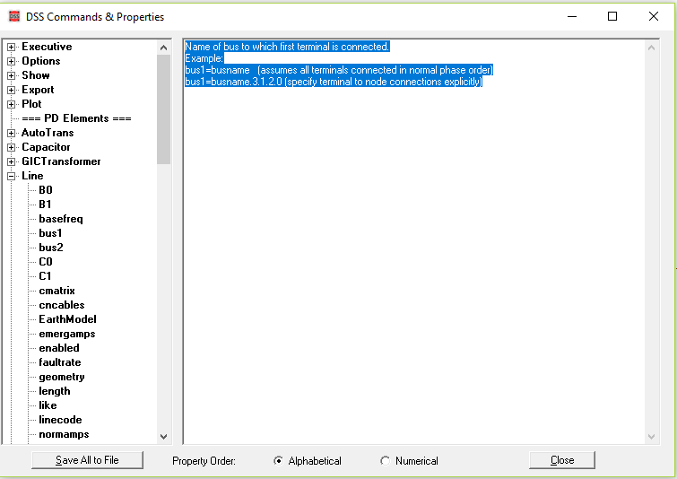
User Interface
[8] Help button: Very useful.
ECpE Department

Slide 51
Contents
General introduction of OpenDSS
Installation & User interface
Workflow
Overall concept
Overall structure of solving power flow
ECpE Department

Slide 52
Workflow
In general, the user has 4 steps to develop a project:
Define the circuit;
Set up the circuit options;
Solve;
Perform analysis.
ECpE Department

Slide 53
1. Define circuit
Create new lines, transformers, loads, generators, etc…
the best way to do this is by creating a dss script;
Once a script has been written, use “Compile file listed” button to run the selected script.
ECpE Department

Slide 54
2. Set up circuit options
Such as the solution mode (snapshot, daily, harmonic, etc…)
This is accomplished through the commands in the Set menu. The most basic form of analysis is the “snapshot” which is analogous to a traditional power flow.
ECpE Department

Slide 55
3. Solve
Solve the power flow problem.
Ensure that the bus list is created and the base voltages found by running Do → Calc Voltage Bases;
Then use the “Solve” button in the toolbar to solve the circuit.
ECpE Department

Slide 56
4. Perform analysis
The specifics of how to accomplish this vary from analysis to analysis, but some general tasks include:
Looking at a branch, transformer, load, or other element in the system – To do this, first select the element type and then the element from the element toolbar. Then select the C, V, or P buttons to see a current, voltage, or power visualization. Select the “Form edit on active element” button to edit the element.
…
ECpE Department

Slide 57
4. Perform analysis
The specifics of how to accomplish this vary from analysis to analysis, but some general tasks include:
…
Visualize the voltage profile of the system – Type “plot profile” into the main script window, and press Ctrl‐D to Do that command. A voltage profile will come up showing how the voltage progresses as one progresses down the feeder.
…
ECpE Department

Slide 58
4. Perform analysis
The specifics of how to accomplish this vary from analysis to analysis, but some general tasks include:
…
Visualize data onto a one‐line of the feeder – If you provide bus location data via the “buscoords” command, you can superimpose power flow data onto a map/one‐line of the system. To do this, go Plot > Circuit Plots > Circuit Plot.
…
ECpE Department

Slide 59
4. Perform analysis
The specifics of how to accomplish this vary from analysis to analysis, but some general tasks include:
…
Export data for analysis in 3rd party program – All results obtained through OpenDSS can be exported through the various commands in the “Export” menu. Results are .csv files.
ECpE Department

Slide 60
Contents
General introduction of OpenDSS
Installation & User interface
Workflow
Overall concept
Overall structure of solving power flow
ECpE Department

Slide 61
Overall concept
Overall circuit model;
Bus and terminal models;
Power delivery elements;
Power conversion elements;
Putting it all together.
ECpE Department

Slide 62
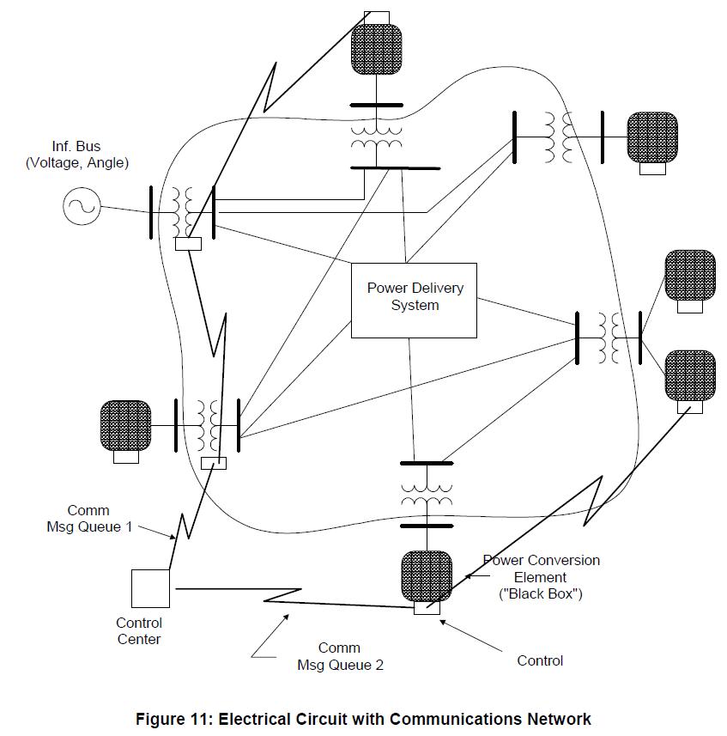
Overall circuit model
The OpenDSS consists of a model of the electrical power distribution system in the rms steady state, overlaid with a communications network that interconnects controls on power delivery elements and on power conversion elements.
ECpE Department

Slide 63
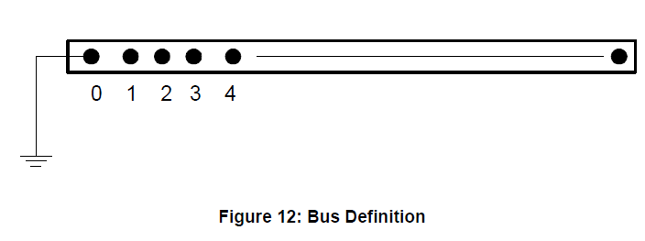
Bus and terminal models -- Bus definition
A bus is a circuit element having [1..N] nodes. Buses are the connection point for all other circuit elements. In many other power system analysis programs, “bus” and “node” are nearly synonymous, but they are distinctively different in OpenDSS. Bus is the container of Node objects. That is to say, a Bus has Nodes.
ECpE Department

Slide 64
Bus and terminal models -- Bus definition
The main electrical property of a Bus is voltage. Each node has a voltage with respect to the zero voltage reference (remote ground). There is a nodal admittance equation written for every node (i.e., the current is summed at each node). That basically dictates the size of the problem that must be solved, although there is also computational overhead computing the injection, or compensation, currents.
ECpE Department

Slide 65
Bus and terminal models -- Bus naming
Buses are named by an alphanumeric string of characters. The names may be numbers, but are always treated as strings. Internally, buses will be numbered (actually, each node is numbered), but are referenced through the COM or command interface by name. The internal index number is subject to change if something in the circuit changes and is not a reliable way to refer to a bus or node.
It is better if names do not contain blanks, tabs, or other “white space” or control characters. If the name contains a blank, for example, it must be enclosed in quotes (single or double, parentheses, or brackets). This can be a source of errors because of the different entry points for the names (user interface, files, COM interface). However, names from models in other programs such as PSS/E may contain names (may also be duplicates).
ECpE Department

Slide 66
Bus and terminal models -- Bus naming
Names may be any length and are passed to the OpenDSS through the COM interface as standard null‐terminated strings (actually, widestrings). This is the common way for representing strings in the Windows environment. Thus, it is a simple matter to drive the OpenDSS from most programming languages.
ECpE Department

Slide 67
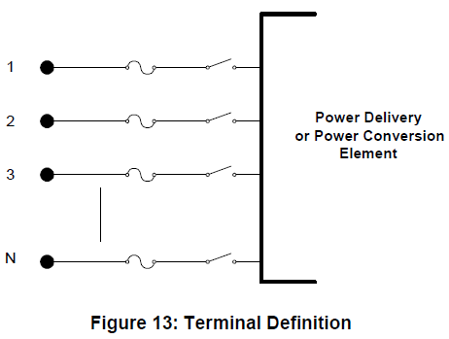
Bus and terminal models -- Terminal definition
Each electrical element in the power system has one or more terminals. Each terminal has one or more conductors. Each conductor conceptually contains a disconnect switch and a TCC (fuse) curve [The Fuse simulation in the terminal conductors has been disabled in this version and is being redesigned; a Relay object or a separate Fuse object can be used, if needed, to control the switches in the terminal conductors.]. The conductors are numbered [1, 2, 3,…].
ECpE Department

Slide 68
Bus and terminal models -- Terminal definition
If the terminal is connected to an N‐phase device, the first N conductors are assumed to correspond to the phases, in order. The remaining conductors may be virtually any other conductor but are frequently neutrals or other non‐power conductors.
The OpenDSS bus is a connecting place with 1 or more nodes for connecting individual phases and other conductors, from the terminals of both power delivery elements and power conversion elements.
ECpE Department

Slide 69
Bus and terminal models -- Terminal definition
Buses are named with null‐terminated strings of arbitrary length. Therefore, you may use quite long names.
Node 0 of each bus is implicitly connected to the voltage reference (i.e., the node's voltage is always zero and is never explicitly included in the Y matrix).
ECpE Department

Slide 70
Bus and terminal models -- Terminal references
Terminals are not named separately from the device. Each device will have a name and a defined number of multiphase terminals. Terminals will be referenced explicitly by number [1, 2, 3 …] or by inference, in the sequence in which they appear. Internally, they will be sequenced by position in a list.
ECpE Department

Slide 71
Bus and terminal models -- Phases and other conductors
Each terminal has one or more phases, or normal power‐carrying conductors and, optionally, a number of other conductors to represent neutral, or grounding, conductors or conductors for any other purpose. By convention, if a device is declared as having N phases, the first N conductors of each terminal are assumed to be the phase conductors, in the same sequence on each terminal. Remaining conductors at each terminal refer to “neutral” or “ground” or "earth“ conductors. However, the conductors can represent other power carrying conductors. There is no hard rule.
ECpE Department

Slide 72
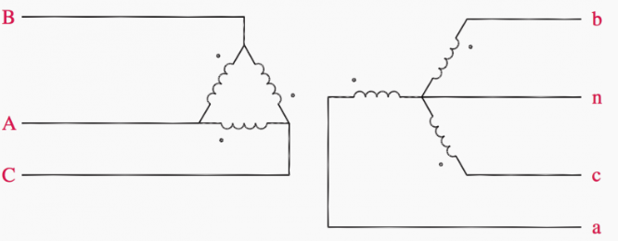
Bus and terminal models -- Phases and other conductors
All terminals of a device are defined to have the same number of conductors. For most devices, this causes no ambiguity, but for transformers with both delta and wye (star) winding connections, there will be an extra conductor at the delta‐connected terminal. The neutral is explicit to allow connection of neutral impedances to the wye‐connected winding. The extra conductor for the delta connection is simply connected to ground (voltage reference) and the admittances are all set to zero. Thus, the conductor effectively does not appear in the problem; it is ignored. However, you may see it appear in reports that explicitly list all the voltages and currents in a circuit.
The terminal conductors and bus nodes may be combined to form any practical connection.
This picture is from https://electrical-engineering-portal.com/3-phase-transformer-connections
ECpE Department

Slide 73
Bus and terminal models -- Phases and other conductors
Buses have Nodes: A bus may have any number of nodes (places to connect device terminal conductors). Nodes are integer numbers. The nodes may be arbitrarily numbered. However, the first N are by default reserved for the N phases of devices connected to them. Thus, if a bus has 3‐phase devices connected to it, connections would be expected to nodes 1, 2, and 3. So the DSS would use these voltages to compute the sequence voltages, for example. Phase 1 would nominally represent the same phase throughout the circuit, although there is nothing to enforce that standard. It is up to the user to maintain a consistent definition. If only the default connections are used, the consistency is generally maintained automatically, although there can be exceptions.
Any other nodes would simply be points of connection with no special meaning. Each Bus object keeps track of the allocation and designation of its nodes.
This picture is from https://electrical-engineering-portal.com/3-phase-transformer-connections
ECpE Department

Slide 74
Bus and terminal models -- Phases and other conductors
Node 0 of a bus is always the voltage reference (a.k.a, ground, or earth). That is, it always has a voltage of exactly zero volts.
ECpE Department

Slide 75
Bus and terminal models -- Specifying connections
The user can define how terminals are to be connected to buses in three ways, not just one way:
Generically connect a circuit element’s terminal to a bus without specifying node‐to-conductor connections. This is the default connection. Normal phase sequence is assumed. Phase 1 of the terminal is connected to Node 1 of the Bus, and so on. Neutrals default to ground (Node 0).
ECpE Department

Slide 76
Bus and terminal models -- Specifying connections
The user can define how terminals are to be connected to buses in three ways, not just one way:
Generically connect a circuit element’s terminal to a bus without specifying node‐to-conductor connections. This is the default connection. Normal phase sequence is assumed. Phase 1 of the terminal is connected to Node 1 of the Bus, and so on. Neutrals default to ground (Node 0).
ECpE Department

Slide 77
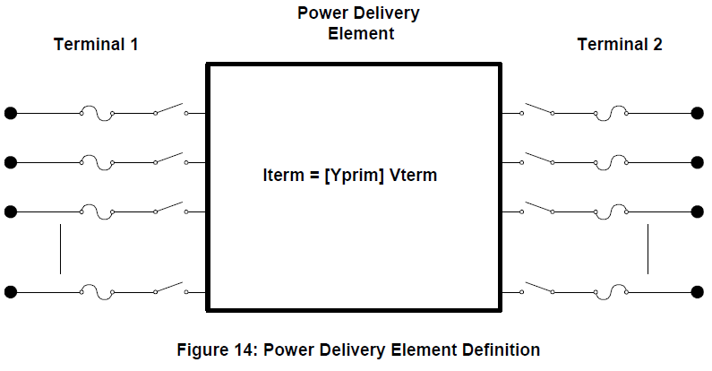
Power delivery elements
Power delivery elements usually consist of two or more multiphase terminals. Their basic function is to transport energy from one point to another. On the power system, the most common power delivery elements are lines and transformers. Thus, they generally have more than one terminal (capacitors and reactors can be an exception when shunt‐connected rather than series‐connected). Power delivery elements are standard electrical elements generally completely defined in the rms steady state by their impedances. Thus, they can be represented fully by the primitive y matrix (Yprim).
ECpE Department

Slide 78
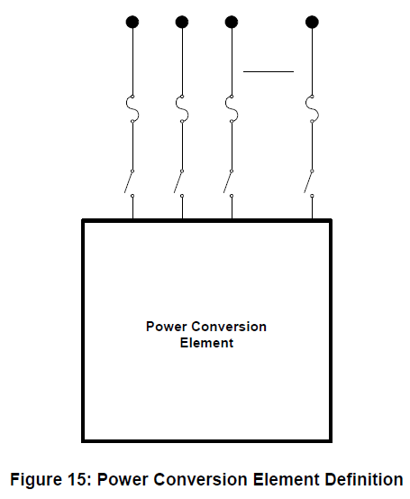
Power conversion elements
Power conversion elements convert power from electrical form to some other form, or vice-versa. Some may temporarily store energy and then give it back, as is the case for reactive elements. Most will have only one connection to the power system and, therefore, only one multiphase terminal.
ECpE Department

Slide 79
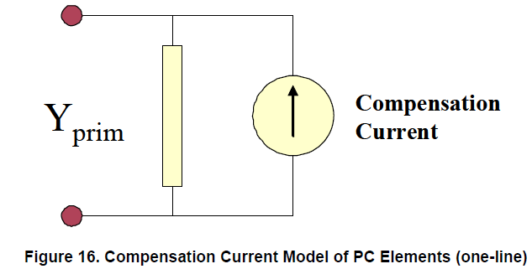
Power conversion elements
Within the OpenDSS, the typical implementation of a PC element is as shown below. Nonlinear elements, in particular Load and Generator elements, are treated as Norton equivalents with a constant Yprim and a “compensation” current or injection current that compensates for the nonlinear portion. This works well for most distribution loads and allows a wide range of models of load variation with voltage. It converges well for the vast majority of typical distribution system conditions. The Yprim matrix is generally kept constant for computational efficiency, although the OpenDSS does not require this. This limits the number of times the system Y matrix has to be rebuilt, which contributes greatly to computational efficiency for long runs, such as annual loading simulations.
ECpE Department

Slide 80
Power conversion elements
The Compensation current is the current that is added into the injection current vector in the main solver (see next section). This model accommodates a large variety of load models quite easily. The Load element models presently implemented are:
Constant P and constant Q load model: generically called constant power load model. It is the model most commonly used in power flow studies. It can suffer convergence problems when the voltage deviates too far from the normal range;
Constant Z (or constant impedance) load model: P and Q vary by the square of the voltage. This load model usually guarantees the convergence in any loading condition. The model is essentially linear;
Constant P and quadratic Q load model: the reactive power, Q, varies quadratically with
the voltage (as a constant reactance) while the active power, P, is independent from the voltage, somewhat like a motor;
…
ECpE Department

Slide 81
Power conversion elements
…
Exponential load model: the voltage dependency of P and Q is defined by exponential parameters (see CVRwatts and CVRvars). This model is typically used for Conservation Voltage Reduction (CVR) studies. It is also used for general distribution feeder load mix models when the exact behavior of loads is not known;
Constant I (or constant current magnitude) load model: P and Q vary linearly with the voltage magnitude while the load current magnitude remains constant. This is a common in distribution system analysis programs;
Constant P and fixed Q2 (Q is a fixed value independent of time and voltage);
Constant P and quadratic Q: Q varies with square of the voltage
ZIP load model: P and Q are described as a mixture of constant power, constant current and constant impedance load models whose contribution is defined by coefficients (see ZIPV).
ECpE Department

Slide 82
Power conversion elements
Loads can be exempt from loadshape mulitipliers. All load models revert to constant impedance constant Z load model outside the normal voltage range (that can defined by the user), in an attempt to guarantee convergence even when the voltage drops very low. This is important for performing annual simulations.
ECpE Department

Slide 83
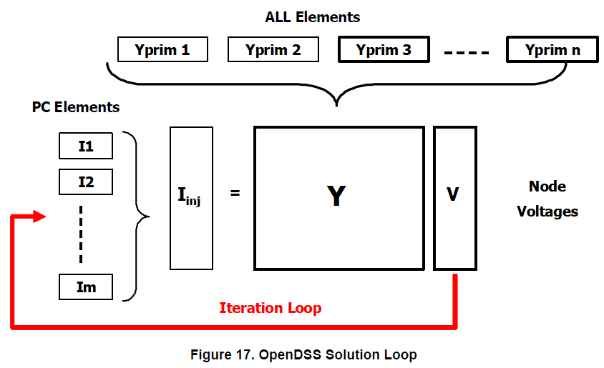
Putting it all together
The figure below illustrates how the DSS puts all the PD elements and PC elements together to perform a solution.
Basically, the upper structure of the OpenDSS (the part that is written in Delphi) manages the creation and modification of the primitive y matrices (Yprim) for each element in the circuit as well as managing the bus lists, the collection of results through Meter elements, and the execution of Control elements. The Yprim matrices are fed to the sparse matrix solver, which constructs the system Y matrix.
ECpE Department

Slide 84
Putting it all together
An initial guess at the voltages is obtained by performing a zero load power flow. That is, all shunt elements are disconnected and only the series power delivery elements are considered. This gets all the phase angles and voltage magnitudes in the proper relationship. This is important because the OpenDSS is designed to solve arbitrary n‐phase networks in which there can be all sorts of transformer ratios and connections.
ECpE Department

Slide 85
Putting it all together
The iteration cycle begins by obtaining the injection currents from all the power conversion (PC) elements in the system and adding them into the appropriate slot in the Iinj vector. The sparse set is then solved for the next guess at the voltages. The cycle repeats until the voltages converge to typically 0.0001 pu. The system Y matrix is typically not rebuilt during this process so the iterations go quickly.
ECpE Department

Slide 86
Putting it all together
This simple iterative solution has been found to converge quite well for most distribution systems that have adequate capacity to serve the load. The key is to have a dominant bulk power source, which is the case for most distribution systems. In the DSS, this is the “Normal” solution algorithm. There is also a “Newton” algorithm for more difficult systems (not to be confused with the typical Newton‐Raphson power flow method).
ECpE Department

Slide 87
Putting it all together
When performing Daily or Yearly simulations, the solution at the present time step is used as the starting point for the solution at the next time step. Unless there is a large change in load, the solution will typically converge in 2 iterations – one to do the solution and one to check it to make sure it is converged. Thus, the DSS is able to perform such calculations quite efficiently.
Control iterations are performed outside this loop. That is, a converged solution is achieved before checking to see if control actions are required.
ECpE Department

Slide 88
Contents
General introduction of OpenDSS
Installation & User interface
Workflow
Overall concept
Overall structure of solving power flow
ECpE Department

Slide 89
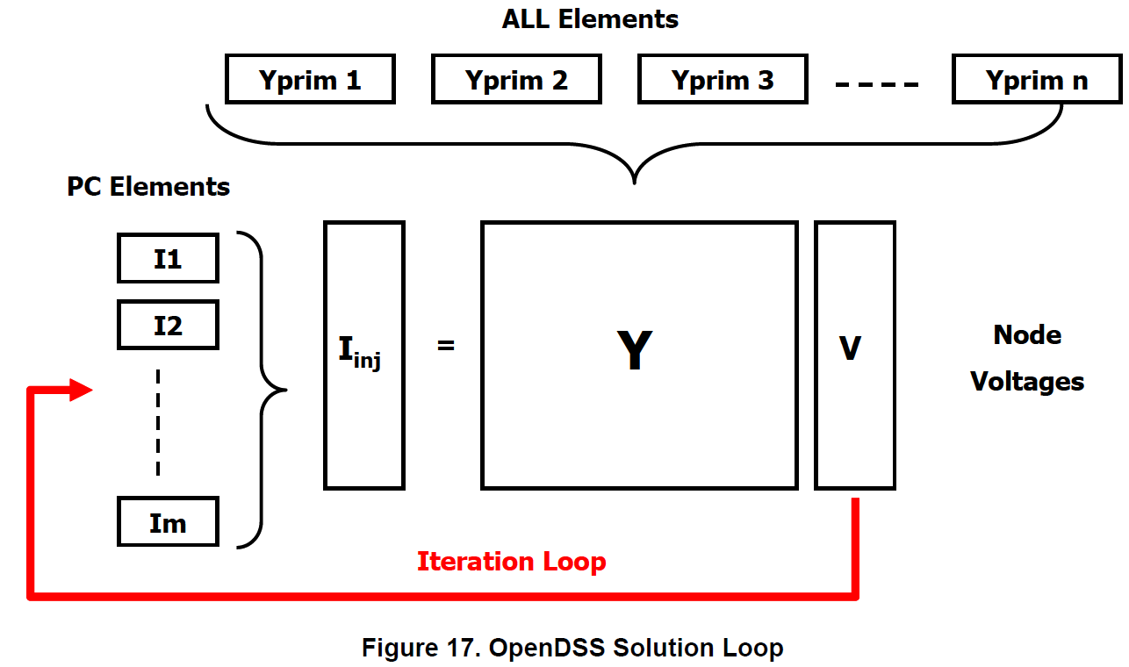
Overall Structure of Solving Power Flow
This figure illustrates how the OpenDSS puts all the power delivery elements and power conversion elements together to perform a solution.
Power delivery elements transport energy from one point to another.
Line, transformer, capacitor and reactor, etc.
Power conversion elements convert power from electrical form to some other form, or vice versa.
Load and generator, etc.
ECpE Department

Slide 90
Overall Structure of Solving Power Flow
Example 1 (Constant-Z Load):
Vsource
Bus k
Bus m
Bus n
Load (const. Z)
Line 1
Line 2
~
1
1
1
~
2
2
2
~
3
3
3
OpenDSS model:
Clear
//-------------- Define a new circuit --------------------//
new circuit.experiment
//---------------Define a Voltage source------------------//
Edit "Vsource.source" phases=3 basekv=13.8 Pu=1.02 bus1=K R1=5 X1=0 R0=5 X0=0
//----------------- Define line codes --------------------//
New LineCode.Code1 nphases= 3 Units= mi
~ Rmatrix= (0.62 | 0.17 0.62 | 0.17 0.17 0.62 )
~ Xmatrix= (1.21 | 0.43 1.21 | 0.43 0.43 1.21 )
New LineCode.Code2 nphases= 3 Units= mi
~ Rmatrix= (1.19 | 0.23 1.19 | 0.23 0.23 1.19 )
~ Xmatrix= (1.21 | 0.49 1.21 | 0.49 0.49 1.21 )
… (continued)
ECpE Department

Slide 91
Overall Structure of Solving Power Flow
Example 1:
Vsource
Bus k
Bus m
Bus n
Load (const. Z)
Line 1
Line 2
~
1
1
1
~
2
2
2
~
3
3
3
OpenDSS model:
… (continued)
//--------------- Define line 1 and 2 ------------------//
New Line.1 phases=3 Bus1=k.1.2.3 Bus2=m.1.2.3 length=1 units=mi LineCode=Code1
New Line.2 phases=3 Bus1=m.1.2.3 Bus2=n.1.2.3 length=1 units=mi LineCode=Code2
//---------------- Define a load -----------------------//
New Load.L Bus1=n.1.2.3.0 Phases=3 Conn=wye Model=2 kV=13.8 kW=500 kvar=0
Set VoltageBases = "13.8"
Solve
Constant-impedance load
ECpE Department

Slide 92






Overall Structure of Solving Power Flow
Example 1 (Injection Current):
Vsource
Bus k
Bus m
Bus n
Load (const. Z)
Line 1
Line 2
~
1
1
1
~
2
2
2
~
3
3
3
Load with compensation current
Bus k
Isource
Bus k
Bus n
Vsource
Bus n
Load (const. Z)
~
$$V_{s1}$$
1
1
→
$$I_{s1}$$
1
1
→
~
$$V_{s2}$$
2
→
2
2
2
→
~
$$V_{s3}$$
$$I_{s2}$$
3
→
3
3
$$I_{s3}$$
3
→
Various loads to a generic load model (Constant Z + compensation current)
For const. Z, I=0
Thevinen equivalent to Norton equivalent
ECpE Department

Slide 93





























































Overall Structure of Solving Power Flow
Example 1 (Injection Current):
Vsource
Bus k
Bus m
Bus n
Load (const. Z)
Line 1
Line 2
~
1
1
1
~
2
2
2
~
3
3
3
Vsource
Bus k
Line 1
Bus m
Line 2
Bus n
Load
$$z_{k1}$$
$$I_{k1}$$
$$I_{k1}^{in}$$
$$I_{km1}$$
$$z_{km1}$$
$$I_{mk1}$$
$$I_{m1}^{in}$$
$$I_{mn1}$$
$$z_{mn1}$$
$$I_{nm1}$$
$$I_{n1}^{in}$$
$$I_{n1}$$
$$z_{n1}$$
$$V_{k1}$$
$$z_{km12}$$
$$z_{km13}$$
$$V_{m1}$$
$$V_{n1}$$
$$z_{k2}$$
$$I_{k2}$$
$$I_{k2}^{in}$$
$$I_{km2}$$
$$z_{km2}$$
$$I_{mk2}$$
$$I_{m2}^{in}$$
$$I_{mn2}$$
$$z_{mn2}$$
$$z_{mn12}$$
$$z_{mn13}$$
$$I_{nm2}$$
$$I_{n2}^{in}$$
$$I_{n2}$$
$$z_{n2}$$
$$V_{k2}$$
$$V_{m2}$$
$$V_{n2}$$
$$z_{k3}$$
$$I_{k3}$$
$$I_{k3}^{in}$$
$$I_{km3}$$
$$z_{km3}$$
$$z_{km23}$$
$$I_{mk3}$$
$$I_{m3}^{in}$$
$$I_{mn3}$$
$$z_{mn3}$$
$$z_{mn23}$$
$$I_{nm3}$$
$$I_{n3}^{in}$$
$$I_{n3}$$
$$z_{n3}$$
$$V_{k3}$$
$$V_{m3}$$
$$V_{n3}$$
$$Z_{k}$$
$$Z_{km}$$
$$Z_{mn}$$
$$Z_{n}$$
$$I_{k1}^{in}=I_{s1}=\frac{V_{s1}}{z_{k1}}, I_{k2}^{in}=I_{s2}=\frac{V_{s2}}{z_{k2}}, I_{k3}^{in}=I_{s3}=\frac{V_{s3}}{z_{k3}}$$
$$I_{m1}^{in}=I_{m2}^{in}=I_{m3}^{in}=0$$
Compensation current$:$
$$I_{n1}^{in}=I_{n2}^{in}=I_{n3}^{in}=0$$
ECpE Department

Slide 94



















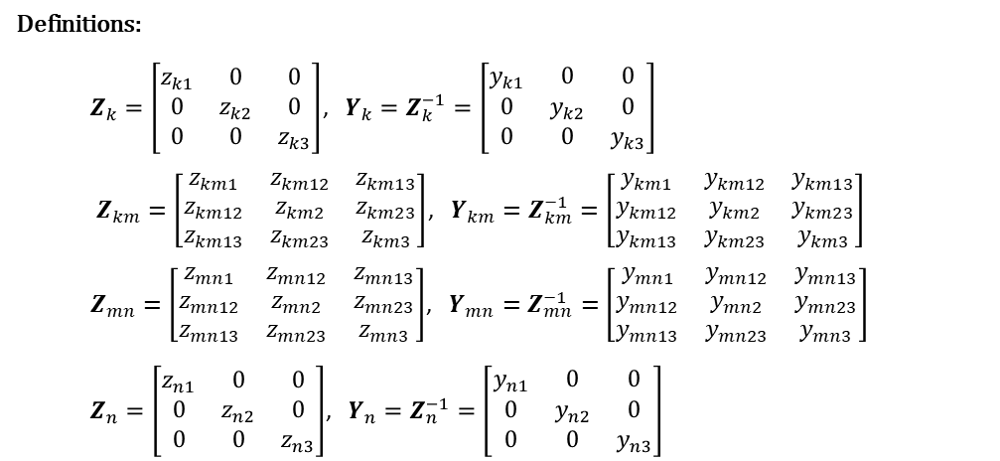
















Overall Structure of Solving Power Flow
Example 1 (Constructing Y):
Vsource
Bus k
Line 1
Bus m
Line 2
Bus n
Load (const. Z)
$$z_{k1}$$
$$I_{k1}$$
$$I_{k1}^{in}$$
$$I_{km1}$$
$$z_{km1}$$
$$I_{mk1}$$
$$I_{m1}^{in}$$
$$I_{mn1}$$
$$z_{mn1}$$
$$I_{nm1}$$
$$I_{n1}^{in}$$
$$I_{n1}$$
$$z_{n1}$$
$$V_{k1}$$
$$z_{km12}$$
$$z_{km13}$$
$$V_{m1}$$
$$V_{n1}$$
$$z_{k2}$$
$$I_{k2}$$
$$I_{k2}^{in}$$
$$I_{km2}$$
$$z_{km2}$$
$$I_{mk2}$$
$$I_{m2}^{in}$$
$$I_{mn2}$$
$$z_{mn2}$$
$$z_{mn12}$$
$$z_{mn13}$$
$$I_{nm2}$$
$$I_{n2}^{in}$$
$$I_{n2}$$
$$z_{n2}$$
$$V_{k2}$$
$$V_{m2}$$
$$V_{n2}$$
$$z_{k3}$$
$$I_{k3}$$
$$I_{k3}^{in}$$
$$I_{km3}$$
$$z_{km3}$$
$$z_{km23}$$
$$I_{mk3}$$
$$I_{m3}^{in}$$
$$I_{mn3}$$
$$z_{mn3}$$
$$z_{mn23}$$
$$I_{nm3}$$
$$I_{n3}^{in}$$
$$I_{n3}$$
$$z_{n3}$$
$$V_{k3}$$
$$V_{m3}$$
$$V_{n3}$$
$$Z_{k}$$
$$Z_{km}$$
$$Z_{mn}$$
$$Z_{n}$$
Definitions:
$Z_{k}=\left[\begin{matrix}z_{k1} & 0 & 0 \\ 0 & z_{k2} & 0 \\ 0 & 0 & z_{k3}\end{matrix}\right]$, $Y_{k}=Z_{k}^{−1}=\left[\begin{matrix}y_{k1} & 0 & 0 \\ 0 & y_{k2} & 0 \\ 0 & 0 & y_{k3}\end{matrix}\right]$
$Z_{km}=\left[\begin{matrix}z_{km1} & z_{km12} & z_{km13} \\ z_{km12} & z_{km2} & z_{km23} \\ z_{km13} & z_{km23} & z_{km3}\end{matrix}\right]$, $Y_{km}=Z_{km}^{−1}=\left[\begin{matrix}y_{km1} & y_{km12} & y_{km13} \\ y_{km12} & y_{km2} & y_{km23} \\ y_{km13} & y_{km23} & y_{km3}\end{matrix}\right]$
$Z_{mn}=\left[\begin{matrix}z_{mn1} & z_{mn12} & z_{mn13} \\ z_{mn12} & z_{mn2} & z_{mn23} \\ z_{mn13} & z_{mn23} & z_{mn3}\end{matrix}\right]$, $Y_{mn}=Z_{mn}^{−1}=\left[\begin{matrix}y_{mn1} & y_{mn12} & y_{mn13} \\ y_{mn12} & y_{mn2} & y_{mn23} \\ y_{mn13} & y_{mn23} & y_{mn3}\end{matrix}\right]$
$Z_{n}=\left[\begin{matrix}z_{n1} & 0 & 0 \\ 0 & z_{n2} & 0 \\ 0 & 0 & z_{n3}\end{matrix}\right]$, $Y_{n}=Z_{n}^{−1}=\left[\begin{matrix}y_{n1} & 0 & 0 \\ 0 & y_{n2} & 0 \\ 0 & 0 & y_{n3}\end{matrix}\right]$
ECpE Department

Slide 95
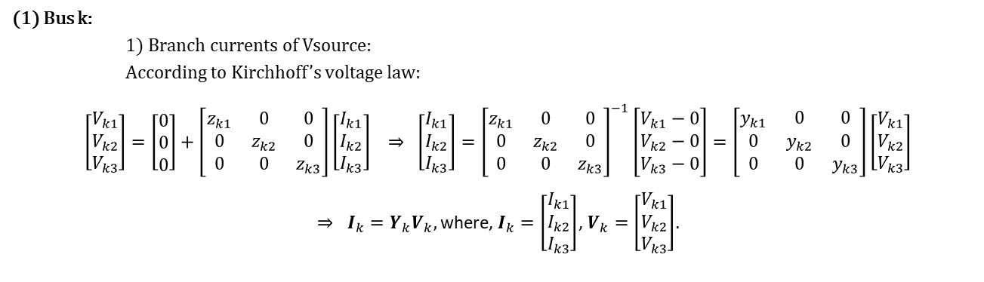
Overall Structure of Solving Power Flow
Example 1 (Constructing Y):
Vsource
Bus k
Line 1
Bus m
Line 2
Bus n
Load (const. Z)
$$z_{k1}$$
$$I_{k1}$$
$$I_{k1}^{in}$$
$$I_{km1}$$
$$z_{km1}$$
$$I_{mk1}$$
$$I_{m1}^{in}$$
$$I_{mn1}$$
$$z_{mn1}$$
$$I_{nm1}$$
$$I_{n1}^{in}$$
$$I_{n1}$$
$$z_{n1}$$
$$V_{k1}$$
$$z_{km12}$$
$$z_{km13}$$
$$V_{m1}$$
$$V_{n1}$$
$$z_{k2}$$
$$I_{k2}$$
$$I_{k2}^{in}$$
$$I_{km2}$$
$$z_{km2}$$
$$I_{mk2}$$
$$I_{m2}^{in}$$
$$I_{mn2}$$
$$z_{mn2}$$
$$z_{mn12}$$
$$z_{mn13}$$
$$I_{nm2}$$
$$I_{n2}^{in}$$
$$I_{n2}$$
$$z_{n2}$$
$$V_{k2}$$
$$V_{m2}$$
$$V_{n2}$$
$$z_{k3}$$
$$I_{k3}$$
$$I_{k3}^{in}$$
$$I_{km3}$$
$$z_{km3}$$
$$z_{km23}$$
$$I_{mk3}$$
$$I_{m3}^{in}$$
$$I_{mn3}$$
$$z_{mn3}$$
$$z_{mn23}$$
$$I_{nm3}$$
$$I_{n3}^{in}$$
$$I_{n3}$$
$$z_{n3}$$
$$V_{k3}$$
$$V_{m3}$$
$$V_{n3}$$
$$Z_{k}$$
$$Z_{km}$$
$$Z_{mn}$$
$$Z_{n}$$
(1) Bus k:
1) Branch currents of Vsource:
According to Kirchhoff’s voltage law:
$$\left[\begin{matrix}V_{k1} \\ V_{k2} \\ V_{k3}\end{matrix}\right]=\left[\begin{matrix}0 \\ 0 \\ 0\end{matrix}\right]+\left[\begin{matrix}z_{k1} & 0 & 0 \\ 0 & z_{k2} & 0 \\ 0 & 0 & z_{k3}\end{matrix}\right]\left[\begin{matrix}I_{k1} \\ I_{k2} \\ I_{k3}\end{matrix}\right] ⇒ \left[\begin{matrix}I_{k1} \\ I_{k2} \\ I_{k3}\end{matrix}\right]={\left[\begin{matrix}z_{k1} & 0 & 0 \\ 0 & z_{k2} & 0 \\ 0 & 0 & z_{k3}\end{matrix}\right]}^{−1}\left[\begin{matrix}V_{k1}−0 \\ V_{k2}−0 \\ V_{k3}−0\end{matrix}\right]=\left[\begin{matrix}y_{k1} & 0 & 0 \\ 0 & y_{k2} & 0 \\ 0 & 0 & y_{k3}\end{matrix}\right]\left[\begin{matrix}V_{k1} \\ V_{k2} \\ V_{k3}\end{matrix}\right]$$
$⇒ I_{k}=Y_{k}V_{k},$where, $I_{k}=\left[\begin{matrix}I_{k1} \\ I_{k2} \\ I_{k3}\end{matrix}\right]$, $V_{k}=\left[\begin{matrix}V_{k1} \\ V_{k2} \\ V_{k3}\end{matrix}\right]$.
ECpE Department

Slide 96
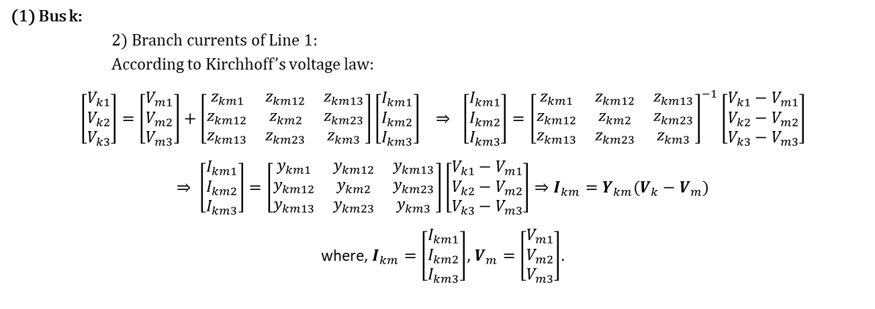
Overall Structure of Solving Power Flow
Example 1 (Constructing Y):
Vsource
Bus k
Line 1
Bus m
Line 2
Bus n
Load (const. Z)
$$z_{k1}$$
$$I_{k1}$$
$$I_{k1}^{in}$$
$$I_{km1}$$
$$z_{km1}$$
$$I_{mk1}$$
$$I_{m1}^{in}$$
$$I_{mn1}$$
$$z_{mn1}$$
$$I_{nm1}$$
$$I_{n1}^{in}$$
$$I_{n1}$$
$$z_{n1}$$
$$V_{k1}$$
$$z_{km12}$$
$$z_{km13}$$
$$V_{m1}$$
$$V_{n1}$$
$$z_{k2}$$
$$I_{k2}$$
$$I_{k2}^{in}$$
$$I_{km2}$$
$$z_{km2}$$
$$I_{mk2}$$
$$I_{m2}^{in}$$
$$I_{mn2}$$
$$z_{mn2}$$
$$z_{mn12}$$
$$z_{mn13}$$
$$I_{nm2}$$
$$I_{n2}^{in}$$
$$I_{n2}$$
$$z_{n2}$$
$$V_{k2}$$
$$V_{m2}$$
$$V_{n2}$$
$$z_{k3}$$
$$I_{k3}$$
$$I_{k3}^{in}$$
$$I_{km3}$$
$$z_{km3}$$
$$z_{km23}$$
$$I_{mk3}$$
$$I_{m3}^{in}$$
$$I_{mn3}$$
$$z_{mn3}$$
$$z_{mn23}$$
$$I_{nm3}$$
$$I_{n3}^{in}$$
$$I_{n3}$$
$$z_{n3}$$
$$V_{k3}$$
$$V_{m3}$$
$$V_{n3}$$
$$Z_{k}$$
$$Z_{km}$$
$$Z_{mn}$$
$$Z_{n}$$
(1) Bus k:
2) Branch currents of Line 1:
According to Kirchhoff’s voltage law:
$$\left[\begin{matrix}V_{k1} \\ V_{k2} \\ V_{k3}\end{matrix}\right]=\left[\begin{matrix}V_{m1} \\ V_{m2} \\ V_{m3}\end{matrix}\right]+\left[\begin{matrix}z_{km1} & z_{km12} & z_{km13} \\ z_{km12} & z_{km2} & z_{km23} \\ z_{km13} & z_{km23} & z_{km3}\end{matrix}\right]\left[\begin{matrix}I_{km1} \\ I_{km2} \\ I_{km3}\end{matrix}\right] ⇒ \left[\begin{matrix}I_{km1} \\ I_{km2} \\ I_{km3}\end{matrix}\right]={\left[\begin{matrix}z_{km1} & z_{km12} & z_{km13} \\ z_{km12} & z_{km2} & z_{km23} \\ z_{km13} & z_{km23} & z_{km3}\end{matrix}\right]}^{−1}\left[\begin{matrix}V_{k1}−V_{m1} \\ V_{k2}−V_{m2} \\ V_{k3}−V_{m3}\end{matrix}\right]$$
$$⇒ \left[\begin{matrix}I_{km1} \\ I_{km2} \\ I_{km3}\end{matrix}\right]=\left[\begin{matrix}y_{km1} & y_{km12} & y_{km13} \\ y_{km12} & y_{km2} & y_{km23} \\ y_{km13} & y_{km23} & y_{km3}\end{matrix}\right]\left[\begin{matrix}V_{k1}−V_{m1} \\ V_{k2}−V_{m2} \\ V_{k3}−V_{m3}\end{matrix}\right]⇒I_{km}=Y_{km}(V_{k}−V_{m})$$
where, $I_{km}=\left[\begin{matrix}I_{km1} \\ I_{km2} \\ I_{km3}\end{matrix}\right]$, $V_{m}=\left[\begin{matrix}V_{m1} \\ V_{m2} \\ V_{m3}\end{matrix}\right]$.
ECpE Department

Slide 97
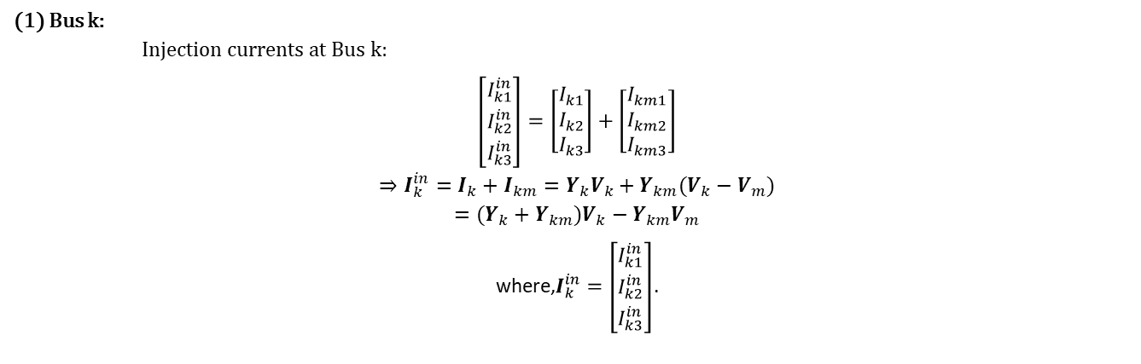
Overall Structure of Solving Power Flow
Example 1 (Constructing Y):
Vsource
Bus k
Line 1
Bus m
Line 2
Bus n
Load (const. Z)
$$z_{k1}$$
$$I_{k1}$$
$$I_{k1}^{in}$$
$$I_{km1}$$
$$z_{km1}$$
$$I_{mk1}$$
$$I_{m1}^{in}$$
$$I_{mn1}$$
$$z_{mn1}$$
$$I_{nm1}$$
$$I_{n1}^{in}$$
$$I_{n1}$$
$$z_{n1}$$
$$V_{k1}$$
$$z_{km12}$$
$$z_{km13}$$
$$V_{m1}$$
$$V_{n1}$$
$$z_{k2}$$
$$I_{k2}$$
$$I_{k2}^{in}$$
$$I_{km2}$$
$$z_{km2}$$
$$I_{mk2}$$
$$I_{m2}^{in}$$
$$I_{mn2}$$
$$z_{mn2}$$
$$z_{mn12}$$
$$z_{mn13}$$
$$I_{nm2}$$
$$I_{n2}^{in}$$
$$I_{n2}$$
$$z_{n2}$$
$$V_{k2}$$
$$V_{m2}$$
$$V_{n2}$$
$$z_{k3}$$
$$I_{k3}$$
$$I_{k3}^{in}$$
$$I_{km3}$$
$$z_{km3}$$
$$z_{km23}$$
$$I_{mk3}$$
$$I_{m3}^{in}$$
$$I_{mn3}$$
$$z_{mn3}$$
$$z_{mn23}$$
$$I_{nm3}$$
$$I_{n3}^{in}$$
$$I_{n3}$$
$$z_{n3}$$
$$V_{k3}$$
$$V_{m3}$$
$$V_{n3}$$
$$Z_{k}$$
$$Z_{km}$$
$$Z_{mn}$$
$$Z_{n}$$
(1) Bus k:
Injection currents at Bus k:
$$\left[\begin{matrix}I_{k1}^{in} \\ I_{k2}^{in} \\ I_{k3}^{in}\end{matrix}\right]=\left[\begin{matrix}I_{k1} \\ I_{k2} \\ I_{k3}\end{matrix}\right]+\left[\begin{matrix}I_{km1} \\ I_{km2} \\ I_{km3}\end{matrix}\right]$$
$$⇒I_{k}^{in}=I_{k}+I_{km}=Y_{k}V_{k}+Y_{km}(V_{k}−V_{m})$$
$$=(Y_{k}+Y_{km})V_{k}−Y_{km}V_{m}$$
where,$I_{k}^{in}=\left[\begin{matrix}I_{k1}^{in} \\ I_{k2}^{in} \\ I_{k3}^{in}\end{matrix}\right]$.
ECpE Department

Slide 98
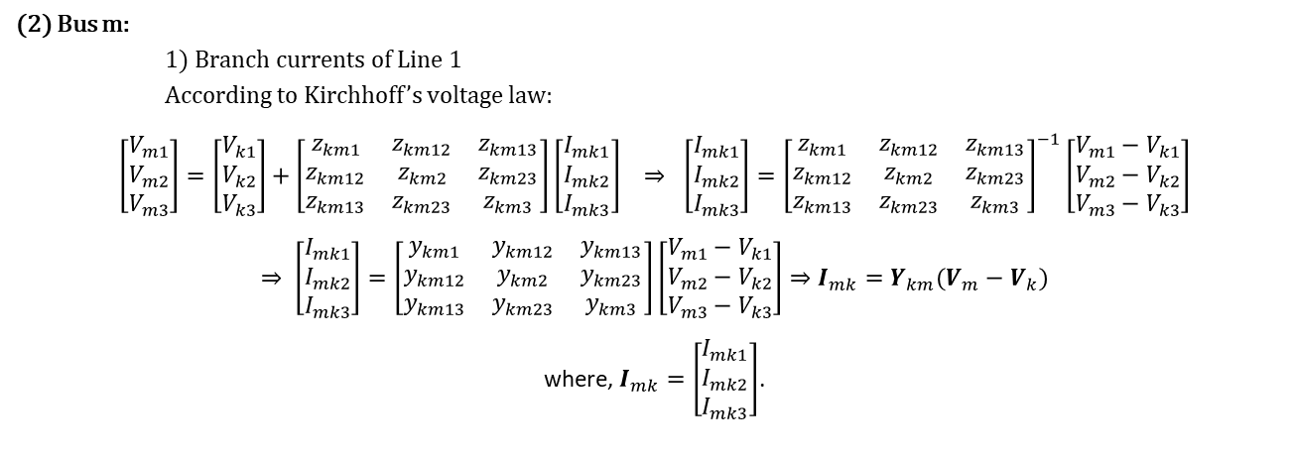
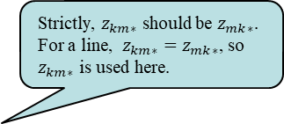
Overall Structure of Solving Power Flow
Example 1 (Constructing Y):
Vsource
Bus k
Line 1
Bus m
Line 2
Bus n
Load (const. Z)
$$z_{k1}$$
$$I_{k1}$$
$$I_{k1}^{in}$$
$$I_{km1}$$
$$z_{km1}$$
$$I_{mk1}$$
$$I_{m1}^{in}$$
$$I_{mn1}$$
$$z_{mn1}$$
$$I_{nm1}$$
$$I_{n1}^{in}$$
$$I_{n1}$$
$$z_{n1}$$
$$V_{k1}$$
$$z_{km12}$$
$$z_{km13}$$
$$V_{m1}$$
$$V_{n1}$$
$$z_{k2}$$
$$I_{k2}$$
$$I_{k2}^{in}$$
$$I_{km2}$$
$$z_{km2}$$
$$I_{mk2}$$
$$I_{m2}^{in}$$
$$I_{mn2}$$
$$z_{mn2}$$
$$z_{mn12}$$
$$z_{mn13}$$
$$I_{nm2}$$
$$I_{n2}^{in}$$
$$I_{n2}$$
$$z_{n2}$$
$$V_{k2}$$
$$V_{m2}$$
$$V_{n2}$$
$$z_{k3}$$
$$I_{k3}$$
$$I_{k3}^{in}$$
$$I_{km3}$$
$$z_{km3}$$
$$z_{km23}$$
$$I_{mk3}$$
$$I_{m3}^{in}$$
$$I_{mn3}$$
$$z_{mn3}$$
$$z_{mn23}$$
$$I_{nm3}$$
$$I_{n3}^{in}$$
$$I_{n3}$$
$$z_{n3}$$
$$V_{k3}$$
$$V_{m3}$$
$$V_{n3}$$
$$Z_{k}$$
$$Z_{km}$$
$$Z_{mn}$$
$$Z_{n}$$
Strictly, $z_{km∗}$ should be $z_{mk∗}$. For a line, $z_{km∗}=z_{mk∗}$, so $z_{km∗}$ is used here.
(2) Bus m:
1) Branch currents of Line 1
According to Kirchhoff’s voltage law:
$$\left[\begin{matrix}V_{m1} \\ V_{m2} \\ V_{m3}\end{matrix}\right]=\left[\begin{matrix}V_{k1} \\ V_{k2} \\ V_{k3}\end{matrix}\right]+\left[\begin{matrix}z_{km1} & z_{km12} & z_{km13} \\ z_{km12} & z_{km2} & z_{km23} \\ z_{km13} & z_{km23} & z_{km3}\end{matrix}\right]\left[\begin{matrix}I_{mk1} \\ I_{mk2} \\ I_{mk3}\end{matrix}\right] ⇒ \left[\begin{matrix}I_{mk1} \\ I_{mk2} \\ I_{mk3}\end{matrix}\right]={\left[\begin{matrix}z_{km1} & z_{km12} & z_{km13} \\ z_{km12} & z_{km2} & z_{km23} \\ z_{km13} & z_{km23} & z_{km3}\end{matrix}\right]}^{−1}\left[\begin{matrix}V_{m1}−V_{k1} \\ V_{m2}−V_{k2} \\ V_{m3}−V_{k3}\end{matrix}\right]$$
$$⇒ \left[\begin{matrix}I_{mk1} \\ I_{mk2} \\ I_{mk3}\end{matrix}\right]=\left[\begin{matrix}y_{km1} & y_{km12} & y_{km13} \\ y_{km12} & y_{km2} & y_{km23} \\ y_{km13} & y_{km23} & y_{km3}\end{matrix}\right]\left[\begin{matrix}V_{m1}−V_{k1} \\ V_{m2}−V_{k2} \\ V_{m3}−V_{k3}\end{matrix}\right]⇒I_{mk}=Y_{km}(V_{m}−V_{k})$$
where, $I_{mk}=\left[\begin{matrix}I_{mk1} \\ I_{mk2} \\ I_{mk3}\end{matrix}\right]$.
ECpE Department

Slide 99
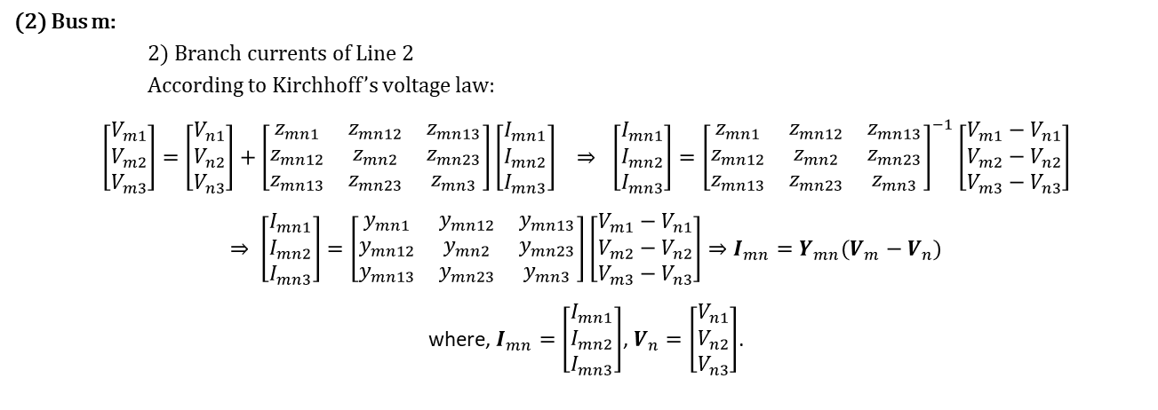
Overall Structure of Solving Power Flow
Example 1 (Constructing Y):
Vsource
Bus k
Line 1
Bus m
Line 2
Bus n
Load (const. Z)
$$z_{k1}$$
$$I_{k1}$$
$$I_{k1}^{in}$$
$$I_{km1}$$
$$z_{km1}$$
$$I_{mk1}$$
$$I_{m1}^{in}$$
$$I_{mn1}$$
$$z_{mn1}$$
$$I_{nm1}$$
$$I_{n1}^{in}$$
$$I_{n1}$$
$$z_{n1}$$
$$V_{k1}$$
$$z_{km12}$$
$$z_{km13}$$
$$V_{m1}$$
$$V_{n1}$$
$$z_{k2}$$
$$I_{k2}$$
$$I_{k2}^{in}$$
$$I_{km2}$$
$$z_{km2}$$
$$I_{mk2}$$
$$I_{m2}^{in}$$
$$I_{mn2}$$
$$z_{mn2}$$
$$z_{mn12}$$
$$z_{mn13}$$
$$I_{nm2}$$
$$I_{n2}^{in}$$
$$I_{n2}$$
$$z_{n2}$$
$$V_{k2}$$
$$V_{m2}$$
$$V_{n2}$$
$$z_{k3}$$
$$I_{k3}$$
$$I_{k3}^{in}$$
$$I_{km3}$$
$$z_{km3}$$
$$z_{km23}$$
$$I_{mk3}$$
$$I_{m3}^{in}$$
$$I_{mn3}$$
$$z_{mn3}$$
$$z_{mn23}$$
$$I_{nm3}$$
$$I_{n3}^{in}$$
$$I_{n3}$$
$$z_{n3}$$
$$V_{k3}$$
$$V_{m3}$$
$$V_{n3}$$
$$Z_{k}$$
$$Z_{km}$$
$$Z_{mn}$$
$$Z_{n}$$
(2) Bus m:
2) Branch currents of Line 2
According to Kirchhoff’s voltage law:
$$\left[\begin{matrix}V_{m1} \\ V_{m2} \\ V_{m3}\end{matrix}\right]=\left[\begin{matrix}V_{n1} \\ V_{n2} \\ V_{n3}\end{matrix}\right]+\left[\begin{matrix}z_{mn1} & z_{mn12} & z_{mn13} \\ z_{mn12} & z_{mn2} & z_{mn23} \\ z_{mn13} & z_{mn23} & z_{mn3}\end{matrix}\right]\left[\begin{matrix}I_{mn1} \\ I_{mn2} \\ I_{mn3}\end{matrix}\right] ⇒ \left[\begin{matrix}I_{mn1} \\ I_{mn2} \\ I_{mn3}\end{matrix}\right]={\left[\begin{matrix}z_{mn1} & z_{mn12} & z_{mn13} \\ z_{mn12} & z_{mn2} & z_{mn23} \\ z_{mn13} & z_{mn23} & z_{mn3}\end{matrix}\right]}^{−1}\left[\begin{matrix}{V_{m1}−V}_{n1} \\ V_{m2}−V_{n2} \\ {V_{m3}−V}_{n3}\end{matrix}\right]$$
$$⇒ \left[\begin{matrix}I_{mn1} \\ I_{mn2} \\ I_{mn3}\end{matrix}\right]=\left[\begin{matrix}y_{mn1} & y_{mn12} & y_{mn13} \\ y_{mn12} & y_{mn2} & y_{mn23} \\ y_{mn13} & y_{mn23} & y_{mn3}\end{matrix}\right]\left[\begin{matrix}{V_{m1}−V}_{n1} \\ V_{m2}−V_{n2} \\ {V_{m3}−V}_{n3}\end{matrix}\right]⇒I_{mn}=Y_{mn}(V_{m}−V_{n})$$
where, $I_{mn}=\left[\begin{matrix}I_{mn1} \\ I_{mn2} \\ I_{mn3}\end{matrix}\right]$, $V_{n}=\left[\begin{matrix}V_{n1} \\ V_{n2} \\ V_{n3}\end{matrix}\right]$.
ECpE Department

Slide 100
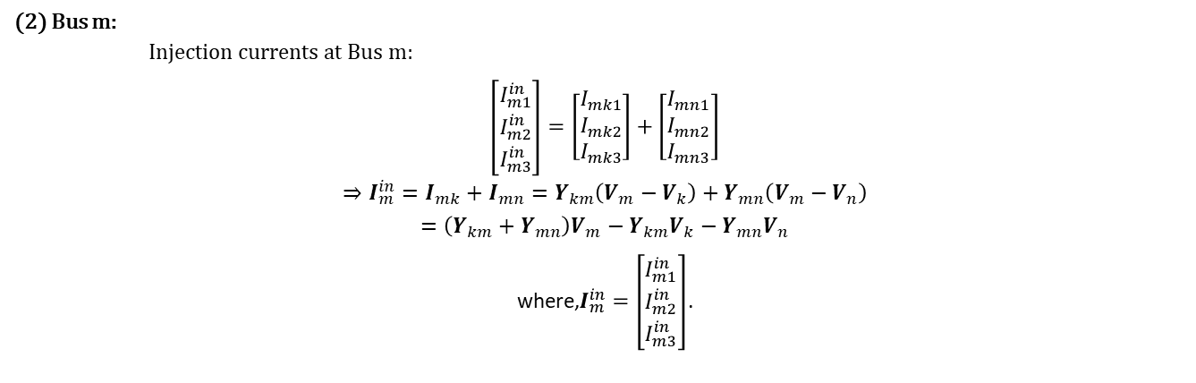
Overall Structure of Solving Power Flow
Example 1 (Constructing Y):
Vsource
Bus k
Line 1
Bus m
Line 2
Bus n
Load (const. Z)
$$z_{k1}$$
$$I_{k1}$$
$$I_{k1}^{in}$$
$$I_{km1}$$
$$z_{km1}$$
$$I_{mk1}$$
$$I_{m1}^{in}$$
$$I_{mn1}$$
$$z_{mn1}$$
$$I_{nm1}$$
$$I_{n1}^{in}$$
$$I_{n1}$$
$$z_{n1}$$
$$V_{k1}$$
$$z_{km12}$$
$$z_{km13}$$
$$V_{m1}$$
$$V_{n1}$$
$$z_{k2}$$
$$I_{k2}$$
$$I_{k2}^{in}$$
$$I_{km2}$$
$$z_{km2}$$
$$I_{mk2}$$
$$I_{m2}^{in}$$
$$I_{mn2}$$
$$z_{mn2}$$
$$z_{mn12}$$
$$z_{mn13}$$
$$I_{nm2}$$
$$I_{n2}^{in}$$
$$I_{n2}$$
$$z_{n2}$$
$$V_{k2}$$
$$V_{m2}$$
$$V_{n2}$$
$$z_{k3}$$
$$I_{k3}$$
$$I_{k3}^{in}$$
$$I_{km3}$$
$$z_{km3}$$
$$z_{km23}$$
$$I_{mk3}$$
$$I_{m3}^{in}$$
$$I_{mn3}$$
$$z_{mn3}$$
$$z_{mn23}$$
$$I_{nm3}$$
$$I_{n3}^{in}$$
$$I_{n3}$$
$$z_{n3}$$
$$V_{k3}$$
$$V_{m3}$$
$$V_{n3}$$
$$Z_{k}$$
$$Z_{km}$$
$$Z_{mn}$$
$$Z_{n}$$
(2) Bus m:
Injection currents at Bus m:
$$\left[\begin{matrix}I_{m1}^{in} \\ I_{m2}^{in} \\ I_{m3}^{in}\end{matrix}\right]=\left[\begin{matrix}I_{mk1} \\ I_{mk2} \\ I_{mk3}\end{matrix}\right]+\left[\begin{matrix}I_{mn1} \\ I_{mn2} \\ I_{mn3}\end{matrix}\right]$$
$$⇒I_{m}^{in}=I_{mk}+I_{mn}=Y_{km}\left(V_{m}−V_{k}\right)+Y_{mn}\left(V_{m}−V_{n}\right)$$
$$=\left(Y_{km}+Y_{mn}\right)V_{m}−Y_{km}V_{k}−Y_{mn}V_{n}$$
where,$I_{m}^{in}=\left[\begin{matrix}I_{m1}^{in} \\ I_{m2}^{in} \\ I_{m3}^{in}\end{matrix}\right]$.
ECpE Department

Slide 101
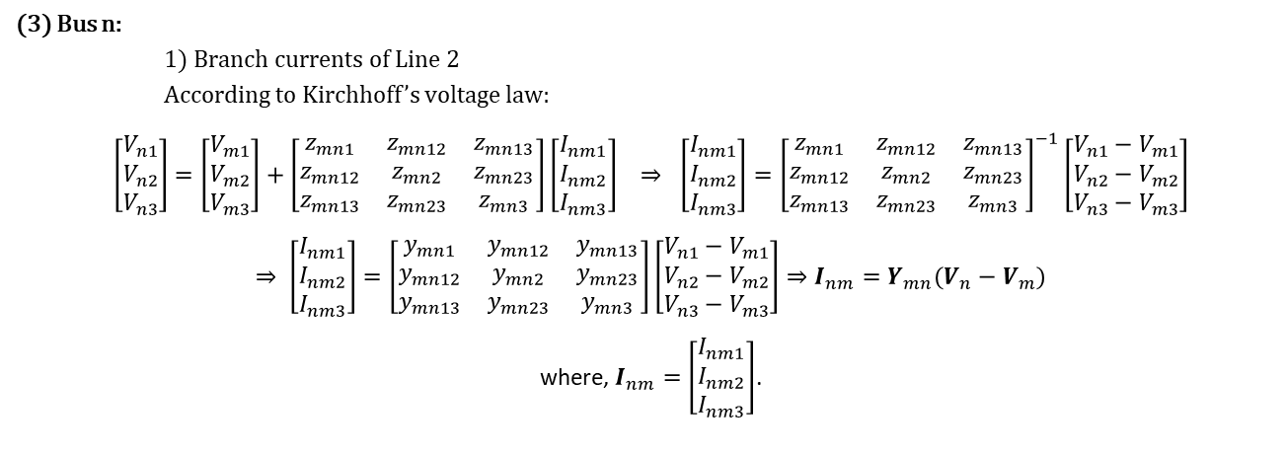
Overall Structure of Solving Power Flow
Example 1 (Constructing Y):
Vsource
Bus k
Line 1
Bus m
Line 2
Bus n
Load (const. Z)
$$z_{k1}$$
$$I_{k1}$$
$$I_{k1}^{in}$$
$$I_{km1}$$
$$z_{km1}$$
$$I_{mk1}$$
$$I_{m1}^{in}$$
$$I_{mn1}$$
$$z_{mn1}$$
$$I_{nm1}$$
$$I_{n1}^{in}$$
$$I_{n1}$$
$$z_{n1}$$
$$V_{k1}$$
$$z_{km12}$$
$$z_{km13}$$
$$V_{m1}$$
$$V_{n1}$$
$$z_{k2}$$
$$I_{k2}$$
$$I_{k2}^{in}$$
$$I_{km2}$$
$$z_{km2}$$
$$I_{mk2}$$
$$I_{m2}^{in}$$
$$I_{mn2}$$
$$z_{mn2}$$
$$z_{mn12}$$
$$z_{mn13}$$
$$I_{nm2}$$
$$I_{n2}^{in}$$
$$I_{n2}$$
$$z_{n2}$$
$$V_{k2}$$
$$V_{m2}$$
$$V_{n2}$$
$$z_{k3}$$
$$I_{k3}$$
$$I_{k3}^{in}$$
$$I_{km3}$$
$$z_{km3}$$
$$z_{km23}$$
$$I_{mk3}$$
$$I_{m3}^{in}$$
$$I_{mn3}$$
$$z_{mn3}$$
$$z_{mn23}$$
$$I_{nm3}$$
$$I_{n3}^{in}$$
$$I_{n3}$$
$$z_{n3}$$
$$V_{k3}$$
$$V_{m3}$$
$$V_{n3}$$
$$Z_{k}$$
$$Z_{km}$$
$$Z_{mn}$$
$$Z_{n}$$
(3) Bus n:
1) Branch currents of Line 2
According to Kirchhoff’s voltage law:
$$\left[\begin{matrix}V_{n1} \\ V_{n2} \\ V_{n3}\end{matrix}\right]=\left[\begin{matrix}V_{m1} \\ V_{m2} \\ V_{m3}\end{matrix}\right]+\left[\begin{matrix}z_{mn1} & z_{mn12} & z_{mn13} \\ z_{mn12} & z_{mn2} & z_{mn23} \\ z_{mn13} & z_{mn23} & z_{mn3}\end{matrix}\right]\left[\begin{matrix}I_{nm1} \\ I_{nm2} \\ I_{nm3}\end{matrix}\right] ⇒ \left[\begin{matrix}I_{nm1} \\ I_{nm2} \\ I_{nm3}\end{matrix}\right]={\left[\begin{matrix}z_{mn1} & z_{mn12} & z_{mn13} \\ z_{mn12} & z_{mn2} & z_{mn23} \\ z_{mn13} & z_{mn23} & z_{mn3}\end{matrix}\right]}^{−1}\left[\begin{matrix}{V_{n1}−V}_{m1} \\ V_{n2}−V_{m2} \\ {V_{n3}−V}_{m3}\end{matrix}\right]$$
$$⇒ \left[\begin{matrix}I_{nm1} \\ I_{nm2} \\ I_{nm3}\end{matrix}\right]=\left[\begin{matrix}y_{mn1} & y_{mn12} & y_{mn13} \\ y_{mn12} & y_{mn2} & y_{mn23} \\ y_{mn13} & y_{mn23} & y_{mn3}\end{matrix}\right]\left[\begin{matrix}{V_{n1}−V}_{m1} \\ V_{n2}−V_{m2} \\ {V_{n3}−V}_{m3}\end{matrix}\right]⇒I_{nm}=Y_{mn}(V_{n}−V_{m})$$
where, $I_{nm}=\left[\begin{matrix}I_{nm1} \\ I_{nm2} \\ I_{nm3}\end{matrix}\right]$.
ECpE Department

Slide 102

Overall Structure of Solving Power Flow
Example 1 (Constructing Y):
Vsource
Bus k
Line 1
Bus m
Line 2
Bus n
Load (const. Z)
$$z_{k1}$$
$$I_{k1}$$
$$I_{k1}^{in}$$
$$I_{km1}$$
$$z_{km1}$$
$$I_{mk1}$$
$$I_{m1}^{in}$$
$$I_{mn1}$$
$$z_{mn1}$$
$$I_{nm1}$$
$$I_{n1}^{in}$$
$$I_{n1}$$
$$z_{n1}$$
$$V_{k1}$$
$$z_{km12}$$
$$z_{km13}$$
$$V_{m1}$$
$$V_{n1}$$
$$z_{k2}$$
$$I_{k2}$$
$$I_{k2}^{in}$$
$$I_{km2}$$
$$z_{km2}$$
$$I_{mk2}$$
$$I_{m2}^{in}$$
$$I_{mn2}$$
$$z_{mn2}$$
$$z_{mn12}$$
$$z_{mn13}$$
$$I_{nm2}$$
$$I_{n2}^{in}$$
$$I_{n2}$$
$$z_{n2}$$
$$V_{k2}$$
$$V_{m2}$$
$$V_{n2}$$
$$z_{k3}$$
$$I_{k3}$$
$$I_{k3}^{in}$$
$$I_{km3}$$
$$z_{km3}$$
$$z_{km23}$$
$$I_{mk3}$$
$$I_{m3}^{in}$$
$$I_{mn3}$$
$$z_{mn3}$$
$$z_{mn23}$$
$$I_{nm3}$$
$$I_{n3}^{in}$$
$$I_{n3}$$
$$z_{n3}$$
$$V_{k3}$$
$$V_{m3}$$
$$V_{n3}$$
$$Z_{k}$$
$$Z_{km}$$
$$Z_{mn}$$
$$Z_{n}$$
(3) Bus n:
2) Branch currents of Load
According to Kirchhoff’s voltage law:
$$\left[\begin{matrix}V_{n1} \\ V_{n2} \\ V_{n3}\end{matrix}\right]=\left[\begin{matrix}0 \\ 0 \\ 0\end{matrix}\right]+\left[\begin{matrix}z_{n1} & 0 & 0 \\ 0 & z_{n2} & 0 \\ 0 & 0 & z_{n3}\end{matrix}\right]\left[\begin{matrix}I_{n1} \\ I_{n2} \\ I_{n3}\end{matrix}\right]⇒ \left[\begin{matrix}I_{n1} \\ I_{n2} \\ I_{m3}\end{matrix}\right]={\left[\begin{matrix}z_{n1} & 0 & 0 \\ 0 & z_{n2} & 0 \\ 0 & 0 & z_{n3}\end{matrix}\right]}^{−1}\left[\begin{matrix}V_{n1} \\ V_{n2} \\ V_{n3}\end{matrix}\right]$$
$$⇒\left[\begin{matrix}I_{n1} \\ I_{n2} \\ I_{m3}\end{matrix}\right]=\left[\begin{matrix}y_{n1} & 0 & 0 \\ 0 & y_{n2} & 0 \\ 0 & 0 & y_{n3}\end{matrix}\right]\left[\begin{matrix}V_{n1} \\ V_{n2} \\ V_{n3}\end{matrix}\right]⇒I_{n}=Y_{n}V_{n}$$
where, $I_{n}=\left[\begin{matrix}I_{n1} \\ I_{n2} \\ I_{m3}\end{matrix}\right]$.
ECpE Department

Slide 103

Overall Structure of Solving Power Flow
Example 1 (Constructing Y):
Vsource
Bus k
Line 1
Bus m
Line 2
Bus n
Load (const. Z)
$$z_{k1}$$
$$I_{k1}$$
$$I_{k1}^{in}$$
$$I_{km1}$$
$$z_{km1}$$
$$I_{mk1}$$
$$I_{m1}^{in}$$
$$I_{mn1}$$
$$z_{mn1}$$
$$I_{nm1}$$
$$I_{n1}^{in}$$
$$I_{n1}$$
$$z_{n1}$$
$$V_{k1}$$
$$z_{km12}$$
$$z_{km13}$$
$$V_{m1}$$
$$V_{n1}$$
$$z_{k2}$$
$$I_{k2}$$
$$I_{k2}^{in}$$
$$I_{km2}$$
$$z_{km2}$$
$$I_{mk2}$$
$$I_{m2}^{in}$$
$$I_{mn2}$$
$$z_{mn2}$$
$$z_{mn12}$$
$$z_{mn13}$$
$$I_{nm2}$$
$$I_{n2}^{in}$$
$$I_{n2}$$
$$z_{n2}$$
$$V_{k2}$$
$$V_{m2}$$
$$V_{n2}$$
$$z_{k3}$$
$$I_{k3}$$
$$I_{k3}^{in}$$
$$I_{km3}$$
$$z_{km3}$$
$$z_{km23}$$
$$I_{mk3}$$
$$I_{m3}^{in}$$
$$I_{mn3}$$
$$z_{mn3}$$
$$z_{mn23}$$
$$I_{nm3}$$
$$I_{n3}^{in}$$
$$I_{n3}$$
$$z_{n3}$$
$$V_{k3}$$
$$V_{m3}$$
$$V_{n3}$$
$$Z_{k}$$
$$Z_{km}$$
$$Z_{mn}$$
$$Z_{n}$$
(3) Bus n:
Injection currents at Bus n:
$\left[\begin{matrix}I_{n1}^{in} \\ I_{n2}^{in} \\ I_{n3}^{in}\end{matrix}\right]=\left[\begin{matrix}I_{nm1} \\ I_{nm2} \\ I_{nm3}\end{matrix}\right]+\left[\begin{matrix}I_{n1} \\ I_{n2} \\ I_{n3}\end{matrix}\right]$
$$⇒I_{n}^{in}=I_{nm}+I_{n}=Y_{mn}\left(V_{n}−V_{m}\right)+Y_{n}V_{n}$$
$$=(Y_{mn}+Y_{n})V_{n}−Y_{mn}V_{m}$$
where,$I_{n}^{in}=\left[\begin{matrix}I_{n1}^{in} \\ I_{n2}^{in} \\ I_{n3}^{in}\end{matrix}\right]$.
ECpE Department

Slide 104


Overall Structure of Solving Power Flow
Example 1 (Constructing Y):
Vsource
Bus k
Line 1
Bus m
Line 2
Bus n
Load (const. Z)
$$z_{k1}$$
$$I_{k1}$$
$$I_{k1}^{in}$$
$$I_{km1}$$
$$z_{km1}$$
$$I_{mk1}$$
$$I_{m1}^{in}$$
$$I_{mn1}$$
$$z_{mn1}$$
$$I_{nm1}$$
$$I_{n1}^{in}$$
$$I_{n1}$$
$$z_{n1}$$
$$V_{k1}$$
$$z_{km12}$$
$$z_{km13}$$
$$V_{m1}$$
$$V_{n1}$$
$$z_{k2}$$
$$I_{k2}$$
$$I_{k2}^{in}$$
$$I_{km2}$$
$$z_{km2}$$
$$I_{mk2}$$
$$I_{m2}^{in}$$
$$I_{mn2}$$
$$z_{mn2}$$
$$z_{mn12}$$
$$z_{mn13}$$
$$I_{nm2}$$
$$I_{n2}^{in}$$
$$I_{n2}$$
$$z_{n2}$$
$$V_{k2}$$
$$V_{m2}$$
$$V_{n2}$$
$$z_{k3}$$
$$I_{k3}$$
$$I_{k3}^{in}$$
$$I_{km3}$$
$$z_{km3}$$
$$z_{km23}$$
$$I_{mk3}$$
$$I_{m3}^{in}$$
$$I_{mn3}$$
$$z_{mn3}$$
$$z_{mn23}$$
$$I_{nm3}$$
$$I_{n3}^{in}$$
$$I_{n3}$$
$$z_{n3}$$
$$V_{k3}$$
$$V_{m3}$$
$$V_{n3}$$
$$Z_{k}$$
$$Z_{km}$$
$$Z_{mn}$$
$$Z_{n}$$
Put all the injection currents together:
$⇒$ $\left[\begin{matrix}I_{k}^{in} \\ I_{m}^{in} \\ I_{n}^{in}\end{matrix}\right]=\left[\begin{matrix}Y_{k}+Y_{km} & −Y_{km} & 0 \\ −Y_{km} & Y_{km}+Y_{mn} & −Y_{mn} \\ 0 & −Y_{mn} & Y_{mn}+Y_{n}\end{matrix}\right]\left[\begin{matrix}V_{k} \\ V_{m} \\ V_{n}\end{matrix}\right]$
$⇒$ $I_{inj}=YV$
where, $I_{inj}=\left[\begin{matrix}I_{k}^{in} \\ I_{m}^{in} \\ I_{n}^{in}\end{matrix}\right], Y=\left[\begin{matrix}Y_{k}+Y_{km} & −Y_{km} & 0 \\ {−Y}_{km} & Y_{km}+Y_{mn} & −Y_{mn} \\ 0 & −Y_{mn} & Y_{mn}+Y_{n}\end{matrix}\right]$, $V=\left[\begin{matrix}V_{k} \\ V_{m} \\ V_{n}\end{matrix}\right]$.
Conclusions for constructing Y : (1) $Y_{ij}=Y_{ji}$; (2) $Y_{ij}=−Y_{ij}$; (3) $Y_{ii}=Y_{i}+\sum_{k=1,k≠i}^{N}{Y_{ik}}$
$$I_{k}^{in}=(Y_{k}+Y_{km})V_{k}−Y_{km}V_{m}$$
$$I_{m}^{in}=\left(Y_{km}+Y_{mn}\right)V_{m}−Y_{km}V_{k}−Y_{mn}V_{n}$$
$$I_{n}^{in}=(Y_{mn}+Y_{n})V_{n}−Y_{mn}V_{m}$$
ECpE Department

Slide 105









Overall Structure of Solving Power Flow
G
B
Exported primitive admittance matrix of each element from OpenDSS:
Vsource
0.2 | 0 | 0 | 0 | 0 | 0 | -0.2 | 0 | 0 | 0 | 0 | 0
0 | 0 | 0.2 | 0 | 0 | 0 | 0 | 0 | -0.2 | 0 | 0 | 0
0 | 0 | 0 | 0 | 0.2 | 0 | 0 | 0 | 0 | 0 | -0.2 | 0
-0.2 | 0 | 0 | 0 | 0 | 0 | 0.2 | 0 | 0 | 0 | 0 | 0
0 | 0 | -0.2 | 0 | 0 | 0 | 0 | 0 | 0.2 | 0 | 0 | 0
0 | 0 | 0 | 0 | -0.2 | 0 | 0 | 0 | 0 | 0 | 0.2 | 0
Line 1
0.4314 | -0.7738 | -0.1235 | 0.1881 | -0.1235 | 0.1881 | -0.4314 | 0.7738 | 0.1235 | -0.1881 | 0.1235 | -0.1881
-0.1235 | 0.1881 | 0.4314 | -0.7738 | -0.1235 | 0.1881 | 0.1235 | -0.1881 | -0.4314 | 0.7738 | 0.1235 | -0.1881
-0.1235 | 0.1881 | -0.1235 | 0.1881 | 0.4314 | -0.7738 | 0.1235 | -0.1881 | 0.1235 | -0.1881 | -0.4314 | 0.7738
-0.4314 | 0.7738 | 0.1235 | -0.1881 | 0.1235 | -0.1881 | 0.4314 | -0.7738 | -0.1235 | 0.1881 | -0.1235 | 0.1881
0.1235 | -0.1881 | -0.4314 | 0.7738 | 0.1235 | -0.1881 | -0.1235 | 0.1881 | 0.4314 | -0.7738 | -0.1235 | 0.1881
0.1235 | -0.1881 | 0.1235 | -0.1881 | -0.4314 | 0.7738 | -0.1235 | 0.1881 | -0.1235 | 0.1881 | 0.4314 | -0.7738
Line 2
0.5176 | -0.4304 | -0.1491 | 0.0696 | -0.1491 | 0.0696 | -0.5176 | 0.4304 | 0.1491 | -0.0696 | 0.1491 | -0.0696
-0.1491 | 0.0696 | 0.5176 | -0.4304 | -0.1491 | 0.0696 | 0.1491 | -0.0696 | -0.5176 | 0.4304 | 0.1491 | -0.0696
-0.1491 | 0.0696 | -0.1491 | 0.0696 | 0.5176 | -0.4304 | 0.1491 | -0.0696 | 0.1491 | -0.0696 | -0.5176 | 0.4304
-0.5176 | 0.4304 | 0.1491 | -0.0696 | 0.1491 | -0.0696 | 0.5176 | -0.4304 | -0.1491 | 0.0696 | -0.1491 | 0.0696
0.1491 | -0.0696 | -0.5176 | 0.4304 | 0.1491 | -0.0696 | -0.1491 | 0.0696 | 0.5176 | -0.4304 | -0.1491 | 0.0696
0.1491 | -0.0696 | 0.1491 | -0.0696 | -0.5176 | 0.4304 | -0.1491 | 0.0696 | -0.1491 | 0.0696 | 0.5176 | -0.4304
Load
0.002625 | 0 | 0 | 0 | 0 | 0 | -0.00263 | 0
0 | 0 | 0.002625 | 0 | 0 | 0 | -0.00263 | 0
0 | 0 | 0 | 0 | 0.002625 | 0 | -0.00263 | 0
-0.00263 | 0 | -0.00263 | 0 | -0.00263 | 0 | 0.007877 | 0
$$Y_{k}$$
$$−Y_{k}$$
$$−Y_{k}$$
$$Y_{k}$$
$$Y_{km}$$
$$−Y_{km}$$
$$−Y_{km}$$
$$Y_{km}$$
$$Y_{mn}$$
$$−Y_{mn}$$
$$−Y_{mn}$$
$$Y_{mn}$$
Why the Vsource has 6 rows, while the Load has 4 rows?
In OpenDSS, a 3-phase Vsource is a two-terminal object, and is defined as a voltage source behind an impedance, so it has 6 nodes. In contrast, a 3-phase wye-connected load only has one terminal, and only has 4 nodes, A, B, C and neutral.
$$Y_{n}$$
ECpE Department

Slide 106
Overall Structure of Solving Power Flow
Put all elements’ Yprim together:
Vsource
0.2 | 0 | 0 | 0 | 0 | 0 | -0.2 | 0 | 0 | 0 | 0 | 0
0 | 0 | 0.2 | 0 | 0 | 0 | 0 | 0 | -0.2 | 0 | 0 | 0
0 | 0 | 0 | 0 | 0.2 | 0 | 0 | 0 | 0 | 0 | -0.2 | 0
-0.2 | 0 | 0 | 0 | 0 | 0 | 0.2 | 0 | 0 | 0 | 0 | 0
0 | 0 | -0.2 | 0 | 0 | 0 | 0 | 0 | 0.2 | 0 | 0 | 0
0 | 0 | 0 | 0 | -0.2 | 0 | 0 | 0 | 0 | 0 | 0.2 | 0
Line 1
0.4314 | -0.7738 | -0.1235 | 0.1881 | -0.1235 | 0.1881 | -0.4314 | 0.7738 | 0.1235 | -0.1881 | 0.1235 | -0.1881
-0.1235 | 0.1881 | 0.4314 | -0.7738 | -0.1235 | 0.1881 | 0.1235 | -0.1881 | -0.4314 | 0.7738 | 0.1235 | -0.1881
-0.1235 | 0.1881 | -0.1235 | 0.1881 | 0.4314 | -0.7738 | 0.1235 | -0.1881 | 0.1235 | -0.1881 | -0.4314 | 0.7738
-0.4314 | 0.7738 | 0.1235 | -0.1881 | 0.1235 | -0.1881 | 0.4314 | -0.7738 | -0.1235 | 0.1881 | -0.1235 | 0.1881
0.1235 | -0.1881 | -0.4314 | 0.7738 | 0.1235 | -0.1881 | -0.1235 | 0.1881 | 0.4314 | -0.7738 | -0.1235 | 0.1881
0.1235 | -0.1881 | 0.1235 | -0.1881 | -0.4314 | 0.7738 | -0.1235 | 0.1881 | -0.1235 | 0.1881 | 0.4314 | -0.7738
Line 2
0.5176 | -0.4304 | -0.1491 | 0.0696 | -0.1491 | 0.0696 | -0.5176 | 0.4304 | 0.1491 | -0.0696 | 0.1491 | -0.0696
-0.1491 | 0.0696 | 0.5176 | -0.4304 | -0.1491 | 0.0696 | 0.1491 | -0.0696 | -0.5176 | 0.4304 | 0.1491 | -0.0696
-0.1491 | 0.0696 | -0.1491 | 0.0696 | 0.5176 | -0.4304 | 0.1491 | -0.0696 | 0.1491 | -0.0696 | -0.5176 | 0.4304
-0.5176 | 0.4304 | 0.1491 | -0.0696 | 0.1491 | -0.0696 | 0.5176 | -0.4304 | -0.1491 | 0.0696 | -0.1491 | 0.0696
0.1491 | -0.0696 | -0.5176 | 0.4304 | 0.1491 | -0.0696 | -0.1491 | 0.0696 | 0.5176 | -0.4304 | -0.1491 | 0.0696
0.1491 | -0.0696 | 0.1491 | -0.0696 | -0.5176 | 0.4304 | -0.1491 | 0.0696 | -0.1491 | 0.0696 | 0.5176 | -0.4304
Load
0.002625 | 0 | 0 | 0 | 0 | 0 | -0.00263 | 0
0 | 0 | 0.002625 | 0 | 0 | 0 | -0.00263 | 0
0 | 0 | 0 | 0 | 0.002625 | 0 | -0.00263 | 0
-0.00263 | 0 | -0.00263 | 0 | -0.00263 | 0 | 0.007877 | 0
$$Y_{k}$$
$$−Y_{k}$$
$$−Y_{k}$$
$$Y_{k}$$
$$Y_{km}$$
$$−Y_{km}$$
$$−Y_{km}$$
$$Y_{km}$$
$$Y_{mn}$$
$$−Y_{mn}$$
$$−Y_{mn}$$
$$Y_{mn}$$
$$Y_{n}$$
$$Y_{k}+Y_{km}$$
Constructing Y
$$−Y_{km}$$
$$Y_{km}+Y_{mn}$$
$$−Y_{mn}$$
 | K.1 |  | K.2 |  | K.3 |  | M.1 |  | M.2 |  | M.3 |  | N.1 |  | N.2 |  | N.3
K.1 | 0.6314 | -0.7738 | -0.1235 | 0.1881 | -0.1235 | 0.1881 | -0.4314 | 0.7738 | 0.1235 | -0.1881 | 0.1235 | -0.1881 | 0 | 0 | 0 | 0 | 0 | 0
K.2 | -0.1235 | 0.1881 | 0.6314 | -0.7738 | -0.1235 | 0.1881 | 0.1235 | -0.1881 | -0.4314 | 0.7738 | 0.1235 | -0.1881 | 0 | 0 | 0 | 0 | 0 | 0
K.3 | -0.1235 | 0.1881 | -0.1235 | 0.1881 | 0.6314 | -0.7738 | 0.1235 | -0.1881 | 0.1235 | -0.1881 | -0.4314 | 0.7738 | 0 | 0 | 0 | 0 | 0 | 0
M.1 | -0.4314 | 0.7738 | 0.1235 | -0.1881 | 0.1235 | -0.1881 | 0.9490 | -1.2042 | -0.2726 | 0.2577 | -0.2726 | 0.2577 | -0.5176 | 0.4304 | 0.1491 | -0.0696 | 0.1491 | -0.0696
M.2 | 0.1235 | -0.1881 | -0.4314 | 0.7738 | 0.1235 | -0.1881 | -0.2726 | 0.2577 | 0.9490 | -1.2042 | -0.2726 | 0.2577 | 0.1491 | -0.0696 | -0.5176 | 0.4304 | 0.1491 | -0.0696
M.3 | 0.1235 | -0.1881 | 0.1235 | -0.1881 | -0.4314 | 0.7738 | -0.2726 | 0.2577 | -0.2726 | 0.2577 | 0.9490 | -1.2042 | 0.1491 | -0.0696 | 0.1491 | -0.0696 | -0.5176 | 0.4304
N.1 | 0 | 0 | 0 | 0 | 0 | 0 | -0.5176 | 0.4304 | 0.1491 | -0.0696 | 0.1491 | -0.0696 | 0.5202 | -0.4304 | -0.1491 | 0.0696 | -0.1491 | 0.0696
N.2 | 0 | 0 | 0 | 0 | 0 | 0 | 0.1491 | -0.0696 | -0.5176 | 0.4304 | 0.1491 | -0.0696 | -0.1491 | 0.0696 | 0.5202 | -0.4304 | -0.1491 | 0.0696
N.3 | 0 | 0 | 0 | 0 | 0 | 0 | 0.1491 | -0.0696 | 0.1491 | -0.0696 | -0.5176 | 0.4304 | -0.1491 | 0.0696 | -0.1491 | 0.0696 | 0.5202 | -0.4304
$$−Y_{mn}$$
$$Y_{n}+Y_{mn}$$
ECpE Department

Slide 107


Overall Structure of Solving Power Flow
How to solve power flow?
A general outline of solution of the power flow:
Step 1: Initialization.
Calculate the injection currents of the Vsource:$I_{source}=Y_{source}∗V_{source}$
Calculate the initial nodal voltages using $I_{source}$ with all other injections currents set to 0: $V_{0}=Y^{−1}∗I_{inj,0}$
Step 2:
Calculate the injection (compensation) currents for all the power conversion (PC) elements and adding them into the appropriate slot in the current vector to obtain $I_{inj,n}$, where, $n$ denotes the $n′$th iteration.
Step 3:
Update voltage vector: $V_{n+1}=Y^{−1}∗I_{inj,n}$
Step 4:
Check whether the voltage error exceeds the tolerance. If not, go to Step 2.
Note, regarding the injection currents:
1. $I_{source}$ does not change in each iteration;
2. The injection currents for a non-constant-Z load will change in each iteration.
ECpE Department

Slide 108



Overall Structure of Solving Power Flow
R
X
4.9355 | 0.0004 | 0.0001 | 0.0002 | 0.0001 | 0.0002 | 4.9274 | -0.0152 | -0.0022 | -0.0053 | -0.0022 | -0.0053 | 4.9119 | -0.0307 | -0.0052 | -0.0116 | -0.0052 | -0.0116
0.0001 | 0.0002 | 4.9355 | 0.0004 | 0.0001 | 0.0002 | -0.0022 | -0.0053 | 4.9274 | -0.0152 | -0.0022 | -0.0053 | -0.0052 | -0.0116 | 4.9119 | -0.0307 | -0.0052 | -0.0116
0.0001 | 0.0002 | 0.0001 | 0.0002 | 4.9355 | 0.0004 | -0.0022 | -0.0053 | -0.0022 | -0.0053 | 4.9274 | -0.0152 | -0.0052 | -0.0116 | -0.0052 | -0.0116 | 4.9119 | -0.0307
4.9274 | -0.0152 | -0.0022 | -0.0053 | -0.0022 | -0.0053 | 5.5428 | 1.1746 | 0.168 | 0.4164 | 0.168 | 0.4164 | 5.5301 | 1.1525 | 0.1674 | 0.4063 | 0.1674 | 0.4063
-0.0022 | -0.0053 | 4.9274 | -0.0152 | -0.0022 | -0.0053 | 0.168 | 0.4164 | 5.5428 | 1.1746 | 0.168 | 0.4164 | 0.1674 | 0.4063 | 5.5301 | 1.1525 | 0.1674 | 0.4063
-0.0022 | -0.0053 | -0.0022 | -0.0053 | 4.9274 | -0.0152 | 0.168 | 0.4164 | 0.168 | 0.4164 | 5.5428 | 1.1746 | 0.1674 | 0.4063 | 0.1674 | 0.4063 | 5.5301 | 1.1525
4.9119 | -0.0307 | -0.0052 | -0.0116 | -0.0052 | -0.0116 | 5.5301 | 1.1525 | 0.1674 | 0.4063 | 0.1674 | 0.4063 | 6.7083 | 2.3318 | 0.3988 | 0.8812 | 0.3988 | 0.8812
-0.0052 | -0.0116 | 4.9119 | -0.0307 | -0.0052 | -0.0116 | 0.1674 | 0.4063 | 5.5301 | 1.1525 | 0.1674 | 0.4063 | 0.3988 | 0.8812 | 6.7083 | 2.3318 | 0.3988 | 0.8812
-0.0052 | -0.0116 | -0.0052 | -0.0116 | 4.9119 | -0.0307 | 0.1674 | 0.4063 | 0.1674 | 0.4063 | 5.5301 | 1.1525 | 0.3988 | 0.8812 | 0.3988 | 0.8812 | 6.7083 | 2.3318
$Y^{−1}$=
$$I_{inj,0}=\left[\begin{matrix}I_{k1,0}^{in} \\ I_{k2,0}^{in} \\ I_{k3,0}^{in} \\ I_{m1,0}^{in} \\ I_{m2,0}^{in} \\ I_{m3,0}^{in} \\ I_{n1,0}^{in} \\ I_{n2,0}^{in} \\ I_{n3,0}^{in}\end{matrix}\right]=\left[\begin{matrix}I_{s1} \\ I_{s2} \\ I_{s3} \\ 0 \\ 0 \\ 0 \\ 0 \\ 0 \\ 0\end{matrix}\right]=\left[\begin{matrix}1625.36 +j0 \\ −812.68−j1407.6 \\ −812.68+j1407.6 \\ 0 \\ 0 \\ 0 \\ 0 \\ 0 \\ 0\end{matrix}\right]$$
$$I_{source}=\left[\begin{matrix}I_{s1} \\ I_{s2} \\ I_{s3}\end{matrix}\right]=Y_{source}∗V_{source}$$
$$=\left[\begin{matrix}1625.36 +j0 \\ −812.68−j1407.6 \\ −812.68+j1407.6\end{matrix}\right]A$$
ECpE Department

Slide 109
Overall Structure of Solving Power Flow
Matlab code for solving power flow using OpenDSS’s method:
clear;
j = sqrt(-1);
%% Compute the Y matrix of each element
% Vsource
Z_k = [5+j*0, 0, 0; 0, 5+j*0, 0; 0, 0, 5+j*0];
Y_k = inv(Z_k);
% line 1
Rmatrix_1 = [0.62, 0.17, 0.17; 0.17, 0.62, 0.17; 0.17, 0.17, 0.62];
Xmatrix_1 = [1.21, 0.43, 0.43; 0.43, 1.21, 0.43; 0.43, 0.43, 1.21];
Z_km = Rmatrix_1 * 1 + j * Xmatrix_1 * 1;
Y_km = inv(Z_km);
% line 2
Rmatrix_2 = [1.19, 0.23, 0.23; 0.23, 1.19, 0.23; 0.23, 0.23, 1.19];
Xmatrix_2 = [1.21, 0.49, 0.49; 0.49, 1.21, 0.49; 0.49, 0.49, 1.21];
Z_mn = Rmatrix_2 * 1 + j * Xmatrix_2 * 1;
Y_mn = inv(Z_mn);
% load
S_load = 500 + j * 0;
S_n = [S_load/3; S_load/3; S_load/3];
V_load_mag = 13.8;
Z_LN = 1000*V_load_mag^2/conj(S_load);
Z_n = [Z_LN, 0, 0; 0, Z_LN, 0; 0, 0, Z_LN];
Y_n = inv(Z_n);
% system Y matrix
Y = [Y_k + Y_km, -Y_km, zeros(3,3); ...
-Y_km, Y_km + Y_mn, -Y_mn; ...
zeros(3,3), -Y_mn, Y_mn + Y_n];
%% initialization
I_source = [(1.02*13800/3^0.5)/5; (1.02*13800/3^0.5)/5 * (-1/2-j*3^0.5/2); (1.02*13800/3^0.5)/5 * (-1/2+j*3^0.5/2)];
I_0 = zeros(9, 1);
I_0(1:3, :) = I_source;
V_0 = Y\I_0; % For a constant impedance load, we do not have to perform iterations
A constant-Z load does not need a compensation current. This is the final voltage vector.
ECpE Department

Slide 110
Overall Structure of Solving Power Flow
Matlab code for solving power flow using Forward method:
clear;
j = sqrt(-1);
%% Compute the Z matrix of each element
% Vsource
Z_k = [5+j*0, 0, 0; 0, 5+j*0, 0; 0, 0, 5+j*0];
% line 1
Rmatrix_1 = [0.62, 0.17, 0.17; 0.17, 0.62, 0.17; 0.17, 0.17, 0.62];
Xmatrix_1 = [1.21, 0.43, 0.43; 0.43, 1.21, 0.43; 0.43, 0.43, 1.21];
Z_km = Rmatrix_1 * 1 + j * Xmatrix_1 * 1;
% line 2
Rmatrix_2 = [1.19, 0.23, 0.23; 0.23, 1.19, 0.23; 0.23, 0.23, 1.19];
Xmatrix_2 = [1.21, 0.49, 0.49; 0.49, 1.21, 0.49; 0.49, 0.49, 1.21];
Z_mn = Rmatrix_2 * 1 + j * Xmatrix_2 * 1;
% load
S_load = 500 + j * 0;
S_n = [S_load/3; S_load/3; S_load/3];
V_load_mag = 13.8;
Z_LN = 1000*V_load_mag^2/conj(S_load);
Z_n = [Z_LN, 0, 0; 0, Z_LN, 0; 0, 0, Z_LN];
%% Vsource & Z_total
V0 = 1.02*13800/(3^0.5);
Vnom = [V0;V0*exp(j*(-2*pi/3));V0*exp(j*(2*pi/3))];
Z_total = [Z_k+Z_km+Z_mn+Z_n];
%% Load Current
I = inv(Z_total)*Vnom;
%% Bus Voltage
Vk = Vnom - Z_k*I; % Forward
Vm = Vk - Z_km*I; % Forward
Vn = Vm - Z_mn*I; % Forward
ECpE Department

Slide 111
Overall Structure of Solving Power Flow
Result Comparison:
Node
Real
Imaginary
Node
Real
Imaginary
Node
Real
Imaginary
Vk1 | 8021.87 | 0.41
Vk2 | -4010.58 | -6947.34
Vk3 | -4011.28 | 6946.94
Vm1 | 8012.36 | -15.92
Vm2 | -4019.97 | -6930.94
Vm3 | -3992.39 | 6946.87
Vn1 | 7992.16 | -30.95
Vn2 | -4022.89 | -6905.93
Vn3 | -3969.27 | 6936.89
Vk1 | 8021.87 | 0.41
Vk2 | -4010.58 | -6947.34
Vk3 | -4011.28 | 6946.94
Vm1 | 8012.36 | -15.92
Vm2 | -4019.97 | -6930.94
Vm3 | -3992.39 | 6946.87
Vn1 | 8012.36 | -15.92
Vn2 | -4019.97 | -6930.94
Vn3 | -3992.39 | 6946.87
Vk1 | 8021.87 | 0.00
Vk2 | -4010.94 | -6947.14
Vk3 | -4010.94 | 6947.14
Vm1 | 8012.38 | -15.38
Vm2 | -4019.51 | -6931.23
Vm3 | -3992.87 | 6946.61
Vn1 | 7992.17 | -30.69
Vn2 | -4022.66 | -6906.08
Vn3 | -3969.51 | 6936.77
Computed Voltages (volts) by Matlab Code Using OpenDSS’s Method
Computed Voltages (volts) by Matlab Code Using Forward Method
Voltages (volts) Exported from OpenDSS
ECpE Department

Slide 112

Overall Structure of Solving Power Flow
Example 2 (Constant-PQ Load):
Vsource
Bus k
Bus m
Bus n
Load (const. PQ)
Line 1
Line 2
~
1
1
1
~
2
2
2
~
3
3
3
$$P+jQ$$
OpenDSS model:
Clear
//-------------- Define a new circuit --------------------//
new circuit.experiment
//---------------Define a Voltage source------------------//
Edit "Vsource.source" phases=3 basekv=13.8 Pu=1.02 bus1=K R1=5 X1=0 R0=5 X0=0
//----------------- Define line codes --------------------//
New LineCode.Code1 nphases= 3 Units= mi
~ Rmatrix= (0.62 | 0.17 0.62 | 0.17 0.17 0.62 )
~ Xmatrix= (1.21 | 0.43 1.21 | 0.43 0.43 1.21 )
New LineCode.Code2 nphases= 3 Units= mi
~ Rmatrix= (1.19 | 0.23 1.19 | 0.23 0.23 1.19 )
~ Xmatrix= (1.21 | 0.49 1.21 | 0.49 0.49 1.21 )
… (continued)
ECpE Department

Slide 113
Overall Structure of Solving Power Flow
Example 2:
Vsource
Bus k
Bus m
Bus n
Load (const. PQ)
Line 1
Line 2
~
1
1
1
~
2
2
2
~
3
3
3
OpenDSS model:
… (continued)
//--------------- Define line 1 and 2 ------------------//
New Line.1 phases=3 Bus1=k.1.2.3 Bus2=m.1.2.3 length=1 units=mi LineCode=Code1
New Line.2 phases=3 Bus1=m.1.2.3 Bus2=n.1.2.3 length=1 units=mi LineCode=Code2
//---------------- Define a load -----------------------//
New Load.L Bus1=n.1.2.3.0 Phases=3 Conn=wye Model=1 kV=13.8 kW=500 kvar=500
Set VoltageBases = "13.8"
Solve
Constant-PQ load
ECpE Department

Slide 114
Overall Structure of Solving Power Flow
Example 2 (Injection Current):
Vsource
Bus k
Bus m
Bus n
Load (const. PQ)
Line 1
Line 2
~
1
1
1
~
2
2
2
~
3
3
3
Load with compensation current
Bus k
Isource
Bus k
Bus n
Vsource
Bus n
Load (const. PQ)
~
$$V_{s1}$$
1
1
→
$$I_{s1}$$
1
1
→
~
$$V_{s2}$$
2
→
2
2
2
→
~
$$V_{s3}$$
$$I_{s2}$$
3
→
3
3
$$I_{s3}$$
3
→
Thevinen equivalent to Norton equivalent
Various loads to a generic load model (Constant Z + compensation current)
ECpE Department

Slide 115



































Overall Structure of Solving Power Flow
Example 2 (Injection Current):
Vsource
Bus k
Bus m
Bus n
Load (const. PQ)
Line 1
Line 2
~
1
1
1
~
2
2
2
~
3
3
3
Vsource
Bus k
Line 1
Bus m
Line 2
Bus n
Load
$$I_{k1}$$
$$I_{km1}$$
$$I_{mk1}$$
$$I_{mn1}$$
$$I_{nm1}$$
$$I_{n1}$$
$$(S=P+jQ)$$
$$z_{k1}$$
$$I_{k1}^{in}$$
$$z_{km1}$$
$$I_{m1}^{in}$$
$$z_{mn1}$$
$$I_{n1}^{in}$$
$$z_{n1}$$
$$V_{k1}$$
$$z_{km12}$$
$$z_{km13}$$
$$V_{m1}$$
$$V_{n1}$$
$$z_{k2}$$
$$I_{k2}$$
$$I_{k2}^{in}$$
$$I_{km2}$$
$$z_{km2}$$
$$I_{mk2}$$
$$I_{m2}^{in}$$
$$I_{mn2}$$
$$z_{mn2}$$
$$z_{mn12}$$
$$z_{mn13}$$
$$I_{nm2}$$
$$I_{n2}^{in}$$
$$I_{n2}$$
$$z_{n2}$$
$$V_{k2}$$
$$V_{m2}$$
$$V_{n2}$$
$$z_{k3}$$
$$I_{k3}$$
$$I_{k3}^{in}$$
$$I_{km3}$$
$$z_{km3}$$
$$z_{km23}$$
$$I_{mk3}$$
$$I_{m3}^{in}$$
$$I_{mn3}$$
$$z_{mn3}$$
$$z_{mn23}$$
$$I_{nm3}$$
$$I_{n3}^{in}$$
$$I_{n3}$$
$$z_{n3}$$
$$V_{k3}$$
$$V_{m3}$$
$$V_{n3}$$
$$Z_{k}$$
$$Z_{km}$$
$$Z_{mn}$$
Compensation current$:$
$$Z_{n}$$
$I_{n1}^{in}=−[{\left(\frac{S}{3V_{n1}}\right)}^{∗}$ $−\frac{V_{n1}}{z_{n1}}]$,
$I_{n2}^{in}=−[{\left(\frac{S}{3V_{n2}}\right)}^{∗}$ $−\frac{V_{n2}}{z_{n2}}]$,
$I_{n3}^{in}=−[{\left(\frac{S}{3V_{n3}}\right)}^{∗}$ $−\frac{V_{n3}}{z_{n3}}]$
$$I_{k1}^{in}=I_{s1}=\frac{V_{s1}}{z_{k1}}, I_{k2}^{in}=I_{s2}=\frac{V_{s2}}{z_{k2}}, I_{k3}^{in}=I_{s3}=\frac{V_{s3}}{z_{k3}}$$
$$I_{m1}^{in}=I_{m2}^{in}=I_{m3}^{in}=0$$
Updated in each iteration
ECpE Department

Slide 116



Overall Structure of Solving Power Flow
R
X
4.9352 | 0.0634 | 0.0003 | -0.0001 | 0.0003 | -0.0001 | 4.9119 | 0.0556 | -0.0073 | -0.0035 | -0.0073 | -0.0035 | 4.8812 | 0.055 | -0.0163 | -0.0068 | -0.0163 | -0.0068
0.0003 | -0.0001 | 4.9352 | 0.0634 | 0.0003 | -0.0001 | -0.0073 | -0.0035 | 4.9119 | 0.0556 | -0.0073 | -0.0035 | -0.0163 | -0.0068 | 4.8812 | 0.055 | -0.0163 | -0.0068
0.0003 | -0.0001 | 0.0003 | -0.0001 | 4.9352 | 0.0634 | -0.0073 | -0.0035 | -0.0073 | -0.0035 | 4.9119 | 0.0556 | -0.0163 | -0.0068 | -0.0163 | -0.0068 | 4.8812 | 0.055
4.9119 | 0.0556 | -0.0073 | -0.0035 | -0.0073 | -0.0035 | 5.5076 | 1.2497 | 0.155 | 0.4179 | 0.155 | 0.4179 | 5.4732 | 1.2398 | 0.1446 | 0.4084 | 0.1446 | 0.4084
-0.0073 | -0.0035 | 4.9119 | 0.0556 | -0.0073 | -0.0035 | 0.155 | 0.4179 | 5.5076 | 1.2497 | 0.155 | 0.4179 | 0.1446 | 0.4084 | 5.4732 | 1.2398 | 0.1446 | 0.4084
-0.0073 | -0.0035 | -0.0073 | -0.0035 | 4.9119 | 0.0556 | 0.155 | 0.4179 | 0.155 | 0.4179 | 5.5076 | 1.2497 | 0.1446 | 0.4084 | 0.1446 | 0.4084 | 5.4732 | 1.2398
4.8812 | 0.055 | -0.0163 | -0.0068 | -0.0163 | -0.0068 | 5.4732 | 1.2398 | 0.1446 | 0.4084 | 0.1446 | 0.4084 | 6.6214 | 2.4303 | 0.3614 | 0.8818 | 0.3614 | 0.8818
-0.0163 | -0.0068 | 4.8812 | 0.055 | -0.0163 | -0.0068 | 0.1446 | 0.4084 | 5.4732 | 1.2398 | 0.1446 | 0.4084 | 0.3614 | 0.8818 | 6.6214 | 2.4303 | 0.3614 | 0.8818
-0.0163 | -0.0068 | -0.0163 | -0.0068 | 4.8812 | 0.055 | 0.1446 | 0.4084 | 0.1446 | 0.4084 | 5.4732 | 1.2398 | 0.3614 | 0.8818 | 0.3614 | 0.8818 | 6.6214 | 2.4303
$Y^{−1}$=
This is different from the $Y^{−1}$ in Example 1, due to a different load.
$$I_{inj,0}=\left[\begin{matrix}I_{k1,0}^{in} \\ I_{k2,0}^{in} \\ I_{k3,0}^{in} \\ I_{m1,0}^{in} \\ I_{m2,0}^{in} \\ I_{m3,0}^{in} \\ I_{n1,0}^{in} \\ I_{n2,0}^{in} \\ I_{n3,0}^{in}\end{matrix}\right]=\left[\begin{matrix}I_{s1} \\ I_{s2} \\ I_{s3} \\ 0 \\ 0 \\ 0 \\ 0 \\ 0 \\ 0\end{matrix}\right]=\left[\begin{matrix}1625.36 +j0 \\ −812.68−j1407.6 \\ −812.68+j1407.6 \\ 0 \\ 0 \\ 0 \\ 0 \\ 0 \\ 0\end{matrix}\right]$$
$$I_{source}=\left[\begin{matrix}I_{s1} \\ I_{s2} \\ I_{s3}\end{matrix}\right]=Y_{source}∗V_{source}$$
$$=\left[\begin{matrix}1625.36 +j0 \\ −812.68−j1407.6 \\ −812.68+j1407.6\end{matrix}\right]A$$
ECpE Department

Slide 117
Overall Structure of Solving Power Flow
Matlab code for solving power flow using OpenDSS’s method:
clear;
j = sqrt(-1);
%% compute the Y matrix of each element
% Vsource
Z_k = [5+j*0, 0, 0; 0, 5+j*0, 0; 0, 0, 5+j*0];
Y_k = inv(Z_k);
% line 1
Rmatrix_1 = [0.62, 0.17, 0.17; 0.17, 0.62, 0.17; 0.17, 0.17, 0.62];
Xmatrix_1 = [1.21, 0.43, 0.43; 0.43, 1.21, 0.43; 0.43, 0.43, 1.21];
Z_km = Rmatrix_1 * 1 + j * Xmatrix_1 * 1;
Y_km = inv(Z_km);
% line 2
Rmatrix_2 = [1.19, 0.23, 0.23; 0.23, 1.19, 0.23; 0.23, 0.23, 1.19];
Xmatrix_2 = [1.21, 0.49, 0.49; 0.49, 1.21, 0.49; 0.49, 0.49, 1.21];
Z_mn = Rmatrix_2 * 1 + j * Xmatrix_2 * 1;
Y_mn = inv(Z_mn);
% load
S_load = 500 + j * 500;
S_n = [S_load/3; S_load/3; S_load/3];
V_load_mag = 13.8;
Z_LN = 1000*V_load_mag^2/conj(S_load);
Z_n = [Z_LN, 0, 0; 0, Z_LN, 0; 0, 0, Z_LN];
Y_n = inv(Z_n);
… (continued)
ECpE Department

Slide 118
Overall Structure of Solving Power Flow
Matlab code for solving power flow using OpenDSS’s method:
…(continued)
% system Y matrix
Y = [Y_k + Y_km, -Y_km, zeros(3,3); ...
-Y_km, Y_km + Y_mn, -Y_mn; ...
zeros(3,3), -Y_mn, Y_mn + Y_n];
%% initialization
I_source = [(1.02*13800/3^0.5)/5; (1.02*13800/3^0.5)/5 * (-1/2-j*3^0.5/2); (1.02*13800/3^0.5)/5 * (-1/2+j*3^0.5/2)];
I_0 = zeros(9, 1);
I_0(1:3, :) = I_source;
V_0 = Y\I_0;
V_i = V_0;
I_i = I_0;
V_last = V_0;
%% iteration
V_error = [];
for i = 1:10000
I_load_inj = - conj(1000*S_n ./ V_i(end-2:end, :)) + Y_n * V_i(end-2:end, :);
I_i(end-2:end, :) = I_load_inj;
V_i = Y\I_i;
V_diff_iter = V_i - V_last;
V_diff_iter_pu = max(abs(V_diff_iter))/(13800/3^0.5);
V_last = V_i;
V_error = [V_error; V_diff_iter_pu];
if V_diff_iter_pu <= 10^(-15)
break;
end
end
ECpE Department

Slide 119
Overall Structure of Solving Power Flow
Matlab code for solving power flow using Backward-Forward algorithm:
clear;
j = sqrt(-1);
%% Compute the Z matrix of each element
% Vsource
Z_k = [5+j*0, 0, 0; 0, 5+j*0, 0; 0, 0, 5+j*0];
% line 1
Rmatrix_1 = [0.62, 0.17, 0.17; 0.17, 0.62, 0.17; 0.17, 0.17, 0.62];
Xmatrix_1 = [1.21, 0.43, 0.43; 0.43, 1.21, 0.43; 0.43, 0.43, 1.21];
Z_km = Rmatrix_1 * 1 + j * Xmatrix_1 * 1;
% line 2
Rmatrix_2 = [1.19, 0.23, 0.23; 0.23, 1.19, 0.23; 0.23, 0.23, 1.19];
Xmatrix_2 = [1.21, 0.49, 0.49; 0.49, 1.21, 0.49; 0.49, 0.49, 1.21];
Z_mn = Rmatrix_2 * 1 + j * Xmatrix_2 * 1;
% load
S_load = 500 + j * 500;
S_n = [S_load/3; S_load/3; S_load/3];
V_load_mag = 13.8;
Z_LN = 1000*V_load_mag^2/conj(S_load);
Z_n = [Z_LN, 0, 0; 0, Z_LN, 0; 0, 0, Z_LN];
… (continued)
ECpE Department

Slide 120
Overall Structure of Solving Power Flow
Matlab code for solving power flow using Backward-Forward algorithm:
… (continued)
%% Initilization
I = zeros(3,1);
Vprevious = zeros(3,1);
V0 = 1.02*13800/(3^0.5);
Vnom = [V0; V0*exp(j*(-2*pi/3)); V0*exp(j*(2*pi/3))];
Vk = Vnom - Z_k*I;
Vm = Vk - Z_km*I;
Vn = Vm - Z_mn*I;
Verror = abs(abs(Vn) - abs(Vprevious))/(13800/3^0.5);
m = 0;
%% Iteration
ave_Verror = [];
while (max(Verror)>=10^(-15))
Vk = Vnom - Z_k*I; % Forward
Vm = Vk - Z_km*I; % Forward
Vn = Vm - Z_mn*I; % Forward
I = conj(1000*S_n./Vn); % Backward
Verror = abs(abs(Vn)-abs(Vprevious))/(13800/3^0.5);
Vprevious = Vn;
m = m+1;
ave_Verror = [ave_Verror, max(Verror)];
end
ECpE Department

Slide 121



Overall Structure of Solving Power Flow
Results:
$$dV=\frac{||V_{i}|−|V_{i−1}||}{V_{nominal}}$$
Matlab Code Using OpenDSS’s Method
Matlab Code Using Backward-Forward Method
Node
Real
Imaginary
Node
Real
Imaginary
Node
Real
Imaginary
Vk1 | 8020.78 | 103.35
Vk2 | -3920.89 | -6997.88
Vk3 | -4099.90 | 6894.53
Vm1 | 7995.12 | 96.12
Vm2 | -3914.32 | -6972.04
Vm3 | -4080.80 | 6875.92
Vn1 | 7959.89 | 100.70
Vn2 | -3892.74 | -6943.81
Vn3 | -4067.15 | 6843.12
Vk1 | 8020.78 | 103.35
Vk2 | -3920.89 | -6997.88
Vk3 | -4099.90 | 6894.53
Vm1 | 7995.12 | 96.12
Vm2 | -3914.32 | -6972.04
Vm3 | -4080.80 | 6875.92
Vn1 | 7995.12 | 96.12
Vn2 | -3914.32 | -6972.04
Vn3 | -4080.80 | 6875.92
Vk1 | 8020.78 | 103.60
Vk2 | -3920.67 | -6998.00
Vk3 | -4100.11 | 6894.40
Vm1 | 7995.13 | 96.29
Vm2 | -3914.18 | -6972.13
Vm3 | -4080.95 | 6875.84
Vn1 | 7959.91 | 100.03
Vn2 | -3893.33 | -6943.50
Vn3 | -4066.59 | 6843.47
Computed Voltages (volts) by Matlab Code Using OpenDSS’s Method
Computed Voltages (volts) by Matlab Code Using Backward-Forward Method
Voltages (volts) Exported from OpenDSS
ECpE Department

Slide 122
Thank you!
ECpE Department

