Slide 1

Big Data Analytics in Distribution Grids: Hosting Capacity Analysis, EV Detection, and Conservation Voltage Reduction Assessment
Zhaoyu Wang
Professor
Department of Electrical and Computer Engineering

Slide 2
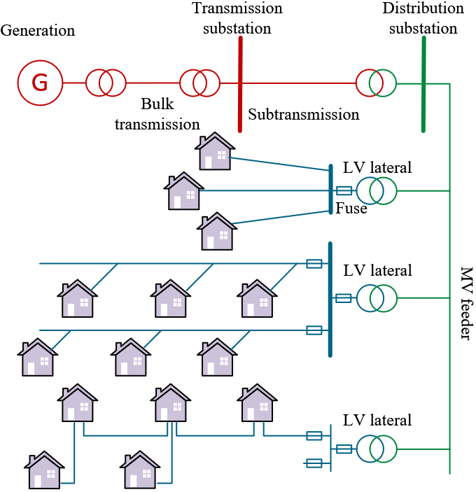









Overview
SCADA
ComEd
AES
MVEC
Micro-PMU
Alliant Energy
Cedar Falls
Algona Municipal
Smart Meter
Linn County REC
Diagram of a power system.
MiEnergy

Slide 3
Contents
Hosting Capacity Analysis
Electric Vehicle (EV) Charging Detection
Conservation Voltage Reduction (CVR) Assessment

Slide 4
Hosting Capacity Analysis - Voltage Estimation in Secondary Distribution Grids

Slide 5
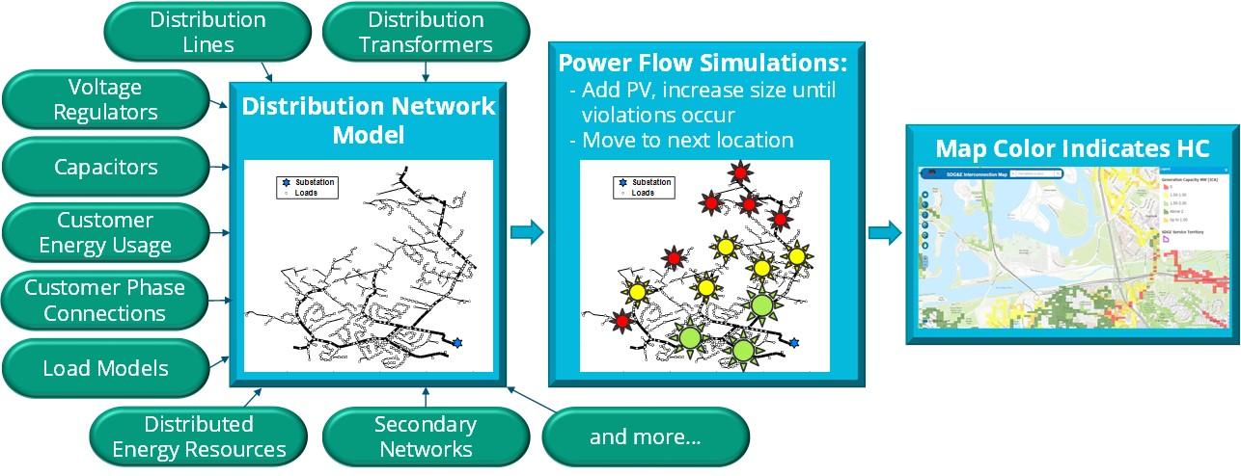
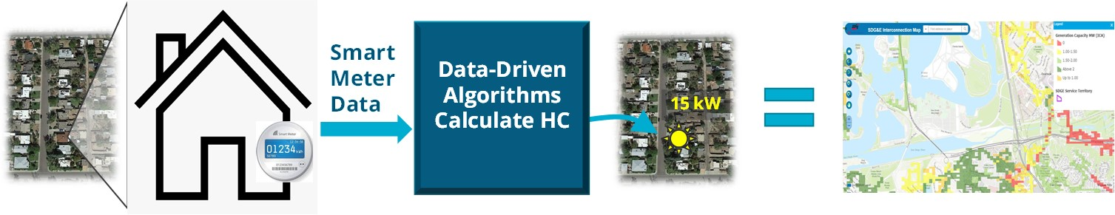
Background – Volt Estimation
Smart Meter Data: A Gateway for Reducing Solar Soft Costs with Model-Free Hosting Capacity (MoHCA) Maps
The objective of the project is to develop scalable algorithms for estimating the voltage-constrained and thermal-constrained HC at smart meter locations through Data-driven Model-free HCA method.
The developed algorithms will be validated on utility datasets and incorporated into Open Modeling Framework (OMF.coop).
Conventional model-based HCA
Data-driven model-free HCA
Notes:
Advantages of Data-driven Model-free HCA:
Any changes to the distribution network are inherently captured in the smart meter data
I.e., the approach is robust to phase changes, network upgrades, etc. without user intervention
Captures low-voltage secondary network characteristics, which are often missing or over-simplified in utility models
No simulations are required = much faster than model-based methods
Reduced computational burden means HC maps can be updated more frequently to keep pace with increasing levels of interconnection requests
Can accommodate both static and time-series hosting capacity analysis
Static: limited by any violation at any time during the year
Time-series: relaxes constraints to allow for some violations to occur (aligned with standards that allow temporary violations)

Slide 6
Voltage Estimation in Secondary Networks
Integrating DERs into distribution networks introduces voltage issues.
Model-free voltage calculation is a promising approach, yet existing research still presents certain limitations:
Voltage surge caused by PV generation
Overlooking low-voltage secondary distribution network (SDNets)
Performing poorly for high-impact, low-probability extreme voltage scenarios
Typically, black-box, lacking physics-informed interpretability
Fig. 11 The illustration of DER influence on customer voltage
We propose a model-free voltage calculation method for integrated primary-secondary networks based on a customized physics-inspired neural network (PINN) by using only smart meter data.
Note: Primary Distribution Network (PDNet) Secondary Distribution Network (SDNet) Power Flow (PFlw)

Slide 7
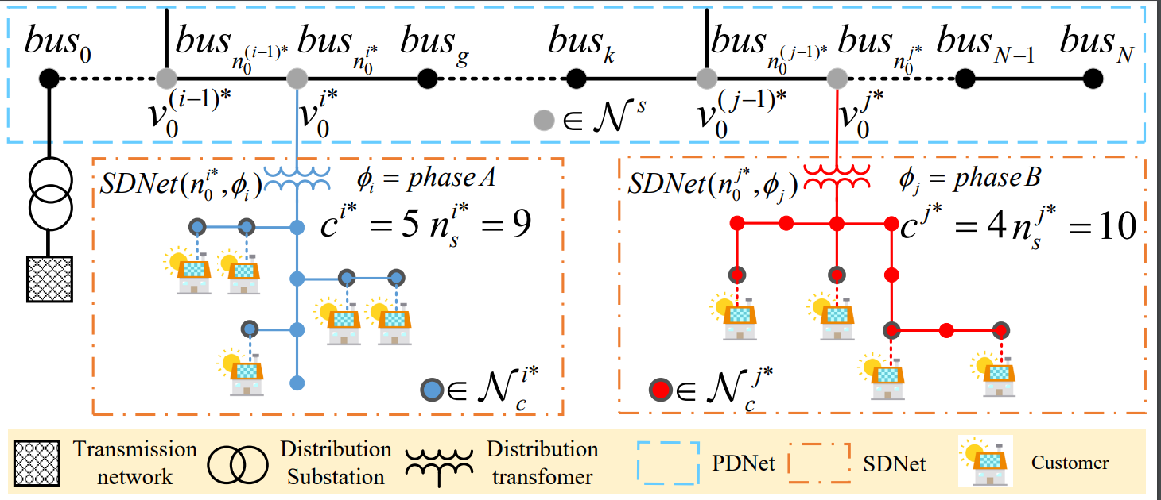
PDNet-SDNets Coupled Power Flow Model
To assist the design of PINN model structure, we develop a coupled power flow (PFlw) model for integrated primary-secondary networks.
The PFlw model explicitly captures the SDNets PFlw using linearized power flow equations, and implicitly considers the influence from PDNet PFlw changes.
Fig. 12 The structure of integrated primary-secondary distribution networks
PDNet-SDNets coupled PFlw model
Model the SDNets using linearized power flow equations.
Customers’ active power and reactive power recorded by smart meters
Consider the voltage variances at customer nodes caused by the PFlw changes in the PDNet.
Squared voltages recorded by customers’ smart meters
Compensate for the linearization error caused by lines’ and secondary xfrms’ losses.
Notes:
The PDNet-SDNets coupled PFlow model represents the SDNets PFlow using linearized power flow (LPF) equations. Typically, when employing the LPF model, the voltage at the head node bus is assumed to be a constant V_0​. However, in our case, the voltage of the head nodes for the SDNets (highlighted in the figure) fluctuates due to PFlow changes in the PDNet. Consequently, we've incorporated an additional term in the model to subtly account for the intricate influences stemming from the PDNet
“implicitly” because we cannot write down an explicit math expression of the influence, and it has to be captured by NN

Slide 8
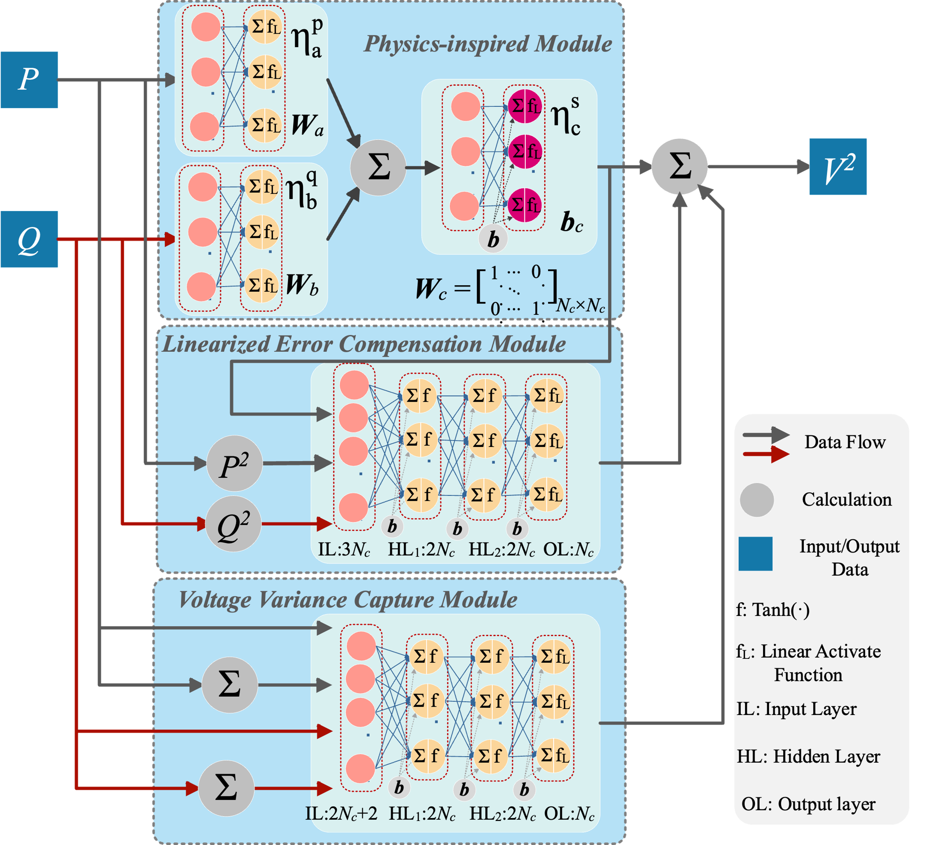
Physics-inspired Model-Free Voltage Estimation
Inspired by the coupled PFlw model, we design a PINN model
Physics-inspired module (PIM)
We design the PIM module to capture the linearized power flow equations of the SNDets.
The inputs of the PIM module are P,Q data for all customers.
Linearized error compensation module (LECM)
We use a fully connected neural network to capture the linearization error caused by lines’ and xfrms’ losses.
Squared P, Q data and squared approximate V of each customer are considered as inputs.
Voltage variance capturing module (VVCM)
We utilize a fully connected neural network to capture the customer voltage variance caused by PFlw changes in the PDNet.
The P, Q data of each customer and total P, Q loads of all customers are the inputs.
Fig. 13 The structure of the proposed PINN model
Notes:
Based on the format of the PDNet-SDNets coupled PFlw model, we design the PINN model.
Actually, vc is V square, but most papers just use vc to represent V square.
The NN is trained for the entire networks because we do not have any topology/connectivity information.
Physics-inspired module (PIM) use linear layer to simulate the linearized power flow equations of the SNDets. I use three red dashed boxes to exhibit the three main parts of the module. We don’t need to pay more attention to the inside of the boxes.
Because the Linearization error is related to the quadratic terms of load and voltage, we use the squared P, Q data, and squared v as input. It should be noted that the squared voltage used here is the approximate voltage from the PIM module. After all, the squared v is the model's output; we cannot know it ahead of time.

Slide 9
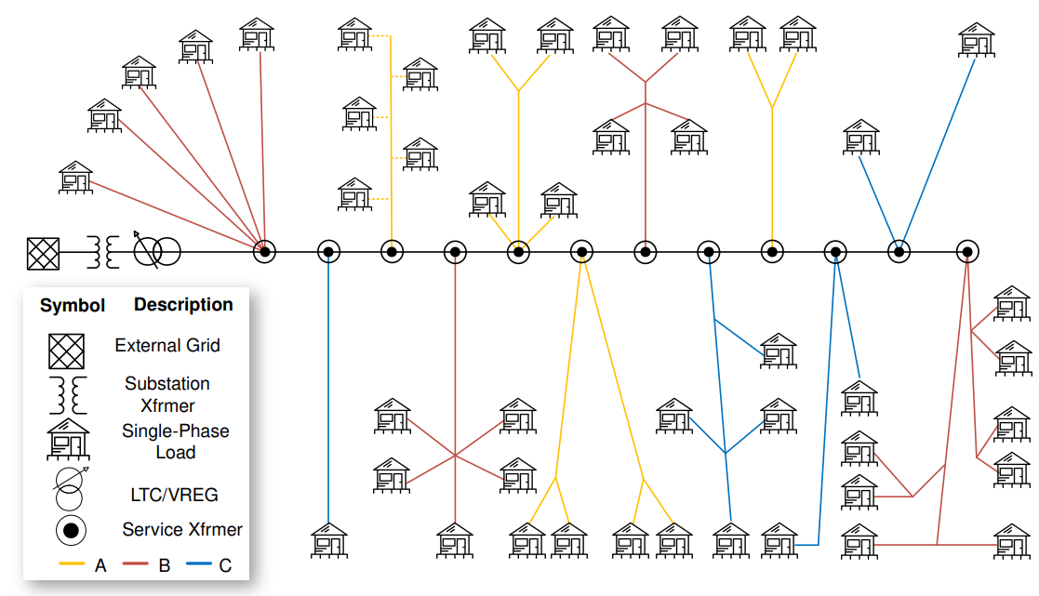
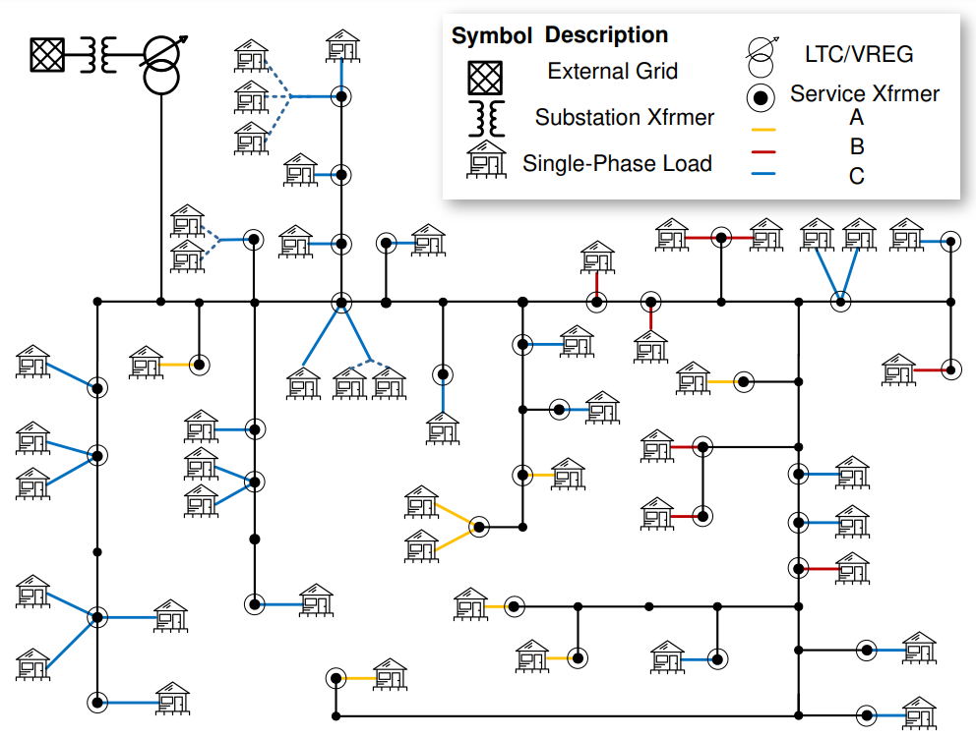
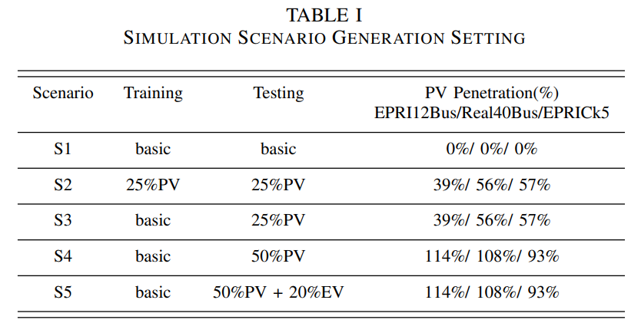
Case Studies
Three distribution feeder models are used to perform case studies, and each model integrates secondary xfrms and SDNets.
Two public testing circuits, namely, EPRI Secondary Topology Model marked as “EPRI12Bus” and EPRI Ck5 circuit.
One real utility feeder marked as “Real40Bus”.
We test the proposed model in five scenarios, denoted as S1 to S5 in Table I.
The PV load data comes from over 300 solar inverters at 4-10 kW in Midwest U.S. The EV data is collected from various real datasets and has charging capacities at 3-10 kW.
Fig. 14 Topologies of EPRI12Bus model (left) and Real40Bus model (right)
Notes:
The “basic” represent the historical data without additional PV or EV loads.
In S1, we fully trained and tested the model on historical data without additional PV or EV loads, assessing its performance under normal conditions.
S2 introduced PV for 25\% of customers in both training and testing data. This scenario tested the model's performance under increased voltage variations caused by fluctuating PV generation.
In S3, S4, and S5, the datasets included various PV and EV penetration levels, while the training data remained historical data as in S1. These experiments evaluated the model's extrapolation capability under ``unseen" scenarios.
The “25%PV” means 25% of the customers have PV systems
The Penetration here is calculated by PV Penetration = (Peak PV Power) / (Peak Load Apparent Power)

Slide 10
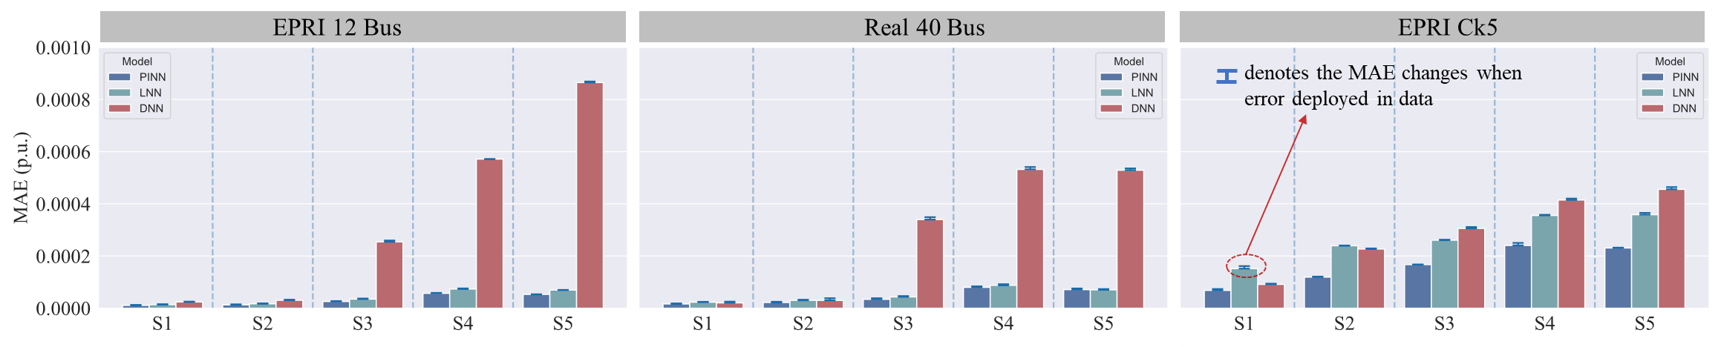
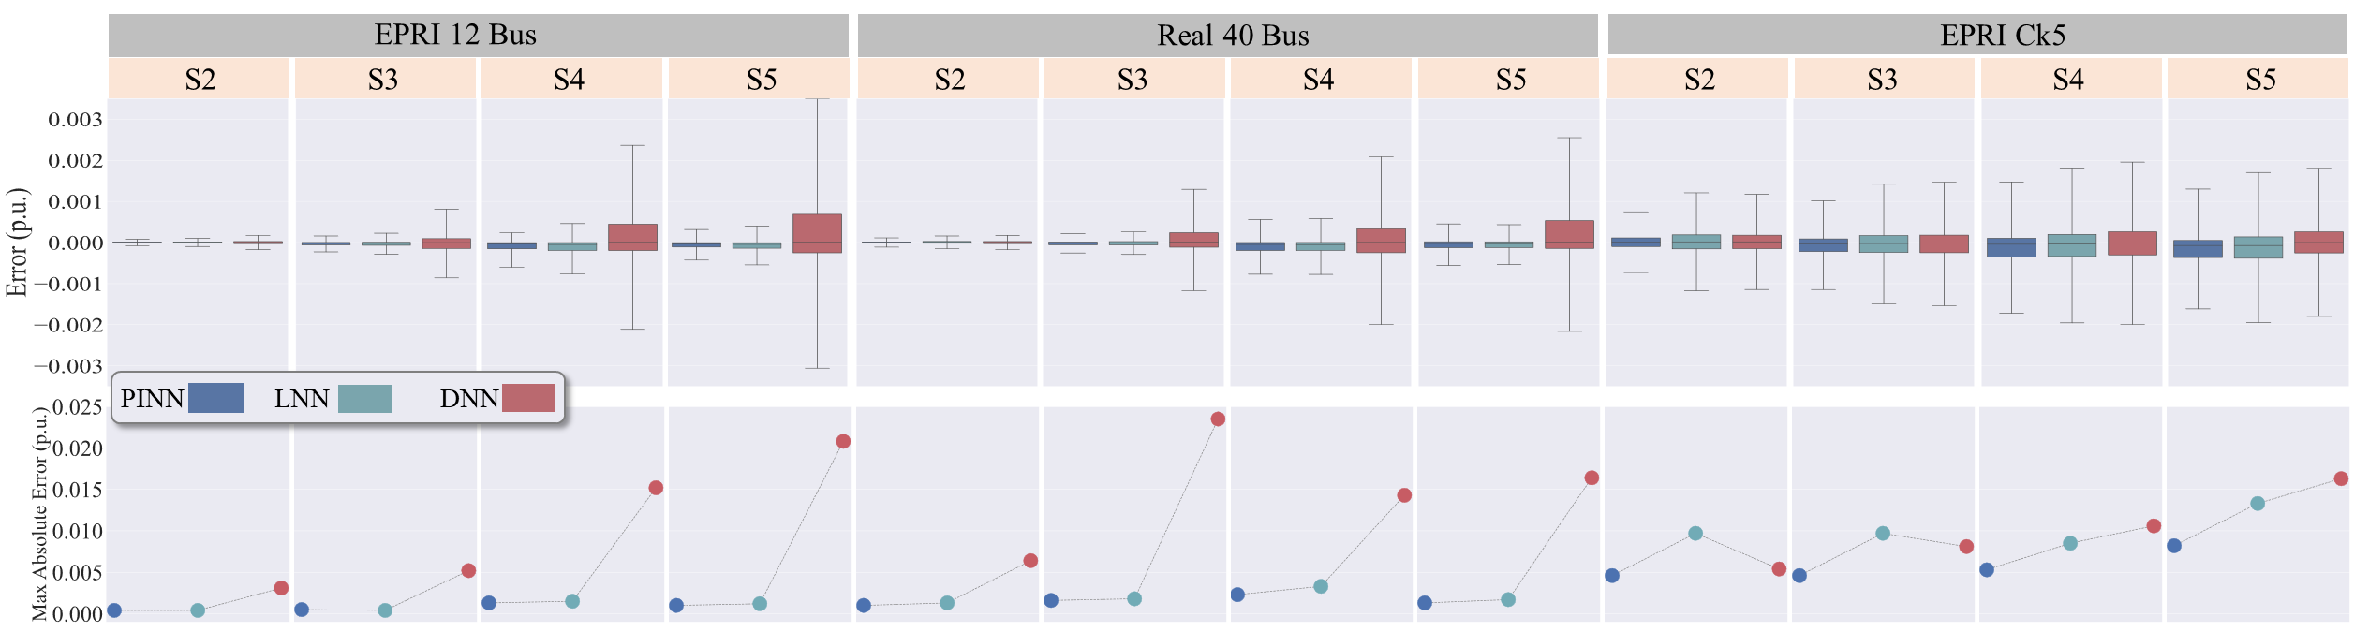
10
Case Studies
Models are built on one-year smart meter data, among which 80% data is used for training and 20% is used for validating, and then tested on another one-year data. The errors of voltage calculation results are shown below.
Fig. 15 The MAE of three models over different scenarios based on accurate data and noise-added data
Fig. 16 The error distribution of three models over different scenarios during daytime (6 a.m. to 6 p.m.) period and max absolute error in each scenarios
Notes:
We also apply 0.5% noise in each scenario, which means measurements adhere to ±0.5% of true values, on the training and testing data. Above each bar in Fig.5 , there is a blue symbol to represent how the MAE varies when the noise is considered. The error increase is not obvious.
In scenarios S1 and S2, where no unseen cases are present in the test set, the normal DNN model and our PINN model both perform well. However, in the S3. S4 and S5, where new scenarios are generated, the DNN does not exhibit a good voltage calculation accuracy, while the PINN still performs well.
When the testing model is small (e.g., EPRI12Bus and Real40Bus), the accuracy of the two models is similar. However, in the EPRICk5 model, where the PFlw relationships of PDNet become more complex due to a larger number of buses, the LNN model (linear NN, no compensation, i.e., no LECM or VVCM) struggles to capture these complexities, resulting in increased MAE errors. Conversely, including compensation modules in the PINN model enhances its performance, particularly in complex scenarios where PFlw relationships are intricate.
Validation is a process to tune NN parameters according to the outputs.
Testing is a process to really test the NN without any further tuning.

Slide 11
EV Charging Detection

Slide 12
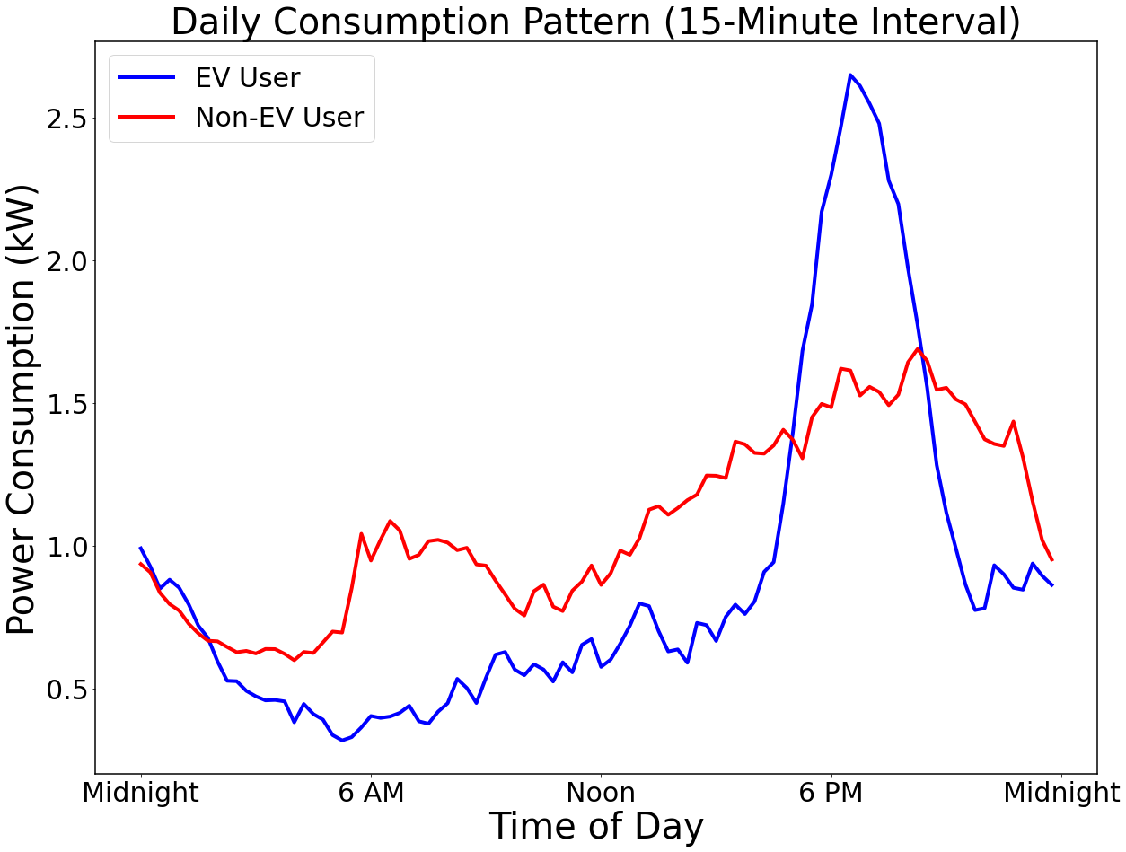
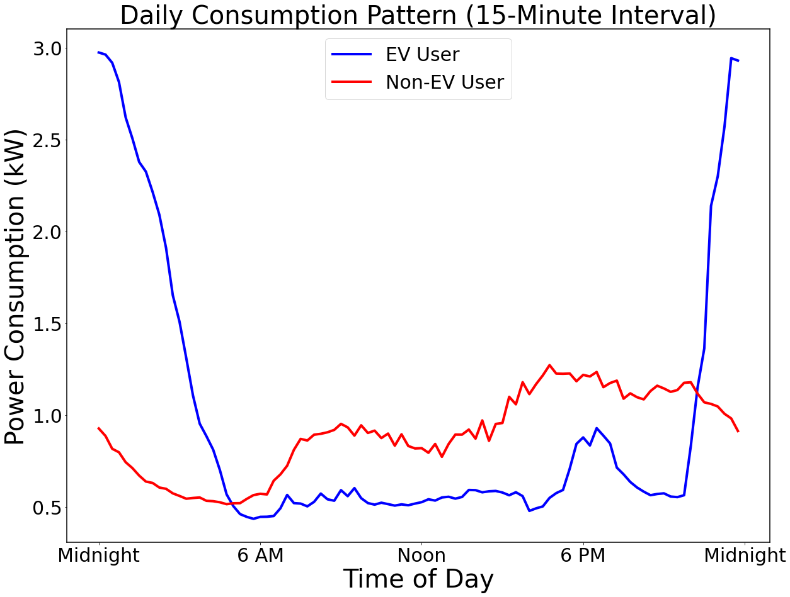
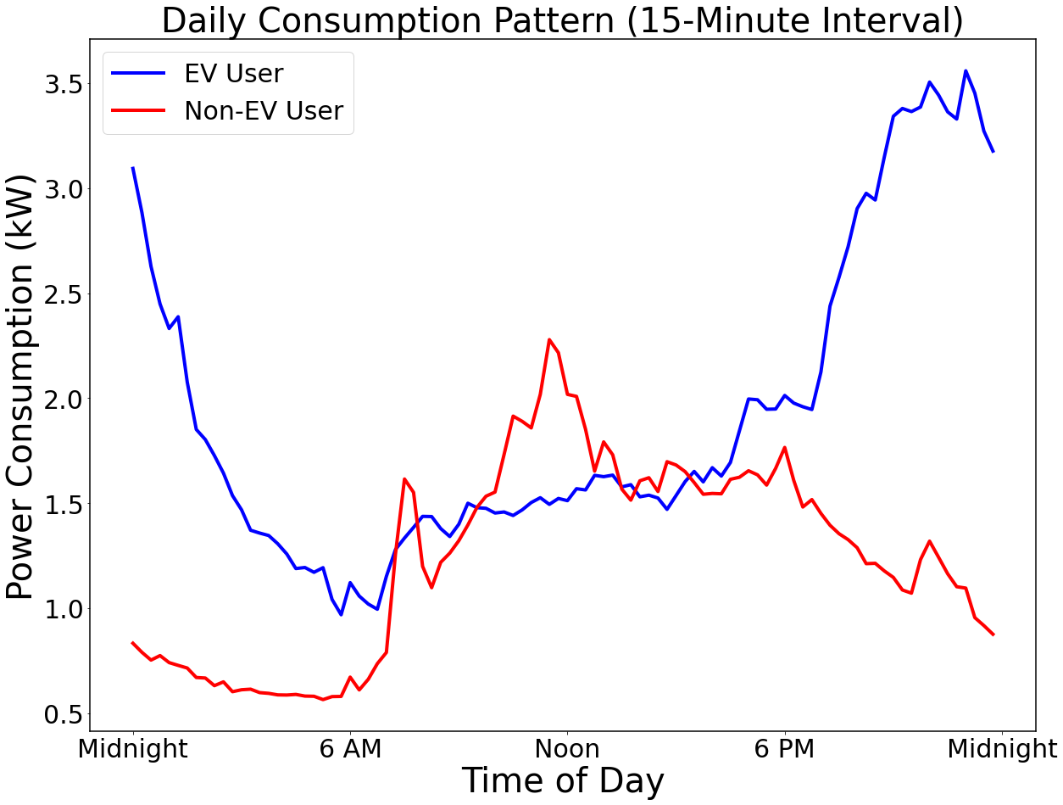
Introduction to Utility EV Dataset
One year (2023/10/01 – 2024/09/30) of customer AMI data from customers with and without EVs (no sub-meter for EV), under 15-minute resolution, were provided by a utility partner.
After clean up and pre-processing, the dataset includes 298 aggregated load data from customers with EVs (EV Users) and 21,735 load data from customers without EVs (non-EV Users).
The figures below show six users’ daily consumption plots as examples.
Notes:
clean up and pre-processing of the data:
1. Remove missing and bad data.
2. Did not normalized the data because we want to see the true consumption difference and variations between two types of user.
3. We may not guarantee that the non-EV customer data is well updated and correct labeled. The non-EV users dataset could also contain some newer EV users that have not been reported to the utility, neither by file a rebate, nor request for a TOU rate. Therefore, we assume that the non-EV dataset will potentially have some EV users and induced some noise. To ensure the data quality and perform an extra check, we adopt isolation forest method to remove the potential EV profiles. Basically, the potential EV users are detected as outliers or anomaly data compared to the customer without EV, and they are removed from the dataset. It also removed the customer with erroneous data recorded by SM errors. Considering the remaining dataset is huge, it is acceptable to simply remove those customers. This process is not a major contribution of the work so we can skim it if audience did not ask.

Slide 13
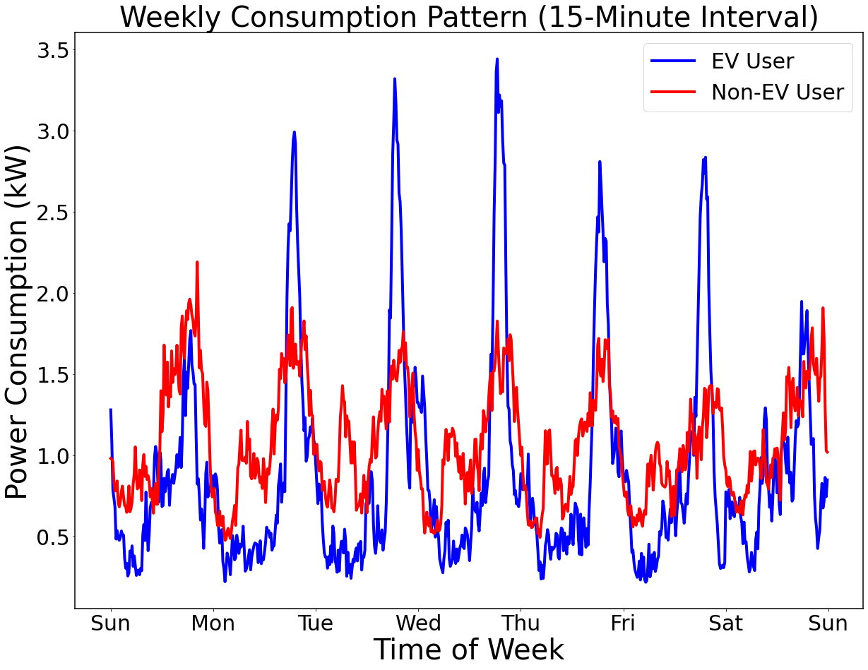
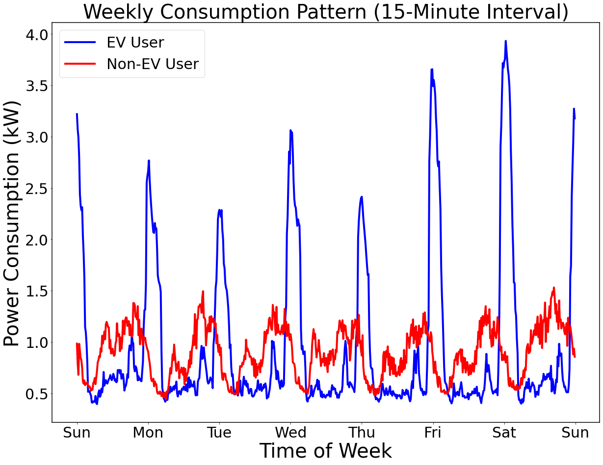
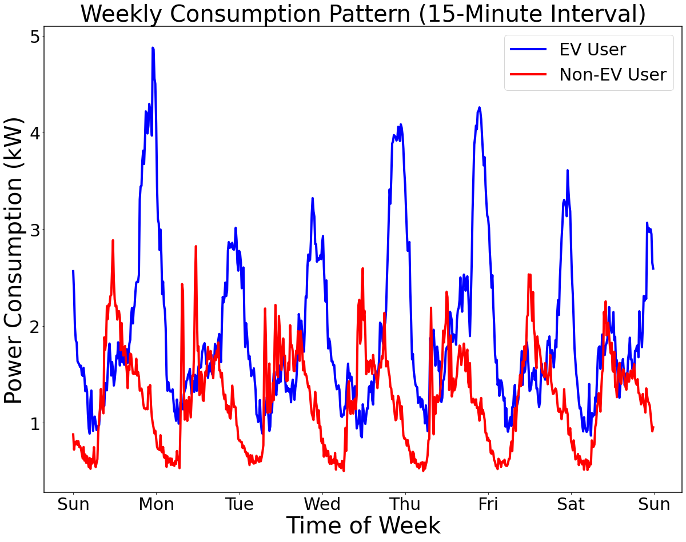
Introduction to Utility EV Dataset
The figure below illustrates the weekly consumption of six users, three users are with EVs.
Despite there exist visible differences between the two user groups, an algorithm for automatic EV detection is needed for a faster, scalable, and more accurate detection.

Slide 14
EV Detection Using Real Utility AMI Data
Problem Statement:
Identify EV users in the distribution network based on consumption patterns.
Develop an open-source tool to enable utilities to quickly visualize user consumption patterns and identify EV penetration levels.
Challenges:
Imbalance between EV and non-EV data (non-EV data >> EV data).
EV charging behaviors are highly random, which requires methods to discover hidden features in the EV data.
Solutions:
Apply a Random Forest classifier, which performs well with imbalanced datasets and temporal features, reduces overfitting, and handles large datasets efficiently.
Use sliding window and feature engineering techniques to capture temporal dynamics and enhance feature representation.

Slide 15
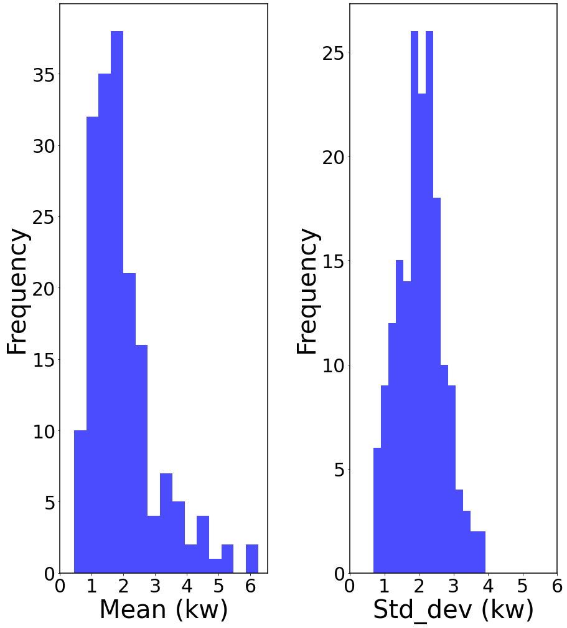
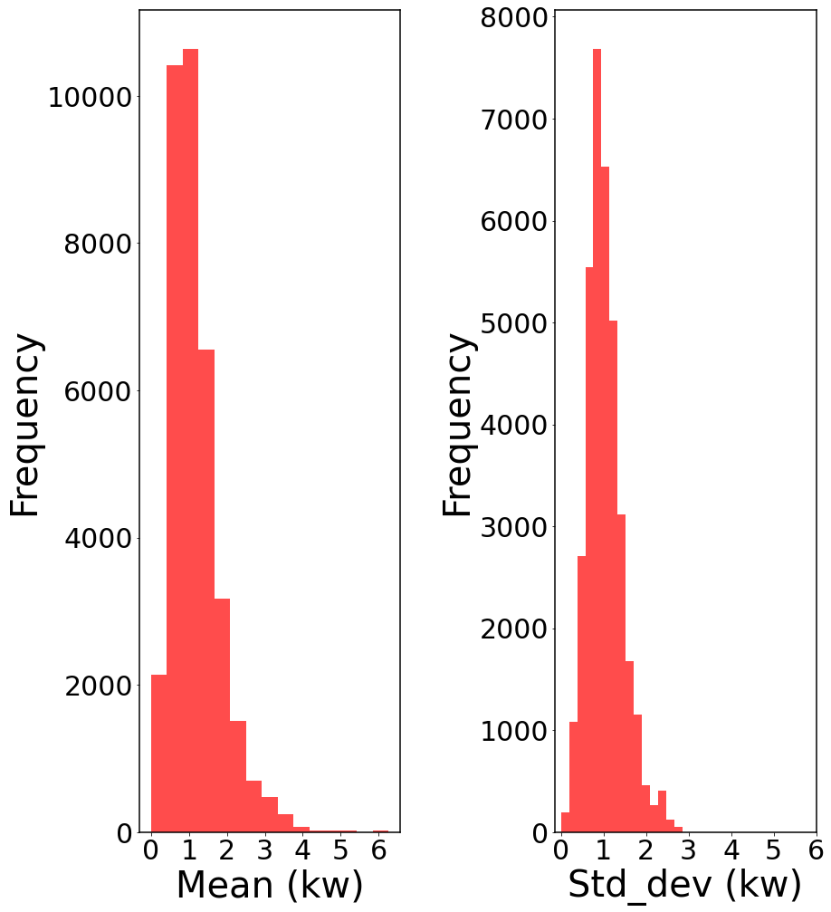
EV Detection Algorithm – Feature Engineering
Apply feature engineering to explore temporal information and hidden features.
Statistical Features:
Calculate statistical features such as global mean, maximum, and standard deviation for each customer across the entire time span; and averages for each sliding window to capture overall patterns.
These features distinguish between high-consumption spikes (from EV charging) and non-EV patterns.
The plots illustrate the distributions of global means and standard deviations for EV and non-EV users.
EV Users
Non-EV Users
Level-2 EV chargers can reach 15-19 kW power, which creates visible spikes in some customer data.
EV users usually have a higher standard deviations.
Global mean value distributions are similar for EV and non-EV users.
Notes:
Difference between global mean and moving window mean:
- The global mean is the average for each customer across the entire time span.
- The average for each sliding window is the mean for each window. After testing, we choose the window size to be 1 day (96 data points), and each time we slide a window by 6 hours (24 points) ahead to create overlapping windows, capturing more granular, continuous changes in the data. This can be useful for capturing short-term variations that might indicate EV charging events.

Slide 16
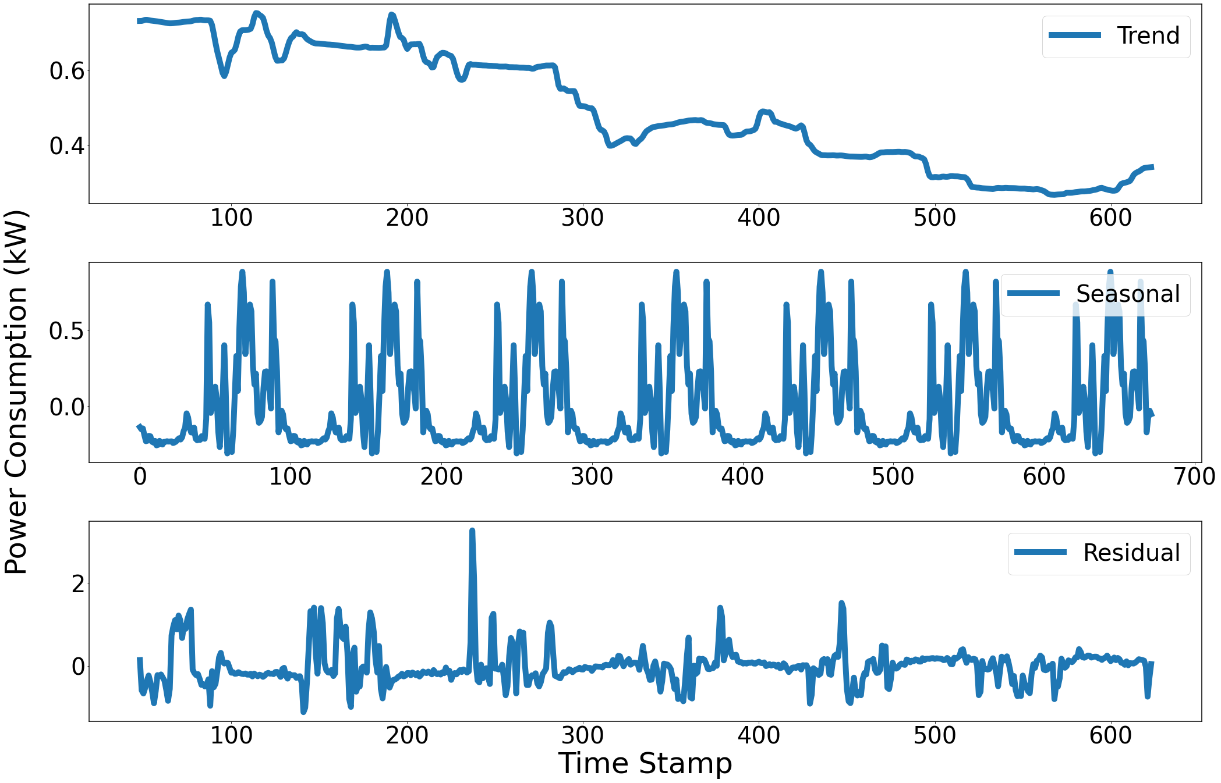
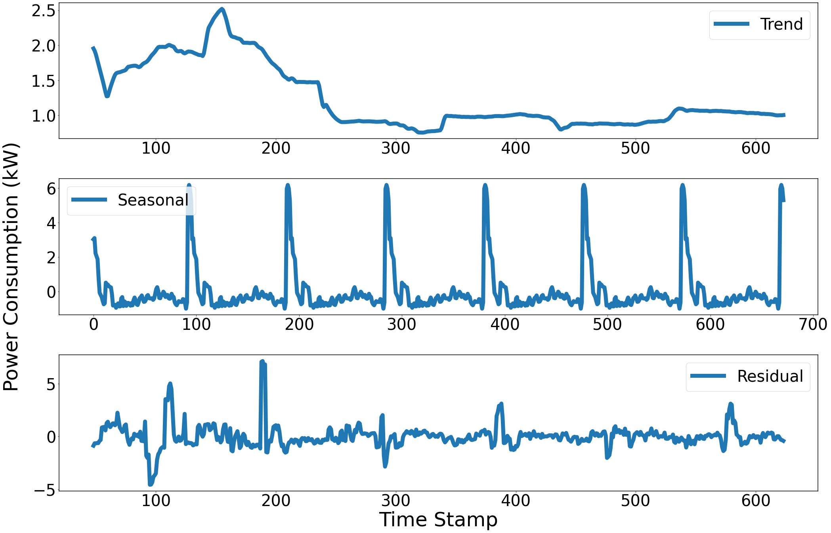
EV Detection Algorithm – Feature Engineering
EV charging is a repeated behavior; thus, it is necessary to discover the trend in the data.
Seasonal Decomposition:
Decompose time-series data into trend, seasonal, and residual components to capture recurring patterns.
Trend shows long-term changes that may correlate with consistent charging habits.
Seasonal reveals recurring behaviors, such as regular charging times.
Residuals capture anomalies or irregular spikes that could indicate irregular EV charging sessions.
Non-EV user
Stable EV usage
EV user
One-week snapshot of Seasonal Decomposition Components for one non-EV user and one EV user as an example.
Notes:
The plot is from the same week for EV and non-EV users. We perform this decomposition for each customer across the entire time span.
Seasonal Component
The trend component could indicate when an EV is frequently charged, this trend becoming stable over time, indicating the charging pattern is more detectable.
Seasonal Component:
For EV users, the seasonal component captures regular charging patterns, such as daily or weekly peaks at specific hours or days (e.g., overnight charging).
Residual (or Irregular) Component
The residual component might indicate unscheduled EV charging sessions, irregular appliance use, or other unexpected high-power events. This helps filter the data.
Equations for calculating those three components are in the backup slides.

Slide 17
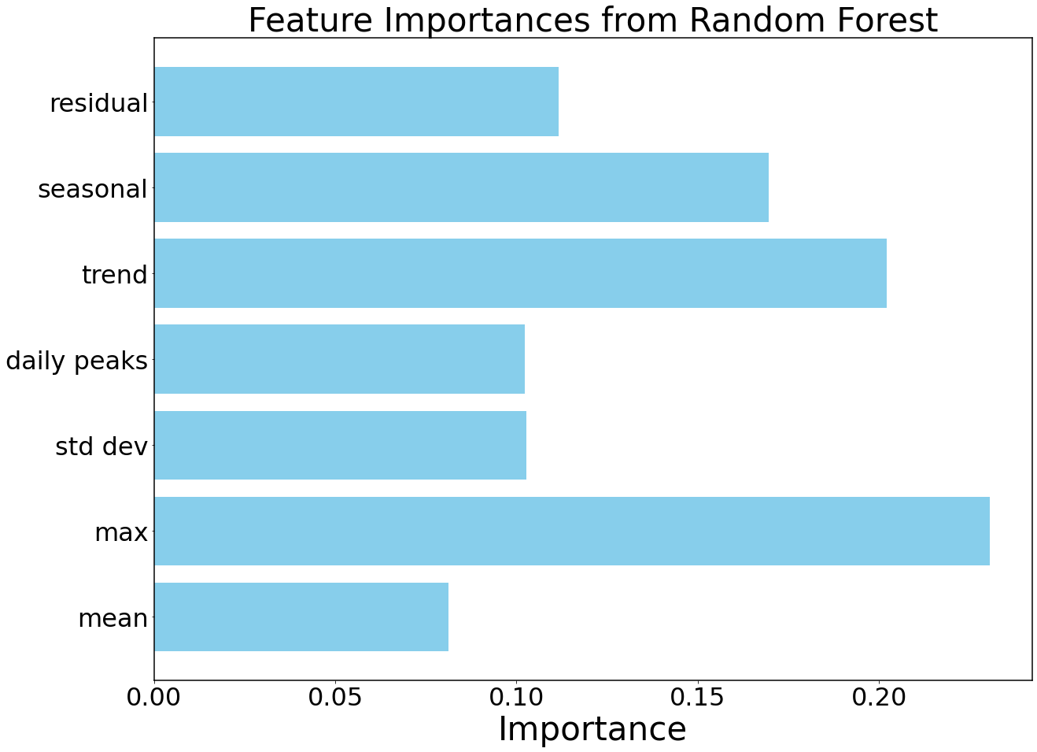
EV Detection Algorithm – Training result
Random Forest can rank the importance of features.
We can see that the trend (consistent high-power usage when an EV is frequently charged), max value, and seasonal (regular charging patterns, such as daily or weekly peaks at specific hours or days) have higher impacts in the RF training.
The newly added feature engineering approach is useful in the RF training process.

Slide 18
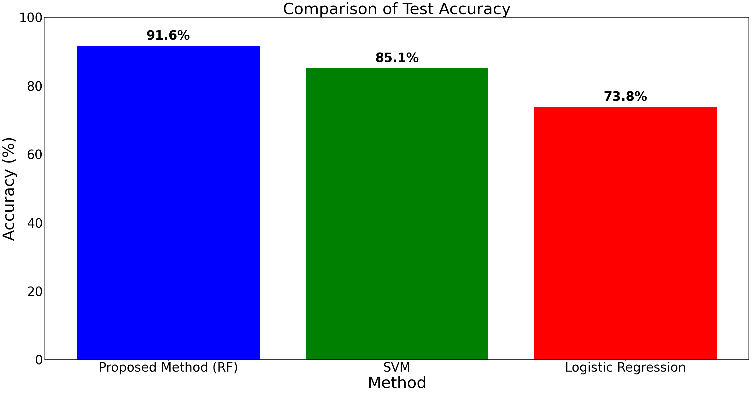
EV Detection Algorithm – Training result
The prediction results show that the detection accuracy using the test set (10,614 customers) is 91.6%.
Compare proposed RF with two widely used methods: Support Vector Machine (SVM) and Logistic Regression.
The results indicate that the proposed method achieves the highest accuracy in EV detection.
Notes:
Detailed performance metrics in backup slides.

Slide 19
Conservation Voltage Reduction

Slide 20
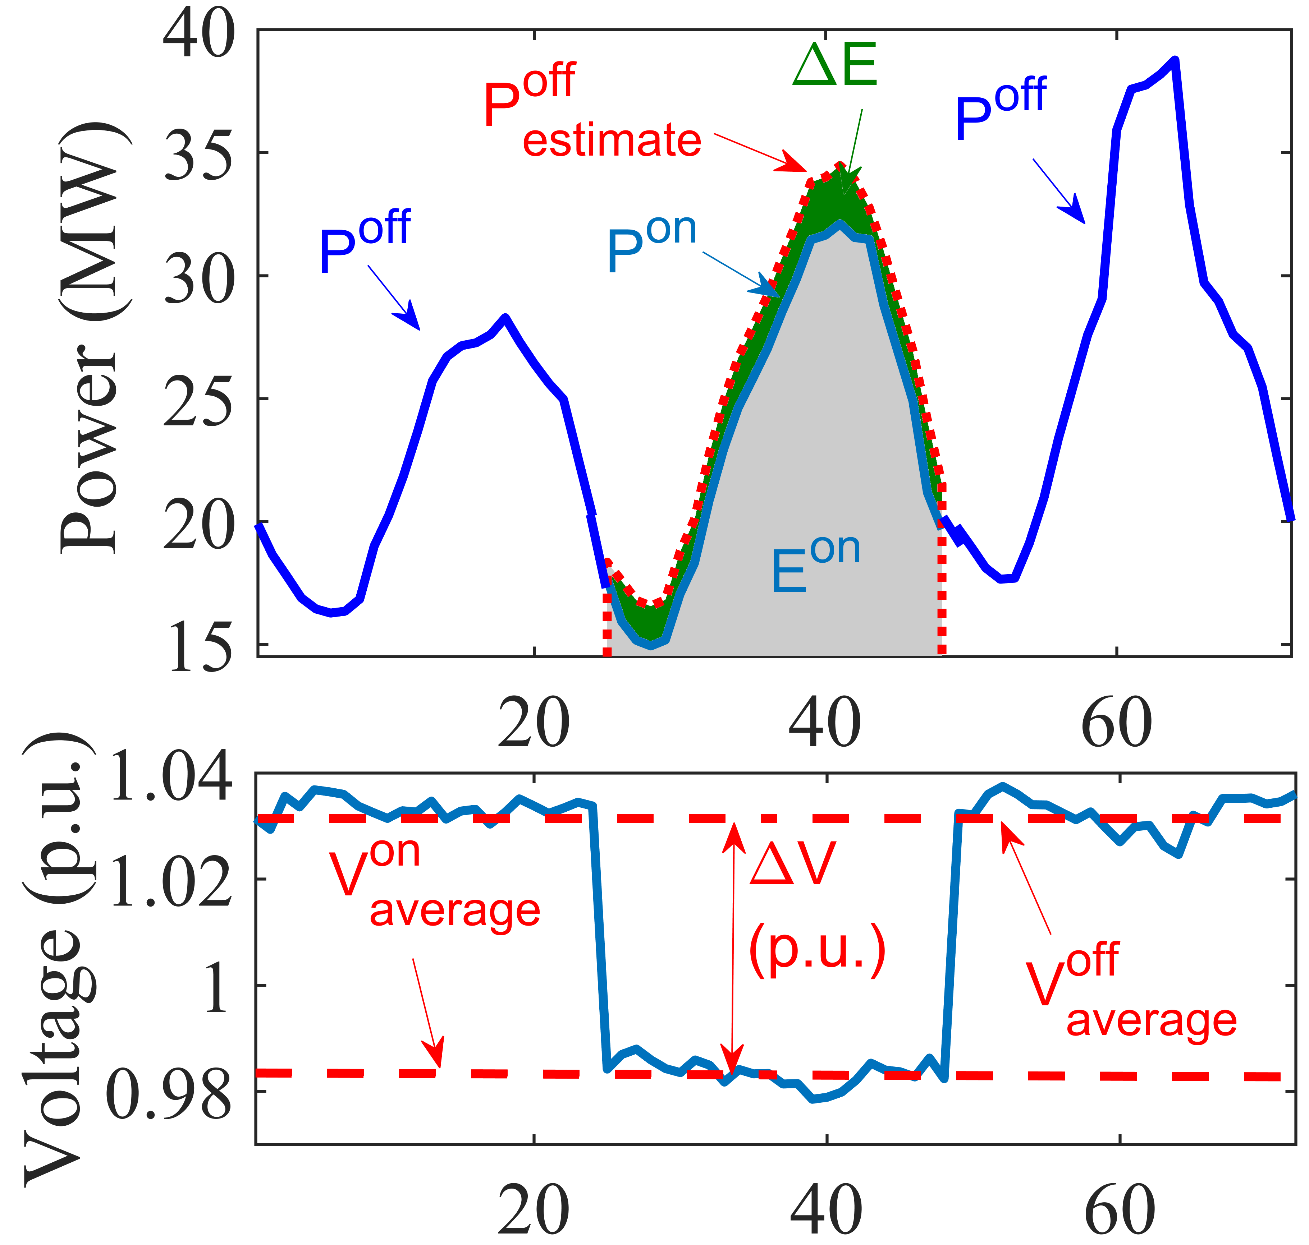
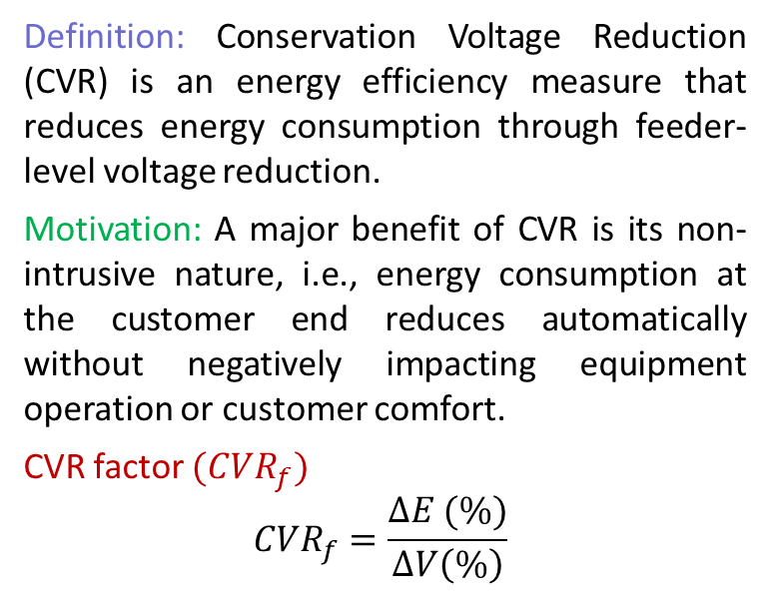
Conservation Voltage Reduction
Definition: Conservation Voltage Reduction (CVR) is an energy efficiency measure that reduces energy consumption through feeder-level voltage reduction.
Motivation: A major benefit of CVR is its non-intrusive nature, i.e., energy consumption at the customer end reduces automatically without negatively impacting equipment operation or customer comfort.
CVR factor $({CVR}_{f})$
$${CVR}_{f}=\frac{∆E (\%)}{∆V\left(\%\right)}$$
Fig. 1 Definition of CVR.

Slide 21
IEEE Std. P3102 Standard for Conservation Voltage Reduction (CVR) Data Collection and Management Procedures
Initiated and led by ComEd
IEEE PES T&D Committee
IEEE Standard Association
Passed 3 rounds of balloting, approved by IEEE RevCom, to be online soon
Data Collection
Anh Tran/ Damien Tholomier/ Wen Fan
Data Cleaning
Ahmed Saber/ Hong Chun/ Wen Fan
Data Reconstruction
Amin Khodaei/ Shakil Hossan
Methodology Selection
Zhaoyu Wang/Zixiao Ma/ Yingmeng Xiang/Amin Khodaei

Slide 22
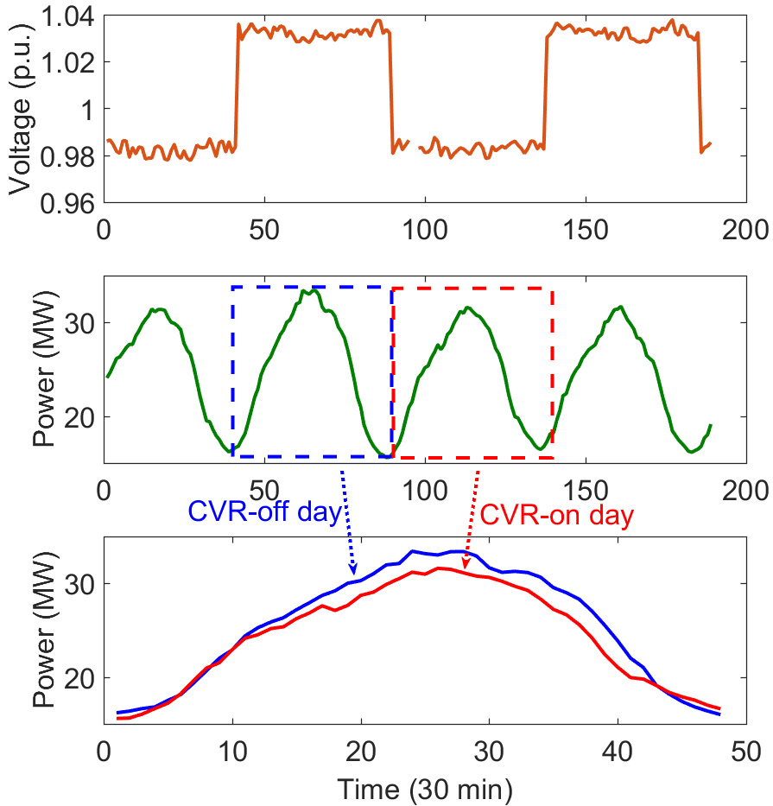
Methodologies
Comparison-Based Method
There are two approaches in comparison-based method.
Select two similar feeders in the same performance period (similar configurations, topologies, loading conditions). Voltage reduction is applied to only one feeder.
Perform a CVR test on a feeder and apply normal voltage to the same feeder but during another time period with similar loading conditions.
Fig. 2 Demonstration of comparison-based method for evaluating CVR factor.

Slide 23
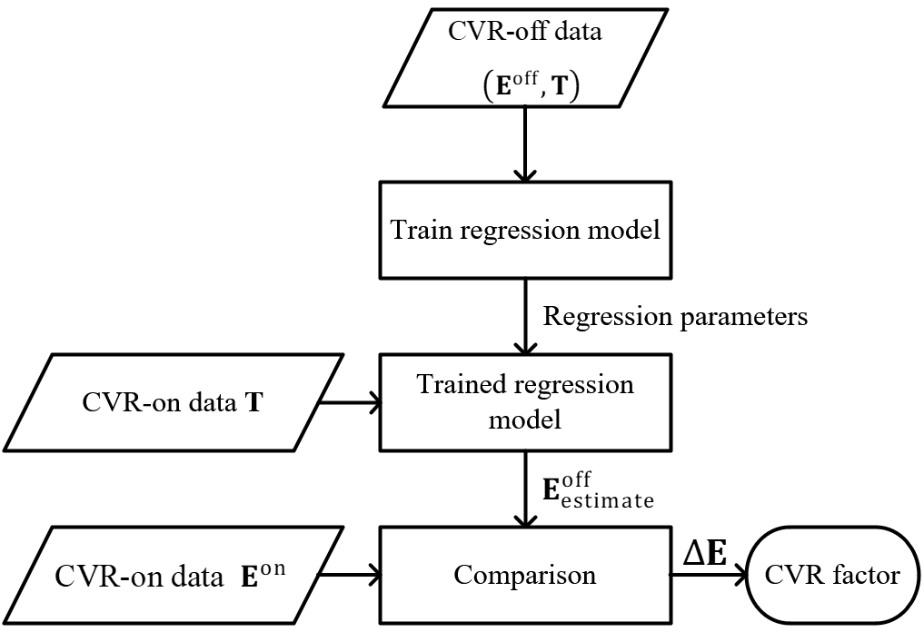
Methodologies
Regression-Based Method
In regression-based method, load consumption is modeled as a function of certain impact factors, e.g., temperature.
A model for the normal-voltage load is identified using linear regression, and its outputs are compared with the measured reduced-voltage load to calculate the CVR factor.
Fig. 3 Flowchart of regression-based method for evaluating CVR factor.

Slide 24
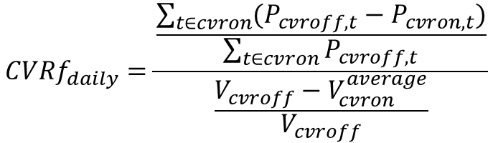
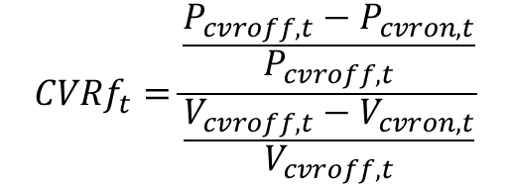
Regression-Based Method
Substation-level power and voltage data, ambient temperature, time stamps.
The real-time CVR factors are computed using the active power difference between real-time baseline active power and measured active power, and the real-time voltage difference between baseline voltage and measure voltage, which only needs single data points.
The daily CVR factors are computed using the energy difference between the baseline active load and measured load over the CVR on period, and the voltage difference between the baseline voltage and the average measured voltage over the CVR on period.
Real-time CVR factor
$$CVRf_{t}=\frac{\frac{P_{cvroff,t}−P_{cvron,t}}{P_{cvroff,t}}}{\frac{{V_{cvroff,t}−V}_{cvron,t}}{V_{cvroff,t}}}$$
$$CVRf_{daily}=\frac{\frac{\sum_{t∈cvron}{(P_{cvroff,t}−P_{cvron,t})}}{\sum_{t∈cvron}{P_{cvroff,t}}}}{\frac{V_{cvroff}−V_{cvron}^{average}}{V_{cvroff}}}$$
Daily CVR factor

Slide 25
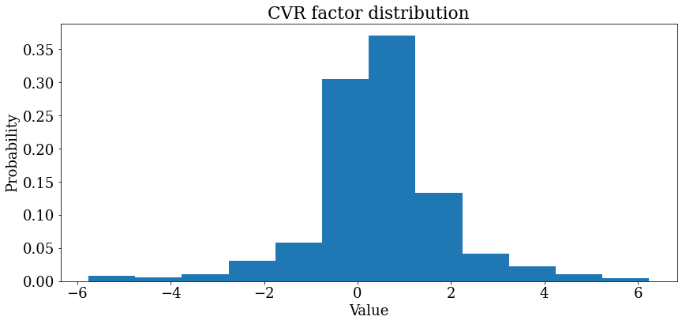
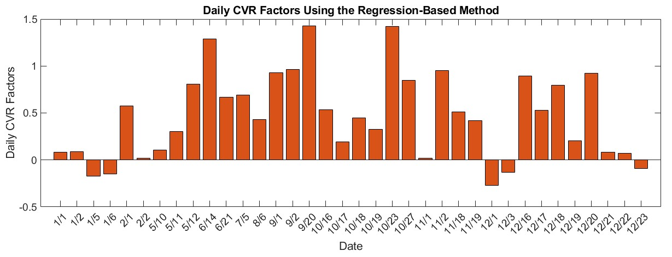
Regression-Based Method
Because LSTM model outputs are baseline load, most of the predicted loads are higher than the measurement. However, due to inherent randomness in load, some predicted baseline loads are still lower than the measurements, leading to negative CVR factors.
The real-time CVR factors obtained from the regression-based method ranges between -6 to 6, with a concentration between -1 to 2 (82.14%).
The obtained daily CVR factors range between
-0.267 to 1.491.
Fig.4 Real-time CVR factor distribution using the regression-based method
Fig.5 Sorted daily CVR factors for Farley substation in year 2022

Slide 26
Methodologies
Load Modeling-Based Method
Distribution Substation
Measurement Devices
The nature of CVR is that electrical loads are sensitive to voltage. Whether voltage reduction is applied or not, loads are always sensitive to voltage and the sensitivities vary with time due to the ever-changing load compositions.
In the load modeling-based method, load consumption is represented as a function of voltage and other exogenous factors. This function can be used to capture the load-to-voltage sensitivities by identifying the model parameters in real time.
CVR Factor Calculation
Load Model
Identified load model
_
+
Identification Algorithm
Fig. 6 Demonstration of load modeling-based method for evaluating CVR factor.

Slide 27
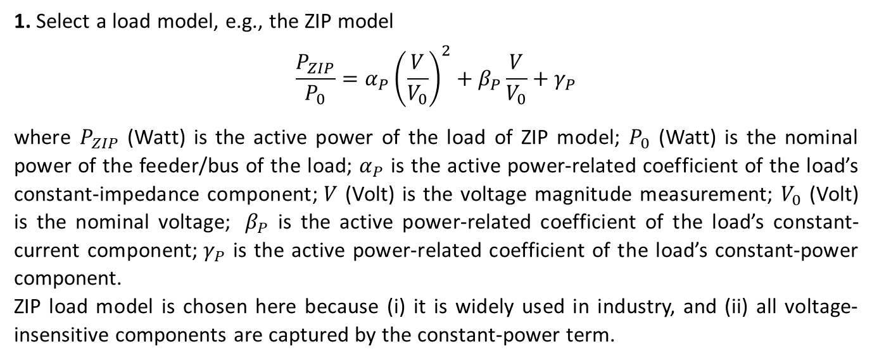
Methodologies
Load Modeling-Based Method
1. Select a load model, e.g., the ZIP model
$$\frac{P_{ZIP}}{P_{0}}=α_{P}{\left(\frac{V}{V_{0}}\right)}^{2}+β_{P}\frac{V}{V_{0}}+γ_{P}$$
where $P_{ZIP}$ (Watt) is the active power of the load of ZIP model; $P_{0}$ (Watt) is the nominal power of the feeder/bus of the load; $α_{P}$ is the active power-related coefficient of the load’s constant-impedance component;$V$ (Volt) is the voltage magnitude measurement; $V_{0}$ (Volt) is the nominal voltage; $β_{P}$ is the active power-related coefficient of the load’s constant-current component;$γ_{P}$ is the active power-related coefficient of the load’s constant-power component.
ZIP load model is chosen here because (i) it is widely used in industry, and (ii) all voltage-insensitive components are captured by the constant-power term.

Slide 28
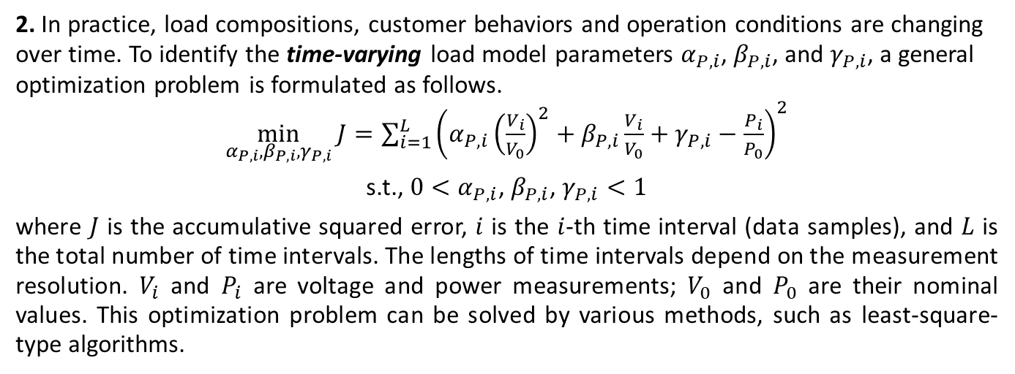
Methodologies
Load Modeling-Based Method
2. In practice, load compositions, customer behaviors and operation conditions are changing over time. To identify the time-varying load model parameters $α_{P,i}$, $β_{P,i}$, and $γ_{P,i}$, a general optimization problem is formulated as follows.
$\min_{α_{P, i}, β_{P,i}, γ_{P,i}}{J=\sum_{i=1}^{L}{{\left(α_{P,i}{\left(\frac{V_{i}}{V_{0}}\right)}^{2}+β_{P,i}\frac{V_{i}}{V_{0}}+γ_{P,i}−\frac{P_{i}}{P_{0}}\right)}^{2}}}$
s.t., $0<α_{P,i}$, $β_{P,i}$, $γ_{P,i}<1$
where $J$ is the accumulative squared error, $i$ is the $i$-th time interval (data samples), and $L$ is the total number of time intervals. The lengths of time intervals depend on the measurement resolution. $V_{i}$ and $P_{i}$ are voltage and power measurements; $V_{0}$ and $P_{0}$ are their nominal values. This optimization problem can be solved by various methods, such as least-square-type algorithms.

Slide 29
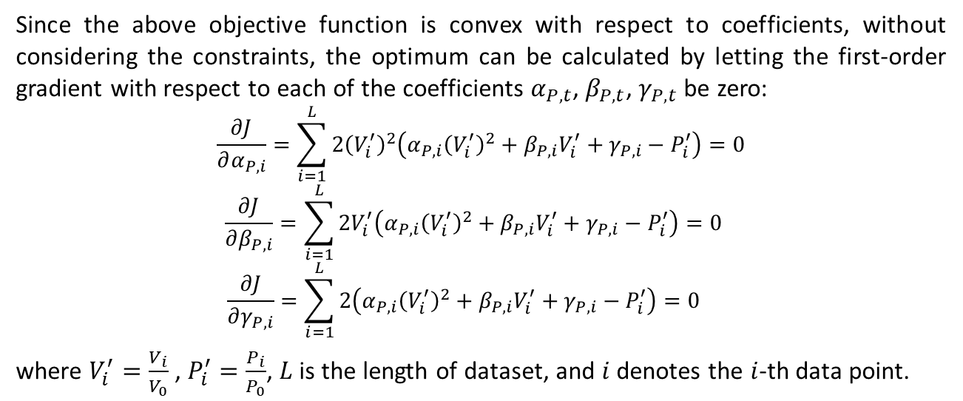
Methodologies
Sliding Window-based Time-Varying Load Parameter Identification
Since the above objective function is convex with respect to coefficients, without considering the constraints, the optimum can be calculated by letting the first-order gradient with respect to each of the coefficients $α_{P, t}$, $β_{P,t}$, $γ_{P,t}$ be zero:
$$\begin{aligned}\frac{∂J}{∂α_{P, i}}=\sum_{i=1}^{L}{2{\left(V_{i}^{′}\right)}^{2}\left(α_{P, i}{\left(V_{i}^{′}\right)}^{2}+β_{P,i}V_{i}^{′}+γ_{P,i}−P_{i}^{′}\right)}=0\end{aligned}$$
$$\begin{aligned}\frac{∂J}{∂β_{P, i}}=\sum_{i=1}^{L}{2V_{i}^{′}\left(α_{P, i}{\left(V_{i}^{′}\right)}^{2}+β_{P,i}V_{i}^{′}+γ_{P,i}−P_{i}^{′}\right)}=0 \end{aligned}$$
$$\begin{aligned}\frac{∂J}{∂γ_{P, i}}=\sum_{i=1}^{L}{2\left(α_{P, i}{\left(V_{i}^{′}\right)}^{2}+β_{P,i}V_{i}^{′}+γ_{P,i}−P_{i}^{′}\right)}=0 \end{aligned}$$
where $V_{i}^{′}=\frac{V_{i}}{V_{0}}$ , $P_{i}^{′}=\frac{P_{i}}{P_{0}}$, $L$ is the length of dataset, and $i$ denotes the $i$-th data point.

Slide 30
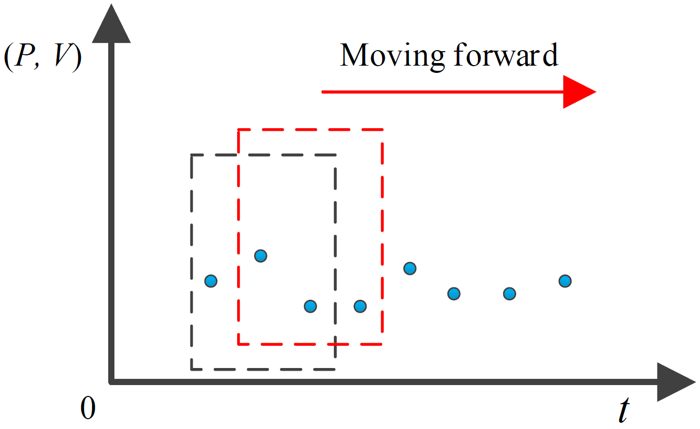
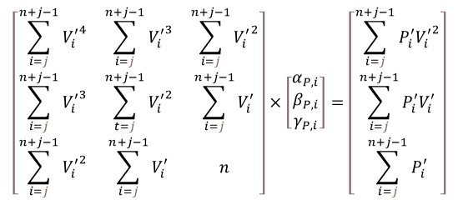

Methodologies
Sliding Window-based Time-Varying Parameter Identification
A sliding window approach is designed to calculate the time-varying parameters $α_{P, i}$, $β_{P,i}$ and $γ_{P,i}$, the window size is denoted as $n$.
The parameters are assumed to be constant in each time window but varied as window moves forward.
The calculated parameters within each window are considered as the result for the very last time stamp in the window.
The parameter identification starts from $(α_{P, n}$, $β_{P,n}$, $γ_{P,n})$, i.e. $i=n,n+1,…,L.$ Let $j=i−n+1$, where $j$ denotes the $j$-th window, $i$ denotes the $i$-th time step, $n$ denotes the window size,.
The below problem has a unique solution only if $n≥3$.
$$\left[\begin{matrix}\sum_{i=j}^{n+j−1}{{V_{i}^{′}}^{4}} & \sum_{i=j}^{n+j−1}{{V_{i}^{′}}^{3}} & \sum_{i=j}^{n+j−1}{{V_{i}^{′}}^{2}} \\ \sum_{i=j}^{n+j−1}{{V_{i}^{′}}^{3}} & \sum_{t=j}^{n+j−1}{{V_{i}^{′}}^{2}} & \sum_{i=j}^{n+j−1}{V_{i}^{′}} \\ \sum_{i=j}^{n+j−1}{{V_{i}^{′}}^{2}} & \sum_{i=j}^{n+j−1}{V_{i}^{′}} & n\end{matrix}\right]×\left[\begin{matrix}α_{P, i} \\ β_{P,i} \\ γ_{P,i}\end{matrix}\right]=\left[\begin{matrix}\sum_{i=j}^{n+j−1}{P_{i}^{′}{V_{i}^{′}}^{2}} \\ \sum_{i=j}^{n+j−1}{P_{i}^{′}V_{i}^{′}} \\ \sum_{i=j}^{n+j−1}{P_{i}^{′}}\end{matrix}\right]$$
Fig. 7 Demonstration of a moving time window.

Slide 31
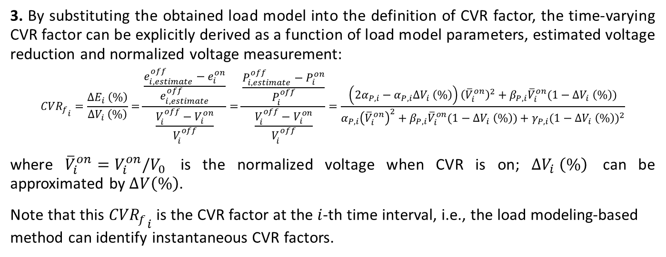
Methodologies
Load Modeling-Based Method
3. By substituting the obtained load model into the definition of CVR factor, the time-varying CVR factor can be explicitly derived as a function of load model parameters, estimated voltage reduction and normalized voltage measurement:
$${{CVR}_{f}}_{i}=\frac{{∆E}_{i} \left(\%\right)}{{∆V}_{i} \left(\%\right)}=\frac{\frac{e_{i,estimate}^{off}−e_{i}^{on}}{e_{i,estimate}^{off}}}{\frac{V_{i}^{off}−V_{i}^{on}}{V_{i}^{off}}}=\frac{\frac{P_{i,estimate}^{off}−P_{i}^{on}}{P_{i}^{off}}}{\frac{V_{i}^{off}−V_{i}^{on}}{V_{i}^{off}}}=\frac{\left({2α}_{P,i}−α_{P,i}{∆V}_{i} \left(\%\right)\right){\left({\overline{V}}_{i}^{on}\right)}^{2}+β_{P,i}{\overline{V}}_{i}^{on}(1−{∆V}_{i} \left(\%\right))}{α_{P,i}{\left({\overline{V}}_{i}^{on}\right)}^{2}+β_{P,i}{\overline{V}}_{i}^{on}(1−{∆V}_{i} \left(\%\right))+γ_{P,i}{(1−{∆V}_{i} \left(\%\right))}^{2}}$$
where ${\overline{V}}_{i}^{on}=V_{i}^{on}/V_{0}$ is the normalized voltage when CVR is on; ${∆V}_{i} \left(\%\right)$ can be approximated by $∆V\left(\%\right)$.
Note that this ${{CVR}_{f}}_{i}$ is the CVR factor at the $i$-th time interval, i.e., the load modeling-based method can identify instantaneous CVR factors.

Slide 32
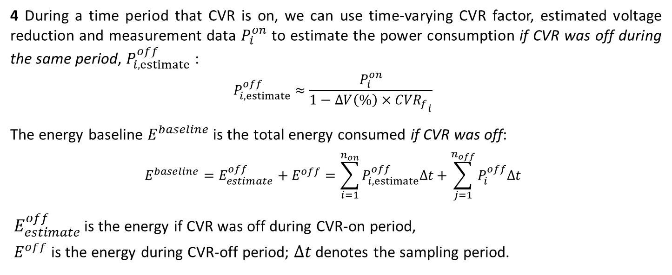
Methodologies
Load Modeling-Based Method
4 During a time period that CVR is on, we can use time-varying CVR factor, estimated voltage reduction and measurement data $P_{i}^{on}$ to estimate the power consumption if CVR was off during the same period, $P_{i,estimate}^{off}$:
$$P_{i,estimate}^{off}≈\frac{P_{i}^{on}}{1−∆V\left(\%\right)×{{CVR}_{f}}_{i}}$$
The energy baseline $E^{baseline}$ is the total energy consumed if CVR was off:
$$E^{baseline}=E_{estimate}^{off}+E^{off}=\sum_{i=1}^{n_{on}}{P_{i,estimate}^{off}∆t}+\sum_{j=1}^{n_{off}}{P_{i}^{off}∆t}$$
$E_{estimate}^{off}$ is the energy if CVR was off during CVR-on period,
$E^{off}$ is the energy during CVR-off period; $∆t$ denotes the sampling period.

Slide 33
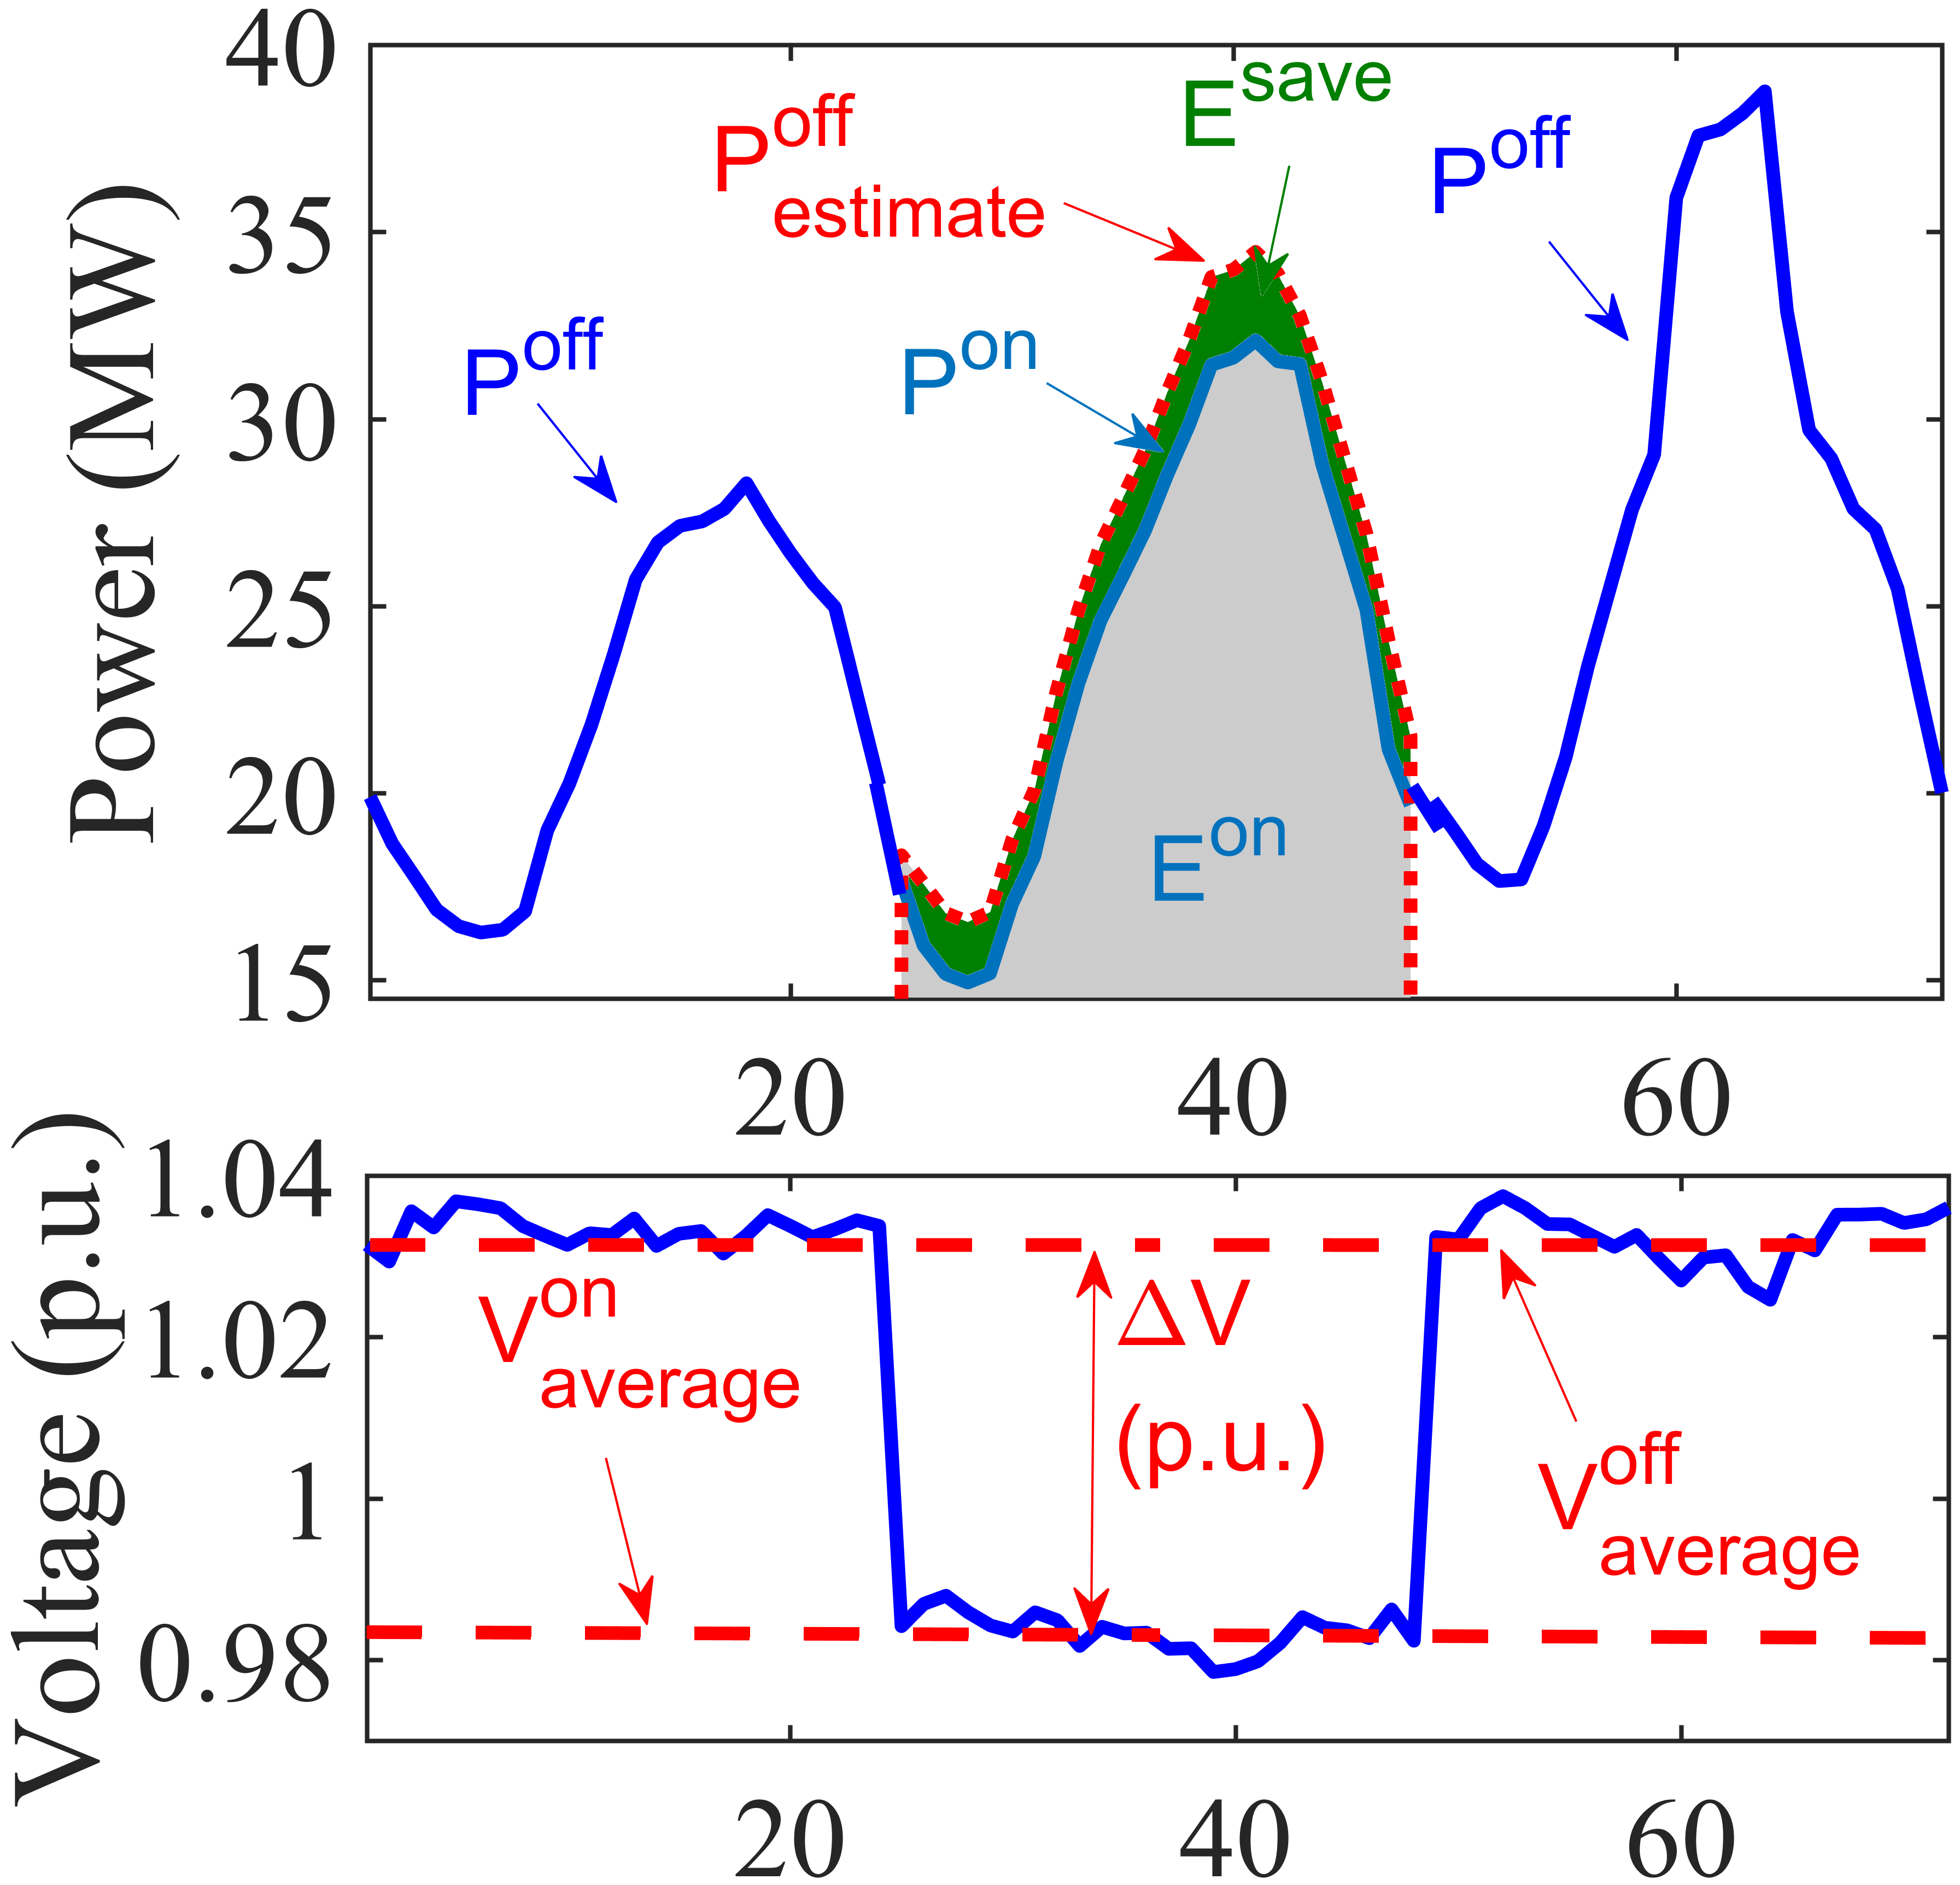

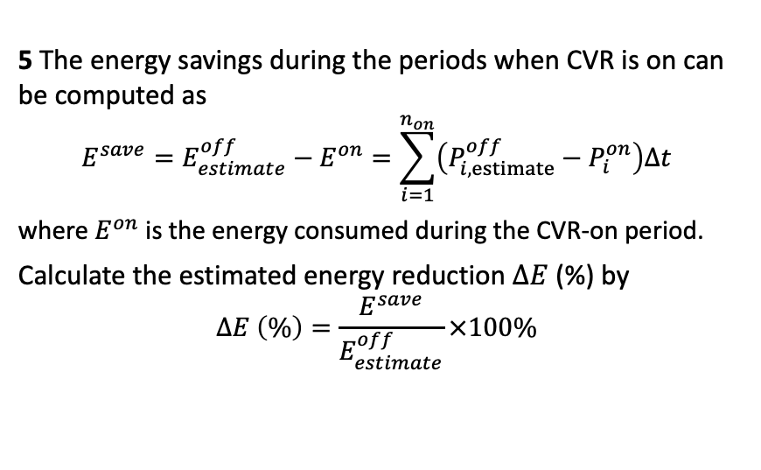
Methodologies
Load Modeling-Based Method
5 The energy savings during the periods when CVR is on can be computed as
$$E^{save}=E_{estimate}^{off}−E^{on}=\sum_{i=1}^{n_{on}}{\left(P_{i,estimate}^{off}−P_{i}^{on}\right)∆t}$$
where $E^{on}$ is the energy consumed during the CVR-on period.
Calculate the estimated energy reduction $∆E$ (%) by
$$∆E \left(\%\right)=\frac{E^{save}}{E_{estimate}^{off}}×100\%$$
Fig. Relationship among variables.
The CVR factors computed in Step 4 are a series of “instantaneous” values at different time intervals. To integrate them into a single value, the overall CVR factor can be computed as
$${CVR}_{f}=\frac{∆E (\%)}{∆V\left(\%\right)}$$

Slide 34
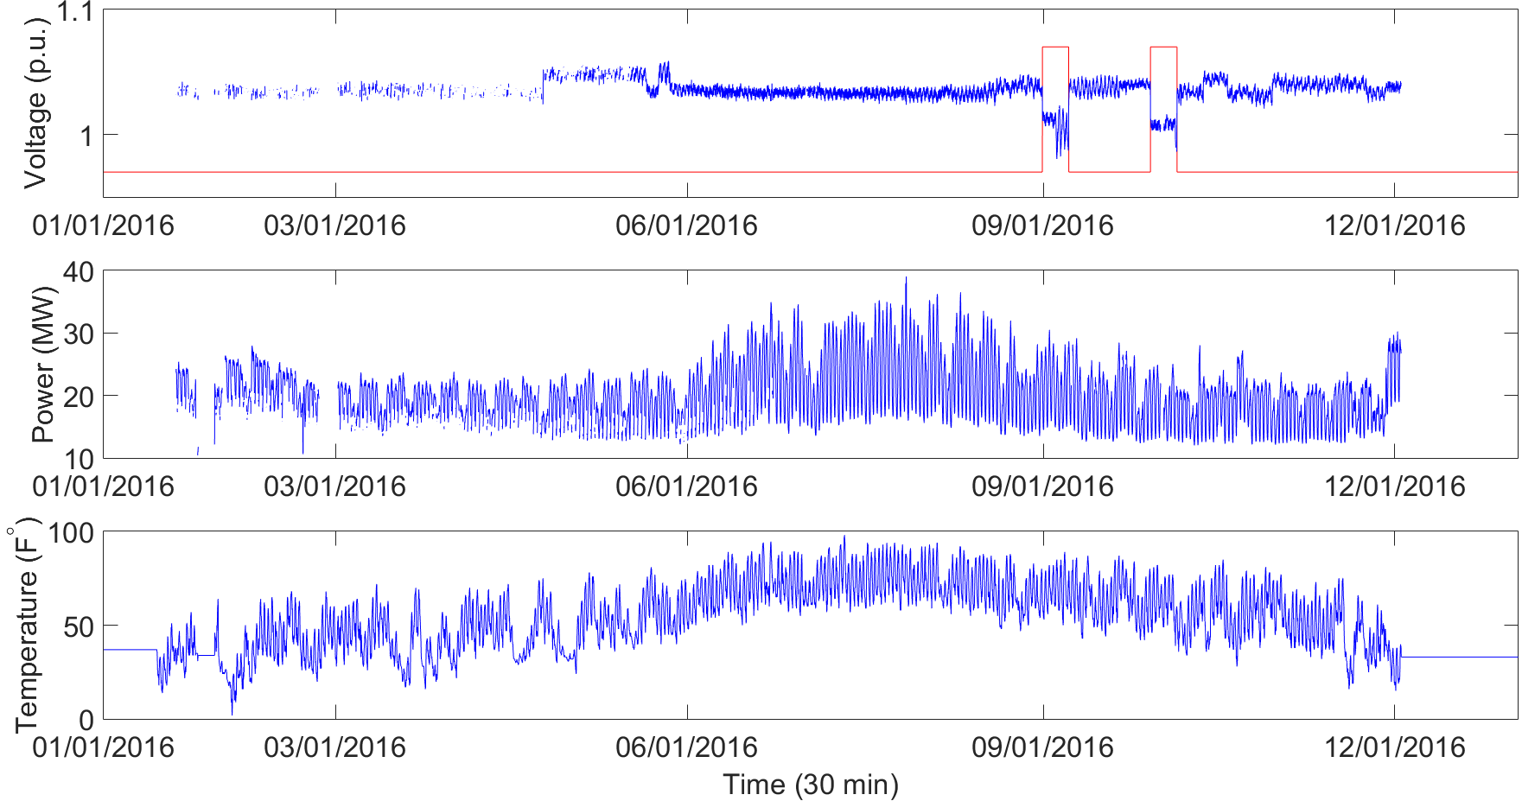
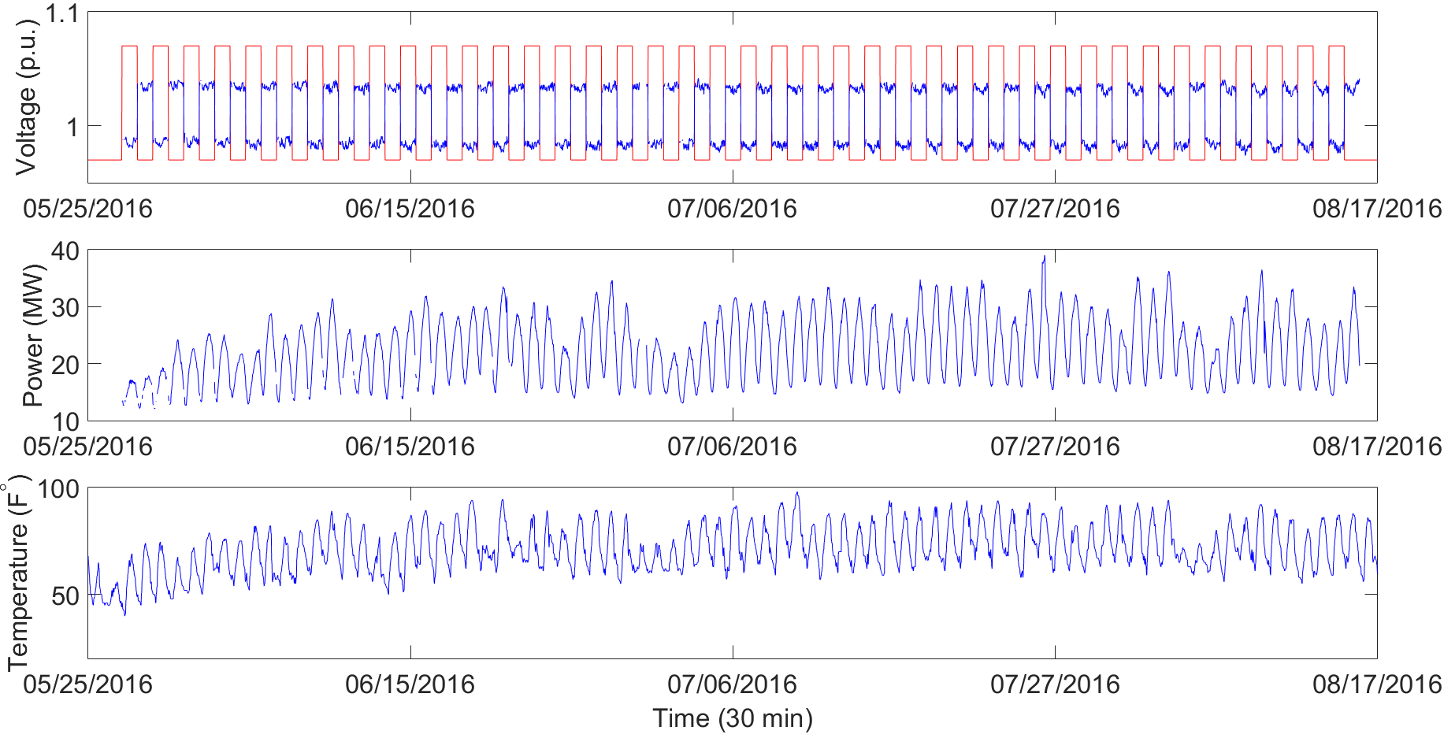
Case Studies
Description of Data Set
The case studies are conducted on two data sets (named as D2_2016 and D3_2016) from two different sources during 01/01/2016~12/31/2016 and 05/25/2016~08/17/2016, respectively.
The data sets have five different time resolutions (5, 10, 15, 30, 60 min).
Both data sets contain CVR-on and CVR-off tests. In D2, the CVR is applied during 08/30/2016 ~ 09/06/2016 and 09/27/2016 ~ 10/04/2016. In D3, the CVR is applied every other day during 05/28/2016 ~ 08/14/2016.
Fig. 8 D2_2016 from 01/01/2016 to 12/31/2016 (30 min).
Fig. 9 D3_2016 from 05/25/2016 to 08/17/2016 (30 min).

Slide 35
Case Studies
Verification Setup
Three case studies are carried out.
Case A (Base case): Clean data is prepared by averaging raw values over 30-min intervals.
Case B (Analyzing missing data impact): 30-min frequency data with 5%, 10%, 20%, 30% and 50% randomly selected missing data points included.
For the load modeling-based method, the initial values of ZIP coefficients are selected as [0.3,0.3,0.4].

Slide 36
Case Studies
Case A: Verification based on no data anomalies
Comparison-Based | Comparison-Based
Name | Ebaseline (MWh) | Estimated Voltage Reduction (%) | Estimated Energy Reduction (%) | Esavings (MWh) | CVR Factor
D2_2016 | 178314.14 | 2.70 | -0.90 | -58.38 | -0.33
D3_2016 | 202501.17 | 4.83 | 4.73 | 1,050.97 | 0.98
Regression-Based | Regression-Based
Name | Ebaseline (MWh) | Estimated Voltage Reduction (%) | Estimated Energy Reduction (%) | Esavings (MWh) | CVR Factor
D2_2016 | 181791.73 | 2.78 | 8.50 | 611.01 | 3.07
D3_2016 | 203938.65 | 4.85 | 3.69 | 820.95 | 0.76
Load Modeling-Based | Load-Modeling-Based
Name | Ebaseline (MWh) | Estimated Voltage Reduction (%) | Estimated Energy Reduction (%) | Esavings (MWh) | CVR Factor
D2_2016 | 181335.39 | 2.78 | 2.21 | 136.92 | 0.79
D3_2016 | 203989.32 | 4.85 | 3.96 | 845.47 | 0.82

Slide 37
Case Studies
Case B: Verification based on additional missing data (D2_2016)
Comparison-Based | Comparison-Based
Missing data | Ebaseline (MWh) | Estimated Voltage Reduction (%) | Estimated Energy Reduction (%) | Esavings (MWh) | CVR Factor
5% | 178384.99 | 2.63 | -0.66 | -43.10 | -0.25
10% | 178194.29 | 2.62 | -2.65 | -168.75 | -1.01
20% | 178703.04 | 2.74 | 1.00 | 65.60 | 0.36
30% | 178707.13 | 2.59 | 0.20 | 13.01 | 0.08
Regression-Based | Regression-Based
Missing data | Ebaseline (MWh) | Estimated Voltage Reduction (%) | Estimated Energy Reduction (%) | Esavings (MWh) | CVR Factor
5% | 181842.47 | 2.77 | 8.42 | 605.57 | 3.05
10% | 181804.15 | 2.77 | 8.52 | 611.85 | 3.09
20% | 182031.56 | 2.76 | 8.93 | 642.75 | 3.25
30% | 182268.37 | 2.78 | 9.17 | 659.89 | 3.31
Load Modeling-Based | Load-Modeling-Based
Missing data | Ebaseline (MWh) | Estimated Voltage Reduction (%) | Estimated Energy Reduction (%) | Esavings (MWh) | CVR Factor
5% | 181394.49 | 2.77 | 2.21 | 130.51 | 0.80
10% | 181357.72 | 2.77 | 2.21 | 121.09 | 0.80
20% | 181566.75 | 2.76 | 2.20 | 109.29 | 0.80
30% | 181807.29 | 2.78 | 2.21 | 95.76 | 0.79

Slide 38
Case Studies
Case B: Verification based on additional missing data (D3_2016)
Comparison-Based | Comparison-Based
Missing data | Ebaseline (MWh) | Estimated Voltage Reduction (%) | Estimated Energy Reduction (%) | Esavings (MWh) | CVR Factor
5% | 202271.96 | 4.86 | 4.37 | 966.51 | 0.90
10% | 202715.66 | 4.86 | 4.86 | 1081.35 | 1.00
20% | 202777.20 | 4.87 | 4.38 | 966.38 | 0.90
30% | 202701.06 | 4.85 | 4.57 | 1017.19 | 0.94
Regression-Based | Regression-Based
Missing data | Ebaseline (MWh) | Estimated Voltage Reduction (%) | Estimated Energy Reduction (%) | Esavings (MWh) | CVR Factor
5% | 203734.97 | 4.84 | 3.72 | 825.41 | 0.77
10% | 204151.99 | 4.85 | 3.77 | 838.85 | 0.78
20% | 204284.76 | 4.85 | 3.52 | 778.64 | 0.73
30% | 204148.90 | 4.85 | 3.26 | 724.82 | 0.67
Load Modeling-Based | Load-Modeling-Based
Missing data | Ebaseline (MWh) | Estimated Voltage Reduction (%) | Estimated Energy Reduction (%) | Esavings (MWh) | CVR Factor
5% | 203779.76 | 4.84 | 3.96 | 808.64 | 0.82
10% | 204180.31 | 4.85 | 3.95 | 780.15 | 0.81
20% | 204392.96 | 4.85 | 3.99 | 702.53 | 0.82
30% | 204252.29 | 4.85 | 3.85 | 628.77 | 0.79

Slide 39
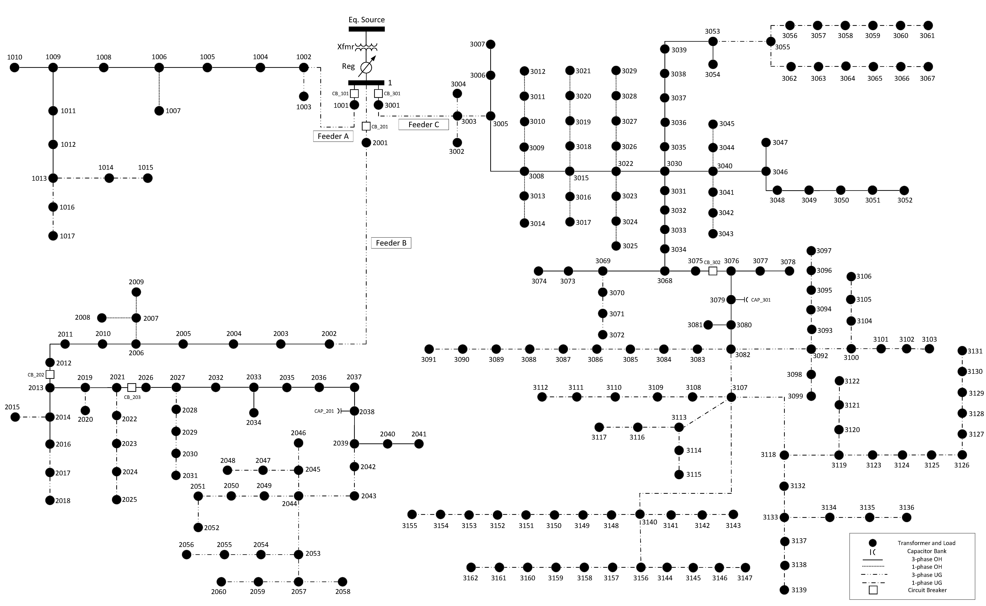
Data Sharing
With permission from our utility partner, we share a real distribution grid model with one-year smart meter measurements. This dataset provides an opportunity for researchers and engineers to perform validation and demonstration using real utility grid models and field measurements.
The system consists of 3 feeders and 240 nodes and is located in Midwest U.S.
The system has 1120 customers and all of them are equipped with smart meters. These smart meters measure hourly energy consumption (kWh). We share the one-year real smart meter measurements for 2017.
The system has standard electric components such as overhead lines, underground cables, substation transformers with LTC, line switches, capacitor banks, and secondary distribution transformers. The real system topology and component parameters are included.
Test system diagram
You may download the dataset at: http://wzy.ece.iastate.edu/Testsystem.html , including system description (in .doc and .xlsx), smart meter data (in .xlsx), OpenDSS model, and Matlab code for quasi-static time-series simulation.

Slide 40
Course Materials
Introduction to Power Distribution Systems
Introduction to Distribution Systems
Nature of Loads
Approximate Method of Analysis
Power Distribution System Power Flow – Basics
Modeling Series Impedance
Modeling Shunt Admittance
Modeling Series Components-Lines
Modeling Voltage Regulators
Modeling Transformers
Distribution Feeder Modeling and Analysis
Center-Tapped Transformers and Secondaries
Y-bus Method for Power Flow Calculation
Advanced Power Distribution Systems
Distribution System Planning
Distribution System Operation and Automation
Analysis of Distribution System Operation Function
Distribution System Transformers
Distribution Line Models
Distribution System Analysis
Distribution System Protection
Distribution System Reliability
Distribution System Grounding
Power Quality for Distribution System
Economics of Distribution System
You may download the slides (.pptx) at: https://wzy.ece.iastate.edu/Teaching.html

Slide 41
Thank You!
Q&A
http://wzy.ece.iastate.edu
wzy@iastate.ed

Slide 42
Backup Slides
Steps for comparison-based method

Slide 43
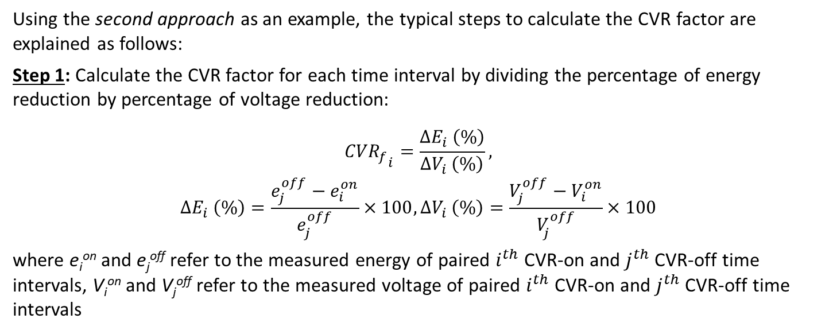
Methodologies
Comparison-Based Methods
Using the second approach as an example, the typical steps to calculate the CVR factor are explained as follows:
Step 1: Calculate the CVR factor for each time interval by dividing the percentage of energy reduction by percentage of voltage reduction:
$${{CVR}_{f}}_{i}=\frac{{∆E}_{i} \left(\%\right)}{{∆V}_{i} \left(\%\right)},$$
$${∆E}_{i} \left(\%\right)=\frac{e_{j}^{off}−e_{i}^{on}}{e_{j}^{off}}×100,{∆V}_{i} \left(\%\right)=\frac{V_{j}^{off}−V_{i}^{on}}{V_{j}^{off}}×100$$
where e_{i}^{on} and e_{j}^{off} refer to the measured energy of paired $i^{th}$ CVR-on and $j^{th}$ CVR-off time intervals, V_{i}^{on} and V_{j}^{off} refer to the measured voltage of paired $i^{th}$ CVR-on and $j^{th}$ CVR-off time intervals

Slide 44
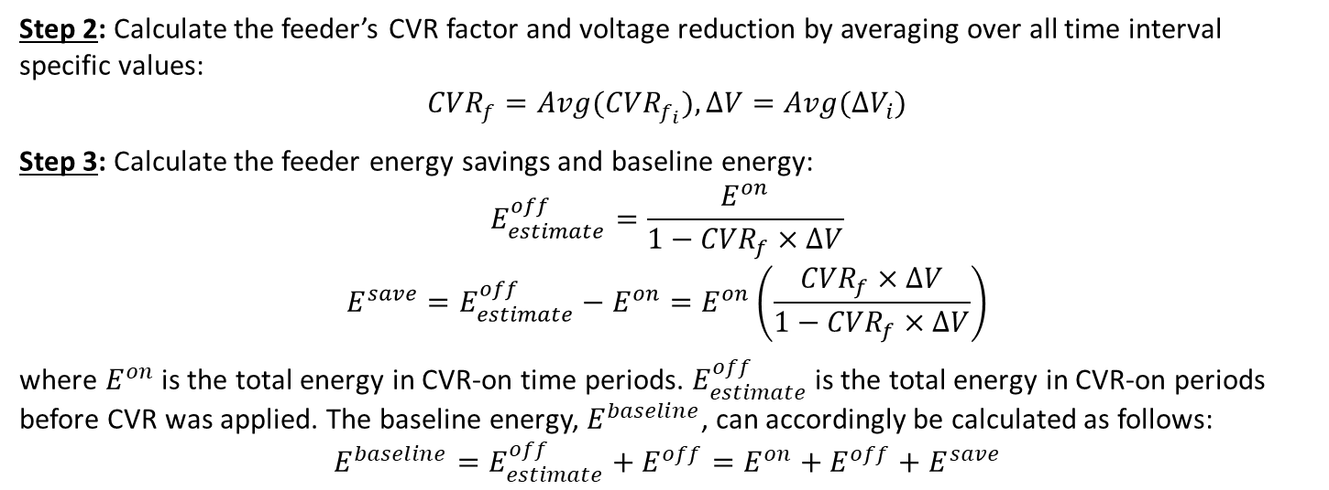
Methodologies
Comparison-Based Methods
Step 2: Calculate the feeder’s CVR factor and voltage reduction by averaging over all time interval specific values:
$${CVR}_{f}=Avg({CVR}_{f_{i}}),∆V=Avg({∆V}_{i})$$
Step 3: Calculate the feeder energy savings and baseline energy:
$$E_{estimate}^{off}=\frac{E^{on}}{1−{CVR}_{f}×∆V}$$
$$E^{save}=E_{estimate}^{off}−E^{on}=E^{on}\left(\frac{{CVR}_{f}×∆V}{1−{CVR}_{f}×∆V}\right)$$
where $E^{on}$ is the total energy in CVR-on time periods. $E_{estimate}^{off}$is the total energy in CVR-on periods before CVR was applied. The baseline energy, $E^{baseline}$, can accordingly be calculated as follows:
$$E^{baseline}=E_{estimate}^{off}+E^{off}=E^{on}+E^{off}+E^{save}$$

Slide 45
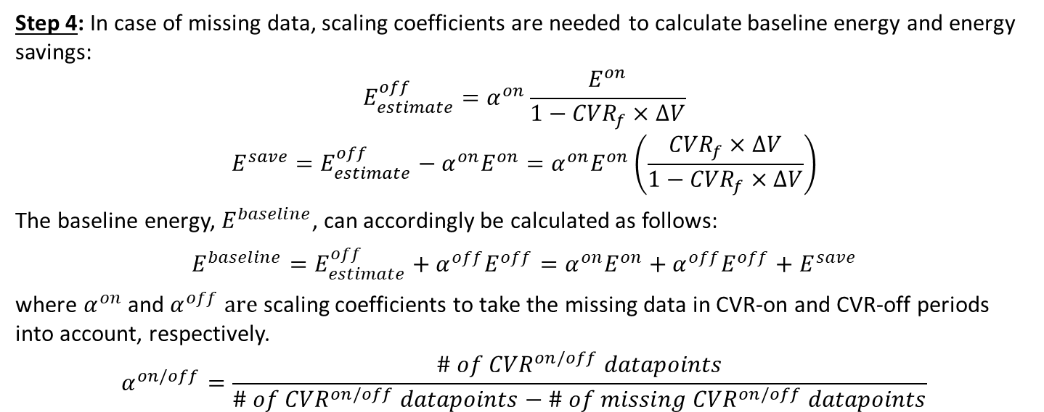
Methodologies
Comparison-Based Methods
Step 4: In case of missing data, scaling coefficients are needed to calculate baseline energy and energy savings:
$$E_{estimate}^{off}=α^{on}\frac{E^{on}}{1−{CVR}_{f}×∆V}$$
$$E^{save}=E_{estimate}^{off}−α^{on}E^{on}=α^{on}E^{on}\left(\frac{{CVR}_{f}×∆V}{1−{CVR}_{f}×∆V}\right)$$
The baseline energy, $E^{baseline}$, can accordingly be calculated as follows:
$$E^{baseline}=E_{estimate}^{off}+α^{off}E^{off}=α^{on}E^{on}+α^{off}E^{off}+E^{save}$$
where $α^{on}$ and $α^{off} are$ scaling coefficients to take the missing data in CVR-on and CVR-off periods into account, respectively.
$$α^{on/off}=\frac{\# of {CVR}^{on/off} datapoints}{\# of {CVR}^{on/off} datapoints−\# of {missing CVR}^{on/off} datapoints}$$

Slide 46
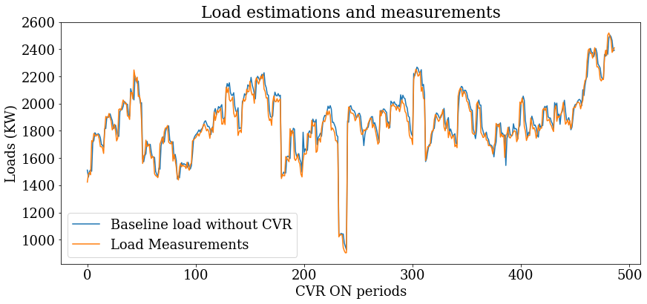
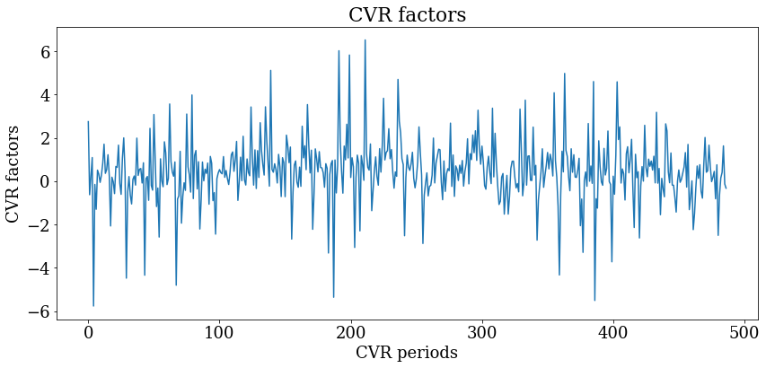
Regression-Based Method
Only the data for CVR-off periods is used to train the LSTM load forecasting model, so the model output is the baseline load without doing CVR.
By comparing the model outputs and the measured loads for CVR-on periods, the load changes due to running CVR can be obtained.
CVR factors can be calculated using the load changes and voltage changes during CVR on periods.
Fig. Load forecasting results for Farley substation CVR ON periods
Fig. Real-time CVR factor estimations for Farley substation CVR ON periods

Slide 47
Backup Slides
Regression-based method

Slide 48
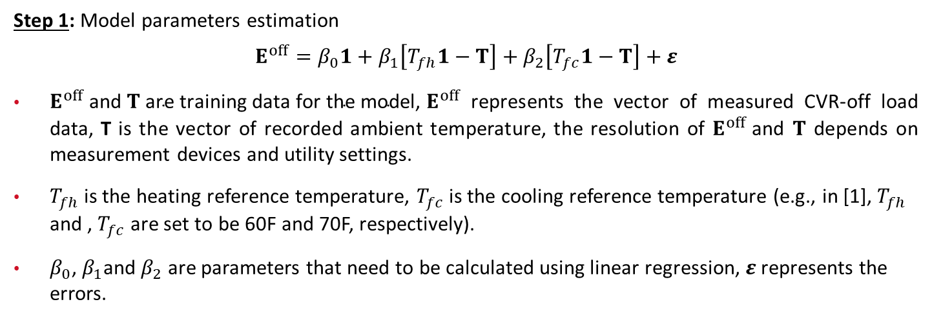
Methodologies
Regression-Based Methods
Step 1: Model parameters estimation
$$E^{off}=β_{0}1+β_{1}\left[T_{fh}1−T\right]+β_{2}\left[T_{fc}1−T\right]+ε$$
$E^{off} \text{and} T \text{are} \text{training} \text{data} \text{for} \text{the} \text{model}\text{, }E^{off}$ represents the vector of measured CVR-off load data, T is the vector of recorded ambient temperature, the resolution of $E^{off}$and $T$ depends on measurement devices and utility settings.
$T_{fh}$is the heating reference temperature, $T_{fc}$ is the cooling reference temperature (e.g., in [1], $T_{fh}$ and , $T_{fc}$ are set to be 60F and 70F, respectively).
$β_{0}$, $β_{1}$and $β_{2}$ are parameters that need to be calculated using linear regression, $ε$ represents the errors.
[1] Z. Wang and J. Wang, “Review on Implementation and Assessment of Conservation Voltage Reduction,” IEEE Trans. on Power Systems, vol. 29, no. 3, pp. 1306-1315, May 2014.

Slide 49
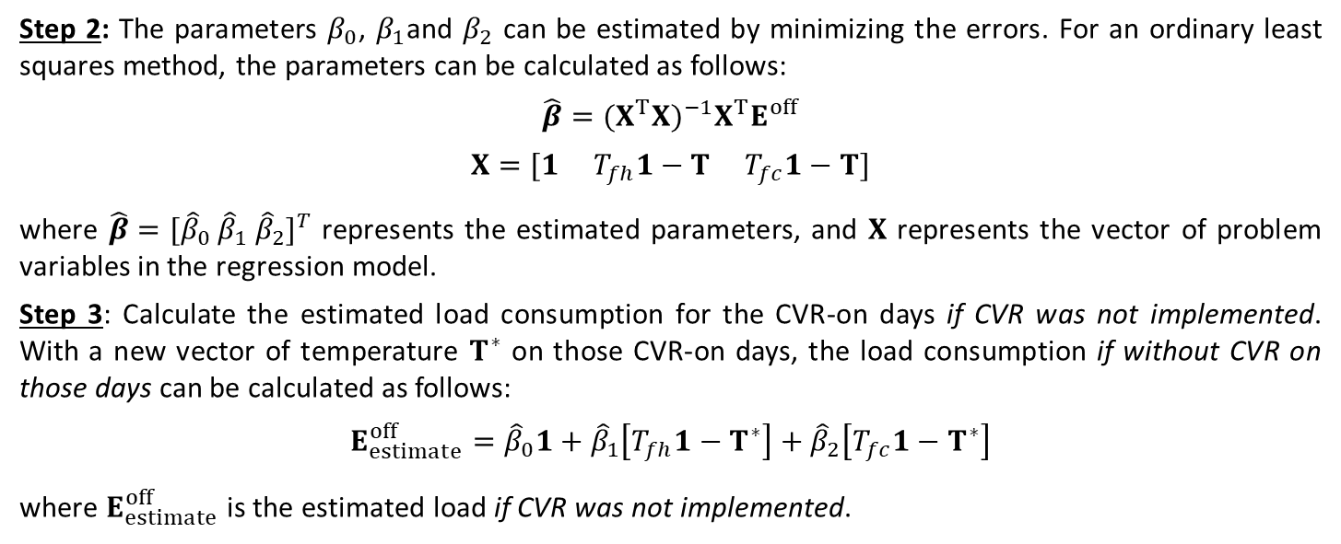
Methodologies
Regression-Based Methods
Step 2: The parameters $β_{0}$, $β_{1}$and $β_{2}$ can be estimated by minimizing the errors. For an ordinary least squares method, the parameters can be calculated as follows:
$$\hat{β}={(X^{T}X)}^{−1}X^{T}E^{off}$$
$$X=[1{ T}_{fh}1−T T_{fc}1−T]$$
where $\hat{β}={[{\hat{β}}_{0} {\hat{β}}_{1} {\hat{β}}_{2}]}^{T}$ represents the estimated parameters, and $X$ represents the vector of problem variables in the regression model.
Step 3: Calculate the estimated load consumption for the CVR-on days if CVR was not implemented. With a new vector of temperature $T^{∗}$ on those CVR-on days, the load consumption if without CVR on those days can be calculated as follows:
$$E_{estimate}^{off}={\hat{β}}_{0}1+{\hat{β}}_{1}\left[T_{fh}1−T^{∗}\right]+{\hat{β}}_{2}\left[T_{fc}1−T^{∗}\right]$$
where $E_{estimate}^{off}$ is the estimated load if CVR was not implemented.

Slide 50
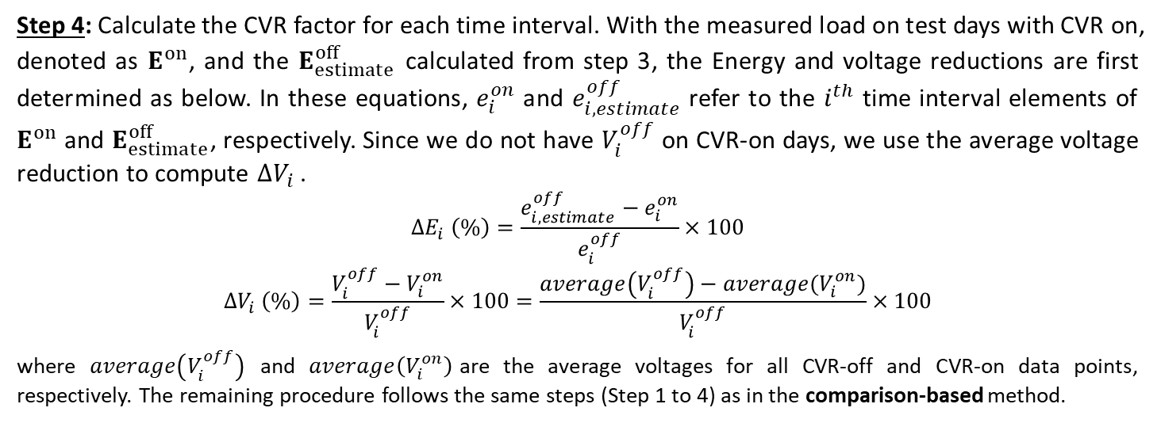
Methodologies
Regression-Based Methods
Step 4: Calculate the CVR factor for each time interval. With the measured load on test days with CVR on, denoted as $E^{on}$, and the $E_{estimate}^{off}$ calculated from step 3, the Energy and voltage reductions are first determined as below. In these equations, $e_{i}^{on}$ and $e_{i,estimate}^{off}$ refer to the $i^{th}$ time interval elements of $E^{on}$ and $E_{estimate}^{off}$, respectively. Since we do not have $V_{i}^{off}$ on CVR-on days, we use the average voltage reduction to compute ${∆V}_{i}$.
$${∆E}_{i} \left(\%\right)=\frac{e_{i,estimate}^{off}−e_{i}^{on}}{e_{i}^{off}}×100$$
$${∆V}_{i} \left(\%\right)=\frac{V_{i}^{off}−V_{i}^{on}}{V_{i}^{off}}×100=\frac{average\left(V_{i}^{off}\right)−average(V_{i}^{on})}{V_{i}^{off}}×100$$
where $average\left(V_{i}^{off}\right)$ and $average\left(V_{i}^{on}\right)$are the average voltages for all CVR-off and CVR-on data points, respectively. The remaining procedure follows the same steps (Step 1 to 4) as in the comparison-based method.

Slide 51


Methodologies
Findings of Regression-Based Method
The accuracy of the regression-based method also depends on data selection.
Take D2 data sets as an example, all the blue curves denote the measured power data when CVR is off. All the red curves are the estimated powers using regression method, which is trained by the blue curve.
Figure 15 shows the accuracy of by using all the CVR-off data points. The missing data has already been deleted.
Figure 16 shows the accuracy of by using part of the CVR-off data points (08/29/2016~09/27/2016). The missing data has already been deleted.
The root mean squared errors (RMSEs) of Fig. 17, and Fig. 18 are 4.07 and 2.82, respectively; the mean absolute percentage error (MAPEs) are 8.36% and 8.01%, respectively.
Fig. Load modeling result using all data points.
Fig. Load modeling result using selected data points.

Slide 52
Backup Slides
Soft-constrained gradient analysis method

Slide 53


Methodologies
Load Modeling-Based Method
Step 3: Compute estimated voltage reduction $∆V\left(\%\right)$ for the i-th time interval from the measurement data:
$$∆V\left(\%\right)=\frac{V_{average}^{off}−V_{average}^{on}}{V_{average}^{off}}×100\%$$
$$V_{average}^{off}=\frac{\left(\sum_{i=1}^{n_{off}}{V_{i}^{off}}\right)}{n_{off}}, V_{average}^{off}=\frac{\left(\sum_{i=1}^{n_{on}}{V_{i}^{on}}\right)}{n_{on}}$$
where $V_{average}^{off}$ and $V_{average}^{on}$ are averaged voltages when CVR is on and off, respectively; $V_{i}^{off}$ and $V_{i}^{on}$ are voltages for CVR-off and CVR-on respectively; $n_{on}$ and $n_{off}$ are the total numbers of measurements for CVR is on and CVR is off, respectively.
Fig. Demonstration of average voltages and voltage reduction.

Slide 54

Methodologies
Problem formulation of load modeling
To identify the time-varying load model parameters $α_{P,i}$, $β_{P,i}$, and $γ_{P,i}$, a general optimization problem is formulated as follows
$\min_{α_{P, i}, β_{P,i}, γ_{P,i}}{J=\sum_{i=1}^{L}{{\left(α_{P,i}{\left(\frac{V_{i}}{V_{0}}\right)}^{2}+β_{P,i}\frac{V_{i}}{V_{0}}+γ_{P,i}−\frac{P_{i}}{P_{0}}\right)}^{2}}}$
s.t., $0<α_{P,i}$, $β_{P,i}$, $γ_{P,i}<1$
where $J$ is the accumulative squared error, $i$ is the $i$-th time interval, and $L$ is the total number of time intervals, $V_{i}$ and $P_{i}$ are field voltage and power measurements.
Note that we removed the constraint $α_{P,i}+β_{P,i}+γ_{P,i}=1$, because it can result in severe overshoots of identified parameters.

Slide 55


Methodologies
Findings
The hard-constrained optimization problem (*) can be directly solved using nonlinear programming methods, such as interior point method, however, it will result in unstable CVR factors as shown in Fig. 19.
The sharp fluctuations in CVR factors of the hard-constrained problem are caused by the large variations of identified parameters as shown in Fig. 20.
To obtain smoother and more stable CVR factors, we propose a soft-constrained sliding-window-based time-varying parameter identification method at the cost of an acceptable identification error.
Fig. CVR factor of the hard-constrained problem.
Fig. 20 Curves of the Z, I, P coefficients for the hard-constrained problem.

Slide 56







Why we need the window size to be 𝑛≥3?
Theorem 1: The following determinant problem has a unique solution only if $n≥3$.
Proof 1: For simplicity of notations, we take the first slide window for example,
$$\left[\begin{matrix}\sum_{i=1}^{n}{{V_{i}^{′}}^{4}} & \sum_{i=1}^{n}{{V_{i}^{′}}^{3}} & \sum_{i=1}^{n}{{V_{i}^{′}}^{2}} \\ \sum_{i=1}^{n}{{V_{i}^{′}}^{3}} & \sum_{t=1}^{n}{{V_{i}^{′}}^{2}} & \sum_{i=j}^{n}{V_{i}^{′}} \\ \sum_{i=1}^{n}{{V_{i}^{′}}^{2}} & \sum_{i=1}^{n}{V_{i}^{′}} & n\end{matrix}\right]×\left[\begin{matrix}α_{P, i} \\ β_{P,i} \\ γ_{P,i}\end{matrix}\right]=\left[\begin{matrix}\sum_{i=1}^{n}{P_{i}^{′}{V_{i}^{′}}^{2}} \\ \sum_{i=1}^{n}{P_{i}^{′}V_{i}^{′}} \\ \sum_{i=1}^{n}{P_{i}^{′}}\end{matrix}\right]$$
$$\begin{aligned}A_{i}=\left[\begin{matrix}{V_{i}^{′}}^{4} & {V_{i}^{′}}^{3} & {V_{i}^{′}}^{2} \\ {V_{i}^{′}}^{3} & {V_{i}^{′}}^{2} & V_{i}^{′} \\ {V_{i}^{′}}^{2} & V_{i}^{′} & 1\end{matrix}\right]\#\end{aligned}$$
$$A_{Σ,i}=\sum_{i=1}^{n}{A_{i}}$$
$$A_{Σ,i}$$
$$X_{t}$$
$$B_{Σ,t}$$
The rank of $A_{i}$, $rank\left(A_{i}\right)=1$. We know that the rank of the sum of $n$ matrices are less than or equal to the sum of the ranks of each matrix, i.e., $\begin{aligned}rank\left(A_{Σ,i}\right)≤\sum_{i=1}^{n}{rank\left(A_{i}\right)}=n\end{aligned}$.
Thus, the necessary condition for that $A_{Σ,i}$ has full rank is $n≥3$. Only under this necessary condition, it is possible to calculate the solution as $X_{i}=A_{Σ,i}^{−1}B_{Σ,i}$. □

Slide 57


Methodologies
Sliding Window-based Time-Varying Parameter Identification
To deal with the constraint, improve the robustness and capture the temporal correlation of loads, we propose a method using over-determinant least squares optimization with soft constraints as follows
The lower three rows in over-determinant problem softly constrain the values of $α_{P, i}$, $β_{P,i}$ and $γ_{P,i}$ by guiding them towards a near optimal initial estimation that is in the normal range.
The initial estimation is a weighted average of two components: (1) solution of current time window $α_{P,i}^{o}$, $β_{P,i}^{o}$ and $γ_{P,i}^{o}$ obtained by solving the original optimization problem (*) with interior point method; (2) the solution from the last time window, $α_{P,i−1}$, $β_{P,i−1}$ and $γ_{P,i−1}$.
To ensure meaningful CVR factor, $α_{P,0}$, $β_{P,0}$ and $γ_{P,0}$ must be selected within the normal range.
$$\left[\begin{matrix}\sum_{i=t^{′}}^{n}{{V_{i}^{′}}^{4}} & \sum_{i=i^{′}}^{n}{{V_{i}^{′}}^{3}} & \sum_{i=i^{′}}^{n}{{V_{i}^{′}}^{2}} \\ \sum_{i=i^{′}}^{n}{{V_{i}^{′}}^{3}} & \sum_{t=i^{′}}^{n}{{V_{i}^{′}}^{2}} & \sum_{i=i^{′}}^{n}{V_{i}^{′}} \\ \sum_{t=i^{′}}^{n}{{V_{i}^{′}}^{2}} & \sum_{i=i^{′}}^{n}{V_{i}^{′}} & n \\ ε_{1}+ε_{2} & 0 & 0 \\ 0 & ε_{1}+ε_{2} & 0 \\ 0 & 0 & ε_{1}+ε_{2}\end{matrix}\right]×\left[\begin{matrix}α_{P, i} \\ β_{P,i} \\ γ_{P,i}\end{matrix}\right]=\left[\begin{matrix}\sum_{i=i^{′}}^{n}{P_{i}^{′}{V_{i}^{′}}^{2}} \\ \sum_{i=i^{′}}^{n}{P_{i}^{′}V_{i}^{′}} \\ \sum_{i=i^{′}}^{n}{P_{i}^{′}} \\ ε_{1}α_{P,i}^{o}+ε_{2}α_{P,i−1} \\ ε_{1}β_{P,i}^{o}+ε_{2}β_{P,i−1} \\ ε_{1}γ_{P,i}^{o}+ε_{2}γ_{P,i−1}\end{matrix}\right]$$
Solved by least-square method

Slide 58

How do the soft constraints work?
Take $α_{P, i}$ as an example. The fourth line of the over-determinant problem can be rewritten as
$α_{P, i}=\frac{ε_{1}}{ε_{1}+ε_{2}}α_{P,i}^{o}+\frac{ε_{2}}{ε_{1}+ε_{2}}$ $α_{P,i−1}$
Then consider three cases:
$ε_{1}=0,ε_{2}≠0$: we have $α_{P, i}=α_{P,i−1}=α_{P,0}$, where $α_{P,0}$ is an empirical initial value selected within the normal range [0,1]. In this case, the $α_{P, i}$ will be driven to approach $α_{P,0}$ and the identification accuracy highly relies on the selection of $α_{P,0}$.
$ε_{1}≠0,ε_{2}=0$: we have $α_{P, i}=α_{P,i}^{o}$, where $α_{P,i}^{o}$ is the solution of the original optimization problem (*) in the current window. With a large number of case studies using real utility data, we find this solution $α_{P,i}^{o}$ usually oscillate between [0,1] violently. Thus, using this value only will also result in a violently oscillated CVR factor result.
$ε_{1}≠0,ε_{2}≠0$: in this case, $α_{P,i}^{o}$ can be viewed as a weighted correction term which helps dynamically tune the empirical initial value $α_{P,0}$ to achieve a more accurate identification, while guaranteeing that the objective value $α_{P, i}$ in the current window still lies in [0,1] (because both $α_{P,i}^{o}$ and $α_{P,0}$ are in [0,1]).

Slide 59


Why we need the window size to be 𝑛≥3?
Note that $n≥3$ is just a necessary condition but is not sufficient. In practice, one still needs to check the real rank of $A_{Σ,i}$ in each window. For example, repetitive measurement data will reduce the rank of $A_{Σ,i}.$ To ensure the uniqueness of the solution, a method with varying window size is designed as follows.
To minimize the data requirement, we set $n=3$ as a start.
Then, the rank of $A_{Σ,i}$ is checked in each sliding window. If $rank(A_{Σ,i})<3$, extend window size forward to $n+1$, and check the rank again.
Repeat this step until $A_{Σ,i}$ has full rank and finally begin the parameter identification.
Note that $A_{Σ,i}$ is $3×3$, thus the rank checking would not significantly increase computational burden.
varying window size
Fig. Flowchart of the proposed CVR factor evaluation method.

Slide 60
Methodologies
Load Modeling-Based Method
4 During a time period that CVR is on, we can use time-varying CVR factor, estimated voltage reduction and measurement data $P_{i}^{on}$ to estimate the power consumption if CVR was off during the same period, $P_{i,estimate}^{off}$:
$$P_{i,estimate}^{off}≈\frac{P_{i}^{on}}{1−∆V\left(\%\right)×{{CVR}_{f}}_{i}}$$
The energy baseline $E^{baseline}$ is the total energy consumed if CVR was off:
$$E^{baseline}=E_{estimate}^{off}+E^{off}=\sum_{i=1}^{n_{on}}{P_{i,estimate}^{off}∆t}+\sum_{j=1}^{n_{off}}{P_{i}^{off}∆t}$$
$E_{estimate}^{off}$ is the energy if CVR was off during CVR-on period,
$E^{off}$ is the energy during CVR-off period; $∆t$ denotes the sampling period.

Slide 61


Methodologies
Load Modeling-Based Method
5 The energy savings during the periods when CVR is on can be computed as
$$E^{save}=E_{estimate}^{off}−E^{on}=\sum_{i=1}^{n_{on}}{\left(P_{i,estimate}^{off}−P_{i}^{on}\right)∆t}$$
where $E^{on}$ is the energy consumed during the CVR-on period.
Step 7: Calculate the estimated energy reduction $∆E$ (%) by
$$∆E \left(\%\right)=\frac{E^{save}}{E_{estimate}^{off}}×100\%$$
Fig. Relationship among variables.
Step 8: The CVR factors computed in Step 4 are a series of “instantaneous” values at different time intervals. To integrate them into a single value, the overall CVR factor can be computed as
$${CVR}_{f}=\frac{∆E (\%)}{∆V\left(\%\right)}$$

Slide 62

Methodologies
Load Modeling-Based Method
Step 9: In case of missing data, scaling coefficients are needed to calculate baseline energy and energy savings:
$$E_{estimate}^{off}=α^{on}\sum_{i=1}^{n_{on}}{P_{i,estimate}^{off}∆t}$$
$$E^{save}=E_{estimate}^{off}−α^{on}E^{on}=α^{on}\sum_{i=1}^{n_{on}}{\left(P_{i,estimate}^{off}−P_{i}^{on}\right)∆t}$$
The baseline energy, $E^{baseline}$, can accordingly be calculated as follows:
$$E^{baseline}=E_{estimate}^{off}+α^{off}E^{off}=α^{on}E^{on}+α^{off}E^{off}+E^{save}$$
where $α^{on}$ and $α^{off} are$ scaling coefficients to take the missing data in CVR-on and CVR-off periods into account, respectively.
$$α^{on/off}=\frac{\# of {CVR}^{on/off} datapoints}{\# of {CVR}^{on/off} datapoints−\# of {missing CVR}^{on/off} datapoints}$$

Slide 63
Background and Motivation
The existing methods for measuring CVR effect can be classified in the following table.
 | Pros | Cons
Comparison-based | Most simple and easy to understand | Assume two feeders or two days have exactly the same load compositions
Linear-regression-based | A comprehensive model considering many factors that influence the CVR effect | Assume coefficients are constant & time-invariant in the period of regression Assume a linear relationship
Load modeling-based | Estimating CVR factors from the nature: load is sensitive to voltage Focusing on load-to-voltage sensitivities while all other factors are reflected in the voltage insensitive part Can estimate time-varying CVR factor | Assume load-to-voltage sensitivity follows a ZIP relationship Assume the ZIP coefficients maintain constant in a time window (how to select the time window?)

Slide 64
Backup Slides
Case Studies

Slide 65
Review of CVR factor Range
A comprehensive study was conducted to review the values of reported CVR factors in utilities.
Utility | CVR Factor Value | Methodology
Clark Public Utilities | 0.3
Douglas PUD | 2.07-2.17
Snohomish County Public Utility | 0.74 | Comparison-based
New York State Electric & Gas | 0.6
Central Florida Electric Cooperative | 0.5-0.75
Clay Electric Cooperative | 1.0
Progress Energy-Florida | 1.0
Georgia Power | 0.5-1.7
Cobb EMC | 0.75
Progress Energy | 0.4
Kansas City Power and Light | 0.889 | Comparison-based
Clatskanie PUD | 1.4
Inland power & light | 0.93
Seattle city light | 0.13
BC Hydro | 0.6-0.77 | Regression-based
Hydro-Québec | 0.06-0.97
Bonneville Power Administration | 0.41-0.99
AEP | 0.35-0.89 | Regression-based
Korea Electric Power Corporation | 0.681-0.939
San Diego Gas & Electric | 0.08-1.14
City-of-Lethbridge-Electric-Utility | 0.83-0.9
Utility | CVR Factor Value | Methodology
Central Lincoln People’s Utility District | 0.43- 1.05 | Comparison-based
Ameren Illinois | 0.148 - 1.48 | Regression-based
ComEd | 0.8 | Regression/Constant
Idaho Power Company | 0.41-5.75 | Constant/ Comparison-based
West Penn Power Company | 0.86 | Regression-based
Indianapolis Power & Light | 0.75 | Comparison-based
PECO Energy | 1.08 | Regression-based
Duke Energy Ohio | 0.50-0.79 | Constant CVR factor
Xcel Energy | 0.8 | Simulation/Statistical
PG&E | 0.6-0.8 | Regression-based
Southern California Edison | 1.56 | Regression-based
Puget Sound Energy | 0.475 | Regression-based
Dominion Energy | 0.92 | Comparison-based
Indiana Michigan Power | -0.43-4.48 | Regression-based
NRECA | 1.04 | Comparison-based
NEEA | 0.17-1.12 | Comparison-based
Avista Corp | 0.84 | Regression/Simulation
AIC | 0.148-1.48 | Regression-based
I&M | -0.43-4.48 | Regression-based

Slide 66
Case Studies
Case 1: Verification based on data resolution (D2_2016)
Comparison-Based | Comparison-Based
Resolution | Ebaseline (MWh) | Estimated Voltage Reduction (%) | Estimated Energy Reduction (%) | Esavings (MWh) | CVR Factor
5 min | 180309.13 | 2.76 | -0.27 | -17.90 | -0.10
10 min | 179575.50 | 2.70 | -2.41 | -153.92 | -0.89
15 min | 179461.11 | 2.75 | 2.41 | 161.55 | 0.88
60 min | 177677.06 | 2.77 | 1.11 | 73.59 | 0.40
Regression-Based | Regression-Based
Resolution | Ebaseline (MWh) | Estimated Voltage Reduction (%) | Estimated Energy Reduction (%) | Esavings (MWh) | CVR Factor
5 min | 185468.13 | 2.81 | 8.34 | 606.13 | 2.98
10 min | 184201.85 | 2.79 | 8.41 | 607.71 | 3.02
15 min | 183339.70 | 2.79 | 8.42 | 606.72 | 3.03
60 min | 180372.03 | 2.78 | 8.44 | 604.88 | 3.05
Load Modeling-Based | Load-Modeling-Based
Resolution | Ebaseline (MWh) | Estimated Voltage Reduction (%) | Estimated Energy Reduction (%) | Esavings (MWh) | CVR Factor
5 min | 185003.03 | 2.81 | 1.72 | 98.23 | 0.61
10 min | 183733.89 | 2.79 | 1.82 | 108.05 | 0.65
15 min | 182879.53 | 2.79 | 2.00 | 121.02 | 0.72
60 min | 179922.31 | 2.78 | 2.28 | 141.61 | 0.82

Slide 67
Case Studies
Case 1: Verification based on data resolution (D3_2016)
Comparison-Based | Comparison-Based
Resolution | Ebaseline (MWh) | Estimated Voltage Reduction (%) | Estimated Energy Reduction (%) | Esavings (MWh) | CVR Factor
5 min | 204484.61 | 4.85 | 4.47 | 1,001.76 | 0.92
10 min | 203770.01 | 4.86 | 4.28 | 954.72 | 0.88
15 min | 203191.69 | 4.85 | 3.75 | 828.95 | 0.77
60 min | 201867.62 | 4.83 | 4.33 | 956.15 | 0.90
Regression-Based | Regression-Based
Resolution | Ebaseline (MWh) | Estimated Voltage Reduction (%) | Estimated Energy Reduction (%) | Esavings (MWh) | CVR Factor
5 min | 211690.48 | 4.85 | 3.79 | 877.73 | 0.78
10 min | 208735.21 | 4.85 | 3.83 | 874.28 | 0.79
15 min | 206769.78 | 4.85 | 3.77 | 852.28 | 0.78
60 min | 202398.04 | 4.84 | 3.64 | 801.87 | 0.75
Load Modeling-Based | Load-Modeling-Based
Resolution | Ebaseline (MWh) | Estimated Voltage Reduction (%) | Estimated Energy Reduction (%) | Esavings (MWh) | CVR Factor
5 min | 211604.87 | 4.85 | 3.55 | 673.35 | 0.73
10 min | 208659.75 | 4.85 | 3.55 | 709.09 | 0.73
15 min | 206744.77 | 4.85 | 3.72 | 763.99 | 0.77
60 min | 202459.54 | 4.84 | 3.83 | 831.58 | 0.79

Slide 68
Backup Slides
Creating Ground Truth for CVR Assessment

Slide 69
Creating a Ground Truth using Simulations
Without ground truth, we cannot validate CVR assessment results. To fill this gap:
Model a real utility feeder in OpenDSS, and use simulations to create a control group.
Generate two cases with different voltage levels (normal voltage & reduced voltage) over one year, while keeping the same loading condition for the two cases.
Since the two cases have exactly the same loading condition, the actual CVR factor (the ground truth) can be easily calculated by comparing the power consumptions in the two cases.
Notice that this simulation method is NOT to find the true CVR factors of the modeled feeder, but to create a ground truth under the controlled environment for validation of CVR assessment method.
Suppose a CVR assessment method performs well using this simulation data, it does not guarantee the method can identify the true CVR factors using field data (because there is no ground truth to know its performance), but it at least gives us some confidence on the method.

Slide 70

Case Studies-Creating Ground Truth
Simulation Setup:
Two data sets are generated using OpenDSS with a real utility feeder model as shown in the figure.
Each customers’ load profiles are obtained from one-year real smart meter data.
P & V are measured from the feeder head.
The time resolution is 1 hour. The total period of simulation is 1 year.
Description | Total | Individual Phases/ Connection Type
Primary Nodes | 127
Consumers (No. of smart meters) | 52 | 9 (A) Single Phase- Center Tapped; 7 (B) Single Phase- Center Tapped; 31 (C) Single Phase- Center Tapped; 3(AC) Single Phase Delta- Three Wire Winding; 2 (ABC) Wye- Wye
Secondary Transformers | 39 | (4) 10 kVA; (18) 15 kVA; (11) 25 kVA; (1) 37.5 kVA; (1) 50 kVA; (1) 75 kVA; (3) 1000 kVA
Secondary/Service Lines |  | 1/0 Triplex; 2 Triplex; 4/0 Triplex; 4/0 Quad; 500 Quad
Notes:
ZIP parameters [0.4, 0.4, 0.2], each customer’s load shape comes from its own smart meter data.

Slide 71



Case Studies
Voff
Simulation Setup:
The blue curves show the CVR-off voltage and power. The red curves show the CVR-on voltage and power.
By comparing the blue and red curves, we can easily calculate the CVR factor based on the definition.
This CVR factor is the “ground truth” because the simulation is performed under the controlled environment with exactly the same feeder and the same loading condition.
Von
Poff
$${CVR}_{f}=\frac{(Poff−Pon)/Poff (\%)}{(Voff−Von)/Von\left(\%\right)}$$
Pon

Slide 72

Case Studies
Simulation Results:
Using the CVR-on data, we can identify load models, and calculate instantaneous CVR factor as shown in blue curve in the right figure. The red curve represents ground truth CVR factor.
The mean absolute percentage error (MAPE) is 1.08%.
We can also compute overall CVR factor for the whole year by integration. The ground truth overall CVR factor is 1.1871, while the estimated overall CVR factor with our method is 1.1853.
Comparing the estimated CVR factors by load modeling method with the ground truth.

Slide 73
Conclusions
With the field measurement data only, one cannot obtain the ground truth CVR factors, because it is impossible to know what would happen if the voltage reduction was not applied.
To validate CVR factor evaluation method, we modeled a real utility feeder in OpenDSS, such that we can keep the same loading condition to the same feeder while simulating operations with normal voltage and reduced voltage, to obtain a ground truth.
The simulation result shows that, our proposed time-varying load modeling-based method can provide an accurate estimation of CVR factors comparing to the ground truth. It does not mean the method can identify the true CVR factors using field data (because there is no ground truth), but it at least gives us some confidence on the method.

Slide 74
Backup Slides
EV/Heat Pump Detection

Slide 75
EV and EV Charging Detection – Literature Review
Reference | Main Approach | Data Source | Highlights
[1] | Convolutional and recurrent neural network, Cross-correlation | Pecan Street labeled EV consumption data; Unlabeled Hourly P measurements from SM | It calculates the correlation between a typical EV charging profile with the test data to identify if an EV charging is conducted.
[2] | Convolutional Neural Network and Multilayer Perceptron |  | The combination of CNN and MLP has comprehensive results on EV charging detection. The calculation of feature importance related to the charging power is innovative.
[3] | Pattern recognition, Kmedoids-dynamic time warping, ensemble classification model | SM data at 30-minute intervals with both EV and non-EV users in one dataset | Use Kmedoids and DTW algorithms to identify the typical non-EV user pattern to balance the numbers of EV and non-EV samples in the training dataset.
[4] | Deep neural network, Transfer Learning | One-year Pecan Street P data from 6 EV owners, 31 resident synthetic P data with random EV charging behavior | Customized filtering on output data may help to narrow down the EV detection search space further. Transfer learning helps the algorithm have more scalability across different dataset.
[5] | Outlier detection-based deep neural network | One-year 30-minute interval P data. 39 EV users and 1008 non-EV users | The approach regards the non-EV users as normal data and EV users as abnormal data (outliers) to reshape data imbalanced problem
Limitations:
None of the work used real local utility data.
Only performed EV detection, did not develop EV charging interval identification methods.
Did not utilize the hidden features of the dataset to discover temporal information.
High computational burdens.
Notes:
The hidden features include: mean, min/max, standard dev; recurring charging behaviors over specific intervals, daily, weekly, or monthly cycles; increase in power consumption over time due to consistent charging behavior; frequent charging behaviors, etc. These will further introduced in the seasonal decomposition later.
computational burdens: 1. compared to support vector machines (SVM), SVM are computationally more intensive than RF for larger datasets. SVMs is slower to train than RF for large-scale data such as time-series SM data. 2. Neural networks such as convolutional and recurrent neural networks, have a high computational and memory burden. Both CNNs and RNNs typically require significantly longer training times than RF.

Slide 76

EV Detection Algorithm – Random Forest Method
We employ a random forest ensemble classification method to detect the EV.
Simulation Steps:
1. Training Data: The dataset is first divided into training and test sets. Let the feature matrix be represented as $X$ and the corresponding labels as $y$, where each row in $X$ represents a user’s features, and $y$ indicates whether a user is an EV user ($y$ = 1) or non-EV user ($y$ = 0).
2. Define Parameters: After testing, we defined the following parameters: Number of Trees: 100; Maximum Depth of Each Tree: 10. Others remain default.
3. Bootstrap Sampling: For each tree in the Random Forest, a bootstrap sample is created by randomly sampling with replacement from the training data.
Sample size per tree: 24,764 (same as the number of customers in the training sets).
Number of bootstrap samples: Equal to the number of trees, in our case, 100.
Notes:
We first divide the data into training sets (70%) and test sets (30%). In our case, training sets contain 24764 customers, and testing sets contain 10614 customers.
Maximum Depth of Each Tree Controls the maximum number of splits (or levels) in each tree.
Bootstrap Sampling with Replacement: For each tree in the forest, a new dataset is created by randomly selecting data points from the original dataset. Since the sampling is with replacement, each data point in the original dataset has an equal probability of being selected multiple times in the same bootstrap sample, while some data points may not be selected at all.
Typically, each bootstrap sample is the same size as the original dataset, but because it’s sampled with replacement, about 63% of the original data points are included in each sample (with some data points appearing multiple times). This sampling introduces slight variations between the datasets used to train each tree, resulting in a set of trees that are similar but have learned different patterns due to variations in their training data.
Out-of-Bag (OOB) Samples: Since approximately 37% of data points are left out of each bootstrap sample, these remaining data points (known as out-of-bag or OOB samples) can be used to validate the performance of each tree.

Slide 77
EV Detection Algorithm – Random Forest Method
4. Random Feature Selection: Next, for each bootstrap sample, a decision tree is trained. In Random Forests, each tree does not use all features at every node (split points); instead, a random subset of features is selected for each node. By default, the number of features in this subset is often set to the square root of the total number of features for classification. In our case, after testing, we choose the number of features per split to be 3.
5. Splitting the Tree: Among the randomly selected subset of features, the algorithm evaluates each selected feature based on its ability to split the data effectively. The feature that minimizes impurity (measured by metrics like Gini Impurity) is chosen to split the data at that node. This process repeats at each node.
$$Gini⁡Impurity⁡(t)=1−\sum_{k=1}^{K}{ }p_{k}^{2}$$
where $p_{k}$ is the proportion of samples belonging to class $k$ in node $t$, and $K$ is the total number of classes ( 2 in this case: EV users and non-EV users).
6. Prediction: After that, each decision tree makes an individual prediction for a given input feature vector $X_{i}$. The prediction from tree $b$, denoted as $h_{b}\left(X_{i}\right)$, is a binary classification: $h_{b}\left(X_{i}\right)=1$ for EV users and $h_{b}\left(X_{i}\right)=0$ for non-EV users. The final prediction from the Random Forest classifier is based on the majority vote across all trees (total of 100 trees in our case).
Notes:
A node represents a point in the tree where a decision is made about splitting data based on feature values. Nodes guide the data flow through the tree to reach a final classification output.
The root node is the topmost node in the tree and represents the entire dataset. It contains the first decision (or split) based on a feature that best divides the data into two or more groups, maximizing separation between different classes.
Internal nodes (or decision nodes) are nodes where the data is further split based on specific features. Each internal node applies a condition (e.g., “Is feature X>5”) to partition the data into subsets.
Leaf nodes are the final nodes in the tree, where no further splitting occurs. Each leaf node represents a final output or classification for the data points that reached it. In classification, a leaf node often represents a specific class label (e.g., “EV user” or “Non-EV user”), based on the majority class of data points within that node.
Random Feature Selection: In Random Forests, each tree does not use all features at every split; instead, a random subset of features is selected for each split. By default, the number of features in this subset is often set to the square root of the total number of features for classification.
The best feature to split: Among the randomly selected subset of features, the algorithm evaluates each feature based on its ability to split the data effectively. The feature that minimizes impurity (measured by metrics like Gini Impurity for classification) is chosen to split the data at that node. This recursive process continues until a stopping criterion is met, such as reaching a maximum depth or a minimum number of samples per leaf node.
Gini Impurity is a measure used in decision trees to quantify the disorder of a dataset, reflecting how mixed the classes are within a node. A lower Gini Impurity value indicates a purer node (where most data points belong to a single class), helping the tree make more accurate splits for classification. This number is between 0 – 0.5. A Gini Impurity value of 0 means the node is pure, containing only samples of a single class, while higher values indicate more class mixture.

Slide 78
Conclusion
Successfully developed and tested a framework using real utility data for EV and heat pump detection.
Feature engineering, including statistical metrics, temporal baselines, and seasonal decomposition, proved essential for accurate EV and heat pump identification.
Random Forest classifier and rule-based detection provided reliable performance on imbalanced and high-resolution data, making these methods practical for utility applications.
This work provides tools for utilities to monitor EV and heat pump usage patterns, providing more informed resource planning, demand forecasting, and infrastructure management.

Slide 79
Reference
[1] V. Hoffmann, B. I. Fesche, K. Ingebrigtsen, I. N. Christie, and M. P. Engelstad, "Automated Detection of Electric Vehicles in Hourly Smart Meter Data," 25th International Conference on Electricity Distribution, Madrid, Spain, 2019, pp. 1-5.
[2] Neubert, Martin, Oliver Gnepper, Oliver Mey, and André Schneider. 2022. "Detection of Electric Vehicles and Photovoltaic Systems in Smart Meter Data" Energies 15, no. 13: 4922. https://doi.org/10.3390/en15134922
[3] H. Song, C. Liu, M. Jalili, X. Yu and P. McTaggart, "Ensemble Classification Model for EV Identification From Smart Meter Recordings," in IEEE Transactions on Industrial Informatics, vol. 19, no. 3, pp. 3274-3283, March 2023, doi: 10.1109/TII.2022.3175750.
[4] Wang, Xudong, Guoming Tang, Yi Wang, Srinivasan Keshav, and Yu Zhang. "Evsense: A robust and scalable approach to non-intrusive ev charging detection." In Proceedings of the Thirteenth ACM International Conference on Future Energy Systems, pp. 307-319. 2022.
[5] A. Babalhavaeji, H. Song, M. Radmanesh, and M. Jalili, "Identifying Electric Vehicles from Smart Meter Recordings," 11th IEEE International Conference on Smart Grid, Paris, France, 2023, pp. 1-5, DOI: 10.1109/ICSMARTGRID58556.2023.10171002.

Slide 80
Seasonal Decomposition
The original smart meter data $Y_{t}$ can be represented as the sum of the trend, seasonal, and residual components.
The calculation of the trend components can be expressed as follows:
$$T_{t}=\frac{1}{P}\sum_{i=−\frac{P−1}{2}}^{\frac{P−1}{2}}{ }Y_{t+i}$$
Here, $P$ is the length of the selected window period. We typically calculate the trend by applying a centered moving average with window size to the time series $Y_{t}$, assuming a periodicity $P$ (e.g., 7 for weekly).
To calculate the seasonal component, we first remove the trend from the original data by subtracting $T_{t}$ from $Y_{t}$ to get the remaining data:
$$Y_{t}−T_{t}=S_{t}+R_{t}$$

Slide 81
Seasonal Decomposition
Next, we calculate the seasonal component $S_{t}$ by averaging these de-trended values for each specific position in the seasonal cycle (e.g., every Monday in a weekly cycle). This can be expressed as:
$$S_{t}=\frac{1}{N}\sum_{j=1}^{N}{ }\left(Y_{t+j⋅P}−T_{t+j⋅P}\right)$$
$N$ is the total number of cycles observed in the data. Once we have calculated the trend $T_{t}$ and seasonal $S_{t}$ components, we can derive the residual component by subtracting both the trend and seasonal components from the original data:
$$R_{t}=Y_{t}−T_{t}−S_{t}$$
In this equation, $R_{t}$ represents the remaining part of the data after accounting for both trend and seasonal variations, capturing irregular or random fluctuations in the data.

Slide 82
EV Detection Algorithm – Training result
We use performance matrices to show the training results:
Accuracy: $\text{Accuracy} =\frac{ \text{True} \text{Positives}\text{ (}\text{TP}\text{)} + \text{True} \text{Negatives}\text{ (}\text{TN}\text{)} }{ \text{Total} \text{Number} \text{of} \text{Observations} }$
Precision: $\text{Precision} =\frac{ \text{True} \text{Positives}\text{ (}\text{TP}\text{)} }{ \text{True} \text{Positives}\text{ (}\text{TP}\text{) + }\text{False} \text{Positives}\text{ (}\text{FP}\text{)} }$
Recall: $\text{Recall} =\frac{ \text{True} \text{Positives}\text{ (}\text{TP}\text{)} }{ \text{True} \text{Positives}\text{ (}\text{TP}\text{)} + \text{False} \text{Negatives}\text{ (}\text{FN}\text{)} }$
F1-Score: $\text{F}\text{1}\text{−}\text{Score} =2×\frac{ \text{Precision} × \text{Recall} }{ \text{Precision} + \text{Recall} }$
Class | Precision | Recall | F1-Score
Non-EV User | 0.927 | 0.966 | 0.946
EV User | 0.866 | 0.845 | 0.855
Accuracy: 0.916
Notes:
Accuracy
Definition: Accuracy is the ratio of correctly predicted observations to the total observations.
Precision
Definition: Precision (or Positive Predictive Value) is the ratio of correctly predicted positive observations to the total predicted positive observations.
Precision answers the question, "Of all the observations predicted as positive, how many were actually positive?" High precision is crucial when the cost of false positives is high.
Recall (Sensitivity or True Positive Rate)
Definition: Recall is the ratio of correctly predicted positive observations to all observations in the actual class.
Recall answers the question, "Of all the actual positive observations, how many did the model capture?" High recall is essential when missing positives (false negatives) is costly.
F1-Score
Definition: The F1-score is the harmonic mean of precision and recall, providing a balance between the two metrics.

Slide 83
Residential Heat Pump Detection – Training result
We use performance matrices to show the training results:
Accuracy: $\text{Accuracy} =\frac{ \text{True} \text{Positives}\text{ (}\text{TP}\text{)} + \text{True} \text{Negatives}\text{ (}\text{TN}\text{)} }{ \text{Total} \text{Number} \text{of} \text{Observations} }$
Precision: $\text{Precision} =\frac{ \text{True} \text{Positives}\text{ (}\text{TP}\text{)} }{ \text{True} \text{Positives}\text{ (}\text{TP}\text{) + }\text{False} \text{Positives}\text{ (}\text{FP}\text{)} }$
Recall: $\text{Recall} =\frac{ \text{True} \text{Positives}\text{ (}\text{TP}\text{)} }{ \text{True} \text{Positives}\text{ (}\text{TP}\text{)} + \text{False} \text{Negatives}\text{ (}\text{FN}\text{)} }$
F1-Score: $\text{F}\text{1}\text{−}\text{Score} =2×\frac{ \text{Precision} × \text{Recall} }{ \text{Precision} + \text{Recall} }$
Class | Precision | Recall | F1-Score
Non-HP User | 0.909 | 0.912 | 0.910
HP User | 0.873 | 0.866 | 0.869
Accuracy: 0.890

Slide 84
EV Charging Interval Identification
Problem Statement:
Identify the EV charging intervals by distinguishing their unique EV charging consumption patterns.
Help utilities manage load, predict demand, and optimize resources. Provides insights into user behavior patterns for infrastructure planning.
Challenges:
EV charging profiles can overlap with other high-energy-consuming appliances.
Utility data lacks labels for actual EV charging intervals.
Solutions:
Use statistical method to create a temporal baseline and confidence interval of typical non-EV usage patterns.
Implemented a method to detect charging start and end times by tracking when EV user consumption crosses the baseline.

Slide 85
EV Charging Interval Identification Algorithm
Since we do not have labels for actual EV charging intervals, a rule-based algorithm is developed to find the charging start and end time.
Simulation Steps:
1. Assumptions: With abundant non-EV dataset, we assume that all non-EV users' consumptions at each time stamp follow a normal distribution and within a range.
2. Compute the mean and standard deviation of non-EV user consumption for each time interval to establish a baseline.
3. Define Detection Threshold: Calculate a 90% confidence interval upper bound for non-EV usage:
Upper Bound= Mean + 1.44×Standard Deviation
4. Charging Interval Detection:
For each EV user:
- Start a charging interval when power consumption crosses the non-EV upper bound.
- End the interval when consumption returns below the upper bound.
- Record start time, end time, and duration of each interval.

Slide 86


EV Charging Interval Identification - Results
Figures below demonstrate daily EV charging interval identification results for two example users.
The red line shows the upper bound detection threshold.
The Left figure shows a charging behavior at 18:00. The middle figure shows a charging behavior at 23:00. The right figure shows multiple charging during a day.

Slide 87


EV Charging Interval Identification - Results
Figures below demonstrate weekly EV charging interval Identification results for three different users.
The weekly plots give more clear and distinguishable charging intervals across one week.
Most users are likely to charge the EV during nighttime.
The rule-based method performance are dependent by the other possible high-energy-consuming appliances, considering the lack of labels, the algorithm performed well.

