Slide 1

Department of Electrical and Computer Engineering
Have no fear! The room you’re looking for is right here.

Slide 2
EV and Heat Pump Detection via Feature-Enhanced Ensemble Classification Using Real Utility SM Data

Slide 3
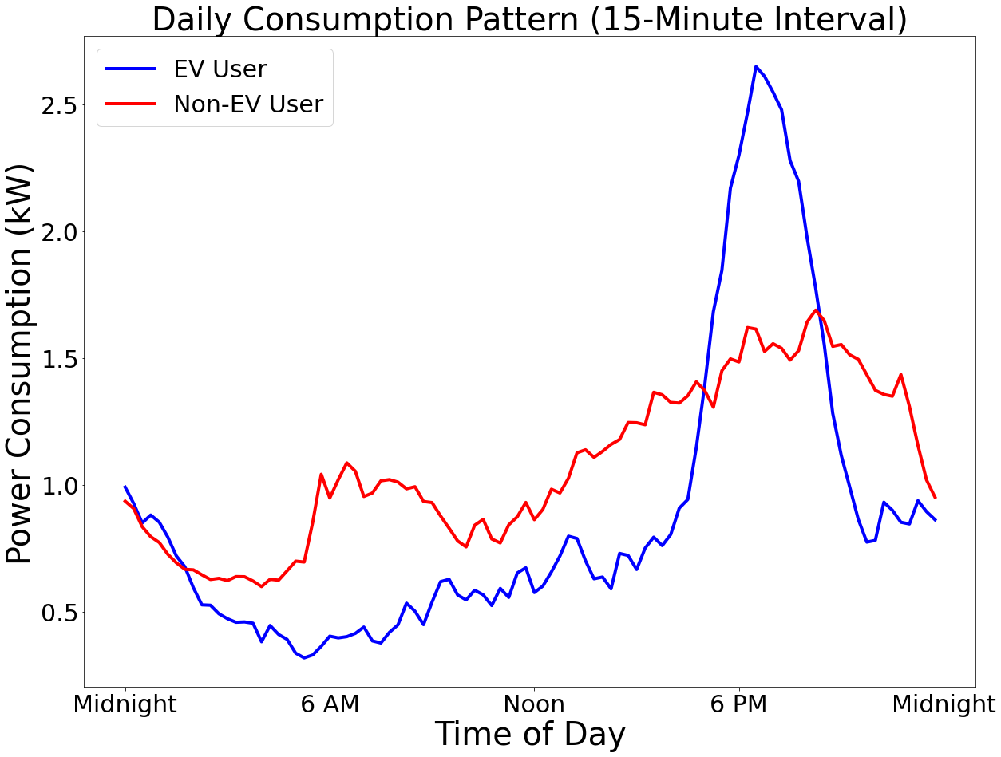
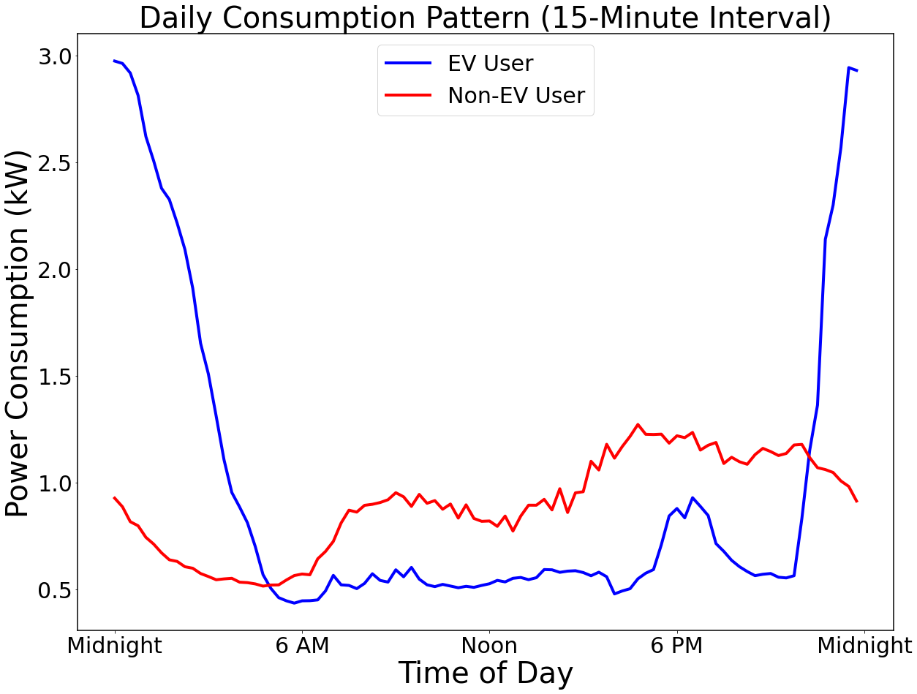
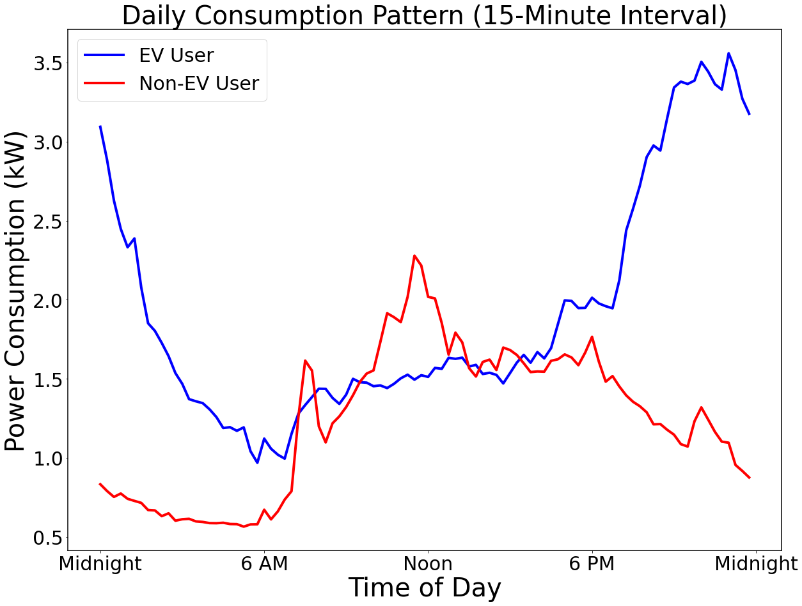
Introduction to Utility EV Dataset
One year (2023/10/01 – 2024/09/30) of customer AMI data from both customers with/without EV (no sub-meter for EV), with 15-minute resolution, was provided by our utility partner.
After data pre-processing, the dataset includes 298 aggregated load data from customers with EVs and 35,000+ load data from customers without EVs.
The figure below shows six users’ daily consumption plots from the dataset.

Slide 4
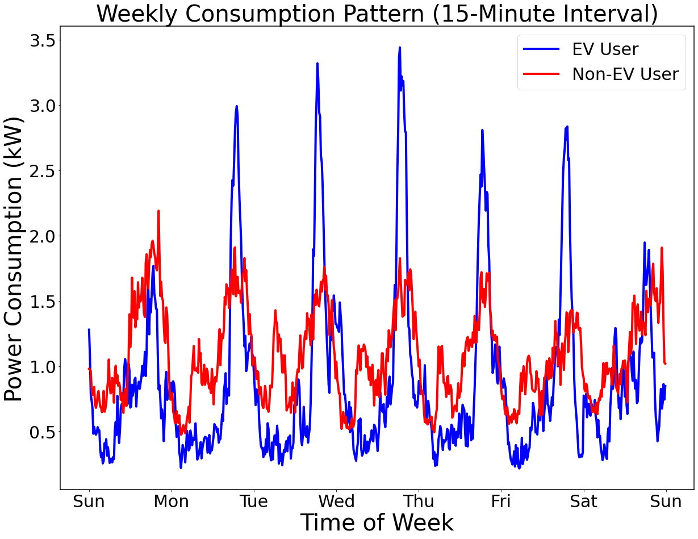
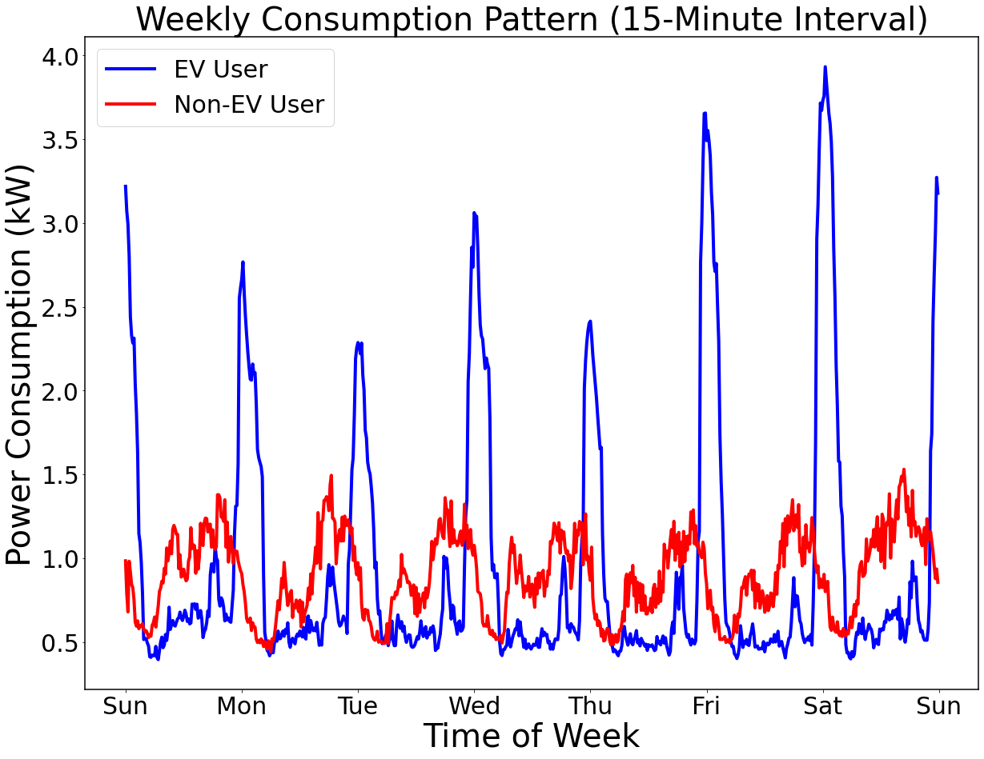
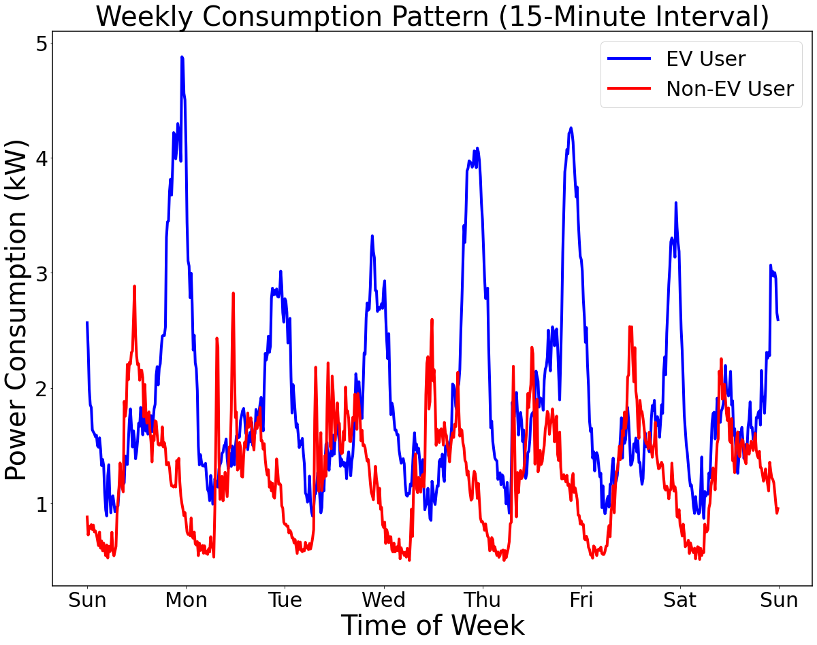
Introduction to Utility EV Dataset
The figure below illustrates the weekly consumption of six users from the dataset, where EV charging behavior is more distinguishable.
Despite visible differences between the two user types, access to an up-to-date dataset is not always available to confirm which users own EVs. An algorithm for EV detection is needed.

Slide 5
EV Detection Using Real Utility AMI Data
Problem Statement:
Identify EV users in the distribution network based on unique consumption patterns.
Develop an open-source tool to enable utilities to quickly visualize user consumption patterns and identify EV penetration levels.
Challenges:
Imbalance between EV and non-EV data (non-EV data >> EV data).
EV charging behavior is random, requiring methods to discover hidden features in the EV data.
Solutions:
Apply a Random Forest classifier, which performs well with imbalanced datasets and temporal features, reduces overfitting, and handles large datasets efficiently.
Use sliding window and feature engineering techniques to capture temporal dynamics and enhance feature representation.

Slide 6
EV and EV Charging Detection – Literature Review
Reference | Main Approach | Data Source | Highlights
[1] | Convolutional and recurrent neural network, Cross-correlation | Pecan Street labeled EV consumption data; Unlabeled Hourly P measurements from SM | It calculates the correlation between a typical EV charging profile with the test data to identify if an EV charging is conducted.
[2] | Convolutional Neural Network and Multilayer Perceptron |  | The combination of CNN and MLP has comprehensive results on EV charging detection. The calculation of feature importance related to the charging power is innovative.
[3] | Pattern recognition, Kmedoids-dynamic time warping, ensemble classification model | SM data at 30-minute intervals with both EV and non-EV users in one dataset | Use Kmedoids and DTW algorithms to identify the typical non-EV user pattern to balance the numbers of EV and non-EV samples in the training dataset.
[4] | Deep neural network, Transfer Learning | One-year Pecan Street P data from 6 EV owners, 31 resident synthetic P data with random EV charging behavior | Customized filtering on output data may help to narrow down the EV detection search space further. Transfer learning helps the algorithm have more scalability across different dataset.
[5] | Outlier detection-based deep neural network | One-year 30-minute interval P data. 39 EV users and 1008 non-EV users | The approach regards the non-EV users as normal data and EV users as abnormal data (outliers) to reshape data imbalanced problem
Limitations:
None of the work used real local utility data.
Only performed EV detection, did not develop EV charging interval identification methods.
Did not utilize the hidden features of the dataset to discover temporal information.
High computational burdens for utilities attempting to replicate their work.
Notes:
The hidden features include: mean, min/max, standard dev; recurring charging behaviors over specific intervals, daily, weekly, or monthly cycles; increase in power consumption over time due to consistent charging behavior; frequent charging behaviors, etc. These will further introduced in the seasonal decomposition later.
computational burdens: 1. compared to support vector machines (SVM), SVM are computationally more intensive than RF for larger datasets. SVMs is slower to train than RF for large-scale data such as time-series SM data. 2. Neural networks such as convolutional and recurrent neural networks, have a high computational and memory burden. Both CNNs and RNNs typically require significantly longer training times than RF.

Slide 7
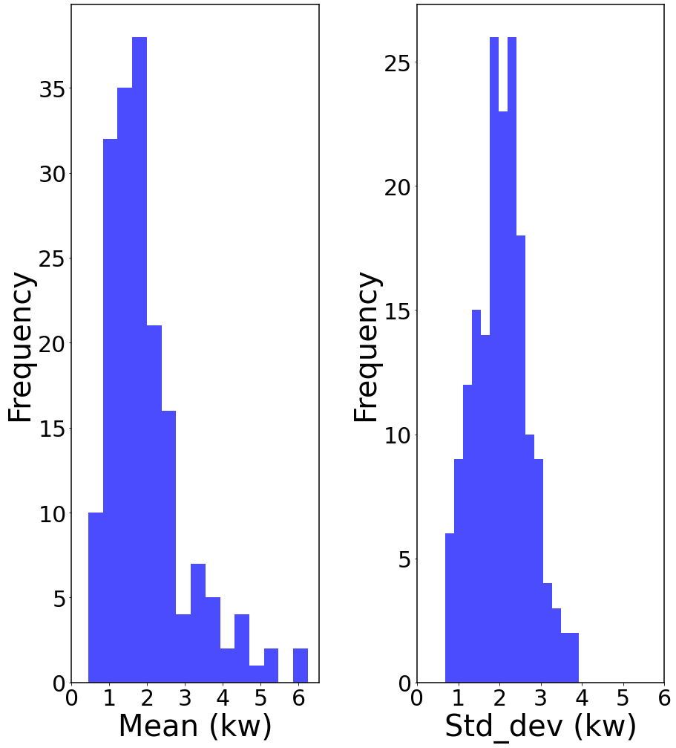
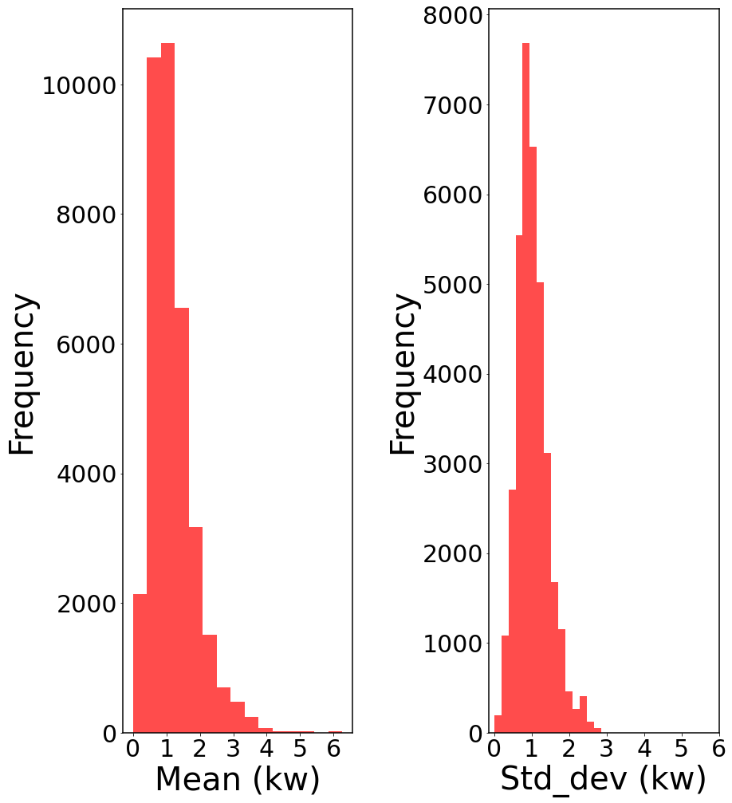
EV Detection Algorithm – Feature Engineering
We employed feature engineering to explore temporal information and hidden features.
Statistical Features:
Calculate statistical features such as global mean, maximum, and standard deviation for each customer across the entire time span; and averages for each sliding window to capture overall usage patterns.
These features distinguish between high-consumption spikes (from EV charging) and non-EV usage patterns.
The plots illustrate the distribution of global mean and standard deviation for EV and non-EV users.
EV Users
Non-EV Users
The level 2 EV charger can reach 15-19 kW power, which appears in some customer data.
EV users usually have a higher standard deviation.
Similar global mean value distribution.
Notes:
Difference between global mean and moving window mean:
- The global mean is the average for each customer across the entire time span.
- The average for each sliding window is the mean for each window. After testing, we choose the window size to be 1 day (96 data points), and each time we slide a window by 6 hours (24 points) ahead to create overlapping windows, capturing more granular, continuous changes in the data. This can be useful for capturing short-term variations that might indicate EV charging events.

Slide 8
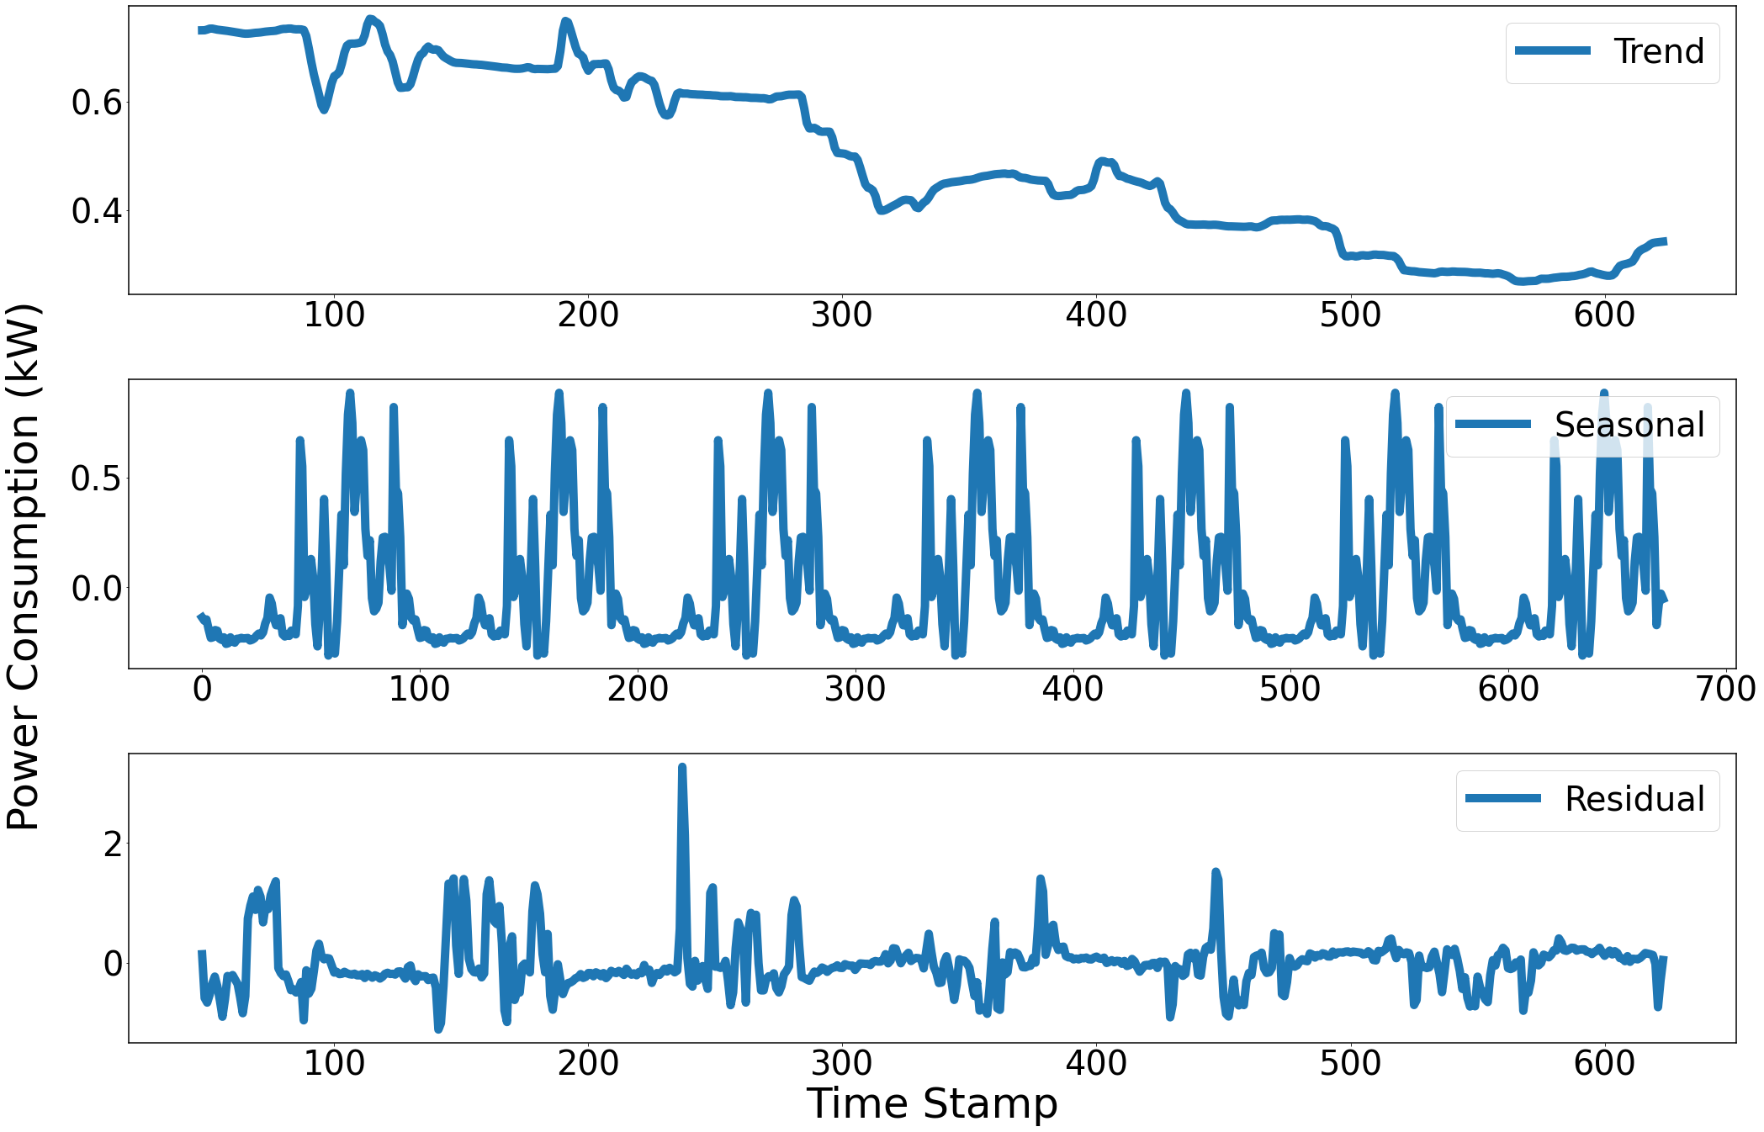
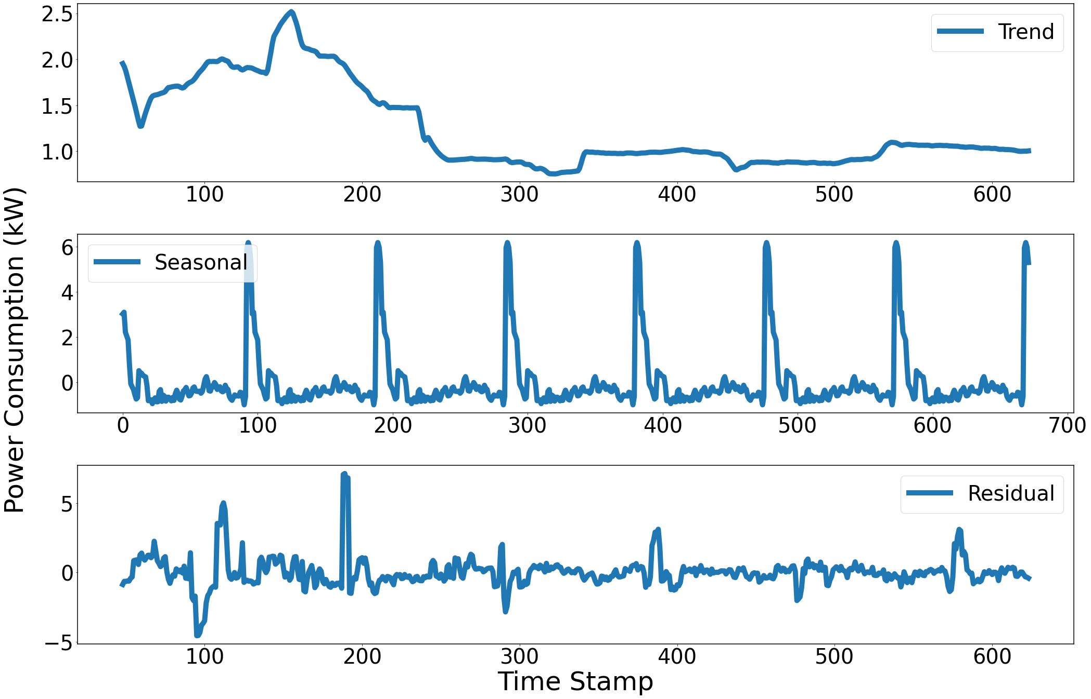
EV Detection Algorithm – Feature Engineering
We know that EV charging is a repeated behavior, and we want to discover the trend in the dataset.
Seasonal Decomposition:
Decomposed time-series data into trend, seasonal, and residual components to capture recurring patterns.
Trend shows long-term changes that may correlate with consistent charging habits.
Seasonal reveals recurring behaviors, such as regular charging times.
Residuals capture anomalies or irregular spikes that could indicate irregular EV charging sessions.
Non-EV user
Stable EV usage
EV user
Seasonal Decomposition Components reveal the hidden pattern of the data
Notes:
Seasonal Component
The trend component could indicate when an EV is frequently charged, this trend becoming stable over time, indicating the charging pattern is more detectable.
Seasonal Component:
For EV users, the seasonal component captures regular charging patterns, such as daily or weekly peaks at specific hours or days (e.g., overnight charging).
Residual (or Irregular) Component
The residual component might indicate unscheduled EV charging sessions, irregular appliance use, or other unexpected high-power events. This helps filter the data.
Equations for calculating those three components are in the backup slides.

Slide 9
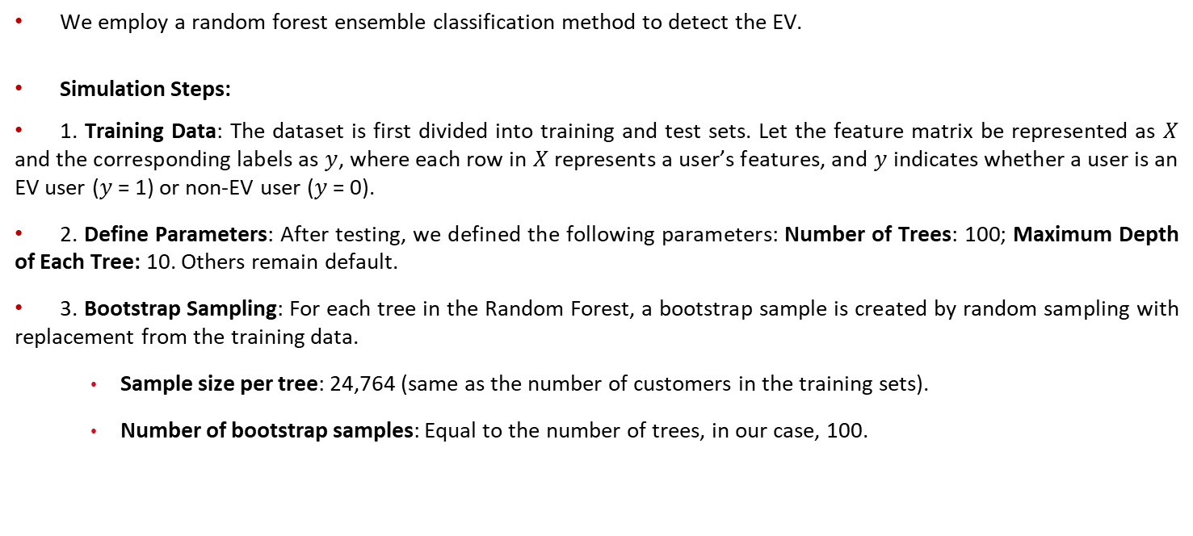
EV Detection Algorithm – Random Forest Method
We employ a random forest ensemble classification method to detect the EV.
Simulation Steps:
1. Training Data: The dataset is first divided into training and test sets. Let the feature matrix be represented as $X$ and the corresponding labels as $y$, where each row in $X$ represents a user’s features, and $y$ indicates whether a user is an EV user ($y$ = 1) or non-EV user ($y$ = 0).
2. Define Parameters: After testing, we defined the following parameters: Number of Trees: 100; Maximum Depth of Each Tree: 10. Others remain default.
3. Bootstrap Sampling: For each tree in the Random Forest, a bootstrap sample is created by random sampling with replacement from the training data.
Sample size per tree: 24,764 (same as the number of customers in the training sets).
Number of bootstrap samples: Equal to the number of trees, in our case, 100.
Notes:
We first divide the data into training sets (70%) and test sets (30%). In our case, training sets contain 24764 customers, and testing sets contain 10614 customers.
Maximum Depth of Each Tree Controls the maximum number of splits (or levels) in each tree.
Bootstrap Sampling with Replacement: For each tree in the forest, a new dataset is created by randomly selecting data points from the original dataset. Since the sampling is with replacement, each data point in the original dataset has an equal probability of being selected multiple times in the same bootstrap sample, while some data points may not be selected at all.
Typically, each bootstrap sample is the same size as the original dataset, but because it’s sampled with replacement, about 63% of the original data points are included in each sample (with some data points appearing multiple times). This sampling introduces slight variations between the datasets used to train each tree, resulting in a set of trees that are similar but have learned different patterns due to variations in their training data.
Out-of-Bag (OOB) Samples: Since approximately 37% of data points are left out of each bootstrap sample, these remaining data points (known as out-of-bag or OOB samples) can be used to validate the performance of each tree.

Slide 10
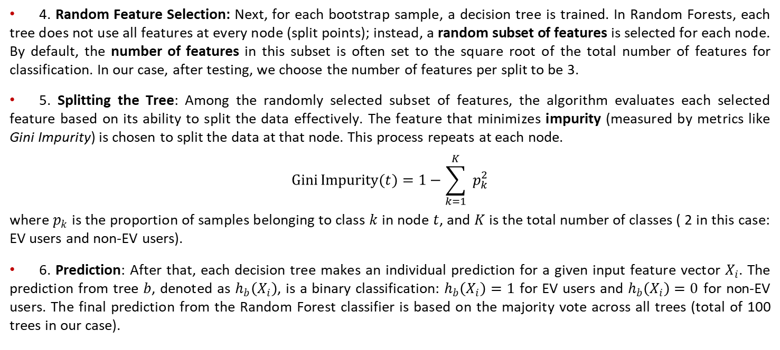
EV Detection Algorithm – Random Forest Method
4. Random Feature Selection: Next, for each bootstrap sample, a decision tree is trained. In Random Forests, each tree does not use all features at every node (split points); instead, a random subset of features is selected for each node. By default, the number of features in this subset is often set to the square root of the total number of features for classification. In our case, after testing, we choose the number of features per split to be 3.
5. Splitting the Tree: Among the randomly selected subset of features, the algorithm evaluates each selected feature based on its ability to split the data effectively. The feature that minimizes impurity (measured by metrics like Gini Impurity) is chosen to split the data at that node. This process repeats at each node.
$$Gini⁡Impurity⁡(t)=1−\sum_{k=1}^{K}{ }p_{k}^{2}$$
where $p_{k}$ is the proportion of samples belonging to class $k$ in node $t$, and $K$ is the total number of classes ( 2 in this case: EV users and non-EV users).
6. Prediction: After that, each decision tree makes an individual prediction for a given input feature vector $X_{i}$. The prediction from tree $b$, denoted as $h_{b}\left(X_{i}\right)$, is a binary classification: $h_{b}\left(X_{i}\right)=1$ for EV users and $h_{b}\left(X_{i}\right)=0$ for non-EV users. The final prediction from the Random Forest classifier is based on the majority vote across all trees (total of 100 trees in our case).
Notes:
A node represents a point in the tree where a decision is made about splitting data based on feature values. Nodes guide the data flow through the tree to reach a final classification output.
The root node is the topmost node in the tree and represents the entire dataset. It contains the first decision (or split) based on a feature that best divides the data into two or more groups, maximizing separation between different classes.
Internal nodes (or decision nodes) are nodes where the data is further split based on specific features. Each internal node applies a condition (e.g., “Is feature X>5”) to partition the data into subsets.
Leaf nodes are the final nodes in the tree, where no further splitting occurs. Each leaf node represents a final output or classification for the data points that reached it. In classification, a leaf node often represents a specific class label (e.g., “EV user” or “Non-EV user”), based on the majority class of data points within that node.
Random Feature Selection: In Random Forests, each tree does not use all features at every split; instead, a random subset of features is selected for each split. By default, the number of features in this subset is often set to the square root of the total number of features for classification.
The best feature to split: Among the randomly selected subset of features, the algorithm evaluates each feature based on its ability to split the data effectively. The feature that minimizes impurity (measured by metrics like Gini Impurity for classification) is chosen to split the data at that node. This recursive process continues until a stopping criterion is met, such as reaching a maximum depth or a minimum number of samples per leaf node.
Gini Impurity is a measure used in decision trees to quantify the disorder of a dataset, reflecting how mixed the classes are within a node. A lower Gini Impurity value indicates a purer node (where most data points belong to a single class), helping the tree make more accurate splits for classification. This number is between 0 – 0.5. A Gini Impurity value of 0 means the node is pure, containing only samples of a single class, while higher values indicate more class mixture.

Slide 11
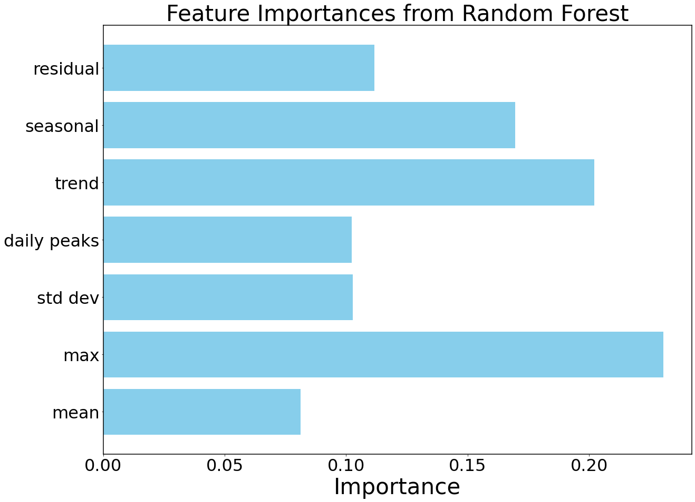
EV Detection Algorithm – Training result
By using Random Forest, we can observe the feature importance:
We can see that the trend (consistent high-power usage when an EV is frequently charged), max value, and seasonal (regular charging patterns, such as daily or weekly peaks at specific hours or days) plays important role in the RF training.
The added feature engineering approach proved to be useful in the RF training process.

Slide 12
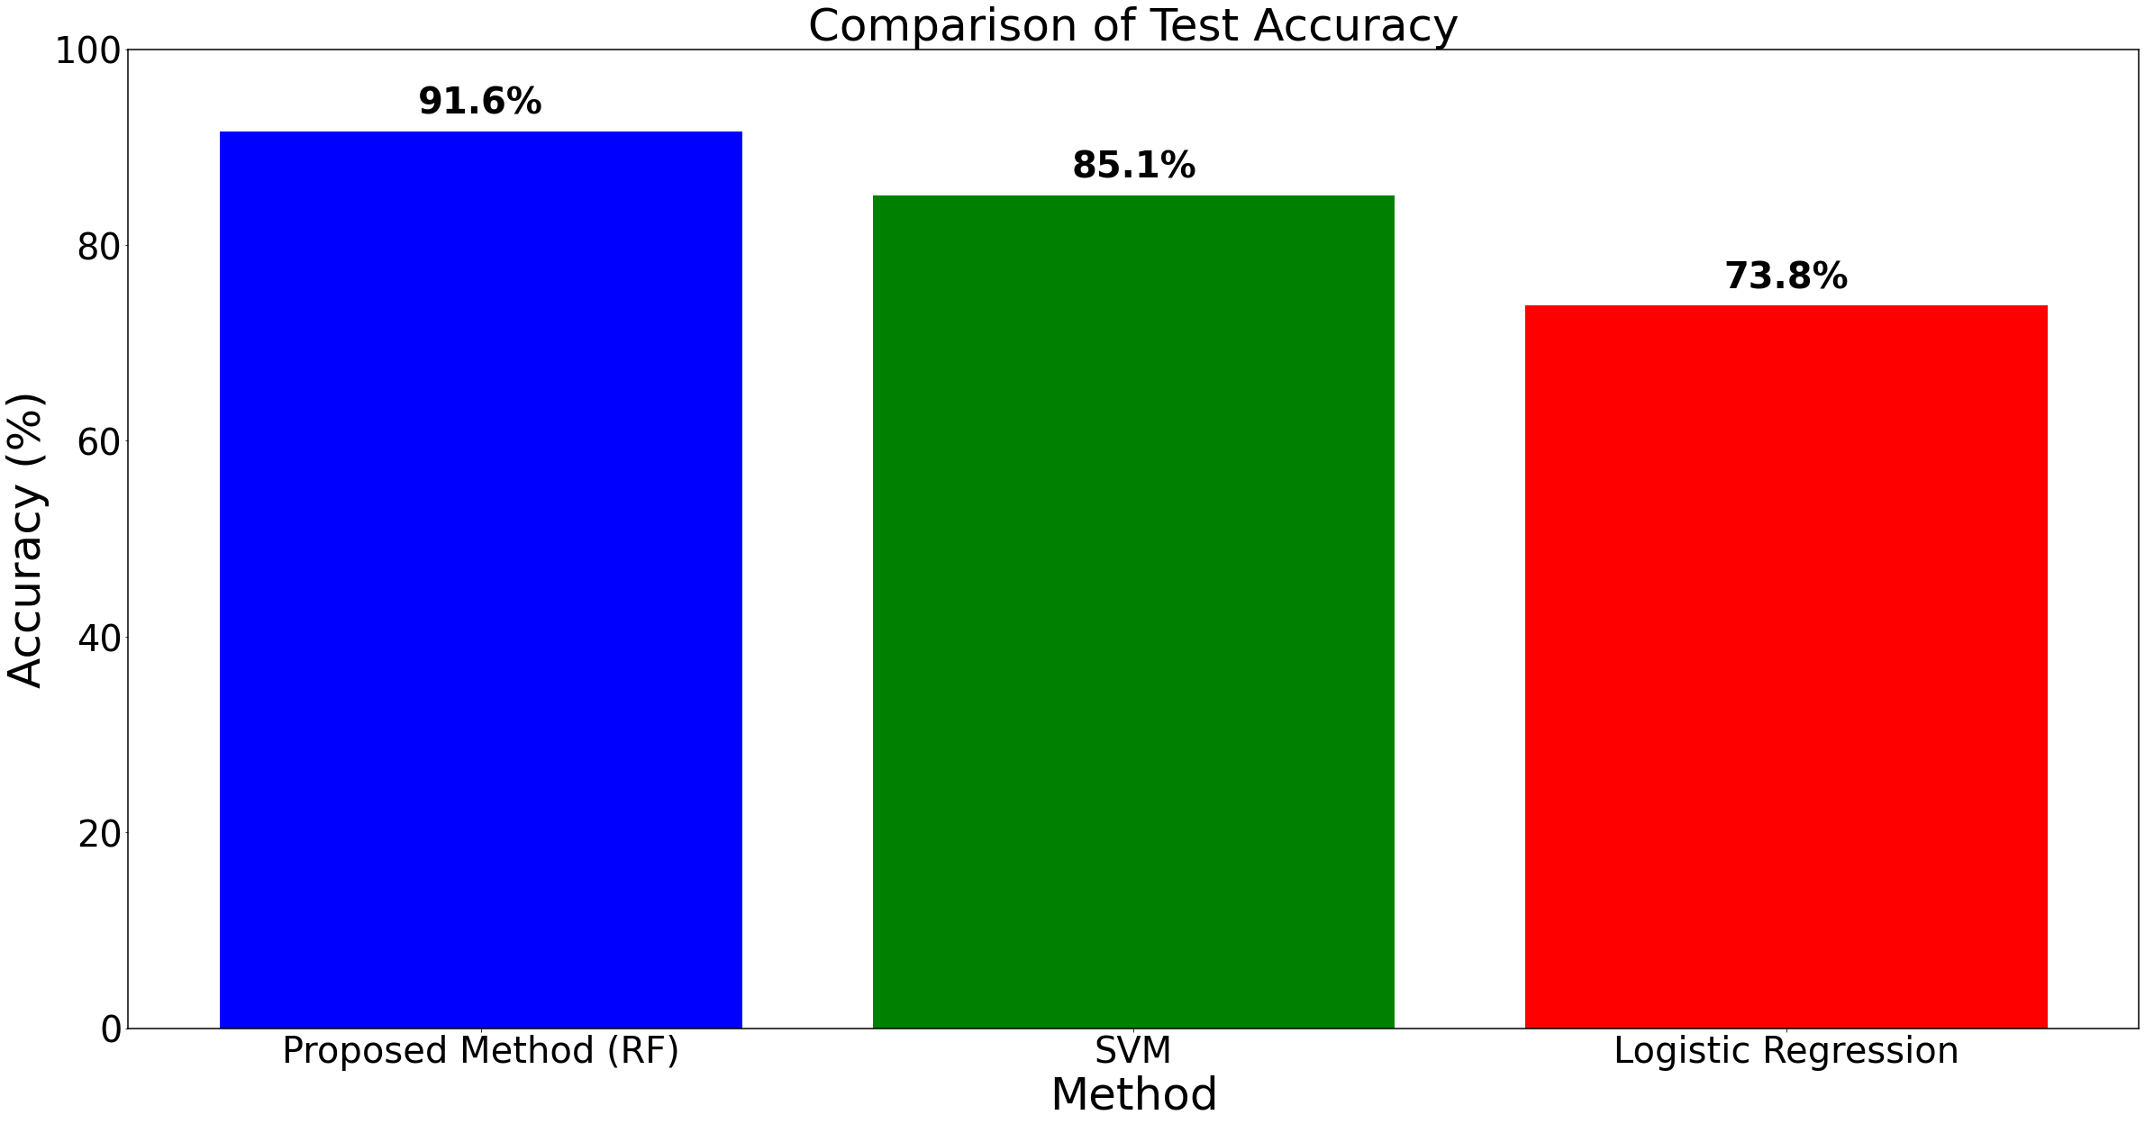
EV Detection Algorithm – Training result
The prediction results show that the detection accuracy using the test set (10614 customers) is 91.6%.
We conducted a comparison test using two widely used methods: Support Vector Machine (SVM) and Logistic Regression.
The results indicate that the proposed method achieves the highest accuracy in EV detection, outperforming SVM and Logistic Regression.
Notes:
Detailed performance metrics in backup slides.

Slide 13
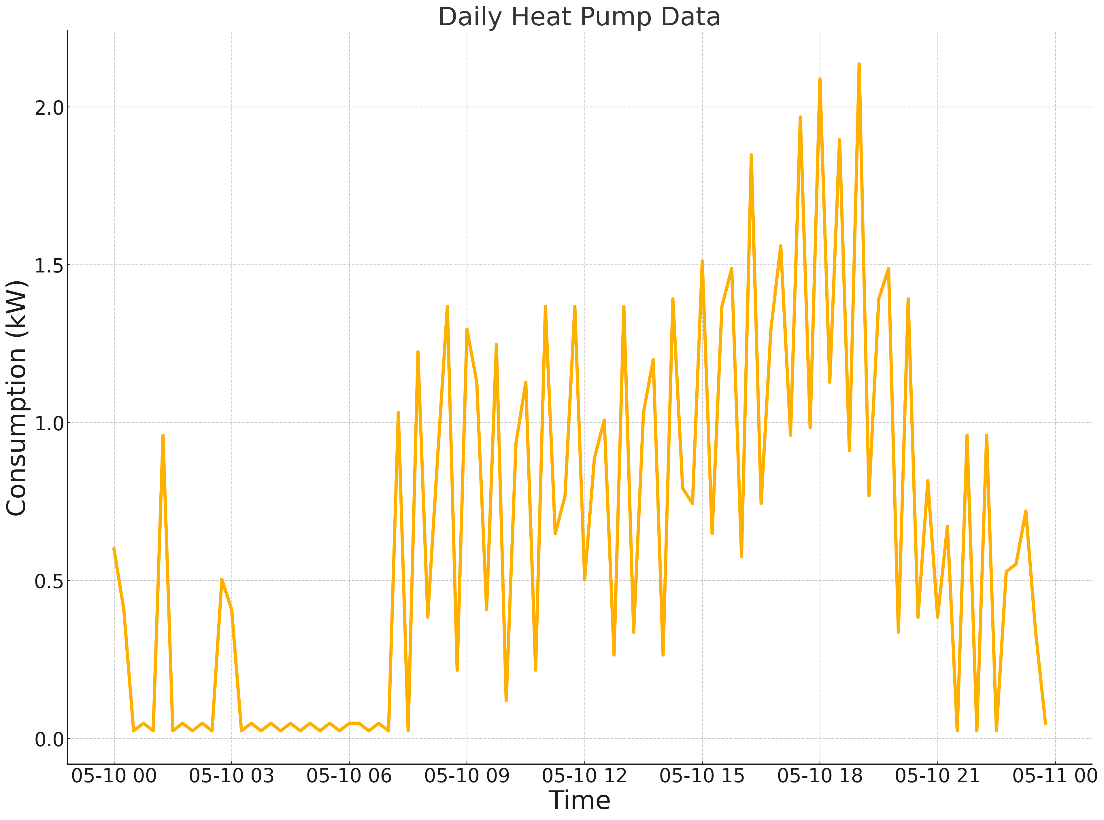
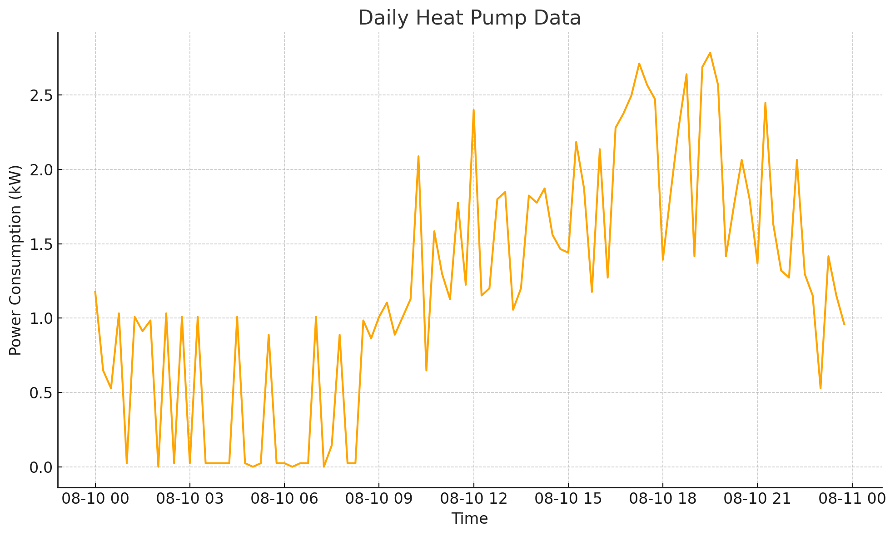
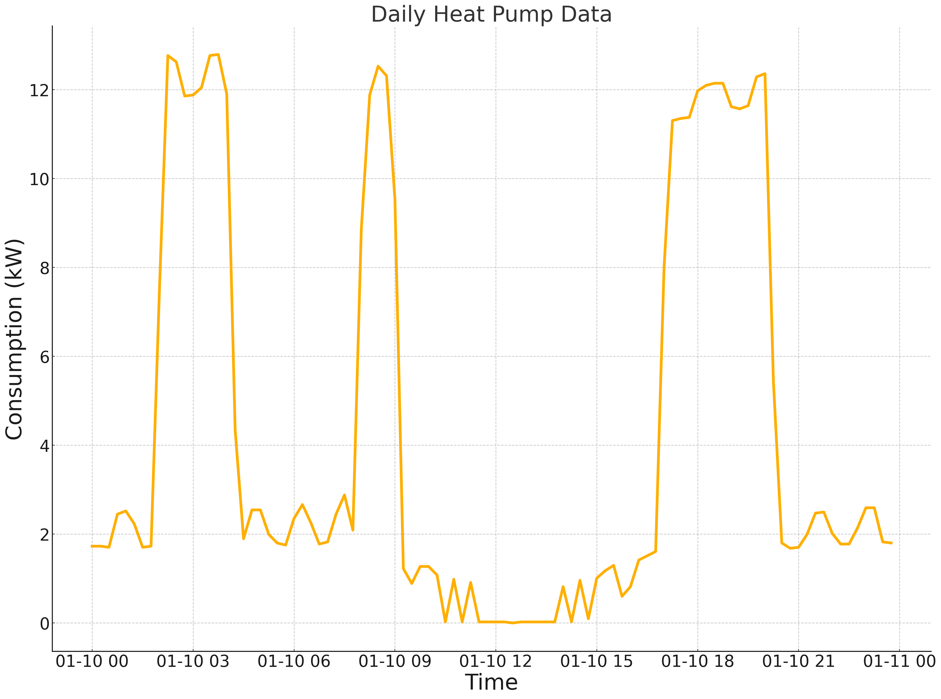
Introduction to Utility Heat Pump Dataset
One-year (2022/04/01 – 2023/04/01) sub-metered heat pump data with 15-min resolution are provided by our utility partner.
After data pre-processing, the dataset includes 1,896 residential heat pump users.
The figure below shows the example of three users’ daily consumption plots from the dataset.
Spring Profile
Summer Profile
Winter Profile
A daily heat pump’s operation tends to follow the typical daily load curve, but with more frequent cycling.

Slide 14
Residential Heat Pump Detection – Features
The ensemble classification algorithm for EV detection is adjusted and extended to the heat pump detection work.
We preserved the statistical and seasonal decomposition features conducted in the EV detection work.
In addition, to incorporate the unique periodic cycling behavior of heat pumps, we perform several feature adjustments to capture these patterns for each customer in the RF classifier:
Average Cycle Count: Counts the average daily number of cycles (a working + idle count as one cycle). Heat pumps have a periodic on/off behavior, which may result in frequent cycling compared to other household appliances.
Average Working Duration: Measures the average working duration.
Average Idle Duration: Measures the duration of periods between working status where no significant consumption occurs, characteristic of heat pumps that have off times.
Heat pump usage is seasonally dependent. Therefore, we employed ambient temperature as an additional feature.

Slide 15
Residential Heat Pump Detection – Features Visualization
Statistic (For all customers with HP) | Value
Min Working Consumption | 0.104 kW
Max Working Consumption | 5.92 kW
Standard Deviation (excluding zeros) | 0.89 kW
Average Working Consumption | 1.478 kW
Median (excluding zeros) | 1.344 kW
Average Cycle Count per Day | 23.7 Cycles
Average Working Duration | 35.5 Minutes
Average Idle Duration | 25.2 Minutes
In this work, pure heat pump data was aggregated with random residential AMI data to create cumulative load patterns. The total number of customers without HP in this study is 33,500.
We create the label (0 or 1) to indicate the presence of heat pumps for each time interval.
Notes:
Since our HP data is sub-metered, we must add some AMI data to create the aggregated load profile.
In this work, pure heat pump data was aggregated with random residential AMI data to create cumulative load patterns. The total number of customers without HP in this study is 33,500.

Slide 16
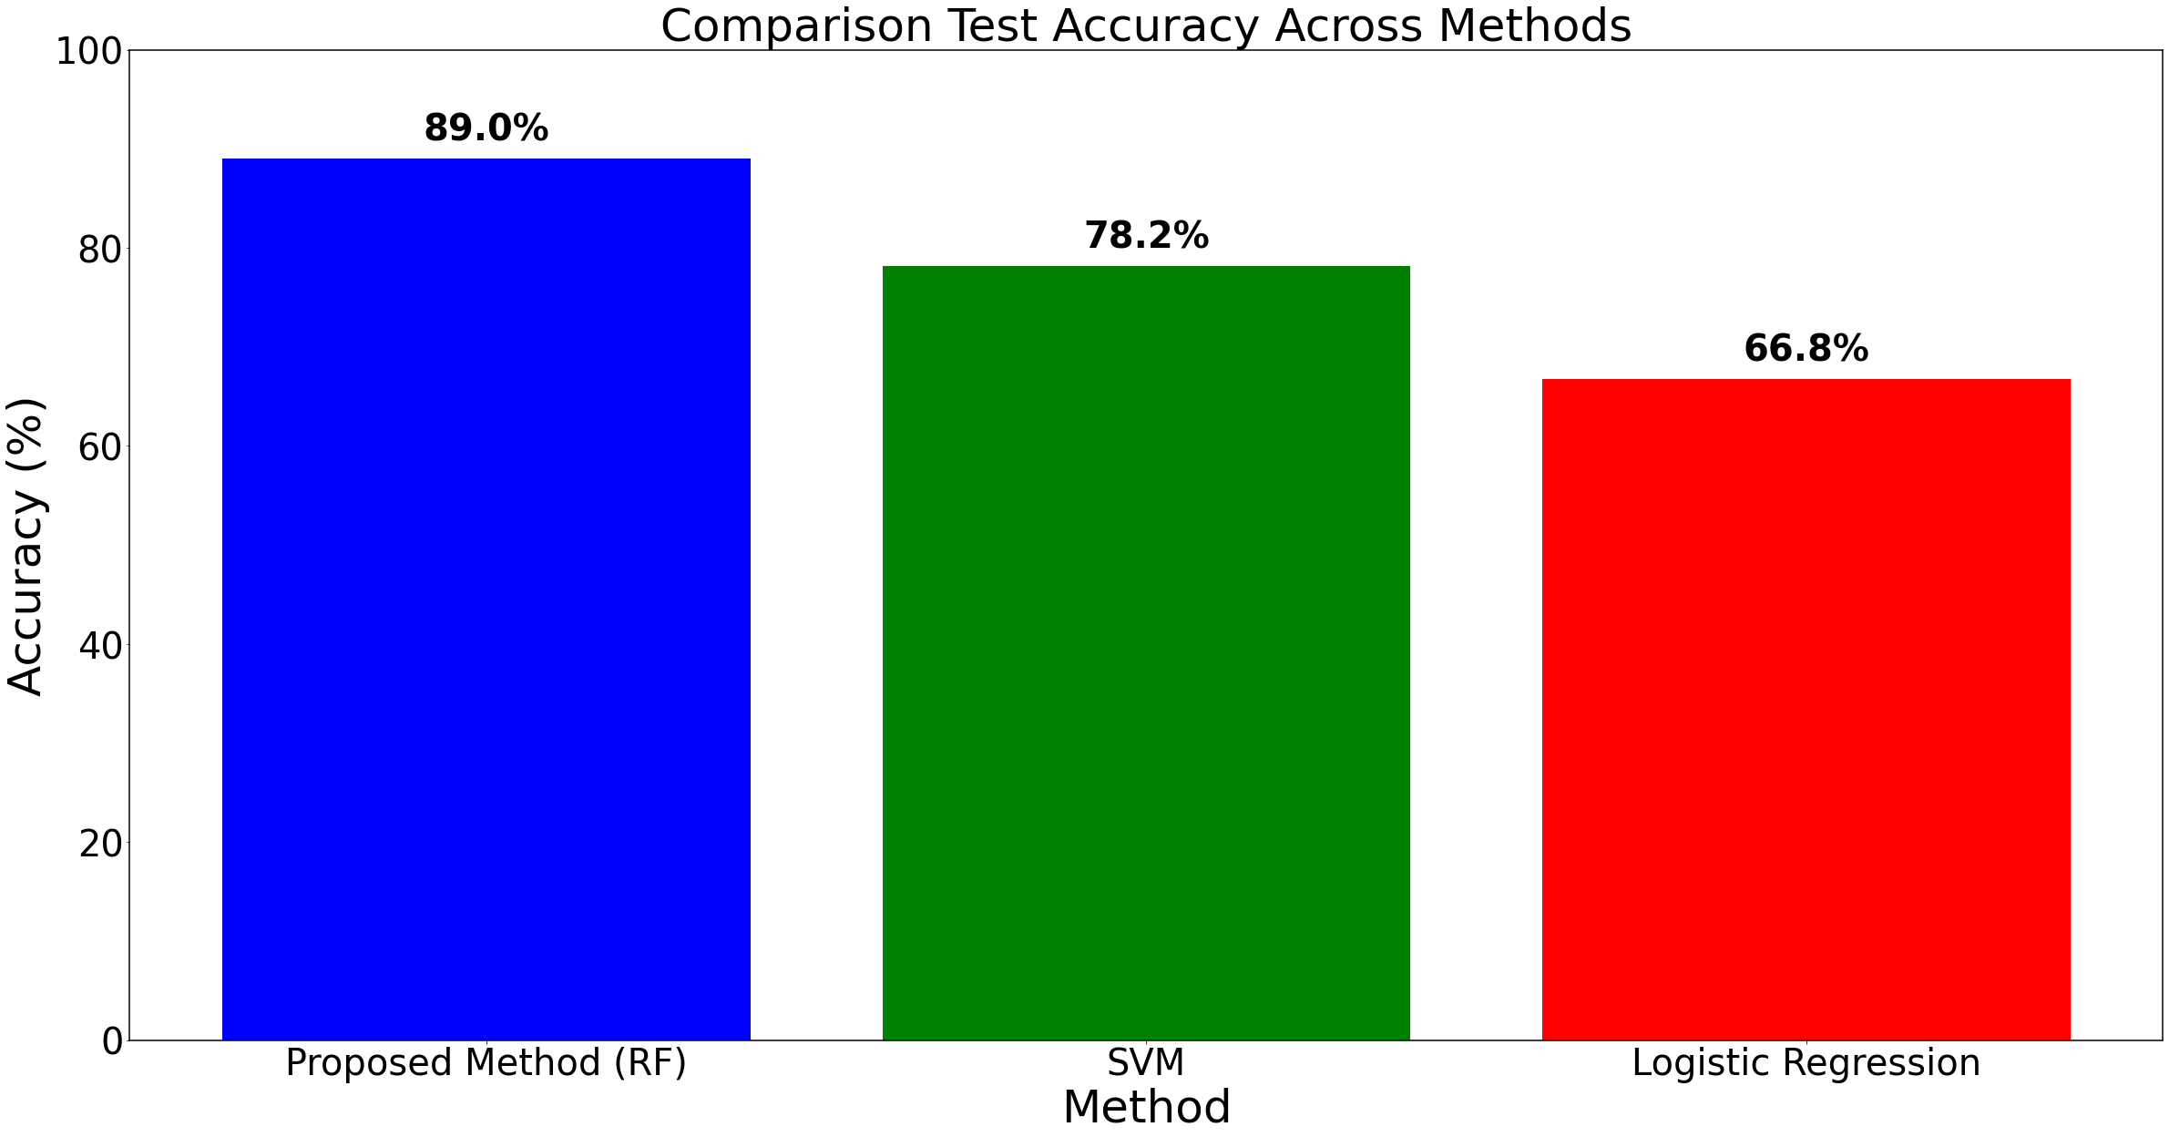
Residential Heat Pump Detection – Results
Similar to the EV detection, we split the dataset to Training and testing dataset by 70%/30%.
The training set contains 24777 customers, and the testing set contains 10619 customers.
The prediction results show that the detection accuracy using the test set is 89%.
We also conducted a comparison test using Support Vector Machine (SVM) and Logistic Regression.

Slide 17
Conclusion
Successfully developed and tested a framework using real utility data for EV and heat pump detection.
Feature engineering, including statistical metrics, temporal baselines, and seasonal decomposition, proved essential for accurate EV and heat pump identification.
Random Forest classifier and rule-based detection provided reliable performance on imbalanced and high-resolution data, making these methods practical for utility applications.
This work provides tools for utilities to monitor EV and heat pump usage patterns, providing more informed resource planning, demand forecasting, and infrastructure management.

Slide 18
Reference
[1] V. Hoffmann, B. I. Fesche, K. Ingebrigtsen, I. N. Christie, and M. P. Engelstad, "Automated Detection of Electric Vehicles in Hourly Smart Meter Data," 25th International Conference on Electricity Distribution, Madrid, Spain, 2019, pp. 1-5.
[2] Neubert, Martin, Oliver Gnepper, Oliver Mey, and André Schneider. 2022. "Detection of Electric Vehicles and Photovoltaic Systems in Smart Meter Data" Energies 15, no. 13: 4922. https://doi.org/10.3390/en15134922
[3] H. Song, C. Liu, M. Jalili, X. Yu and P. McTaggart, "Ensemble Classification Model for EV Identification From Smart Meter Recordings," in IEEE Transactions on Industrial Informatics, vol. 19, no. 3, pp. 3274-3283, March 2023, doi: 10.1109/TII.2022.3175750.
[4] Wang, Xudong, Guoming Tang, Yi Wang, Srinivasan Keshav, and Yu Zhang. "Evsense: A robust and scalable approach to non-intrusive ev charging detection." In Proceedings of the Thirteenth ACM International Conference on Future Energy Systems, pp. 307-319. 2022.
[5] A. Babalhavaeji, H. Song, M. Radmanesh, and M. Jalili, "Identifying Electric Vehicles from Smart Meter Recordings," 11th IEEE International Conference on Smart Grid, Paris, France, 2023, pp. 1-5, DOI: 10.1109/ICSMARTGRID58556.2023.10171002.

Slide 19
Backup Slides

Slide 20
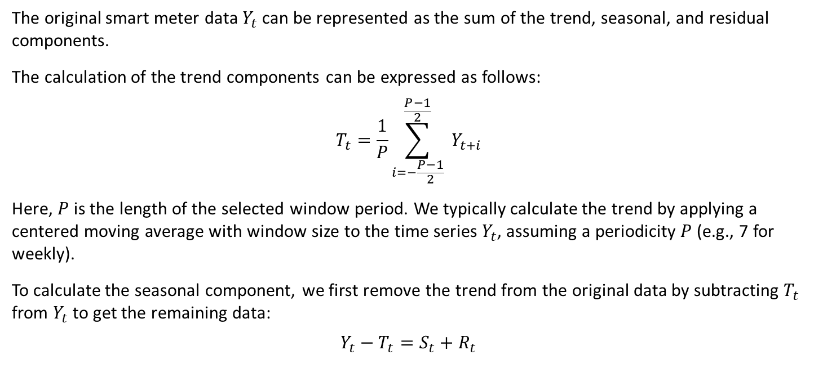
Seasonal Decomposition
The original smart meter data $Y_{t}$ can be represented as the sum of the trend, seasonal, and residual components.
The calculation of the trend components can be expressed as follows:
$$T_{t}=\frac{1}{P}\sum_{i=−\frac{P−1}{2}}^{\frac{P−1}{2}}{ }Y_{t+i}$$
Here, $P$ is the length of the selected window period. We typically calculate the trend by applying a centered moving average with window size to the time series $Y_{t}$, assuming a periodicity $P$ (e.g., 7 for weekly).
To calculate the seasonal component, we first remove the trend from the original data by subtracting $T_{t}$ from $Y_{t}$ to get the remaining data:
$$Y_{t}−T_{t}=S_{t}+R_{t}$$

Slide 21
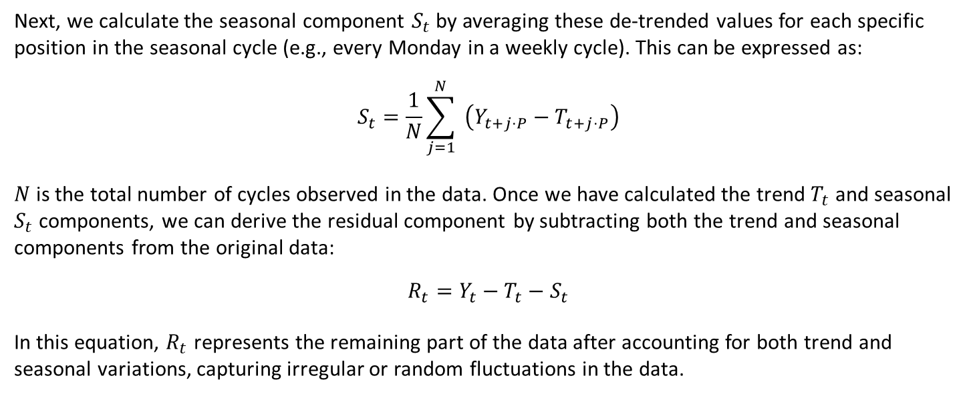
Seasonal Decomposition
Next, we calculate the seasonal component $S_{t}$ by averaging these de-trended values for each specific position in the seasonal cycle (e.g., every Monday in a weekly cycle). This can be expressed as:
$$S_{t}=\frac{1}{N}\sum_{j=1}^{N}{ }\left(Y_{t+j⋅P}−T_{t+j⋅P}\right)$$
$N$ is the total number of cycles observed in the data. Once we have calculated the trend $T_{t}$ and seasonal $S_{t}$ components, we can derive the residual component by subtracting both the trend and seasonal components from the original data:
$$R_{t}=Y_{t}−T_{t}−S_{t}$$
In this equation, $R_{t}$ represents the remaining part of the data after accounting for both trend and seasonal variations, capturing irregular or random fluctuations in the data.

Slide 22
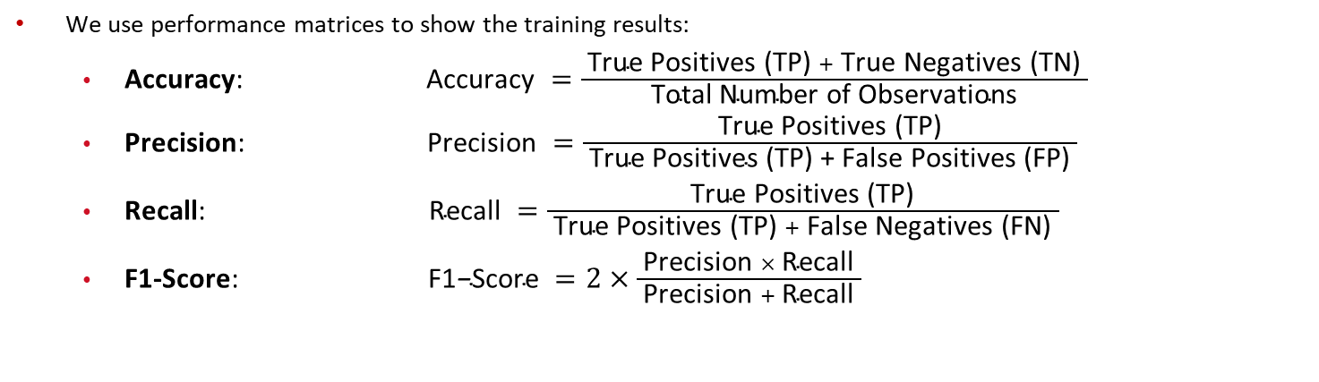
EV Detection Algorithm – Training result
We use performance matrices to show the training results:
Accuracy: $\text{Accuracy} =\frac{ \text{True} \text{Positives}\text{ (}\text{TP}\text{)} + \text{True} \text{Negatives}\text{ (}\text{TN}\text{)} }{ \text{Total} \text{Number} \text{of} \text{Observations} }$
Precision: $\text{Precision} =\frac{ \text{True} \text{Positives}\text{ (}\text{TP}\text{)} }{ \text{True} \text{Positives}\text{ (}\text{TP}\text{) + }\text{False} \text{Positives}\text{ (}\text{FP}\text{)} }$
Recall: $\text{Recall} =\frac{ \text{True} \text{Positives}\text{ (}\text{TP}\text{)} }{ \text{True} \text{Positives}\text{ (}\text{TP}\text{)} + \text{False} \text{Negatives}\text{ (}\text{FN}\text{)} }$
F1-Score: $\text{F}\text{1}\text{−}\text{Score} =2×\frac{ \text{Precision} × \text{Recall} }{ \text{Precision} + \text{Recall} }$
Class | Precision | Recall | F1-Score
Non-EV User | 0.927 | 0.966 | 0.946
EV User | 0.866 | 0.845 | 0.855
Accuracy: 0.916
Notes:
Accuracy
Definition: Accuracy is the ratio of correctly predicted observations to the total observations.
Precision
Definition: Precision (or Positive Predictive Value) is the ratio of correctly predicted positive observations to the total predicted positive observations.
Precision answers the question, "Of all the observations predicted as positive, how many were actually positive?" High precision is crucial when the cost of false positives is high.
Recall (Sensitivity or True Positive Rate)
Definition: Recall is the ratio of correctly predicted positive observations to all observations in the actual class.
Recall answers the question, "Of all the actual positive observations, how many did the model capture?" High recall is essential when missing positives (false negatives) is costly.
F1-Score
Definition: The F1-score is the harmonic mean of precision and recall, providing a balance between the two metrics.

Slide 23
Residential Heat Pump Detection – Training result
We use performance matrices to show the training results:
Accuracy: $\text{Accuracy} =\frac{ \text{True} \text{Positives}\text{ (}\text{TP}\text{)} + \text{True} \text{Negatives}\text{ (}\text{TN}\text{)} }{ \text{Total} \text{Number} \text{of} \text{Observations} }$
Precision: $\text{Precision} =\frac{ \text{True} \text{Positives}\text{ (}\text{TP}\text{)} }{ \text{True} \text{Positives}\text{ (}\text{TP}\text{) + }\text{False} \text{Positives}\text{ (}\text{FP}\text{)} }$
Recall: $\text{Recall} =\frac{ \text{True} \text{Positives}\text{ (}\text{TP}\text{)} }{ \text{True} \text{Positives}\text{ (}\text{TP}\text{)} + \text{False} \text{Negatives}\text{ (}\text{FN}\text{)} }$
F1-Score: $\text{F}\text{1}\text{−}\text{Score} =2×\frac{ \text{Precision} × \text{Recall} }{ \text{Precision} + \text{Recall} }$
Class | Precision | Recall | F1-Score
Non-HP User | 0.909 | 0.912 | 0.910
HP User | 0.873 | 0.866 | 0.869
Accuracy: 0.890

Slide 24
EV Charging Interval Identification
Problem Statement:
Identify the EV charging intervals by distinguishing their unique EV charging consumption patterns.
Help utilities manage load, predict demand, and optimize resources. Provides insights into user behavior patterns for infrastructure planning.
Challenges:
EV charging profiles can overlap with other high-energy-consuming appliances.
Utility data lacks labels for actual EV charging intervals.
Solutions:
Use statistical method to create a temporal baseline and confidence interval of typical non-EV usage patterns.
Implemented a method to detect charging start and end times by tracking when EV user consumption crosses the baseline.

Slide 25
EV Charging Interval Identification Algorithm
Since we do not have labels for actual EV charging intervals, a rule-based algorithm is developed to find the charging start and end time.
Simulation Steps:
1. Assumptions: With abundant non-EV dataset, we assume that all non-EV users' consumptions at each time stamp follow a normal distribution and within a range.
2. Compute the mean and standard deviation of non-EV user consumption for each time interval to establish a baseline.
3. Define Detection Threshold: Calculate a 90% confidence interval upper bound for non-EV usage:
Upper Bound= Mean + 1.44×Standard Deviation
4. Charging Interval Detection:
For each EV user:
- Start a charging interval when power consumption crosses the non-EV upper bound.
- End the interval when consumption returns below the upper bound.
- Record start time, end time, and duration of each interval.

Slide 26
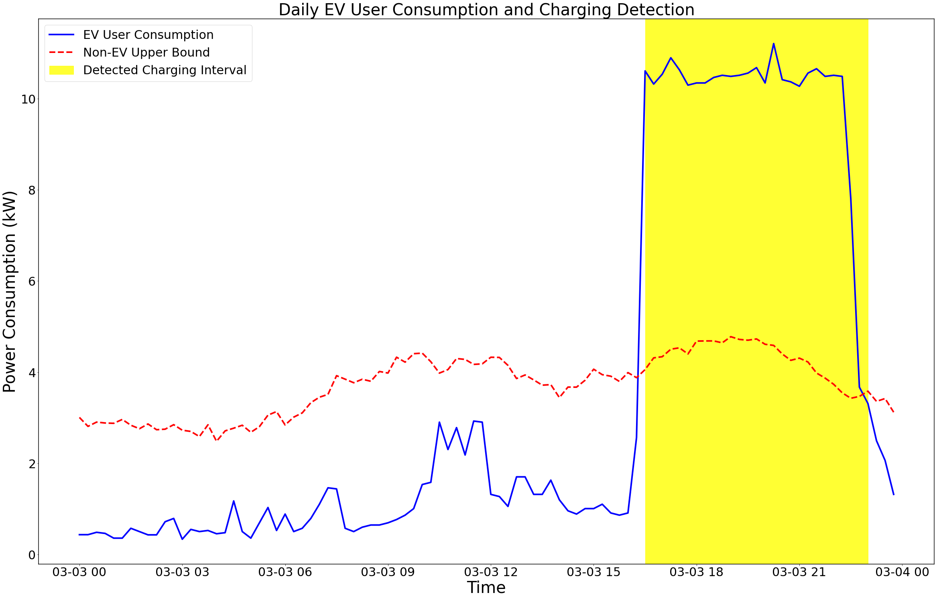
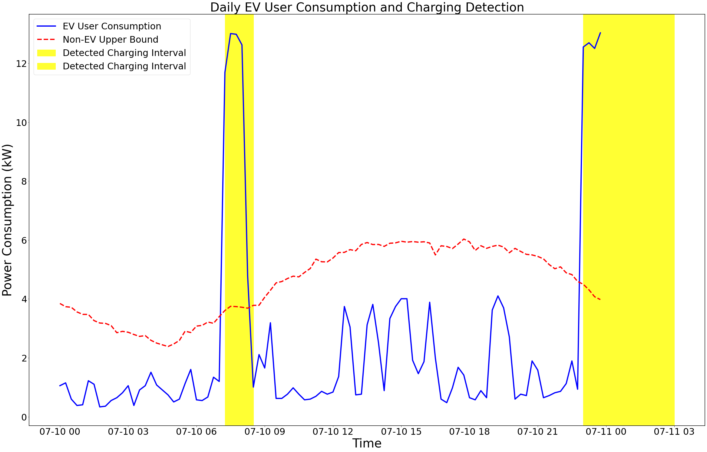
EV Charging Interval Identification - Results
Figures below demonstrate daily EV charging interval identification results for two example users.
The red line shows the upper bound detection threshold.
The Left figure shows a charging behavior at 18:00. The middle figure shows a charging behavior at 23:00. The right figure shows multiple charging during a day.

Slide 27
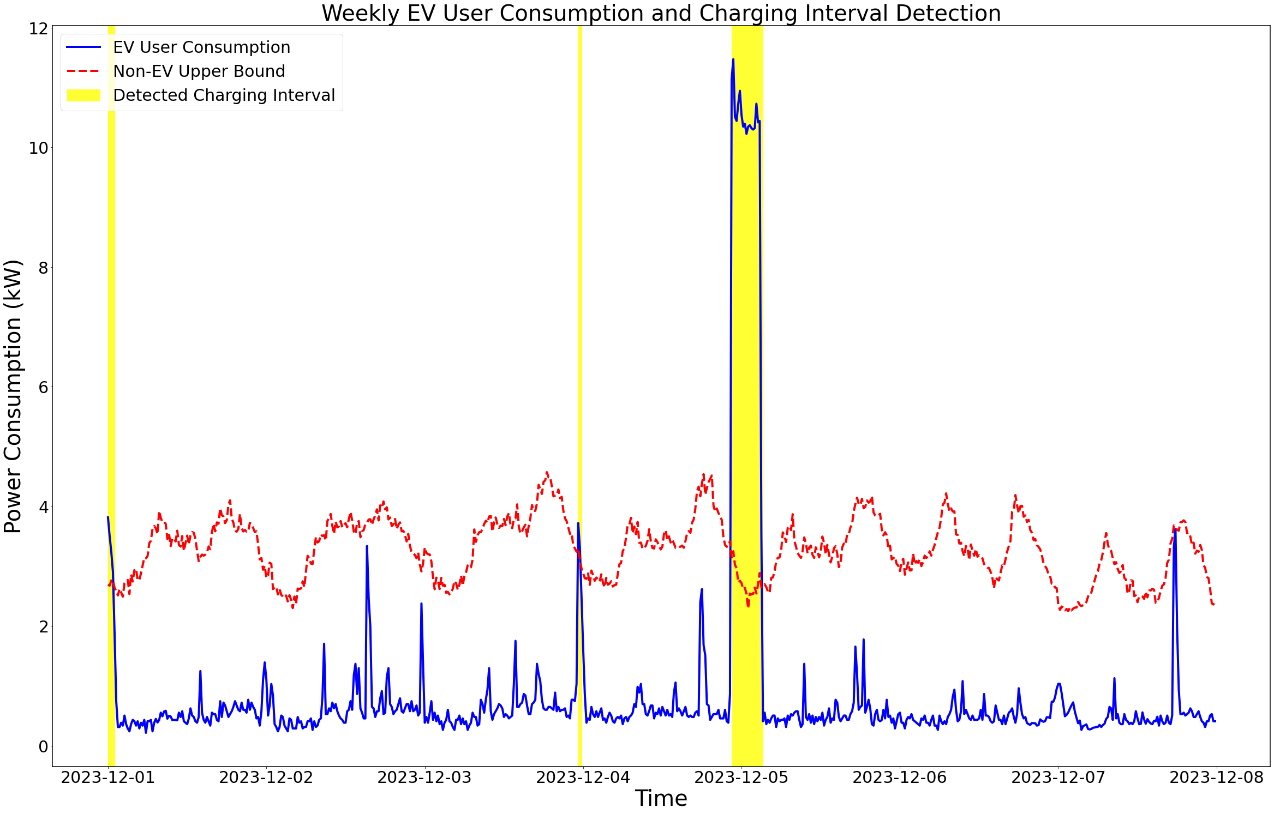
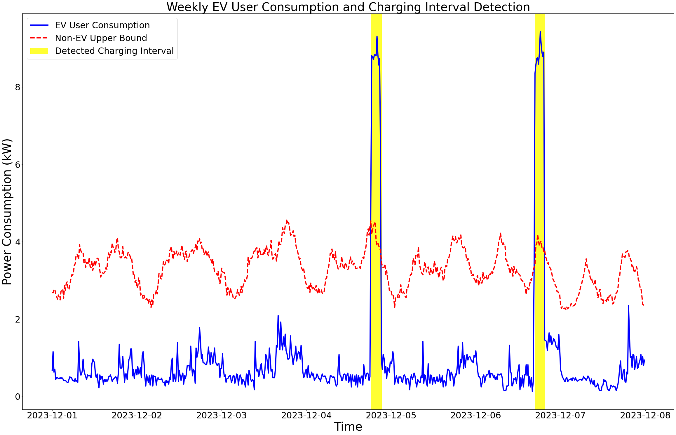
EV Charging Interval Identification - Results
Figures below demonstrate weekly EV charging interval Identification results for three different users.
The weekly plots give more clear and distinguishable charging intervals across one week.
Most users are likely to charge the EV during nighttime.
The rule-based method performance are dependent by the other possible high-energy-consuming appliances, considering the lack of labels, the algorithm performed well.

Slide 28
Thank You!
Q&A

