Slide 1

User Instructions and Sample Output of the Transformer Overloading Evaluation Tool with EV and Heat Pump Penetrations
The development of this tool was funded by the Iowa Energy Center project 22-IEC-3 “Mining Smart Meter Data for Modeling and Mitigating EV Charging Impacts on Distribution Grids”

Slide 2
Tool Overview
Partners: ISU, Algona Municipal Utilities, Linn County REC, Mi-Energy Co-op, Cedar Falls Utilities, IA DOT.
Analyze real EV charging and heap pump data and evaluate the impact on the distribution grid, which could benefit our utility partners.
Used sub-metered heat pump and EV charging data, and aggregated SM data containing EV users to achieve the following tasks:
  Analyze EV charging demands and derive typical EV charging and heat pump patterns.
  Develop an open-source tool for utilities to evaluate annual distribution transformer loading conditions with selected penetration levels of EV and Heat pumps.
Data Type | Provider
Sub-metered EV charging | Mi-Energy Co-op
Sub-metered heat pump | Linn County REC
Aggregated SM | Linn County REC, AMU, CFU

Slide 3
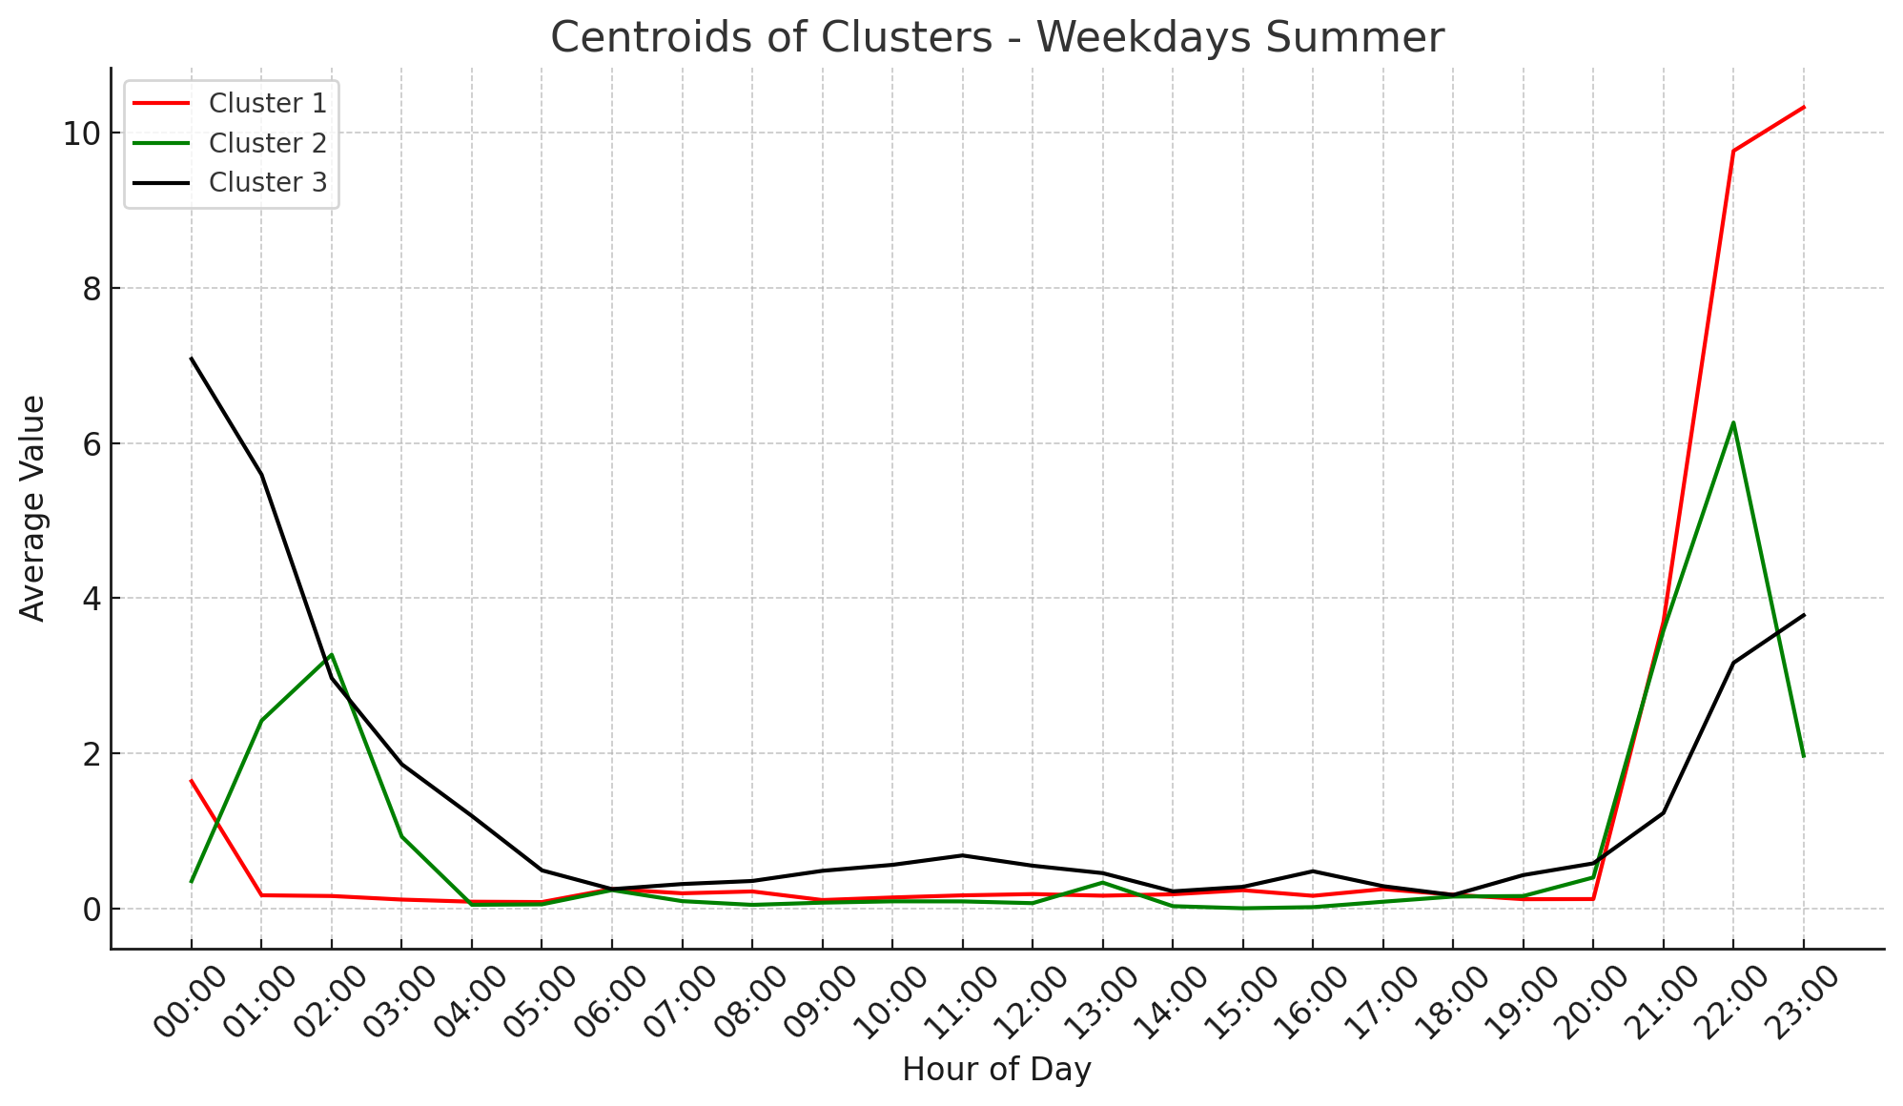
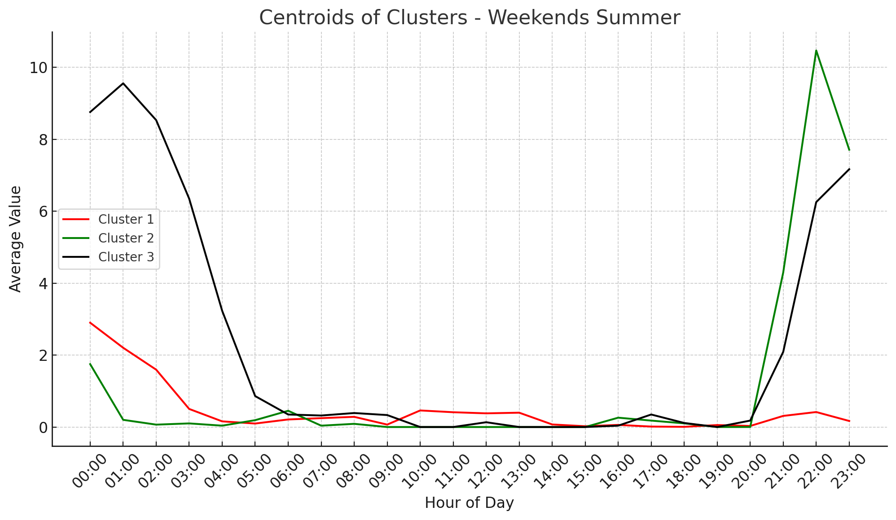
Derive Typical EV Charging and Heat Pump Patterns
Using sub-metered EV charging and heat pump data, explore EV charging behavior variations between seasons and compare behavior between workdays and weekends.
Data segmentation and clustering to extract seasonal representative load shapes for EV and heat pumps.
Cluster probability represents the frequency of each typical profile being selected during the data sampling process.
Cluster | Probability | Customers
0 | 0.8015 | 1519
1 | 0.1985 | 377
Cluster | Probability | Customers
0 | 0.242 | 461
1 | 0.085 | 160
2 | 0.644 | 1219
3 | 0.0299 | 56
Fig. EV charging clusters for summer weekdays and weekends

Slide 4
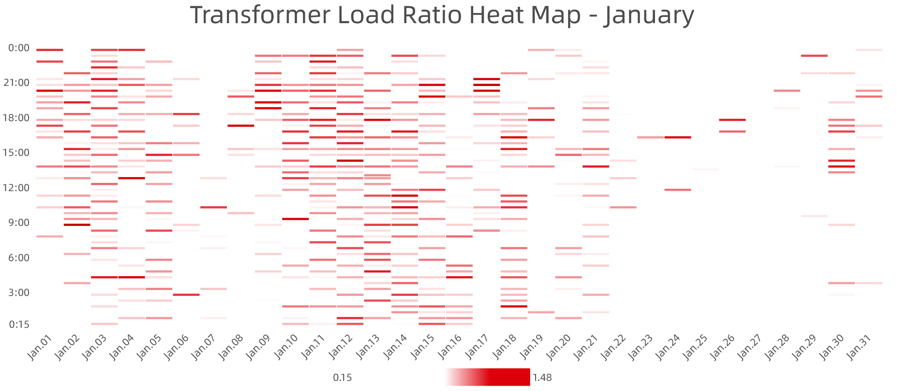
Method of Assessing Transformer Overloading
Use Monte-Carlo Simulation and sample the heat pump and EV charging profiles using the extracted seasonal typical curves with different penetration levels of EVs and heat pumps. Calculate the final aggregated load for each customer with corresponding smart meter data.
Integrate aggregated load with utility models considering transformer-customer connectivity to calculate the distribution transformer thermal loading condition and evaluate overloading duration and intensity.
Open-source tool available for utilities to evaluate annual DT thermal loading conditions with chosen EV and heat pump penetration levels.
Fig. Loading ratio heat map of specific transformer in a month

Slide 5
How This Tool Works
Data Validation:
  Ensures that the transformer data (RAW_TC.xlsx) contains required fields (e.g., MTR_ID, XFMR_ID, XFRM_SIZE).
  Checks AMI data (RAW_AMI.xlsx), including valid timestamps and cross-references meter IDs with transformer data.
  Confirms that AMI data covers a full annual cycle.
Data Transformation:
  Converts transformer sizes to kVA and kW using a predefined power factor.
  Assigns numerical customer indexes based on meter IDs.
  Restructures AMI data to classify time-based features like seasons, weekdays/weekends, and hourly demand patterns.
Load Profile Assignment:
  Randomly selects customers for EV and HP profiles based on predefined penetration levels.
  Assigns seasonal load patterns using probability-based sampling from pre-defined cluster profiles.
  Generates merged load profiles by adding EV and HP consumption patterns to AMI data.
Overloading Evaluation:
  Calculates the total load for each transformer by summing up the loads of its connected customers.
  Identifies peak transformer loads and timestamps of maximum demand.
  Counts occurrences where transformer loads exceed their rated capacity on an annual and monthly basis.
  Outputs results into structured Excel files with multiple sheets for easy interpretation.

Slide 6
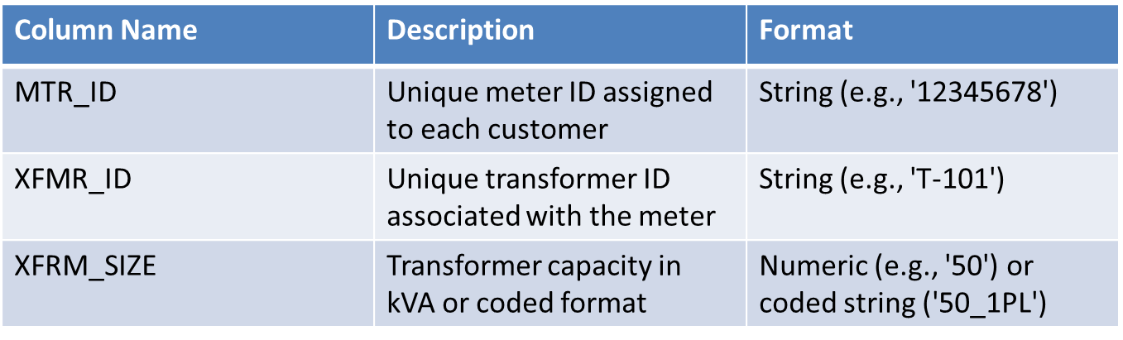
How to Prepare the Input Data
You can refer to the sample data provided. Or follow this instruction:
Preparing Transformer-Customer Data (RAW_TC.xlsx). This file contains essential transformer information and its associated customers. Ensure the following columns are correctly formatted:
Ensure all MTR_IDs are unique and consistent.
Assign correct XFMR_IDs to their respective meters.
XFRM_SIZE must be a numeric value or coded format (e.g., '50_1PL').
No empty cells or missing values.
Ensure column names are exactly as specified.

Slide 7
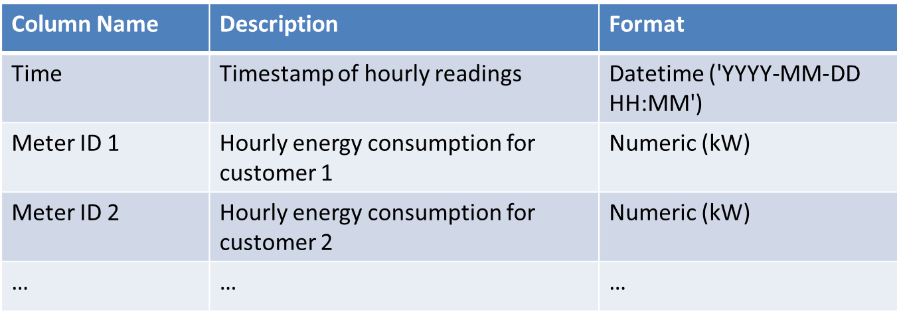
How to Prepare the Input Data
You can refer to the sample data provided. Or follow this instruction:
Preparing Smart Meter Data (RAW_AMI.xlsx). This file contains the hourly power consumption data of customers over a full year. The following columns must be included:
The first column must be named 'Time' and contain 8760 hourly entries or 8784 hourly entries (for leap years).
All meter IDs must match those in RAW_TC.xlsx.
No missing values allowed.
Ensure timestamps are continuous and sequential.

Slide 8
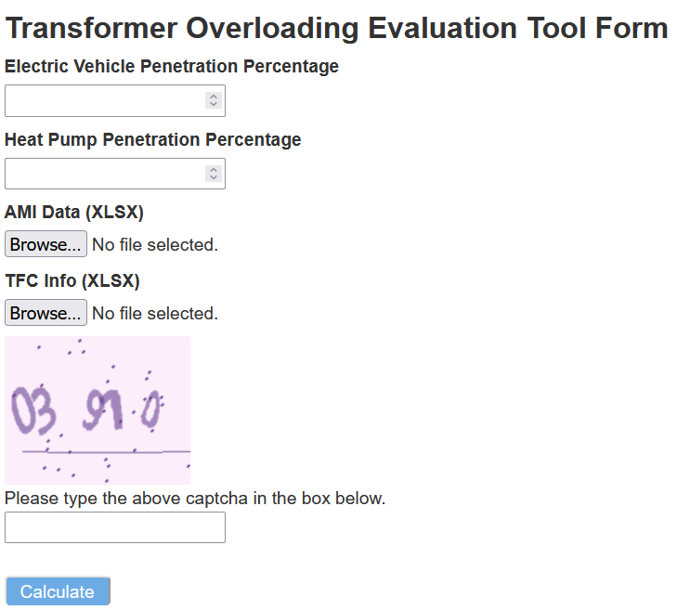
How to Interact with the UI
The user defines a penetration level to indicate how many customers have EVs and heat pumps.
By running the algorithm over again, the results yield differently, because:
  The algorithm randomly selects customers and aggregates EV and heat pump data.
  The algorithm uses the clustering probabilities to assign corresponding EV and heat pump profiles with respect to different seasons and day types (weekdays/weekends).
Provide EV Penetration Percentage in This Block
Provide Heat Pump Penetration Percentage in This Block
Upload Prepared Input Data
Fill the Captcha

Slide 9
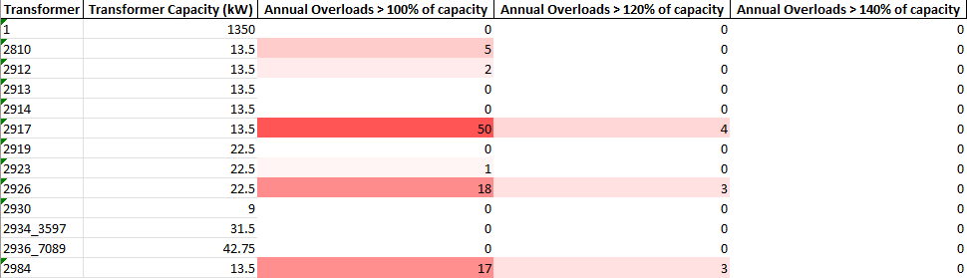
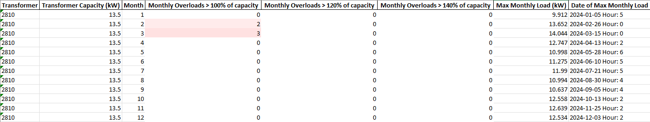
Example Results of DT Load Condition Analysis
Annual peak load, time, and overload counts (hours).
Monthly breakdown for each transformer.

Slide 10



Thank You for Using This Tool!

