Slide 1
Optimizing Dynamic Operating Envelopes for Flexible Integration of Distributed Energy Resources
Zhaoyu Wang
Professor, IEEE Fellow
Electrical and Computer Engineering
Iowa State University

Slide 2
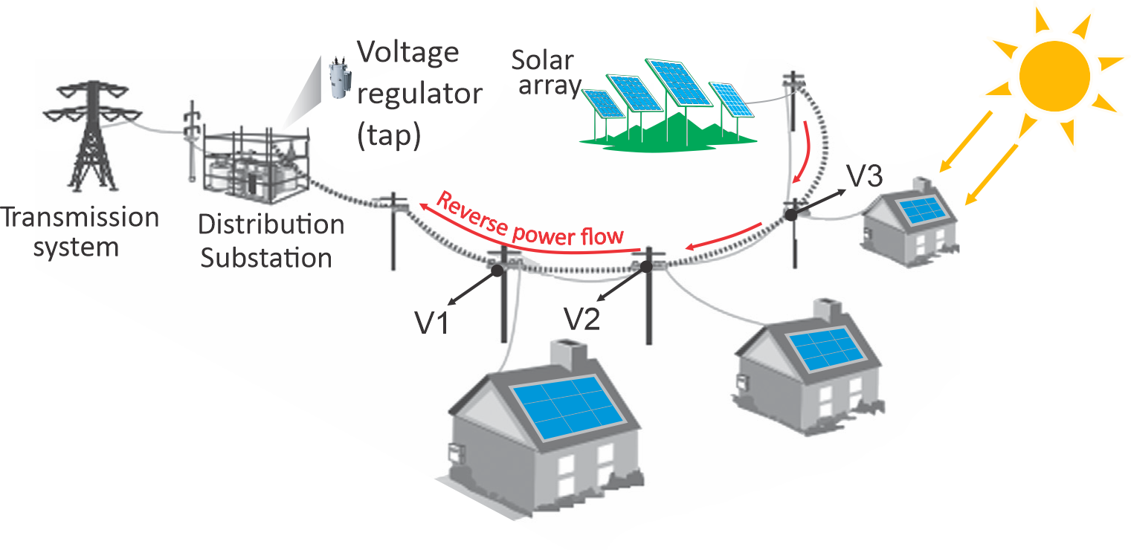
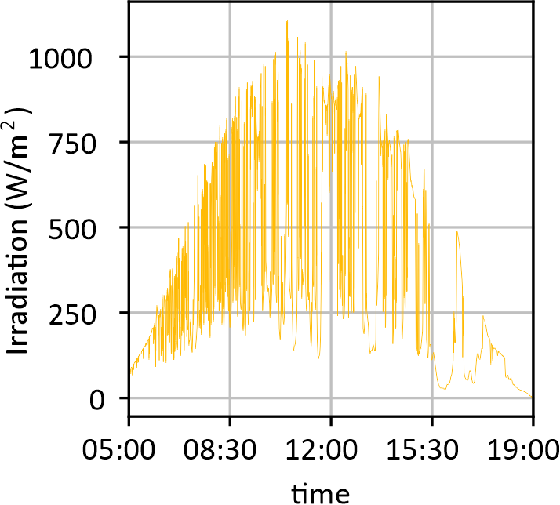
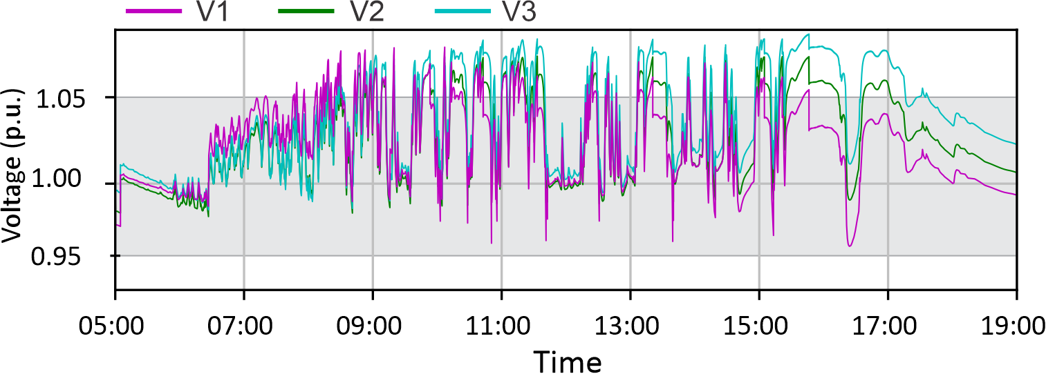
Benefits and challenges of DER integration
DERs such as PV enhance the reliability of power supply, reduce electricity transmission costs, and help decrease the environmental pollutions of traditional fossil fuels.
DERs also brings challenges to distribution networks. Approaches are needed to determine whether the integration of DER will break the operational constraints and increase risks.
Thermal constraints
Voltage constraints
Operational
Constraints
Reverse power flow
Power factor limits
Stochastic and intermittent output
Over voltages
Reverse power flow

Slide 3
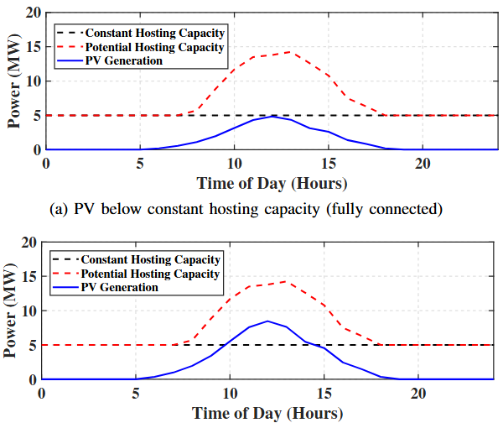
Firm interconnection rules for DER
Under traditional firm interconnection rules, DERs are either allowed full access to the grid or denied interconnection altogether, based on DER hosting capacity.
Conventional hosting capacity ignores time-varying operational conditions of distribution networks, leading to underutilization of both DER and grid infrastructure.
PV beyond constant hosting capacity: Fully denied
(Insufficient utilization of DER generation)
PV within hosting capacity: Fully allowed
(Insufficient utilization of grid infrastructure)
The hosting capacity should be determined by real-time net loads and should be time-varying.

Slide 4
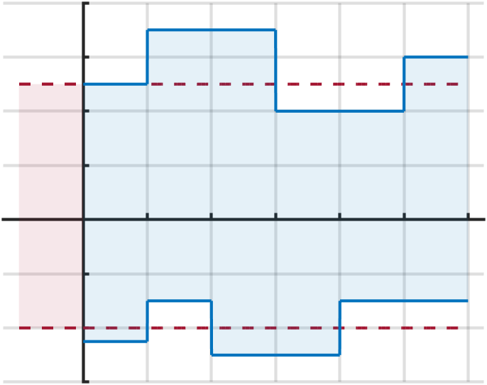






Definition of dynamic operating envelope
The flexible interconnection rule allows DERs to be connected to the grid but operated conditionally. For network integrity, utilities issue dynamic operating envelopes (DOEs), which characterize the time-varying export/import power limits of DERs.
Export power
Dynamic export limit
Benefits of DOE
Promote DER integration
Exploit underutilized infrastructure
Avoid voltage violation, overloading and back feed power
Fixed limits
Dynamic operating envelope
$$t_{0}$$
$$t_{1}$$
$$t_{2}$$
$$t_{3}$$
$$t_{4}$$
Dynamic import limit
Import power

Slide 5
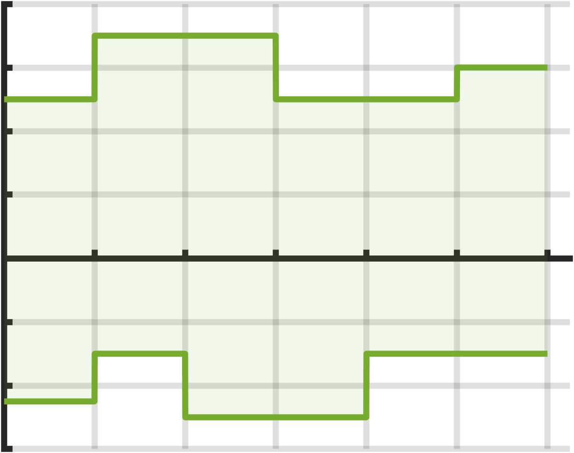


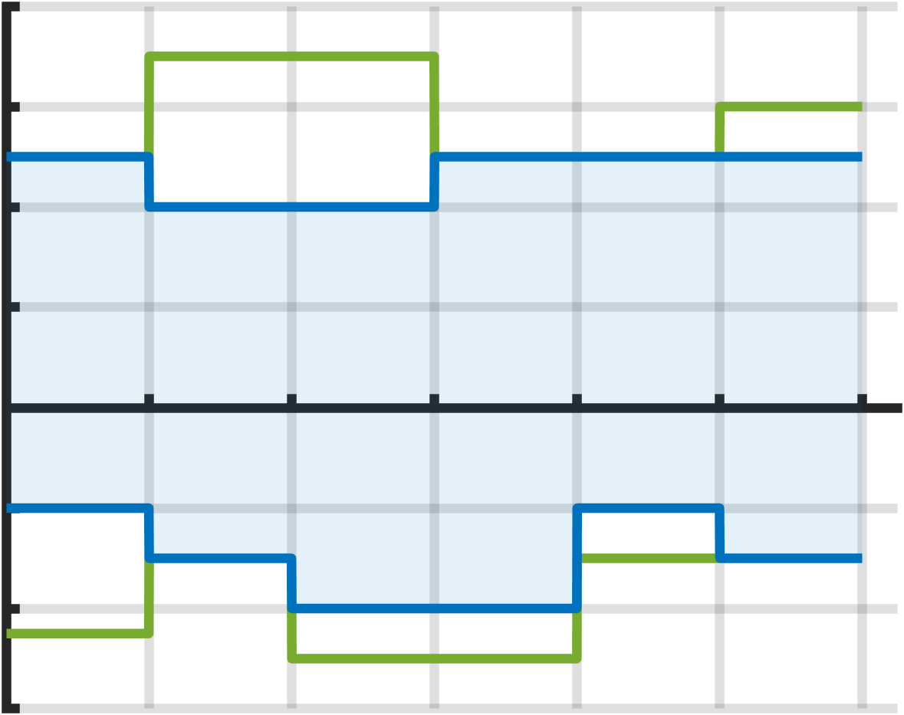





ADMS-DERMS interaction for DOE optimization
DOE optimization involves the interaction between Distributed Energy Resource Management System (DERMS) and Advanced Distribution Management System (ADMS) .
DERMS provides ADMS with forecasted power limits for DERs, which represent the power import/export capabilities of DERs.
ADMS optimizes DOEs for DERs based on DER power limits, loading conditions, and operational constraints (such as voltage limits, thermal capacity, and back feed limits). Then, DOEs will be sent back to DERMS as the dispatchable region for DERs.
Forecasted DER power limits
ADMS
Dynamic Operating Envelopes
DERMS
Load monitoring
DER dispatch
Uncontrollable load
Bus
Line
DERs

Slide 6
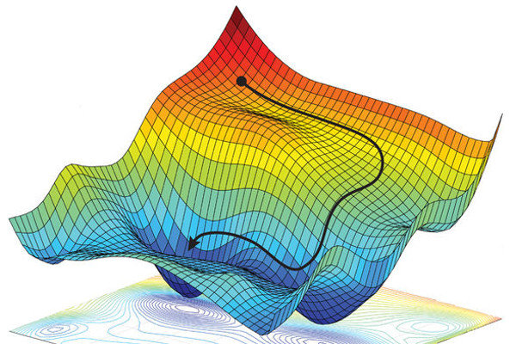
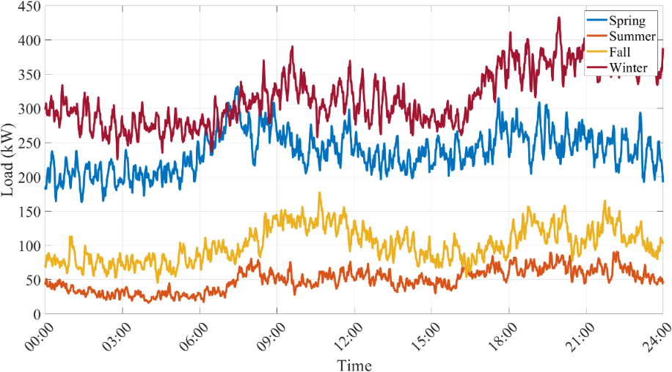

Challenges of DOE optimization
Optimizing DOE is challenging due to the unique characteristics of power systems.
Trade-offs
Non-convexity
Limited time
Optimal DOE needs to balance:
DER power shifts
System stability and resilience
Cost of operating system
Loss and power factor
…
DOE optimization is constrained by power flow equations:
Non-convex and non-linear
Unpredictable convergence time
Trapped in local optimum
DOE is frequently updated:
Loading condition of the system is fast-changing
Uncertainty from both renewables and loads
System cost/loss
DER power shift
Trade-off between multiple factors
Optimizing over non-convex power flow^{[1]}
Fluctuation of residential loads
[1] AI as a Copilot for Grid Operators. Access from: https://www.camus.energy/blog/ai-as-a-utility-copilot

Slide 7
DOE optimization problem
Objective function
Minimize
DER power shift + Active power loss + Tie-line power
Subject to
0.95 p.u. < Voltage < 1.05 p.u.
Power factor > 0.95
DER power limits
Thermal limits
Power flow equations
No back feed power
Soft constraints
(treated as penalty in objective)
Hard constraints

Slide 8
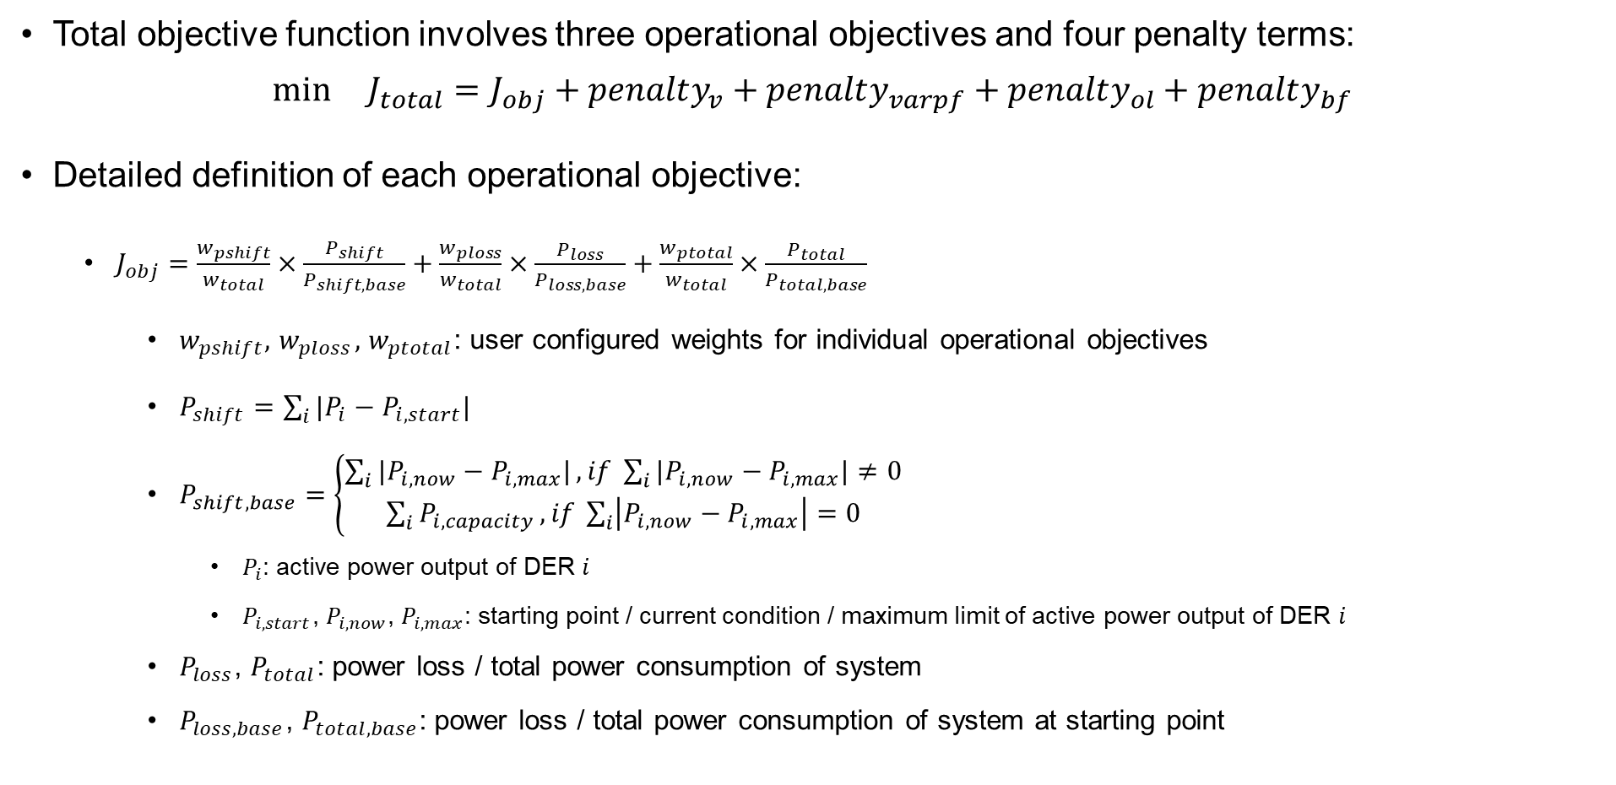
General formulation - objective
Total objective function involves three operational objectives and four penalty terms:
$$\min{J_{total}}=J_{obj}+penalty_{v}+penalty_{varpf}+penalty_{ol}+penalty_{bf}$$
Detailed definition of each operational objective:
$J_{obj}=\frac{w_{pshift}}{w_{total}}×\frac{P_{shift}}{P_{shift,base}}+\frac{w_{ploss}}{w_{total}}×\frac{P_{loss}}{P_{loss,base}}+\frac{w_{ptotal}}{w_{total}}×\frac{P_{total}}{P_{total,base}}$
$w_{pshift},{ w}_{ploss},$ $w_{ptotal}$: user configured weights for individual operational objectives
$P_{shift}=\sum_{i}{|P_{i}−P_{i,start}|}$
$P_{shift,base}=\left\{\begin{matrix}\sum_{i}{|P_{i,now}−P_{i,max}|}, if \sum_{i}{|P_{i,now}−P_{i,max}|≠0} \\ \sum_{i}{P_{i,capacity}}, if \sum_{i}{\left|P_{i,now}−P_{i,max}\right|=0}\end{matrix}\right.$
$P_{i}$: active power output of DER $i$
$P_{i,start}$, $P_{i,now}$, $P_{i,max}$: starting point / current condition / maximum limit of active power output of DER $i$
$P_{loss}$, $P_{total}$: power loss / total power consumption of system
$P_{loss,base}$, $P_{total,base}$: power loss / total power consumption of system at starting point

Slide 9
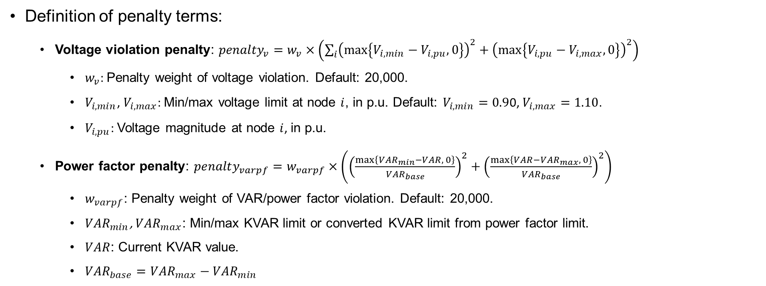
General formulation - objective
Definition of penalty terms:
Voltage violation penalty: ${penalty}_{v}=w_{v}×\left(\sum_{i}{{\left(\max\left\{V_{i,min}−V_{i,pu},0\right\}\right)}^{2}}+{\left(\max\left\{V_{i,pu}−V_{i,max},0\right\}\right)}^{2}\right)$
$w_{v}$: Penalty weight of voltage violation. Default: 20,000.
$V_{i,min}$, $V_{i,max}$: Min/max voltage limit at node $i$, in p.u. Default: $V_{i,min}=0.9$0, $V_{i,max}=1.10$.
$V_{i,pu}$: Voltage magnitude at node $i$, in p.u.
Power factor penalty: ${penalty}_{varpf}=w_{varpf}×\left({\left(\frac{\max\left\{{VAR}_{min}−VAR, 0\right\}}{{VAR}_{base}}\right)}^{2}+{\left(\frac{\max\left\{VAR−{VAR}_{max}, 0\right\}}{{VAR}_{base}}\right)}^{2}\right)$
$w_{varpf}$: Penalty weight of VAR/power factor violation. Default: 20,000.
${VAR}_{min}$, ${VAR}_{max}$: Min/max KVAR limit or converted KVAR limit from power factor limit.
$VAR$: Current KVAR value.
${VAR}_{base}={VAR}_{max}−{VAR}_{min}$

Slide 10

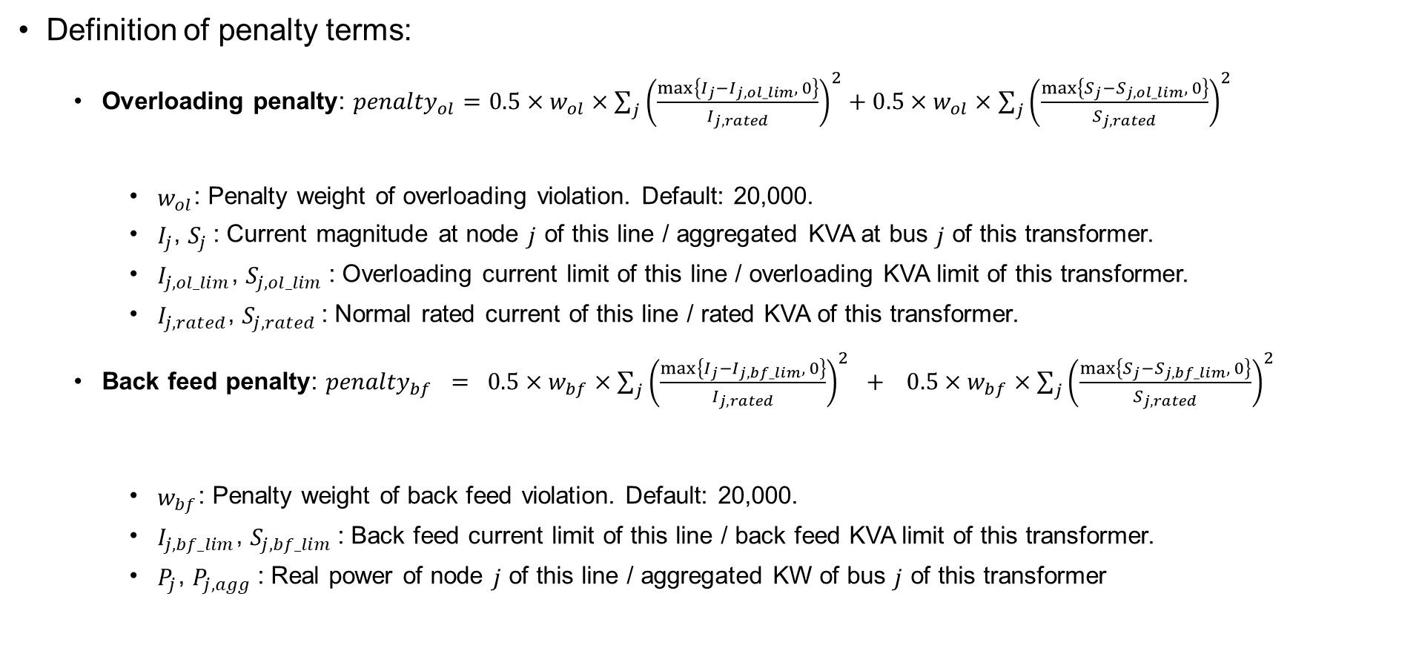

General formulation - objective
Definition of penalty terms:
Overloading penalty: ${penalty}_{ol}=0.5×w_{ol}×\sum_{j}{{\left(\frac{\max\left\{I_{j}−I_{j,ol_lim}, 0\right\}}{I_{j,rated}}\right)}^{2}}+0.5×w_{ol}×\sum_{j}{{\left(\frac{\max\left\{S_{j}−S_{j,ol_lim}, 0\right\}}{S_{j,rated}}\right)}^{2}}$
$w_{ol}$: Penalty weight of overloading violation. Default: 20,000.
$I_{j}$, $S_{j}$: Current magnitude at node $j$ of this line / aggregated KVA at bus $j$ of this transformer.
$I_{j,ol_lim}$, $S_{j,ol_lim}$: Overloading current limit of this line / overloading KVA limit of this transformer.
$I_{j,rated}$, $S_{j,rated}$: Normal rated current of this line / rated KVA of this transformer.
Back feed penalty: ${penalty}_{bf} = {0.5×w}_{bf}×\sum_{j}{{\left(\frac{\max\left\{I_{j}−I_{j,bf_lim}, 0\right\}}{I_{j,rated}}\right)}^{2}} + {0.5×w}_{bf}×\sum_{j}{{\left(\frac{\max\left\{S_{j}−S_{j,bf_lim}, 0\right\}}{S_{j,rated}}\right)}^{2}}$
$w_{bf}$: Penalty weight of back feed violation. Default: 20,000.
$I_{j,bf_lim}$, $S_{j,bf_lim}$: Back feed current limit of this line / back feed KVA limit of this transformer.
$P_{j}$, $P_{j,agg}$: Real power of node $j$ of this line / aggregated KW of bus $j$ of this transformer
Line overloading
Transformer overloading
Line back feed, for $P_{j}<0$
Transformer back feed, for $P_{j,agg}<0$

Slide 11
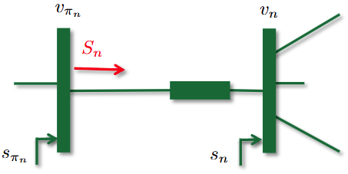



General formulation - constraints
Soft constraints:
Represented by penalty terms in objective function
$$J_{total} =J_{obj}+penalty_{v}+penalty_{varpf}+penalty_{ol}+penalty_{bf}$$
Hard constraint:
DER operating constraints
Power flow constraints with ZIP load model
$${\underset{−}{P}}^{DER}≤P^{DER}≤{\overline{P}}^{DER}$$
$$\sum_{k:n→k}{P_{k}}=p_{n}+P_{n}−r_{n}𝓁_{n}$$
$$\sum_{k:n→k}{Q_{k}}=q_{n}+Q_{n}−x_{n}𝓁_{n}$$
$$v_{n}=v_{π_{n}}−2r_{n}P_{n}−2x_{n}Q_{n}+\left(r_{n}^{2}+x_{n}^{2}\right)𝓁_{n}$$
$$𝓁_{n}=\frac{P_{n}^{2}+Q_{n}^{2}}{v_{π_{n}}}$$
$$p_{n}=p_{n}^{load}\left(k_{n}^{Z}v_{n}+k_{n}^{I}\sqrt{v_{n}}+k_{n}^{P}\right)−p_{n}^{DER}$$
$$q_{n}=q_{n}^{load}\left(k_{n}^{Z}v_{n}+k_{n}^{I}\sqrt{v_{n}}+k_{n}^{P}\right)−q_{n}^{DER}$$
Non-convex model, making DOE optimization problem hard to solve

Slide 12
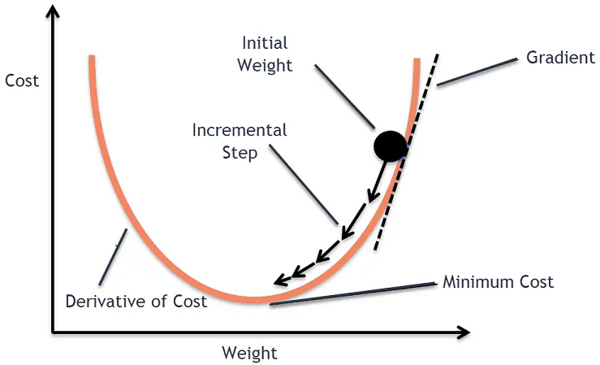
Steepest gradient descent
To take repeated steps in the opposite direction of the gradient (or approximate gradient) of the function at the current point, i.e., the direction of steepest descent.
Intuitive idea and excellent applicability
Adaptive to multi-dimensional problems
High computational efficiency with proper parameters
Step size sensitive
Local optimum
Diagram for steepest gradient descent method^{[1]}
Iteration process:
：objective function
：n-dimensional variables
1. Calculate gradient of objective function at the current point of variables:
2. Update values of decision variables based on gradient $∇f(x^{k})$ and step size $γ_{k}$:
3. Repeat Step 1 and 2, terminate the iteration when the value of objective function converges:
[1] Gradient Descent Algorithm. Access from: https://www.analyticsvidhya.com/blog/2020/10/how-does-the-gradient-descent-algorithm-work-in-machine-learning/

Slide 13
Steepest gradient descent
The accurate gradient can be approximated by variable sensitivity based on finite difference calculations：
The sensitivity-based iteration process will be:
Calculate sensitivity of objective function related to each variable at the current point
Update values of the variables according to sensitivity
Repeat Step 1 and 2, terminate the iteration when the value of objective function converges
The sensitivity needs to be normalized

Slide 14
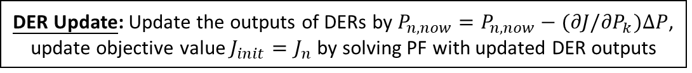
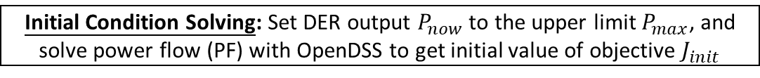

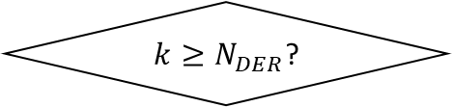
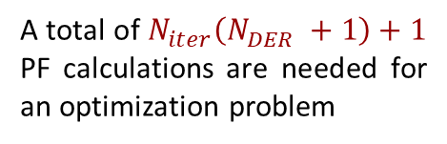

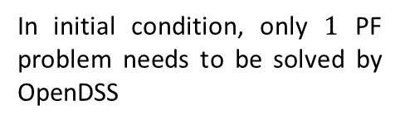
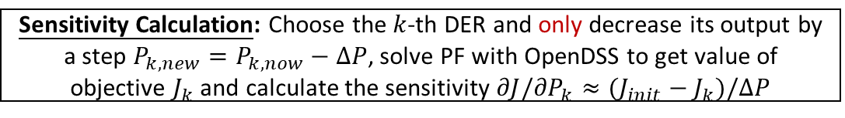
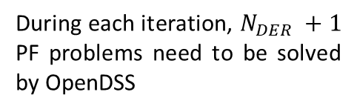
Steepest gradient descent
Complete calculation steps of the sensitivity-based method are shown as follows：
Initial Condition Solving: Set DER output $P_{now}$ to the upper limit $P_{max}$, and solve power flow (PF) with OpenDSS to get initial value of objective $J_{init}$
In initial condition, only $1$ PF problem needs to be solved by OpenDSS
$$k=1$$
Sensitivity Calculation: Choose the $k$-th DER and only decrease its output by a step $P_{k,new}=P_{k,now}−∆P$, solve PF with OpenDSS to get value of objective $J_{k}$ and calculate the sensitivity $∂J/{∂P}_{k}≈(J_{init}−J_{k})/∆P$
N
$k≥N_{DER}$?
During each iteration, $N_{DER} +1$ PF problems need to be solved by OpenDSS
$$k=k+1$$
Y
DER Update: Update the outputs of DERs by $P_{n,now}=P_{n,now}−(∂J/{∂P}_{k})∆P$, update objective value $J_{init}=J_{n}$ by solving PF with updated DER outputs
N
Converge?
A total of $N_{iter}\left(N_{DER} +1\right)+1$ PF calculations are needed for an optimization problem
Y
Results

Slide 15


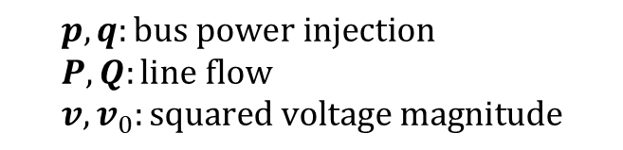
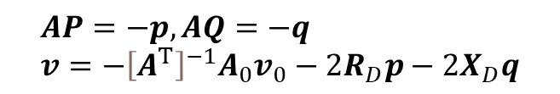
Linear DistFlow model
LinDistFlow (LDF) is a linearized version of the non-convex DistFlow model, with the assumption that losses are negligible.
LinDistFlow can be written in a compact form:
Non-convex DistFlow model
$$\begin{aligned}&\sum_{k:n→k}{P_{k}}=p_{n}+P_{n}−r_{n}𝓁_{n} \\ &\sum_{k:n→k}{Q_{k}}=q_{n}+Q_{n}−x_{n}𝓁_{n} \\ &v_{n}=v_{π_{n}}−2r_{n}P_{n}−2x_{n}Q_{n}+\left(r_{n}^{2}+x_{n}^{2}\right)𝓁_{n} \\ &𝓁_{n}=\frac{P_{n}^{2}+Q_{n}^{2}}{v_{π_{n}}}\end{aligned}$$
Convex LinDistFlow model
$$\begin{aligned}&\sum_{k:n→k}{P_{k}}≃p_{n}+P_{n} \\ &\sum_{k:n→k}{Q_{k}}≃q_{n}+Q_{n} \\ &v_{n}≃v_{π_{n}}−2r_{n}P_{n}−2x_{n}Q_{n}\end{aligned}$$
Omit loss
$$AP=−p,AQ=−q \\ v=−{\left[A^{T}\right]}^{−1}A_{0}v_{0}−2R_{D}p−2X_{D}q$$
$$p,q:bus power injection \\ P,Q:line flow \\ v,v_{0}:squared voltage magnitude$$

Slide 16

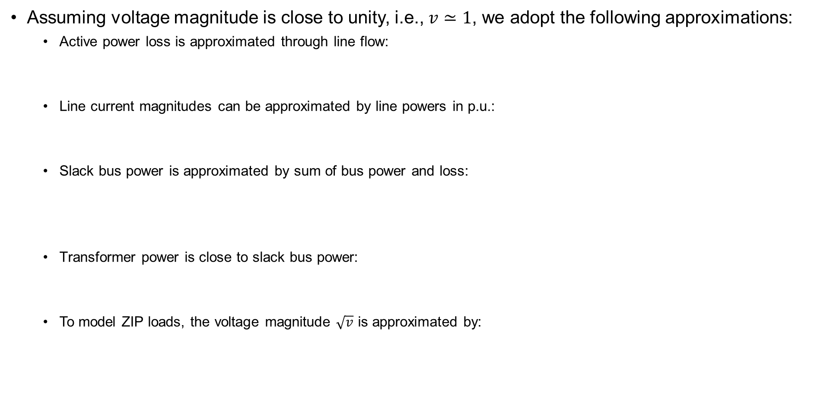
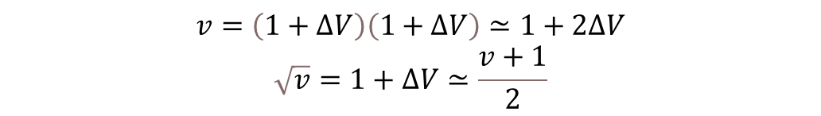
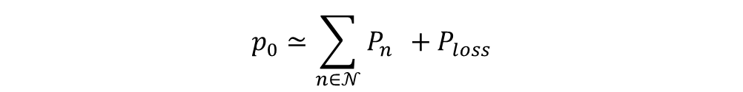
Approximations in LinDistFlow models
Assuming voltage magnitude is close to unity, i.e., $v≃1$, we adopt the following approximations:
Active power loss is approximated through line flow:
Line current magnitudes can be approximated by line powers in p.u.:
Slack bus power is approximated by sum of bus power and loss:
Transformer power is close to slack bus power:
To model ZIP loads, the voltage magnitude $\sqrt{v}$ is approximated by:
$$P_{loss}=I^{T}RI≃P^{T}RP+Q^{T}RQ$$
$${\left|I_{j}\right|}^{2}≃P_{j}^{2}+Q_{j}^{2}$$
$$p_{0}≃\sum_{n∈𝒩}{P_{n}^{}}+P_{loss}$$
$$S^{2}≃{p_{0}}^{2}+{q_{0}}^{2}$$
$$v=\left(1+∆V\right)\left(1+∆V\right)≃1+2∆V$$
$$\sqrt{v}=1+∆V≃\frac{v+1}{2}$$

Slide 17

Convexified Power Flow Model
Based on the LinDistFlow model and the above approximation, the non-convex DOE optimization problem is convexified. We referred to this model as LDF in the following discussion.
$$\begin{aligned}&\min{ }J_{obj}+penalties \\ \\ &s.t. {\underset{−}{P}}^{DER}≤P^{DER}≤{\overline{P}}^{DER} \\ & p=p^{load}−p^{DER},q=q^{load}−q^{DER}−Q^{CAP}v \\ & p^{load}=p^{PQ}+p^{Z}v+p^{I}\frac{v+1}{2}, \\ q^{load}=q^{PQ}+q^{Z}v+q^{I}\frac{v+1}{2} \\ & AP=−p,AQ=−q \\ & v=−{\left[A^{T}\right]}^{−1}A_{0}v_{0}−2R_{D}p−2X_{D}q \\ & p_{0}=1^{T}p+P^{T}D_{r}P+Q^{T}D_{r}Q \\ & q_{0}=1^{T}q+P^{T}D_{x}P+Q^{T}D_{x}Q \\ & \\ \\ \end{aligned}$$
Non-linear, convex objective function
Linear constraints
Although the LDF model is easy to optimize, their performance is limited by power flow approximation errors.

Slide 18
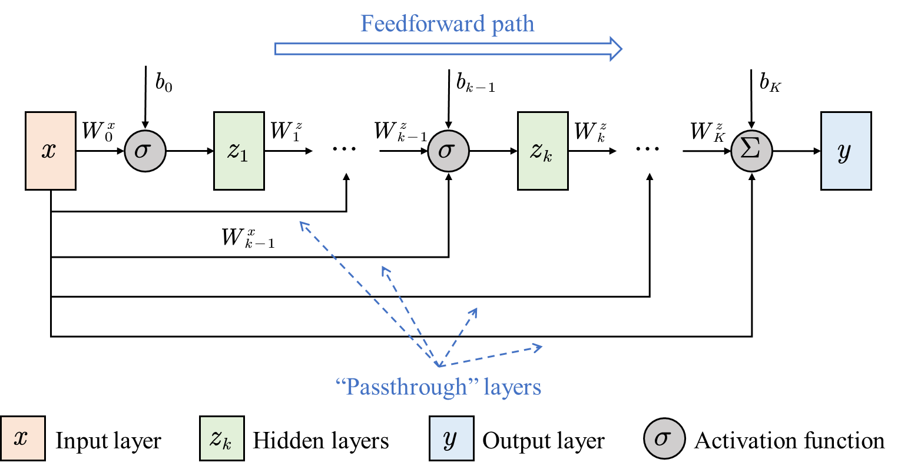


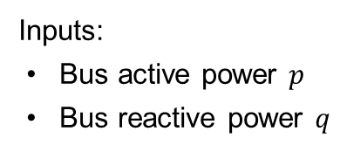
Input convex neural network for optimal power flow
Using MLP results in a mixed-integer programming problem, which is time-consuming to solve.
If we can reformulate the neural networks into convex problems, the computational burden will be significantly reduced. This can be achieved with input convex neural networks (ICNN).
How does an ICNN ensure convex and accurate input-output mapping?
Convexity: enforce the weight matrix $W_{k}^{z}$ of each layer’s output $z_{k}$ to be non-negative;
Accuracy: propagate input $x=[p,q]$ to each layer.
Inputs:
Bus active power $p$
Bus reactive power $q$
Outputs:
Bus voltage $|V_{j}|$
Line current $|I_{ij}|$
Line active power $P_{ij}$
Power factor $PF$
Active power loss $P_{loss}$
Substation power $P_{total}$
…
Structure of an ICNN^{[1]}
[1] H. Li, L. Liu, Y. Li and Z, Wang, " Exploiting Convexity of Neural Networks in Dynamic Operating Envelope Optimization for Distributed Energy Resources," submitted to IEEE Transactions on Smart Grid.

Slide 19
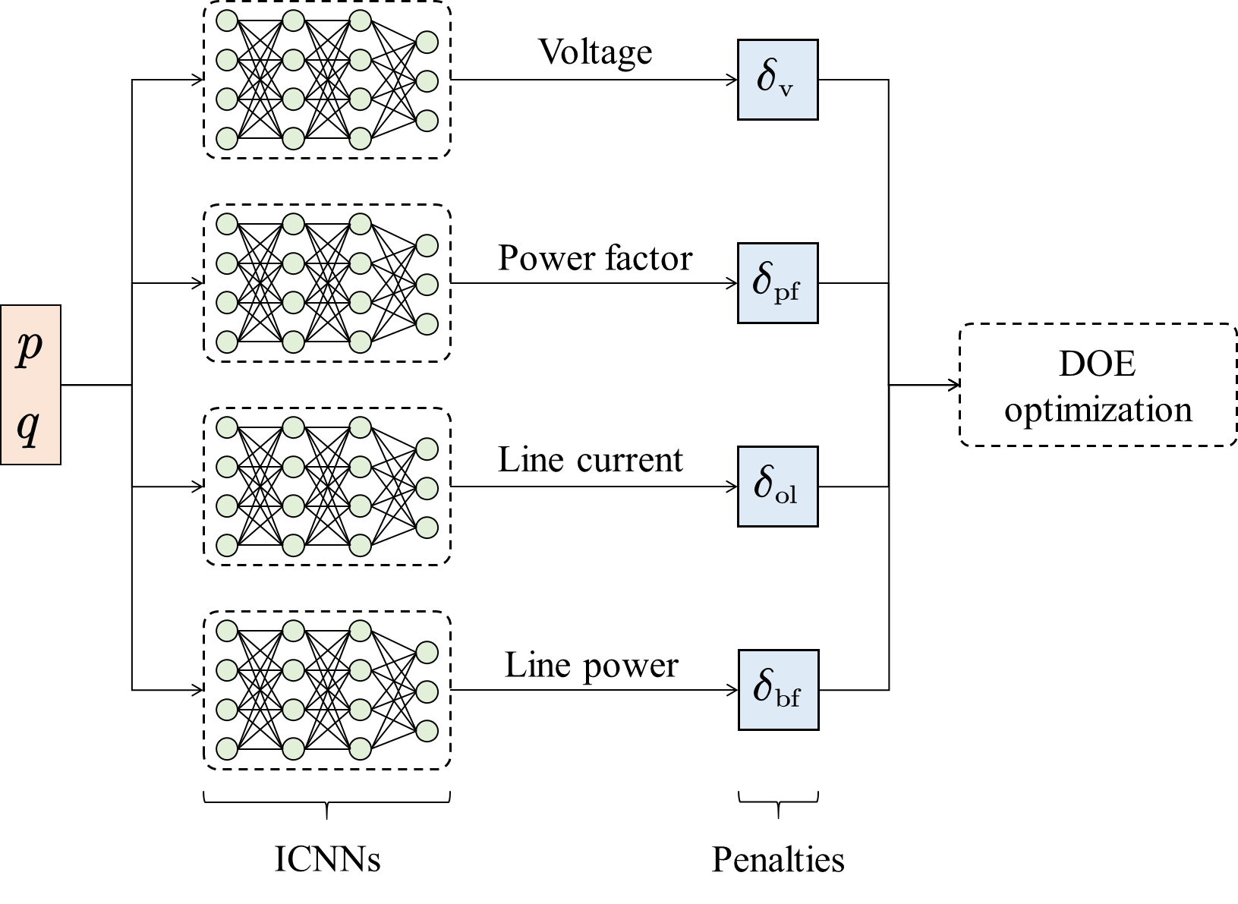



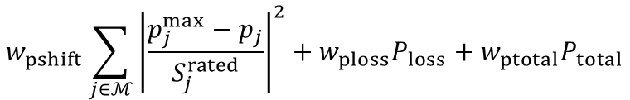



Constraint embedding method for ICNNs
Using ReLU as activation functions, we train ICNNs to learn the mapping between input $x=[p,q]$ and output $y=\{P_{loss}\text{, }P_{total}\text{, }{|V}_{i}|\text{, }|I_{ij}|\text{, }P_{ij}, PF\}$. After training, we obtain weights $W_{k}^{x}$, $W_{k}^{z}$and biases $b_{k}$, which are used to reformulate the ICNN-based DOE optimization problem into a convex piecewise linear programming problem.
$$w_{pshift}\sum_{j∈ℳ}{{\left|\frac{p_{j}^{max}−p_{j}}{S_{j}^{rated}}\right|}^{2}}+w_{ploss}P_{loss}+w_{ptotal}P_{total}$$
$$\min_{p_{j}}$$
$$+w_{v}δ_{v}+w_{varpf}δ_{varpf}+w_{ol}δ_{ol}+w_{bf}δ_{bf}$$
$$s.t.$$
$${\underset{−}{P}}^{DER}≤P^{DER}≤{\overline{P}}^{DER}$$
$$p=p^{load}−p^{DER},q=q^{load}−q^{DER}, x=\left[p,q\right]$$
$$z_{1}^{o}=max\left(W_{0}^{x,o}x+b_{0}^{o},0\right)$$
Trained ICNN model
$$z_{k+1}^{o}=max\left(W_{k}^{z,o}z_{k}^{o}+W_{k}^{x,o}x+b_{k}^{o},0\right),k=1,⋯,K−1$$
$$y^{o}=W_{K}^{z,o}z_{K}^{o}+W_{K}^{x,o}x+b_{K}^{o},o∈\{loss,total,v,varpf,ol,bf\}$$
$$P^{loss}=y^{loss},P^{total}=y^{total}$$
Using ICNNs to reformulate DOE optimization problem^{[1]}
$$δ^{o}=1^{T}max\left(y^{o}+ε^{o},0\right),∀o∈\left\{v,varpf,ol,bf\right\}$$
[1] H. Li, L. Liu, Y. Li and Z, Wang, "Exploiting Convexity of Neural Networks in Dynamic Operating Envelope Optimization for Distributed Energy Resources," submitted to IEEE Transactions on Smart Grid.

Slide 20
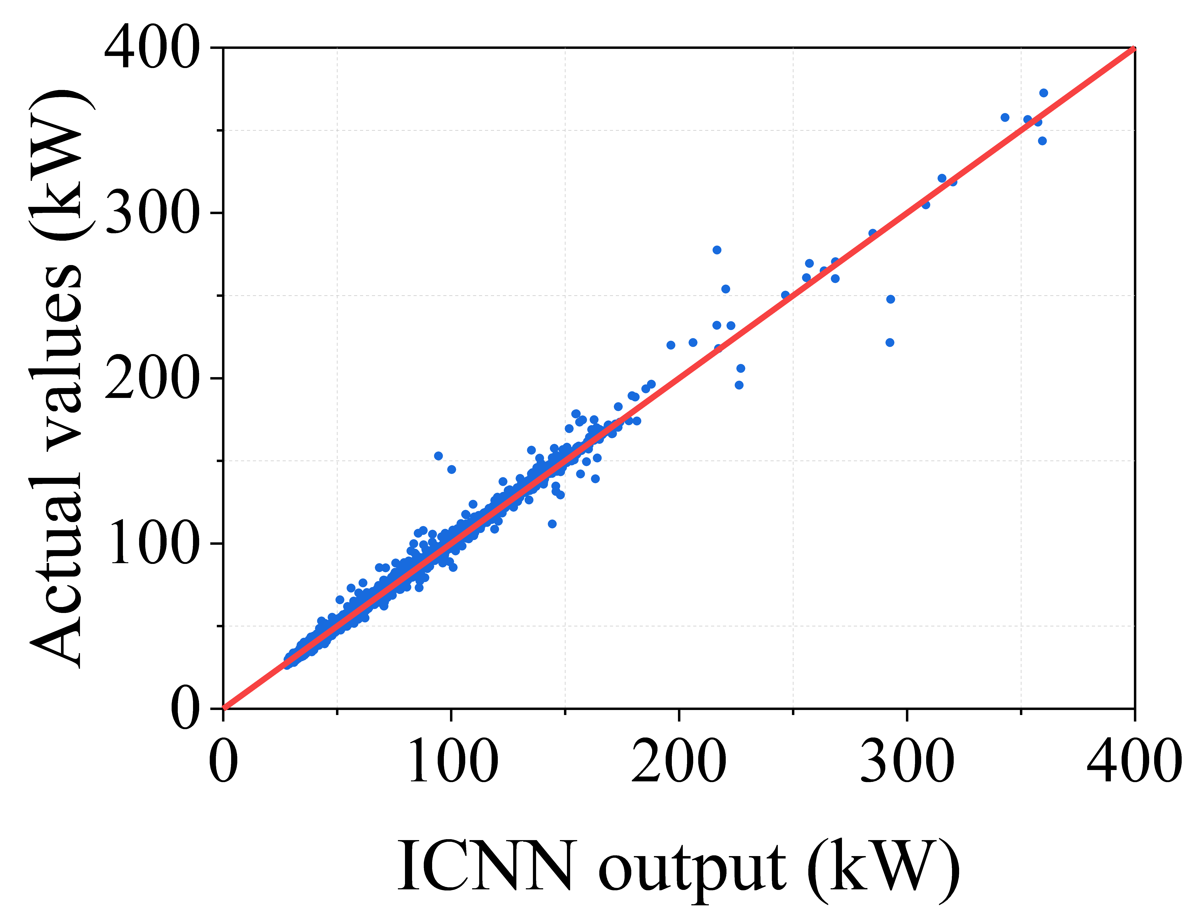
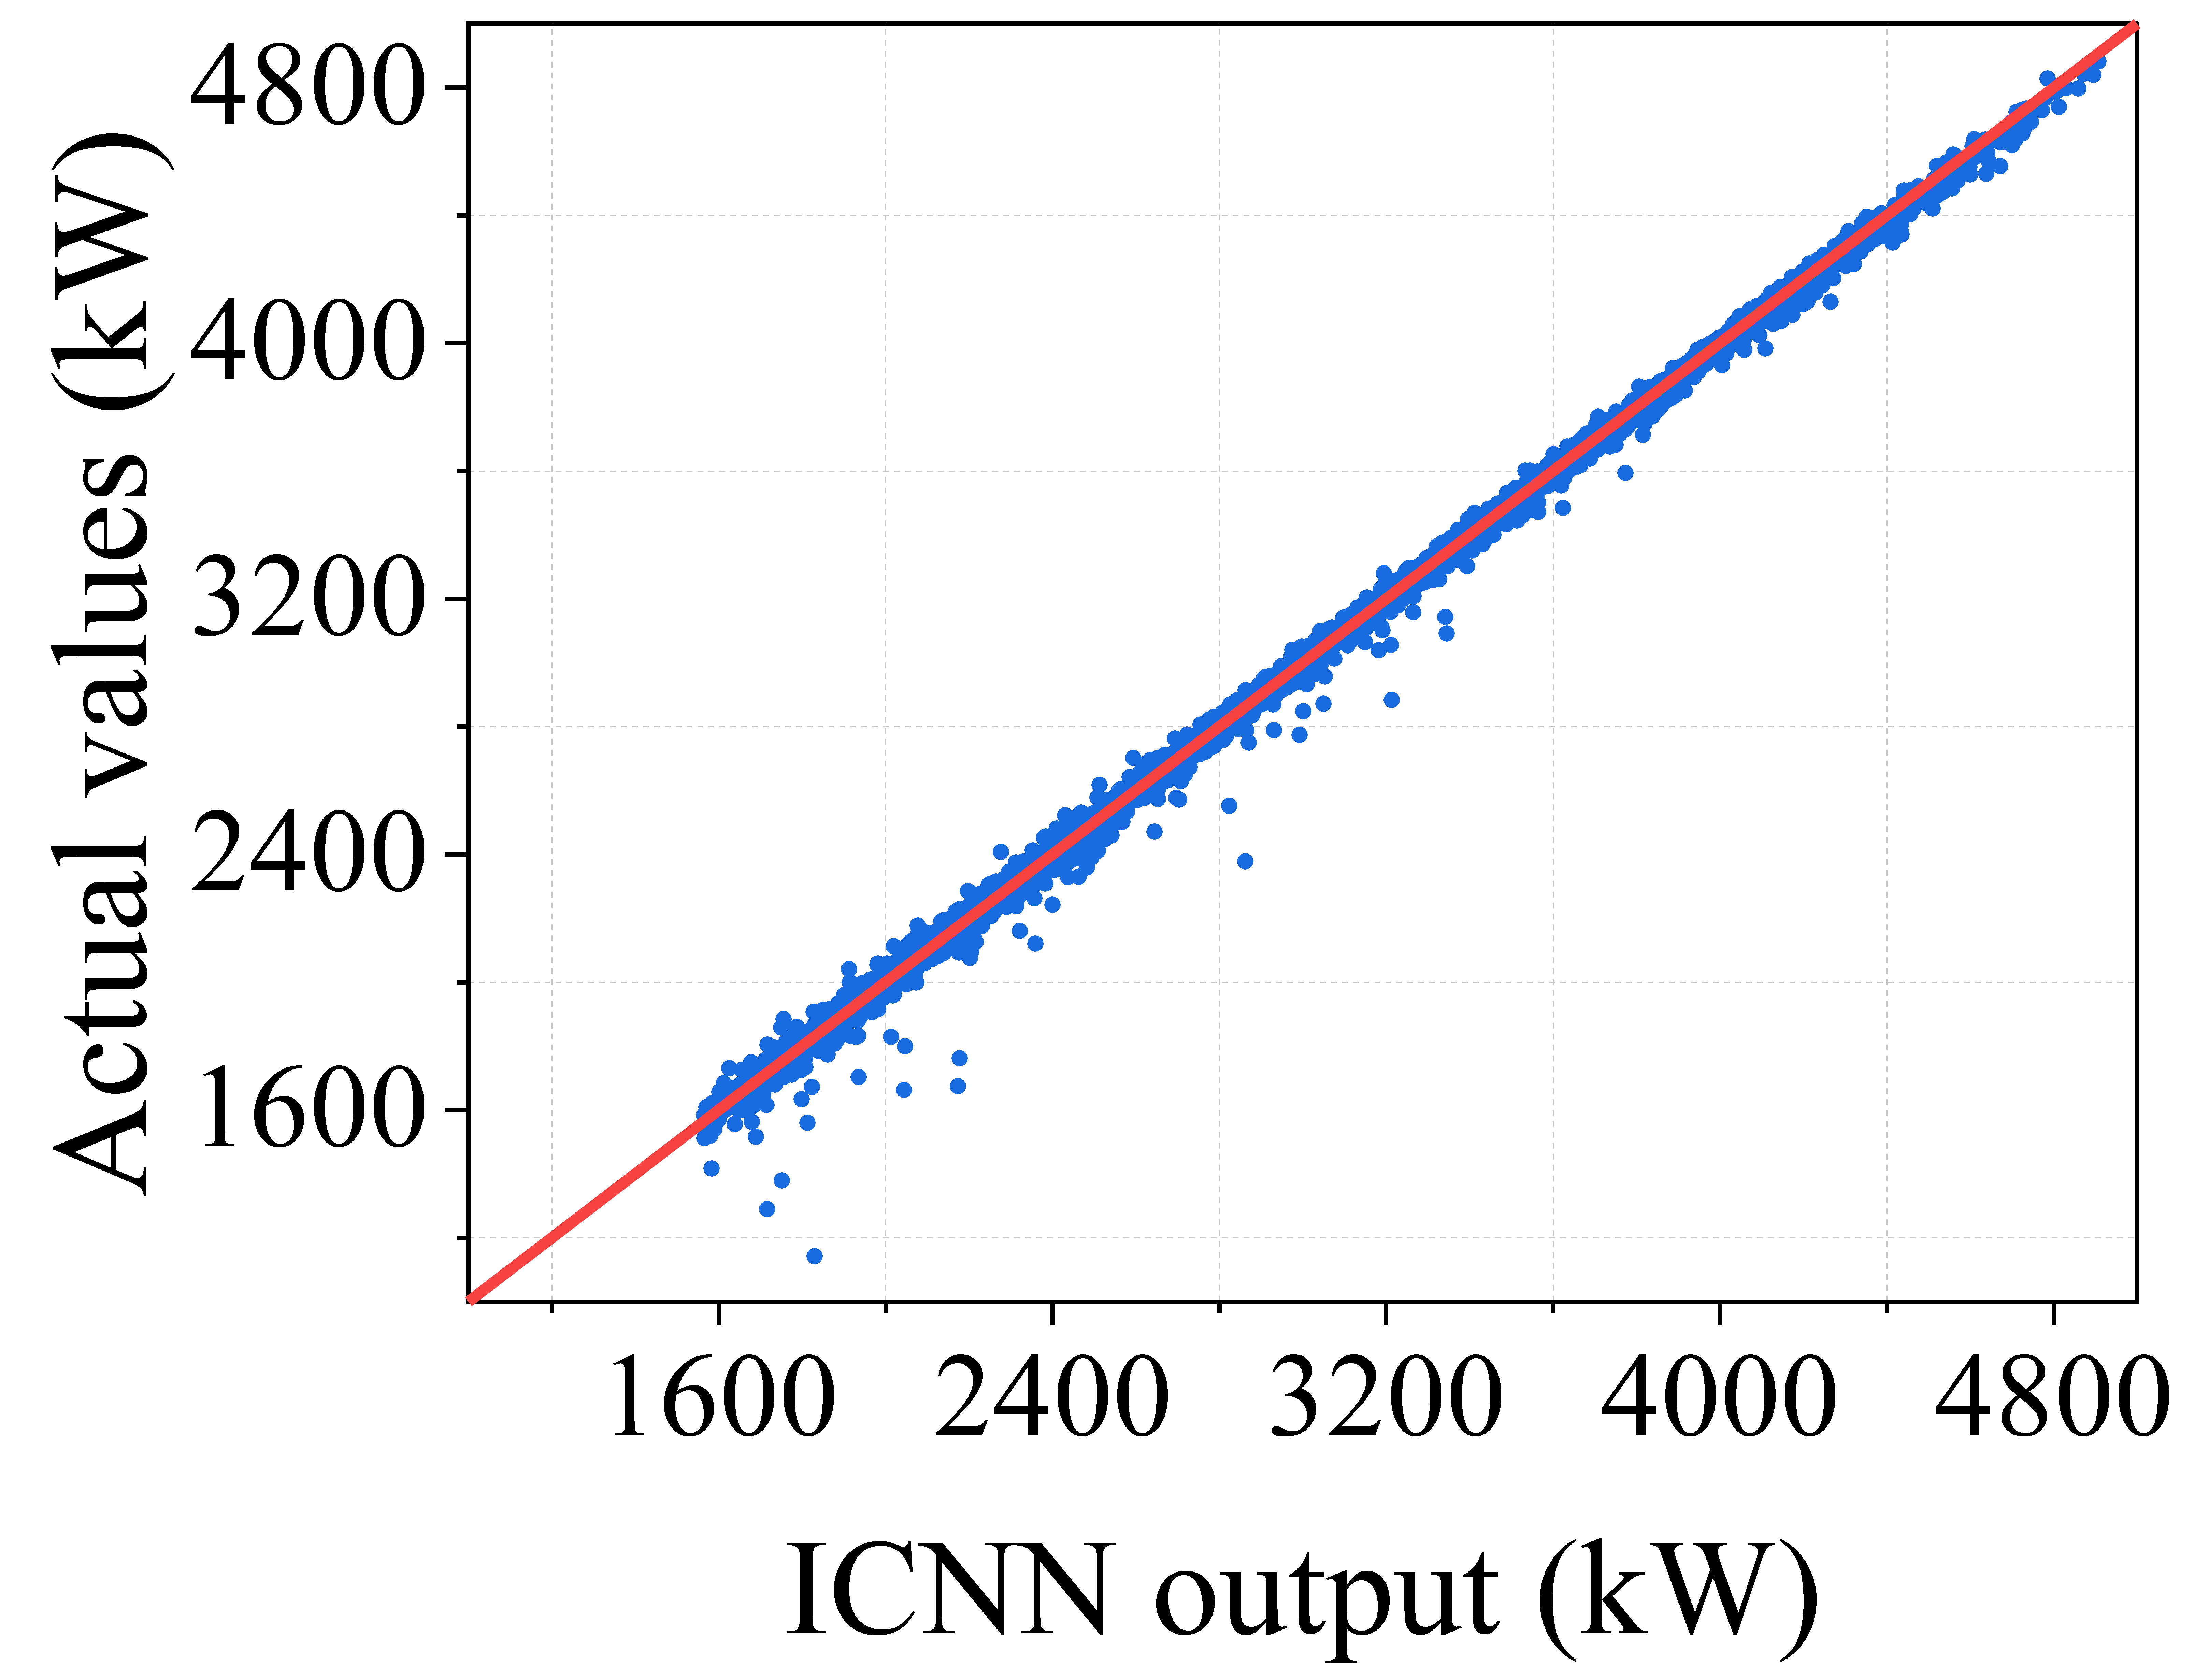
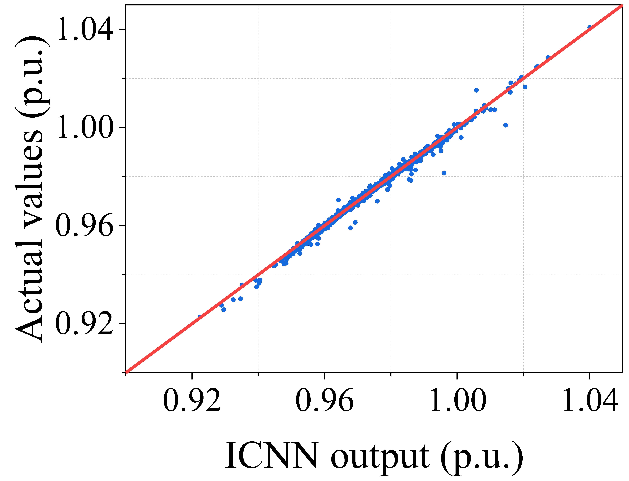
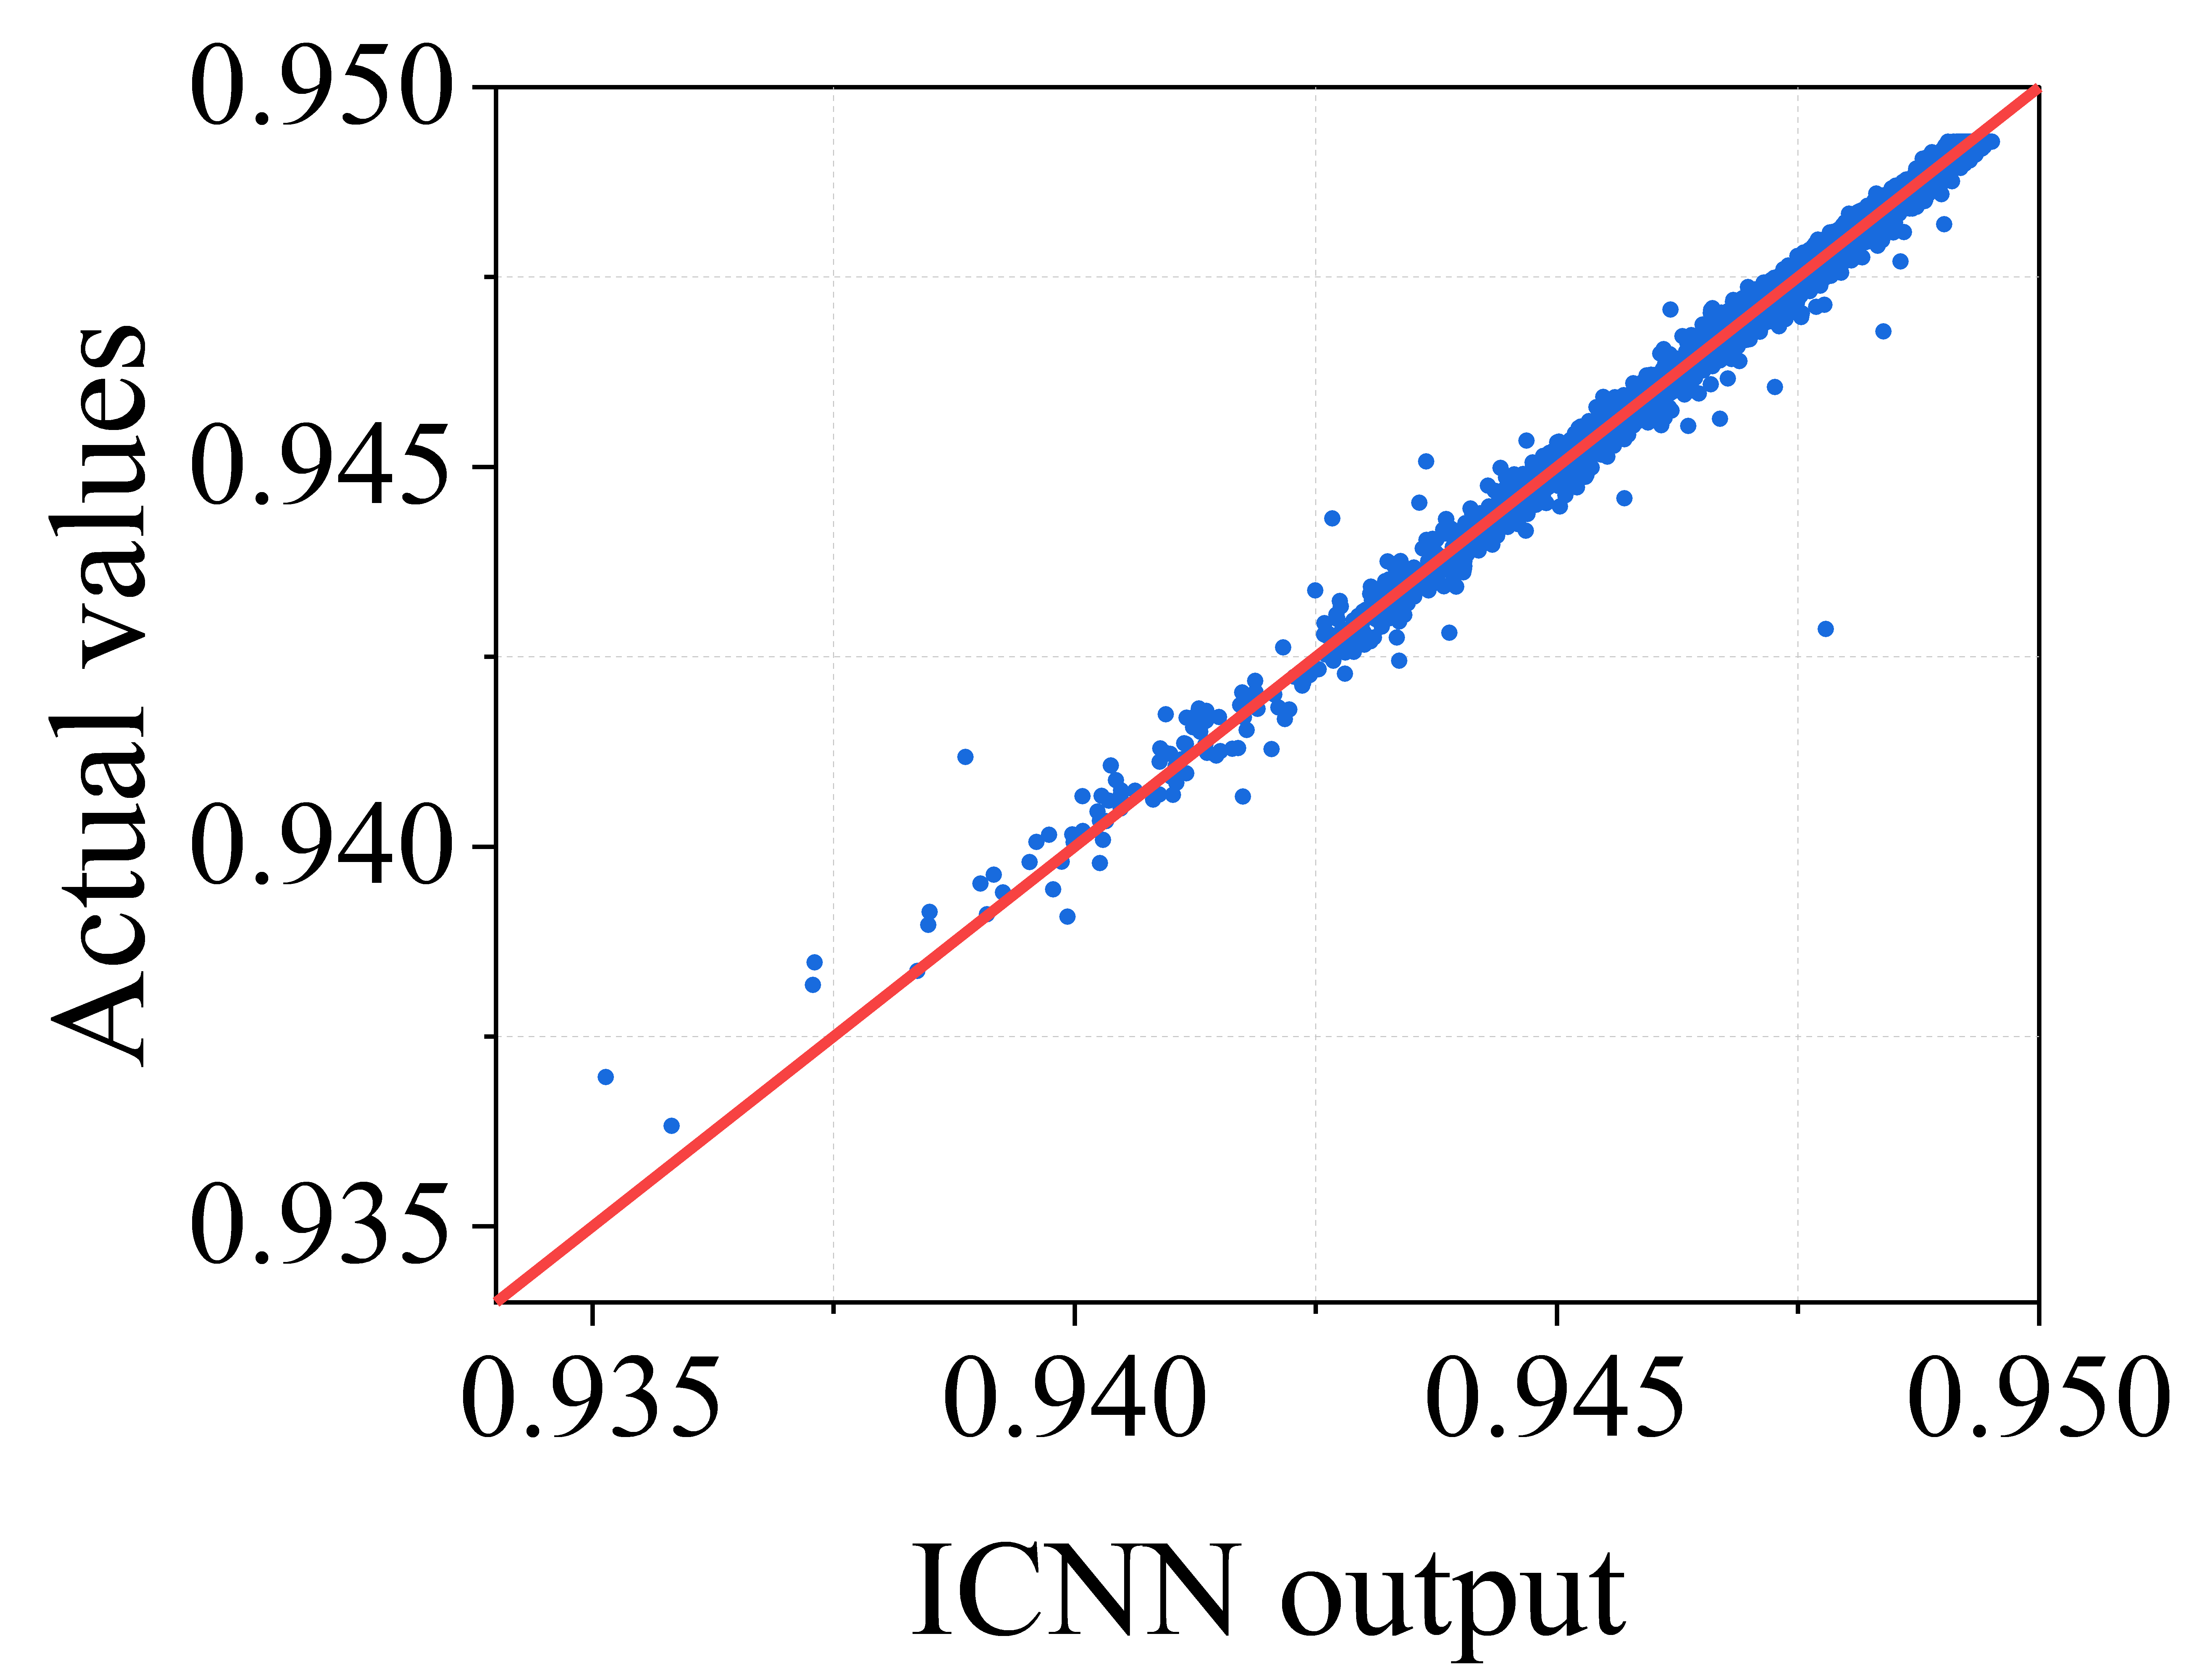
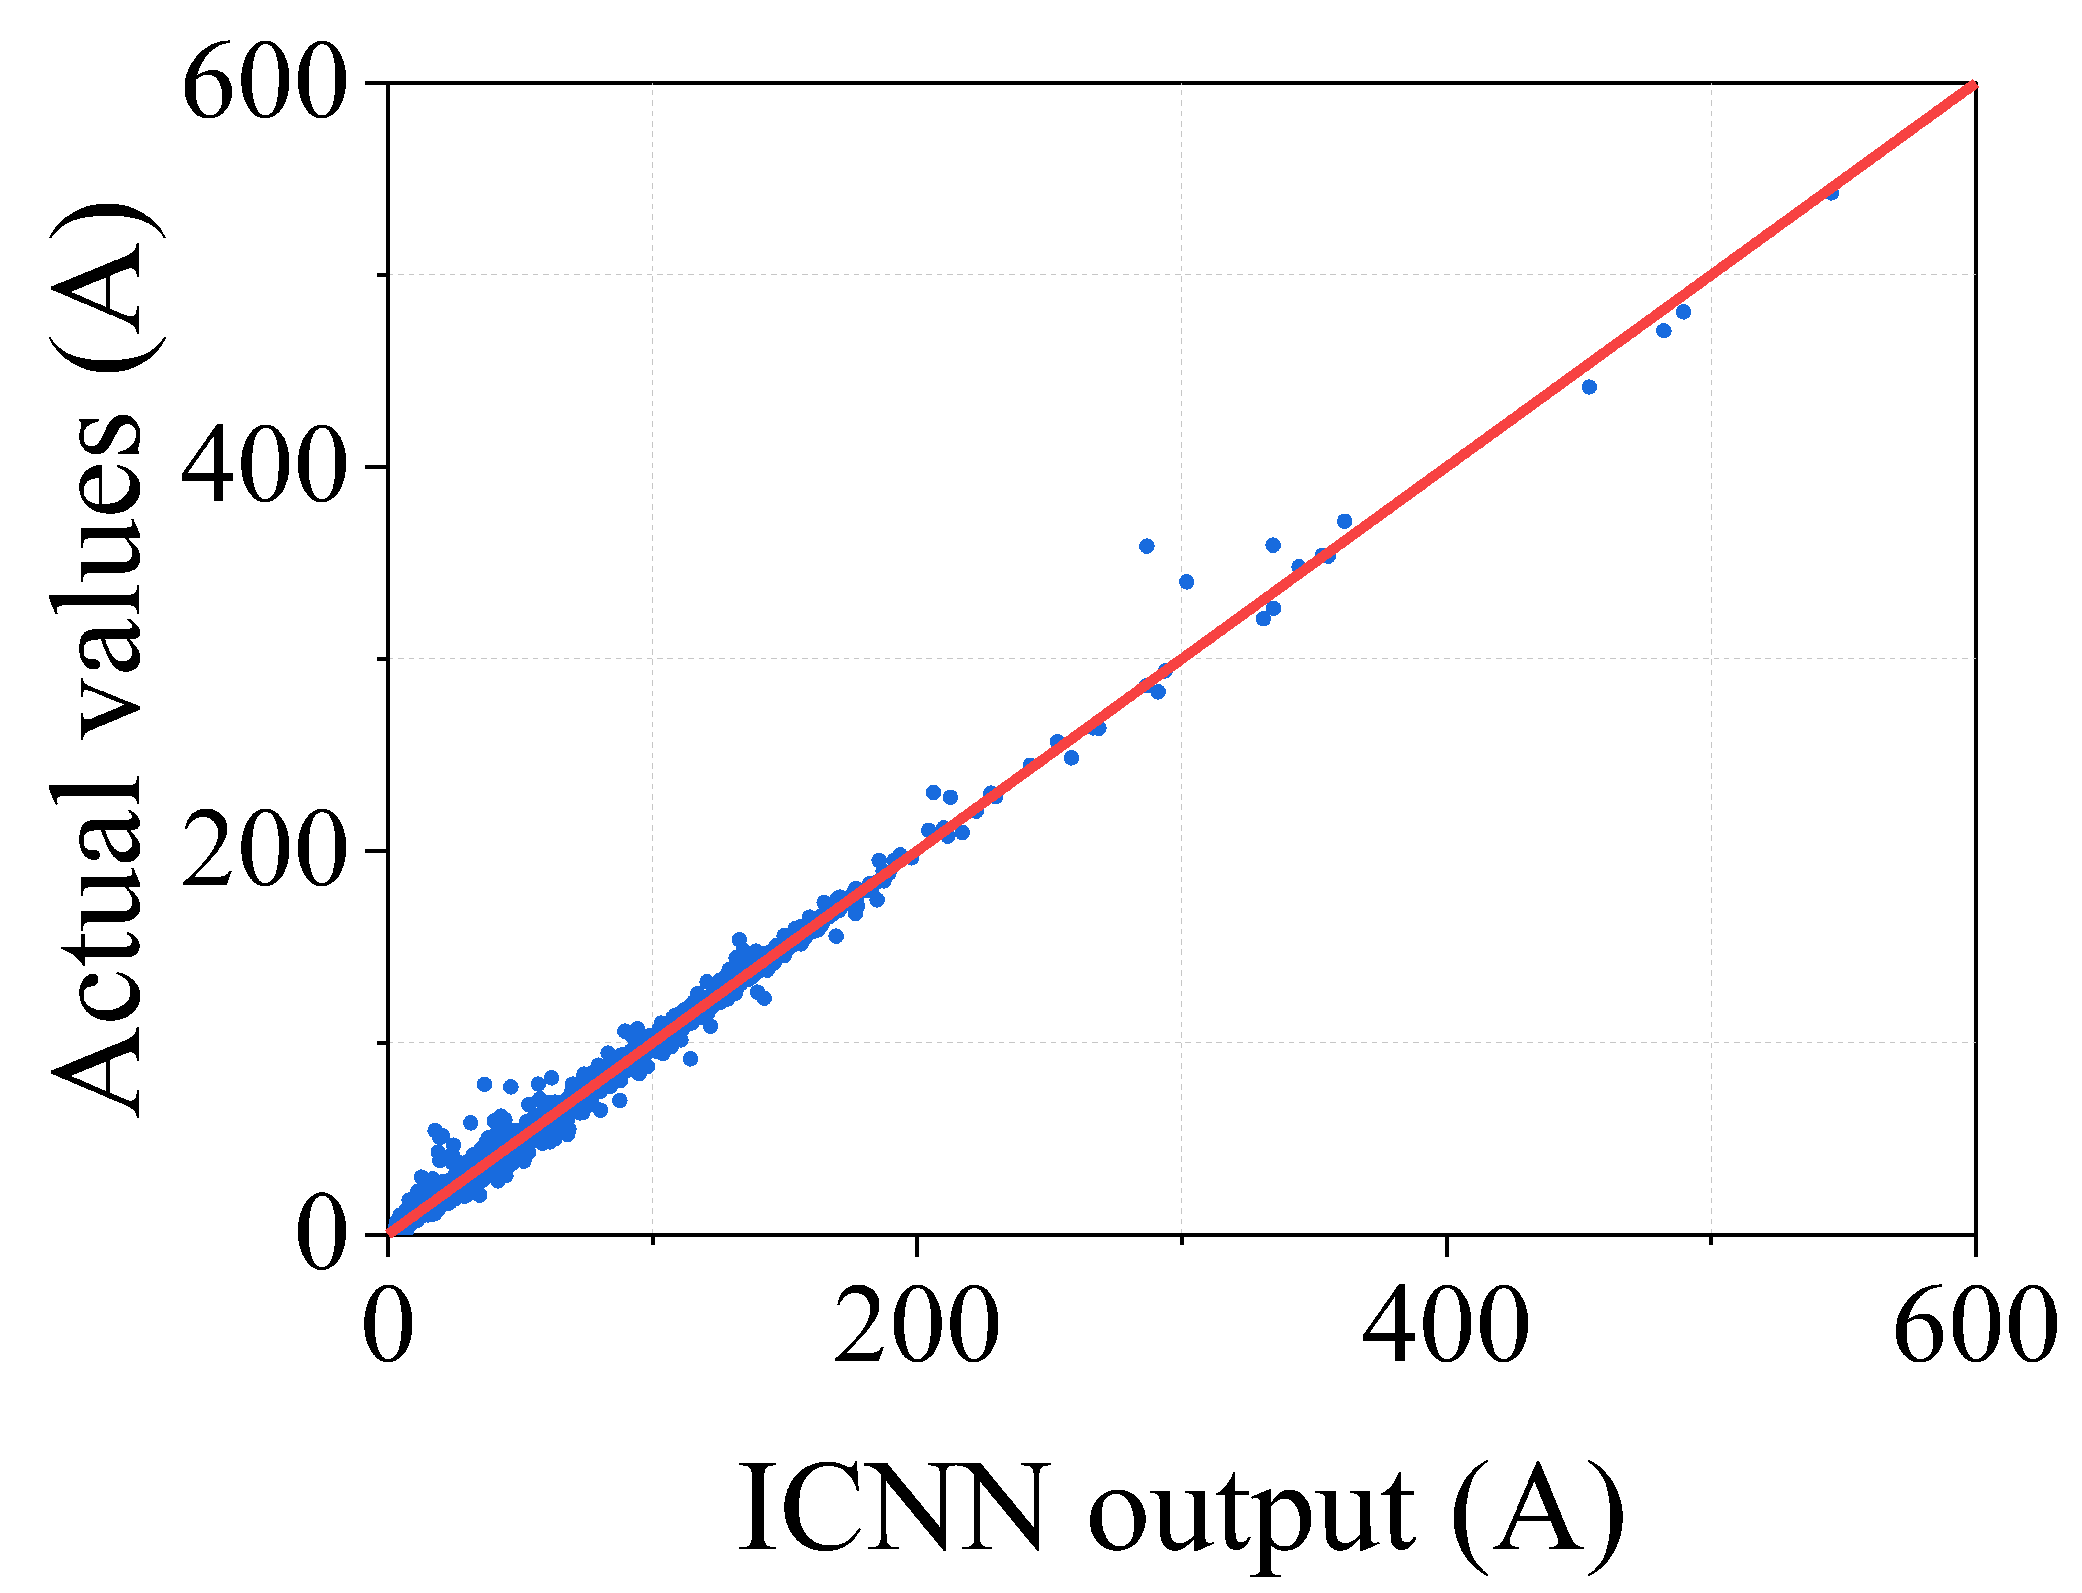
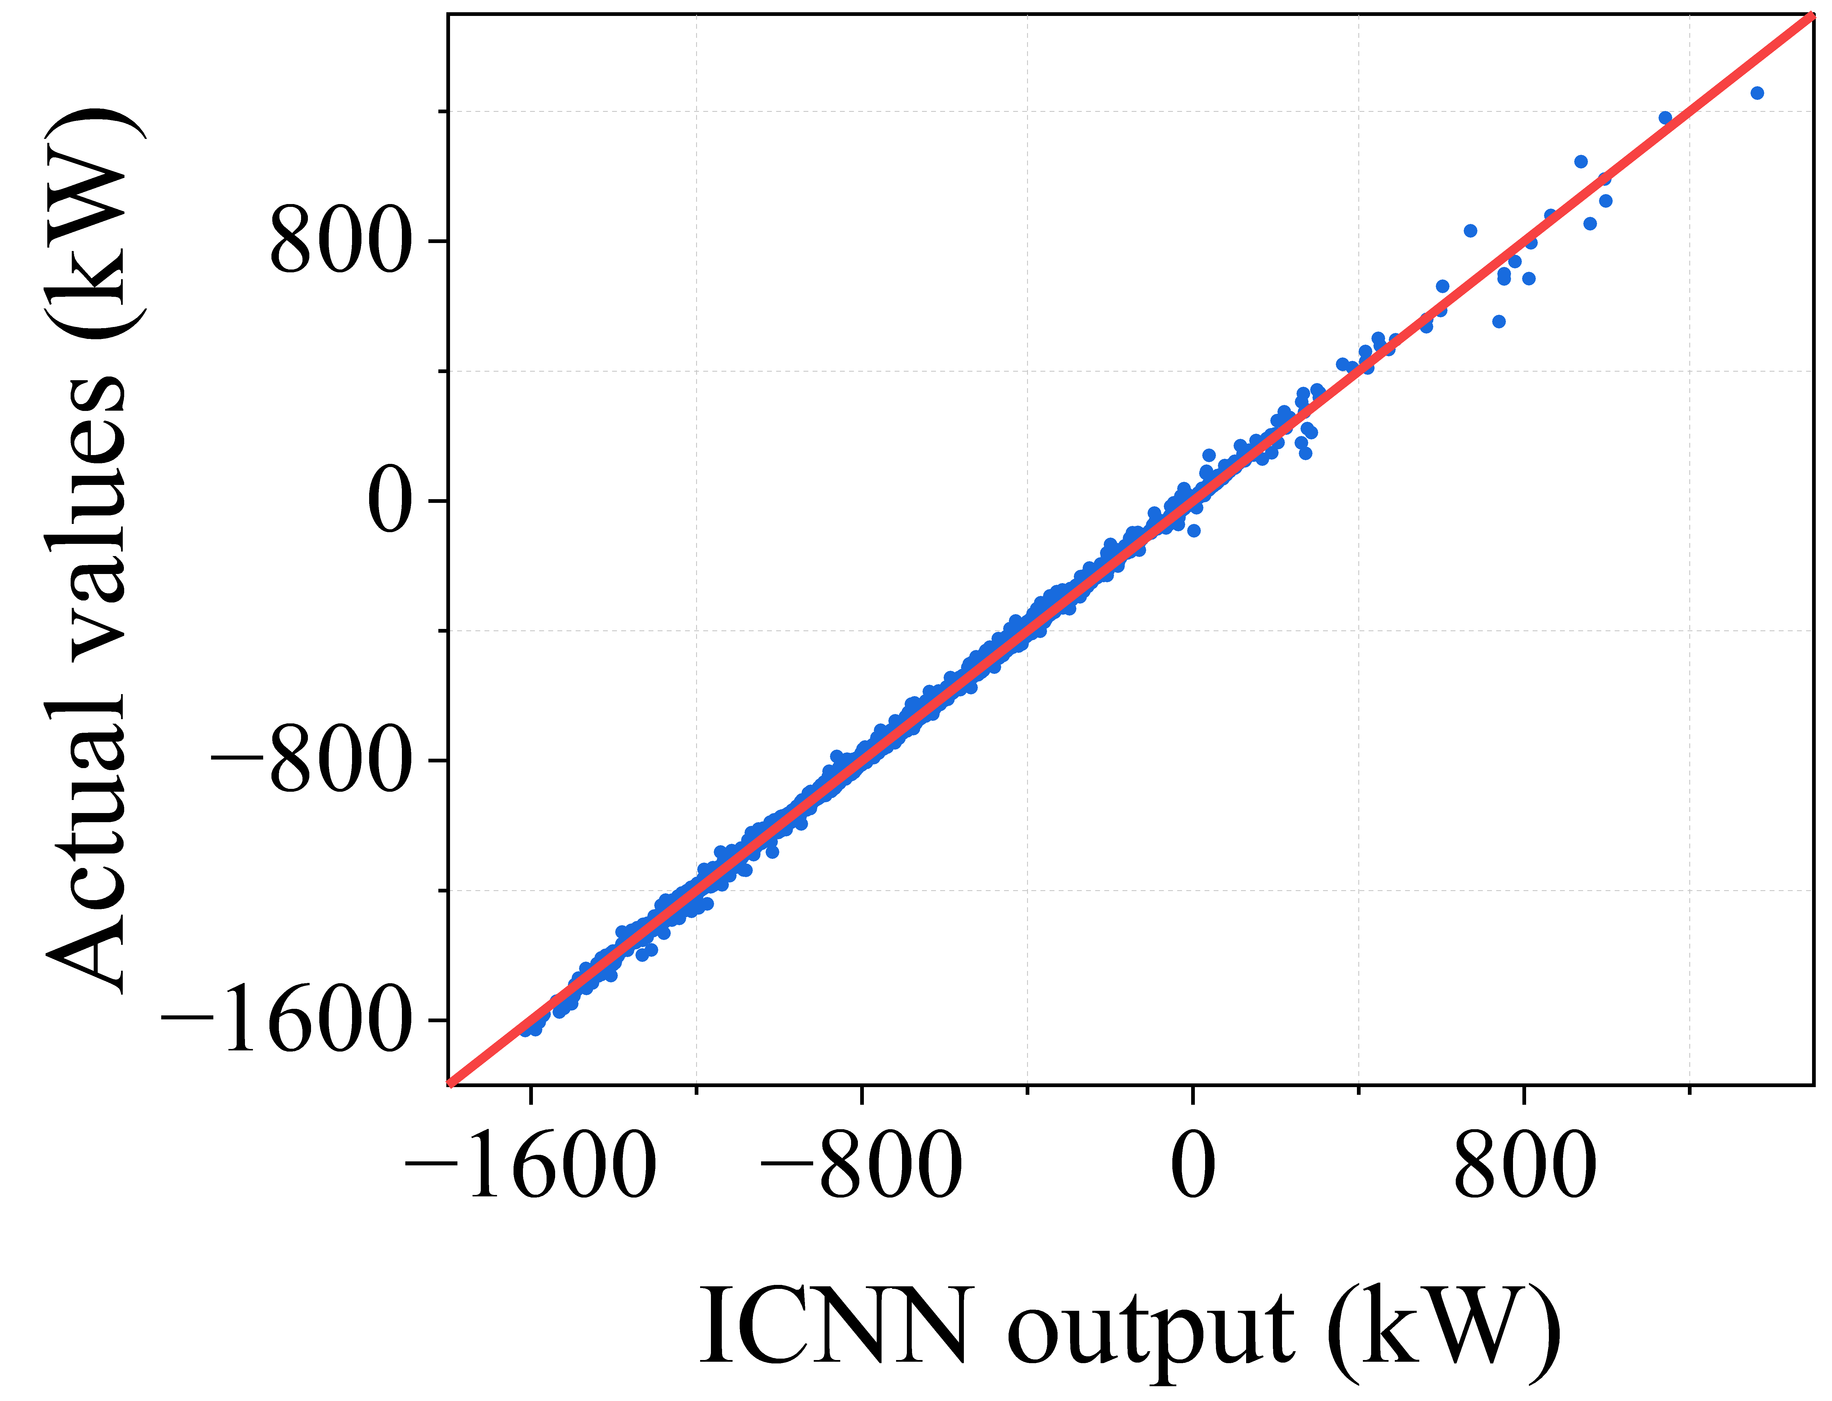





How good can ICNNs represent power flow model?
The blue dots are data points taking the ICNN output as x-values and the actual value as y-values.
Blue dots concentrate around the red lines (reference lines, slope=1), implying that the ICNN outputs are very close to the actual values.
Power loss $P_{loss}$
Substation power $P_{total}$
Nodal voltage $|V_{i}|$
Power factor
Line current $|I_{ij}|$
Line active power $P_{ij}$

Slide 21
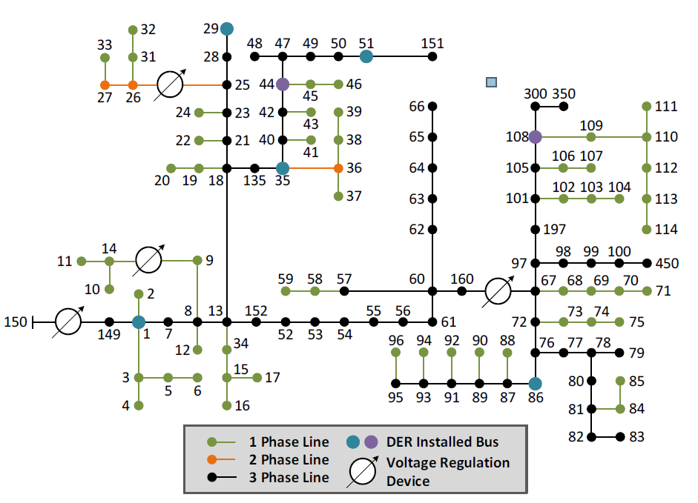
Time-series test case for 24-hour DOE
Seven three-phase DERs are installed to bus 1, 29, 35, 44, 51, 86, 108
DER capacity: 4.2 MVA, 2.11 MW, 0.55 MVar
Total active load = 3.49 MW
Total reactive load = 1.92 MVar
Four capacitors with a total capacity of 0.75 Mvar
Power flow dataset for ICNN training (30,000 samples)
Randomly select load level between 0.9~1.4
Randomly select DER generation level between 0~1
Run OpenDSS to get power flow results
Use 80% of data for training and 20% of data for testing
Train ICNNs with MSE loss to learn power flow relationships
IEEE 123-node test feeder topology

Slide 22
Overall DOE area of seven DERs
The following figures show the overall DOE area, which is the summation of individual DOE areas of all seven DERs.
Among the methods, ICNN shows excellent consistency with SGD at lower bounds, while ICNN is more conservative than SGD at upper bounds.
LDF suffers from inferior accuracy in estimating the DOE area at both upper and lower DOE bounds.

Slide 23
Overall DOE area of seven DERs
For upper limits, SGD and ICNN are less conservative than LDF. Compared with SGD, ICNN is conservative at some intervals since it is less accurate in handling back feed penalties.
For lower limits, ICNN and SGD have similar performance, implying that both methods are accurate in handling overloading penalties.

Slide 24
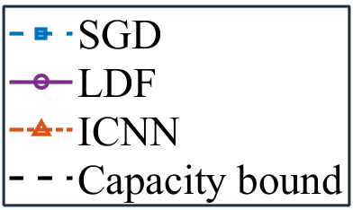
DOEs of individual DERs – upper limits
DOEs generated by different methods are significantly different to each other.
Additional criteria or strategies may be necessary for DOE allocation in specific cases.

Slide 25
DOEs of individual DERs – lower limits
DOEs generated by different methods are significantly different to each other.
Additional criteria or strategies may be necessary for DOE allocation in specific cases.

Slide 26

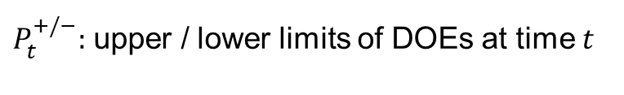
Quantitative comparison of overall DOE
We define the size of DOEs as the sum of dispatchable range at each time intervals:
SGD merits the largest DOE size, allowing aggregators to dispatch DERs more flexibly. The computational efficiency of SGD is also satisfactory.
Compared with SGD, ICNN obtains a relatively smaller DOE size while significantly enhancing the computational efficiency, achieving a great balance between DOE size and computational efficiency.
$$DOE size= \sum_{t=1}^{24}{{(P}_{t}^{+}−P_{t}^{−}）}$$
$P_{t}^{+/−}:$ upper / lower limits of DOEs at time $t$
 | DOE size (kW) | Relative DOE size (vs. SGD) | Time (s)* | Relative time (vs. SGD)
SGD | 50509 | 1 | 73.19 | 1
LDF | 25708 | 50.90% | 84.67 | 115.69%
ICNN | 44177 | 87.46% | 10.30 | 14.07%
*total time for optimizing 24-hour DOEs

Slide 27
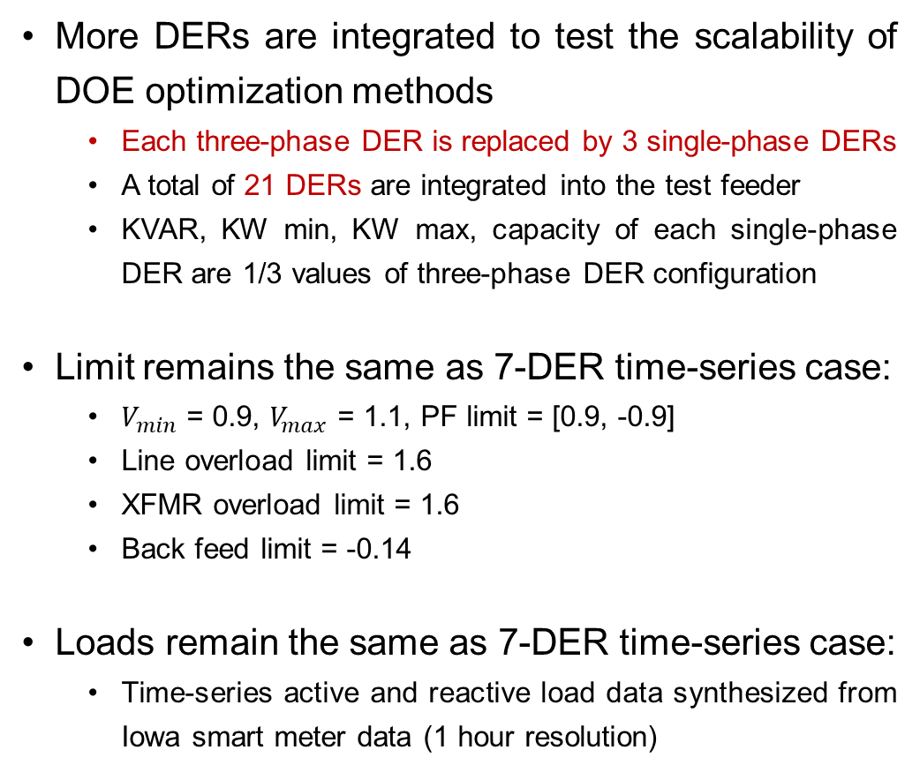
Scalability test case with more DERs
More DERs are integrated to test the scalability of DOE optimization methods
Each three-phase DER is replaced by 3 single-phase DERs
A total of 21 DERs are integrated into the test feeder
KVAR, KW min, KW max, capacity of each single-phase DER are 1/3 values of three-phase DER configuration
Limit remains the same as 7-DER time-series case:
$V_{min}$ = 0.9, $V_{max}$ = 1.1, PF limit = [0.9, -0.9]
Line overload limit = 1.6
XFMR overload limit = 1.6
Back feed limit = -0.14
Loads remain the same as 7-DER time-series case:
Time-series active and reactive load data synthesized from Iowa smart meter data (1 hour resolution)
IEEE 123-node test feeder topology

Slide 28
Overall DOE area of scalability test case
The following figures show the overall DOE area, which is the summation of individual DOE areas of all 21 single-phase DERs.
Due to the similar DER capacity configuration, the general trend of DOE results with 21 DERs are similar to the results of the 7-DER test case.
Similar to the 7-DER test case, ICNN shows excellent consistency with SGD at lower bounds, while ICNN is more conservative than SGD at upper bounds.

Slide 29
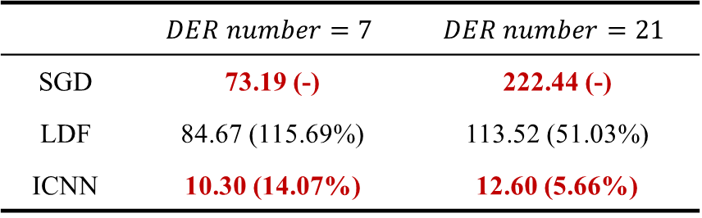
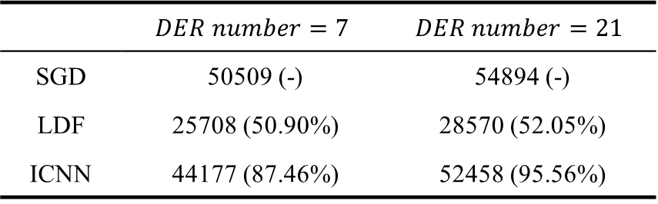
Quantitative results of scalability test case
In the 21-DER test case, SGD also exhibits excellent accuracy in DOE optimization by achieving the largest DOE sizes. ICNN obtains decent DOE sizes in both test cases, which are slightly smaller than SGD.
As DER number increases, the solution time of SGD significantly increases. In the 21-DER test case, compared to SGD, ICNN achieves over 95% of DOE size within less than 6% of solution time, indicating its great potential to be applied in large-scale DOE optimization problems.
DOE size (kW) & Relative DOE size vs. SGD
Solution time (s)* & Relative Solution time vs. SGD
 | $$DER number=7$$ | $$DER number=21$$
SGD | 50509 (-) | 54894 (-)
LDF | 25708 (50.90%) | 28570 (52.05%)
ICNN | 44177 (87.46%) | 52458 (95.56%)
 | $$DER number=7$$ | $$DER number=21$$
SGD | 73.19 (-) | 222.44 (-)
LDF | 84.67 (115.69%) | 113.52 (51.03%)
ICNN | 10.30 (14.07%) | 12.60 (5.66%)
*total time for optimizing 24-hour DOEs

Slide 30
Summary and path forward
DOEs are important to safe DER dispatch in distribution network operations. Accurate DOE results will significantly enhance the integration of DERs and the utilization of grid infrastructures.
Input convex neural networks are effective in handling the challenges in DOE optimization. With decent optimality, the solution time of ICNN-based DOE optimization problem is consistently short, demonstrating superiority in computational efficiency and scalability.
Future research work includes:
Design a hybrid method, which utilizes SGD to refine the solution of ICNN, to achieve fast and accurate DOE optimization in large-scale cases.
Incorporate distribution system topology changes in DOE optimization methods.
Consider load and DER uncertainties with a stochastic DOE optimization model.

Slide 31

Data sharing
With permission from our utility partner, we share a real distribution grid model with one-year smart meter measurements. This dataset provides an opportunity for researchers and engineers to perform validation and demonstration using real utility grid models and field measurements.
The system consists of 3 feeders and 240 nodes and is located in Midwest U.S.
The system has 1120 customers and all of them are equipped with smart meters. These smart meters measure hourly energy consumption (kWh). We share the one-year real smart meter measurements for 2017.
The system has standard electric components such as overhead lines, underground cables, substation transformers with LTC, line switches, capacitor banks, and secondary distribution transformers. The real system topology and component parameters are included.
You may download the dataset at: http://wzy.ece.iastate.edu/Testsystem.html , including system description (in .doc and .xlsx), smart meter data (in .xlsx), OpenDSS model, and Matlab code for quasi-static time-series simulation.

Slide 32
Distribution system courses
EE 455 Introduction to Energy Distribution Systems
Introduction to Distribution Systems
Nature of Loads
Approximate Method of Analysis
Power Distribution System Power Flow – Basics
Modeling Series Impedance
Modeling Shunt Admittance
Modeling Series Components-Lines
Modeling Voltage Regulators
Modeling Transformers
Distribution Feeder Modeling and Analysis
Center-Tapped Transformers and Secondaries
Y-bus Method for Power Flow Calculation
EE 555 Advanced Energy Distribution Systems
Introduction to Distribution Systems
Power Flows in Distribution Systems
Distribution System Transformers
Distribution Line Models
Distribution System Analysis
Distribution System Planning
Economics of Distribution System
Distribution System Operation and Automation
Distribution System Reliability
Distribution System Grounding
Distribution System Protection
Power Quality for Distribution System
Introduction to Distributed Energy Resources and Microgrids
You may download the course material at: http://wzy.ece.iastate.edu
All slides are editable, feel free to use.
Comments are very welcome!

Slide 33
Thank you!
Multiple fully funded (tuition, stipend & benefits) and immediately open PhD positions are available!
wzy@iastate.edu
https://wzy.ece.iastate.edu/

Slide 34


Model-based methods for DOE optimization
Two different model-based methods are utilized as benchmarks: LinDistFlow (LDF) and steepest gradient descent (SGD).
LDF method is based on LinDistFlow power flow model, which is linear and can convexify the non-convex DOE optimization problem.
SGD is an iterative method, which adjusts DER generations based on their sensitivity w.r.t the objective to approach optimum.
Non-linear, convex objective function
$$\begin{aligned}&\min{ }J_{obj}+penalties \\ \\ &s.t. {\underset{−}{P}}^{DER}≤P^{DER}≤{\overline{P}}^{DER} \\ & p=p^{load}−p^{DER},q=q^{load}−q^{DER}−Q^{CAP}v \\ & p^{load}=p^{PQ}+p^{Z}v+p^{I}\frac{v+1}{2}, \\ q^{load}=q^{PQ}+q^{Z}v+q^{I}\frac{v+1}{2} \\ & AP=−p,AQ=−q \\ & v=−{\left[A^{T}\right]}^{−1}A_{0}v_{0}−2R_{D}p−2X_{D}q \\ & p_{0}=1^{T}p+P^{T}D_{r}P+Q^{T}D_{r}Q \\ & q_{0}=1^{T}q+P^{T}D_{x}P+Q^{T}D_{x}Q \\ & \\ \\ \end{aligned}$$
$x$: DER generation
$f(x)$: obj for DOE optimization
$∆x$: step size for DER adjustment
Linear constraints
Calculate sensitivity of objective function related to DERs
Update values of DER generations according to sensitivity
Repeat Step 1 and 2 until convergence

Slide 35
Experiment setup for snapshot cases
We set up two test cases:
Case 1: Back feed (unrestrained DER power leads to back feed limit violations)
Case 2: Overloading (heavy load and insufficient DER generation result in overloading)
The performance of four different methods are compared with the baseline:
w/o opt: baseline case, where DERs keep current operating condition (kW start)
LDF: DOE optimization method based on convexified power flow model
SGD: steepest gradient descent method (adopted in industrial practices)
ICNN: DOE optimization method based on linear power flow counterparts provided by ICNNs
Four scenarios are considered:
Experiments are conducted on a PC with an Intel(R) Xeon(R) W-1370 CPU and a 32.0 GB
more details on next page
Scenario 1: $w_{pshift}=1$, $w_{ploss}=0$, $w_{ptotal}=0$
Scenario 3: $w_{pshift}=0$, $w_{ploss}=0$, $w_{ptotal}=1$
Scenario 2: $w_{pshift}=0$, $w_{ploss}=1$, $w_{ptotal}=0$
Scenario 4: $w_{pshift}=1/3$, $w_{ploss}=1/3$, $w_{ptotal}=1/3$

Slide 36

Case 1: Back feed
Loading scale = 1.1
DER Info:
Name: [g1, g86, g35, g29, g51, g44, g108]
KW start: [900, 140, 150, 300, 500, 60, 60]
KVAR: [250, 60, 60, 80, 100, 0, 0]
KW min: [0, -100, -100, 0, 0, 0, 0]
KW max: [1000, 500, 500, 500, 600, 80, 80]
Capacity: [1000, 600, 600, 500, 600, 80, 80]
Limit:
$V_{min}$ = 0.9, $V_{max}$ = 1.1, PF limit = [0.9, -0.9]
Line overload limit = 1.6, XFMR overload limit = 1.6
Back feed limit = -0.14
Initial Condition:
10 back feed violations (consider both sides)
4 BF on Line L49 (49-50) Phase 1, 2
6 BF on Line L50 (50-51) Phase 1, 2, 3
L49
L50
IEEE 123-node test feeder topology

Slide 37


Experimental results: Case 1 (Back Feed)
Scenario 1: $w_{pshift}=1$, $w_{ploss}=0$, $w_{ptotal}=0$
 | $$J_{obj}$$ | $$penalty_{v}$$ | $$penalty_{pf}$$ | $$penalty_{ol}$$ | $$penalty_{bf}$$ | $$J_{total}$$ | Time | PF Cal.
w/o opt | 0 | 0 | 0 | 0 | 89.0543 | 89.0543 | N/A | 1
LDF | 0.7548 | 0 | 0 | 0 | 0 | 0.7548 | 0.57s | N/A
SGD | 0.0978 | 0 | 0 | 0 | 0.0004 | 0.0982 | 0.61s | 51
ICNN | 0.1084 | 0 | 0 | 0 | 0 | 0.1084 | 0.23s | N/A
Scenario 2: $w_{pshift}=0$, $w_{ploss}=1$, $w_{ptotal}=0$
 | $$J_{obj}$$ | $$penalty_{v}$$ | $$penalty_{pf}$$ | $$penalty_{ol}$$ | $$penalty_{bf}$$ | $$J_{total}$$ | Time | PF Cal.
w/o opt | 1.0000 | 0 | 0 | 0 | 89.0543 | 90.0543 | N/A | 1
LDF | 1.2080 | 0 | 0 | 0 | 0 | 1.2080 | 1.06s | N/A
SGD | 0.7831 | 0 | 0 | 0 | 0 | 0.7831 | 1.81s | 192
ICNN | 0.8449 | 0 | 0 | 0 | 0 | 0.8449 | 0.24s | N/A

Slide 38


Experimental results: Case 1 (Back Feed)
Scenario 3: $w_{pshift}=0$, $w_{ploss}=0$, $w_{ptotal}=1$
 | $$J_{obj}$$ | $$penalty_{v}$$ | $$penalty_{pf}$$ | $$penalty_{ol}$$ | $$penalty_{bf}$$ | $$J_{total}$$ | Time | PF Cal.
w/o opt | 1.0000 | 0 | 0 | 0 | 89.0543 | 90.0543 | N/A | 1
LDF | 1.2334 | 0 | 0 | 0 | 0 | 1.2334 | 0.59s | N/A
SGD | 0.7623 | 0 | 0.0001 | 0 | 0 | 0.7624 | 2.08s | 203
ICNN | 0.8440 | 0 | 0 | 0 | 0 | 0.8440 | 0.24s | N/A
Scenario 4: $w_{pshift}=1/3$, $w_{ploss}=1/3$, $w_{ptotal}=1/3$
 | $$J_{obj}$$ | $$penalty_{v}$$ | $$penalty_{pf}$$ | $$penalty_{ol}$$ | $$penalty_{bf}$$ | $$J_{total}$$ | Time | PF Cal.
w/o opt | 0.6667 | 0 | 0 | 0 | 89.0543 | 89.7209 | N/A | 1
LDF | 1.1953 | 0 | 0 | 0 | 0 | 1.1953 | 0.68s | N/A
SGD | 0.6865 | 0 | 0 | 0 | 0 | 0.6865 | 1.04s | 108
ICNN | 0.8672 | 0 | 0 | 0 | 0 | 0.8672 | 0.28s | N/A

Slide 39

Case 2: Overloading
Loading scale = 1.32
DER Info:
Name: [g1, g86, g35, g29, g51, g44, g108]
KW start: [400, 140, 150, 200, 300, 60, 60]
KVAR: [100, 60, 60, 80, 100, 0, 0]
KW min: [0, -100, -100, 0, 0, 0, 0]
KW max: [500, 300, 300, 400, 400, 80, 80]
Capacity: [500, 400, 400, 400, 400, 80, 80]
Limit:
$V_{min}$ = 0.9, $V_{max}$ = 1.1, PF limit = [0.9, -0.9]
Line overload limit = 1.6, XFMR overload limit = 0.65
Back feed limit = -0.14
Initial Condition:
6 overload violations (consider both sides)
4 OL on Line L3 (1-7) Phase 1 and L7 (7-8) Phase 1
2 OL on xfmr.Reg1
Reg1
L7
L3
IEEE 123-node test feeder topology

Slide 40


Experimental results: Case 2 (Overloading)
Scenario 1: $w_{pshift}=1$, $w_{ploss}=0$, $w_{ptotal}=0$
 | $$J_{obj}$$ | $$penalty_{v}$$ | $$penalty_{pf}$$ | $$penalty_{ol}$$ | $$penalty_{bf}$$ | $$J_{total}$$ | Time | PF Cal.
w/o opt | 0 | 0 | 0 | 166.5087 | 0 | 166.5087 | N/A | 1
LDF | 0.3292 | 0 | 0 | 0.1911 | 0 | 0.5203 | 0.57s | N/A
SGD | 0.3526 | 0 | 0 | 0.0005 | 0 | 0.3532 | 1.57s | 159
ICNN | 0.3665 | 0 | 0 | 0.0071 | 0 | 0.3737 | 0.23s | N/A
Scenario 2: $w_{pshift}=0$, $w_{ploss}=1$, $w_{ptotal}=0$
 | $$J_{obj}$$ | $$penalty_{v}$$ | $$penalty_{pf}$$ | $$penalty_{ol}$$ | $$penalty_{bf}$$ | $$J_{total}$$ | Time | PF Cal.
w/o opt | 1.0000 | 0 | 0 | 166.5087 | 0 | 167.5087 | N/A | 1
LDF | 0.7769 | 0 | 2.9214 | 0 | 0.8225 | 4.5207 | 0.50s | N/A
SGD | 0.7870 | 0 | 0 | 0 | 0 | 0.7870 | 5.08s | 522
ICNN | 0.7986 | 0 | 0 | 0 | 0 | 0.7986 | 0.25s | N/A

Slide 41


Experimental results: Case 2 (Overloading)
Scenario 3: $w_{pshift}=0$, $w_{ploss}=0$, $w_{ptotal}=1$
 | $$J_{obj}$$ | $$penalty_{v}$$ | $$penalty_{pf}$$ | $$penalty_{ol}$$ | $$penalty_{bf}$$ | $$J_{total}$$ | Time | PF Cal.
w/o opt | 1.0000 | 0 | 0 | 166.5087 | 0 | 167.5087 | N/A | 1
LDF | 0.7677 | 0 | 2.9214 | 0 | 0.8225 | 4.5115 | 0.51s | N/A
SGD | 0.7945 | 0 | 0.0001 | 0 | 0 | 0.7946 | 3.83s | 259
ICNN | 0.7978 | 0 | 0 | 0 | 0 | 0.7978 | 0.24s | N/A
Scenario 4: $w_{pshift}=1/3$, $w_{ploss}=1/3$, $w_{ptotal}=1/3$
 | $$J_{obj}$$ | $$penalty_{v}$$ | $$penalty_{pf}$$ | $$penalty_{ol}$$ | $$penalty_{bf}$$ | $$J_{total}$$ | Time | PF Cal.
w/o opt | 0.6667 | 0 | 0 | 166.5087 | 0 | 167.1753 | N/A | 1
LDF | 0.7122 | 0 | 0 | 0.1914 | 0 | 0.9036 | 0.63s | N/A
SGD | 0.7256 | 0 | 0 | 0 | 0 | 0.7256 | 6.53s | 333
ICNN | 0.8261 | 0 | 0 | 0 | 0 | 0.8261 | 0.27s | N/A

Slide 42
Discussion
Experiment results show that ICNNs are accurate in replicating power flow relationships, establishing the foundation for obtaining accurate DOE optimization results.
SGD merits great adaptivity to various case settings and excellent accuracy, requiring relatively low computational efforts. Thus, it is adopted in industrial practices and used as a benchmark method for the evaluation of the ICNN method.
The accuracy performance of ICNN is similar to SGD, and in some scenarios, ICNN even outperforms SGD by achieving lower objective function values.
Due to the linearity of the reformulated DOE optimization problem, the solution time of the ICNN method is short and consistent (~0.25 seconds).

