Slide 1

Data-Driven Outage Modelling and Restoration Time Prediction in Distribution Grids
Zhaoyu Wang
Professor
Department of Electrical and Computer Engineering
Iowa State University
wzy@iastate.edu
Notes:
Our topic is ………

Slide 2
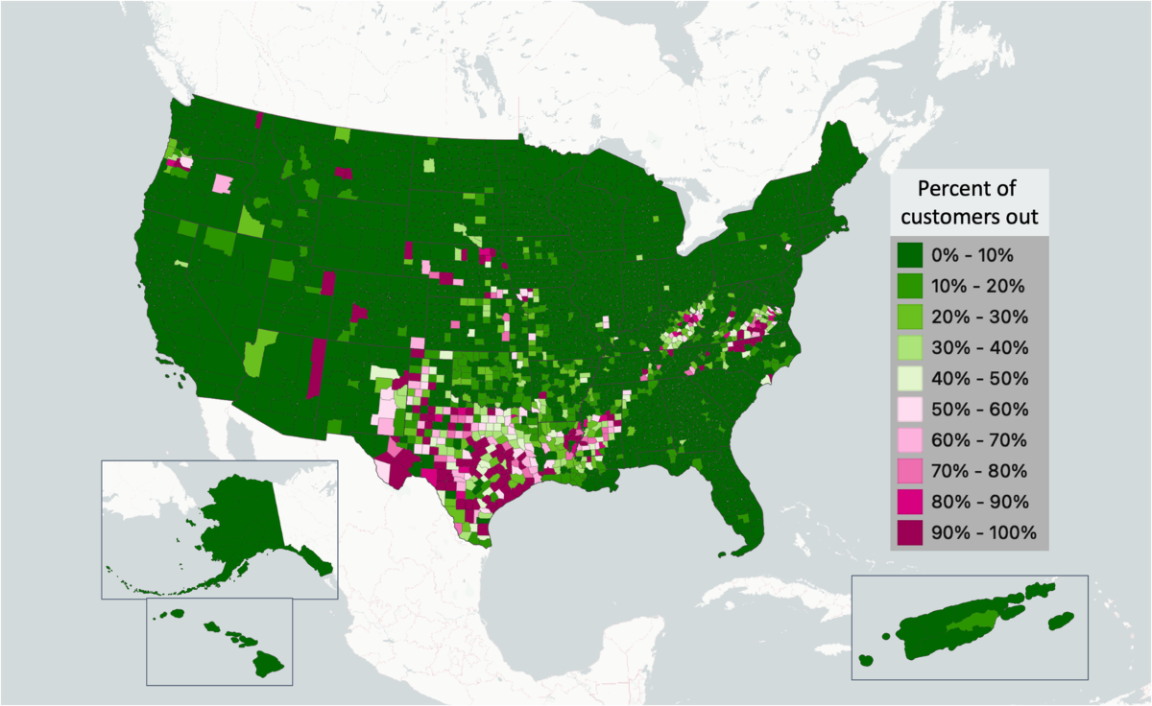
Introduction
Outages have significant impacts on economic losses.
Pacific Gas and Electric Company (PG&E) reported an average interruption duration of 276.4 minutes per customer in 2024 [2].
Over 1,300 outages recorded on the AES Indiana distribution system in 2024.
Outage recovery time prediction significantly impacts customer satisfaction.
Complex outage causes and scales make the restoration prediction challenging.
Recorded outages by US county 2014–2022 [1]
Percent of customers had outages
Notes:
对齐

Slide 3
Literature Review
Group | Reference | Method | Objective
Predict Outage Numbers | [3] | Poisson regression | Predict outage numbers under normal weather conditions
 | [4] | Artificial neural network | Predict outage numbers caused by wind and lightning
Predict Outage Duration | [5] | Linear regression | Predict restoration time under hurricane
 | [6] | Accelerated failure time | Predict restoration time under storms
 | [7] | Exponential regression | Predict restoration time under extreme weather and disasters
 | [8] | Restoration curve fitting | Predict the restoration time by fitting Lognormal curves

Slide 4
Existing Challenges
    Multiple coincident outages can extend restoration time.
    Prior works treat each outage as an independent case.
    Outages have different sizes (scales).
    One-model-fits-all solution cannot accommodate different outage sizes.
    Large-scale outages are rare in real-world outage datasets.
    The model performs poorly on large-scale outages due to data scarcity.

Slide 5
Data-Driven Outage Restoration Time Prediction
via Clustering and Transfer Learning

Slide 6
Our Solution [9]
    Discover latent features and perform feature selection to enrich datasets and improve training.
    Use clustering to classify outages into different groups.
    Train a model for the group with the largest amount of outage data.
    Apply transfer learning to improve model training of other groups.
Notes:
Small/medium outage → a lot of data → can be used to train a model
Large-scale outages → scarce data -> transfer learning

Slide 7
Real-World Outage Dataset - Overview
The outage reports are collected by a utility located in Northeast U.S., including over 16,000 outage records from 2011 ~ 2016.

Slide 8
Real-World Outage Dataset – Data Format
Outage records are automatically collected via the Outage Management System.
The initial outage data features include:
  Start and end time (accurate to seconds resolution)
  Outage locations (latitude, longitude)
  Number of customers interrupted
  Crew travel and outage restoration time (accurate to seconds resolution)
  Outage cause codes (i.e., animal, tree, equipment failure)
Start Time | End Time | Customers Interrupted | Latitude | Longitude | Duration (mins) | Cause Key | Sub Cause Key
Dec 1, 2012 3:21:00 AM | Dec 1, 2012 11:31:00 PM | 126 | xxx | xxx | 2,010 | Vegetation | Tree/Limb In Clearance Zone
Dec 1, 2012 3:39:00 AM | Dec 1, 2012 6:56:00 AM | 55 | xxx | xxx | 317 | Equipment Failure | Animal Touching
Notes:
5 major cause codes and 83 sub-cause codes. For training, we only used sub-cause keys because the major cause may not be significant and shares duplicate information with the sub-cause keys.

Slide 9
Adding Features - Severe Weather
Lightning
Severe weather records from the National Oceanic and Atmospheric Administration are collected and used to label outages.
Each outage is matched to one of six severe weather categories or normal weather based on its start time.
Outages not associated with any severe weather event are labeled as normal weather conditions.
Winter Storm
Flood
Severe
Weather
Code
High
Wind
Heavy Rain
Hail
Notes:
Severe weather type is transformed into codes, such as 1 – lightning, 2 – heavy rain, 3, 4, …

Slide 10
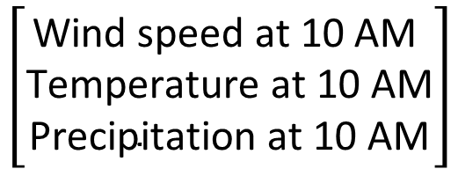
Adding Features - Hourly Weather Data
For each outage, we look up the weather conditions at the nearest past hour to when the outage happened.
Then we add weather conditions (i.e., wind, temperature, precipitation) from NOAA to each outage record.
00:00
10:00
12:00
00:00
$$\left[\begin{aligned}\text{Wind} \text{speed} \text{at}\text{ 10 }\text{AM} \\ \text{T}\text{emperature} \text{at}\text{ 10 }\text{AM} \\ \text{P}\text{recipitation} \text{at}\text{ 10 }\text{AM}\end{aligned}\right]$$
Outage reported at 10:45
Notes:
NOAA weather data is hourly. The outage location will help us select the most nearby weather sensor.

Slide 11
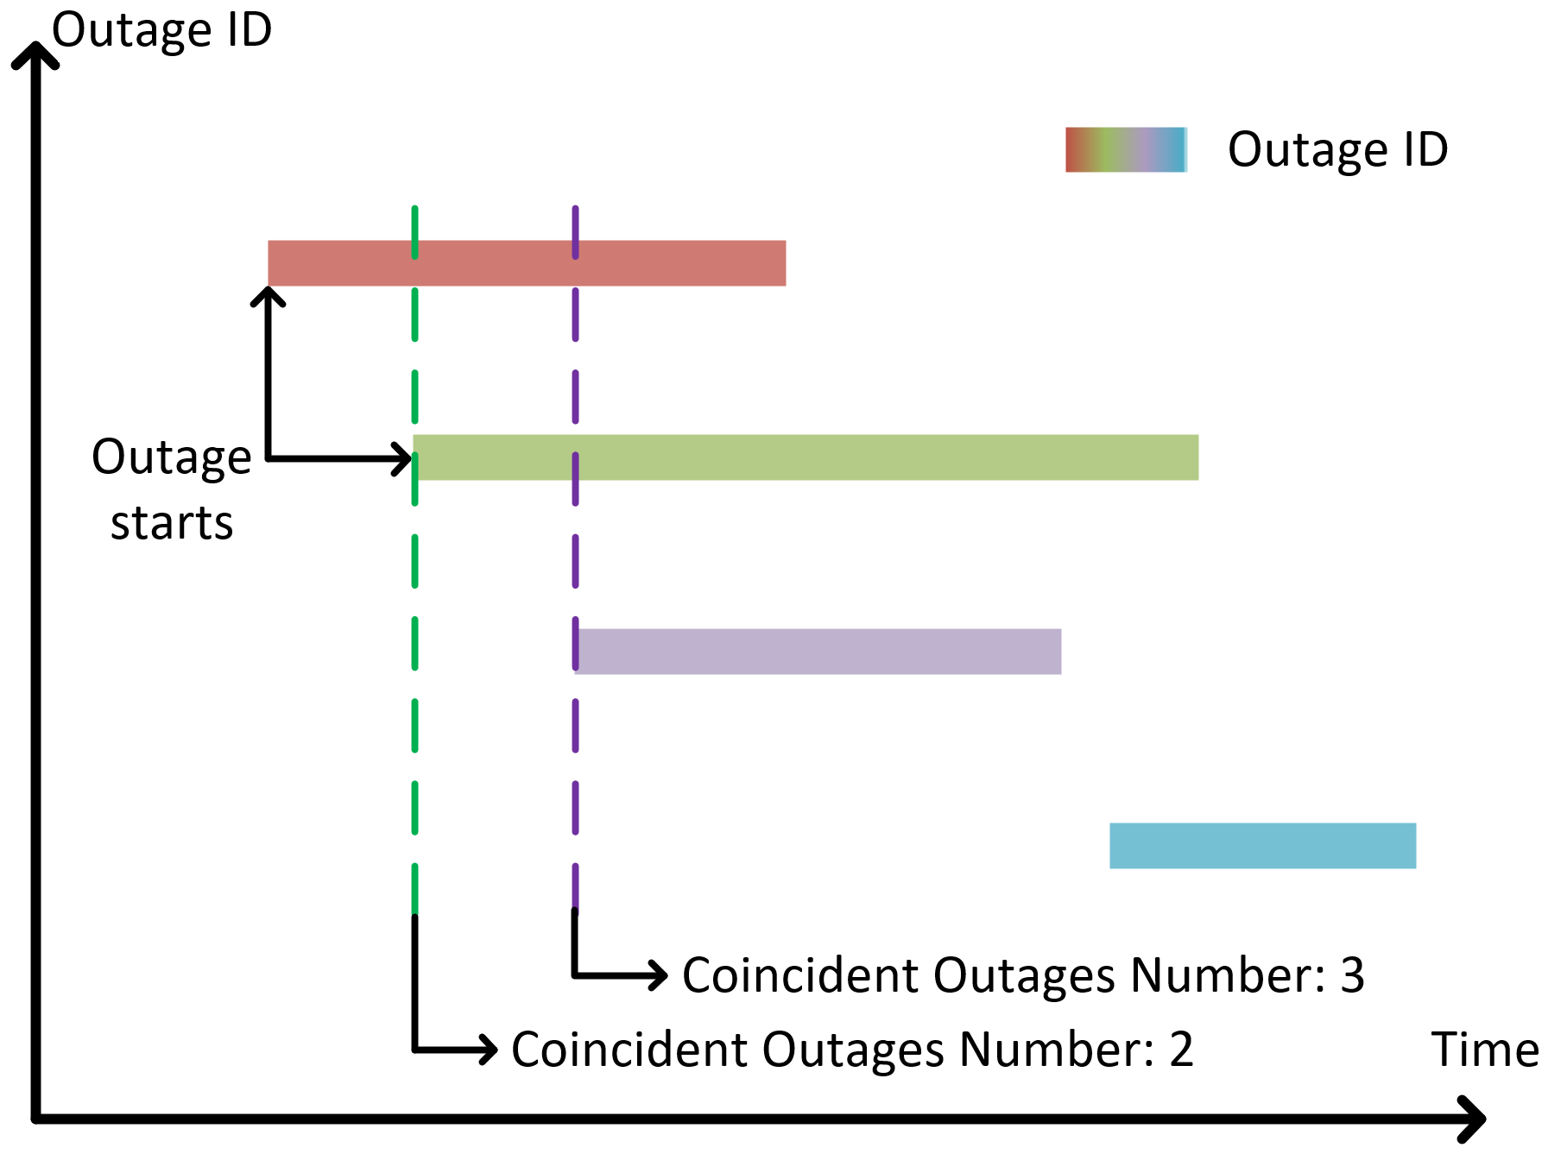
Adding Features - Number of Coincident Outages
Utilities have limited repair crews, and crews need time to travel between outage locations.
The number of coincident outages reflects the current system stress.
Calculate how many existing outages are still unresolved when a new outage is reported.
Calculate the total number of customers being affected by all coincident outages.
Example of coincident outages calculation
Notes:
When a new outage is reported, we calculate the Number of coincident outages. This number is then fixed for the duration of the outage, not dynamic. This helps with feature standardization and training.

Slide 12










Adding Features - Feature Selection
Drop low-impact features that may affect training time and prediction accuracy.
Calculate the Pearson Correlations between each feature and restoration time to quantify feature importance.
Pearson Correlation
Feature Selection
Feature Vectors with $n$ Outages
$feature 1$vs. $restoration$
$$feature 1 {=[f_{1,1}, f_{1,2},…,f_{1,n}]}^{T}$$
$feature 2$vs. $restoration$
$$feature 2 {=[f_{2,1}, f_{2,2},…,f_{2,n}]}^{T}$$
$$…$$
$$…$$
$feature m$vs. $restoration$
$$feature m {=[f_{m,1}, f_{m,2},…,f_{m,n}]}^{T}$$
Restoration Time Vectors
Drop weakly correlated features
$$restoration{=[r_{1}, r_{2}, …,r_{n}]}^{T}$$

Slide 13
Adding Features - Feature Selection
Remove features with Pearson Correlations < 0.1 [9].
Higher Correlation
Removed
Notes:
For typical sample sizes (N > 500), correlations |ρ| < 0.1 are not statistically significant at 95% confidence for noisy engineering data.
From expectation, crew travel time should be highly correlated with the restoration time. However, travel time is a small portion of the overall restoration process.
Travel distances and times vary only within a narrow range.
Many outages do not require on-site travel (remote operations).
Travel effects are nonlinear and inconsistent across events.
Stronger factors (cause, weather, event size) outweigh the impact of travel time.
Dispatch/travel records may be coarse or inaccurate.

Slide 14

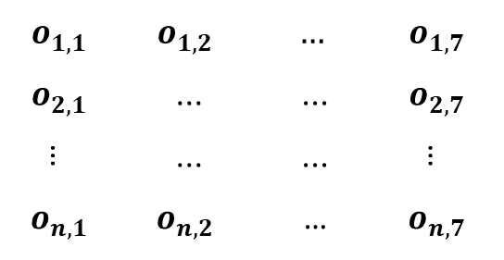



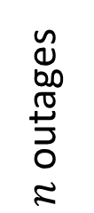
Finalized Outage Records with Features
The outage data matrix, $O$ $∈{ℝ }^{n × 7}$, with $n$outage records and 7 features.
7 features
0. Animal touching
1. Fuse
2. Switch
3. Tree touching
$$o_{1,1}$$ | $$o_{1,2}$$ | $$…$$ | $$o_{1,7}$$
$$o_{2,1}$$ | ... | ... | $$o_{2,7}$$
… | ... | ... | …
$$o_{n,1}$$ | $$o_{n,2}$$ | … | $$o_{n,7}$$
$o_{i,1}$ = Cause Code
$n$ outages
$$⋯$$
0. Normal
1. Lightning
2. Flood
$o_{i,2}$= Severe/Normal Weather code
$$⋯$$
7 features = [ Cause code, Number of coincident outages, Sever/Normal weather code, Customer interrupted, Customer interrupted in coincident outages, Crew travel time, Hourly wind speed ]

Slide 15
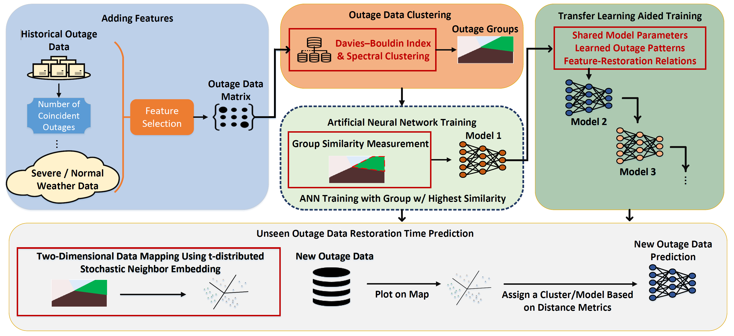
Proposed Outage Restoration Time Prediction Methodology
Notes:
Clusters->map
New data->map

Slide 16
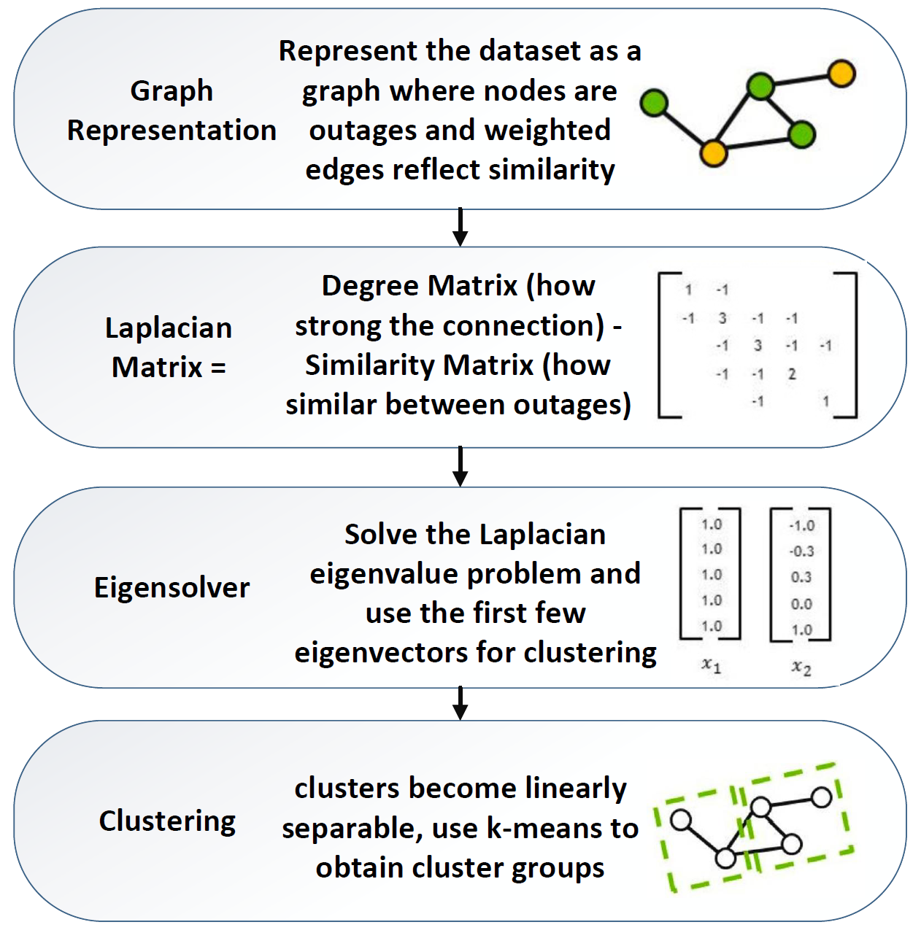
Outage Records Clustering
Use Davies-Bouldin Index to determine cluster numbers.
Treat each outage as a node in a graph. Connect nodes with edges based on the outage similarities.
The Laplacian matrix, L, represents how similar each pair of outages is and how strongly each outage is connected to others.
Solve the eigenvalue problem for L and keep the first few eigenvectors (from DBI) for clustering.
The process makes the clusters linearly separable.
Use the obtained eigenvectors as new features and cluster using k-means to obtain final outage groups.
Notes:
DBI is a cluster performance evaluation index used to determine the optimal number of clusters.
Why can we not directly apply k-means?
K-means cannot be directly applied because it assumes linearly separable, spherical clusters and therefore fails when the data contain nonlinear relationships or complex, irregular shapes. Outage features exhibit strong nonlinear interactions driven by weather, time, and operational context, making the raw features unsuitable for k-means. A spectral clustering step is first needed to capture these nonlinear similarities through a graph representation, and after the process makes the clusters linearly separable, we can apply k-means.

Slide 17
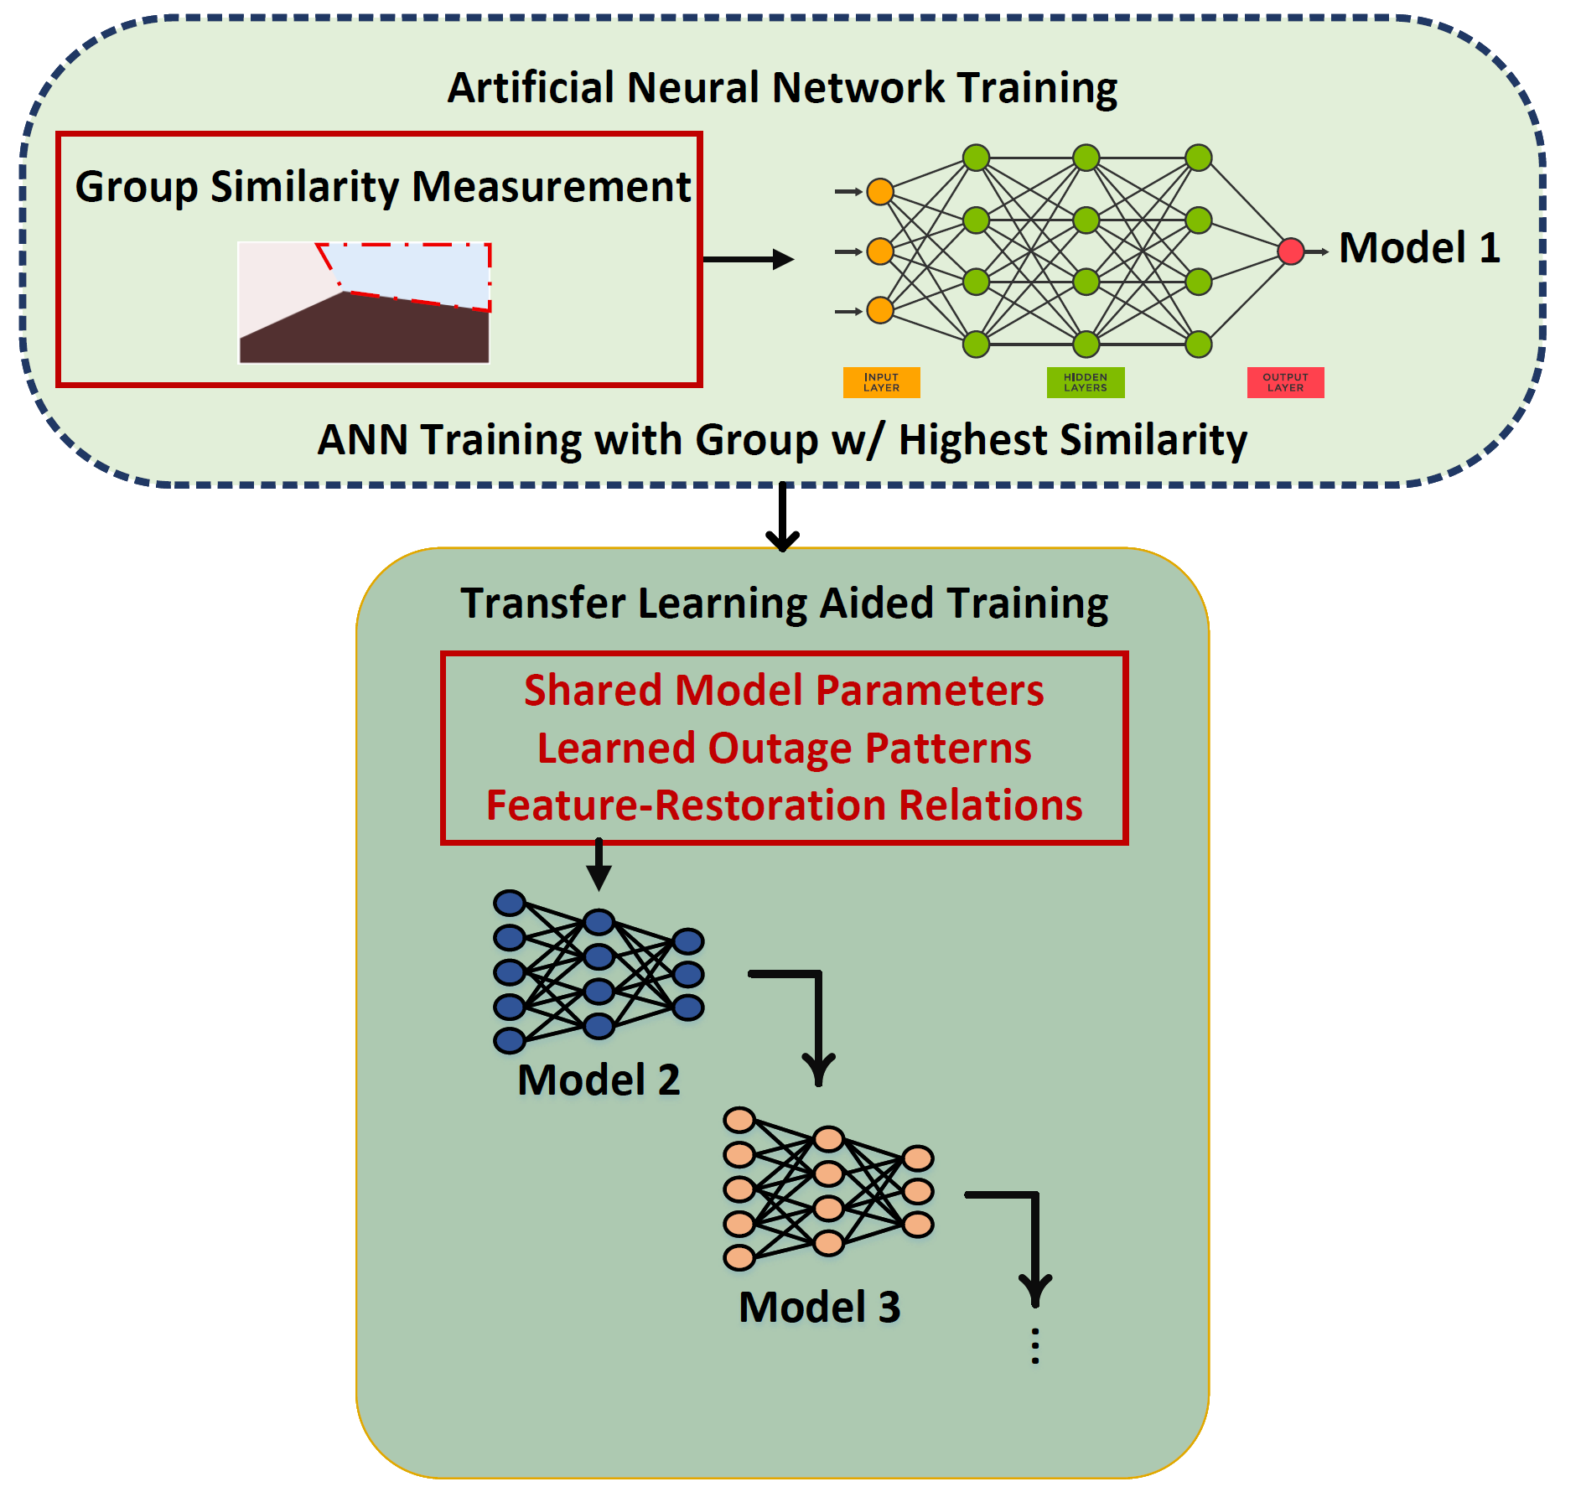
Data Training and Transfer Learning
Train one ANN model for each cluster. Each cluster uses only its own data for training (70%), validation (15%), and testing (15%).
Compute similarities between every pair of clusters. Order clusters per their similarity scores. Use the cluster with the highest score to train an ANN from scratch and obtain a strong base model.
Use transfer learning to train models for other clusters leveraging parameters from previous models.

Slide 18
For a New Outage: Which Model to Use?
T-SNE Map
Assign a new outage to a specific cluster/model for prediction.
t-distributed Stochastic Neighbor Embedding (t-SNE) reduces high-dimensional outage records into a 2-D map while keeping outages belonging to the same clusters close.
Apply t-SNE to all training outages and visualize each cluster with a different color on the 2-D map.
Project the new outage onto the same t-SNE map and assign it to the cluster with a distance-measuring index.
Cluster 2
Cluster 1
New outage with the same features
Cluster 3
Measure the distance between the new outage and the cluster centroid.
: Cluster Centroid
Notes:
Note that the new outage will have the same features as the trained outage records. Which means they needed to be in same length. This including the cause.

Slide 19
Numerical Results – Clustering Summary
Determined number of clusters = 4 using DBI.
Cluster shows different lengths of average restoration times.
Cluster 1 refers to large-scale outages with higher Avg. Customer Interrupted and Avg. Restoration Time.
Clusters 2 and 3 represent mid-scale outages, which are twice as frequent as large-scale outages.
Cluster 4 represents small-scale outages, which occur more frequently but can be resolved quickly.
Cluster | Outage Reports | Avg. Customer Interrupted | Avg. Restoration Time (min)
Cluster 1 | 1379 | 170 | 740.5
Cluster 2 | 5302 | 21 | 288.4
Cluster 3 | 2884 | 16 | 144.5
Cluster 4 | 6872 | 22 | 82.2
Notes:
Note that we used 6 years of outage reports, so the extreme outage may not look very scarce. However, this is on a case-by-case basis. A more resilience grid may have fewer extreme outages, and if we only have one-year outage reports, extreme events may not be significant.
After data cleaning, some bad and missing data are removed. The actual number of outages for clustering may be less than the number we initially received.

Slide 20
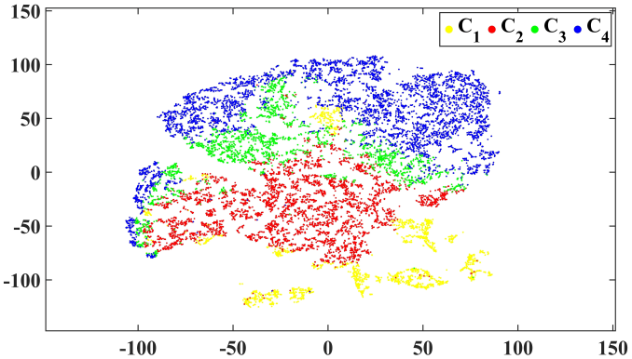
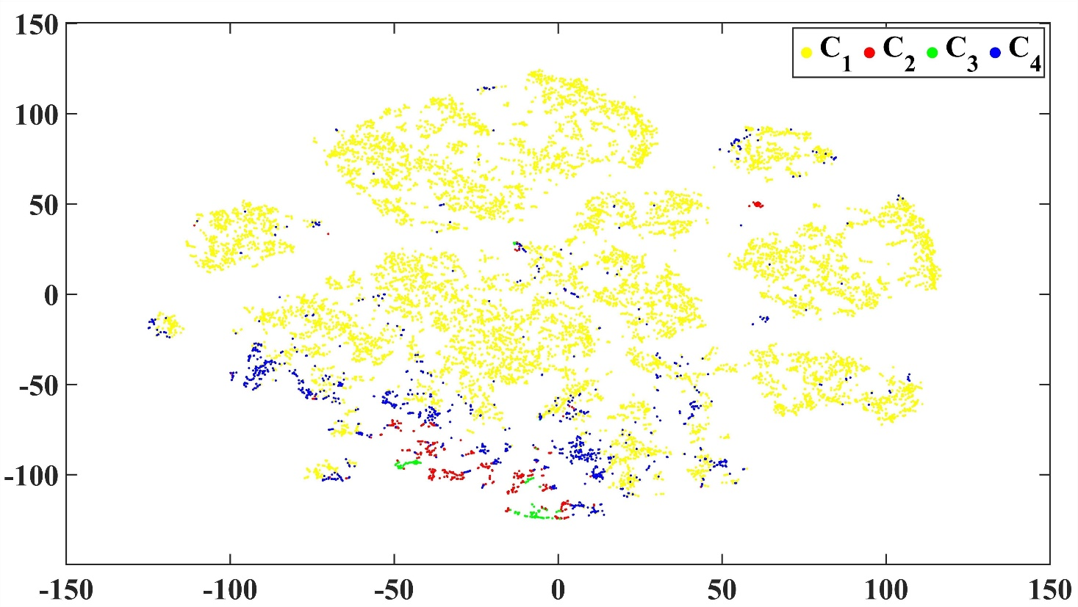
Numerical Results – 2-D Data Plot Using t-SNE
Plots confirm that Spectral clustering outperforms k-means.
Clusters are well-separated and distributed.
t-SNE plot of data using the Spectral clustering
t-SNE plot of data using the k-means
Notes:
We haven’t tested if the new outage is missing some features. How should we handle this issue? This will be a good topic to research.
Assigned 100 new outages to clusters, and the assignment accuracy is 91%.

Slide 21
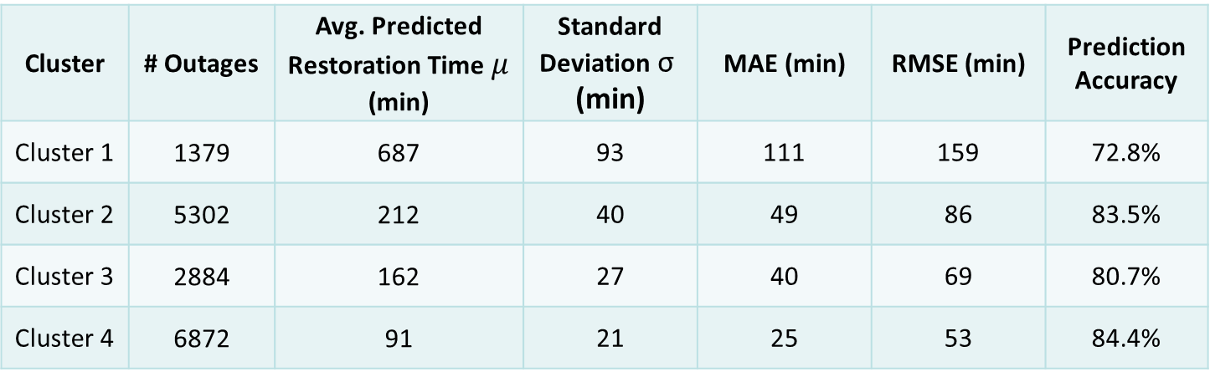
Numerical Results – Restoration Time Estimation
Cluster 4 is selected to train the first model. It shows the highest pair-wise similarity to other clusters. Then, we train Clusters in the order of 2, 3, and 1.
Use Mean Absolute Error (MAE), Root Mean Square Error (RMSE), and accuracy to evaluate model performance.
Cluster | # Outages | Avg. Predicted Restoration Time $μ$ (min) | Standard Deviation $\text{σ}\text{ (}\text{min}\text{)}$ | MAE (min) | RMSE (min) | Prediction Accuracy
Cluster 1 | 1379 | 687 | 93 | 111 | 159 | 72.8%
Cluster 2 | 5302 | 212 | 40 | 49 | 86 | 83.5%
Cluster 3 | 2884 | 162 | 27 | 40 | 69 | 80.7%
Cluster 4 | 6872 | 91 | 21 | 25 | 53 | 84.4%
Accuracy = the percentage of outages whose actual restoration time falls within the predicted uncertainty interval.
Notes:
The first model performs well because the size of the dataset is large, and the outage data are all small-scale. When applying transfer learning, the Accuracy seems to drop; however, you cannot direct compare accuracy between clusters because they represent different model with different sizes of outage, and the number of training samples in each cluster is different. To give an accuracy comparison, we need to test the accuracy without clustering and without transfer learning, which will be shown later.

Slide 22
Numerical Results - Comparison
Prediction of restoration time with and w/o transfer learning
Comparison between the clustered model and the single model
Notes:
Left figure: Cluster 4 is the first model; it is N/A to apply transfer learning.
Right figure: Although the accuracy for the single model is higher than that of cluster 1, it applies to all outage sizes. It may perform very poorly on extreme cases. After testing, for extreme cases, the MAE can be as large as 5 hours or more.

Slide 23
Impact of the Outage Data Features
Remove features from outage data to test the model performance change.
Results highlight the high influence of the outage cause, which is not usually available at the beginning of the outages.
Feature Category | Example Features | Impact on Accuracy | Avg. accuracy Δ for 4 models (%)
Outage Cause | Cause code | Very High | - 8.7 %
Weather Conditions | Wind speed, severe weather code | Moderate | - 4.7 %
Customer Metrics | Customers interrupted | Moderate / Low | - 1.8 %
Restoration Stress | Coinciding outages | Moderate | - 2.5 %

Slide 24
Two-Stage Evidence-Calibrated Outage Restoration Time Prediction Using Real Utility Data
Notes:
Our topic is ………

Slide 25
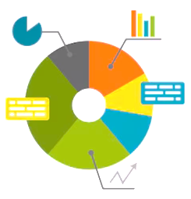

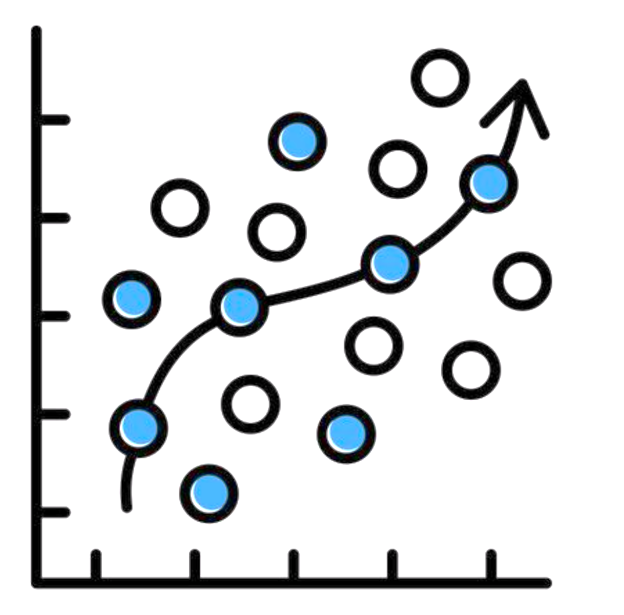


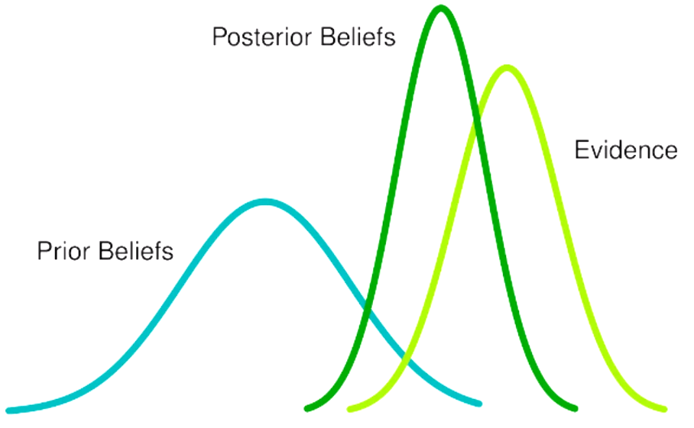


What if cause code not available?
Removing outage-cause drops accuracy by 8.7 %, so we use a two-stage model that stays reliable without it.
Stage-1
Prior Estimate
Customer Interrupted
Storm Severity
Day Type
$$\text{Q}\text{25 }\text{Q}\text{50} \text{Q}\text{75} \text{Q}\text{90}$$
Lower Bound
Input
Median Baseline
Outage Data
Upper-Mid Estimate
Upper Bound
LightGBM
Quantile Regression
Stage-2
Bayesian Update Phase
Posterior Estimate
Equipment Type
Primary Cause
Event Description
Clue / Location
Posterior
Beliefs
$$\begin{matrix}Q_{25}^{∗} \\ Q_{50}^{∗} \\ Q_{75}^{∗} \\ Q_{90}^{∗}\end{matrix}$$
Updated Lower Bound
Evidence-Based Refinement input 2
Updated Median Baseline
Evidence
Prior
Beliefs
Updated Upper-Mid Estimate
Crew Arrival
Updated Upper Bound

Slide 26
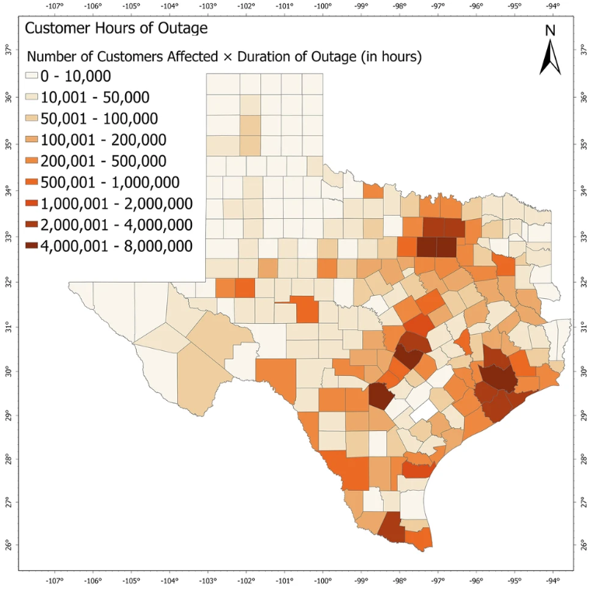
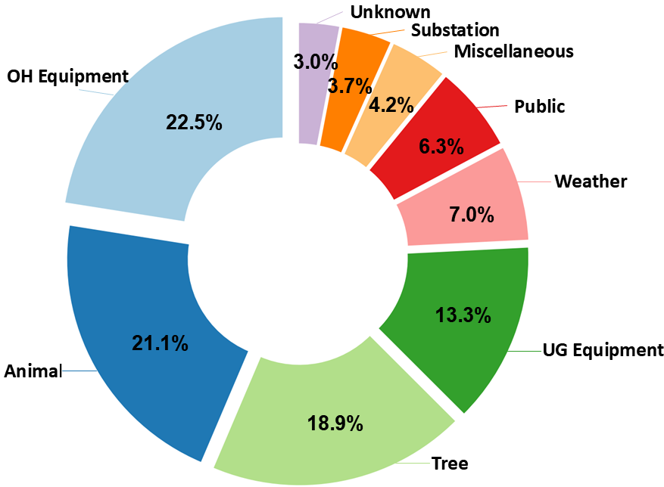
Dataset Overview
The study uses a real utility outage dataset containing approximately 168,000 outages between 2004 and 2024.
Distribution of Outage Causes
An example map from publicly available studies.
Fig: The customer hours of outage caused by Winter Storm Uri (2021). | Communications Earth & Environment
Notes:
“Due to data privacy, we cannot show our actual outage distribution, so we illustrate the concept using an example map from publicly available studies.

Slide 27
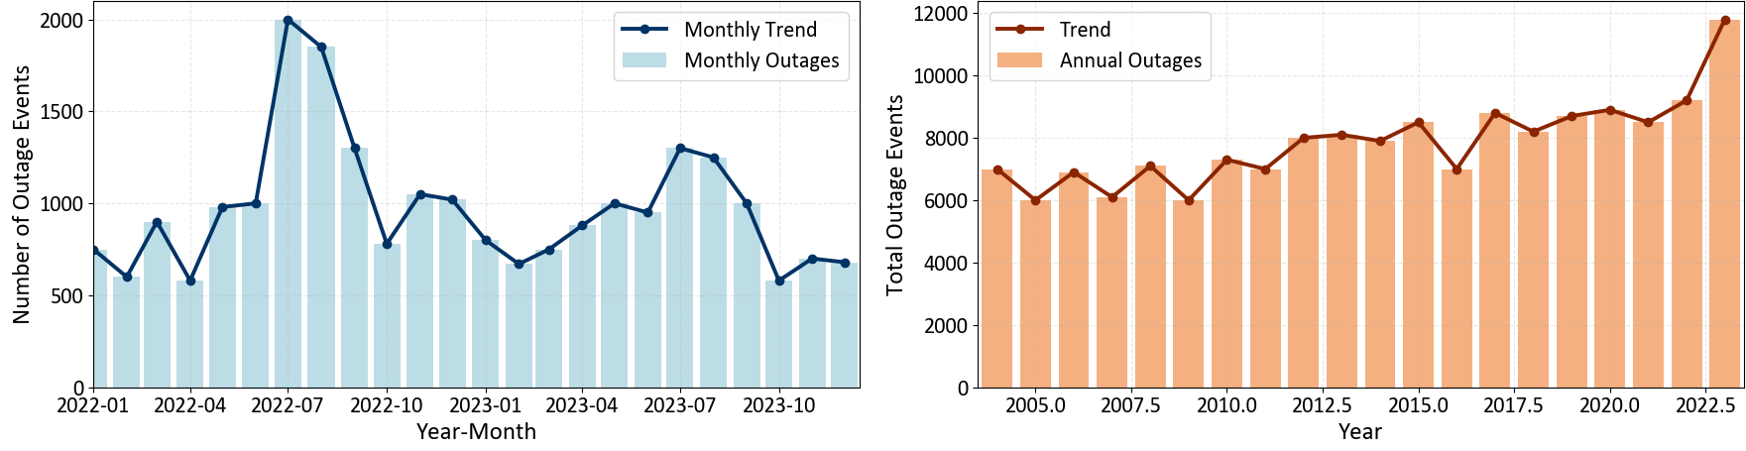
Dataset Overview
STRCTUR_NO | DNI_EQUIP_TYPE | CAUSE_DESC | OCCURN_DESC | CLUE_DESC | storm_ level | day_ type | CREATION_DATETIME | ENERGIZED_DATETIME | CI | time_to_restore | year
CBCB_224 | SSUB | WEATHER\LIGHTNING | LOCK OUT | NEIGHBORHOOD | 3 | MnED | 6/1/2004 22:04 | 6/1/2004 22:15 | 2913 | 11.07 | 2004
CBCB_569 | SSUB | ERROR OF PERSONNEL | LOST SOURCE | NEIGHBORHOOD | 0 | BLUESKY | 4/18/2006 8:59 | 4/18/2006 9:09 | 2794 | 10 | 2006
Monthly and Annual Trends of Outage Events in the Power Distribution System
Notes:
Dataset visualization with sample entries
Monthly and Annual Trends of Outage Events in the Power Distribution System

Slide 28
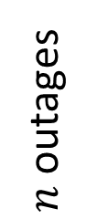
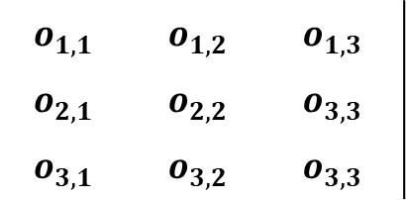
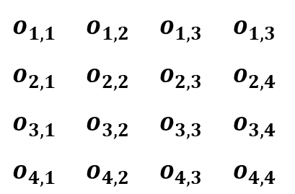


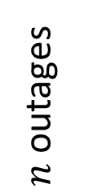
Structured Outage Feature Matrix
The outage data is represented by two matrices, $O^{\left(1\right)}$and $O^{\left(2\right)}$
3 features
$n$ outages
$$o_{1,1}$$ | $$o_{1,2}$$ | $$o_{1,3}$$
$$o_{2,1}$$ | $$o_{2,2}$$ | $$o_{3,3}$$
$$o_{3,1}$$ | $$o_{3,2}$$ | $$o_{3,3}$$
0. Customer Interrupted
1. Storm Level
2. Day Type
Stage 1
$$O^{\left(1\right)}$$
4 features
$$o_{1,1}$$ | $$o_{1,2}$$ | $$o_{1,3}$$ | $$o_{1,3}$$
$$o_{2,1}$$ | $$o_{2,2}$$ | $$o_{2,3}$$ | $$o_{2,4}$$
$$o_{3,1}$$ | $$o_{3,2}$$ | $$o_{3,3}$$ | $$o_{3,4}$$
$$o_{4,1}$$ | $$o_{4,2}$$ | $$o_{4,3}$$ | $$o_{4,4}$$
$n$ outages
0.Equipment Type
1. Primary Cause
2. Sub Cause
3. Crew Travel Time
Stage 2
$$O^{\left(2\right)}$$

Slide 29
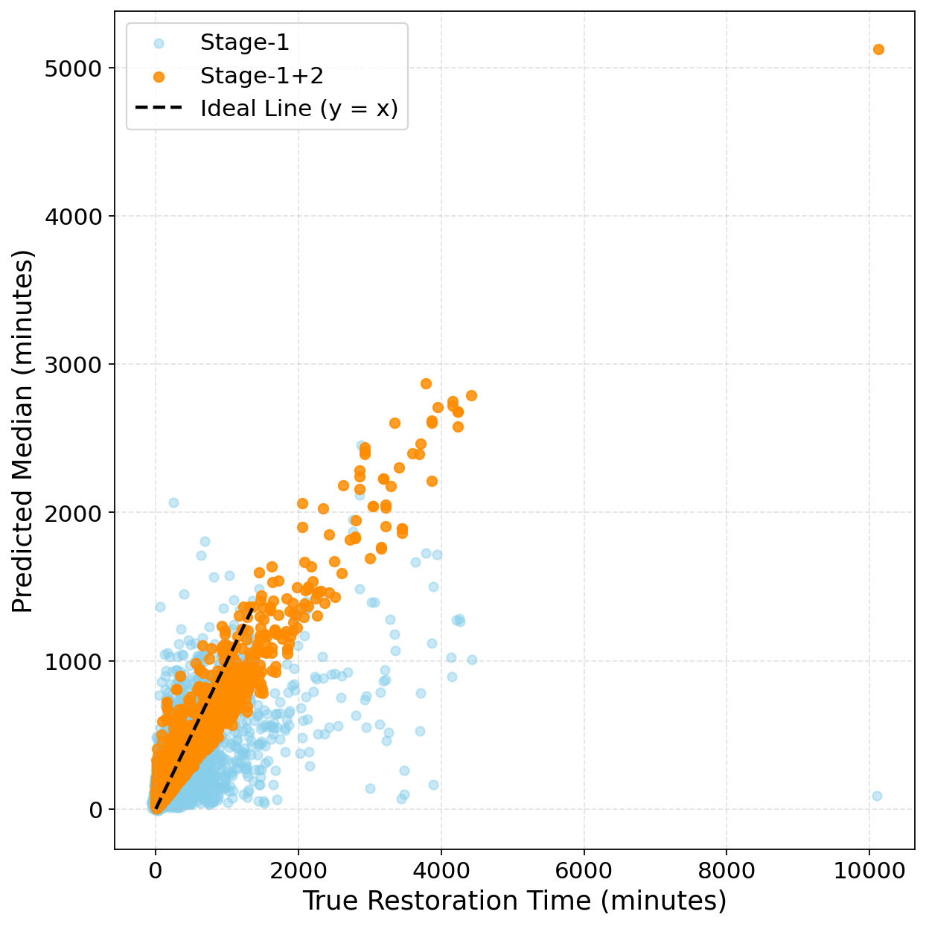
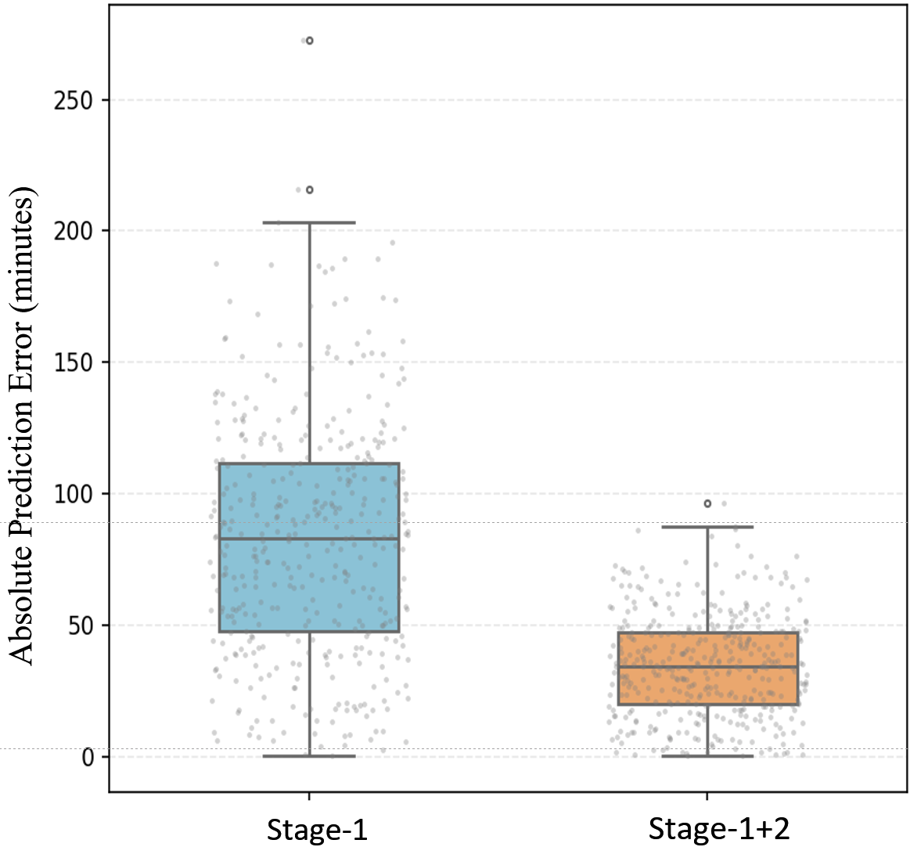
Evaluation Framework
Data are split 70% train, 15% validation, and 15% test.
Validation results closely match the test set, so only test metrics are shown.
Subset | MAE (min) | RMSE (min) | Accuracy
Stage 1 | 79.97 | 229.08 | 60.1%
Stage 1+2 | 30.80 | 78.01 | 86%
Accuracy = the percentage of outages whose actual restoration time falls within the predicted uncertainty interval

Slide 30
Conclusion and Future Works
Outage data clustering and transfer learning can increase the prediction accuracy of outage restoration time. Different sizes of outages have distinct characteristics.
Outage cause and weather information greatly impact the prediction accuracy of outage restoration time.
New models are needed to deal with issues of missing features while keeping prediction accuracy and computational efficiency.
Topology-aware features might be useful to improve prediction accuracy of large-scale outages in extreme events.

Slide 31
Reference
[1] Brelsford, C., Tennille, S., Myers, A. et al. A dataset of recorded electricity outages by United States county 2014–2022. Sci Data 11, 271 (2024).
[2] PG&E Electric reliability reports. https://www.pge.com/en/about/pge-systems/electric-systems/electric-reliability-reports.html
[3] A. Domijan Jr, R. Matavalam, A. Montenegro, W. Wilcox, Y. Joo, L. Delforn, J. Diaz, L. Davis, and J. Agostini, “Effects of norman weather conditions on interuptions in distribution systems,” International Journal of Power & Energy Systems, vol. 25, no. 1, pp. 54–61, 2005.
[4] P. Kankanala, A. Pahwa, and S. Das, “Estimation of overhead distribution system outages caused by wind and lightning using an artificial neural network,” in International Conference on Power System Operation & Planning, vol. 545, 2012.
[5] Nateghi, Roshanak et al. “Comparison and validation of statistical methods for predicting power outage durations in the event of hurricanes.” Risk analysis : an official publication of the Society for Risk Analysis vol. 31,12 (2011): 1897-906.
[6] H. Liu, R. A. Davidson, and T. V. Apanasovich, “Statistical forecasting of electric power restoration times in hurricanes and ice storms,” IEEE Trans. Power Syst., vol. 22, no. 4, pp. 2270–2279, 2007.
[7] Duffey, Romney B. "Power restoration prediction following extreme events and disasters." International Journal of Disaster Risk Science 10.1 (2019): 134-148.
[8] R. B. Duffey and T. Ha, "The Probability and Timing of Power System Restoration," in IEEE Transactions on Power Systems, vol. 28, no. 1, pp. 3-9, Feb. 2013.
[9] D. Wang, Y. Yuan, R. Cheng and Z. Wang, "Data-Driven Outage Restoration Time Prediction via Transfer Learning With Cluster Ensembles," in IEEE Transactions on Power Systems, vol. 39, no. 1, pp. 83-96, Jan. 2024
[10] Ratnasingam S, Muñoz-Lopez J. Distance Correlation-Based Feature Selection in Random Forest. Entropy. 2023; 25(9):1250.

Slide 32
Thank You!
Q&A
https://wzy.ece.iastate.edu

Slide 33
Backup Slides

Slide 34
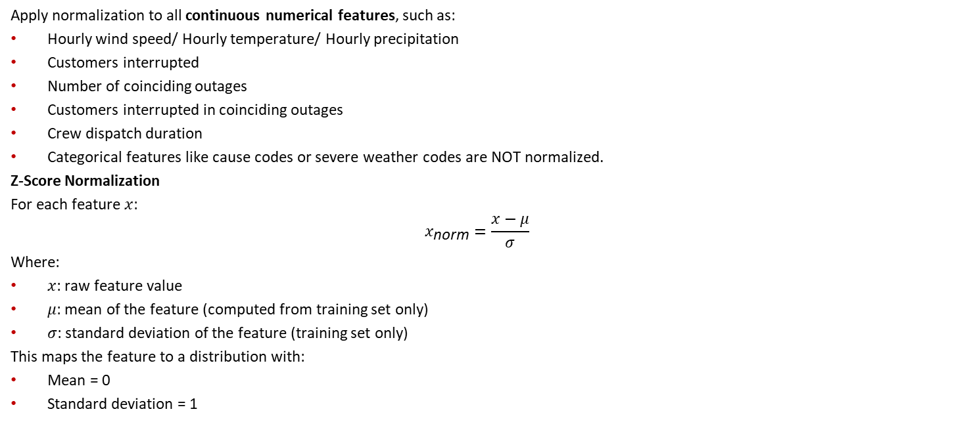
Data Normalization
Apply normalization to all continuous numerical features, such as:
Hourly wind speed/ Hourly temperature/ Hourly precipitation
Customers interrupted
Number of coinciding outages
Customers interrupted in coinciding outages
Crew dispatch duration
Categorical features like cause codes or severe weather codes are NOT normalized.
Z-Score Normalization
For each feature $x$:
$$x_{\text{norm}}=\frac{x−μ}{σ}$$
Where:
$x$: raw feature value
$μ$: mean of the feature (computed from training set only)
$σ$: standard deviation of the feature (training set only)
This maps the feature to a distribution with:
Mean = 0
Standard deviation = 1
Notes:
Even if the cause is represented as:1 = tree 2 = equipment failure 3 = animal 4 = lightning 5 = planned maintenance…The numbers do not represent numeric magnitude or order. Meaning: Code 4 is NOT “twice as much” as code 2. Code 1 < 3 < 5 has no physical meaning. The spacing between codes is arbitrary. Normalization assumes numeric meaning, which causes codes NOT to have.
Normalizing categorical codes creates false relationships. Example after normalization: lightning gets a Z-score of +1.2, and the animal gets -0.4. The ANN may incorrectly assume that “lightning is more intense” or “closer to” some numerical boundary, this is misleading because the numbers are artificial.

Slide 35
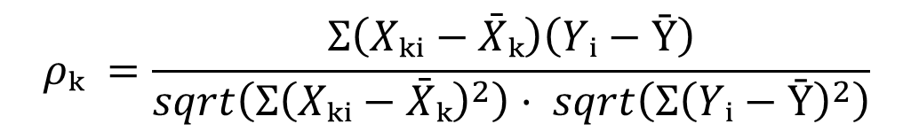
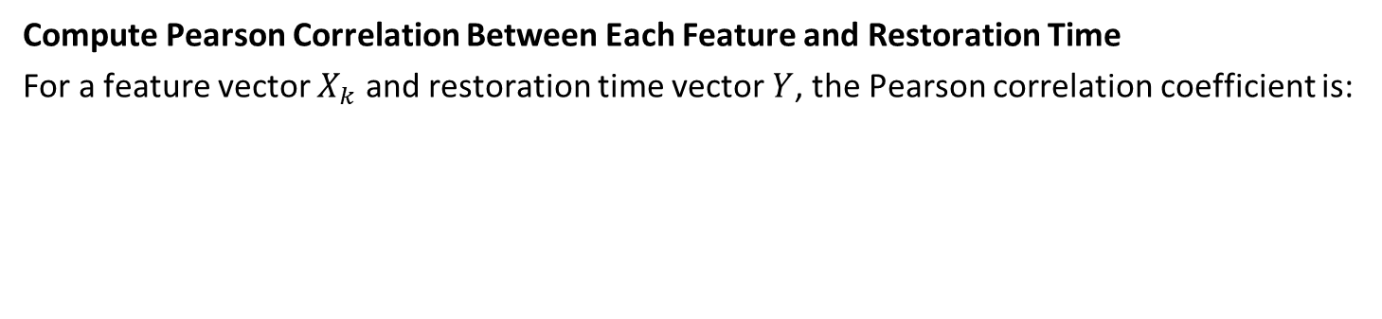
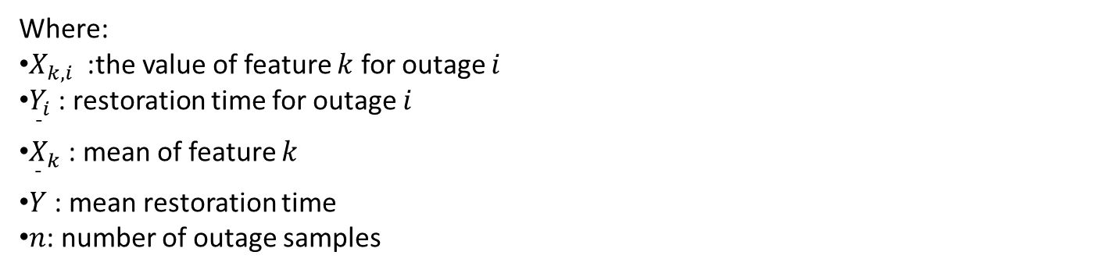
Adding Features - Feature Selection
Compute Pearson Correlation Between Each Feature and Restoration Time
For a feature vector $X_{k}$ and restoration time vector $Y$, the Pearson correlation coefficient is:
$$ρₖ =\frac{Σ\left(Xₖᵢ−\bar{X}ₖ\right)\left(Yᵢ−Ȳ\right)}{sqrt\left(Σ{\left(Xₖᵢ−\bar{X}ₖ\right)}^{2}\right)· sqrt\left(Σ{\left(Yᵢ−Ȳ\right)}^{2}\right)}$$
Where:
$X_{k,i}$ : the value of feature $k$ for outage $i$
$Y_{i}$: restoration time for outage $i$
${\overset{ˉ}{X}}_{k}$: mean of feature $k$
$\overset{ˉ}{Y}$: mean restoration time
$n$: number of outage samples

Slide 36
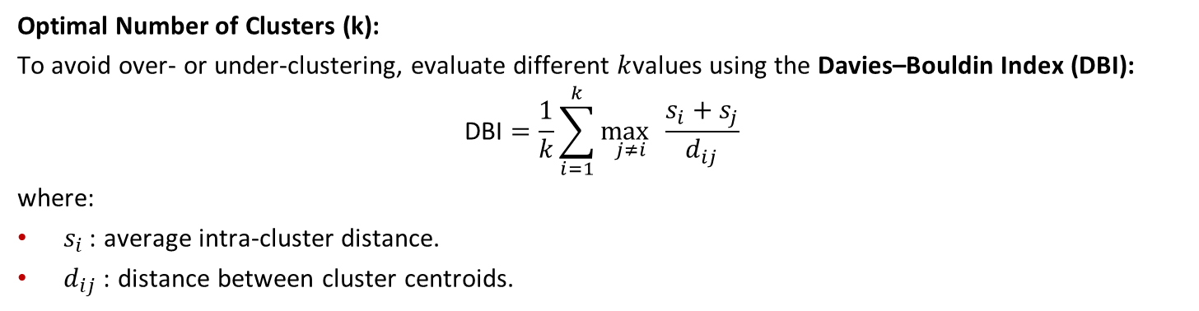
Spectral Clustering - DBI
Optimal Number of Clusters (k):
To avoid over- or under-clustering, evaluate different $k$values using the Davies–Bouldin Index (DBI):
$$\text{DBI}=\frac{1}{k}\sum_{i=1}^{k}{\underset{j≠i}{\max{ }}}\frac{s_{i}+s_{j}}{d_{ij}}$$
where:
$s_{i}$: average intra-cluster distance.
$d_{ij}$: distance between cluster centroids.

Slide 37
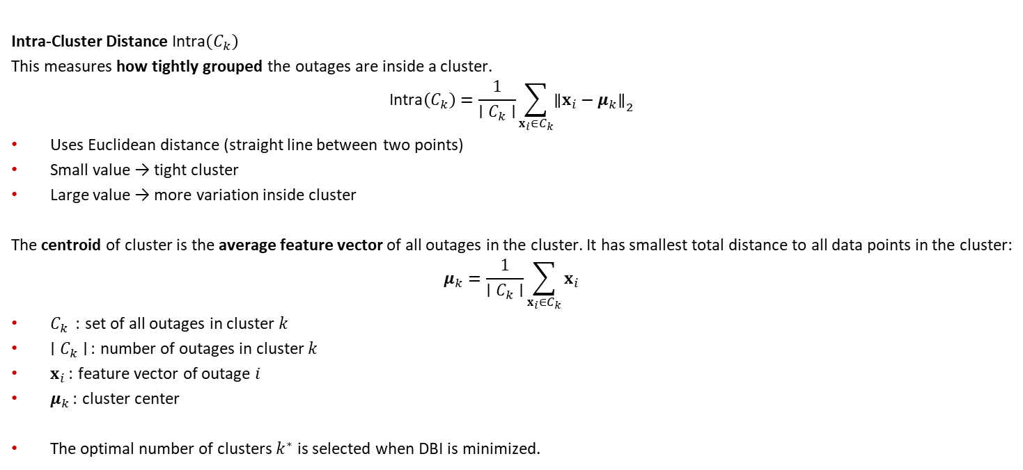
Spectral Clustering - DBI
Intra-Cluster Distance $\text{Intra}\left(C_{k}\right)$
This measures how tightly grouped the outages are inside a cluster.
$$\text{Intra}\left(C_{k}\right)=\frac{1}{∣C_{k}∣}\sum_{x_{i}∈C_{k}}{{∥x_{i}−μ_{k}∥}_{2}}$$
Uses Euclidean distance (straight line between two points)
Small value → tight cluster
Large value → more variation inside cluster
The centroid of cluster is the average feature vector of all outages in the cluster. It has smallest total distance to all data points in the cluster:
$$μ_{k}=\frac{1}{∣C_{k}∣}\sum_{x_{i}∈C_{k}}{x_{i}}$$
$C_{k}$ : set of all outages in cluster $k$
$∣C_{k}∣$: number of outages in cluster $k$
$x_{i}$: feature vector of outage $i$
$μ_{k}$: cluster center
The optimal number of clusters $k^{∗}$ is selected when DBI is minimized.

Slide 38
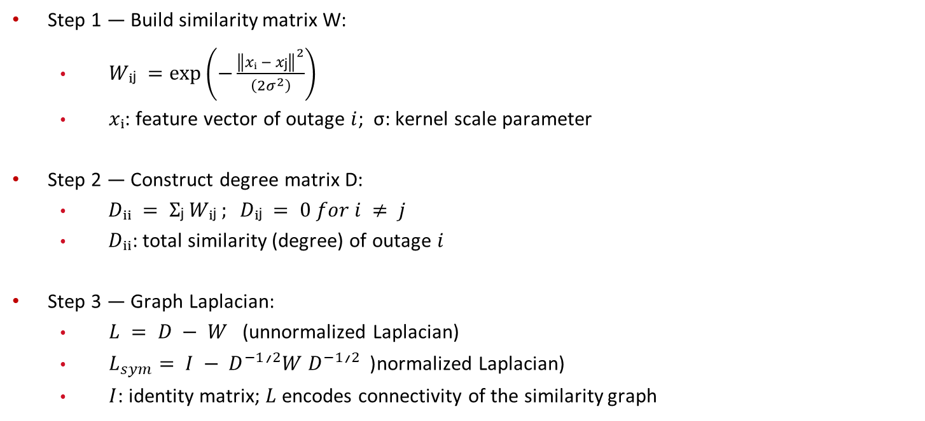
Spectral Clustering
Step 1 — Build similarity matrix W:
  $Wᵢⱼ =\exp\left(−\frac{{\left\|xᵢ − xⱼ\right\|}^{2}}{\left(2σ^{2}\right)}\right)$
  $xᵢ$: feature vector of outage $i$; σ: kernel scale parameter
Step 2 — Construct degree matrix D:
  $Dᵢᵢ = Σⱼ Wᵢⱼ ; Dᵢⱼ = 0 for i ≠ j$
  $Dᵢᵢ$: total similarity (degree) of outage $i$
Step 3 — Graph Laplacian:
  $L = D − W$(unnormalized Laplacian)
  $L_{sym}= I − D^{−1}ᐟ^{2}W D^{−1}ᐟ^{2}$(normalized Laplacian)
  $I$: identity matrix; $L$ encodes connectivity of the similarity graph

Slide 39
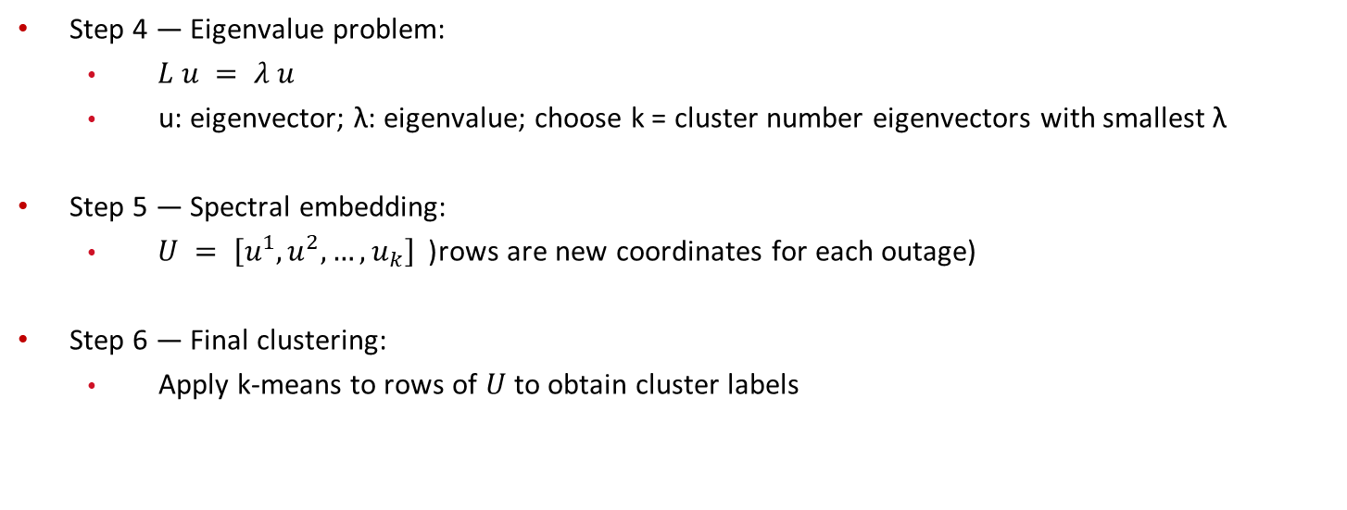
Spectral Clustering
Step 4 — Eigenvalue problem:
  $L u = λ u$
  u: eigenvector; λ: eigenvalue; choose k = cluster number eigenvectors with smallest λ
Step 5 — Spectral embedding:
  $U = \left[u^{1}, u^{2}, …, u_{k}\right]$(rows are new coordinates for each outage)
Step 6 — Final clustering:
  Apply k-means to rows of $U$to obtain cluster labels

Slide 40
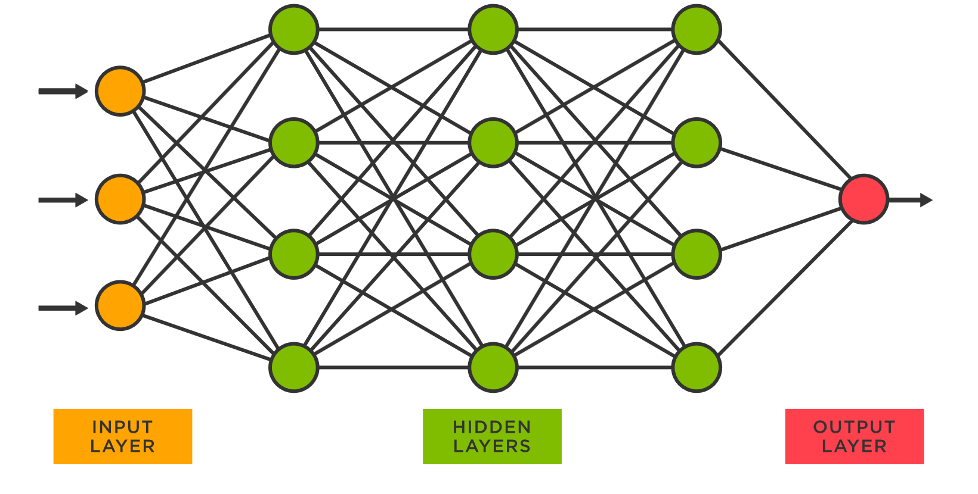
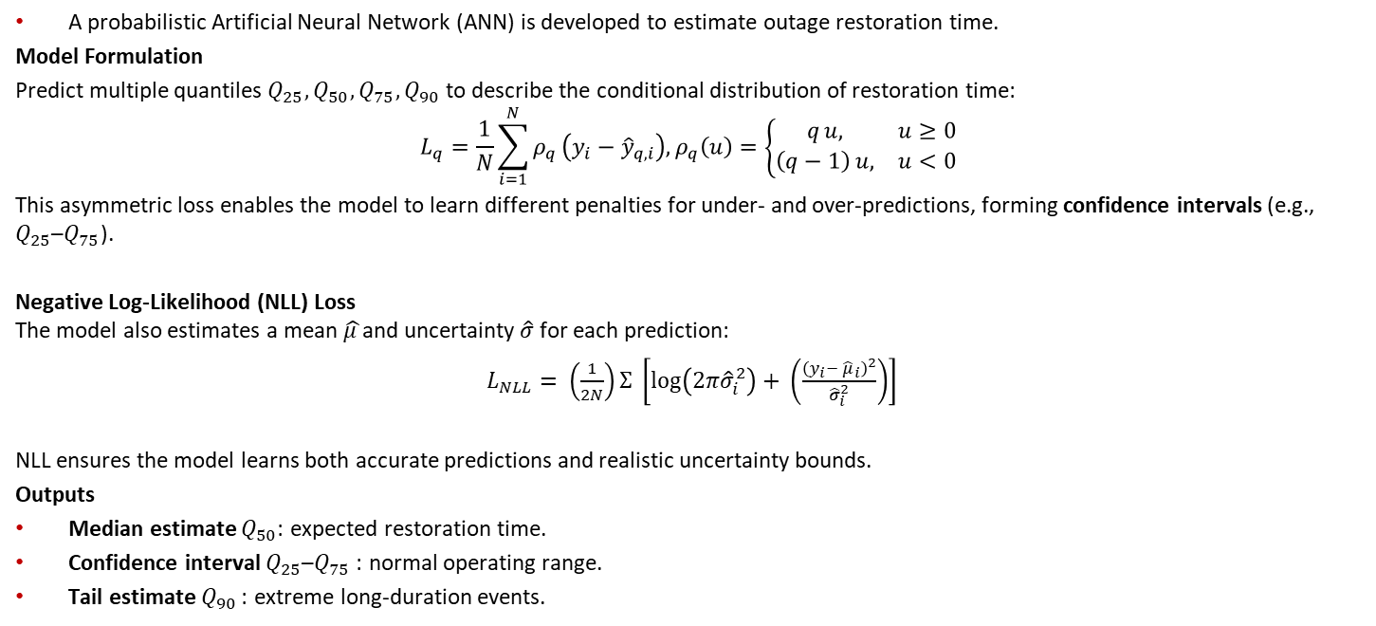
Artificial Neural Network
A probabilistic Artificial Neural Network (ANN) is developed to estimate outage restoration time.
Model Formulation
Predict multiple quantiles $Q_{25},Q_{50},Q_{75},Q_{90}$ to describe the conditional distribution of restoration time:
$$L_{q}=\frac{1}{N}\sum_{i=1}^{N}{ρ_{q}}\left(y_{i}−{\hat{y}}_{q,i}\right), ρ_{q}\left(u\right)=\left\{\begin{matrix}q u, & u≥0 \\ \left(q−1\right) u, & u<0\end{matrix}\right.$$
This asymmetric loss enables the model to learn different penalties for under- and over-predictions, forming confidence intervals (e.g., $Q_{25}$–$Q_{75}$).
Negative Log-Likelihood (NLL) Loss
The model also estimates a mean $\hat{μ }$and uncertainty $\hat{σ}$ for each prediction:
$L_{NLL}= \left(\frac{1}{2N}\right)Σ \left[\log\left(2π{\hat{σ}}_{i}^{2}\right)+ \left(\frac{{\left(y_{i}− {\hat{μ}}_{i}\right)}^{2}}{{\hat{σ}}_{i}^{2}}\right)\right]$
NLL ensures the model learns both accurate predictions and realistic uncertainty bounds.
Outputs
Median estimate $Q_{50}$: expected restoration time.
Confidence interval $Q_{25}$–$Q_{75}$: normal operating range.
Tail estimate $Q_{90}$: extreme long-duration events.
Notes:
ReLU forward pass
80% prediction interval:
PI = [ μ − 1.28σ , μ + 1.28σ ]

Slide 41
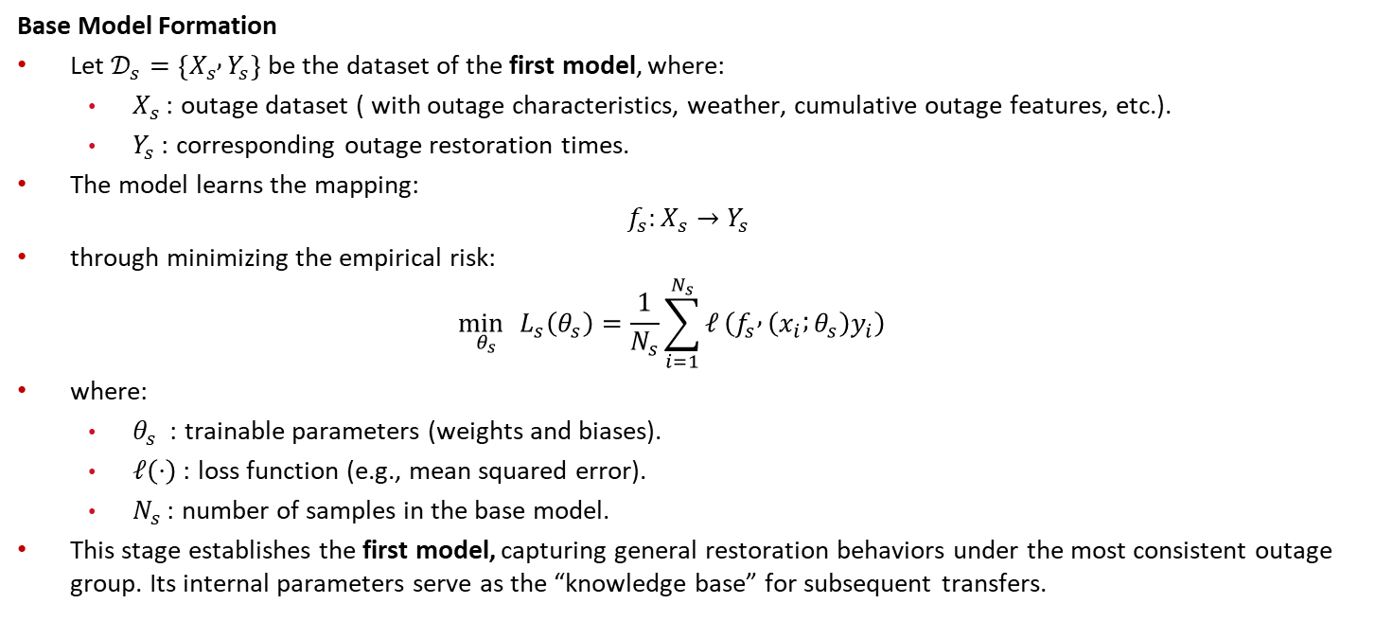
Transfer Learning
Base Model Formation
Let $𝒟_{s}=\left\{X_{s} , Y_{s}\right\}$ be the dataset of the first model, where:
  $X_{s}$: outage dataset ( with outage characteristics, weather, cumulative outage features, etc.).
  $Y_{s}$: corresponding outage restoration times.
The model learns the mapping:
$$f_{s}:X_{s}→Y_{s}$$
through minimizing the empirical risk:
$$\begin{matrix} & \underset{θ_{s}}{\min{ }}L_{s}\left(θ_{s}\right)=\frac{1}{N_{s}}\sum_{i=1}^{N_{s}}{ℓ}\left(f_{s} , \left(x_{i} ; θ_{s}\right)y_{i}\right) & & \end{matrix}$$
where:
  $θ_{s}$ : trainable parameters (weights and biases).
  $ℓ\left(⋅\right)$: loss function (e.g., mean squared error).
  $N_{s}$: number of samples in the base model.
This stage establishes the first model, capturing general restoration behaviors under the most consistent outage group. Its internal parameters serve as the “knowledge base” for subsequent transfers.

Slide 42
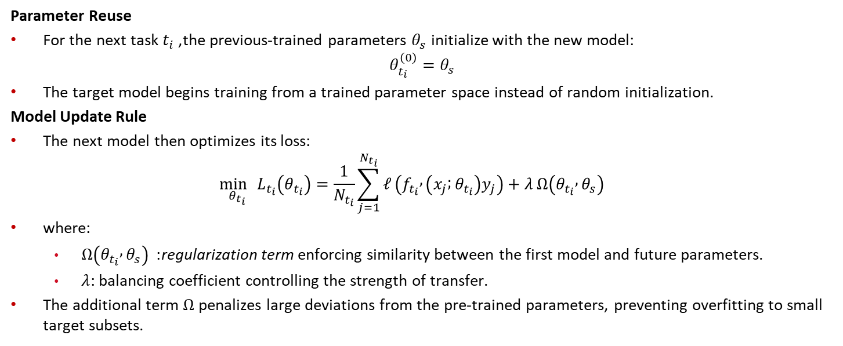
Transfer Learning
Parameter Reuse
For the next task $t_{i}$, the previous-trained parameters $θ_{s}$ initialize with the new model:
$$θ_{t_{i}}^{\left(0\right)}=θ_{s}$$
The target model begins training from a trained parameter space instead of random initialization.
Model Update Rule
The next model then optimizes its loss:
$$\begin{matrix} & \underset{θ_{t_{i}}}{\min{ }}L_{t_{i}}\left(θ_{t_{i}}\right)=\frac{1}{N_{t_{i}}}\sum_{j=1}^{N_{t_{i}}}{ℓ}\left(f_{t_{i}} , \left(x_{j} ; θ_{t_{i}}\right)y_{j}\right)+λ Ω\left(θ_{t_{i}} , θ_{s}\right) & & \end{matrix}$$
where:
  $Ω\left(θ_{t_{i}} , θ_{s}\right)$ : regularization term enforcing similarity between the first model and future parameters.
  $λ$: balancing coefficient controlling the strength of transfer.
The additional term $Ω$ penalizes large deviations from the pre-trained parameters, preventing overfitting to small target subsets.

Slide 43
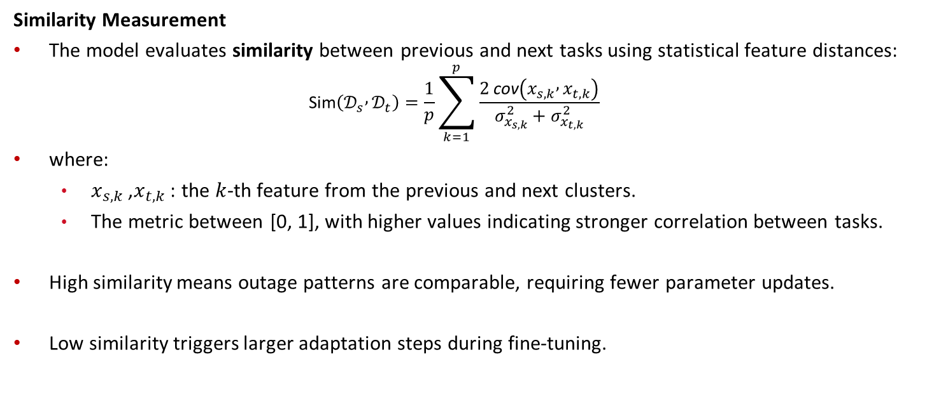
Transfer Learning
Similarity Measurement
The model evaluates similarity between previous and next tasks using statistical feature distances:
$$\begin{matrix} & \text{Sim}\left(𝒟_{s} , 𝒟_{t}\right)=\frac{1}{p}\sum_{k=1}^{p}{\frac{2 \text{cov}\left(x_{s,k} , x_{t,k}\right)}{σ_{x_{s,k}}^{2}+σ_{x_{t,k}}^{2}}} & & \end{matrix}$$
where:
  $x_{s,k}$, $x_{t,k}$: the $k$-th feature from the previous and next clusters.
  The metric between [0, 1], with higher values indicating stronger correlation between tasks.
High similarity means outage patterns are comparable, requiring fewer parameter updates.
Low similarity triggers larger adaptation steps during fine-tuning.

Slide 44
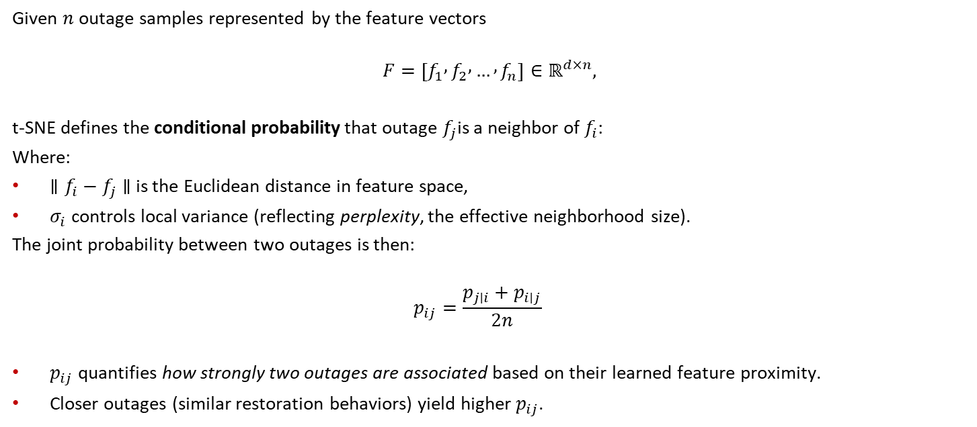
t-distributed Stochastic Neighbor Embedding - Algorithm
Given $n$outage samples represented by the feature vectors
$$F=\left[f_{1} , f_{2} , … , f_{n}\right]∈ℝ^{d×n},$$
t-SNE defines the conditional probability that outage $f_{j}$is a neighbor of $f_{i}$:
Where:
$∥f_{i}−f_{j}∥$ is the Euclidean distance in feature space,
$σ_{i}$ controls local variance (reflecting perplexity, the effective neighborhood size).
The joint probability between two outages is then:
$$\begin{matrix} & p_{ij}=\frac{p_{j∣i}+p_{i∣j}}{2n} & & \end{matrix}$$
$p_{ij}$ quantifies how strongly two outages are associated based on their learned feature proximity.
Closer outages (similar restoration behaviors) yield higher $p_{ij}$.

Slide 45
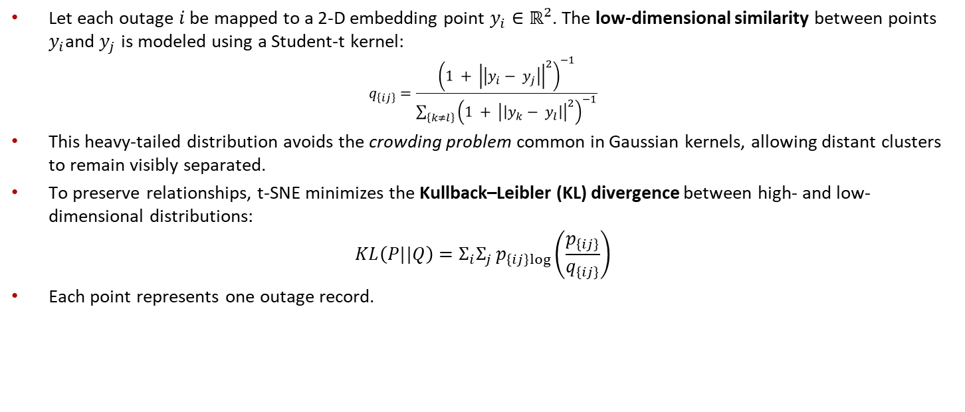
t-distributed Stochastic Neighbor Embedding - - Algorithm
Let each outage $i$ be mapped to a 2-D embedding point $y_{i}∈ℝ^{2}$. The low-dimensional similarity between points $y_{i}$and $y_{j}$ is modeled using a Student-t kernel:
$$q_{\left\{ij\right\}}=\frac{{\left(1 + {\left|\left|y_{i}− y_{j}\right|\right|}^{2}\right)}^{−1}}{{\sum_{\left\{k≠l\right\}}{\left(1 + {\left|\left|y_{k}− y_{l}\right|\right|}^{2}\right)}}^{−1}}$$
This heavy-tailed distribution avoids the crowding problem common in Gaussian kernels, allowing distant clusters to remain visibly separated.
To preserve relationships, t-SNE minimizes the Kullback–Leibler (KL) divergence between high- and low-dimensional distributions:
$$KL\left(P||Q\right)=Σ_{i}Σ_{j}p_{\left\{ij\right\}log}\left(\frac{p_{\left\{ij\right\}}}{q_{\left\{ij\right\}}}\right)$$
Each point represents one outage record.

Slide 46
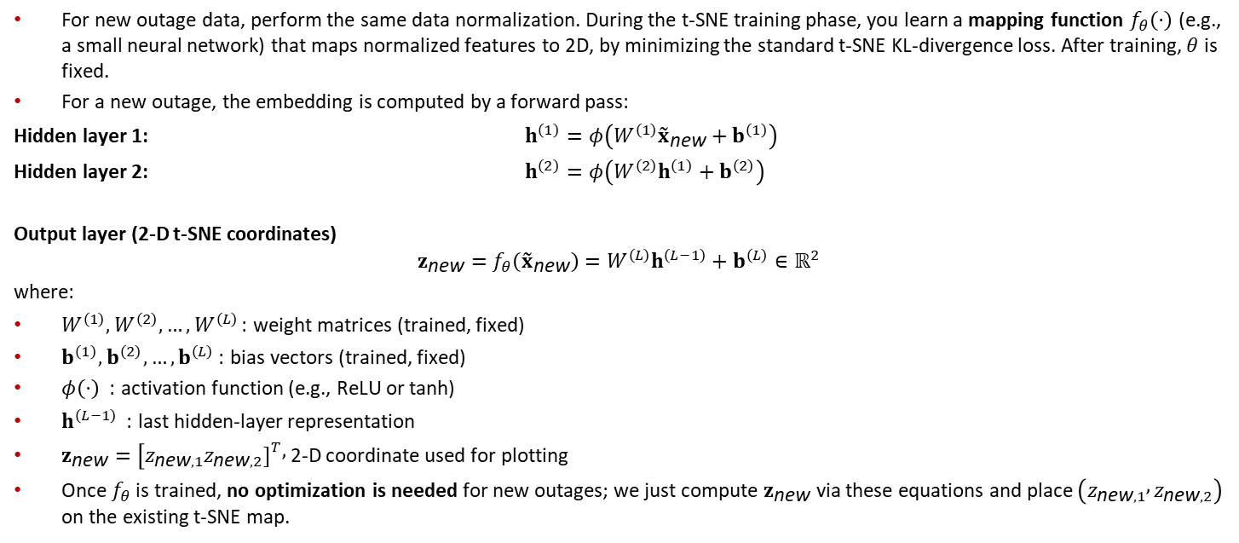
t-distributed Stochastic Neighbor Embedding – New Outages
For new outage data, perform the same data normalization. During the t-SNE training phase, you learn a mapping function $f_{θ}\left(⋅\right)$ (e.g., a small neural network) that maps normalized features to 2D, by minimizing the standard t-SNE KL-divergence loss. After training, $θ$ is fixed.
For a new outage, the embedding is computed by a forward pass:
Hidden layer 1: $h^{\left(1\right)}=φ\left(W^{\left(1\right)}{\tilde{x}}_{\text{new}}+b^{\left(1\right)}\right)$
Hidden layer 2: $h^{\left(2\right)}=φ\left(W^{\left(2\right)}h^{\left(1\right)}+b^{\left(2\right)}\right)$
Output layer (2-D t-SNE coordinates)
$$z_{\text{new}}=f_{θ}\left({\tilde{x}}_{\text{new}}\right)=W^{\left(L\right)}h^{\left(L−1\right)}+b^{\left(L\right)}∈ℝ^{2}$$
where:
$W^{\left(1\right)},W^{\left(2\right)},…,W^{\left(L\right)}$: weight matrices (trained, fixed)
$b^{\left(1\right)},b^{\left(2\right)},…,b^{\left(L\right)}$: bias vectors (trained, fixed)
$φ\left(⋅\right)$ : activation function (e.g., ReLU or tanh)
$h^{\left(L−1\right)}$ : last hidden-layer representation
$z_{\text{new}}=[z_{\text{new},1}z_{\text{new},2}{\left.]\right.}^{T},$ 2-D coordinate used for plotting
Once $f_{θ}$ is trained, no optimization is needed for new outages; we just compute $z_{\text{new}}$ via these equations and place $\left(z_{\text{new},1} , z_{\text{new},2}\right)$ on the existing t-SNE map.
Notes:
To plot a new outage into the existing t-SNE map, the outage feature vector is first normalized using the same method for training data. The normalized vector is then passed through the trained t-SNE mapping function $f_{θ}\left(⋅\right)$, which outputs a 2-dimensional coordinate that can be plotted directly on the existing t-SNE visualization. The new outage is finally assigned to the cluster whose t-SNE centroid is closest to this embedded point.

Slide 47
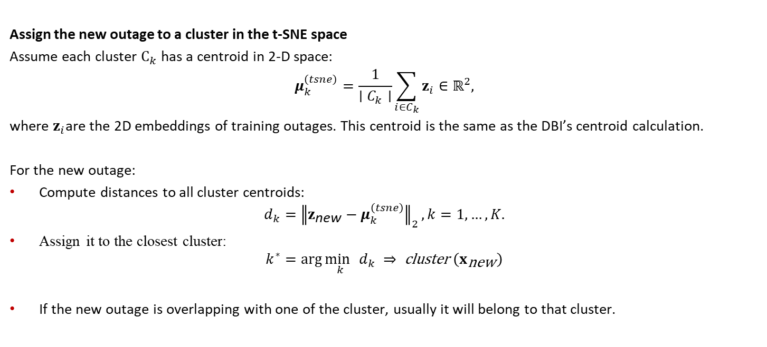
t-distributed Stochastic Neighbor Embedding – New Outages
Assign the new outage to a cluster in the t-SNE space
Assume each cluster $C_{k}$ has a centroid in 2-D space:
$$μ_{k}^{\left(tsne\right)}=\frac{1}{∣C_{k}∣}\sum_{i∈C_{k}}{z_{i}}∈ℝ^{2},$$
where $z_{i}$are the 2D embeddings of training outages. This centroid is the same as the DBI’s centroid calculation.
For the new outage:
Compute distances to all cluster centroids:
$$d_{k}={∥z_{\text{new}}−μ_{k}^{\left(tsne\right)}∥}_{2}, k=1,…,K.$$
Assign it to the closest cluster:
$$k^{∗}=\arg{\underset{k}{\min{ }}}d_{k} ⇒ \text{cluster} \left(x_{\text{new}}\right)$$
If the new outage is overlapping with one of the cluster, usually it will belong to that cluster.

Slide 48
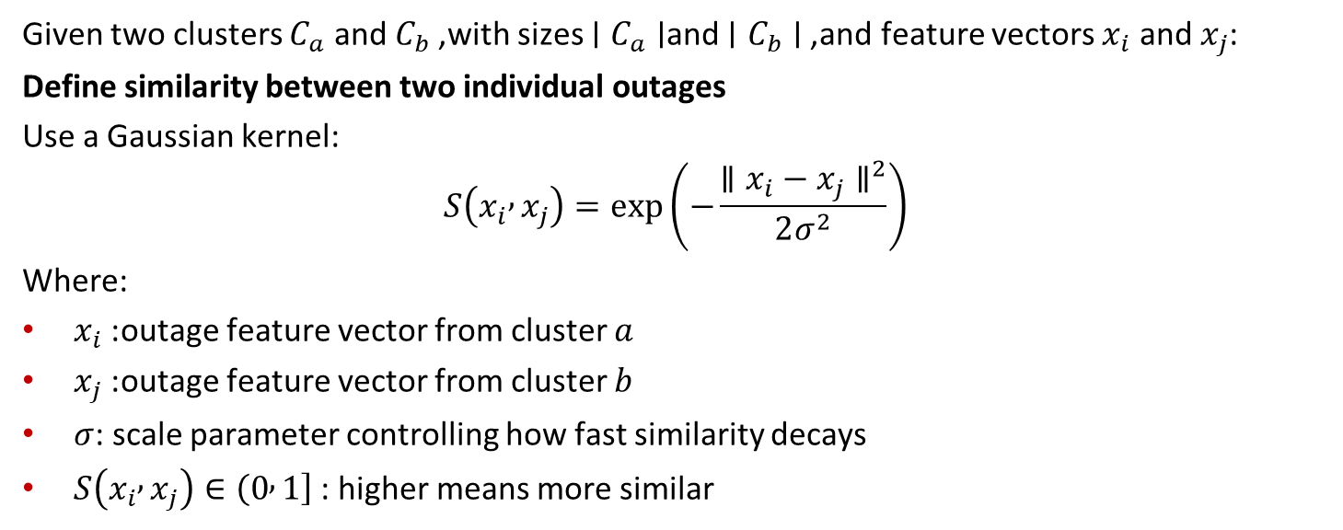
Cluster Similarity Matrix
Given two clusters $C_{a}$ and $C_{b}$, with sizes $∣C_{a}∣$and $∣C_{b}∣$, and feature vectors $x_{i}$ and $x_{j}$:
Define similarity between two individual outages
Use a Gaussian kernel:
$$S\left(x_{i} , x_{j}\right)=\exp\left(−\frac{∥x_{i}−x_{j}∥^{2}}{2σ^{2}}\right)$$
Where:
$x_{i}$: outage feature vector from cluster $a$
$x_{j}$: outage feature vector from cluster $b$
$σ$: scale parameter controlling how fast similarity decays
$S\left(x_{i} , x_{j}\right)∈\left(0 , 1\right]$: higher means more similar

Slide 49
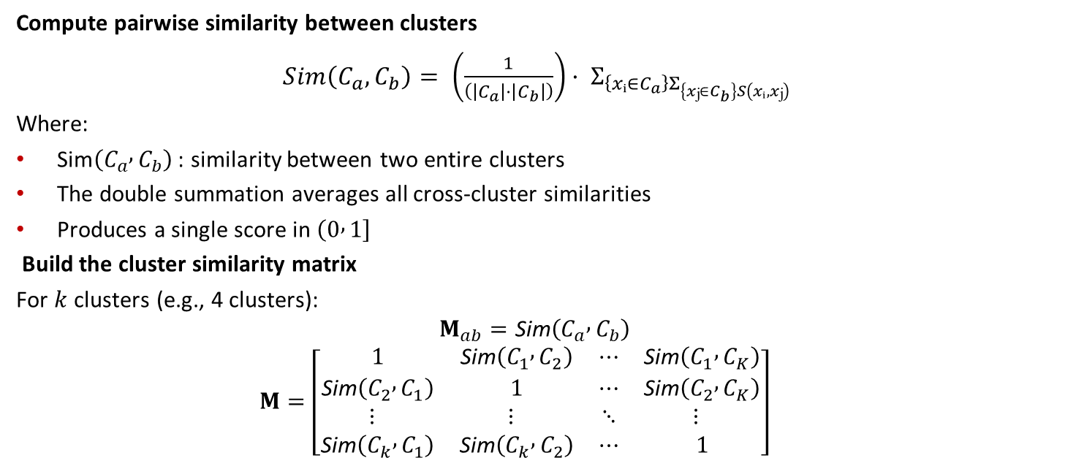
Cluster Similarity Matrix
Compute pairwise similarity between clusters
$Sim\left(C_{a}, C_{b}\right)= \left(\frac{1}{\left(\left|C_{a}\right|·\left|C_{b}\right|\right)}\right)· Σ_{\left\{xᵢ∈C_{a}\right\}Σ_{\left\{xⱼ∈C_{b}\right\}S\left(xᵢ, xⱼ\right)}}$
Where:
$\text{Sim}\left(C_{a} , C_{b}\right)$: similarity between two entire clusters
The double summation averages all cross-cluster similarities
Produces a single score in $\left(0 , 1\right]$
Build the cluster similarity matrix
For $k$clusters (e.g., 4 clusters):
$$M_{ab}=\text{Sim}\left(C_{a} , C_{b}\right)$$
$$M=\left[\begin{matrix}1 & \text{Sim}\left(C_{1} , C_{2}\right) & ⋯ & \text{Sim}\left(C_{1} , C_{K}\right) \\ \text{Sim}\left(C_{2} , C_{1}\right) & 1 & ⋯ & \text{Sim}\left(C_{2} , C_{K}\right) \\ ⋮ & ⋮ & ⋱ & ⋮ \\ \text{Sim}\left(C_{k} , C_{1}\right) & \text{Sim}\left(C_{k} , C_{2}\right) & ⋯ & 1\end{matrix}\right]$$

Slide 50
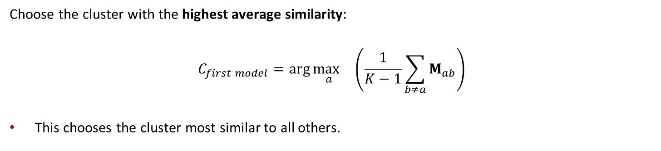
Cluster Similarity Matrix
Choose the cluster with the highest average similarity:
$$C_{first model}=\arg{\underset{a}{\max{ }}} \left(\frac{1}{K−1}\sum_{b≠a}{M_{ab}}\right)$$
This chooses the cluster most similar to all others.

Slide 51
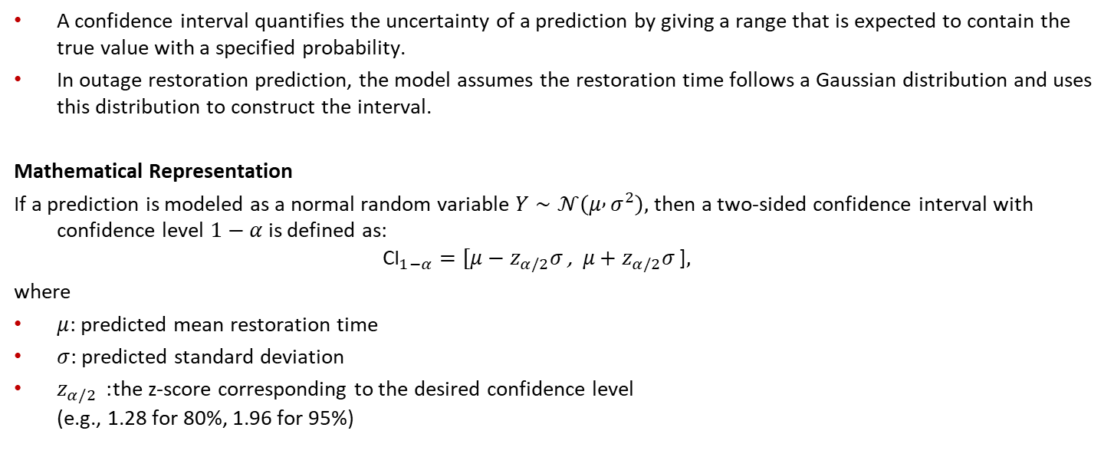
Confidence Interval
A confidence interval quantifies the uncertainty of a prediction by giving a range that is expected to contain the true value with a specified probability.
In outage restoration prediction, the model assumes the restoration time follows a Gaussian distribution and uses this distribution to construct the interval.
Mathematical Representation
If a prediction is modeled as a normal random variable $Y∼𝒩\left(μ , σ^{2}\right),$ then a two-sided confidence interval with confidence level $1−α$is defined as:
$${\text{CI}}_{1−α}=[μ−z_{α/2}σ\text{ , } μ+z_{α/2}σ \text{]},$$
where
$μ$: predicted mean restoration time
$σ$: predicted standard deviation
$z_{α/2}$ : the z-score corresponding to the desired confidence level
(e.g., 1.28 for 80%, 1.96 for 95%)

Slide 52
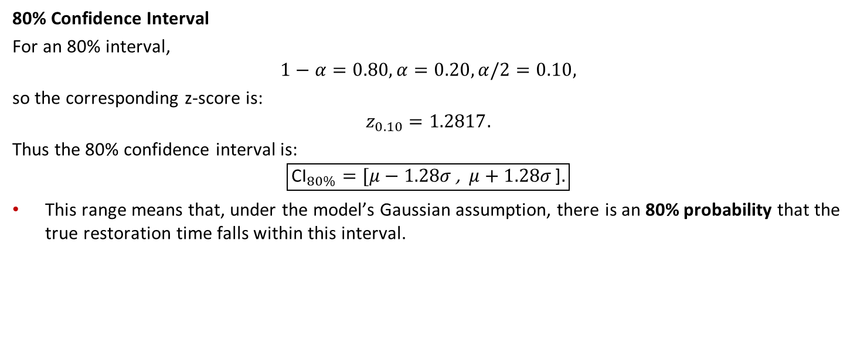
Confidence Interval
80% Confidence Interval
For an 80% interval,
$$1−α=0.80, α=0.20, α/2=0.10,$$
so the corresponding z-score is:
$$z_{0.10}=1.2817.$$
Thus the 80% confidence interval is:
$$\boxed{{\text{CI}}_{80\%}=[μ−1.28σ \text{,} μ+1.28σ \text{]}.}$$
This range means that, under the model’s Gaussian assumption, there is an 80% probability that the true restoration time falls within this interval.

Slide 53
Numerical Results – Similarity Matrix
Similarity matrix used for selecting the first model and the transfer learning order. The similarity index (ranging from 0-1) among different clusters is calculated by a cross-validation principle with an unsupervised process.
Similarity Index (%) | Cluster 1 | Cluster 2 | Cluster 3 | Cluster 4
Cluster 1 | - | 17.7 | 18.6 | 26.2
Cluster 2 | 17.7 | - | 49.8 | 58.7
Cluster 3 | 18.6 | 49.8 | - | 52.3
Cluster 4 | 26.2 | 58.7 | 52.3 | -
Average similarity with other subsets:
    Cluster 1: 20.83%; Cluster 2: 42.06%; Cluster 3: 40.23%; Cluster 4: 45.73%
Cluster 4 exhibits the highest similarity with other subsets, indicating it is suitable as the first model for training.
Similarity Index: 0 means no similarity between two samples, and 1 means two samples are the same.

Slide 54
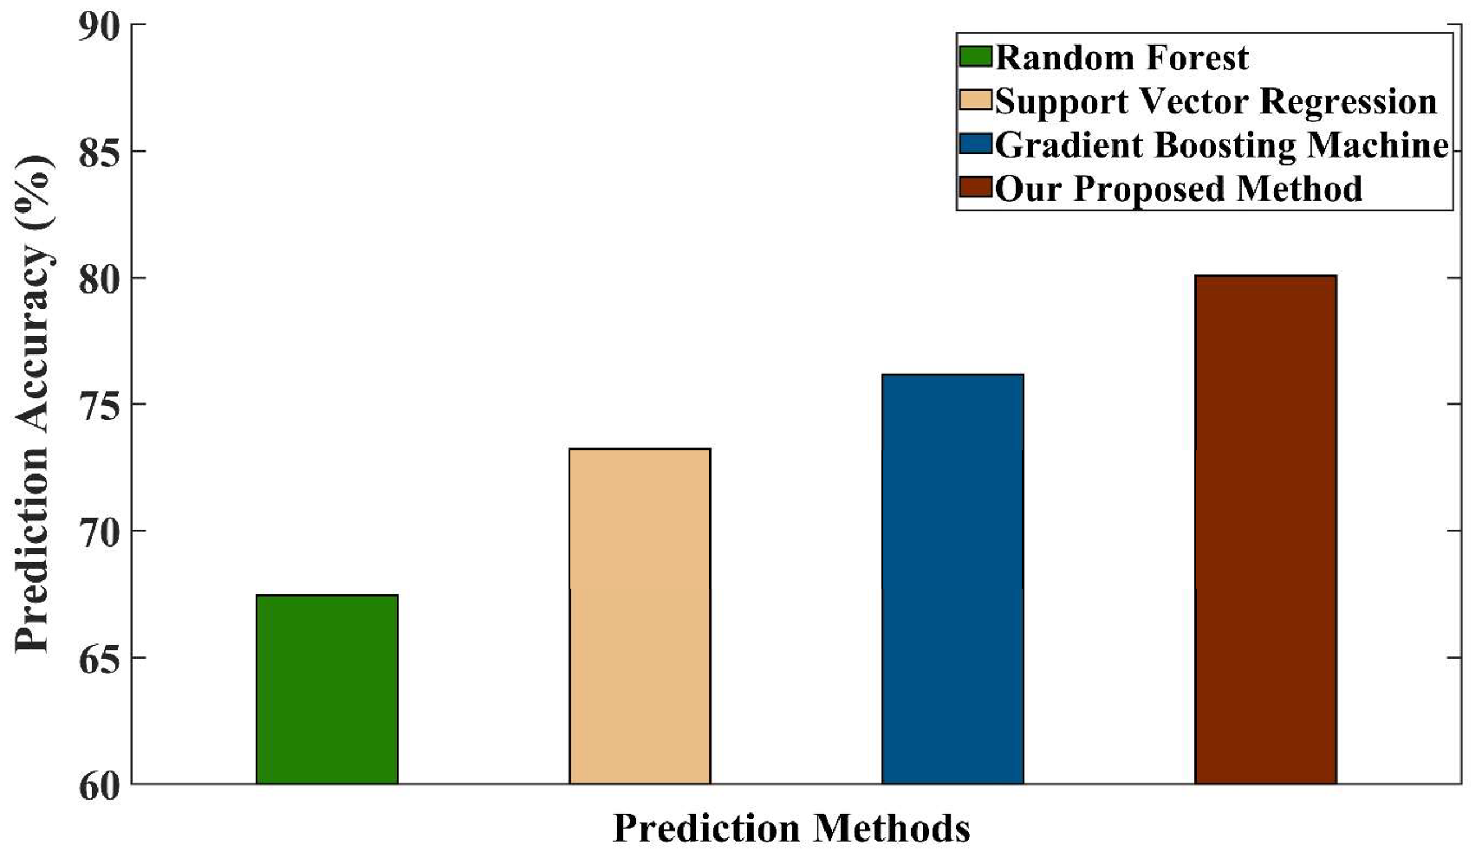
Numerical Results - Comparison
We have conducted numerical comparisons with three existing works [10-12]
The accuracy shown on this figure is the average accuracy of 4 models.
[10] T. Lawanson, V. Sharma, V. Cecchi, and T. Hong, “Analysis of outage frequency and duration in distribution systems using machine learning,” 2020 52nd North American Power Symposium (NAPS), pp. 1–6, 2021.
[11] A. J. Smola and B. Scholkopf, “A tutorial on support vector regression,” Statistics and computing, vol. 14, no. 3, pp. 199–222, 2004
[12] D. Cerrai, D. W. Wanik, M. A. E. Bhuiyan, X. Zhang, J. Yang, M. E. B. Frediani, and E. N. Anagnostou, “Predicting storm outages through new representations of weather and vegetation,” IEEE Access, vol. 7, pp. 29 639–29 654, 2019.

Slide 55
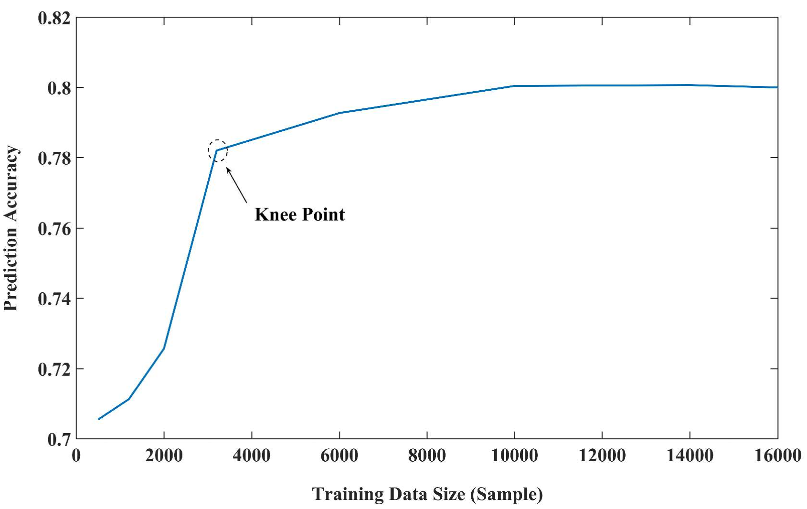
Sensitivity and Uncertainly Analysis
To evaluate how the size of the training dataset affects model performance and to verify the robustness of the proposed transfer-learning-based ANN.
Sensitivity to Training Data Size
The model’s prediction accuracy was tested under varying numbers of training samples.
Performance stabilizes after approximately 3,000 samples, which corresponds to 0.5–1 year of outage data, depending on outage frequency.
This “knee point” indicates that the model achieves adequate generalization with moderate data availability, unlike other works that require significantly larger datasets.
Beyond this threshold, accuracy improvement becomes stable, demonstrating the model’s efficient data utilization and stable convergence.

