Slide 1
Resilience Enhancement of Power Distribution Systems in Response to Hurricanes
Iowa State University
Zhaoyu Wang
Professor
Electrical and Computer Engineering
Iowa State University
PSERC IAB Meeting
Dec. 05, 2024
Notes:
Good afternoon, everyone. Thanks for your attending my preliminary exam. Today I would like to give a presentation on my research “Resilience-oriented design of electrical distribution system.

Slide 2
Introduction to Resilience Enhancement Measures
Two resilience goals of power distribution systems:
System adaptation (to reduce the impact of future events)
System survivability (to maintain an adequate functionality during and after the event)
Resilience enhancement measures:
Resilience-Oriented Design (ROD) Measures
Resilience-Oriented Operational (ROO) Measures
Disaster Response
& Risk Management
Topological and structural upgrades of the utility’s infrastructures
Upgrading distribution poles
Undergrounding
Installing automatic switches
Installing back-up DERs
“Smart” control-based actions
Network reconfiguration
DER rescheduling
Defensive islanding
Microgrid formation
Priority-based load shedding
Exploring effects of ROD measures and ROO measures on system resilience with the consideration of operation response
Notes:
As we have a clear idea of what a resilient distribution system is, we need to know the practical measures to enhance the system resilience.
There are two resilience goals of distribution system, one is system adaptation, which can reduce the impact of future events and the other is system survivability. It is an capability to maintain an adequate functionality of the system during and after the events.
The resilience-enhancement goals can be fulfilled through upgrading and operating measures:
Resilience-oriented design measures refer to the topological and structural upgrades of the utilities infrastructures to make it less susceptible to extreme weather event damages it includes upgrading poles to stronger class, install automatic switches and backup Dgs.
Resilience-oriented operational measures refer to smart control-based actions to provide preventive and corrective operational flexibility for effectively dealing with unfolding extreme weather events

Slide 3
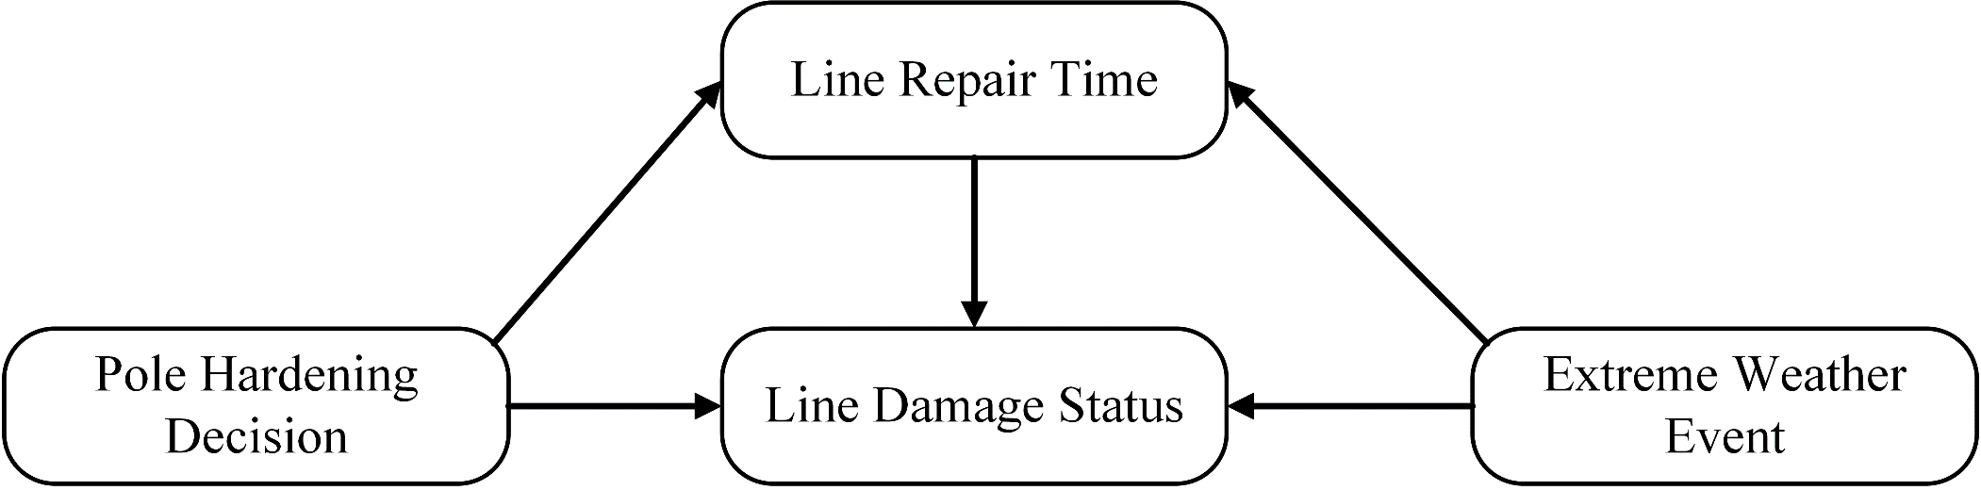
Problem Statement
How to optimally apply ROD measures to prevent distribution systems from extensive damages caused by hurricanes and other extreme events
Some spatial-temporal correlations exist among ROD decisions, extreme weather events, and system operations
Occurrences, intensities, and traveling paths of hurricanes are uncertain
Physical infrastructure damage statuses are affected by both hurricanes and ROD decisions (decision-dependent uncertainty)
ROD decisions affect system recovery and the associated outage/repair costs

Slide 4
A Tri-Level Robust Model for Resilience Planning

Slide 5
A Tri-Level Robust Model for Resilience Planning
First stage: identify hardening strategies
Second stage: determine the set of damaged lines
Third stage: minimize load shedding

Slide 6
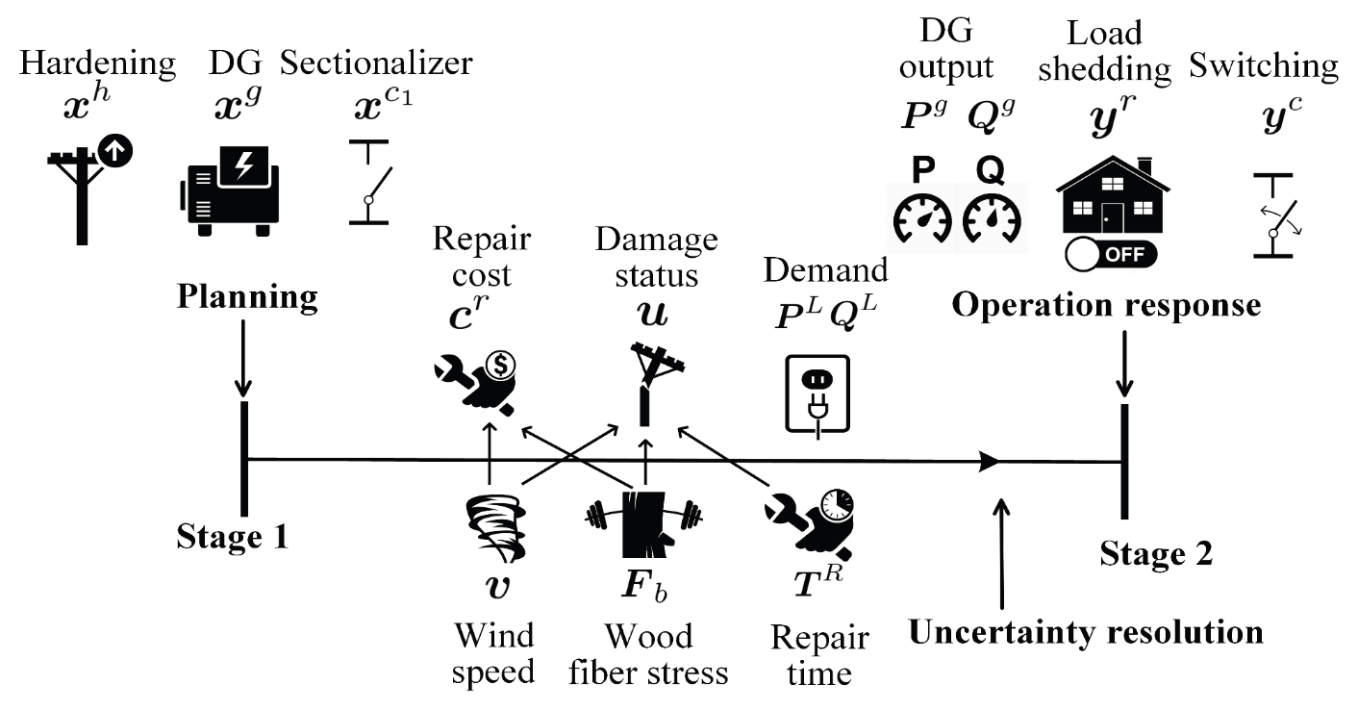
A Two-Stage Stochastic Model for Resilience Planning
ROD problem is modeled as a two-stage stochastic decision process:
Planner makes ROD decisions
The operation uncertainties are resolved during the extreme weather event
Operator makes the operation decisions
Notes:
line statuses are determined by wind speeds, pole strengths, and repair times, all of which are stochastic. In particular, pole strengths and repair times are decision-dependent.

Slide 7







A Two-stage Stochastic Model: First-Stage Formulation
Objective:
Minimize the ROD investment cost and the expected cost of the second stage in realized extreme weather events
First stage ROD variables:
whether hardening line (1) or not (0)
whether adding a sectionalizer at the end of line (1) or not (0)
whether installing DG at node (1) or not (0)
First stage constraints:
Hardening strategy limit
DG number limit
Switch installation constraint
The expected cost of the second stage
Notes:
The objective of the first stage is to minimize the costs of hardening lines, installing backup DGs, adding sectionalizers, and the expected cost of the second stage.
only one hardening strategy can be selected for each line.
Whether line has a switch or not at the end of n, which is used in the second-stage problem.

Slide 8
A Two-stage Stochastic Model: Second-Stage Formulation
Objective
Minimize the cost of the loss of load, DER operations, and damage repair time in a realized extreme weather event given ROD decisions
Faulting logic constraints (model outage propagation)
Virtual node power injection constraints
Voltage magnitude limits
Load shedding ratio limit
Constraints
Distribution system operation constraints
Line damage status constraint
Line repair cost constraint
Line’s on-off status constraints (controlled by switch’s on-off status)
Line flow limits (controlled by line’s on-off status)
Linearized AC power flow equations (Dist-Flow)
DG capacity limits
Radiality constraints
Connected network component constraint
Active branch constraint
Zero Angle indicator constraint (indicating a node with zero angle)
The minimality condition of VDCOPF sub-problem (obtain the degree of freedom of voltage angle)

Slide 9
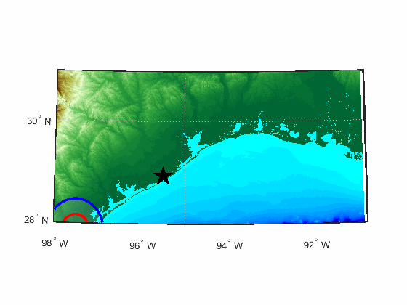
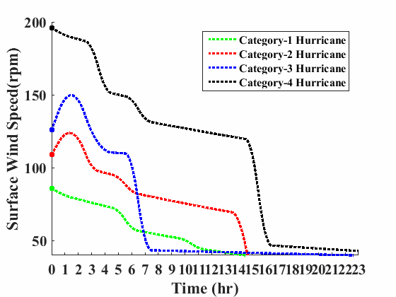
Hurricane Simulations
Category-4 hurricane path tracking
The surface wind speed variations of hurricanes for the test distribution system
It is assumed that the maximum wind speed at the central point of the test system is applied to all the distribution lines.
The red circle indicates the boundary of the maximum winds for the traveling hurricanes at a certain eye location. The area between the red circle and the blue circle experiences 82.5% of the maximum wind speed. The wind speed within areas between 2Rmax and 4Rmax is reduced by 25%.

Slide 10
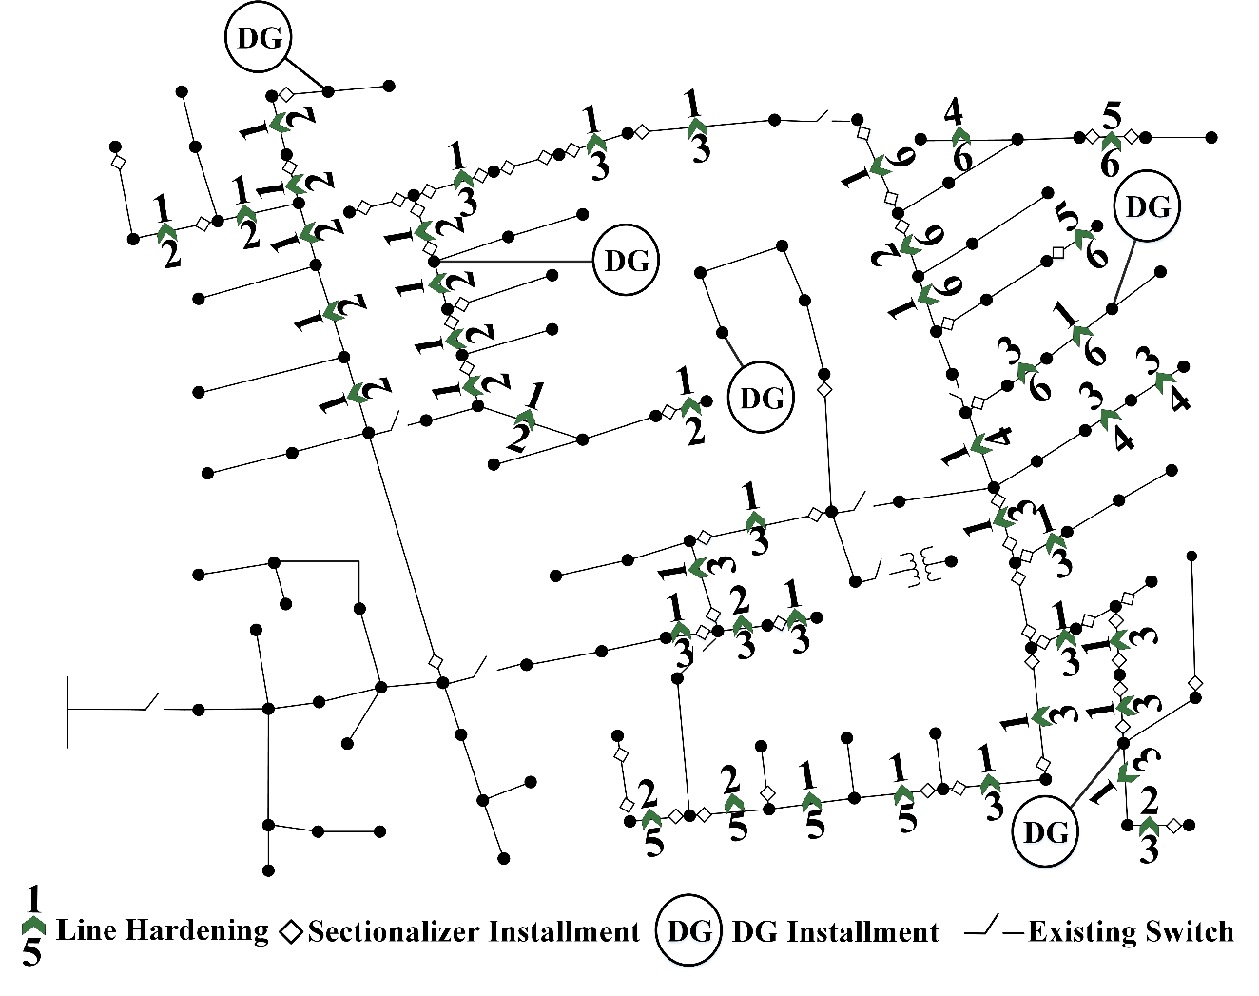
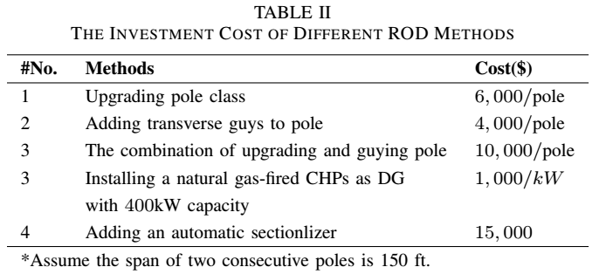

Case Study
The IEEE 123-bus system is mapped into a coastal city.
The repair cost of a single pole for 6 pole types is assumed to be the same
Consider the budget limitation, the total number of backup DERs is limited to be 5
Basic load shedding cost is assumed to be $14/kWh
DER operation cost is assumed to be $8/kWh
20 scenarios are randomly generated
The total investment cost is $5, 048,000

Slide 11
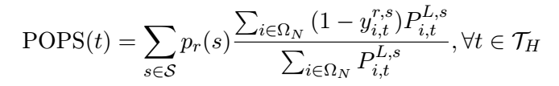
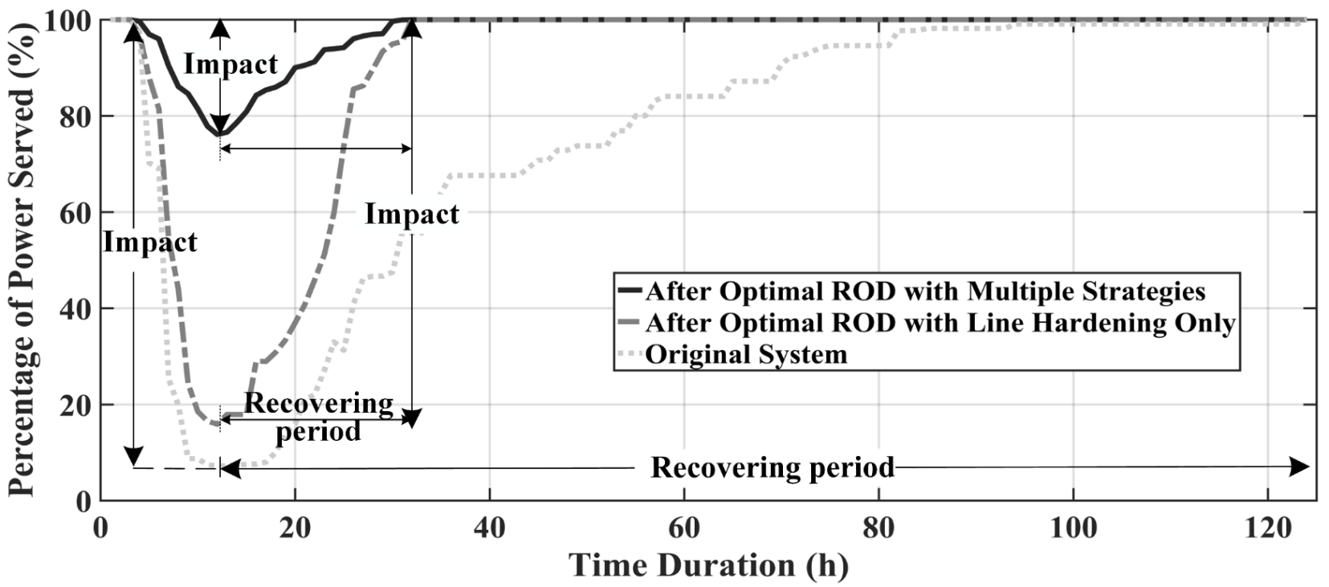
Case Study: Comparison with and without ROD
Compare the system resilience by the resilience curve, which can be expressed by the percentage of power-served (POPS(t)):
The system with optimal ROD has stronger surviving ability to withstand hurricanes and faster recovery
DERs and automatic switches contribute to mitigating hurricanes’ impacts on the system
Notes:
To quantify the impact of ROD measures on system resilience, we compares system resilience curves with and without ROD. Compared to 93% POPS drop in the original system, the system with only optimal line hardening experiences a 84.1% POPS drop and the system after optimal ROD with multiple coordinated ROD options only experiences a 23.9% POPS drop. In addition, the POPS drop starts earlier in the original system. Moreover, systems with optimal ROD have shorter restoration time.

Slide 12
The Challenges
Modeling and computational challenges:
The spatial-temporal correlations among resilience-enhancement decisions, uncertainty space, and system operations during and after extreme weather events, i.e., many decision-dependent uncertainties.
Various fragility models for different infrastructure components under different extreme events.
Interdependencies among infrastructure components.
Planning for multiple weather events.
Economic challenges:
Planning for extreme events v.s. Planning for normal days v.s. Planning for both.
Justification of benefits and costs.

Slide 13
Thank You! Q & A

