Slide 1
Leveraging DERs and Networked Microgrids to Enhance Distribution Grid Resilience
Zhaoyu Wang
Professor
Department of Electrical and Computer Engineering
Iowa State University

Slide 2
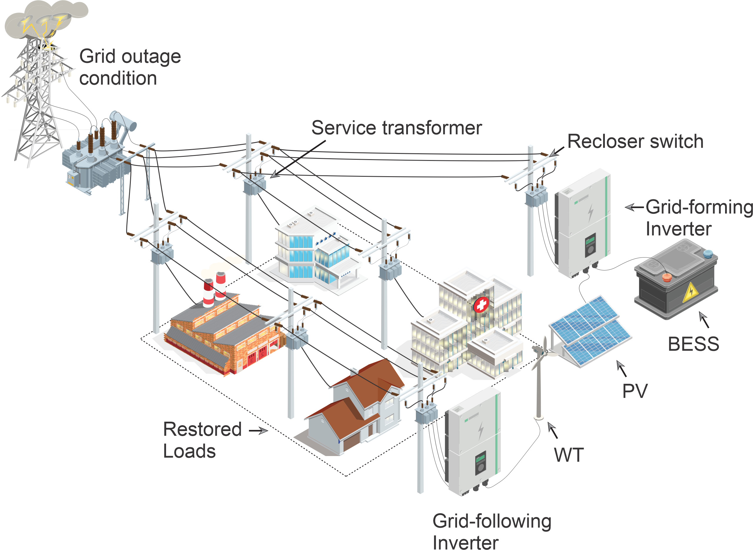
DER-led Blackstart in Distribution Systems
Extreme events may cause outages of transmission grids.
Blackstart distribution systems enabled by DERs and automatic switches.
Requirements:
At least one DER with grid-forming inverter.
Picking up lines/loads should not trip any fuses or reclosers.
No overloading of transformers.
Voltage levels must be within a certain range.
Radial topology must be kept.
Notes:
Context

Slide 3
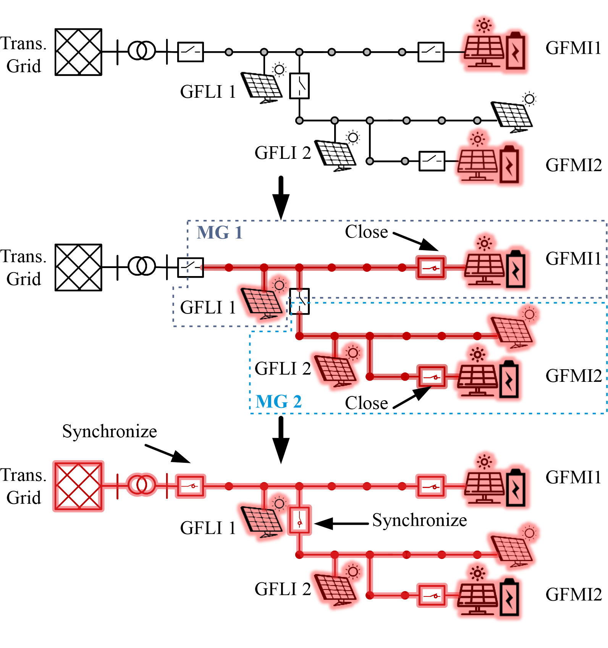
Overview of DER-led Blackstart
Step1: Initiate blackstart with grid-forming inverters.
Step 2: Close switches to energize bus blocks and grid-following inverters to form and expand microgrids.
Step 3: Synchronize microgrids to augment power and energy capacity.
Step 4: Perform synchronization with the transmission grid after it is restored.

Slide 4
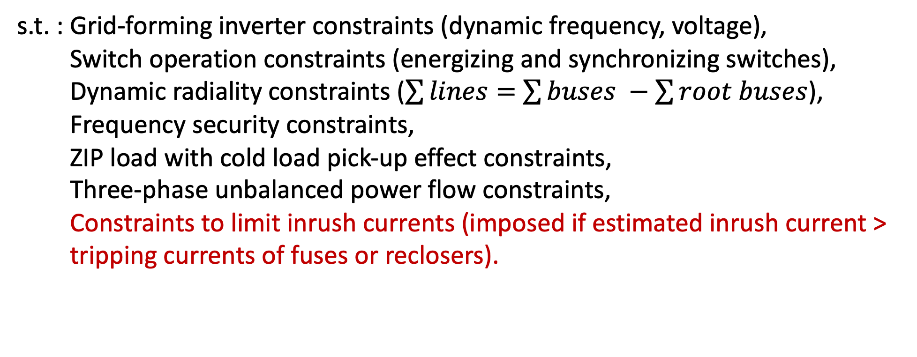
Blackstart Problem Formulation
The objective is to maximize the restored loads considering priorities:
s.t. : Grid-forming inverter constraints (dynamic frequency, voltage),
Switch operation constraints (energizing and synchronizing switches),
Dynamic radiality constraints ($\sum{lines}=$ $\sum{buses} −\sum{root buses}$),
Frequency security constraints,
ZIP load with cold load pick-up effect constraints,
Three-phase unbalanced power flow constraints,
Constraints to limit inrush currents (imposed if estimated inrush current > tripping currents of fuses or reclosers).
x: Sequence of energizing cranking paths, sequence of synchronizing decisions, and sequence of load pickup.

Slide 5
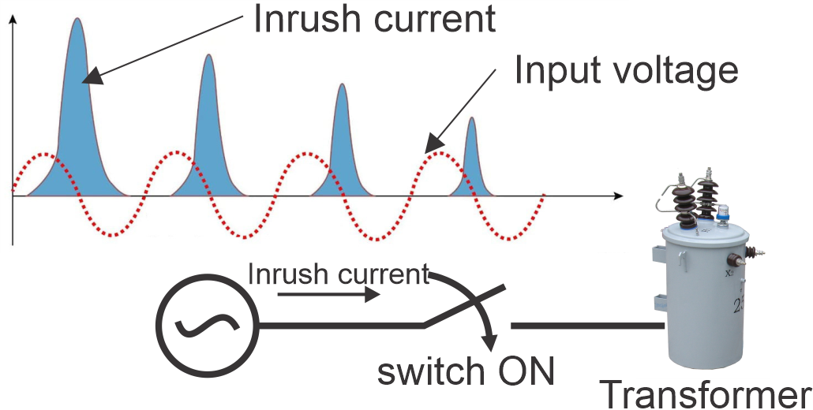
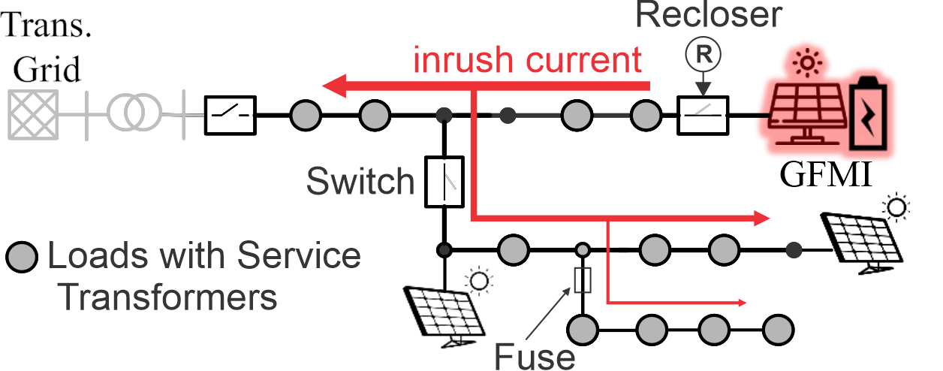
Inrush Currents in Transformers
When an outaged transformer is re-energized, a transient surge current is drawn to establish the magnetic field.
A residual flux is inside the core after transformer is outaged, which causes core saturation when it is re-energized.
Current peak may be 3-5 times of the rated current.
Residual flux eventually dies out.
Inrush current may trip reclosers and fuses.
Notes:
Context

Slide 6
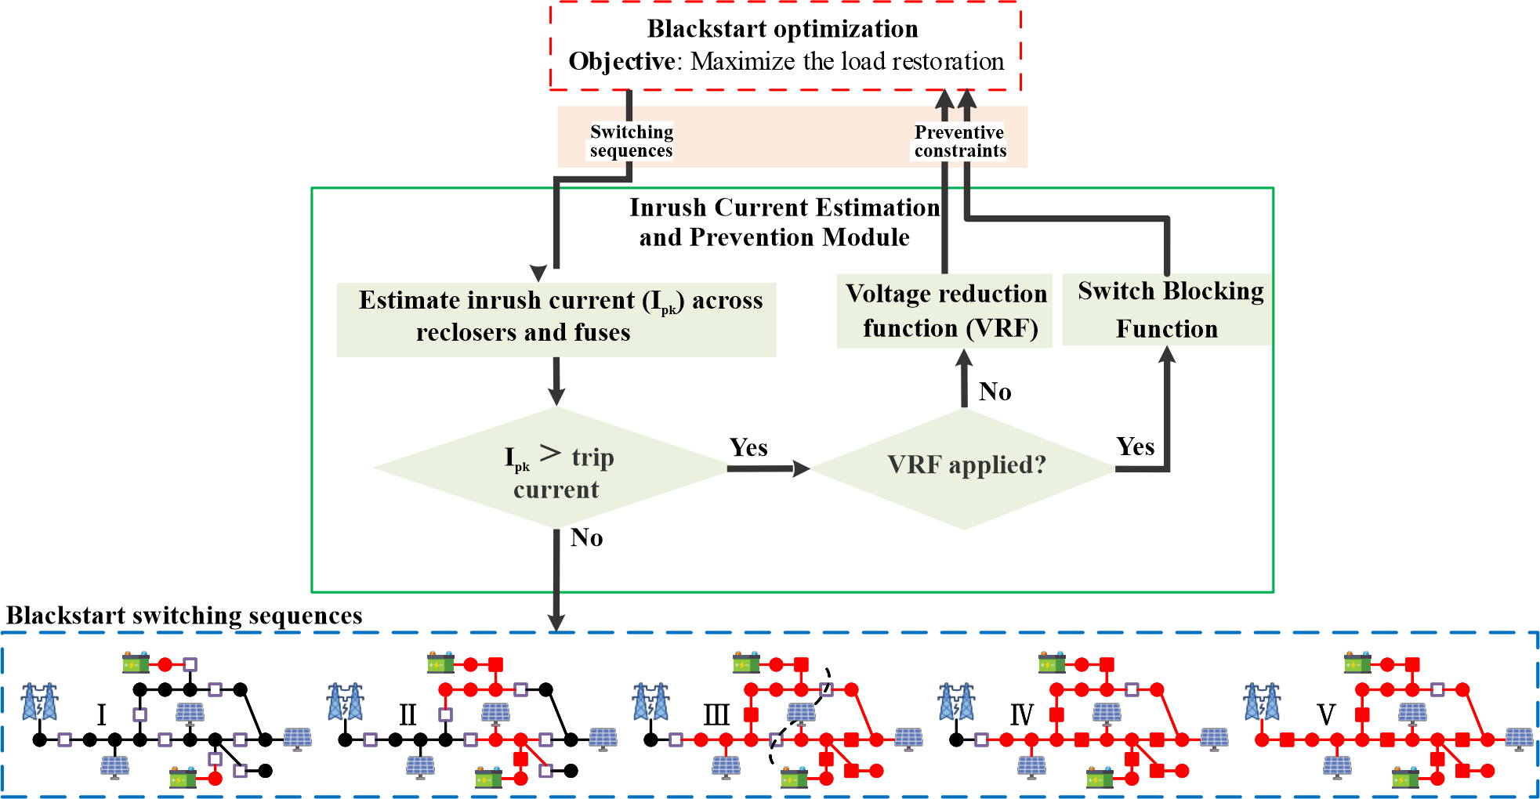
BS Framework considering Inrush Current
Primary preventive measure
Secondary preventive measure

Slide 7
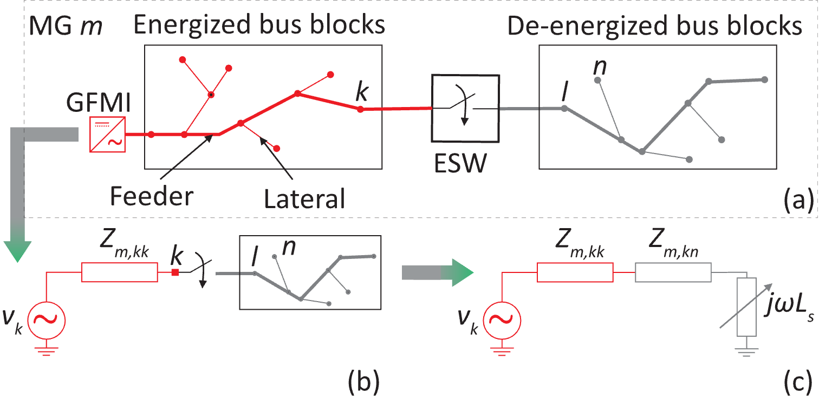
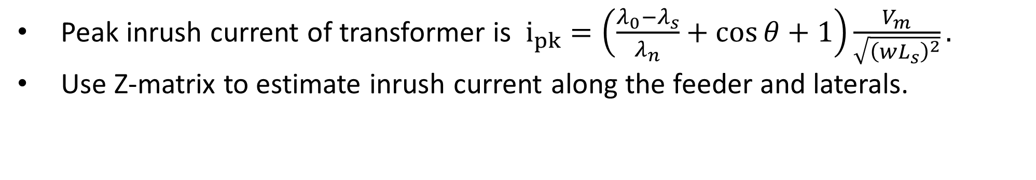
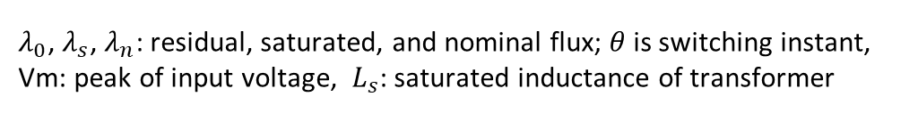
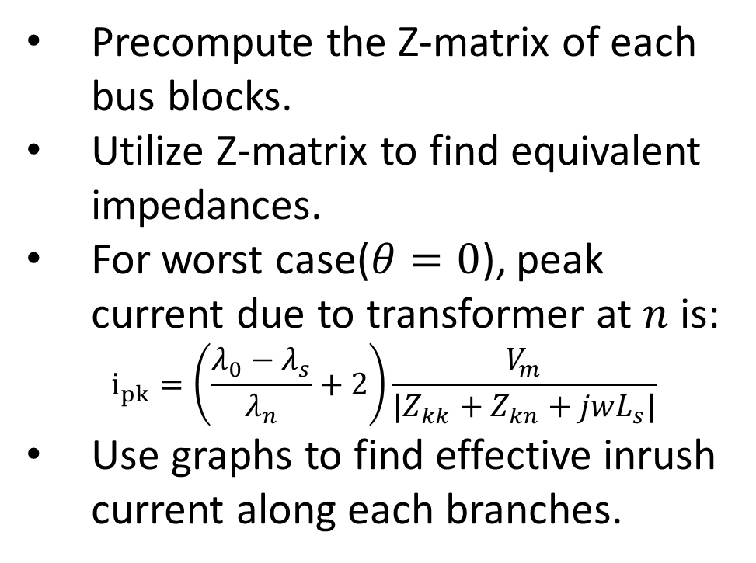
Estimation of Peak Inrush Current in Feeders
Peak inrush current of transformer is $i_{pk}=\left(\frac{λ_{0}−λ_{s}}{λ_{n}}+\cos{θ}+1\right)\frac{V_{m}}{\sqrt{{\left(wL_{s}\right)}^{2}}}.$
Use Z-matrix to estimate inrush current along the feeder and laterals.
Precompute the Z-matrix of each bus blocks.
Utilize Z-matrix to find equivalent impedances.
For worst case($θ=0$), peak current due to transformer at $n$ is:
$$i_{pk}=\left(\frac{λ_{0}−λ_{s}}{λ_{n}}+2\right)\frac{V_{m}}{|Z_{kk}+Z_{kn}+jwL_{s}|}$$
Use graphs to find effective inrush current along each branches.
Thevenin’s
equivalent
Steps for estimating the inrush current due to transformer at n
$λ_{0}$, $λ_{s}$, $λ_{n}$: residual, saturated, and nominal flux; $θ$ is switching instant, Vm: peak of input voltage, $L_{s}$: saturated inductance of transformer
Notes:
Here, $θ$ is switching instant, which can be at zero crossing of input voltage wave or at any phase. The worst case is with $θ$=0.
$λ_{0}$: residual flux
$λ_{s}$: saturated flux
$λ_{n}$: nominal flux
Vm: peak of input voltage. Note that peak inrush current is proportional to input voltage.

Slide 8
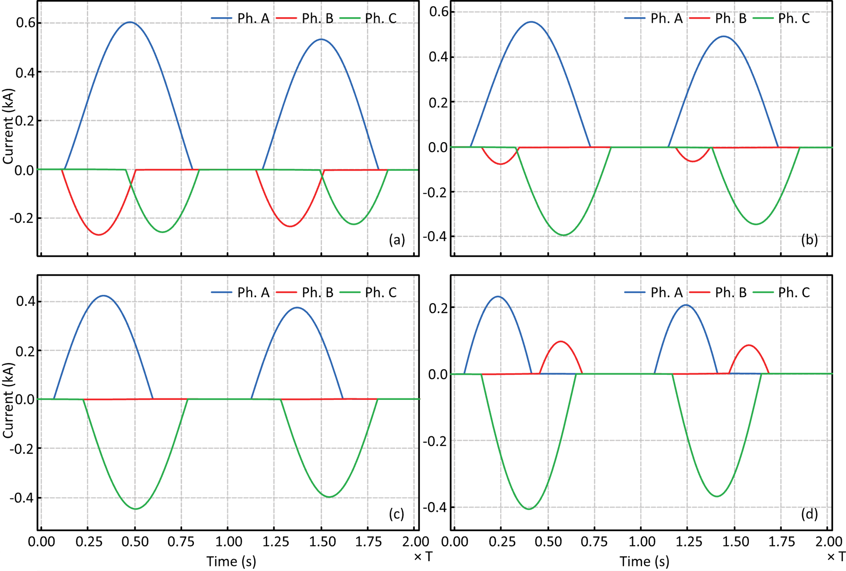
Validation of Inrush Current Estimation
θ | Ph. | Imax (kA) |  | Acc. (%)
 |  | Est. | Mea.
0° | A | 0.6440 | 0.6035 | 93.29
30° | A | 0.5901 | 0.5586 | 94.36
60° | A | 0.4428 | 0.4224 | 95.17
90° | C | 0.3759 | 0.4055 | 92.70
The comparison between the estimated and measured peak inrush currents shows high accuracy in estimation, with all cases exceeding 90%.
Inrush currents seen in EMT simulations of a 100-kVA transformer

Slide 9
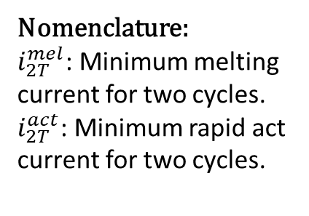
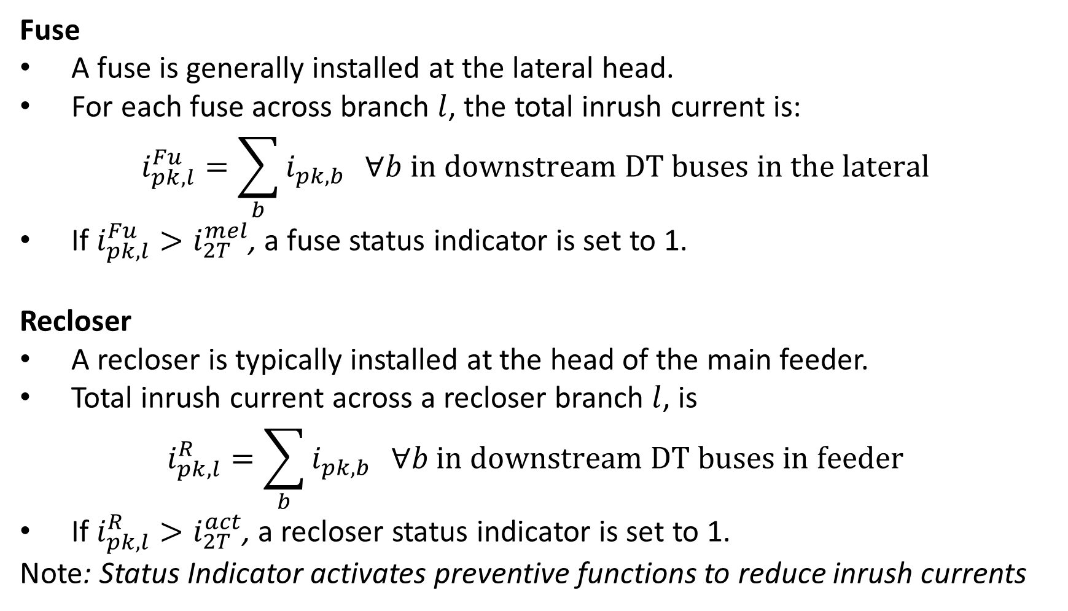
Fuse and Recloser Trip Conditions
Fuse
A fuse is generally installed at the lateral head.
For each fuse across branch $l$, the total inrush current is:
$$i_{pk,l}^{Fu}=\sum_{b}{i_{pk,b}} ∀b in downstream DT buses in the lateral$$
If $i_{pk,l}^{Fu}>i_{2T}^{mel}$, a fuse status indicator is set to 1.
Recloser
A recloser is typically installed at the head of the main feeder.
Total inrush current across a recloser branch $l$, is
$$i_{pk,l}^{R}=\sum_{b}{i_{pk,b}} ∀b in downstream DT buses in feeder$$
If $i_{pk,l}^{R}>i_{2T}^{act}$, a recloser status indicator is set to 1.
Note: Status Indicator activates preventive functions to reduce inrush currents
Nomenclature:
$i_{2T}^{mel}$: Minimum melting
current for two cycles.
$i_{2T}^{act}$: Minimum rapid act current for two cycles.

Slide 10

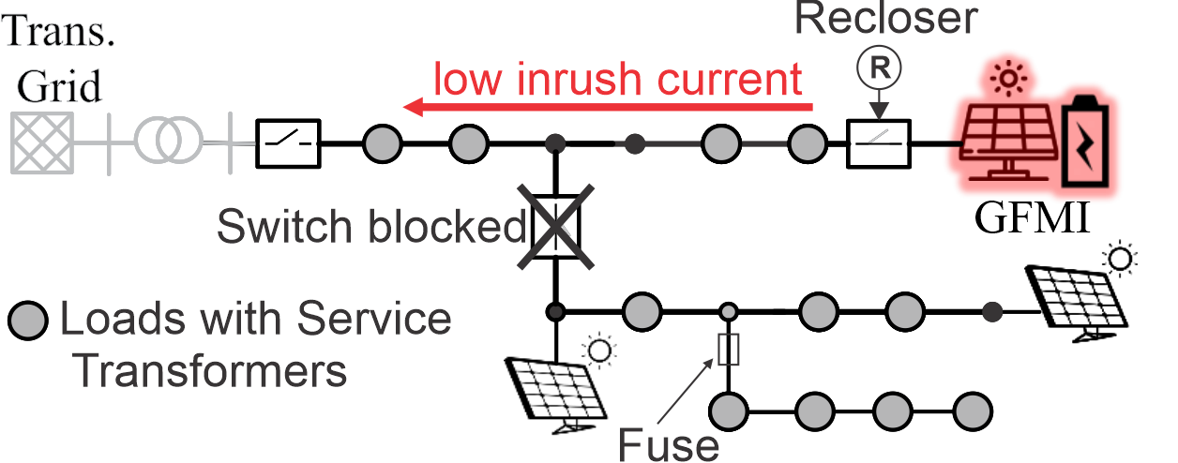
Preventive Functions
First: Voltage Reduction Function
Lower the voltage set-point of GFMI to reduce inrush currents.
Nodal voltages are allowed to temporarily drop to 0.8 pu.
Second: Switch Blocking Function
Identify the switch that causes the problem and block it for one time step.
Inrush current is reduced with energization of a small section.
This switch is released in next time step.
Note: The second function may not be required if the first one can reduce the inrush current sufficiently.
Switch blocking function
Notes:
BS optimization may energize multiple switches to restore more load. If the inrush current estimation module determines the resulting inrush current may trip the recloser, it will first activate voltage reduction function. If this function do not help to reduce the inrush current significantly, it will activate switch blocking function. With this function, it will block, the energization of switch and allow only recloser to energize. This will significantly reduce inrush current.

Slide 11
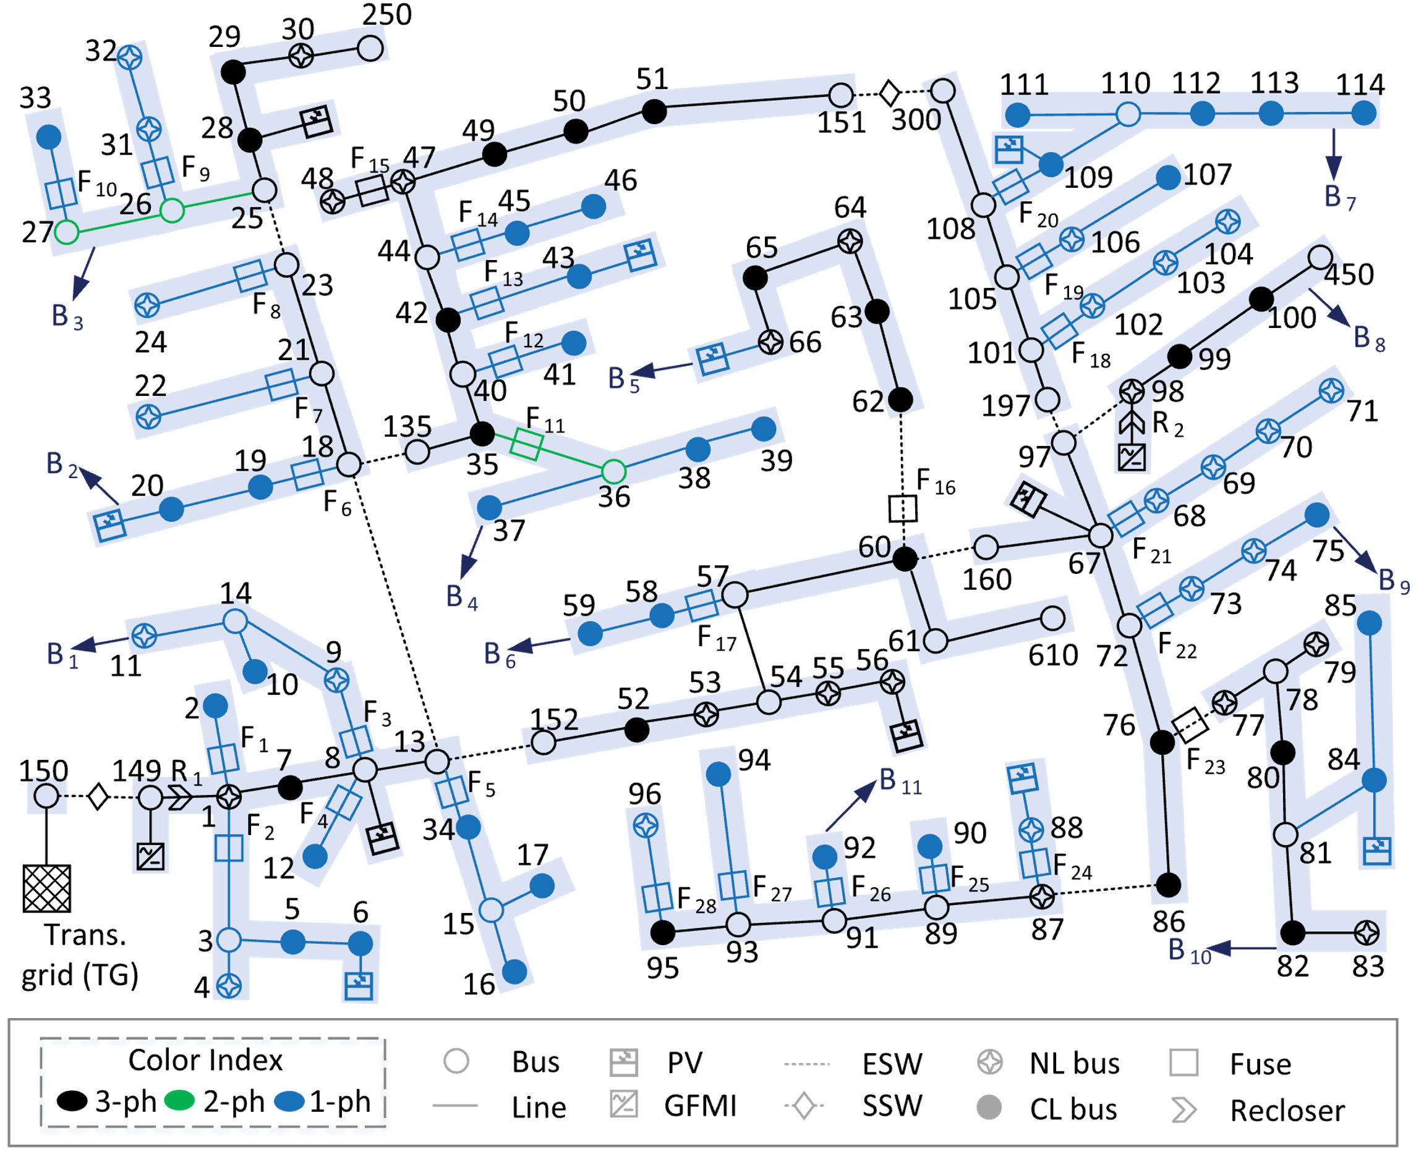
Test System
Modified IEEE-123 feeder
Peak load | 3.49 MW
PV penetration level | 28% of peak load
Recloser | Assigned with GFMI for blackstart of the feeder
Fuses | Assigned to each lateral
Service transformers | Assigned at each load buses. Capacity ranges from 25 to 150 kVA.
Service Transformers Parameters in pu
Residual fluxes for phases A, B, and C | 0.8, -0.4, -0.4
Saturated flux | 1.2
BESS-based | location | MW/MWh
GFMI 1 | 149 | 2.29/3.95
GFMI 2 | 98 | 2.22/3.58

Slide 12
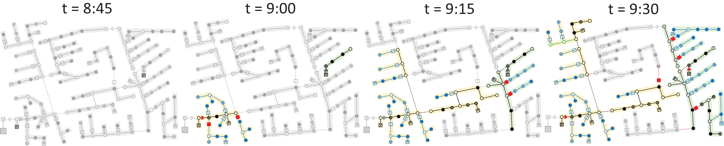
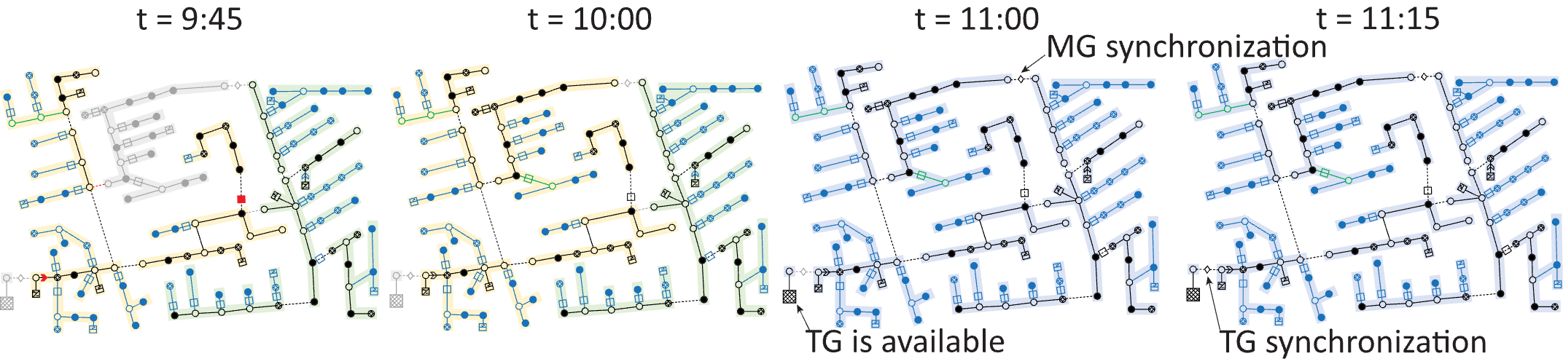
BS Sequence with Inrush-Aware Constraints
Notes:
8:45: BS is initiated by two self-starting GFMI-based BESS
9:00: Bus block B1 and B8 are energized;
Two MG continue to expand restoring loads from 9:15 and 10:00;
10:00: two MG synchronize to form on single MG
11:15: Entire distribution system synchronize with TG.
Note that, the recloser and fuses in red shows that the BS optimization decision were iteratively corrected with remedial functions to prevent their tripping due to excessive peak inrush current.

Slide 13
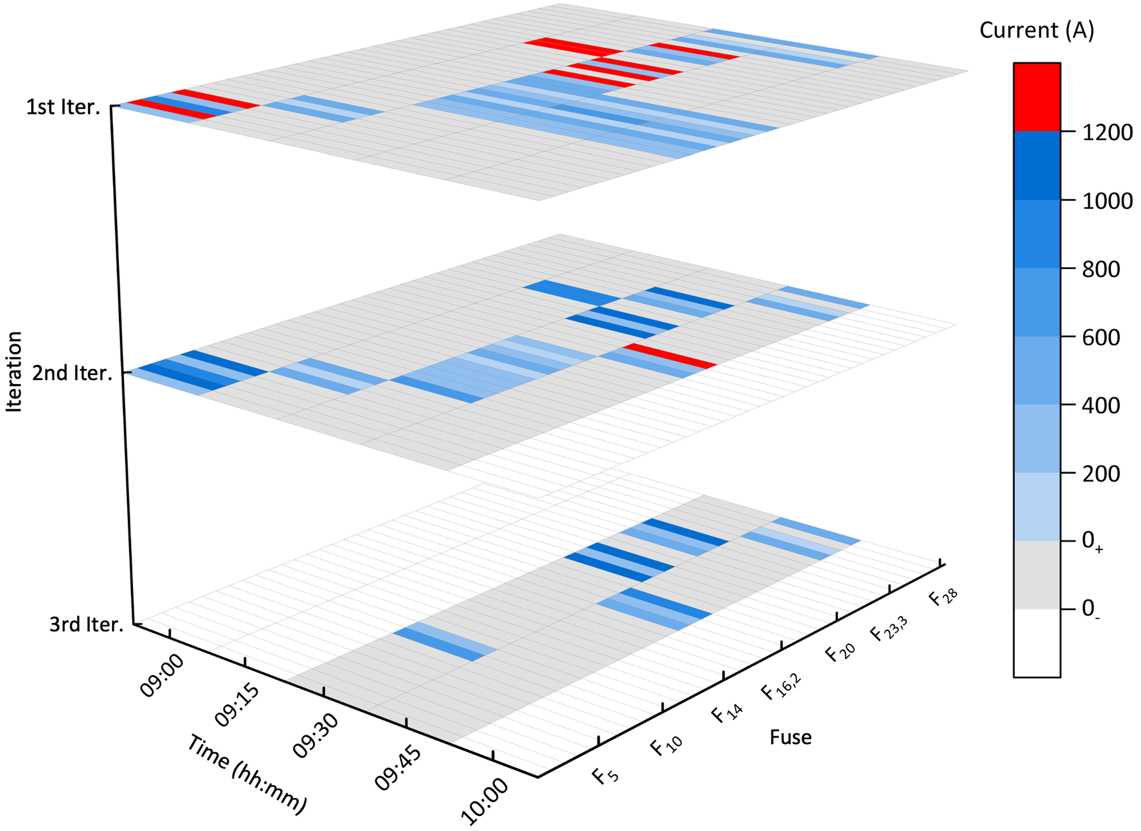
Measures for Preventing Fuse Melts
1st iteration: without preventive functions
2nd iteration: with voltage reduction function
3rd iteration: with switch blocking function augmented
All three iteration was not required for most time steps.
Inrush currents through fuses at various time step and iterations
Notes:
Fuse melted status is in red color

Slide 14
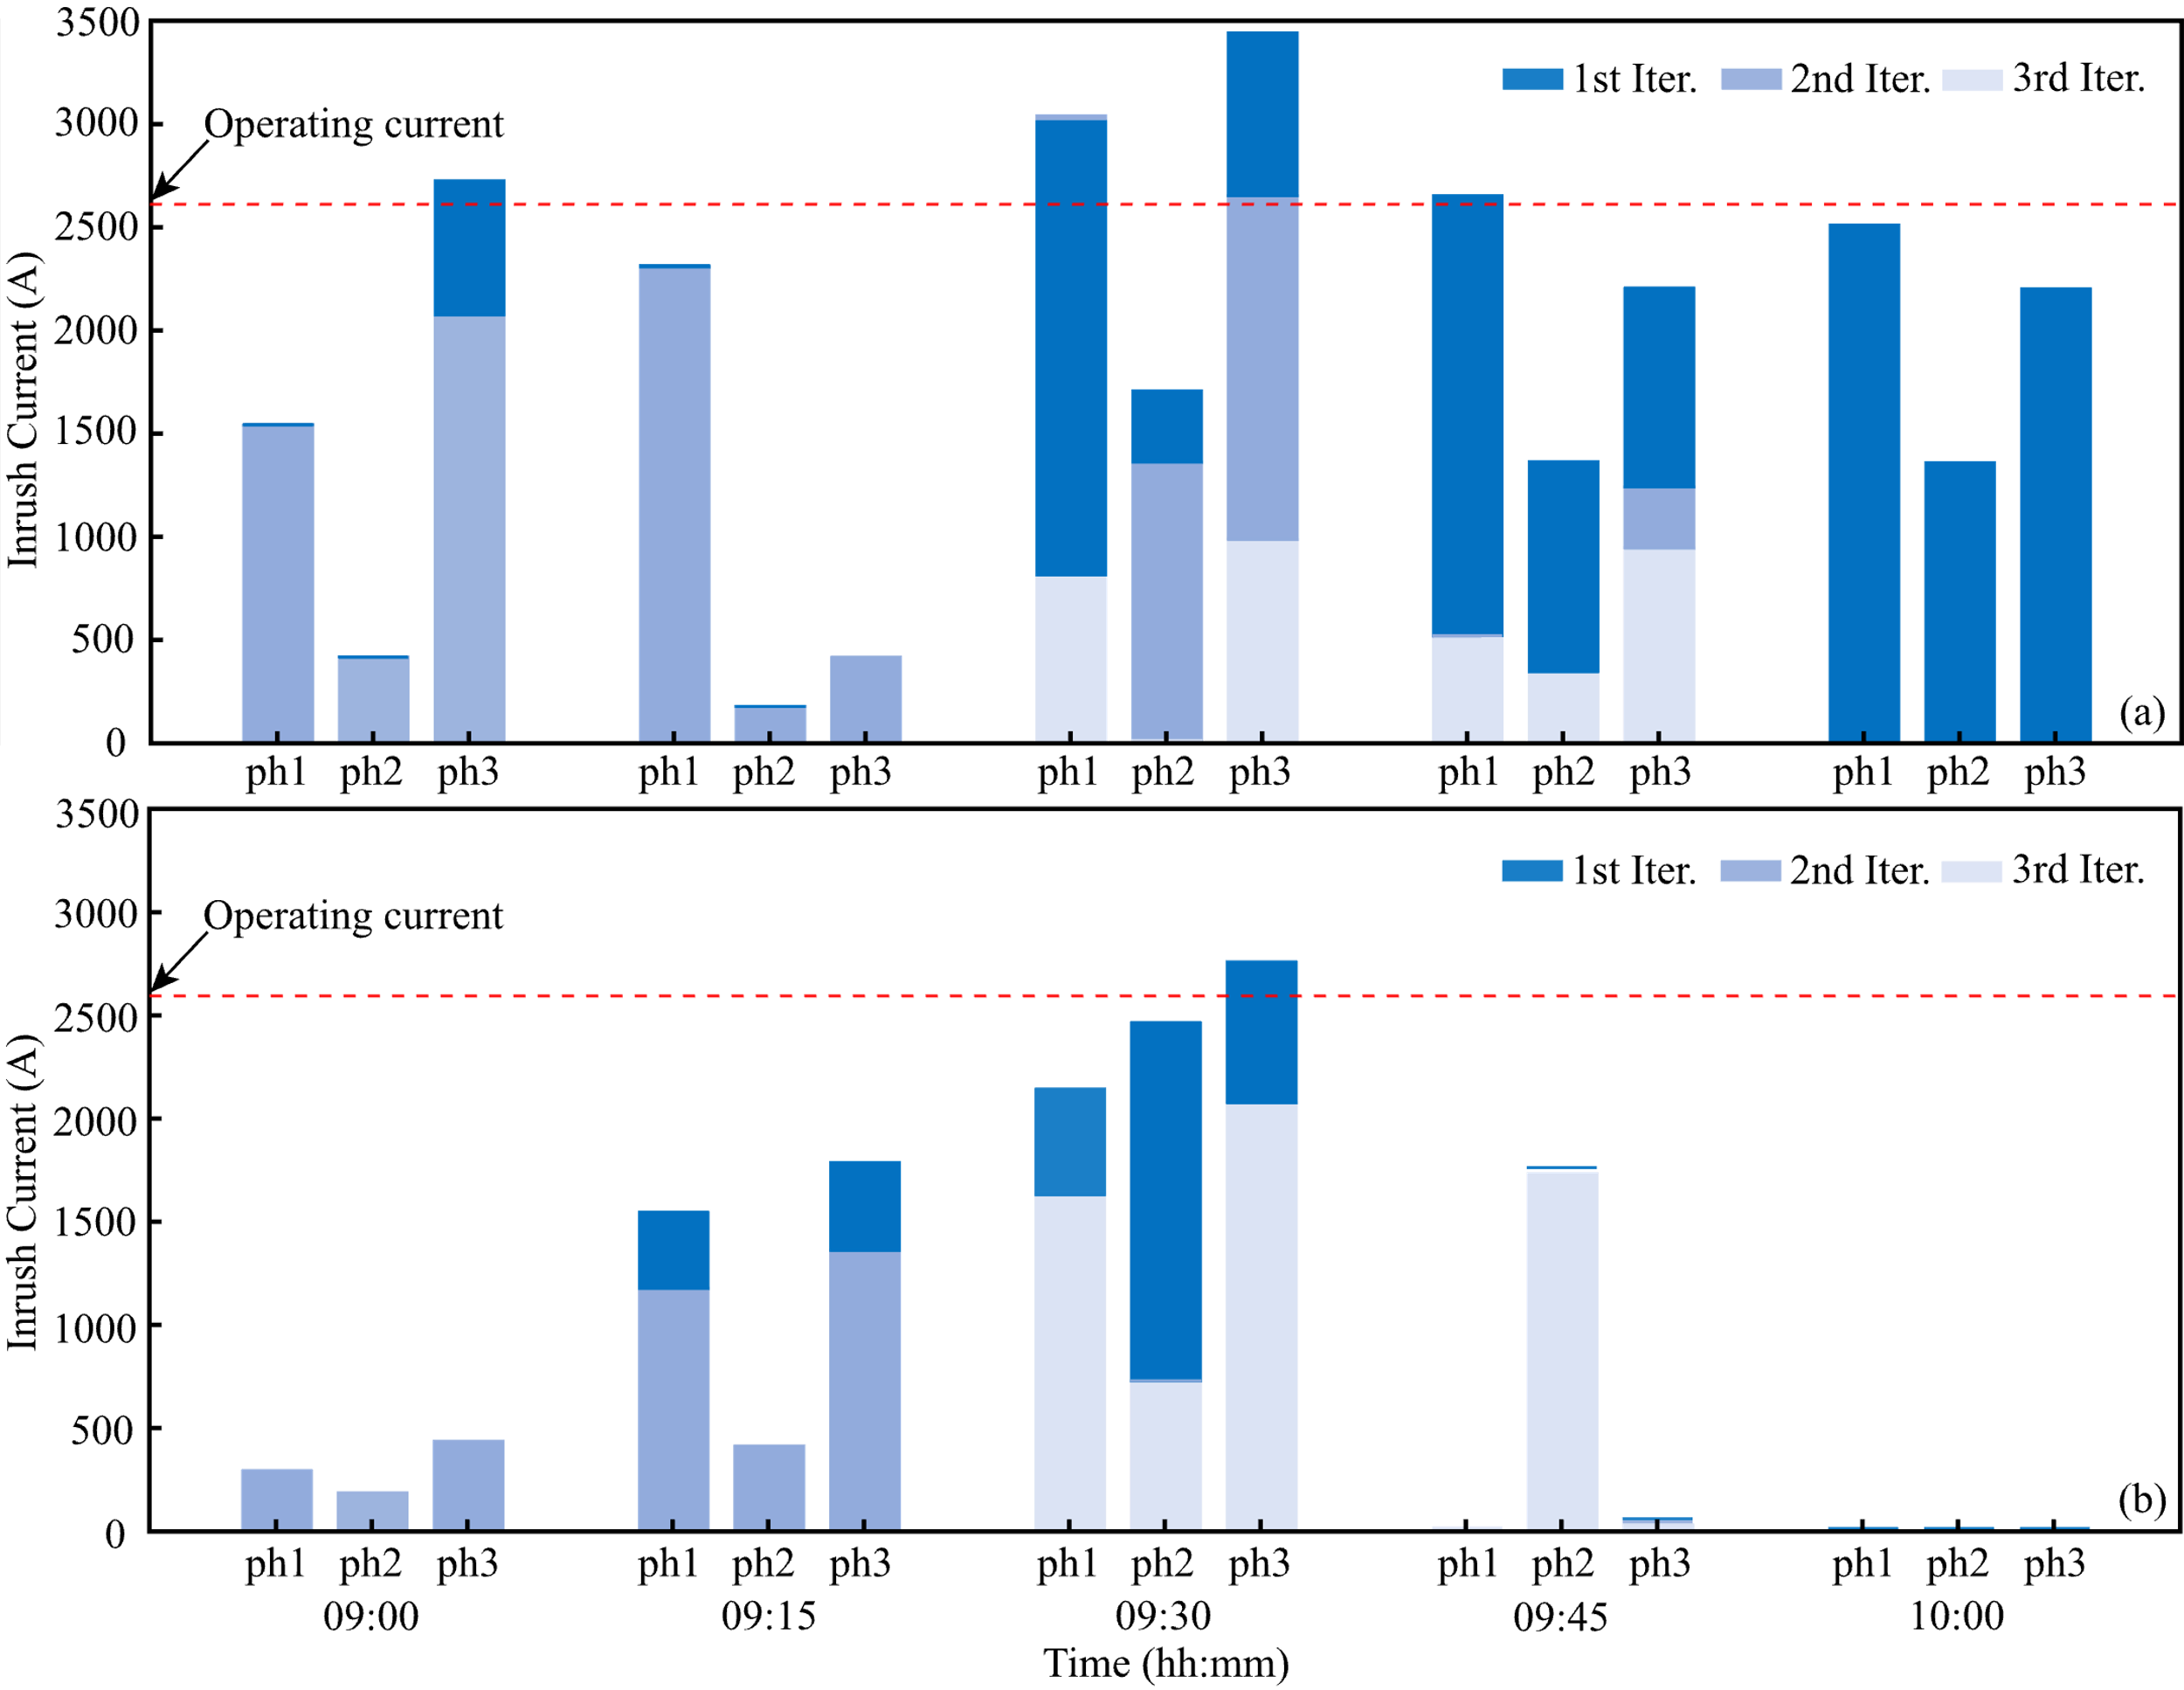
Measures for Preventing Recloser Trips
1st iteration: without preventive functions
2nd iteration: with voltage reduction function
3rd iteration: with switch blocking function augmented
Recloser 1 at 9:30:
The inrush current at phase 3 is 3500 A in 1st iteration.
The voltage reduction function reduced it to 2600 in 2nd iteration
The switch blocking function reduced it to 1000 A in 3rd iteration.
Recloser 1 located at bus 149
Recloser 2 located at bus 98
Inrush currents through two reclosers at various time step and iterations

Slide 15
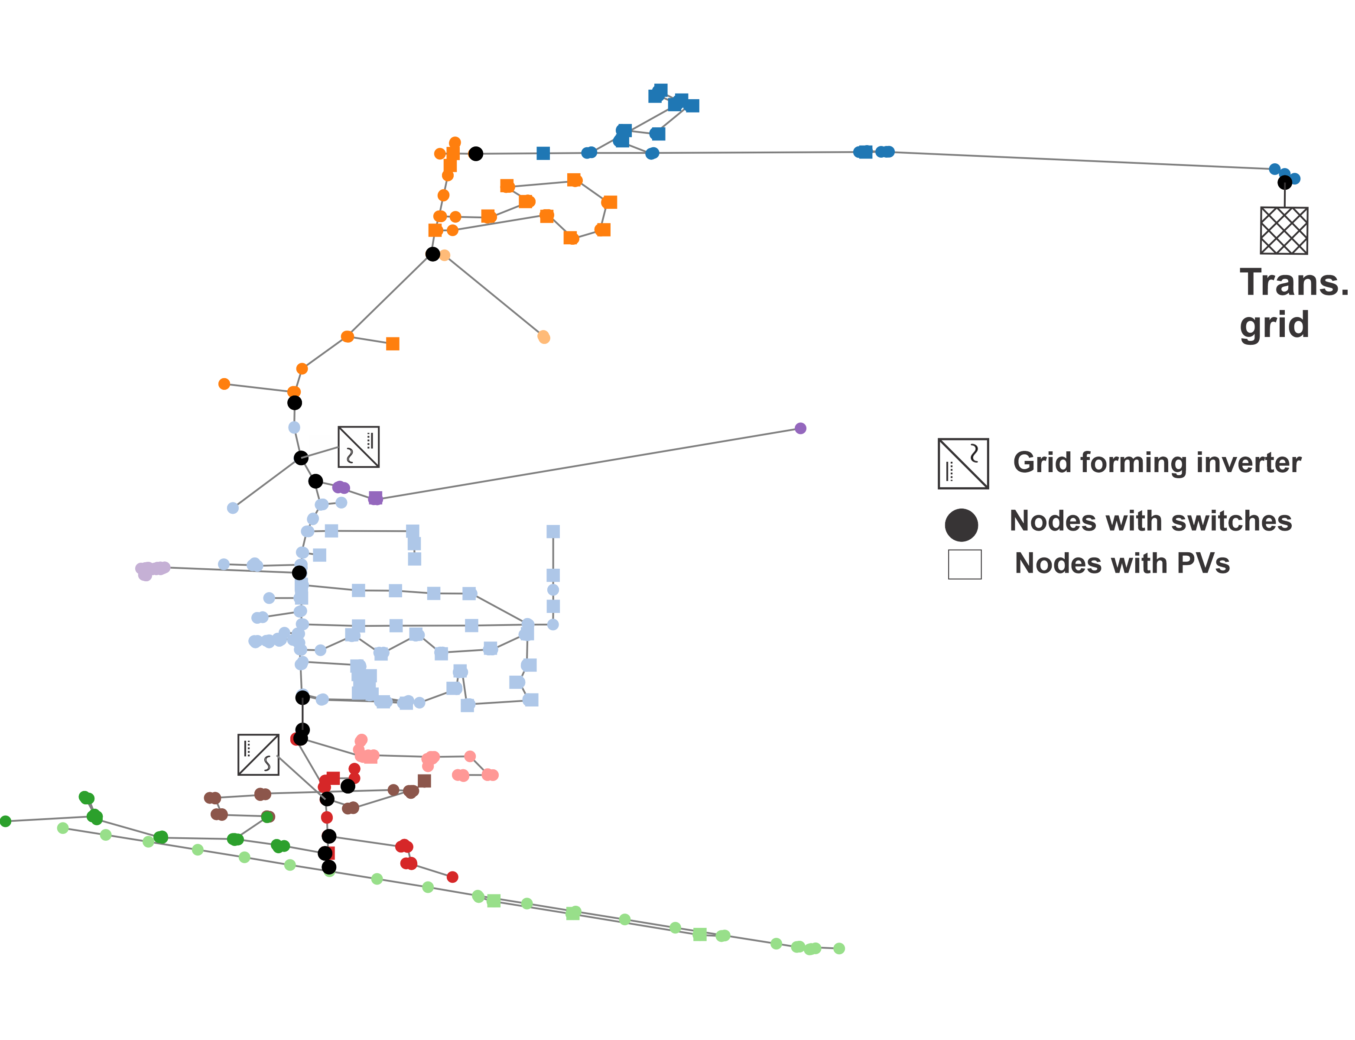
Field Demonstration Plan
The field demonstration will be conducted in one distribution feeder of a Midwest utility company.
  Number of buses >500
  Number of loads >300
  Number of switches > 10
  Total installed solar PVs > 600 kW
  Peak demand > 500 kW
  Battery storage = 1.25MVA/1.5 MWh
NREL-led DOE SETO Project “Solar-Assisted, Stakeholder-Engaged, Autonomous Restoration with Data Orchestration (Solar-HERO)”
15

Slide 16
Conclusion
A comprehensive bottom-up framework for blackstart of distribution system with inrush current is studied.
The framework integrated
    (a) blackstart optimization module; comprising of grid-forming & grid-following inverters, ZIP-based cold loads, switches, reclosers, and fuses
    (b) inrush current estimation and prevention module
The framework iteratively optimized the blackstart switching sequence ensuring no tripping from peak inrush currents.
For detailed mathematical formulation, refer to pre-print:
B. Cong, S. Maharjan, Z. Wang, “Model Predictive Black Start for Dynamic Formation of DER-Led Microgrids with Inrush Current Impacts”, submitted to IEEE Trans. Smart Grid. https://arxiv.org/abs/2507.12569

Slide 17
Thank you!
Q&A
wzy@iastate.edu
https://wzy.ece.iastate.edu

Slide 18
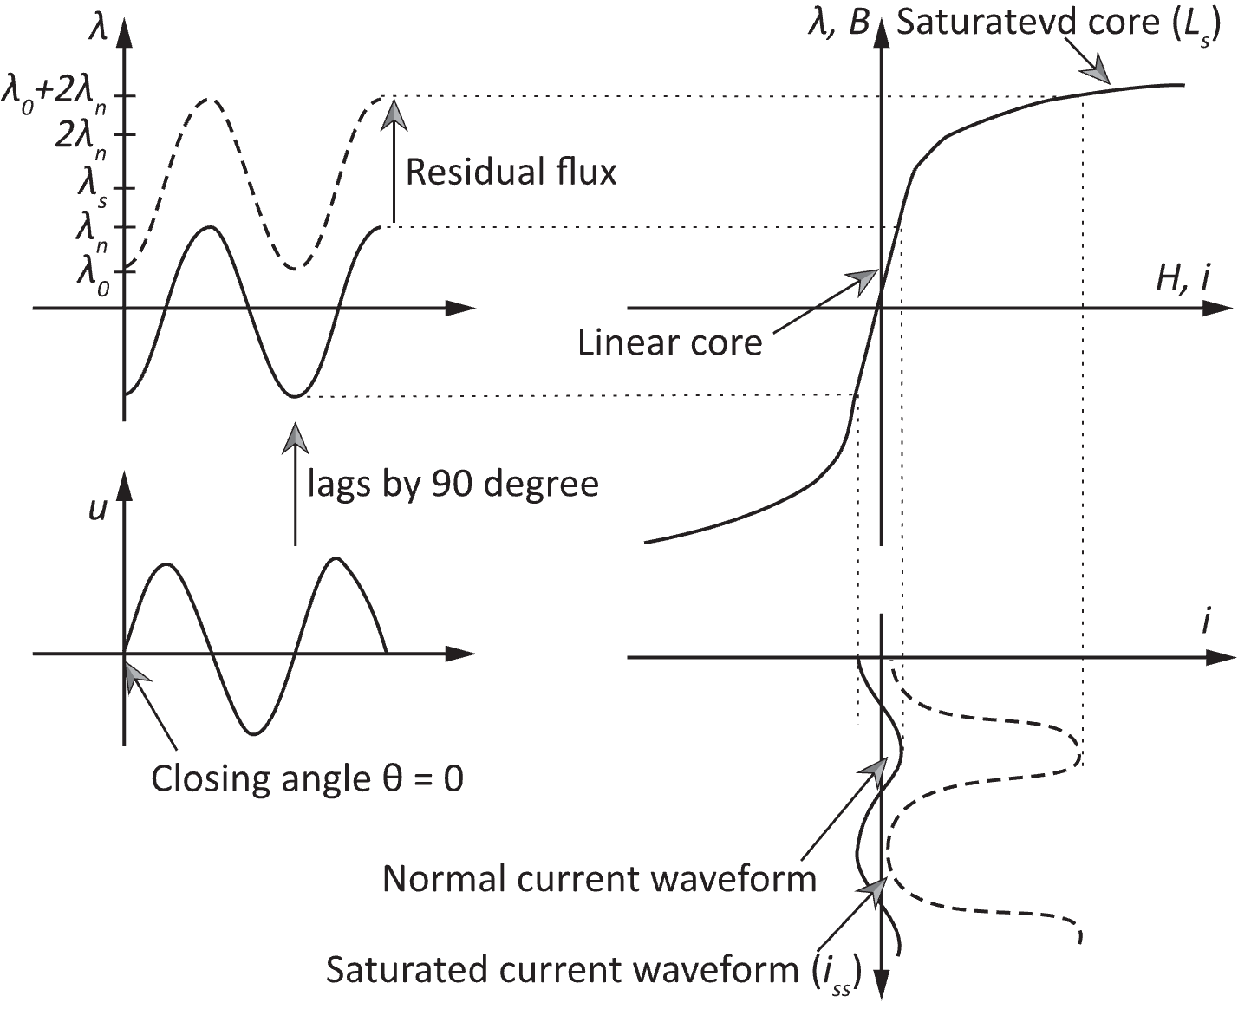
Inrush Current Modeling & Feasibility Check
Distribution Transformer (DT) Saturation Model
Saturation Indicator Function
Peak Value of Inrush Current
Given the λ₀, the worst-case closing angle θ_{WC} can be identified to estimate the maximum i_{pk}.
Core saturation and inrush current

Slide 19
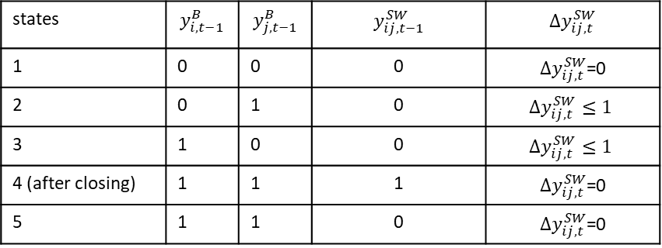
Modeling Energizing Switch (ESW)
ESWs are turned ON to power the inactive bus blocks.
Breaker, reclosers, or tie-switches.
An energizing switch $(i, j)$ may have five states while blackstarting.
All five states of the switch can be defined as:
When a switch $(i, j)$ is closed, ${f_{i}=f}_{j}$, whereas when switch is open ${f_{i}≠f}_{j}$
$${−\left(1−y_{ij,t}^{SW}\right)M≤f}_{i,t}^{ }−f_{j,t}≤\left(1−y_{ij,t}^{SW}\right)M$$
Nomenclature:
$y_{i,t}^{B}$: status of i^{th} bus
$y_{ij,t}^{SW}$: status of a switch (i, j)
${Δy}_{ij,t}^{SW}$: change of switch $status$
$f_{i,t}^{ }$: frequency at bus i
$$y_{ij,t}^{SW}≤y_{i,t−1}^{B}+y_{j,t−1}^{B}$$
${Δy}_{ij,t}^{SW}=$ $y_{ij,t}^{SW} −y_{ij,t−1}^{SW}$
$${Δy}_{ij,t}^{SW}≤2−y_{i,t−1}^{B}−y_{j,t−1}^{B}$$
$${Δy}_{ij,t}^{SW}≥0$$
19
Notes:
State1: neither bus is energized/active; State 2,3,4: at least one bus is energized/active;
An ESW may transit from state 2 or state 3 to state 5. However, from state 5 it cannot transit to state 4 due to lack of synchronizing ability.
However, ESW may transit from state 2 or state 3 directly to state 4. The state 4 is attained due to closing of ESW.
The allowable state transition are defined by a condition on the right of the table. All these condition can be written succinctly by four equation shown in the right of the table.
The last condition indicates that when the ESW is closed the frequency of both the buses should be same. However, they can be significantly different before switch is closed.

Slide 20
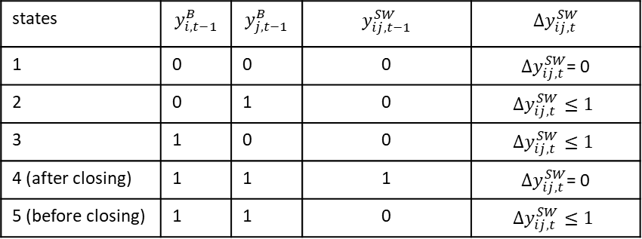
Modeling a Synchronizing Switch (SSW)
Switch equipped with Intelligent Electronic Device that facilitate synchronization.
SSWs can energize bus blocks or synchronize the microgrids.
An SSW $(i, j)$ may have five states while blackstarting.
All five states of the switch can be defined as:
When a switch $(i, j)$ is closed, ${f_{i}=f}_{j}$, whereas when switch is open ${f_{i}≠f}_{j}$
$${−\left(1−y_{ij,t}^{SW}\right)M≤f}_{i,t}^{ }−f_{j,t}≤\left(1−y_{ij,t}^{SW}\right)M$$
Nomenclature:
$y_{i,t}^{B}$: status of i^{th} bus
$y_{ij,t}^{SW}$: status of a switch (i, j)
${Δy}_{ij,t}^{SW}$: change of switch $status$
$f_{i,t}^{ }$: frequency at bus i
$$y_{ij,t}^{SW}≤y_{i,t−1}^{B}+y_{j,t−1}^{B}$$
${Δy}_{ij,t}^{SW}=$ $y_{ij,t}^{SW} −y_{ij,t−1}^{SW}$
$${Δy}_{ij,t}^{SW}≥0$$
20
Notes:
State1: neither bus is energized/active; State 2,3,4: at least one bus is energized/active;
SSW is a special ESW with synchronizing ability, achieved with the help of Intelligent Electronic Devices. Hence, it allows the SSW to transit from state 5 to state 4.
The state table for SSW is only different for the state 5. All the possible transition is succinctly define with three equation on the right of the table.
The last condition indicates that when the ESW is closed the frequency of both the buses should be same. However, they can be significantly different before switch is closed.

Slide 21
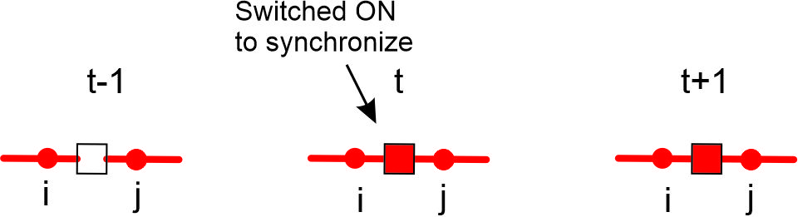
Power Flow Constraint for SSW
While closing an SSW, ideally the power flow across it should be zero.
This is imposed to match the voltage magnitude and angle of bus i and j across the switch (i, j).
At synchronizing time-step, the following condition holds.
$z_{ij,t}=Δy_{ij,t }^{SW}(y_{i,t−1 }^{B}$+ $y_{j,t−1 }^{B}$- $y_{ij,t }^{SW}) →1$
The above three states of power flow across SSW is defined with respect to $z_{ij,t}$.
$−(1−z_{ij,t}\text{)}\text{M}−ε{≤P}_{ij,t}^{ }≤ε+(1−z_{ij,t}$)M
$$−(1−z_{ij,t}\text{)}\text{M} −ε{≤Q}_{ij,t}^{ }≤ε+(1−z_{ij,t}\text{)}\text{M}$$
Nomenclature:
$P_{ij,t}^{ }$: Active power across (i, j)
$Q_{ij,t}^{ }$: Reactive power across (i, j)
$z_{ij,t}^{ }$: binary variable defining synchronizing instant.
$P_{ij,t−1}^{ }=0$ $Q_{ij,t−1}^{ }=0$
$$−ε{≤P}_{ij,t}^{ }≤ε$$
$$−ε{≤Q}_{ij,t}^{ }≤ε$$
$$−M{≤P}_{ij,t+1}^{ }≤M$$
$$−M{≤Q}_{ij,t+1}^{ }≤M$$
21
Notes:
For closing a SSW, it is essential to ensure the voltage magnitude and the angle between the buses i and j are almost same. This can be achieved by imposing a constraint defining the power flow across the switch is nearly 0. However, this constraint must be released after an SSW is closed.
Hence, the power flow across the SSW will have different constraints before, during, and after the instant when SSW is closed. All these are defined using the last two equation defined in terms of z. Here z is auxiliary variable which tends to be 1 only when SSW is closed and is 0 for all other time periods.

Slide 22
Dynamic Radiality Constraints
Generally, radiality constraint states: $\sum{lines}=$ $\sum{buses} −\sum{root buses}$
In black start problem, the number of active lines, buses, and root buses are dynamic.
$$\begin{matrix} & \sum_{(i,j)∈ℒ}{y_{ij,t}^{L}} =\sum_{b∈ℬ}{y_{b,t}^{B}} +\sum_{b∈ℬ_{ss}}{y_{b,t}^{SS}}−R_{t} \\ & \begin{aligned}\begin{aligned}\begin{aligned}where, \\ R_{t}=\sum_{b∈ℛ}{y_{b,t}^{ES}} +\sum_{b∈ℬ_{ss}}{y_{b,t}^{SS}}\end{aligned} \\ \end{aligned} \\ y_{b,t}^{ES}≤y_{b,t−1 }^{ES} ∀b∈ℛ\end{aligned}\end{matrix}$$
Considering $R_{t}$ as an optimization variable allows synchronization of islands.
GFMI are assigned to be root generator ($y_{b,t=0}^{ES}$ = 1) when the black start is initiated.
When a GFMI generator is switched to non-root status, the synchronizing binary variable ($δ_{b,t}$) is activated, as:
$$y_{b,τ}^{ES}=1−\sum_{t∈\left[t_{0},τ\right]}{δ_{b,t}} ∀b∈ℛ$$
Nomenclature:
$y_{ij}^{L}$: status of line (i, j)
$ℒ$: set of lines
$y_{i}^{B}$: status of i^{th} bus
$ℬ$: set of buses
$y_{b,t}^{SS}$: status of substation bus
$ℬ_{ss}$: set of substation buses
$R_{t}$: number of root buses, i.e., grid-forming inverters
$y_{i,t}^{ES}$: status of GFMI as a root generator
$ℛ$: set of buses with GFMI.
22
Notes:
Detailed explanations:
$y_{b,t}^{SS}$ is an input parameter, which depends on the status of the transmission grid. The first equation is the radiality constraint which states $\sum{lines}=$ $\sum{buses} −\sum{root buses}$.
The second equation expresses the number of root buses in the system. A bus connected to BES-inverters, or the transmission grid can be the root bus. However, the former is a decision variable whereas the latter one is an input parameter.
The third equation expresses that a BES-inverter can only change the status from root to non-root status but not again to root status.
The last equation is defined to make $δ_{b,t}$ to 1 only during the transition of GFMI from root to non-root source.

Slide 23
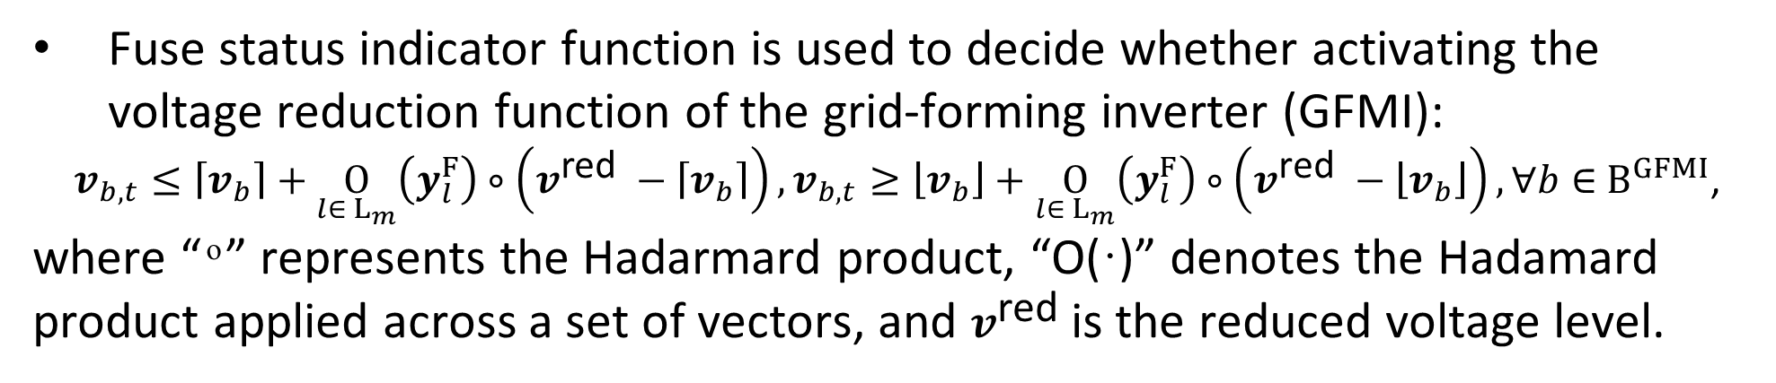
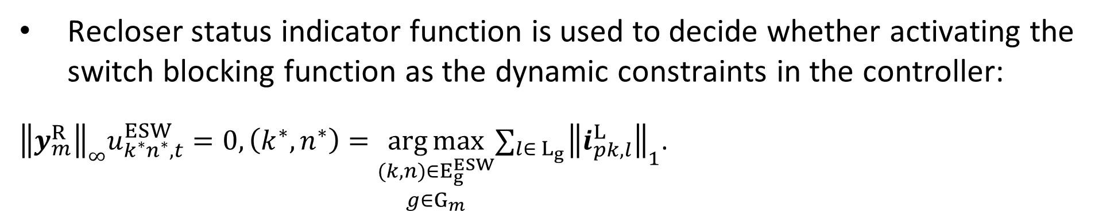
Mitigation of Inrush Current during BS
Voltage Reduction Function
Fuse status indicator function is used to decide whether activating the voltage reduction function of the grid-forming inverter (GFMI):
$v_{b,t}≤\left\lceil v_{b}\right\rceil +\underset{l∈{ L}_{m}}{O}\left(y_{l}^{F}\right)∘\left(v^{\text{red} }−\left\lceil v_{b}\right\rceil \right),v_{b,t}≥\left\lfloor v_{b}\right\rfloor +\underset{l∈{ L}_{m}}{O}\left(y_{l}^{F}\right)∘\left(v^{\text{red} }−\left\lfloor v_{b}\right\rfloor \right),∀b∈{ B}^{GFMI}$,
where “ ͦ ” represents the Hadarmard product, “O(·)” denotes the Hadamard product applied across a set of vectors, and $v^{\text{red} }$is the reduced voltage level.
Switch Blocking Function
Recloser status indicator function is used to decide whether activating the switch blocking function as the dynamic constraints in the controller:
${\left\|y_{m}^{R}\right\|}_{∞}u_{k^{∗}n^{∗},t}^{ESW}=0, \left(k^{∗},n^{∗}\right)=\underset{\begin{matrix}(k,n)∈E_{g}^{ESW} \\ g∈G_{m}\end{matrix}}{arg⁡max}∑_{l∈{ L}_{g}} {\left\|i_{pk,l}^{L}\right\|}_{1}$.
:0-1 variable for a switch status

Slide 24
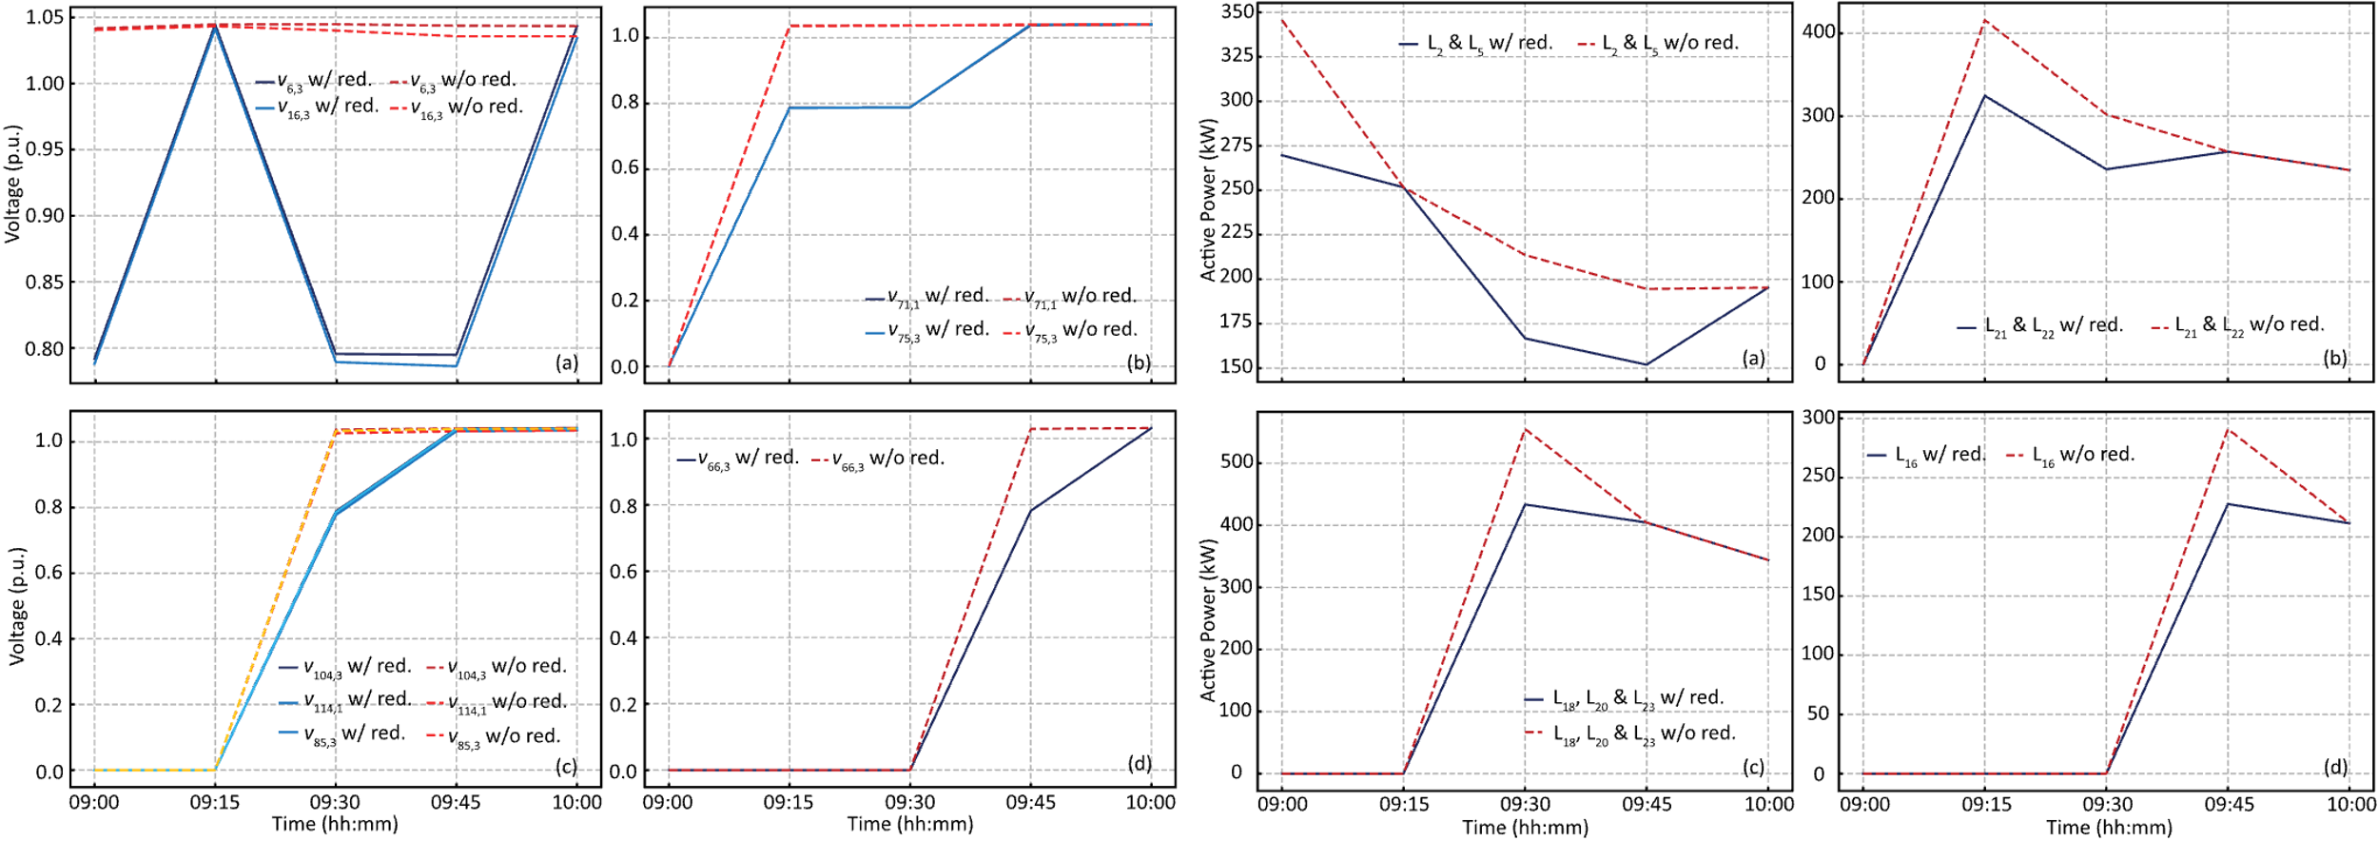
Impact of Voltage Reduction Function
Voltage with or without reduction
Active load with or without reduction

